Slide 1
PuReMD: Purdue Reactive Molecular Dynamics Package Hasan Metin Aktulga and Ananth Grama Purdue University TST Meeting,May 13-14, 2010

Slide 2
Outline (Progress Report)
ReaxFF Parallelization
Algorithms and Numerical Techniques
PuReMD Performance

Slide 3
Overview of ReaxFF
mm
Statistical & Continuum methods
μm
Classical MD methods
nm
ReaxFF
Ab-initio methods
ps
ns
μs
ms

Slide 4
Overview of ReaxFF
Key Challenges:
dynamic bonds modeled through bond orders
→ dynamic 3-body & 4-body interactions
complex formulations of bond, angle, dihedral, van der Waals interactions
additional interactions:
lone pair, over/under-coordination, 3-body & 4-body conjugation
dynamic charges using the QEq method

Slide 5
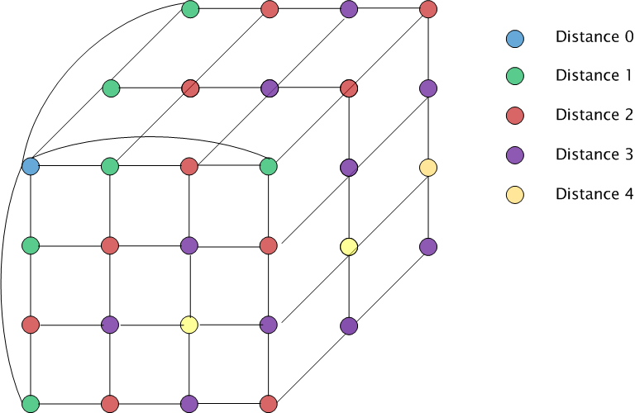
Parallelization: Decomposition
Domain decomposition: 3D torus

Slide 6
Parallelization: Outer-Shell
r
r
b
b
full shell
half shell
r/2
r
b
b
midpoint-shell
tower-plate shell

Slide 7
Parallelization: Outer-Shell
choose full-shell due to dynamic bonding despite the comm. overhead
r
r
b
b
full shell
half shell
r/2
r
b
b
midpoint-shell
tower-plate shell

Slide 8
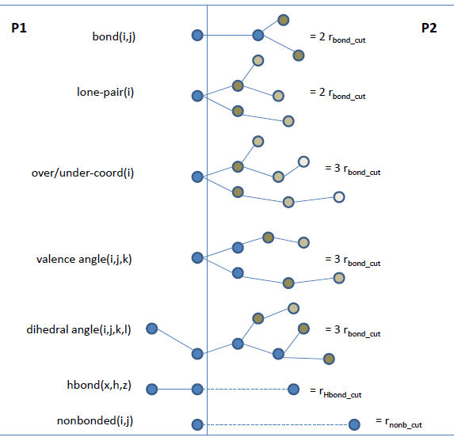
Parallelization: Boundary Intrs.

Slide 9
Parallelization: Messaging

Slide 10
Parallelization: Messaging

Slide 11
Algorithmic & Numerical Tech.
Very efficient generation of neighbors lists
Elimination of bond order derivative lists
Truncate bond related computations at the outer-shell
Lookup tables for fast computation of non-bonded interactions
Highly optimized parallel solver for QEq

Slide 12
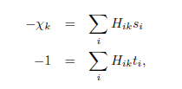
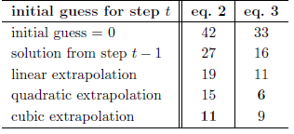
QEq Solver
Mathematical formulation:
Diagonally scaled parallel CG
Decreased iteration count through extrapolation from solutions to prev. steps
Decreased communication overhead:
redundant computations to avoid reverse comm
iterate both systems together

Slide 13
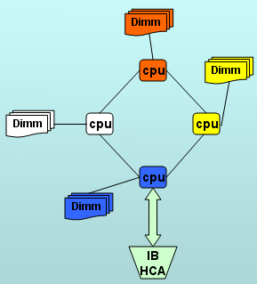
PuReMD Performance
Weak scaling test
Strong scaling test
Comparison to LAMMPS-REAX
Hera cluster at LLNL
4 AMD Opterons/node -- 16 cores/node
800 batch nodes – 10800 cores, 127 TFLOPS/sec
32 GB memory / node
Infiniband interconnect

Slide 14
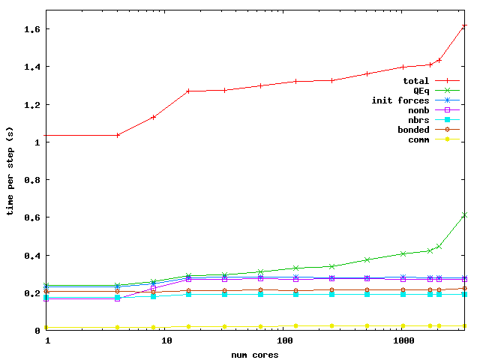
Performance: Weak Scaling
Bulk Water: 6540 atoms in a 40x40x40 A³ box / core

Slide 15
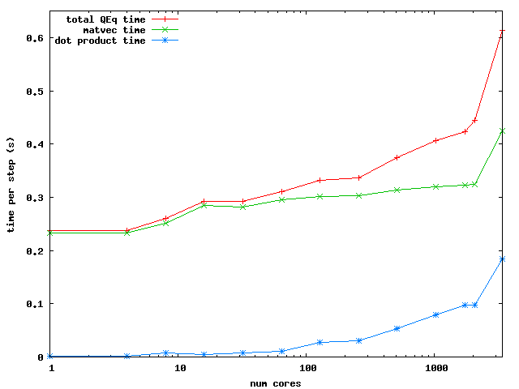
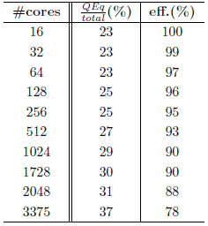
Weak Scaling
QEq scaling →
Efficiency

Slide 16
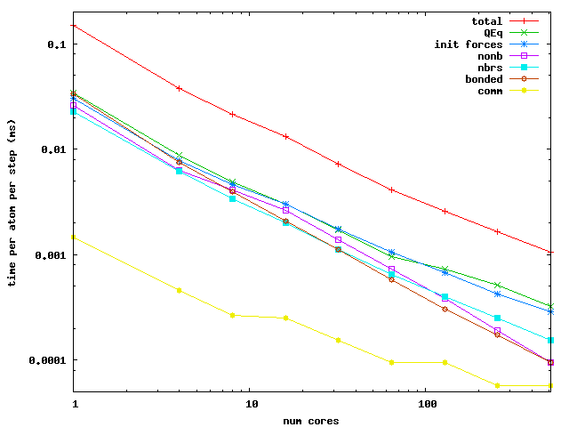
Performance: Strong Scaling
Bulk Water: 52320 atoms in a 80x80x80 A³ box

Slide 17
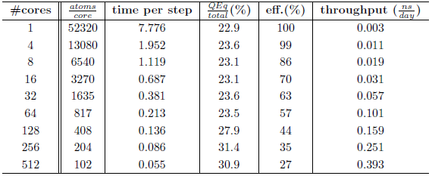
Strong Scaling
Efficiency and throughput

Slide 18
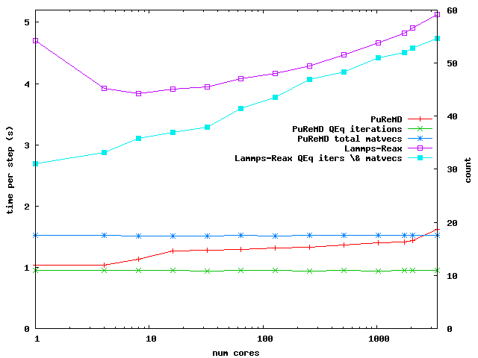
Comparison to Lammps-Reax
Weak Scaling:
4-5 times faster, much lower memory footprint

Slide 19
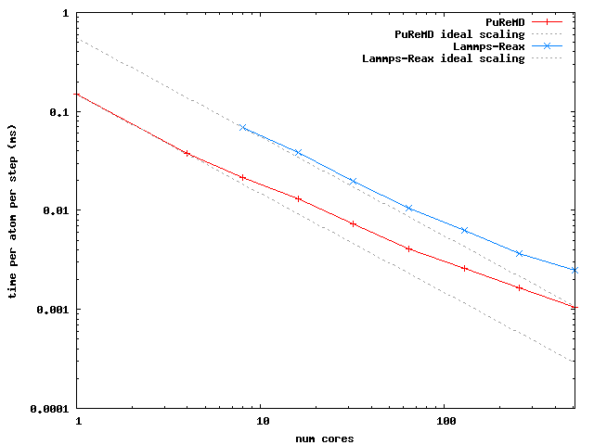
Comparison to Lammps-Reax
Strong Scaling:
3-4 times faster, much lower memory footprint

Slide 20
Conclusions
Verified accuracy against the original ReaxFF code through intensive test
Efficient and scalable parallel implementation for ReaxFF in C using MPI
3-5 faster, much smaller memory usage
Modular and extensible design allows easy improvements and enhancements
Ready for PRISM device simulations
Open-source code, to be released with GPL

