Slide 1
Algorithms, Numerical Techniques, and Software for Atomistic Modeling

Slide 2
Molecular Dynamics Methods vs. ReaxFF
mm
Statistical & Continuum methods
μm
Classical MD methods
nm
ReaxFF
Ab-initio methods
ps
ns
μs
ms

Slide 3
ReaxFF vs. Classical MD
ReaxFF is classical MD in spirit
  basis: atoms (electron & nuclei)
  parameterized interactions: from DFT (ab-initio)
  atom movements: Newtonian mechanics
  many common interactions
    bonds
    valence angles (a.k.a. 3-body interactions)
    dihedrals (a.k.a. 4-body interactions)
    hydrogen bonds
    van der Waals, Coulomb

Slide 4
ReaxFF vs. Classical MD
Static vs. dynamic bonds
  reactivity: bonds are formed/broken during simulations
  consequently: dynamic 3-body & 4-body interactions
  complex formulations of bonded interactions
  additional bonded interactions
    multi-body: lone pair & over/under-coordination – due to imperfect coord.
    3-body: coalition & penalty – for special cases like double bonds
    4-body: conjugation – for special cases
Static vs. dynamic charges
  large sparse linear system (NxN) – N = # of atoms
  updates at every step!
Shorter time-steps (femtoseconds vs. tenths of femtoseconds)
Fully atomistic
Result: a more complex and expensive force field

Slide 5
ReaxFF realizations: State of the Art
Original Fortran Reax code
  reference code
  widely distributed and used
  experimental: sequential, slow
  static interaction lists: large memory footprint
LAMMPS-REAX (Sandia)
  parallel engine: LAMMPS
  kernels: from the original Fortran code
  local optimizations only
  static interaction lists: large memory footprint
Parallel Fortran Reax code from USC
  good parallel scalability
  poor per-timestep running time
  accuracy issues
  no public domain release

Slide 6
Sequential Realization: SerialReax
Excellent per-timestep running time
  efficient generation of neighbors lists
  elimination of bond order derivative lists
  cubic spline interpolation: for non-bonded interactions
  highly optimized linear solver: for charge equilibration
Linear scaling memory footprint
  fully dynamic and adaptive interaction lists
Related publication:
Reactive Molecular Dynamics: Numerical Methods and Algorithmic Techniques
H. M. Aktulga, S. A. Pandit, A. C. T. van Duin, A. Y. Grama
SIAM Journal on Scientific Computing (to appear)

Slide 7
SerialReax Components
SerialReax
Initialization
Read input data
Initialize data structs
Neighbor Generation
3D-grid based O(n) neighbor generation
Several optimizations for improved performance
System
Geometry
Reallocate
Fully dynamic and adaptive memory management:
efficient use of resources
large systems on a single processor
Control
Parameters
Init Forces
Initialize the QEq coef matrix
Compute uncorr. bond orders
Generate H-bond lists
Force Field
Parameters
QEq
Large sparse linear system
PGMRES(50) or PCG
ILUT-based pre-conditioners
give good performance
Compute Bonds
Corrections are applied after all
uncorrected bonds are computed
Program Log
File
Bonded Interactions
Bonds
Lone pairs
Over/UnderCoord
Valence Angles
Hydrogen Bonds
Dihedral/ Torsion
vd Waals & electrostatics
Single pass over the
far nbr-list after
charges are updated
Interpolation with cubic
splines for nice speed-up
System Status
Update
Trajectory
Snapshots
Evolve the System
F_{total} = F_{nonbonded} + F_{bonded}
Update x & v with velocity Verlet
NVE, NVT and NPT ensembles

Slide 8
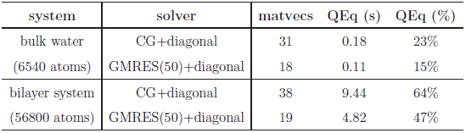
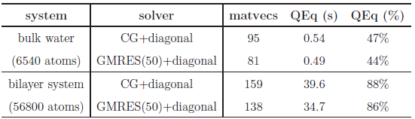
Basic Solvers for QEq
Sample systems
  bulk water: 6540 atoms, liquid
  lipid bilayer system: 56,800 atoms, biological system
  PETN crystal: 48,256 atoms, solid
Solvers: CG and GMRES
  H has heavy diagonal: diagonal pre-conditioning
  slowly evolving environment : extrapolation from prev. solutions
Poor Performance:
# of iterations = # of matrix-vector multiplications
actual running time in seconds
fraction of total computation time
tolerance level = 10⁻⁶
which is fairly satisfactory
due to cache effects
much worse at 10⁻¹⁰ tolerance level
more pronounced here

Slide 9
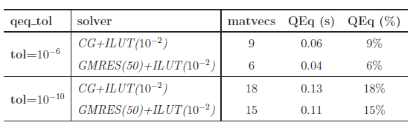
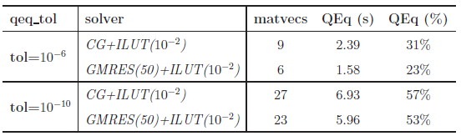
ILU-based preconditioning
ILU-based pre-conditioners: no fill-in, 10⁻² drop tolerance
  effective (considering only the solve time)
  no fill-in + threshold: nice scaling with system size
  ILU factorization is expensive
bulk water system
cache effects are still evident
bilayer system
system/solver | time to compute preconditioner | solve time (s) | total time (s)
bulk water/ GMRES+ILU | 0.50 | 0.04 | 0.54
bulk water/ GMRES+diagonal | ~0 | 0.11 | 0.11

Slide 10
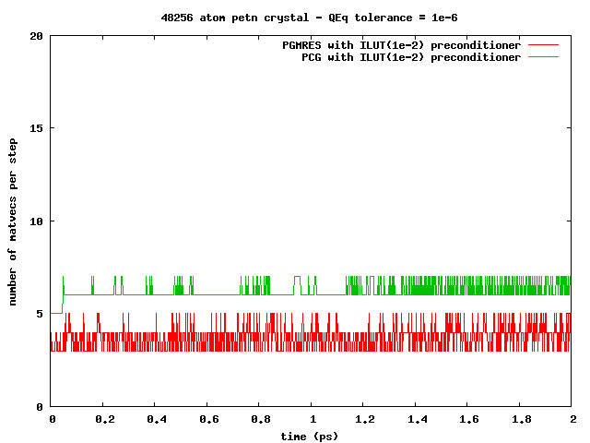
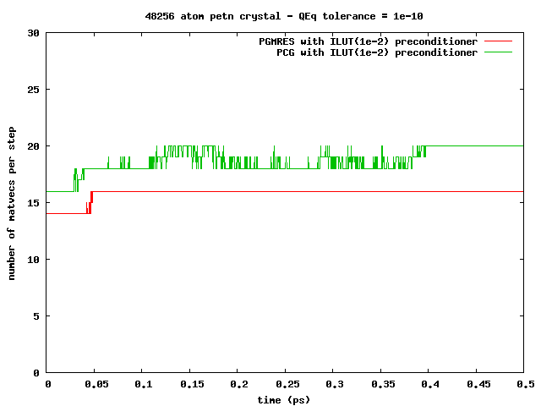
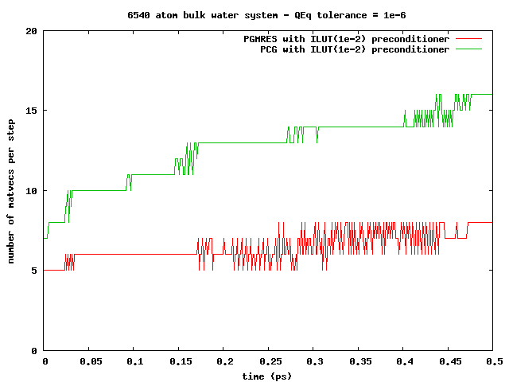
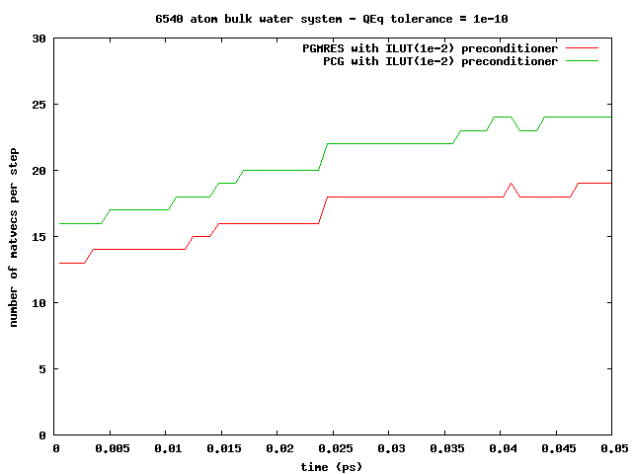
ILU-based preconditioning
Observation: can amortize the ILU factorization cost
slowly changing simulation environment ⇒re-usable pre-conditioners
PETN crystal:
solid, 1000s of steps!
Bulk water:
liquid, 10-100s of steps!

Slide 11
Memory Management
Compact data-structures
Dynamic and adaptive lists
  initially: allocate after estimation
  at every step: monitor & re-allocate if necessary
Low memory foot-print, linear scaling with system size
n-1
n
n-1
n
n-1’s data
n’s data
n-1’s data
n’s data
in CSR format
neighbors list
Qeq matrix
3-body intrs
reserved for n-1
reserved for n
in modified CSR
bonds list
hbonds list

Slide 12
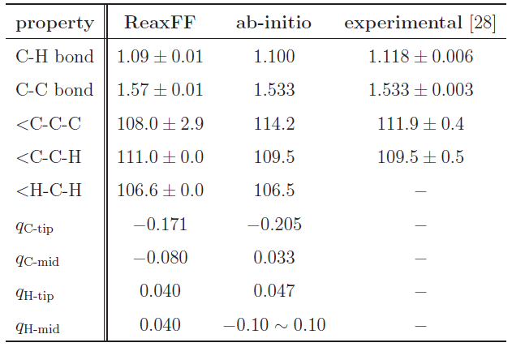
Validation
Hexane (C₆H₁₄) Structure Comparison
Excellent agreement!

Slide 13
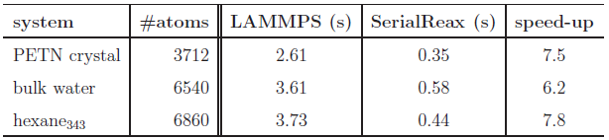
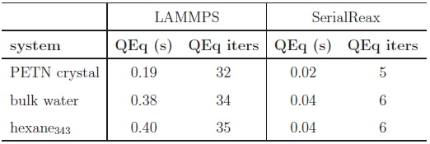
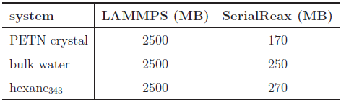
Comparison to LAMMPS-Reax
Time per time-step comparison
Qeq solver performance
Memory foot-print
different QEq formulations
similar results
LAMMPS:
CG / no preconditioner

Slide 14
Parallel Realization: PuReMD
Built on the SerialReax platform
  Excellent per-timestep running time
  Linear scaling memory footprint
Extends its capabilities to large systems, longer time-scales
  Scalable algorithms and techniques
  Demonstrated scaling to over 3K cores
Related publication:
Parallel Reactive Molecular Dynamics: Numerical Methods and Algorithmic Techniques
H. M. Aktulga, J. C. Fogarty, S. A. Pandit, A. Y. Grama
Parallel Computing (to appear)

Slide 15
Parallelization: Outer-Shell
r
r
b
b
full shell
half shell
r/2
r
b
b
midpoint-shell
tower-plate shell

Slide 16
Parallelization: Outer-Shell
choose full-shell due to dynamic bonding despite the comm. overhead
r
r
b
b
full shell
half shell
r/2
r
b
b
midpoint-shell
tower-plate shell

Slide 17
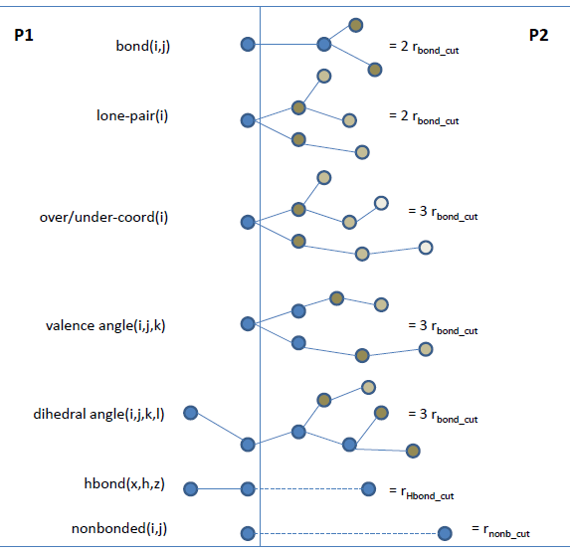
Parallelization: Boundary Interactions
r_{shell}= MAX (3xr_{bond_cut}, r_{hbond_cut}, r_{nonb_cut})

Slide 18
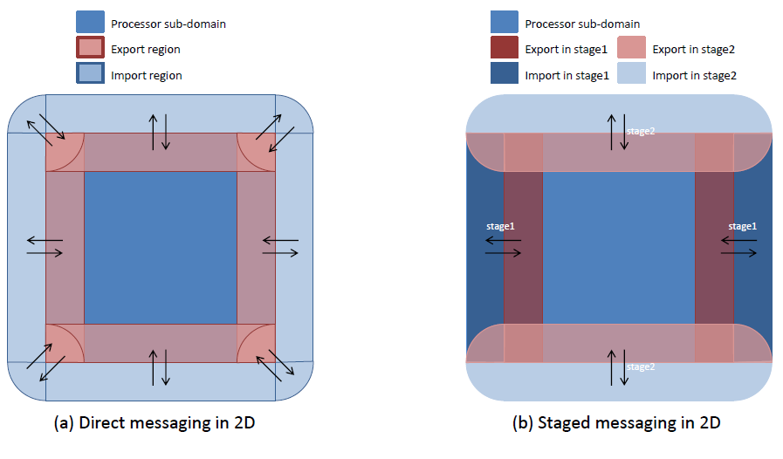
Parallelization: Messaging

Slide 19
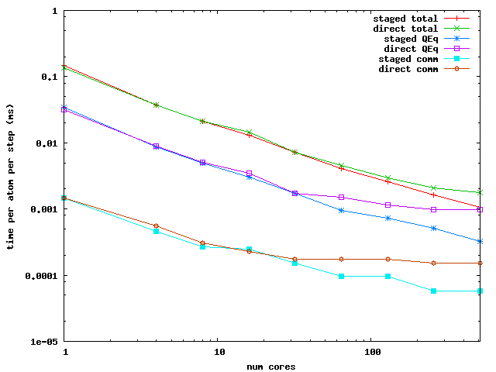
Parallelization: Messaging Performance
Performance Comparison: PuReMD with direct vs. staged messaging

Slide 20
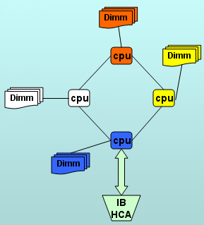
PuReMD: Performance and Scalability
Weak scaling test
Strong scaling test
Comparison to LAMMPS-REAX
Platform: Hera cluster at LLNL
  4 AMD Opterons/node -- 16 cores/node
  800 batch nodes – 10800 cores, 127 TFLOPS/sec
  32 GB memory / node
  Infiniband interconnect
  42nd on TOP500 list as of Nov 2009

Slide 21
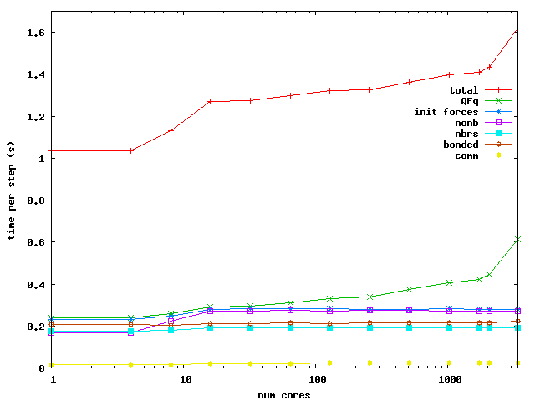
PuReMD: Weak Scaling
Bulk Water: 6540 atoms in a 40x40x40 A³ box / core

Slide 22
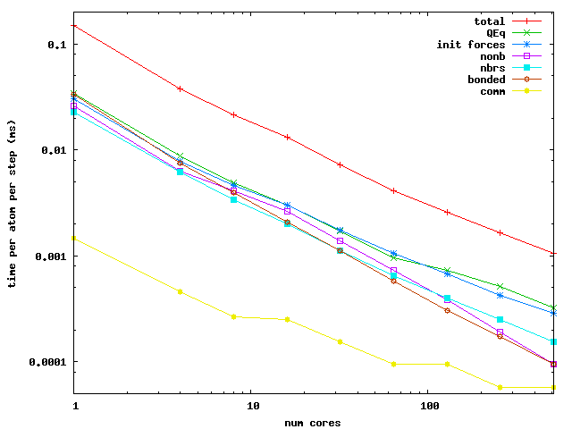
PuReMD: Strong Scaling
Bulk Water: 52320 atoms in a 80x80x80 A³ box

Slide 23
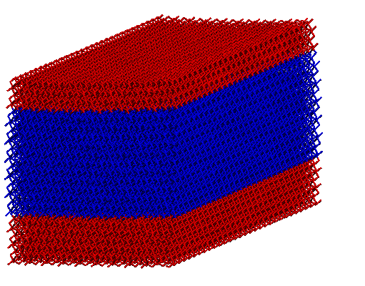
Applications: Si/Ge/Si nanoscale bars
Motivation
  Si/Ge/Si nanobars: ideal for MOSFETs
  as produced: biaxial strain, desirable: uniaxial
  design & production: understanding strain behavior is important
[001], Vertical
[010] , Longitudinal
[100], Transverse
Si
Height (H)
Ge
Related publication:
Strain relaxation in Si/Ge/Si nanoscale bars from molecular dynamics simulations
Y. Park, H.M. Aktulga, A.Y. Grama, A. Strachan
Journal of Applied Physics 106, 1 (2009)
Si
Periodic boundary
conditions
Width (W)

Slide 24
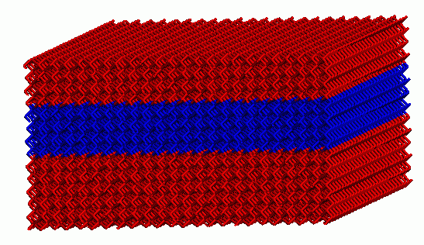
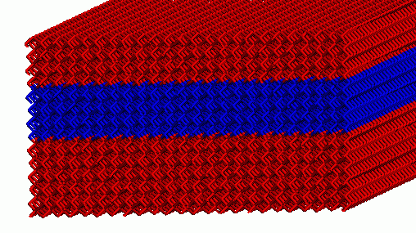
Applications: Si/Ge/Si nanoscale bars
Key Result:
When Ge section is roughly square shaped, it has almost uniaxial strain!
average strains for Si&Ge in each dimension
average transverse Ge strain
Ge
Si
Si
W = 20.09 nm
Simple strain model derived from MD results

Slide 25
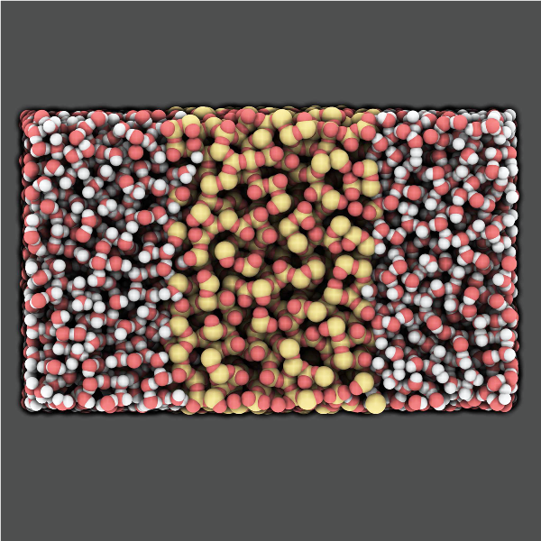
Applications: Water-Silica Interface
Motivation
  a-SiO2: widely used in nano-electronic devices
  also used in devices for in-vivo screening
  understanding interaction with water: critical for reliability of devices
Related publication:
A Reactive Simulation of the Silica-Water Interface
J. C. Fogarty, H. M. Aktulga, A. van Duin, A. Y. Grama, S. A. Pandit
Journal of Chemical Physics 132, 174704 (2010)

Slide 26
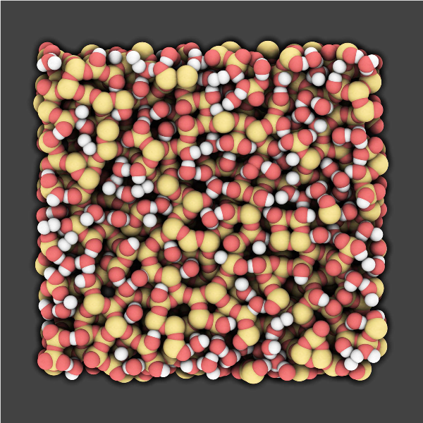
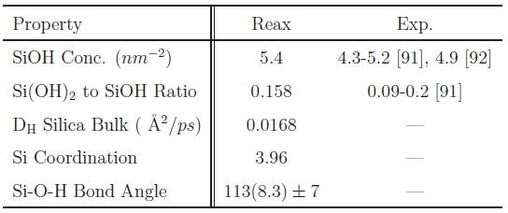
Applications: Water-Silica Interface
Key Result
Silica surface hydroxylation as evidenced by experiments is observed.
Proposed reaction:
H2O + 2Si + O ⇔ 2SiOH
Water
H
O
H
Silica
O
Si
O

Slide 27
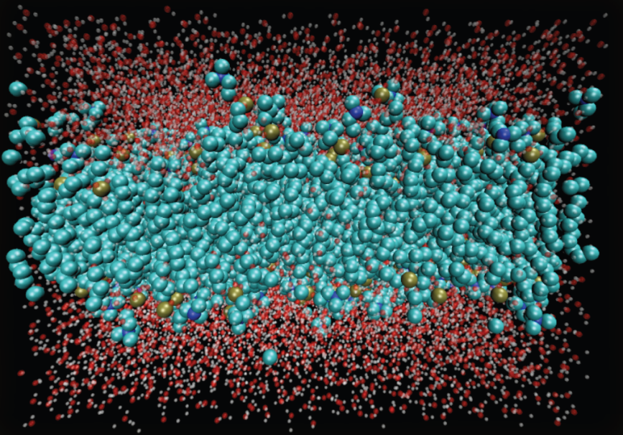
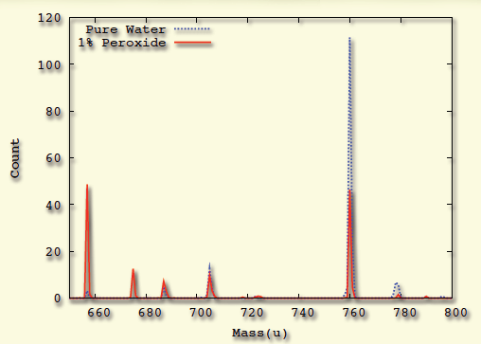
Applications: Oxidative Damage in Lipid Bilayers
Motivation
Modeling reactive processes in biological systems
ROS→ Oxidative stress→ Cancer & Aging
System Preparation
200 POPC lipid + 10,000 water molecules
and same system with 1% H₂O₂ mixed
Mass Spectograph:
Lipid molecule weighs 760 u
Key Result
Oxidative damage observed:
In pure water: 40% damaged
In 1% peroxide: 75% damaged

Slide 28
Software Releases
PuReMD currently in limited release (about 10 collaborating groups, including, Goddard, CalTech, Buehler, MIT, Strachan, Purdue, Pandit, USF, vanDuin, PSU, and others)
Integrated as a fix to LAMMPS, currently in use by over 25 research groups

Slide 29
Ongoing Efforts
Improvements to PureMD/ LAMMPS
  Force field optimization
  Performance Improvements
  Scalability Enhancement

Slide 30
Future Directions
Extending scaling envelope significantly requires radically redesigned algorithms to account for:
  Significantly higher communication/ synchronization costs
  Fault tolerance

Slide 31
Future Directions
Fault-Oblivious Algorithms
  Critical technology for platforms beyond petascale.
  MTBF of components necessitates fault tolerance.
  Hardware fault tolerance can be expensive.
  Software fault tolerance through checkpointing is infeasible because of I/O bandwidth
  Application checkpointing is also constrained by I/O bandwidth

Slide 32
Future Directions
Radically different class of Fault Oblivious Algorithms:
  Concept: Partition and specify a problem in n parts in such a way that if any m (<n) of these partitions run to completion, we can recover complete solution
  Compute counterpart of erasure coded storage
  Immensely useful concept at scale but profound challenges

Slide 33
Future Directions
Fault Oblivious Algorithms:
  Can we derive fault-oblivious algorithms for a sufficiently large class of problems that are efficient?
    Initial proof of concept for linear system solvers and eigenvalue problems
  How are these algorithms specified?
    Programming Languages/ Compilation Techniques
  What are suitable runtime systems?
    Conventional threads/ messaging APIs do not work!

