Slide 1
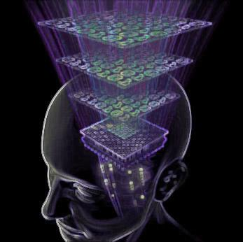

Protein- Cytokine network reconstruction using information theory-based analysis
Farzaneh Farhangmehr
UCSD
Presentation#3
July 25, 2011

Slide 2
What is Information Theory ?
Information is any kind of events that affects the state of a dynamic system
Information theory deals with measurement and transmission of information through a channel
Information theory answers two fundamental questions:
  what is the ultimate reliable transmission rate of information? (the channel capacity C)
  What is the ultimate data compression
  (the entropy H)

Slide 3

Key elements of information theory
Entropy H(X):
  A measure of uncertainty associated with a random variables
  Quantifies the expected value of the information contained in a message
  (Shannon, 1948)
Capacity (C):
  If the entropy of the source is less than the capacity of the channel, asymptotically error-free communication can be achieved.
  The capacity of a channel is the tightest upper bound on the amount of information that can be reliably transmitted over the channel.

Slide 4
Key elements of information theory
Joint Entropy:
  The joint entropy H(X,Y) of a pair of discrete random variables (X, Y) with a joint distribution p(x, y):
  Conditional entropy:
  Quantifies the remaining
  entropy (i.e. uncertainty) of a
  random variable Y given that the
  value of another random variable
  X is known.

Slide 5
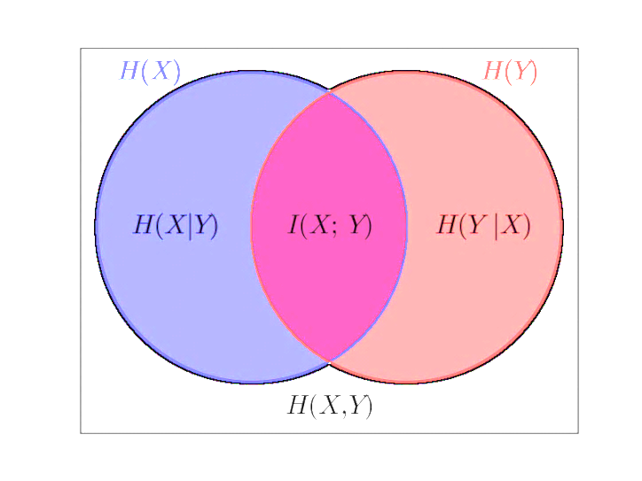
Key elements of information theory
  Mutual Information I(X;Y):
    The reduction in the uncertainty of X due to the knowledge of Y
        I(X;Y) = H(X) + H(Y) -H(X,Y)
        =
  H(Y) - H(YlX)
  = =
  H(X) - H(XlY)

Slide 6
Basic principles of information-theoretic model of network reconstruction
The entire framework of network reconstruction using information theory has two stages: 1-mutual information coefficients computation; 2- the threshold determination.
Mutual information networks rely on the measurement of the mutual information matrix (MIM). MIM is a square matrix whose elements (MIM_{ij} = I(X_{i};Y_{j})) are the mutual information between X_{i} and Y_{j}.
Choosing a proper threshold is a non-trivial problem. The usual way is to perform permutations of expression of measurements many times and recalculate a distribution of the mutual information for each permutation. Then distributions are averaged and the good choice for the threshold is the largest mutual information value in the averaged permuted distribution.
ARCANe, CLR, MRnet, etc

Slide 7
Advantages of information theoretic model to other available methods for network reconstruction
Mutual information makes no assumptions about the functional form of the statistical distribution, so it’s a non-parametric method.
It doesn’t requires any decomposition of the data into modes and there is no need to assume additivity of the original variables
Since it doesn’t need any binning to generate the histograms, consumes less computational resources.

Slide 8
Information-theoretic model of networks
X={x₁ , …,x_{i}} Y={y₁ , …,y_{j}}
We want to find the best model that maps X Y
The general definition: Y= f(X)+U
In linear cases: Y=[A]X+U where [A] is a matrix defines the linear dependency of inputs and outputs
Information theory provides both models (linear and non-linear) and maps inputs to outputs by using the mutual information function:

Slide 9
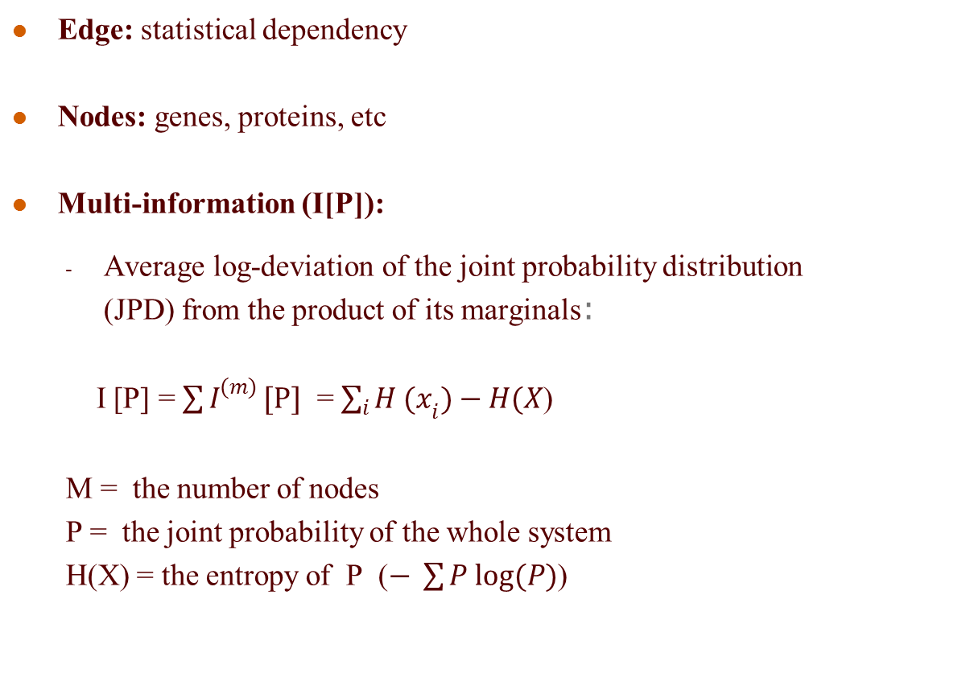
Key elements of information theory-based networks interface
Edge: statistical dependency
Nodes: genes, proteins, etc
Multi-information (I[P]):
  Average log-deviation of the joint probability distribution
  (JPD) from the product of its marginals:
  I [P] = $\sum{I^{(m)}}[P]$ = $\sum_{i}{{H (x}_{i}})−H(X$)
  M = the number of nodes
  P = the joint probability of the whole system
H(X) = the entropy of P ($− \sum{P log(P)}$)

Slide 10
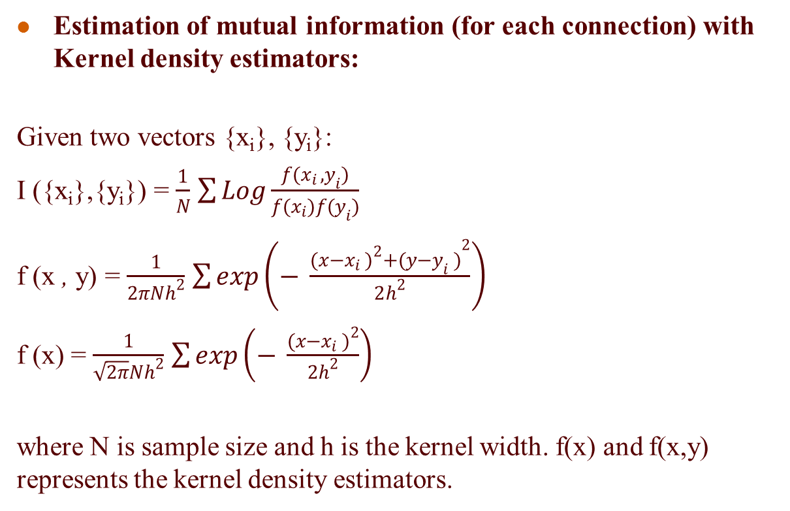
Key elements of information theory-based networks interface
Estimation of mutual information (for each connection) with Kernel density estimators:
Given two vectors {x_{i}}, {y_{i}}:
I ({x_{i}},{y_{i}}) = $\frac{1}{N}$ $\sum{Log\frac{f(x_{i} , y_{i})}{f(x_{i})f(y_{i})}}$
f (x , y) = $\frac{1}{2πNh^{2}}$ $\sum{\exp\left(− \frac{{{(x−x_{i} )}^{2}+(y−y_{i} )}^{2}}{2h^{2}}\right)}$
f (x) = $\frac{1}{\sqrt{2π}Nh^{2}}$ $\sum{\exp\left(− \frac{{(x−x_{i} )}^{2}}{2h^{2}}\right)}$
where N is sample size and h is the kernel width. f(x) and f(x,y) represents the kernel density estimators.

Slide 11
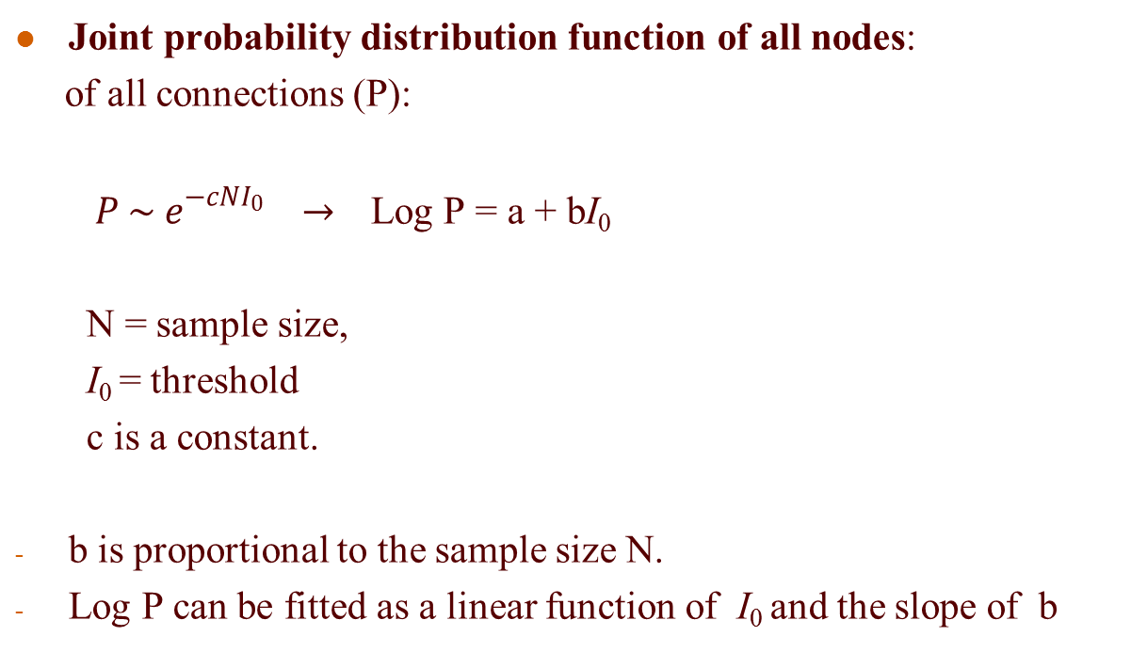
Key elements of information theory-based networks interface
Joint probability distribution function of all nodes:
of all connections (P):
  ${ P \sim e}^{−cNI_{0}}$ $→$ Log P = a + bI₀
  N = sample size,
  I₀ = threshold
  c is a constant.
b is proportional to the sample size N.
Log P can be fitted as a linear function of I₀ and the slope of b

Slide 12
Algorithm for the Reconstruction of Accurate Cellular Networks(ARACNE)
ARACNe is an information-theoretic algorithm for reconstructing networks from microarray data.
ARACNe follows these steps:
  - It assign to each pair of nodes a weight equal to their mutual information.
  - It then scans all nodes and removes the weakest edge. Eventually, a threshold value is used to eliminate the weakest edges.
  - At this point, it calculates the mutual information of the system with Kernel density estimators and assigns a p value, P (joint probability of the system) to find a new threshold.
  - The above steps are repeated until a reliable threshold up to P=0.0001 is obtained.

Slide 13
Protein-Cytokine network:
Histograms and probability mass functions
22 Signaling proteins responsible for cytokine releases:
  cAMP, AKT, ERK1, ERK2, Ezr/Rdx, GSK3A, GSK3B, JNK lg, JNK sh, MSN, p38, p40Phox, NFkB p65, PKCd, PKCmu2,RSK, Rps6 , SMAD2, STAT1a, STAT1b, STAT3, STAT5
7 released cytokines (as signal receivers):
  G-CSF, IL-1a, IL-6, IL-10, MIP-1a, RANTES, TNFa
Using information-theoretic model we want to reconstruct this network from the microarray data and determine what proteins are responsible for each cytokine releases

Slide 14
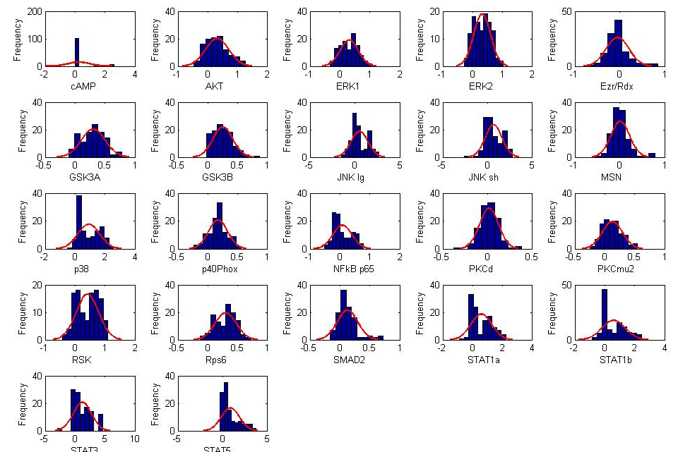
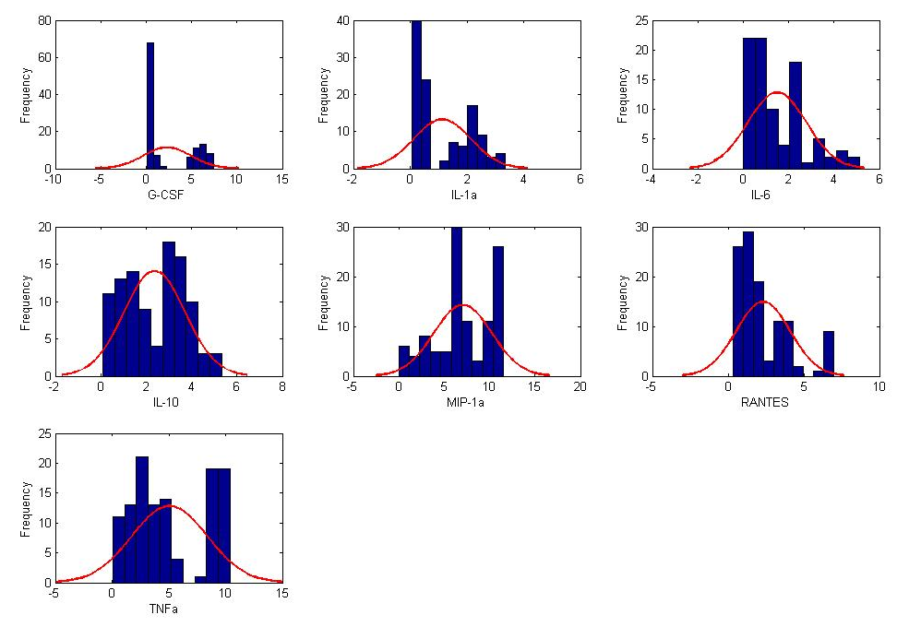
Protein-Cytokine network:
Histograms and probability mass functions
              First step: Finding the probability mass distributions of cytokines and proteins.
              Using the information theory, we want to identify signaling proteins responsible for cytokine releases.
              we reconstruct the network using the information theory techniques.
              The two pictures on the left show the histograms and probability mass functions of cytokines and proteins.

Slide 15
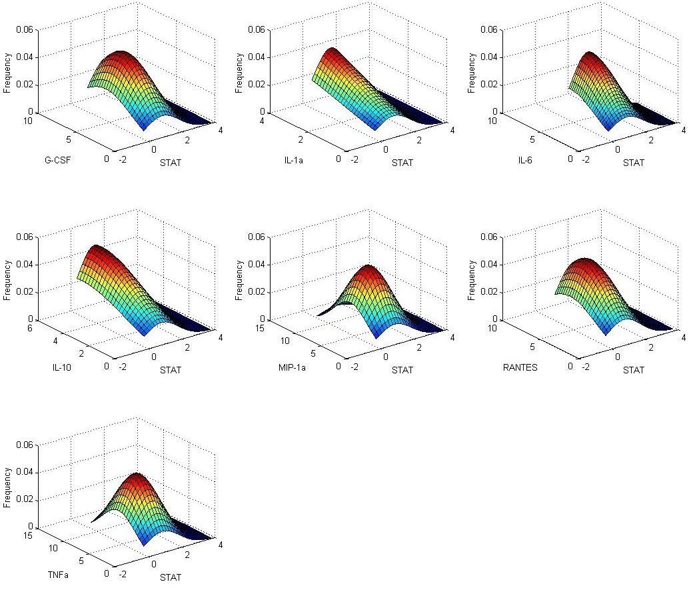
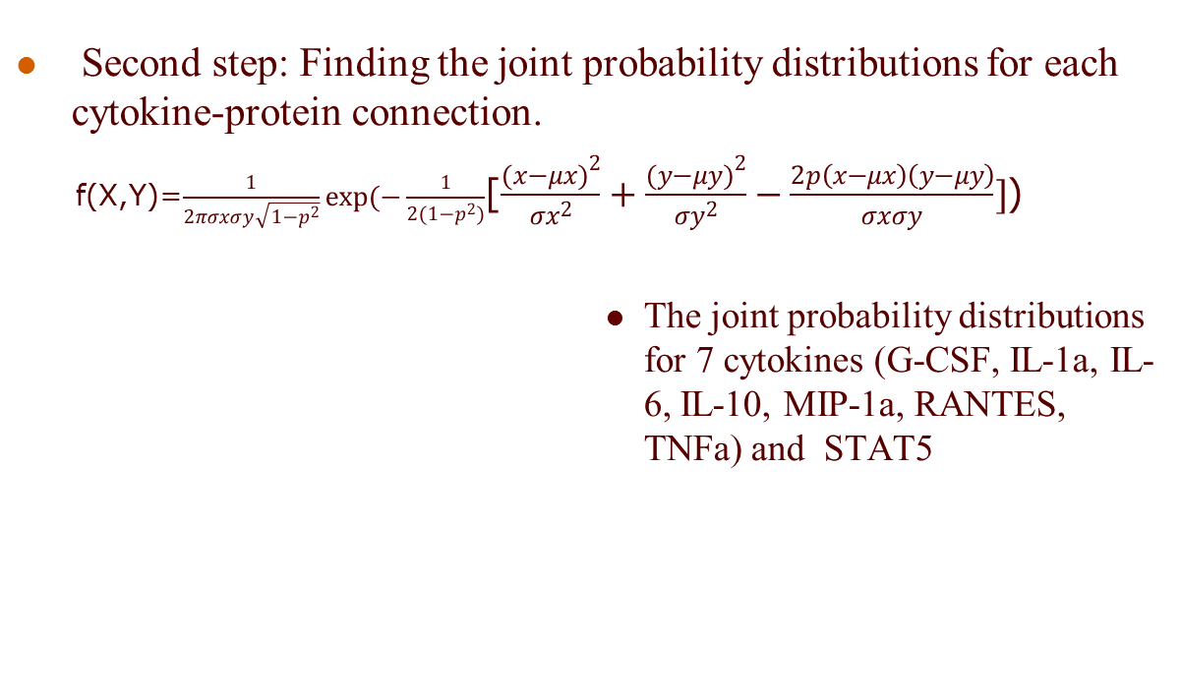
Protein-Cytokine network:
The joint probability mass functions
Second step: Finding the joint probability distributions for each cytokine-protein connection.
f(X,Y)=$\frac{1}{2πσxσy\sqrt{1−p^{2}}}exp(−\frac{1}{2(1−p^{2})}$[$\frac{{(x−μx)}^{2}}{{σx}^{2}}+\frac{{(y−μy)}^{2}}{{σy}^{2}}−\frac{2p\left(x−μx\right)\left(y−μy\right)}{σxσy}]$)
                The joint probability distributions for 7 cytokines (G-CSF, IL-1a, IL-6, IL-10, MIP-1a, RANTES, TNFa) and STAT5

Slide 16
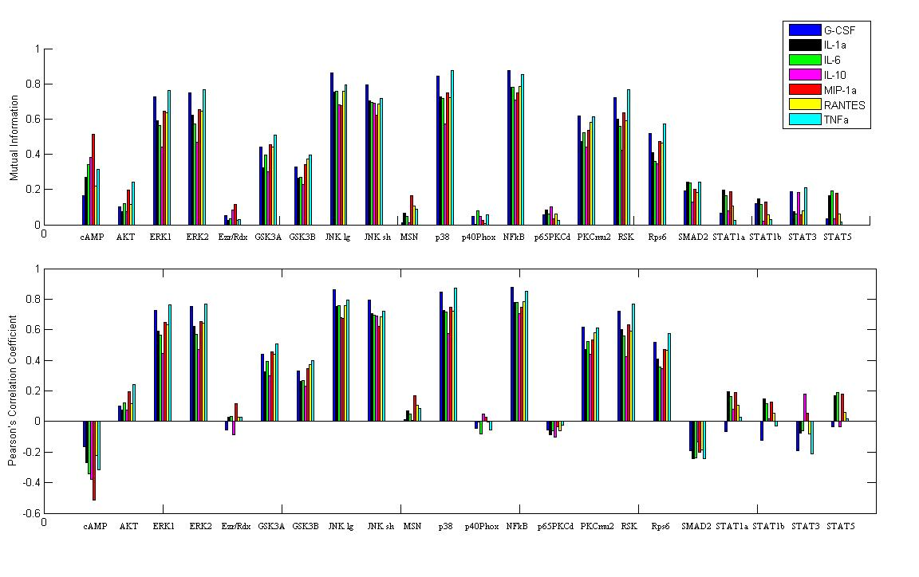
Protein-Cytokine network:
Mutual information for each 22*7 connections
Third step: The mutual information for each 22*7 connections by calculating marginal and joint entropy.

Slide 17
Protein-Cytokine network:
Finding the proper threshold
  Step 4: ARACNe algorithm to find the proper threshold using the mutual information from step 3.
    Using sample size 10,000 and kernel width 0.15, the algorithm is repeated for assigned p values of the joint probability of the system and turns a threshold for each step.
    The thresholds produced by the algorithm becomes stable after several iterations that means the multi information of the system has become reliable until p=0.0001.
    This threshold (0.7512) is used to discard the weak connections.
    The remaining connections are used to reconstruct the network.

Slide 18
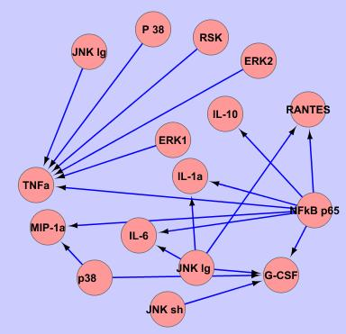
Protein-Cytokine network:
Network reconstruction by keeping the connections above the threshold
                Step 5: After finding the threshold, all connections above the threshold are used to find the topology of each node.
                Scanning all nodes (as receiver or source) turns out the network.
                The left picture shows the reconstructed network of protein-cytokine from the microarray data using the information-theoretic model.

Slide 19


Questions?
Notes:
19

