Slide 1
Emerging Frontiers of
Science of Information
Life Sciences Thrust

Slide 2
Life Sciences: A Discipline in Flux
Biology has rapidly become a data rich science
While broad disciplines within biology, over the past five decades have taken a deconstructive view, there is tremendous activity in an integrated systems view of bio-systems.
Traditional concepts in Information Theory have been critical for traditional analyses and modeling and bioinformatics.

Slide 3
Shannon and Information Flow
Message
Signal
Received Signal
Message
Information Source
Transmitter
Receiver
Destination
Noise Source
A generalized communication system, from Shannon (1948)

Slide 4
Shannon’s Model Applied to DNA Transcription
Received Signal
Completed RNA Sequence
Signal
RNA Sequence
Message
RNA Sequence
Message
Sequence
Information Source
DNA
Transmitter
RNA Polymerase
Receiver
RNA
Destination
Ribosome
Noise Source
Transcription Error, Mutation

Slide 5
Information Theory and Life Sciences: Renaissance
Initial efforts focused on sequence conservation, gene finding, motifs, their structural and functional implications, evolution, and phylogeny.
Complemented by phenotype databases, significant advances have been made in understanding the genetic basis of disease through information theoretic methods and formalisms.

Slide 6
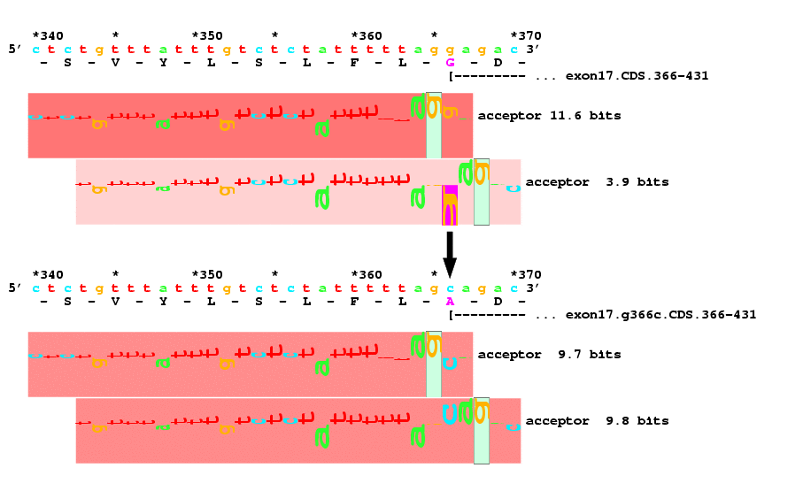
Information Theory and Life Sciences: Some Examples
A G/C mutation at location 366 in the ABCR gene is implicated in macular degeneration (glycene to alanine in exon 17). This was identified through information theoretic analysis of splice acceptors.
Allikmets et al., Gene 1998.

Slide 7
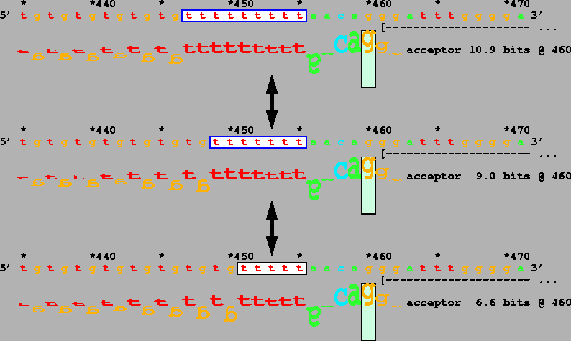
Information Theory and Life Sciences: Some Examples
Splicing varies among 3 common alleles that differ in length in the polymorphic polythymidine tract of the IVS 8 acceptor of the gene encoding the cystic fibrosis transmembrane regulator
Rogan et al., Human Mutation, 1998.

Slide 8
A real life Channel: The Chromosome
Long block code, discrete alphabet, extensive redundancy, perhaps to control against the infiltration of errors.
DNA also controls gene expression, an intra-organism process, so a comprehensive theory of intra-organism communication, i.e. a channel theory is needed.
DNA enables two organisms to communicate; it’s designed for inter-organism communication.

Slide 9
Context is Key
For genetic information, the context includes
  Impact of cellular environment
  Impact of the context within the sequences themselves; are there larger patterns within the genetic code?
  Impact of multiple reading frames
Beyond cells, there is context for tissue-specific development, at coarser levels, organs, organisms, ecosystems, and beyond

Slide 10
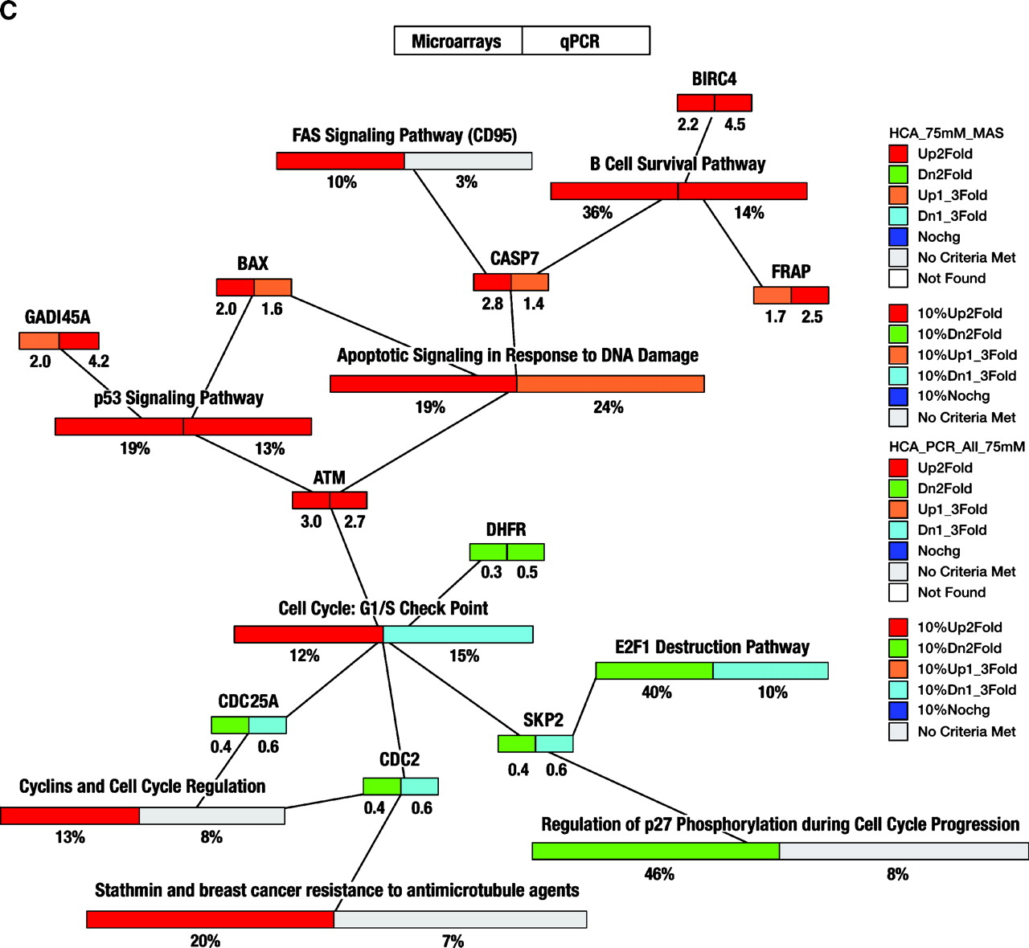
Information Theory and Life Sciences: Scratching the Surface
Enriched functional categories and pathways in colorectal cancer cell lines following treatment
Fatima et al. Cancer Epidemiol Biomarkers Prev 2008

Slide 11
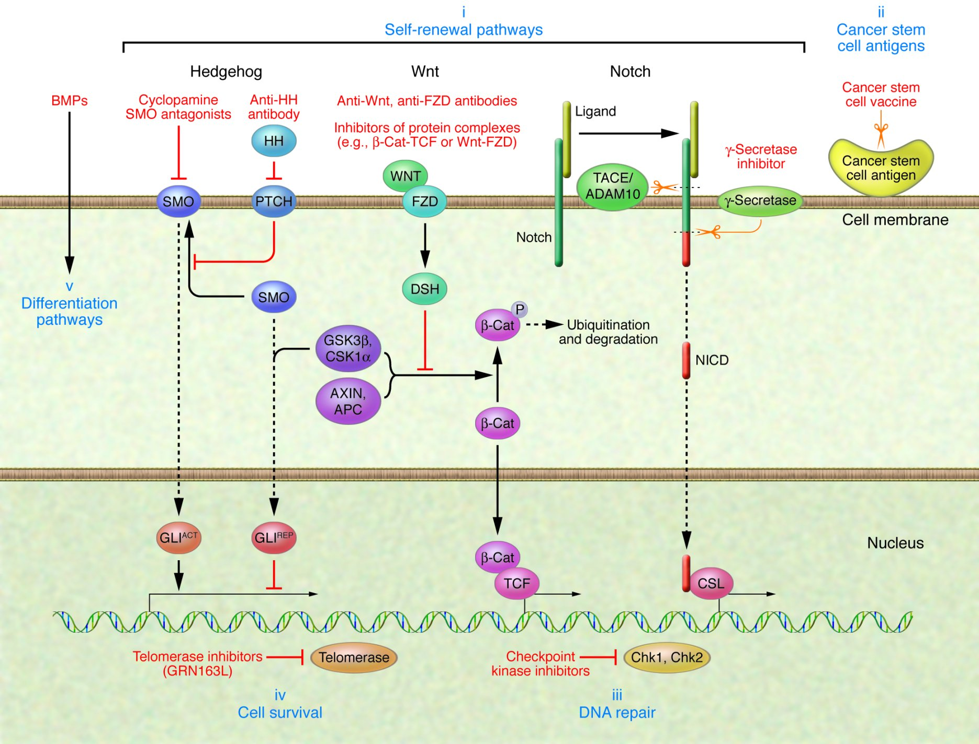
Information Theory and Life Sciences: Emerging Frontiers
Hedgehog (HH), Notch, and Wnt signaling are key stem cell self-renewal pathways that are deregulated in lung cancer and thus represent potential therapeutic targets
Sun et al., JCI 2007

Slide 12
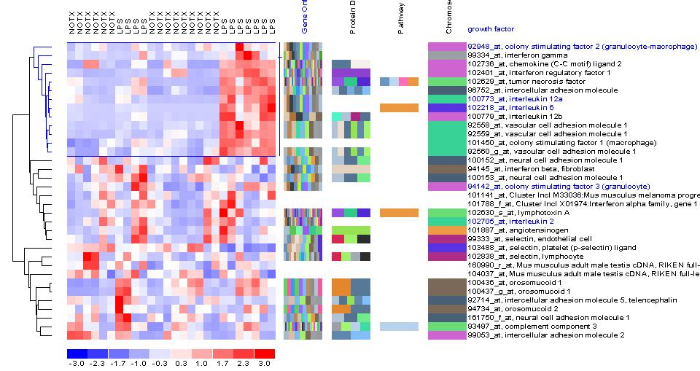
Key Outstanding Challenges
Information in spatio-temporal data
  Scaling from molecular processes within the cell to entire populations
  Timescales ranging from femtosecond-scale ligand binding to eons

Slide 13
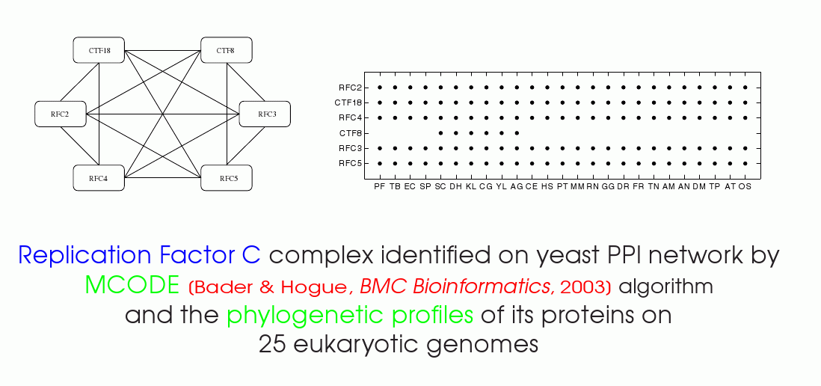
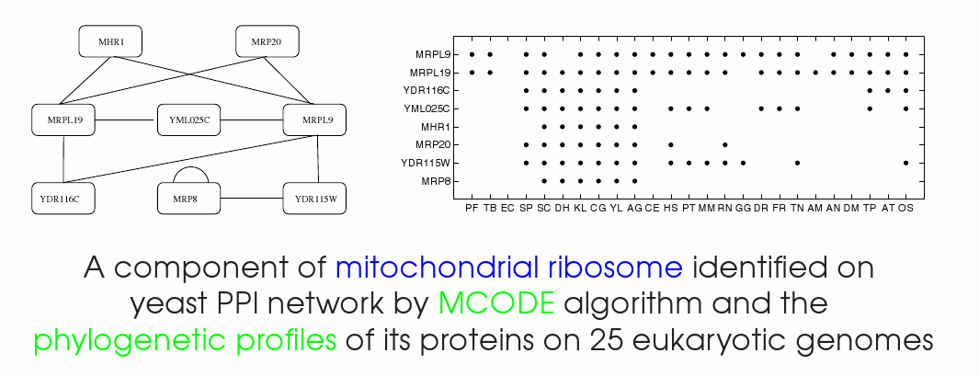
Key Outstanding Challenges
Information in systems/networks
  Modularity and function-based information measures
  Comparative/ discriminant analysis
  Methods and validation

Slide 14
Key Outstanding Challenges
Information and context
  Tissue specific pathways
  Normal physiology versus pathology
Data transformation, reduction, and abstraction
  Data complexity, noise
  Signal transduction
  Models, manifestation, and granularity

Slide 15
Information in Systems: Near-Term Challenges
Information Theoretic measures and methods for modularity in biochemical networks
Models and methods for conservation in large networks
Methods for in-silico network inference
Integration of tools into the BioPathways WorkBench
Identification/ Curation of data sources for phenotype-characterized data in support of discriminant analysis

Slide 16
Information in Systems: Medium-Term (years 2/3) Challenges
Role of spatial compartmentalization in function (spatio-temporal information flow)
Characterization of phenotype-implicated data
Models and methods for discriminant and discriminating sub-networks
Relationship between information content/ flow, network stability, and biological function
Scaling up from cellular to intra-cellular networks

Slide 17
Some Recent Results

Slide 18
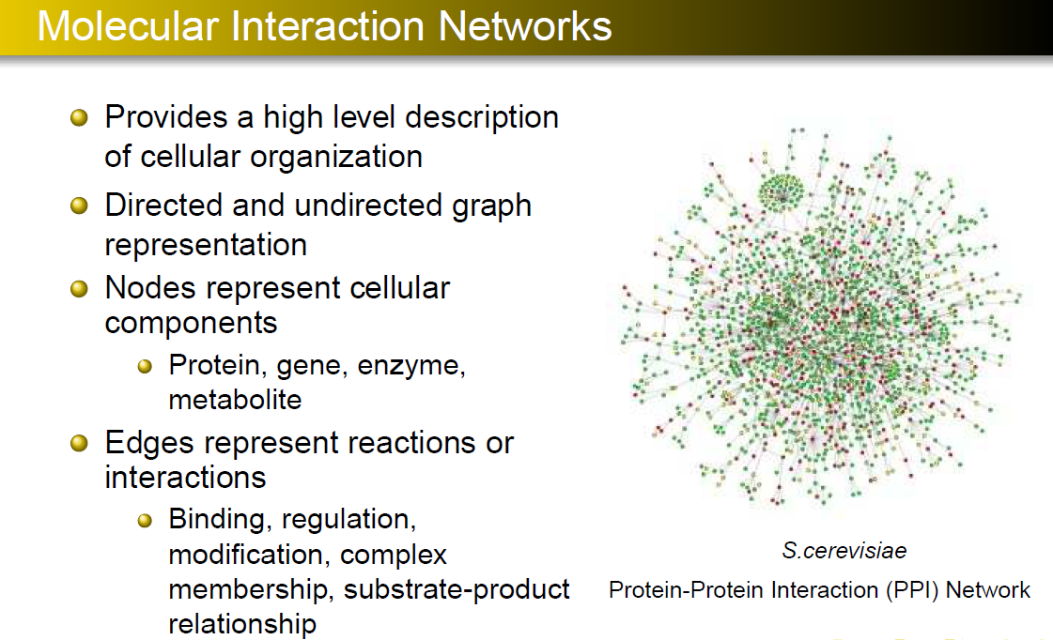

Slide 19
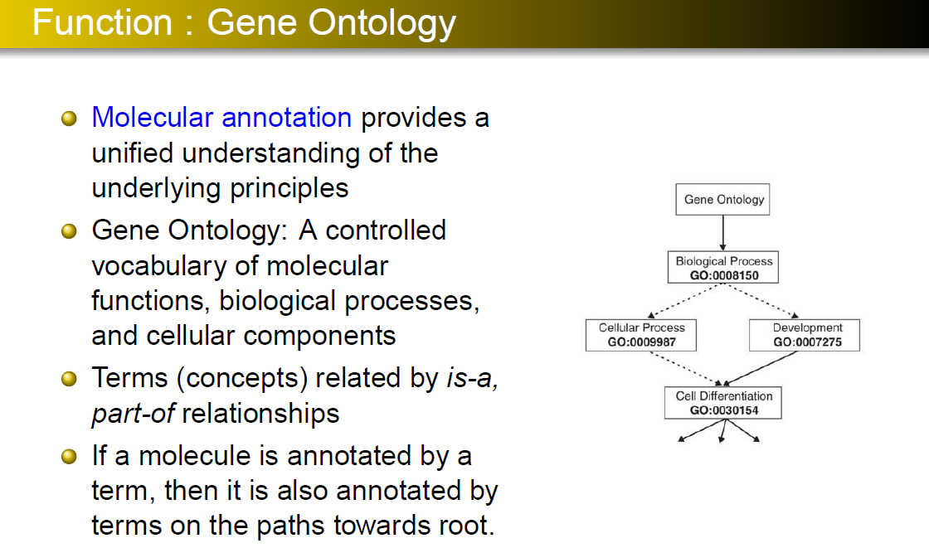

Slide 20
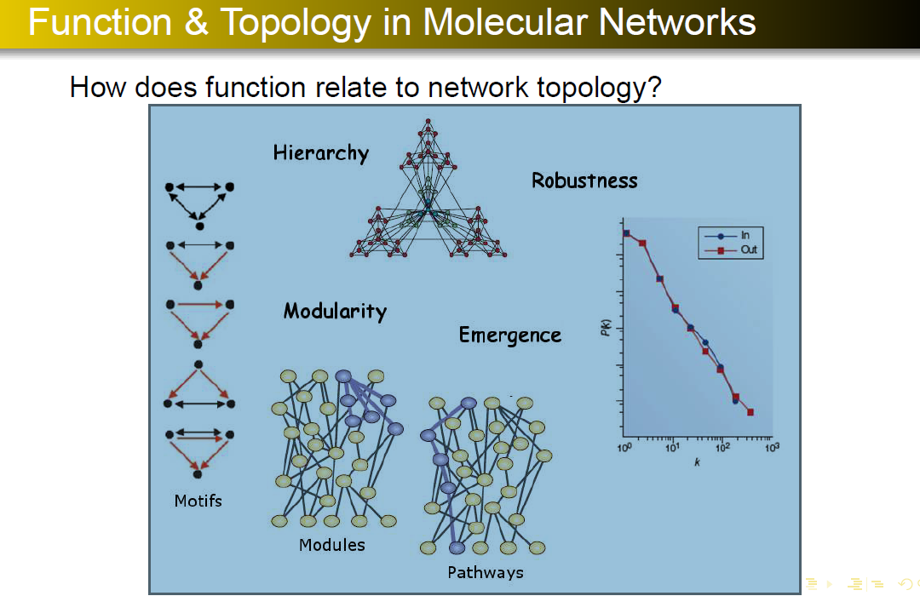

Slide 21
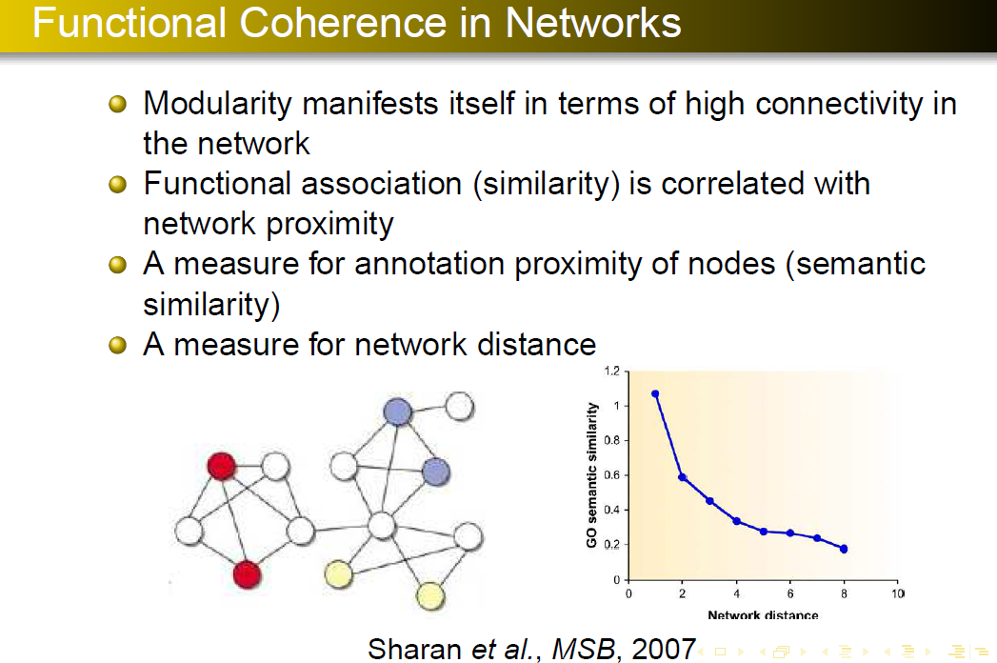

Slide 22
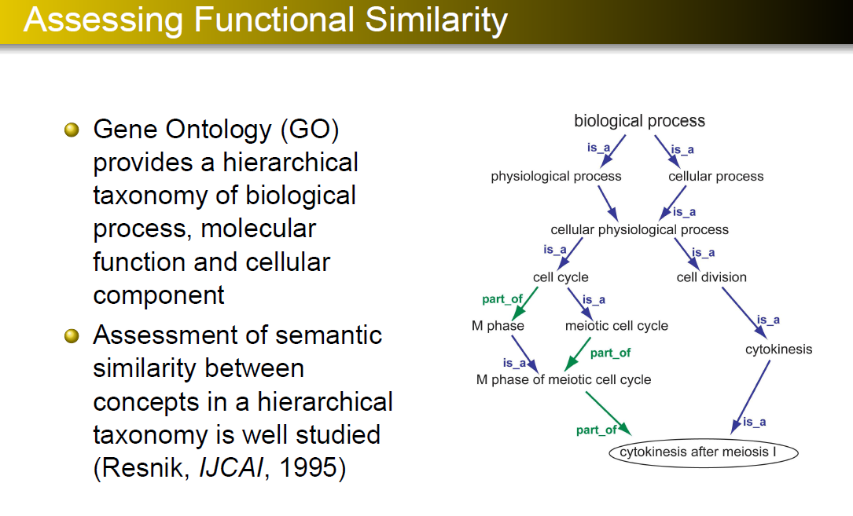

Slide 23
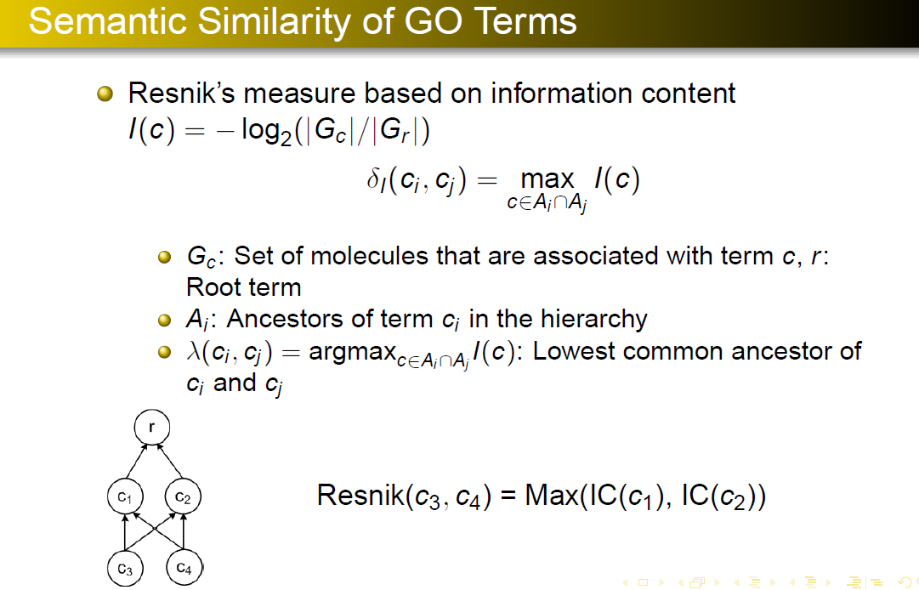

Slide 24
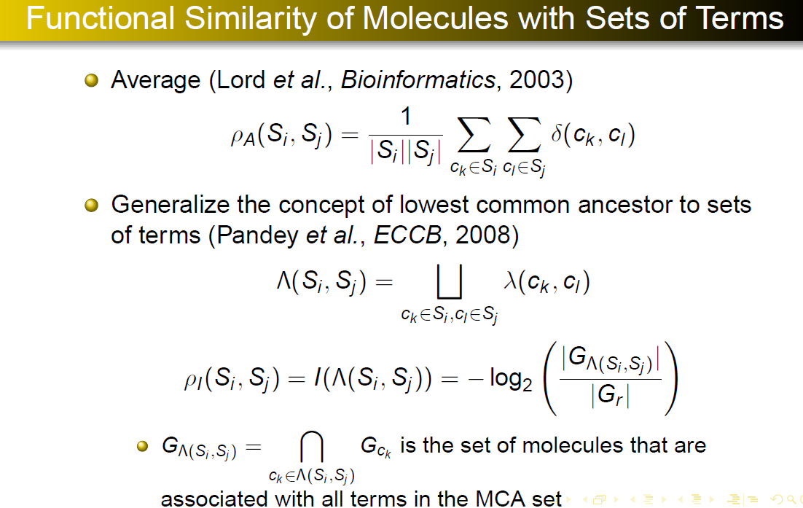

Slide 25
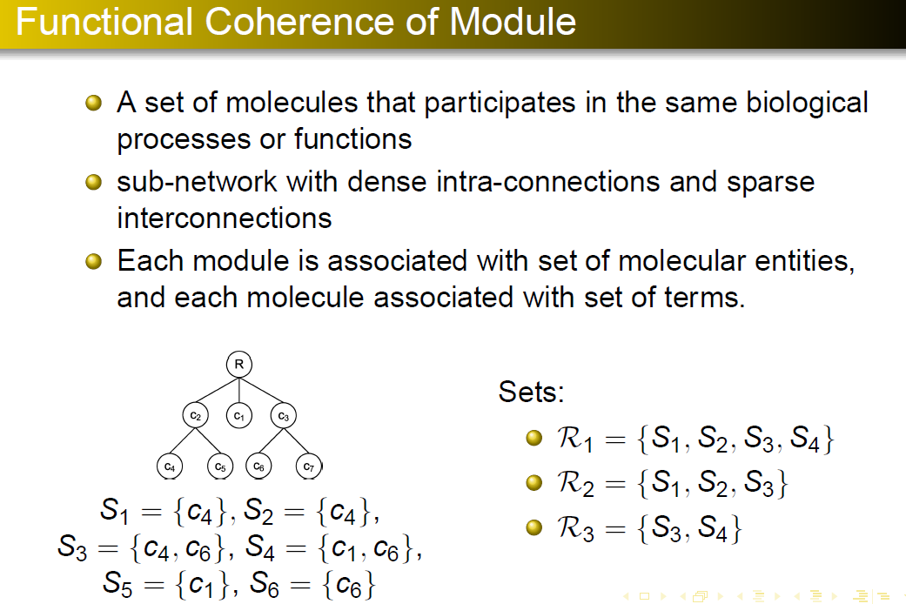

Slide 26
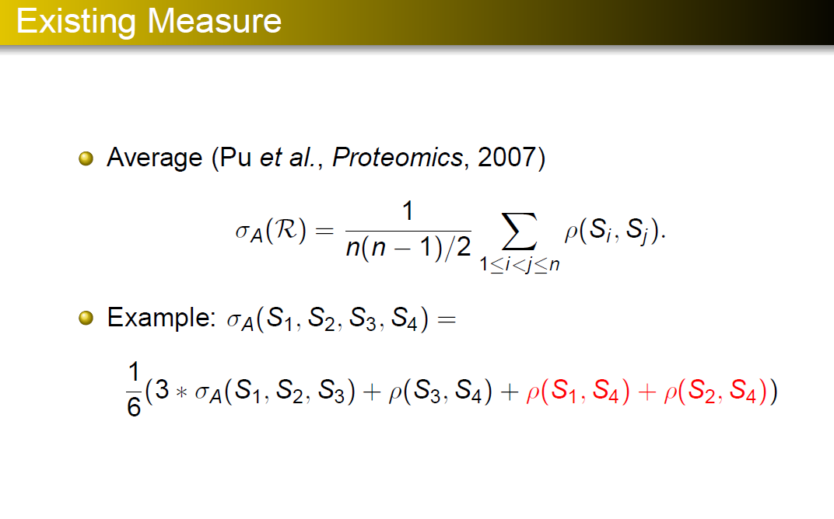

Slide 27
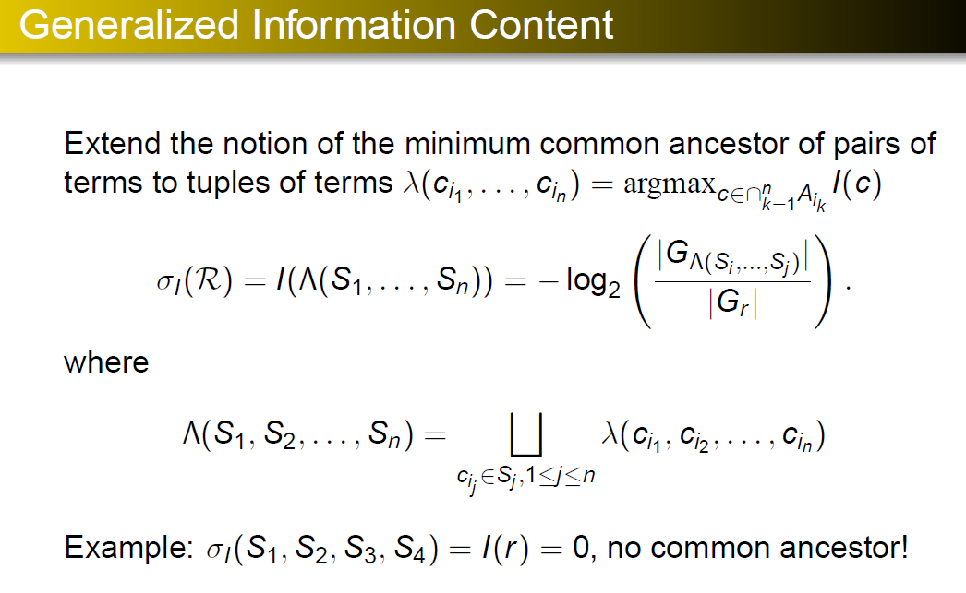

Slide 28
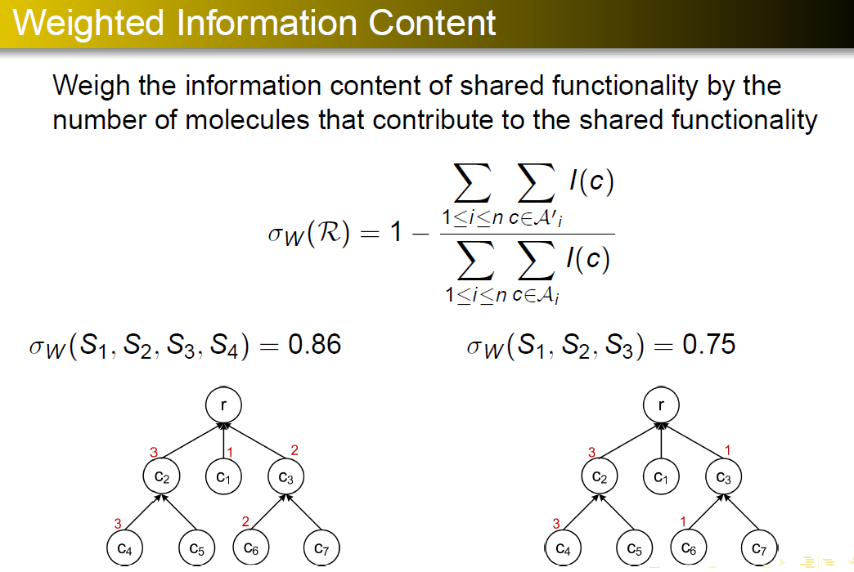

Slide 29
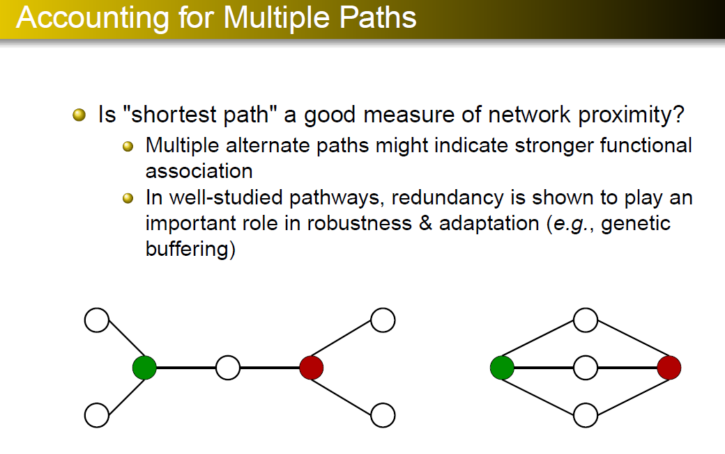

Slide 30
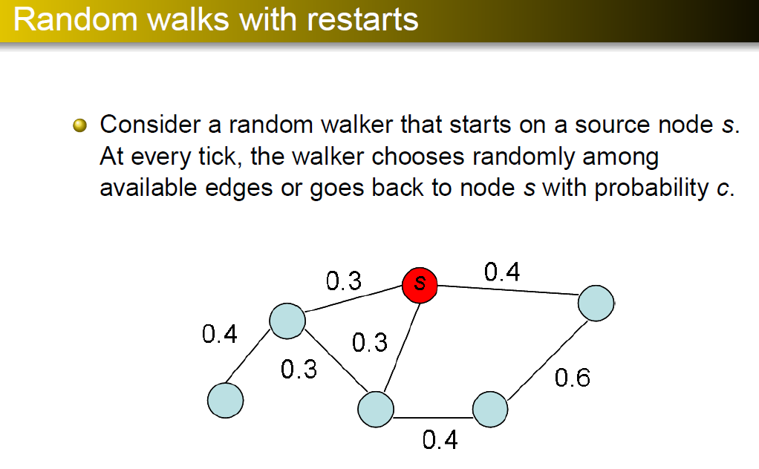

Slide 31
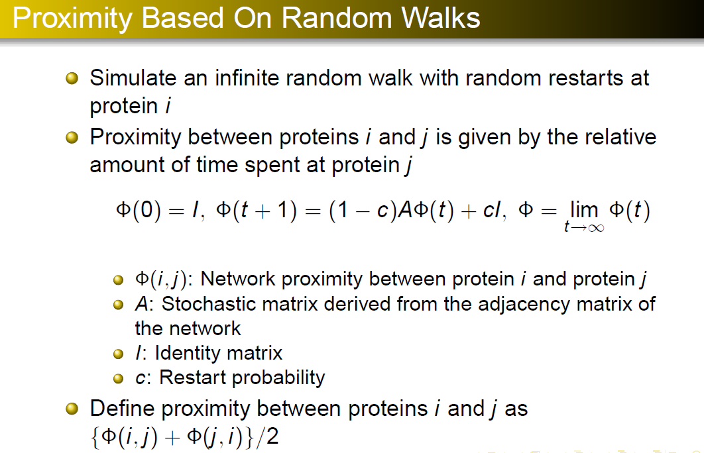

Slide 32
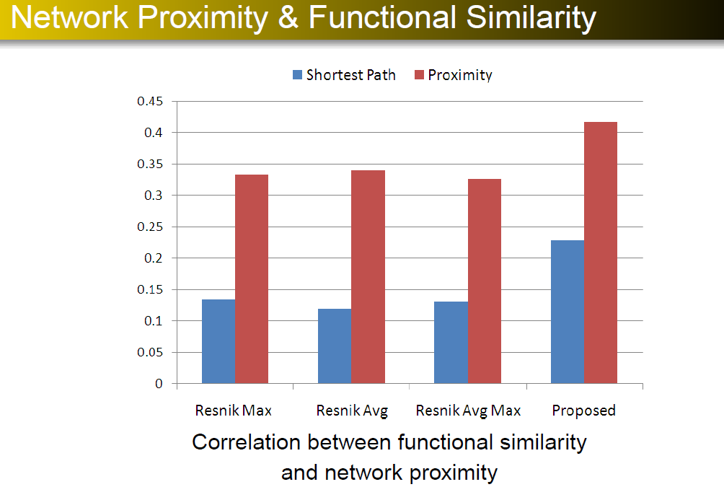

Slide 33


Slide 34
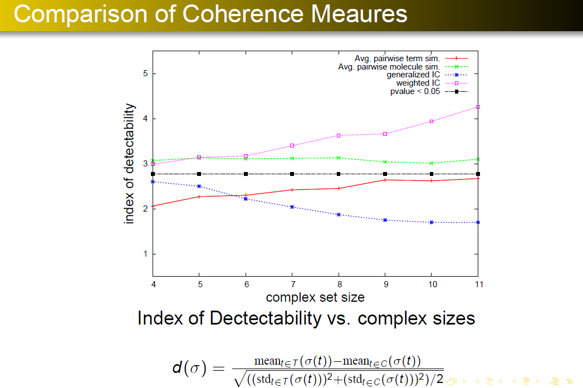

Slide 35
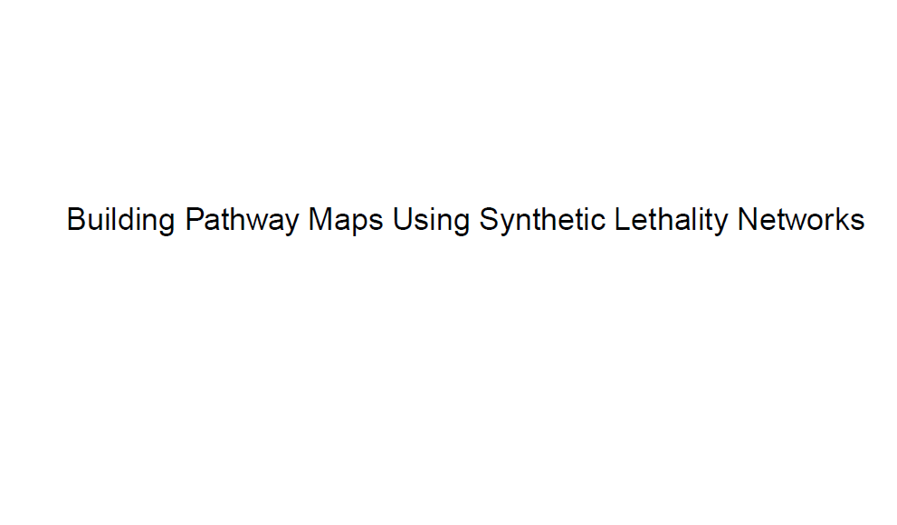

Slide 36
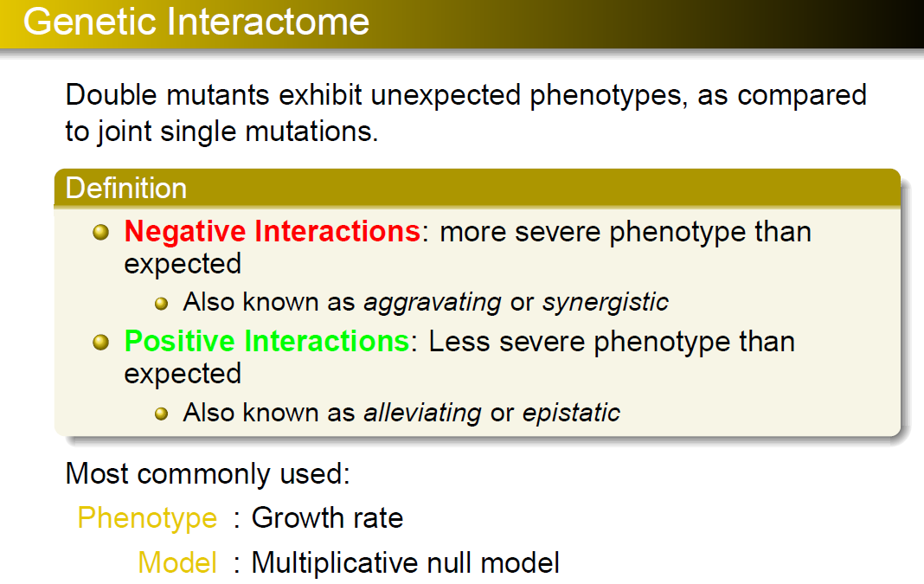

Slide 37
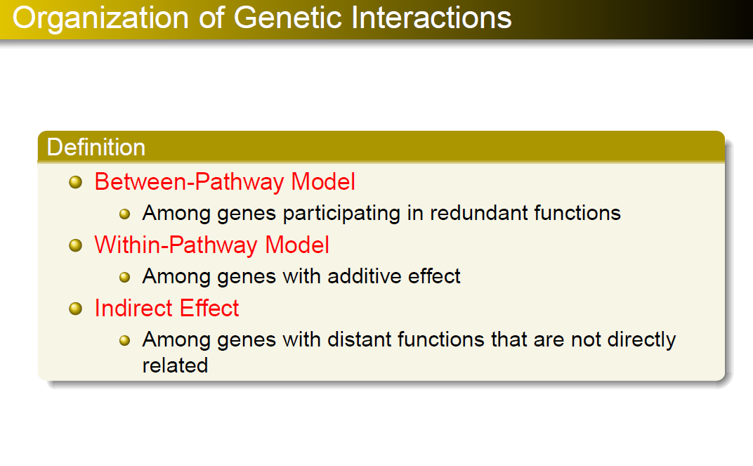

Slide 38
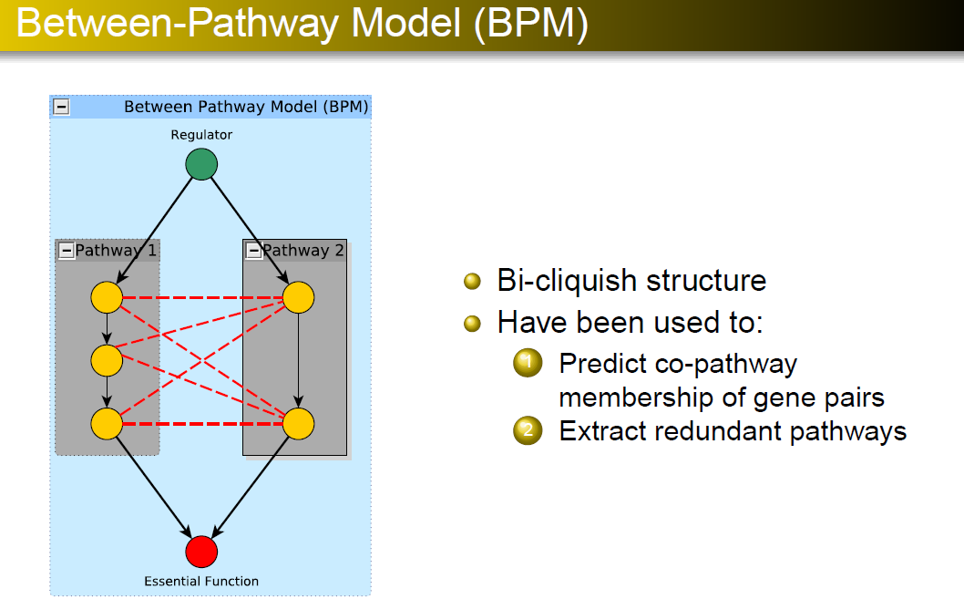

Slide 39
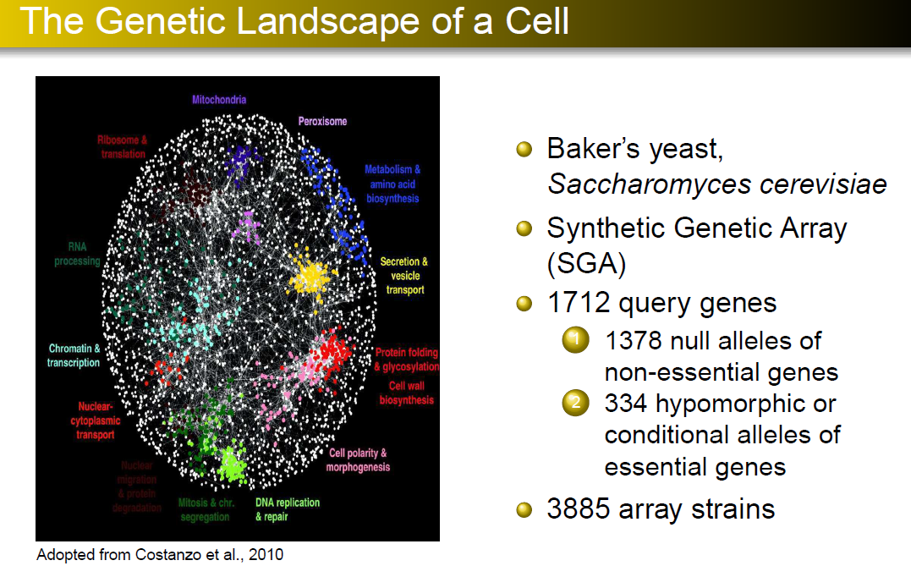

Slide 40
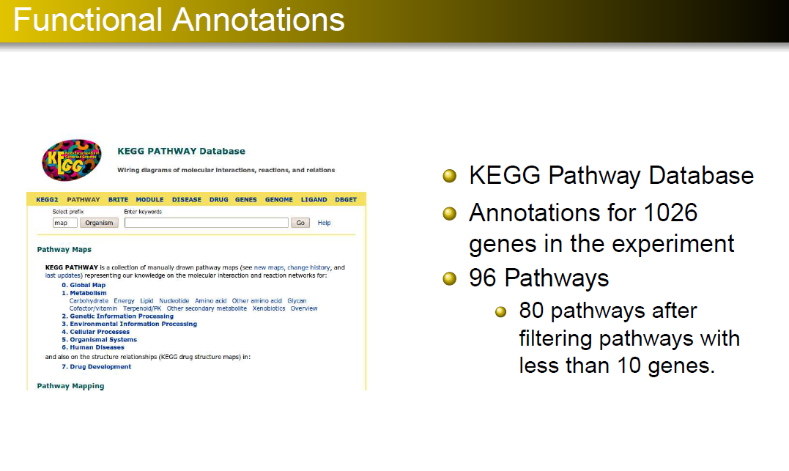

Slide 41
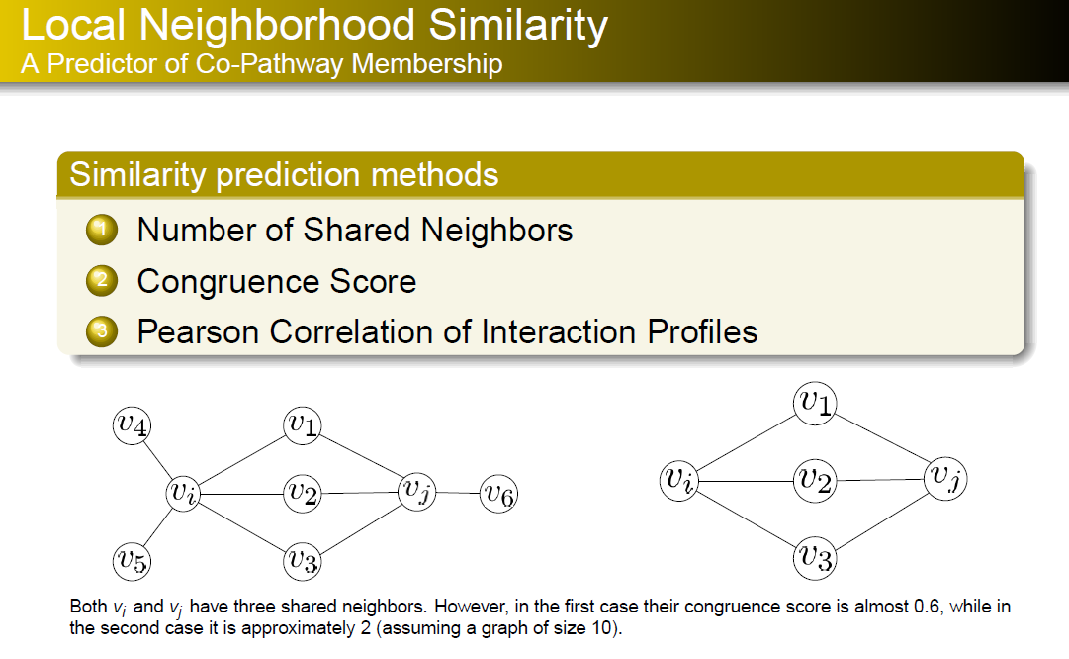

Slide 42
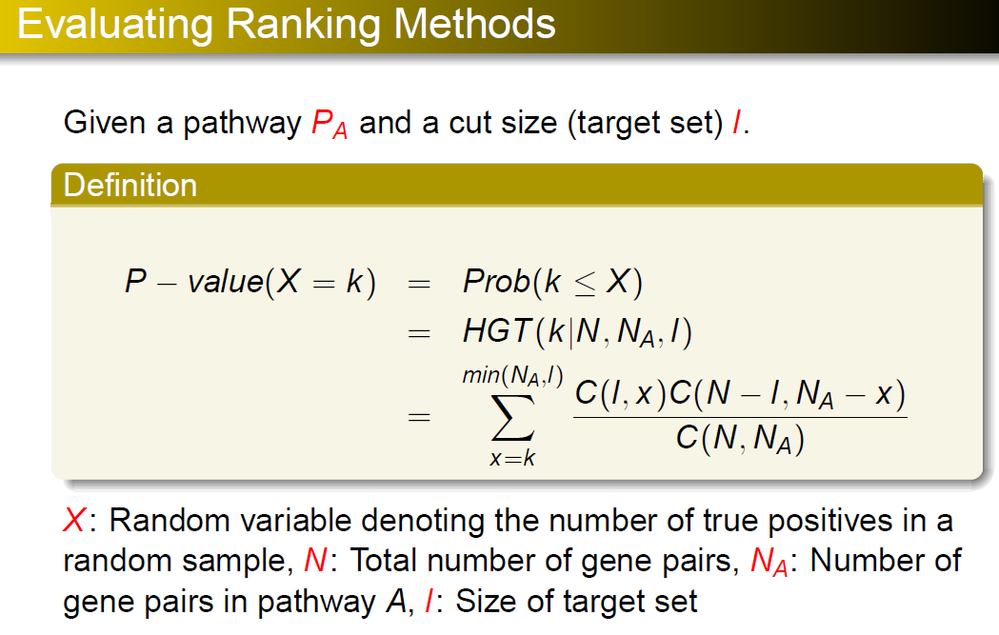

Slide 43
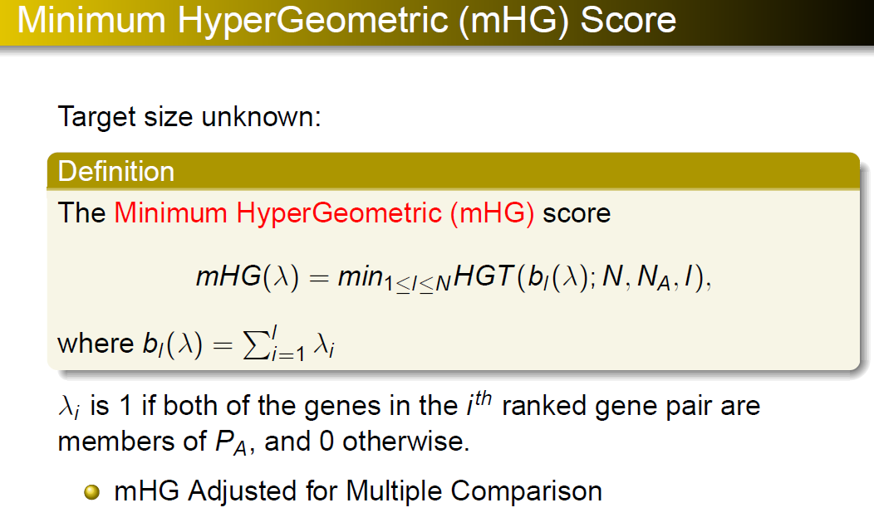

Slide 44
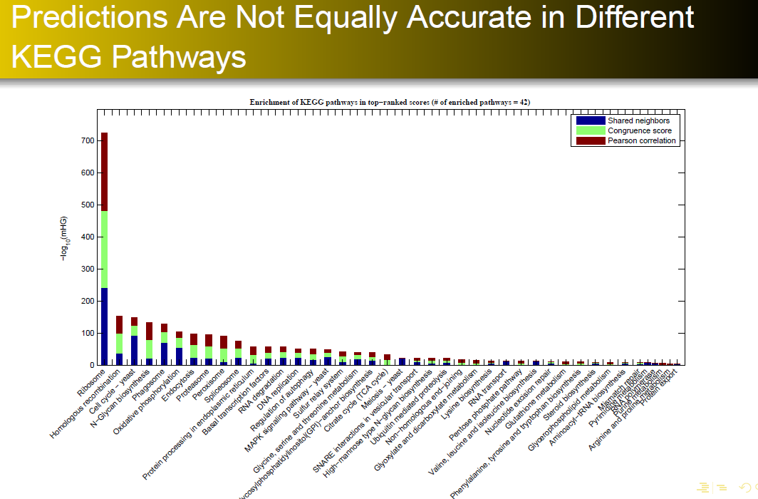

Slide 45
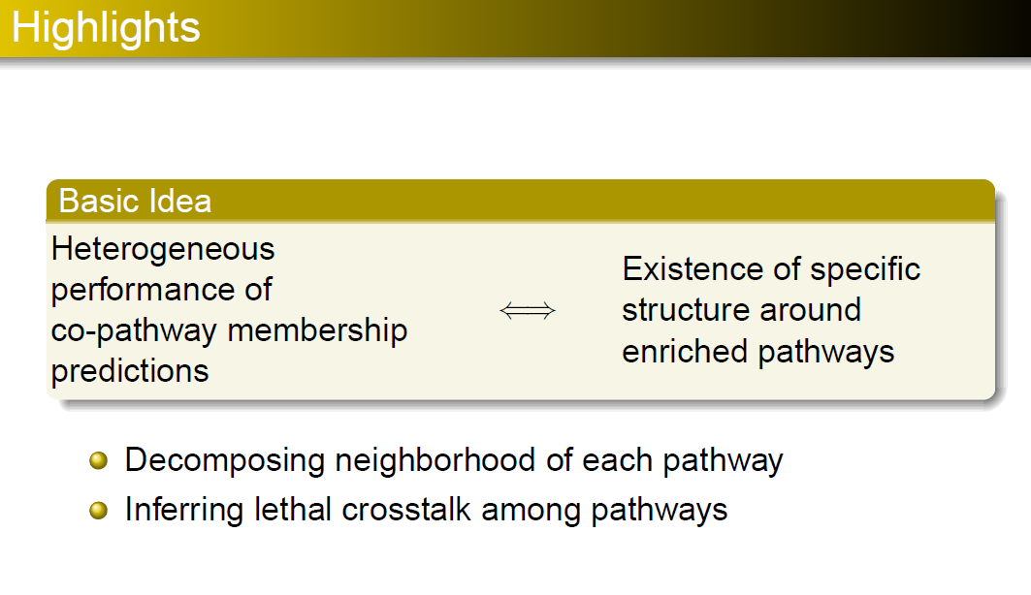

Slide 46
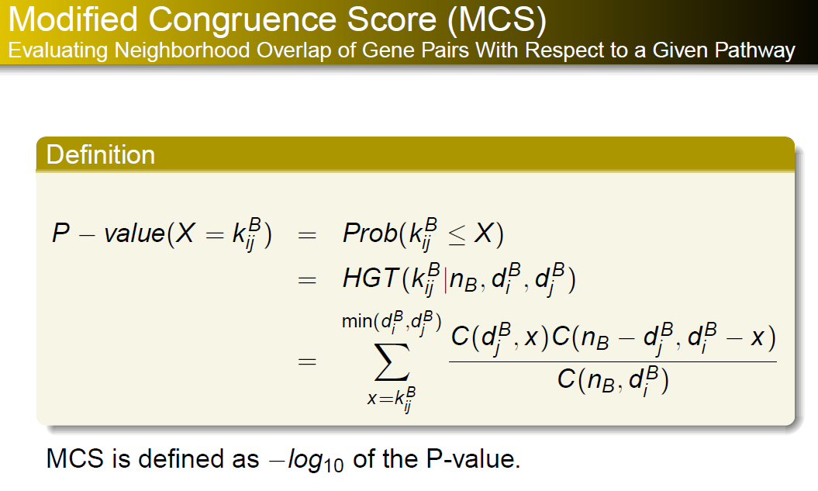

Slide 47
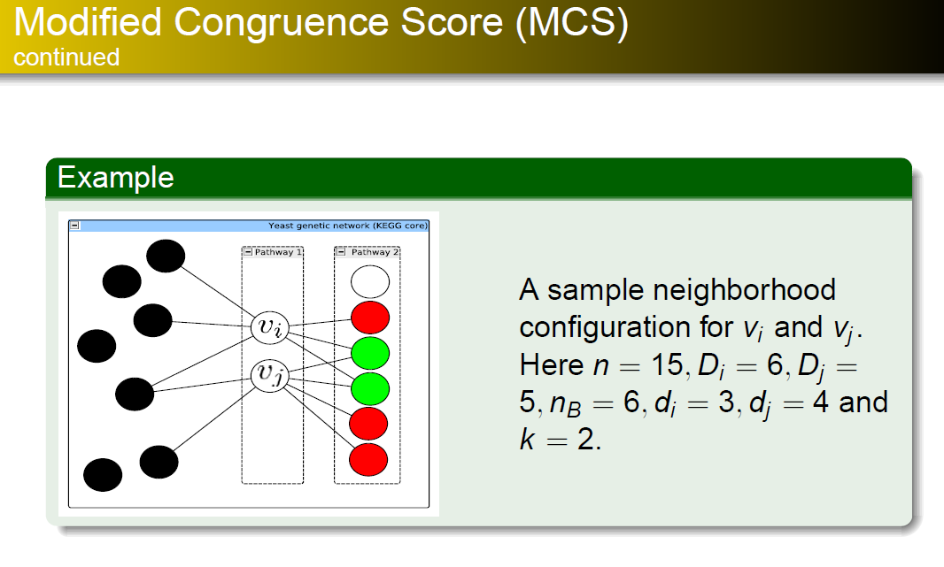

Slide 48
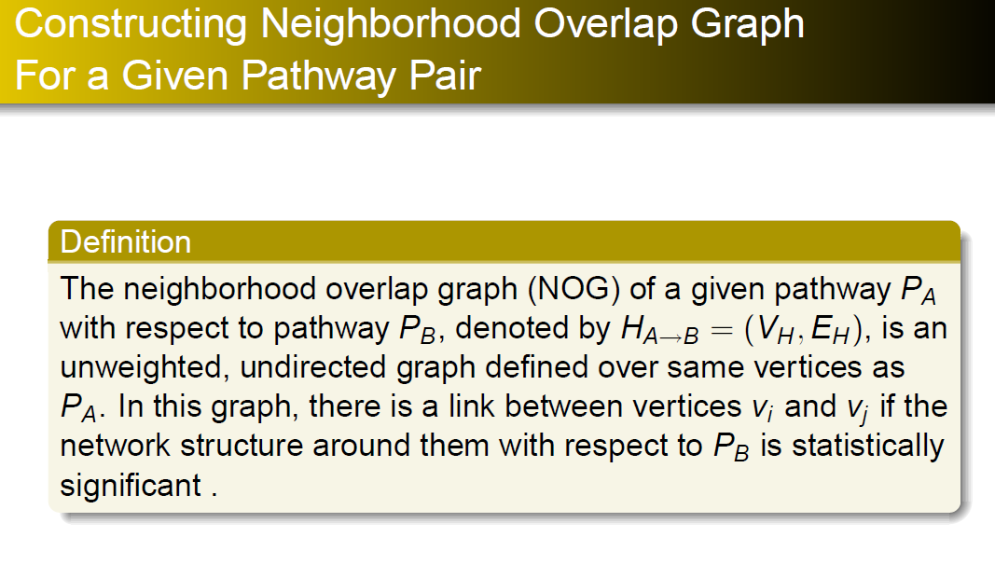

Slide 49
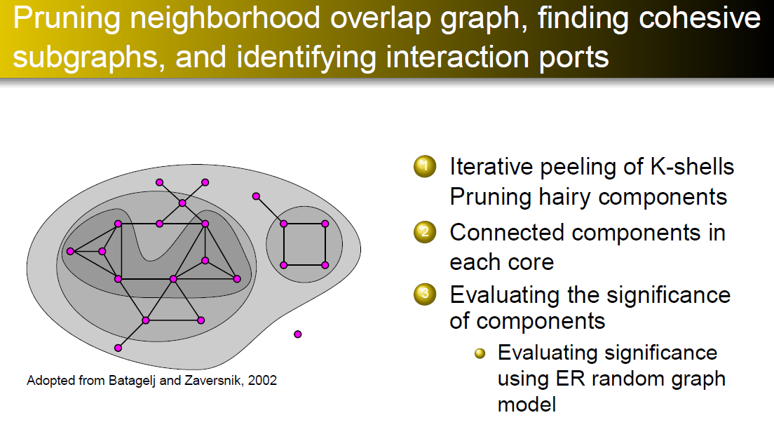

Slide 50
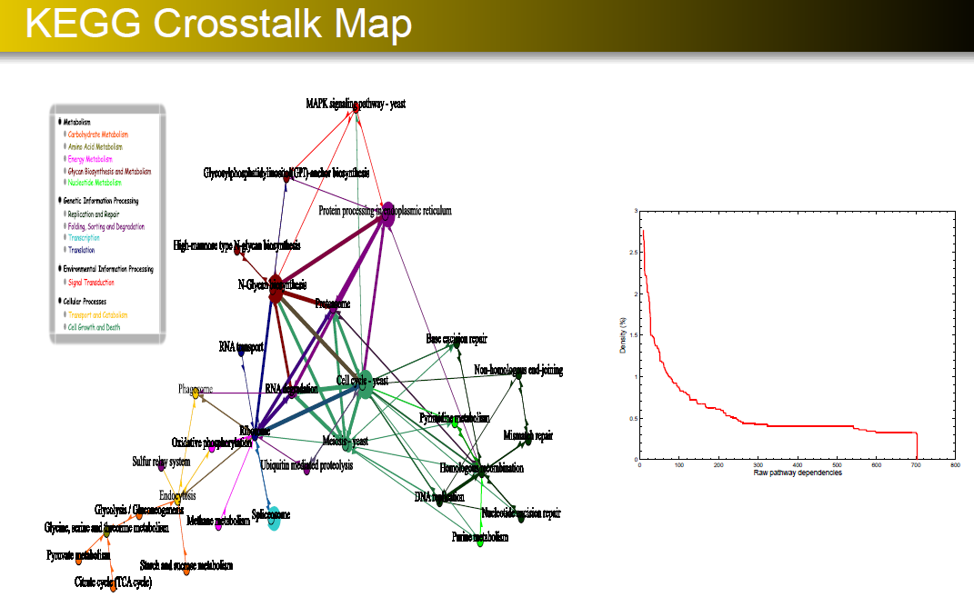

Slide 51
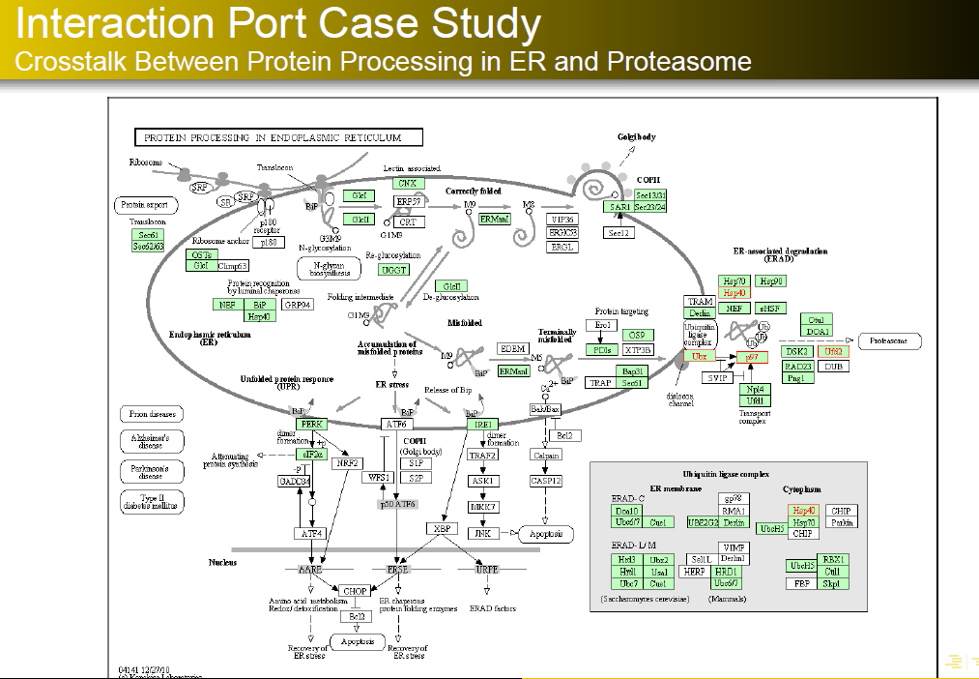

Slide 52
Protein- Cytokine Network Reconstruction
Network reconstruction has two stages: mutual information coefficients computation; threshold determination.
Mutual information networks rely on the measurement of the mutual information matrix (MIM).
Choosing a proper threshold is critical.

Slide 53

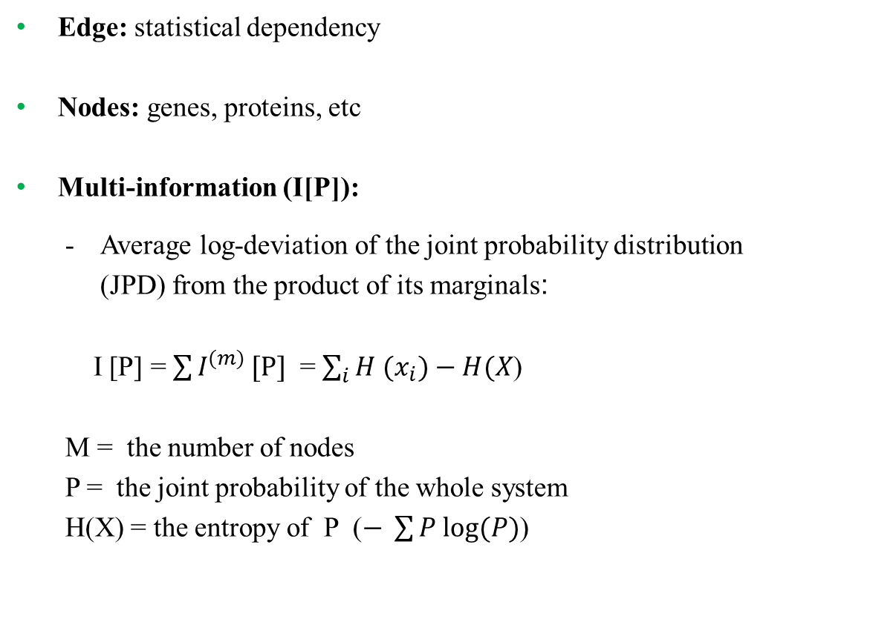
Key elements of network interface
Edge: statistical dependency
Nodes: genes, proteins, etc
Multi-information (I[P]):
  Average log-deviation of the joint probability distribution
  (JPD) from the product of its marginals:
  I [P] = $\sum{I^{(m)}}[P]$ = $\sum_{i}{{H (x}_{i}})−H(X$)
  M = the number of nodes
  P = the joint probability of the whole system
H(X) = the entropy of P ($− \sum{P log(P)}$)

Slide 54
Algorithm for the Reconstruction of Accurate
Cellular Networks (ARACNE)
ARACNe is an information-theoretic algorithm for reconstructing networks from microarray data.
ARACNe follows these steps:
  - It assign to each pair of nodes a weight equal to their mutual information.
  - It then scans all nodes and removes the weakest edge. Eventually, a threshold value is used to eliminate the weakest edges.
  - At this point, it calculates the mutual information of the system with Kernel density estimators and assigns a p value, P (joint probability of the system) to find a new threshold.
  - The above steps are repeated until a reliable threshold up to P=0.0001 is obtained.

Slide 55
Protein-Cytokine network:
Histograms and probability mass functions
22 Signaling proteins responsible for cytokine releases:
  cAMP, AKT, ERK1, ERK2, Ezr/Rdx, GSK3A, GSK3B, JNK lg, JNK sh, MSN, p38, p40Phox, NFkB p65, PKCd, PKCmu2,RSK, Rps6 , SMAD2, STAT1a, STAT1b, STAT3, STAT5
7 released cytokines (as signal receivers):
  G-CSF, IL-1a, IL-6, IL-10, MIP-1a, RANTES, TNFa
Using information-theoretic model we want to reconstruct this network from the microarray data and determine what proteins are responsible for each cytokine releases

Slide 56
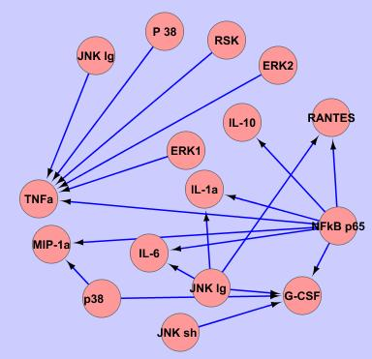
Protein-Cytokine network: Network Reconstruction
                Reconstructed network of protein-cytokine from the microarray data using the information-theoretic model.

Slide 57
Other Approaches to Network Reconstruction
Basics of data-driven network reconstruction
  Least-squares approach
Principal component regression
  Basics and statistical significance testing
Application to phosphoprotein/cytokine modules in macrophages
  A two-step model
Slide 57

Slide 58
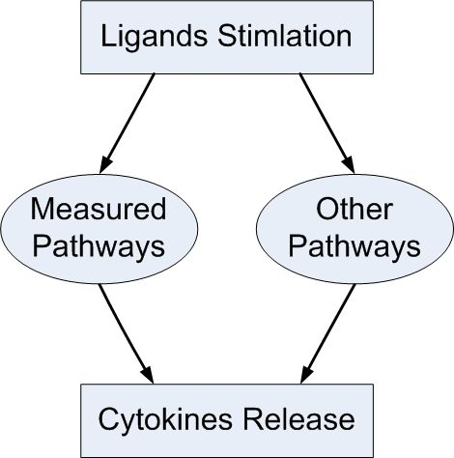
Structure of the Model
Ligand Stimulation
L
Two-part model
Part-I: Capture most of the output as: Y₁ = X*B₁
    Threshold on the ratio, r_{j} = b_{j}/ σ_{j} : r_{th} = 1.96
Part-II: Residual Y – Y₁ = Y₂ = L*B₂
    r_{th} = √2*1.96 = 2.77
X
B₂
B₁
Y₂
Y₁
Total cytokine: Y = Y₁ + Y₂

Slide 59
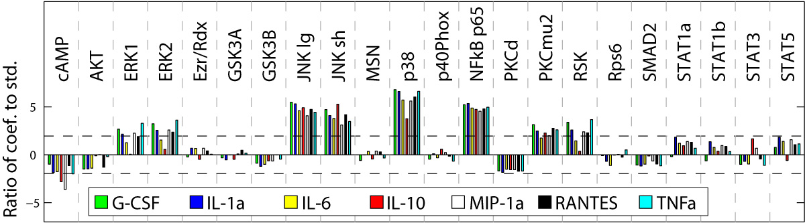
Results: Insights into Pathways
JNK, p38, NF-kB strongest coefficients
  Exert substantial control on transcription
  A candidate for drug targets for inflammatory diseases
ERK1/2 and RSK (ribosomal S6 kinase) similar profile
cAMP is anti-correlated

Slide 60
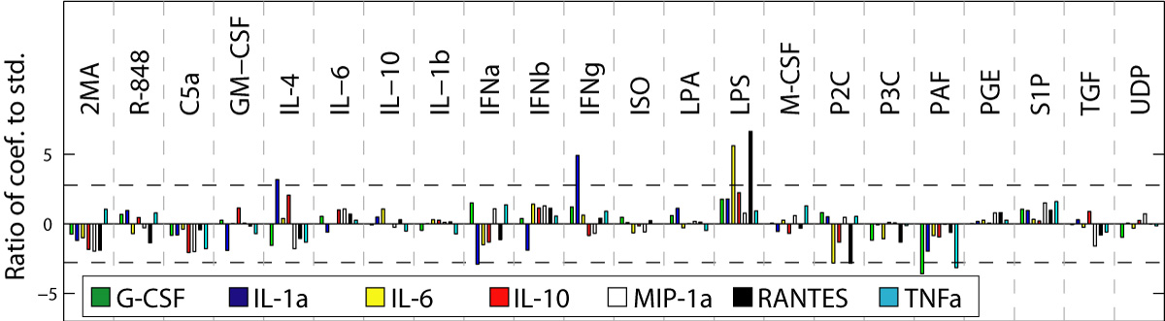
Significant Unmeasured Pathways
Just few ligands significant
IL-4 and IFN-g for IL-1a
LPS for IL-6 and RANTES: possible role of non-canonical (other than NF-kB) pathways
Slide 60

Slide 61
Results: Novel Hypothesis
LPS, P2C
P3C, R-848
ISO
Adrb2
TLR2/1, TLR2/6
TLR4, TLR7
2MA
P2X, P2Y
p38
NF-κB
JNK
G
-
CSF
TNF-alpha: a target for Rheumatoid Arthritis
New hypothesis: M-CSF-specific pathway regulates TNF-alpha?
Notes:
Our minimal model covers all known mechanisms of activation of G-CSF and highlights a potential role for p38 in its posttranscriptional regulation.
For IL-1a, besides all known activators, IFNg and IL-4 are identified as potential novel independent activators.
For IL-6, four predictors were confirmed by literature data whereas cAMP and IL-4 may be false positives although the effect of IL-4 is controversial.
IL-10 was the least convincing model with a misidentification of NF-kB and a lack of identification of p38 and cAMP as positive predictors.
Another obvious missing predictor was NF-kB for MIP-1a. However, in this model, all other important signaling pathways were represented.
For RANTES, all known mechanisms of activation were found.
Finally, all known signaling pathways with the exception of ERK were found for TNFa. This last minimal model also identified a potentially new M-CSF specific pathway for the activation of TNFa

Slide 62
Forthcoming Results
Error Correction in NGS Reads
Information Content of Kinetic Pathways
  Model Selection
  Model Reduction
  Identification of Novel Targets
Higher Order Motifs

Slide 63
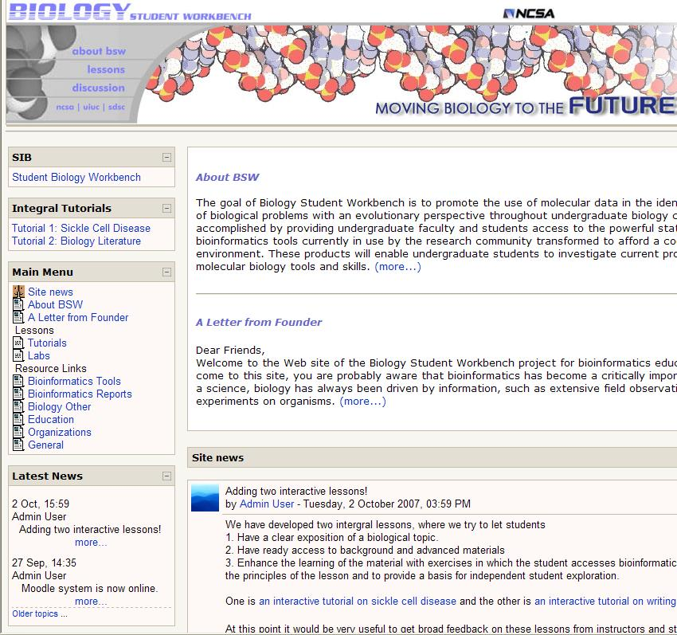
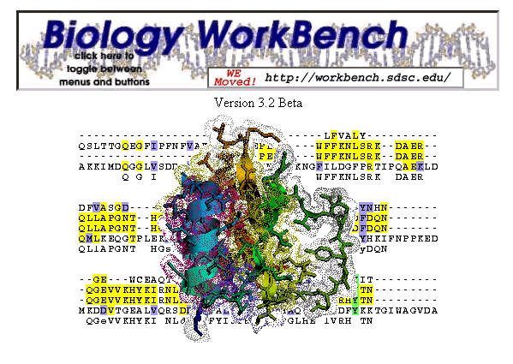
Frameworks and Portals
Over a million sessions and counting!

