Slide 1
Center for
Science of Information
Big Data Applications in Life Sciences:
From Genomes to Connectomes

Slide 2
Big Data in Life Sciences
Clinical Data
  Phenotypic Screens, Vitals, Drugs
  Imaging Data (3D+time)
  Sequences, Transcriptional data
Organism-, Individual-, and Pathology-Specific Data
  Structures, Genomes, Interactomes
  Tissue- and Phenotype-Specific Data
Pharmaco-Genomic Data
  Drug Molecule Databases
  Drug-Biomolecule Interaction Screens

Slide 3
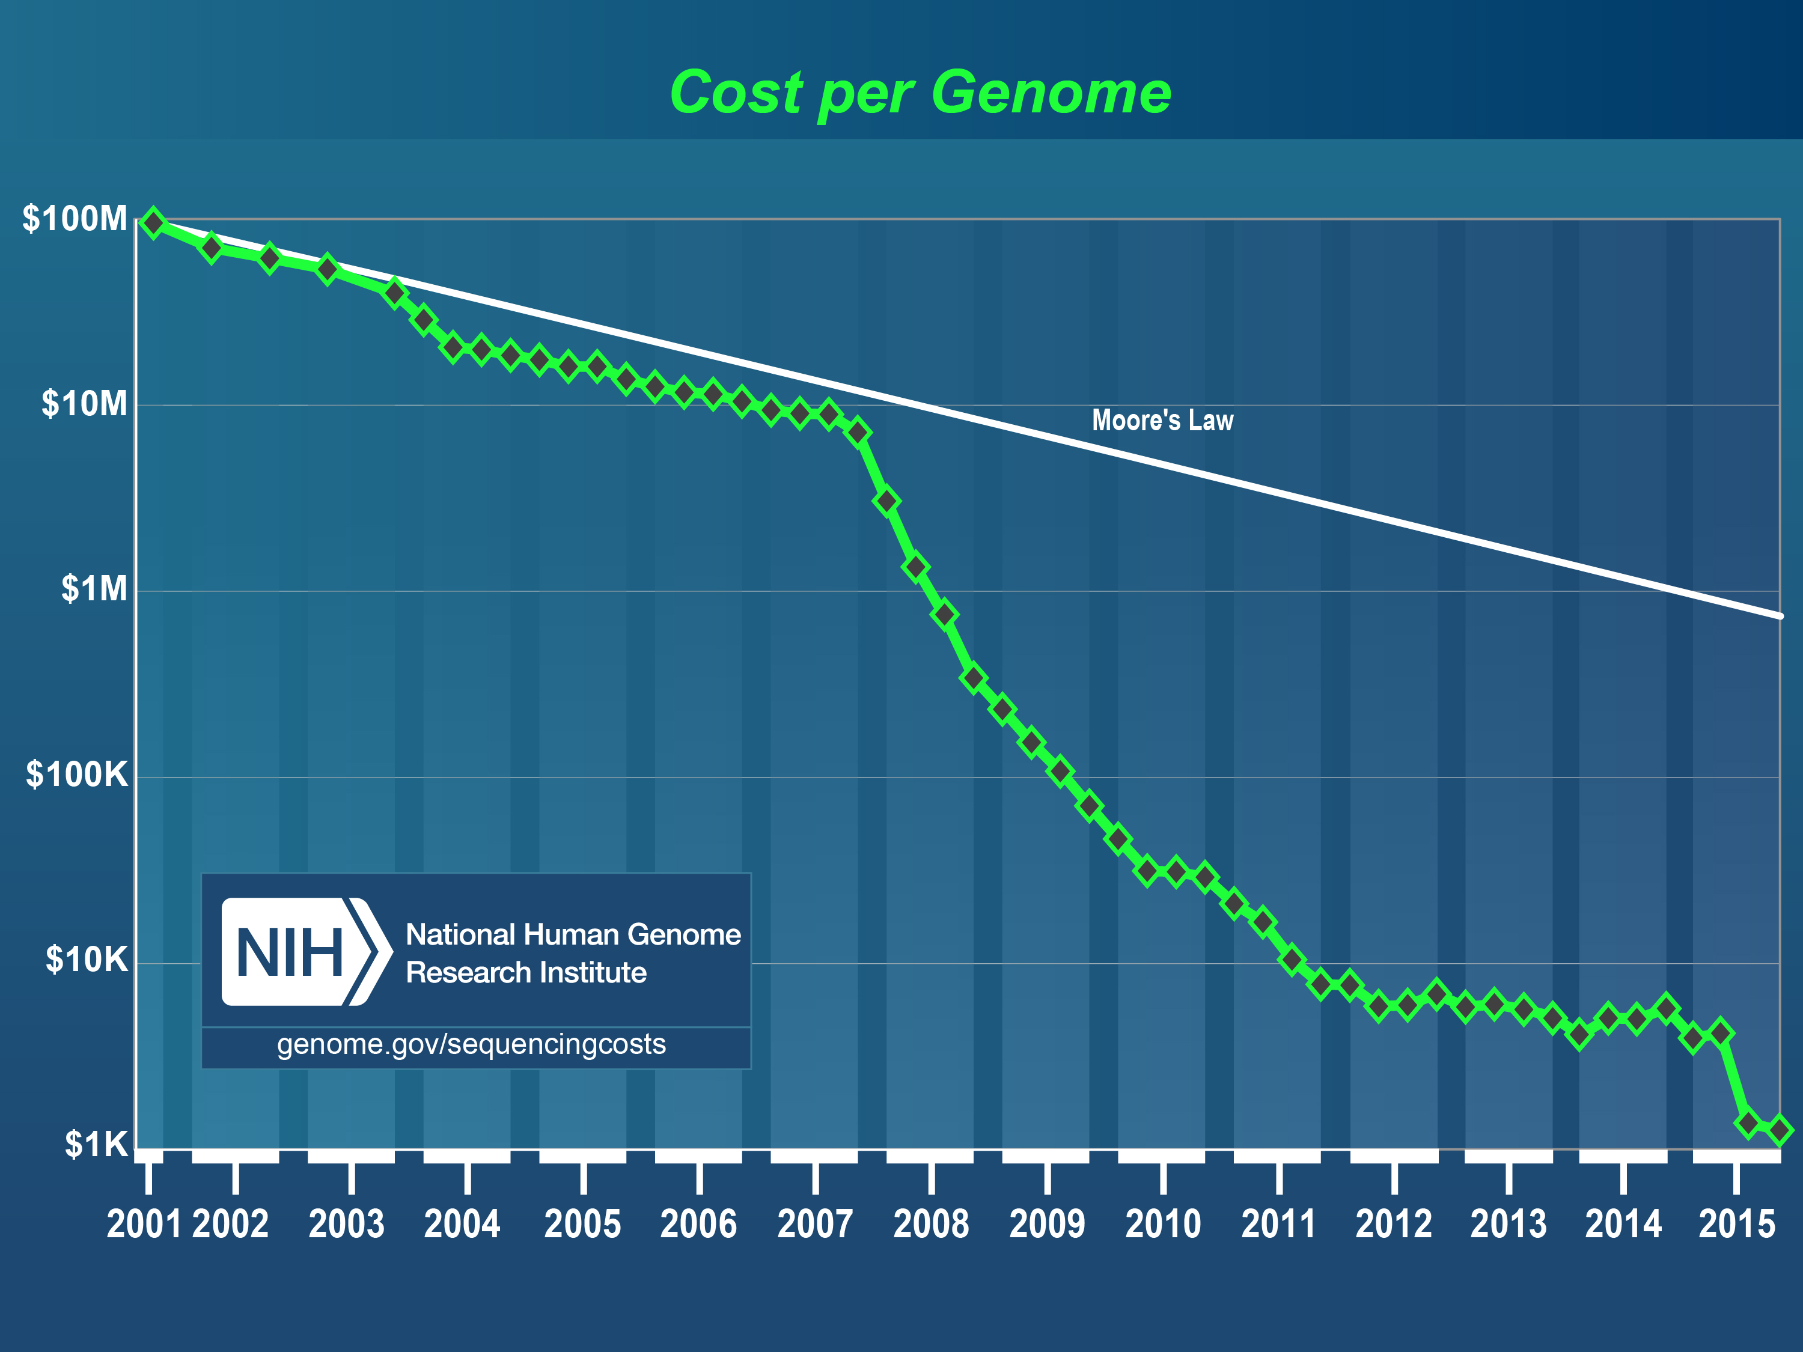
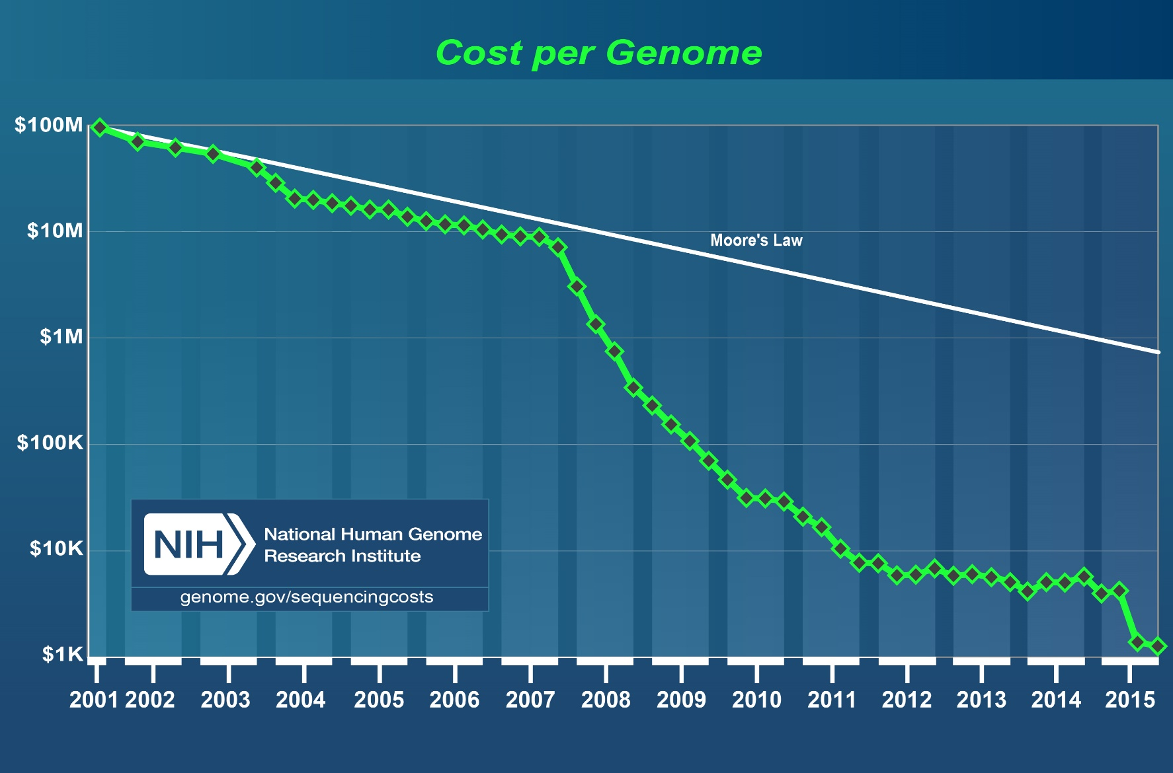
High throughput sequencing revolution
Notes:
Faster than Moore;s Law
Implication to the IT community

Slide 4
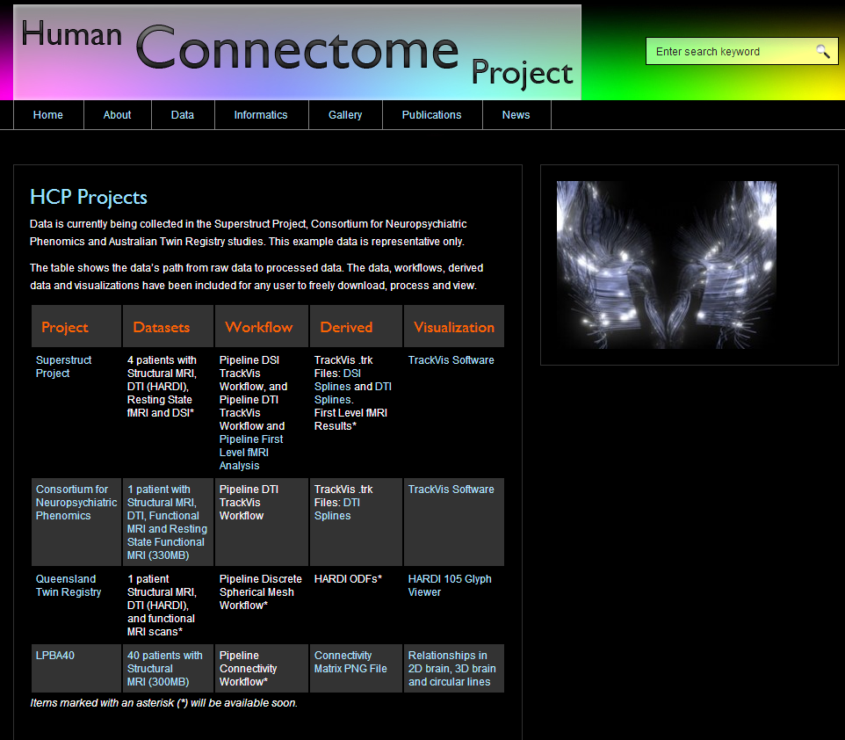
Imaging Databases

Slide 5
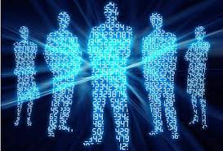
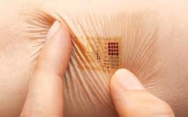
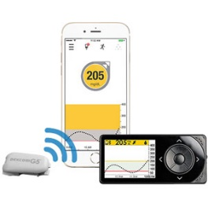
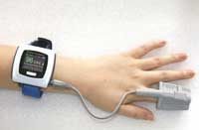
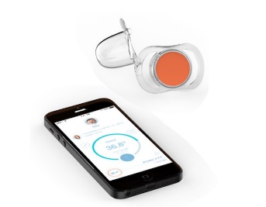

Sensors and Measurements
The Digital Human
Phenotypic Readout
Blood Glucose
Pulse Ox
Infant monitors

Slide 6
Some Key Results
Limits of Sequencing
From Sequences to Structures
From Structure/ Expression to Networks
From Networks to Function
From Function to Pathology
From Pathology to Drugs

Slide 7
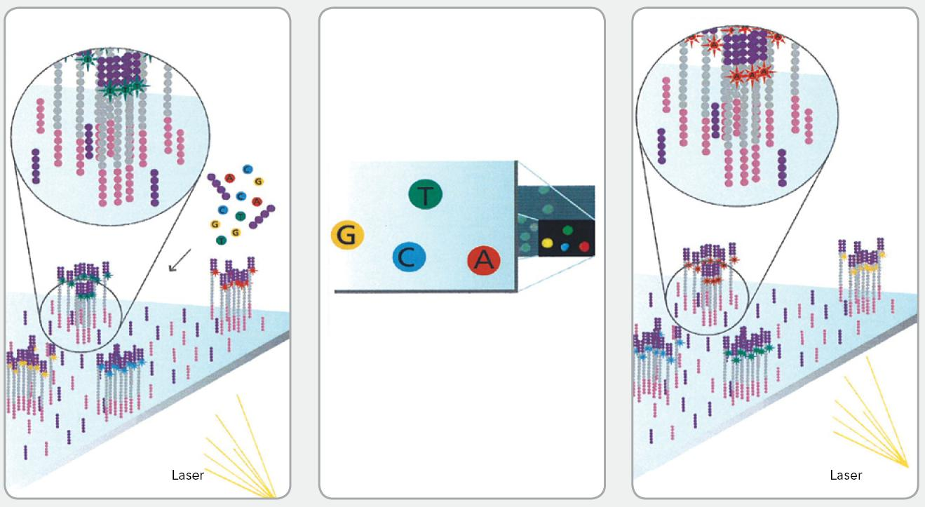
Shotgun sequencing

Slide 8
Assembly as a Software Engineering Problem
A single sequencing experiment can generate 100’s of millions of reads, 10’s to 100’s gigabytes of data.
Primary concerns are to minimize time and memory requirements.
No guarantee on optimality of assembly quality and in fact no optimality criterion at all.
Notes:
Include a paper with many authors

Slide 9


Repeats Make Jigsaw Puzzles Difficult

Slide 10
Critical Read Length L_{critical}
Minimum read length needed to assemble a genome even with infinite coverage depth.
A measure of repeat complexity of the genome from the point of view of assembly.

Slide 11
Fundamental limits and algorithms
normalized
# of reads
(coverage
depth)
greedy
deBruijn
lower bound
simpleBridging
length
multiBridging
Human Chr 19
Build 37
Lander-Waterman coverage
Notes:
4. Multibridging is the algorithm we propose, which is nearly optimal, at least for chromosome 19. Did we get lucky?

Slide 12
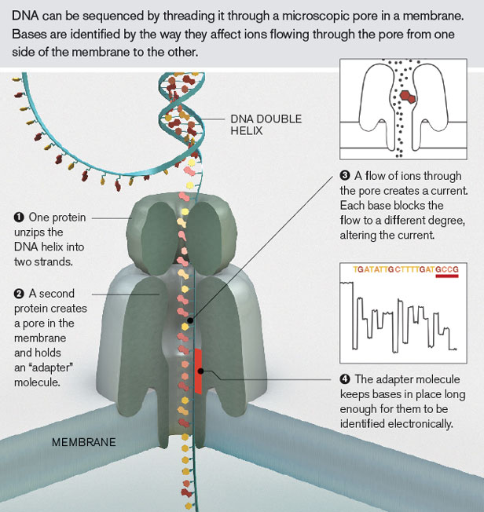
Performance Limits of Nanopore Sequencers

Slide 13
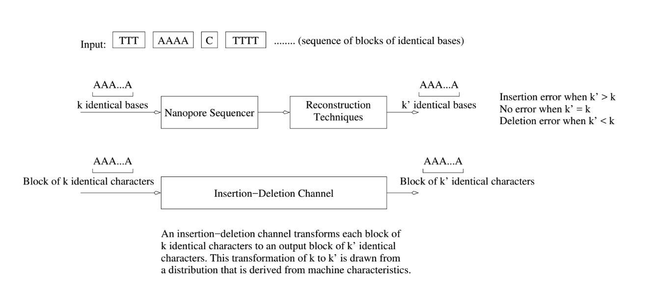
Performance Limits of Nanopore Sequenders

Slide 14
Performance Limits of Nanopore Sequencers
We derive a number of key results:
  The expected length of a sequence without errors is very small.
  The resampling rate for accurate reconstruction is bounded below and above by log N and log³N, respectively.
  Our tight bounds indicate that with relatively low resampling, we can reconstruct large reads.
  For given distributions, we can also derive optimal estimators for block sizes.

Slide 15
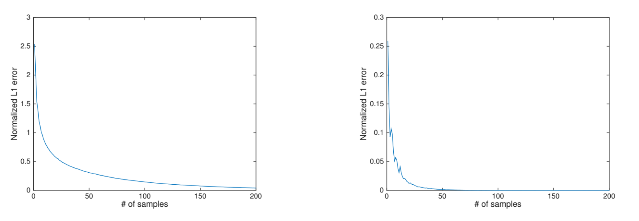
Performance Limits of Nanopore Sequencers
Normalized L1 error for bounded variance (left) and independent insertion-deletion models (right).

Slide 16
From Sequences to Structures:
The Protein Folding Channel

Slide 17
Why So Few Protein Folds?
Protein Folds in Nature
Probability of protein folds vs. sequence rank

Slide 18

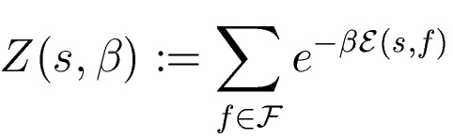
Information-Theoretic Model
s
protein-fold
channel
f
HPHHPPHPHHPPHHPH
Optimal input distribution from Blahut-Arimoto algorithm:

Slide 19











Protein-Protein Channel
: set of self-avoiding walks of length
: Energy of a walk over sequence :
We conjecture that:
is free energy, and
(by subadditivity of ).
Phase transition of the free energy (hence of the capacity ):

Slide 20
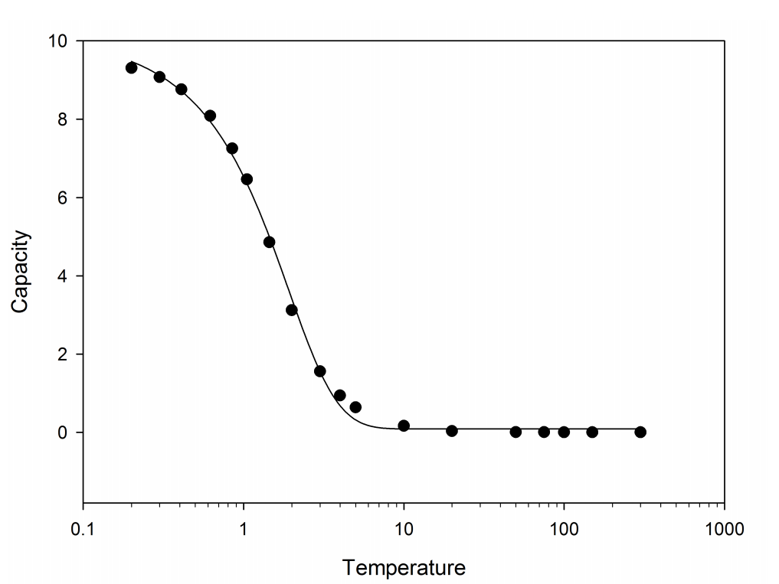
Experimental Evidence of Phase Behavior

Slide 21
From Structure/ Expression to Networks

Slide 22
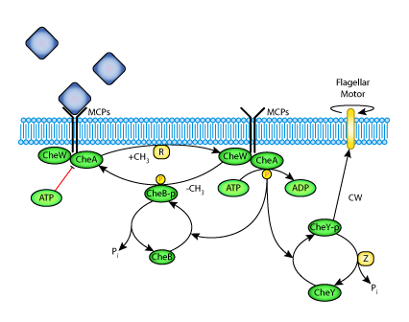
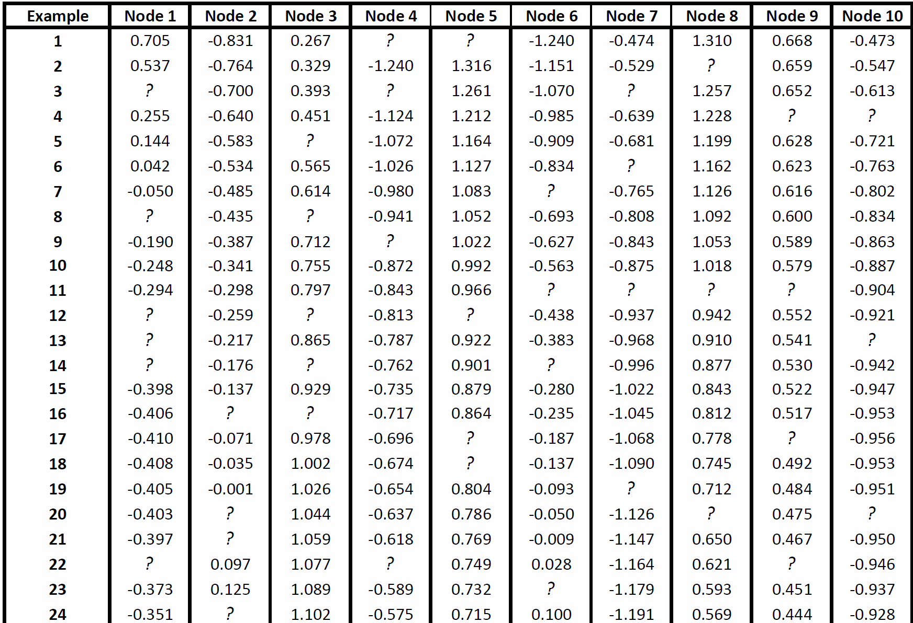
Data-driven network reconstruction of biological systems
  Derive relationships between input/output data
  Represent the relationships as a network
Experiments/Measurements
Notes:
Different slide same message. Maybe one of the simulated pic.

Slide 23
OUR APPROACH: DPLASSO
PLS
Model
LASSO
Reconstructed Network

Slide 24
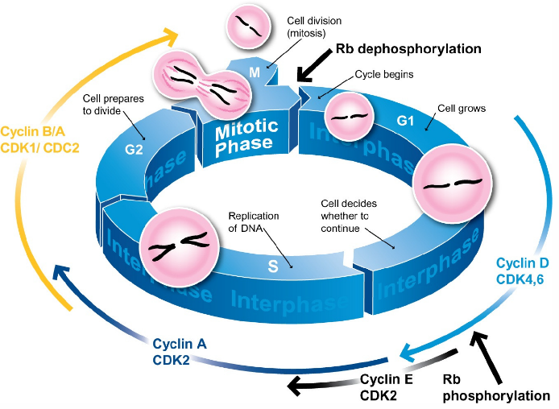
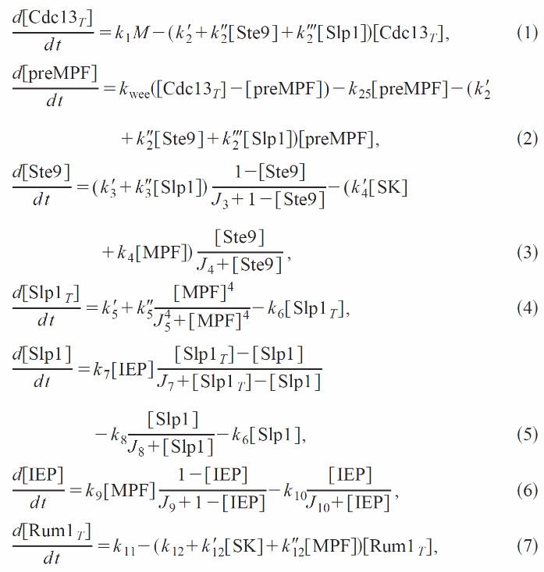
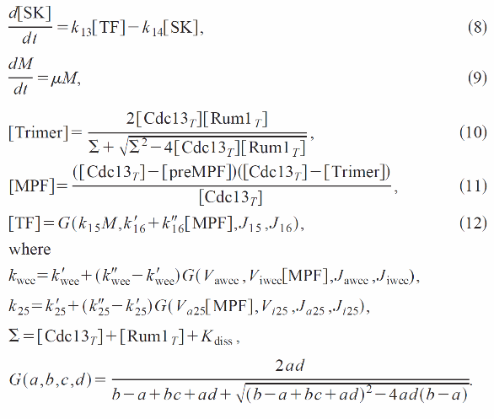
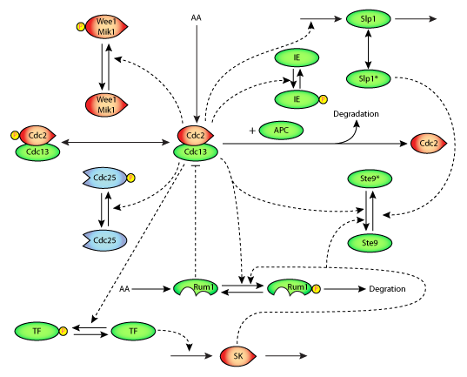
YEAST CELL DIVISION
  Experimental dataset generated via well-known nonlinear model of a cell division cycle of fission yeast. The model is dynamic with 9 state variables.
* Novak, Bela, et al. "Mathematical model of the cell division cycle of fission yeast." Chaos: An Interdisciplinary Journal of Nonlinear Science 11.1 (2001): 277-286.

Slide 25
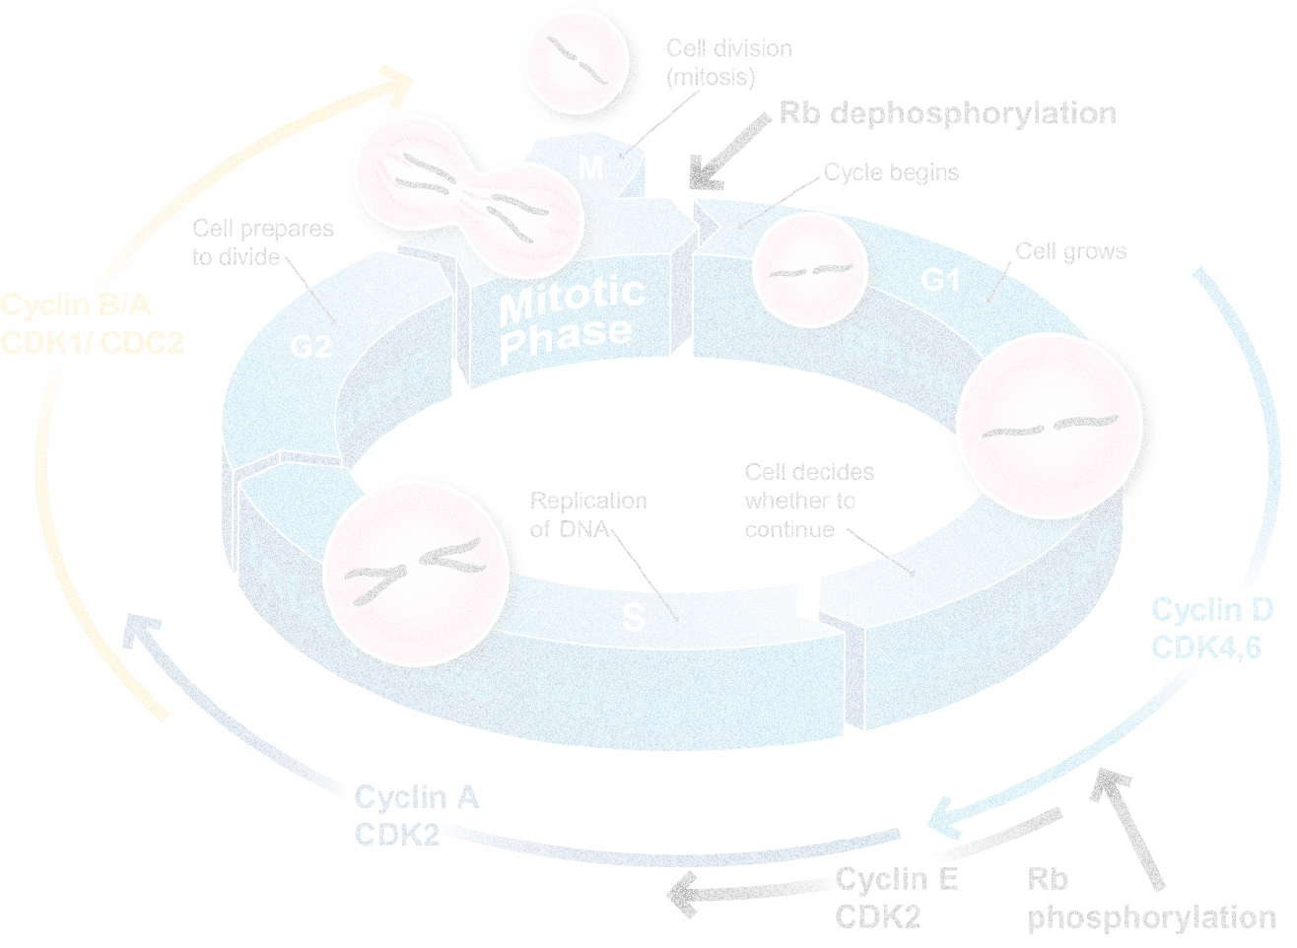
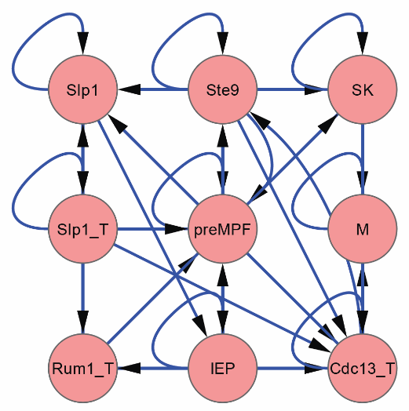
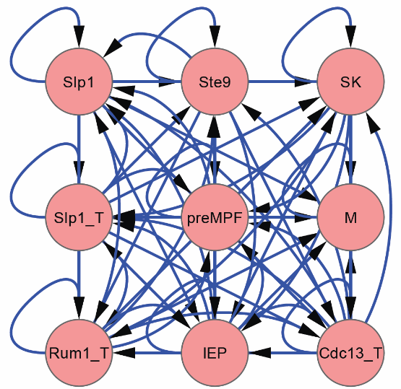
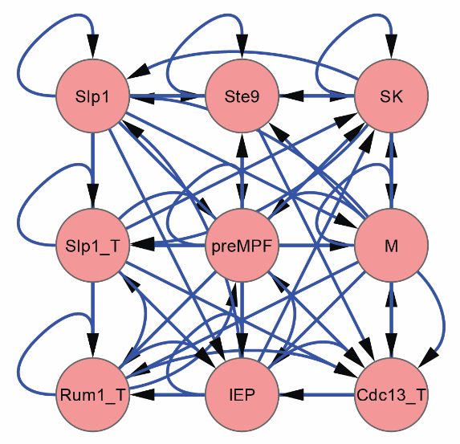
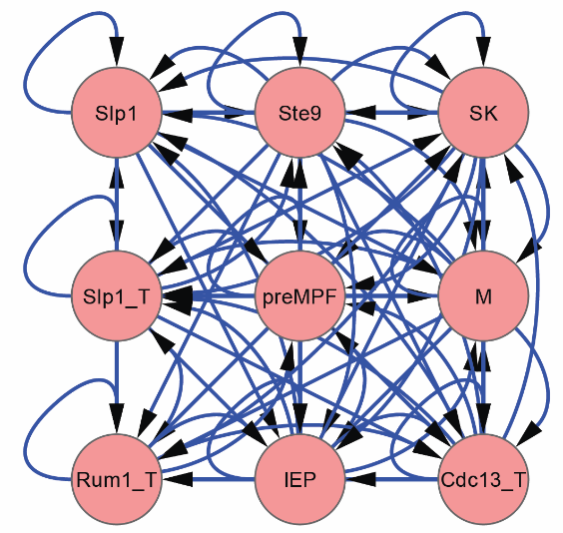
CELL DIVISION CYCLE
True Network (Cell Division Cycle)
Missing in DPLASSO!
PLS
DPLASSO
LASSO

Slide 26
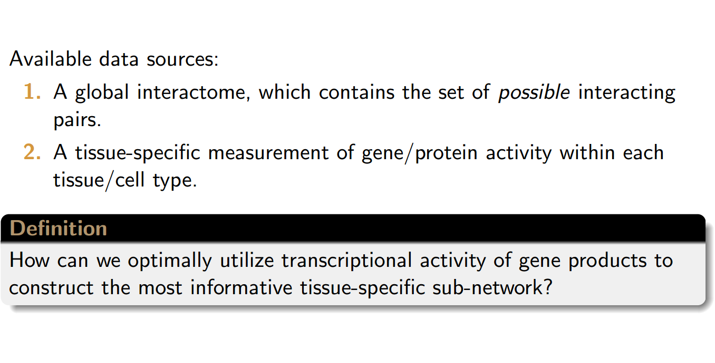
Constructing Tissue-Specific Interactomes

Slide 27
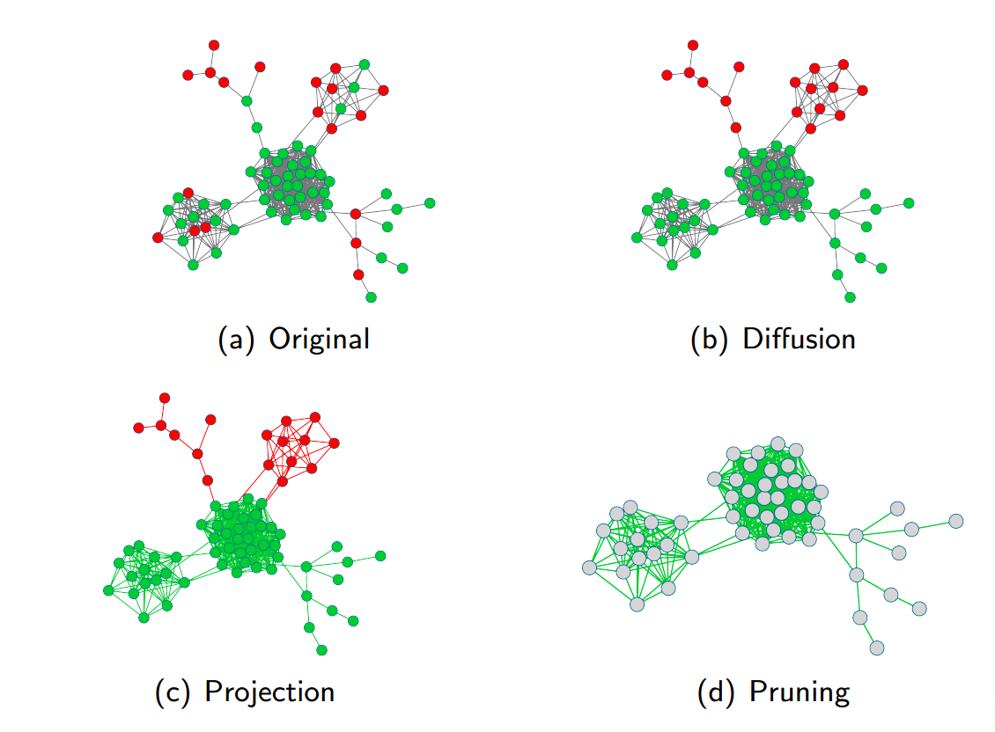
Problem Setting

Slide 28
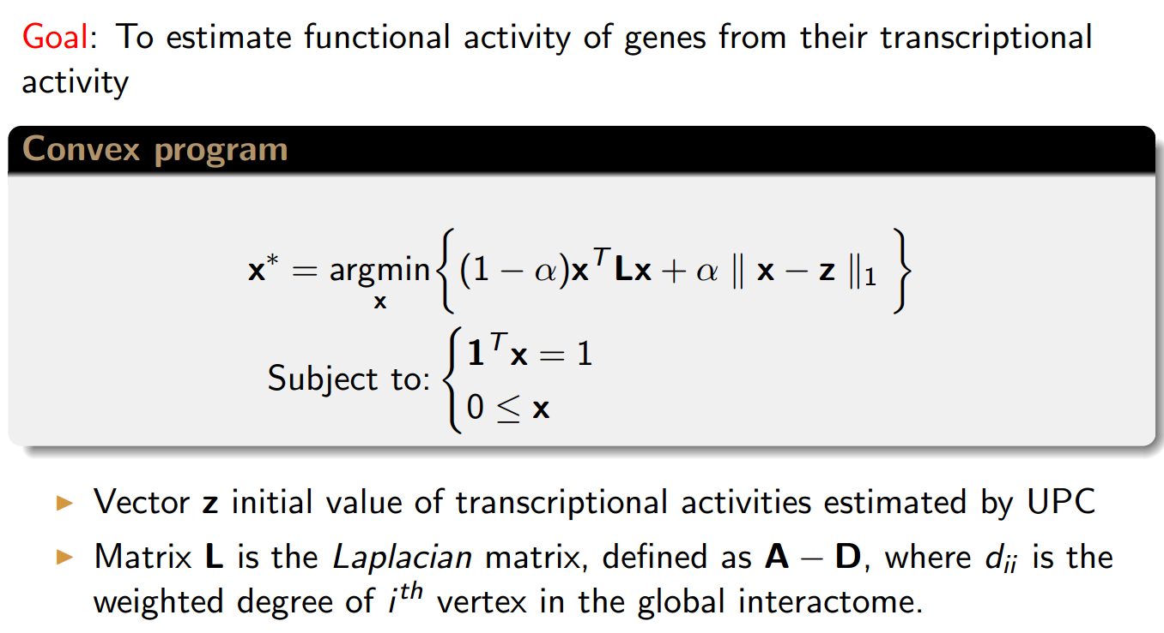
Reweighting Activity Scores Through Optimization

Slide 29
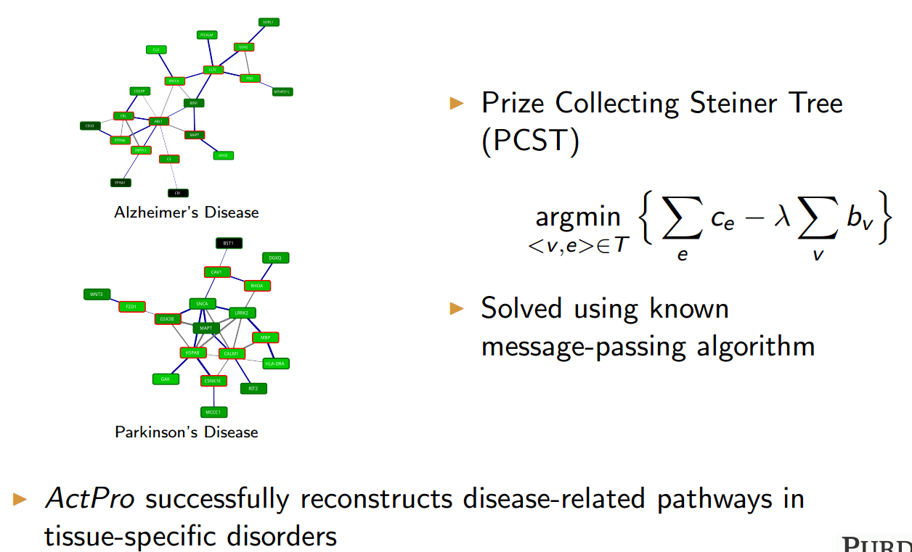
Results: Identifying Novel Disease Related Pathways

Slide 30
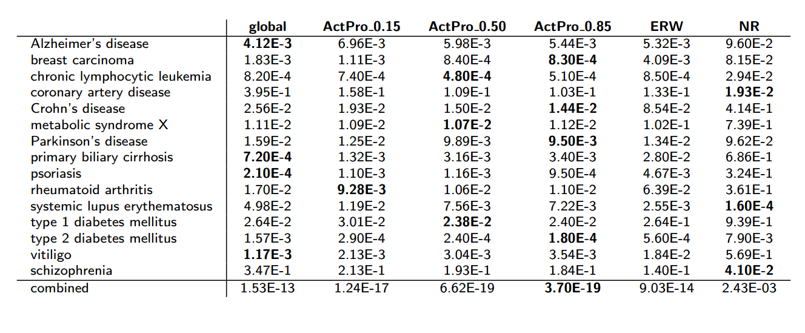
Identifying Disease Related Genes in Tissue-Specific Networks (p-values of compactness of disease-implicated networks)

Slide 31
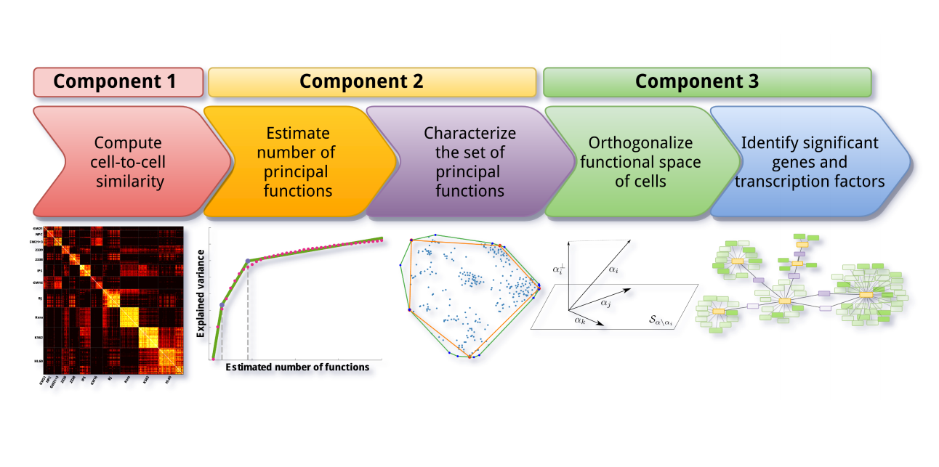
Single Cell Transcriptomes to Transcriptional Networks

Slide 32
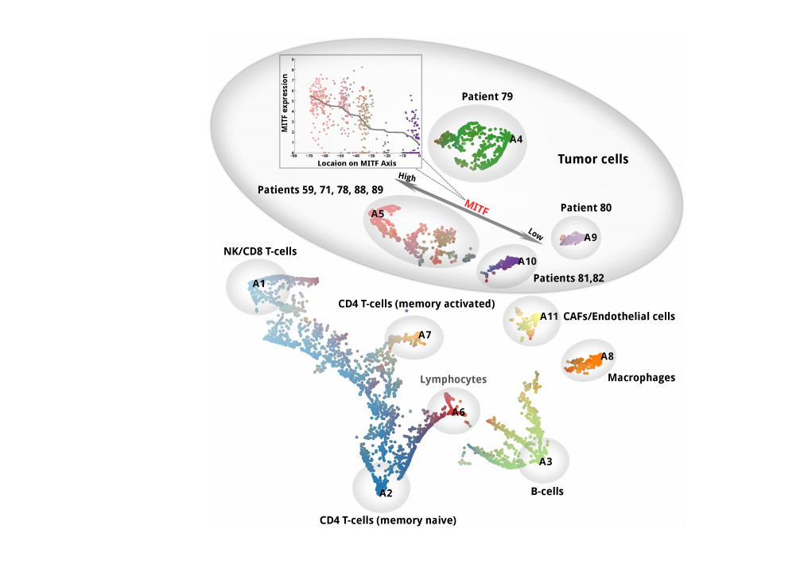
Using Convex-Hull Based Archetypes to Map Single Cell Transcriptional Profiles

Slide 33
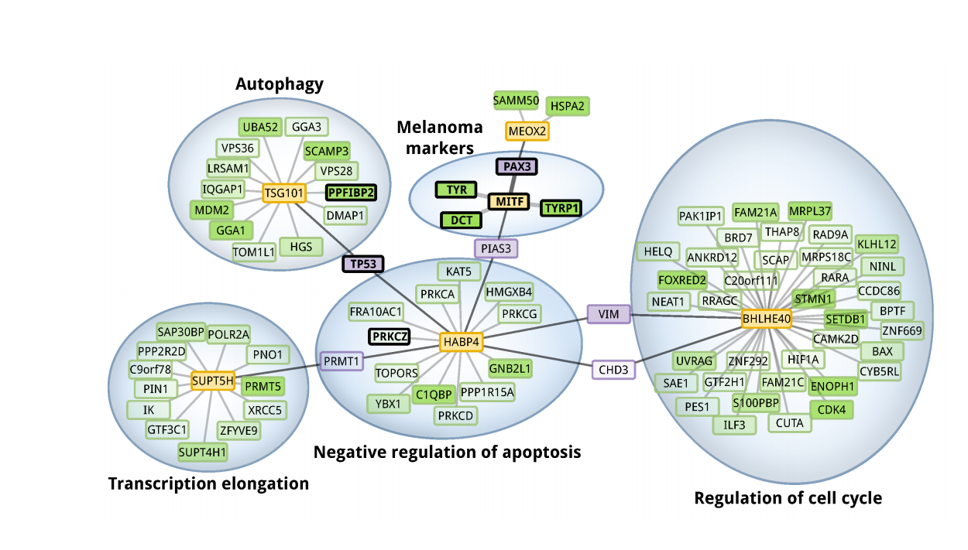
Novel Melanoma Subclasses and Associated Transcriptional Networks (MITF Associated Network)

Slide 34
From Networks to Phenotype

Slide 35
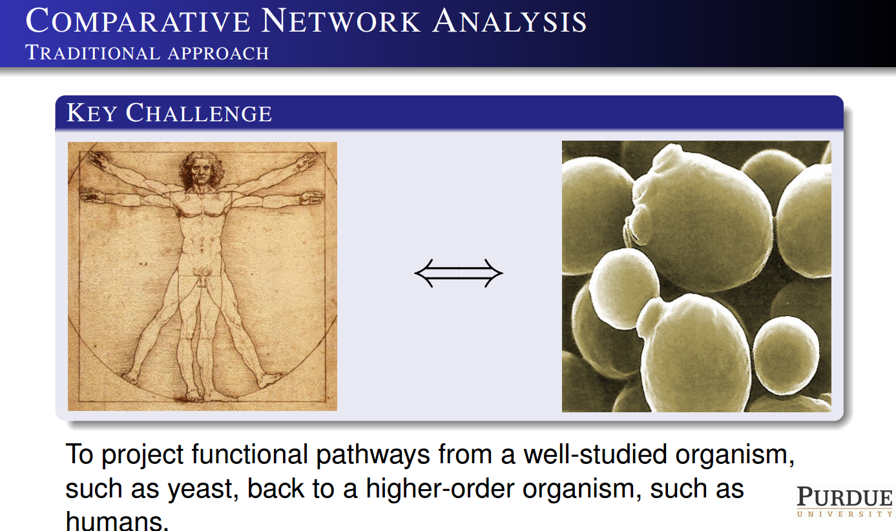

Slide 36
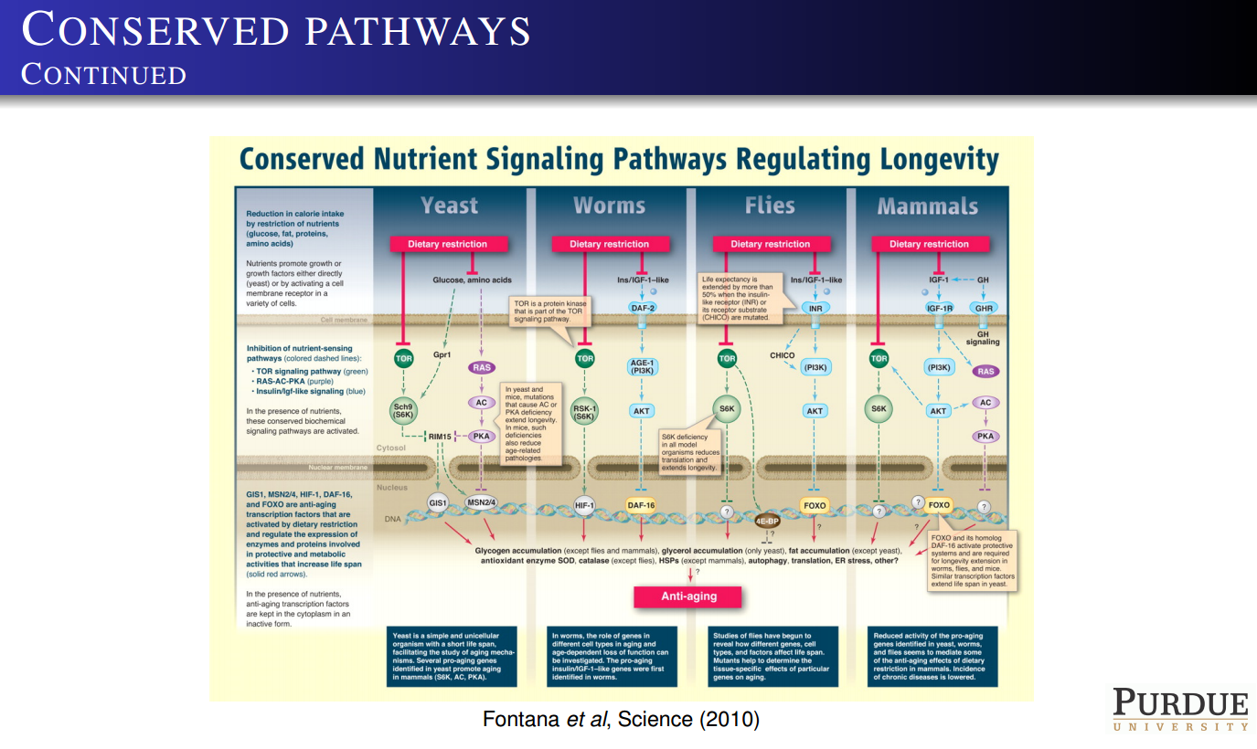

Slide 37
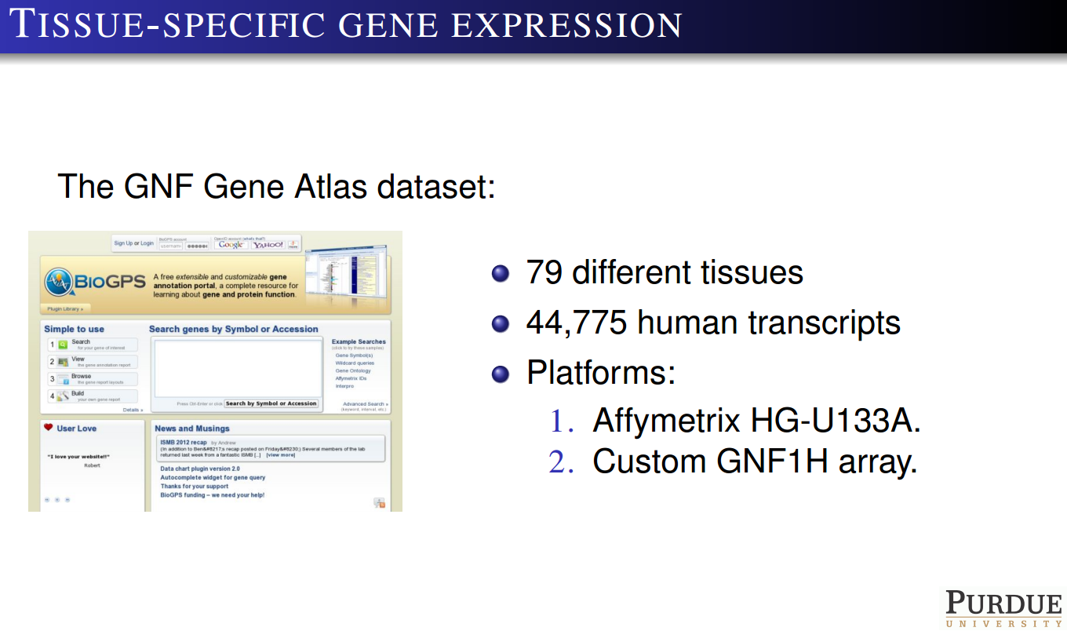

Slide 38
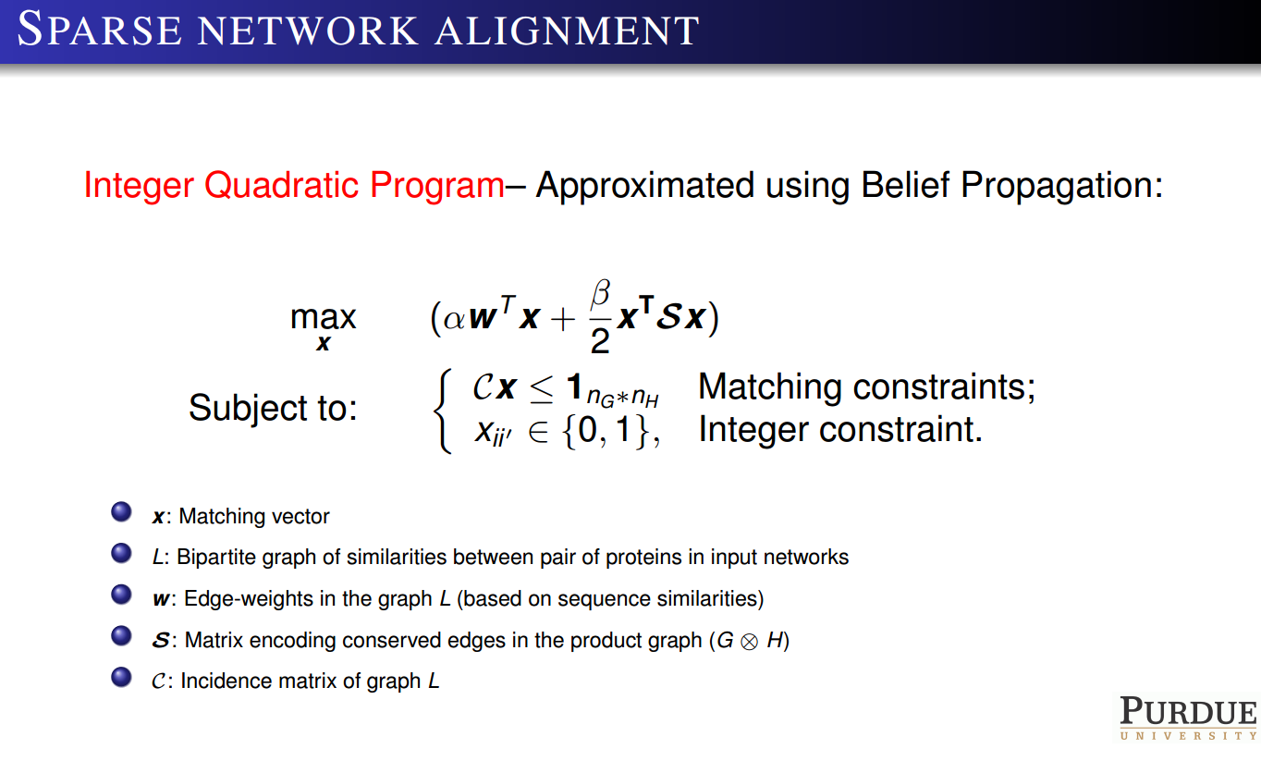

Slide 39
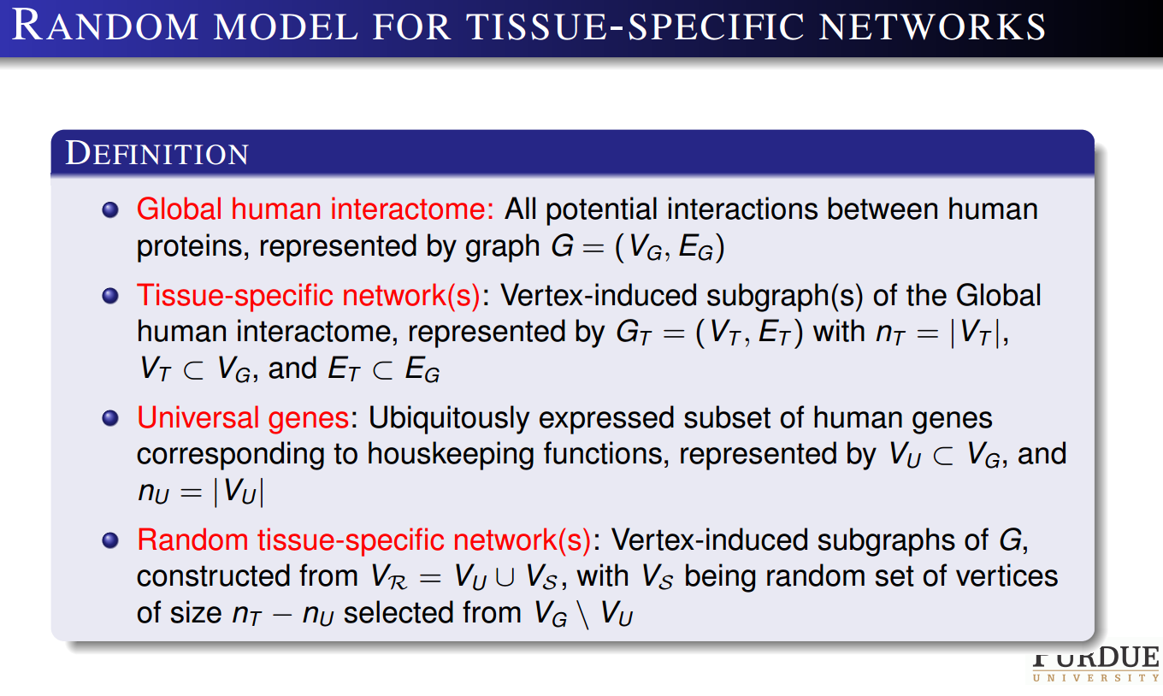

Slide 40
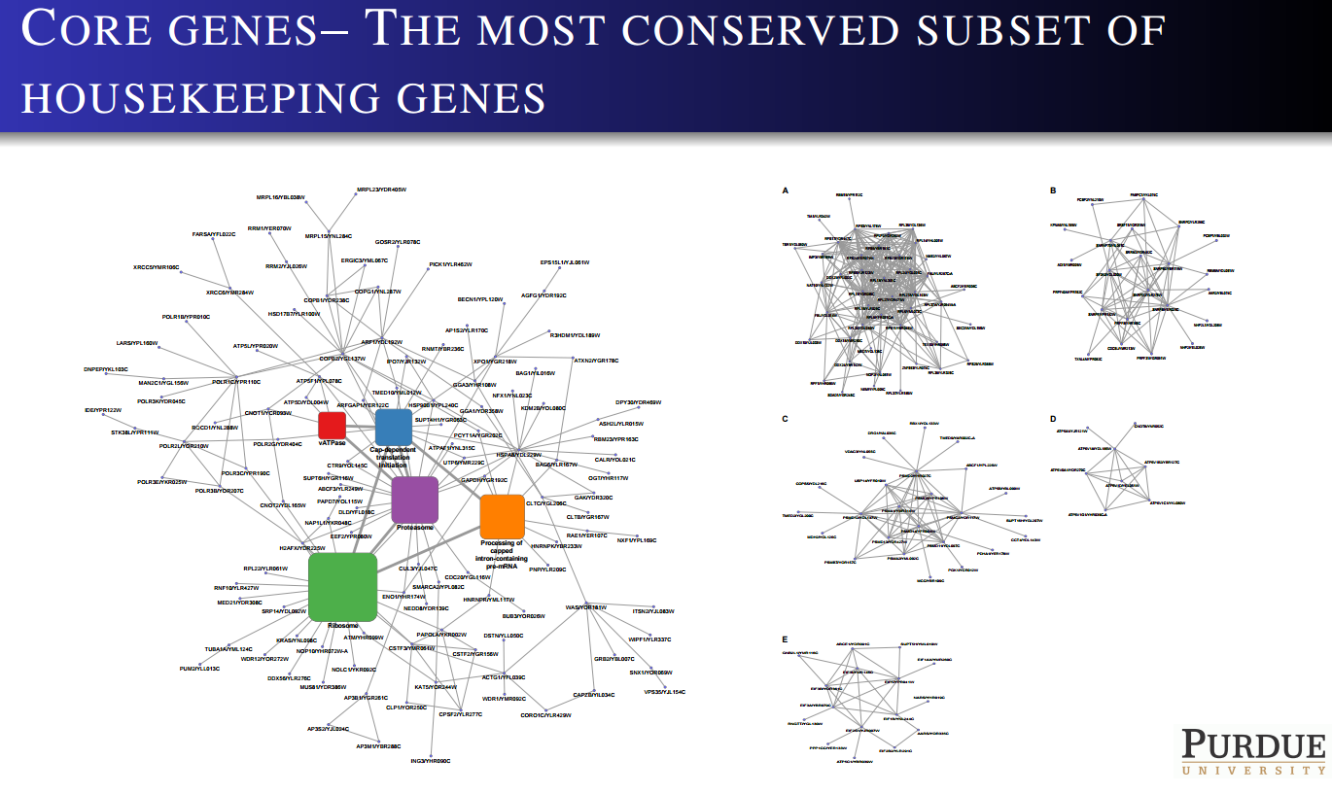

Slide 41
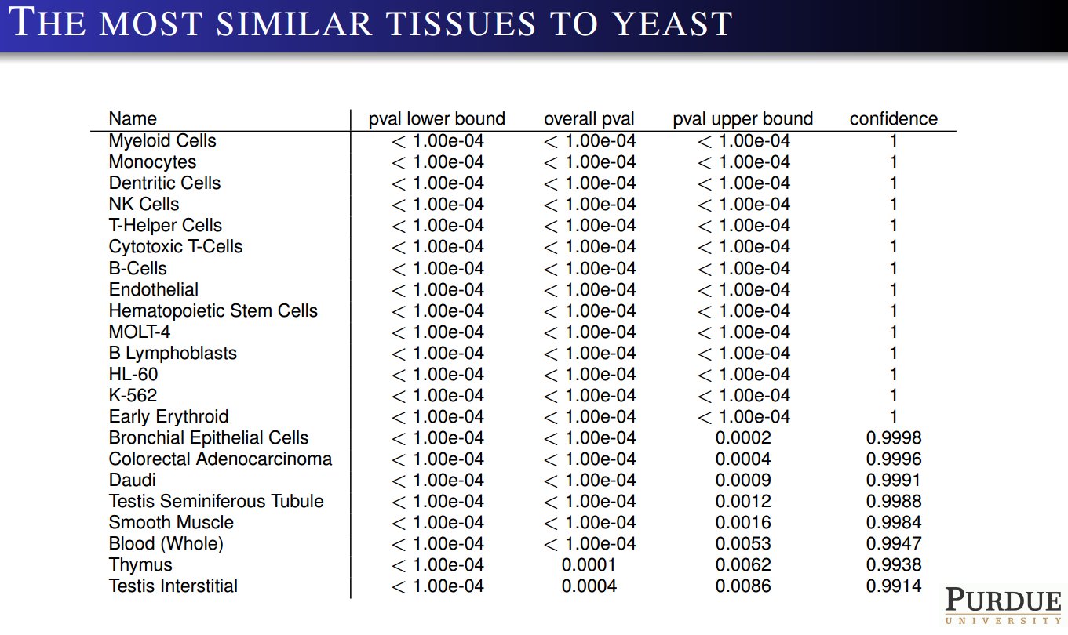

Slide 42
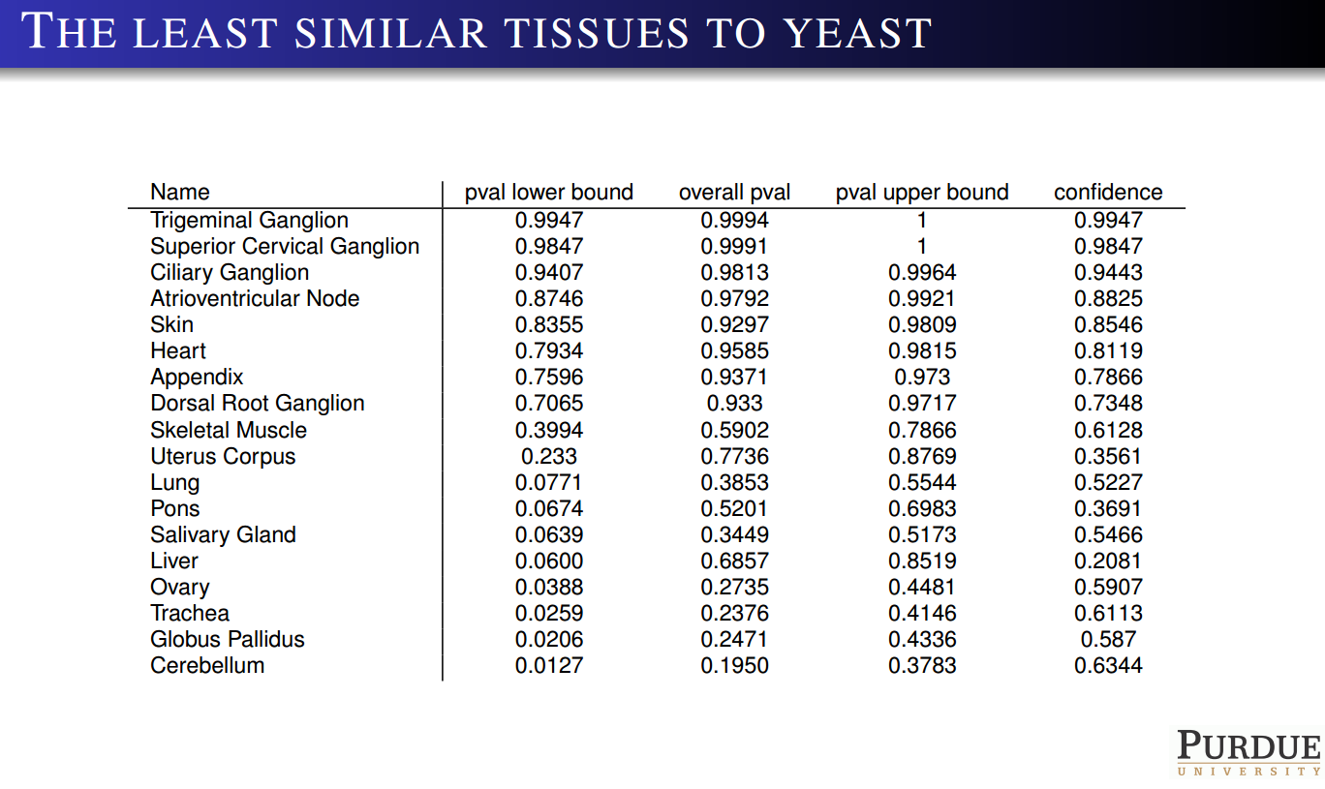

Slide 43
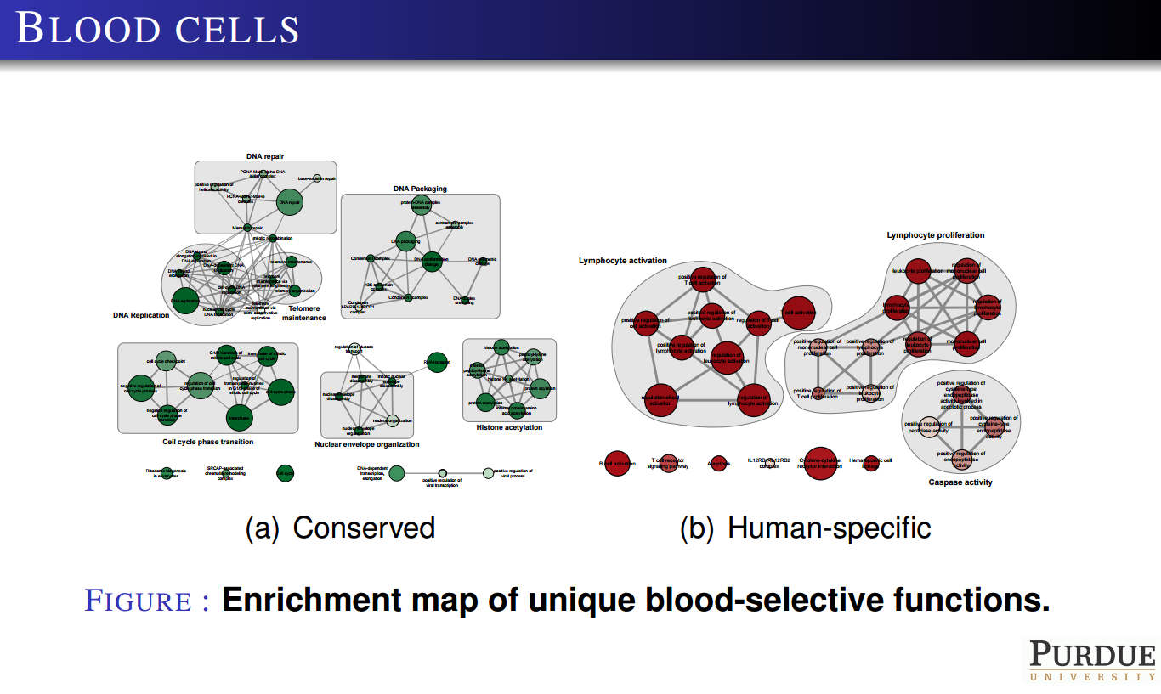

Slide 44
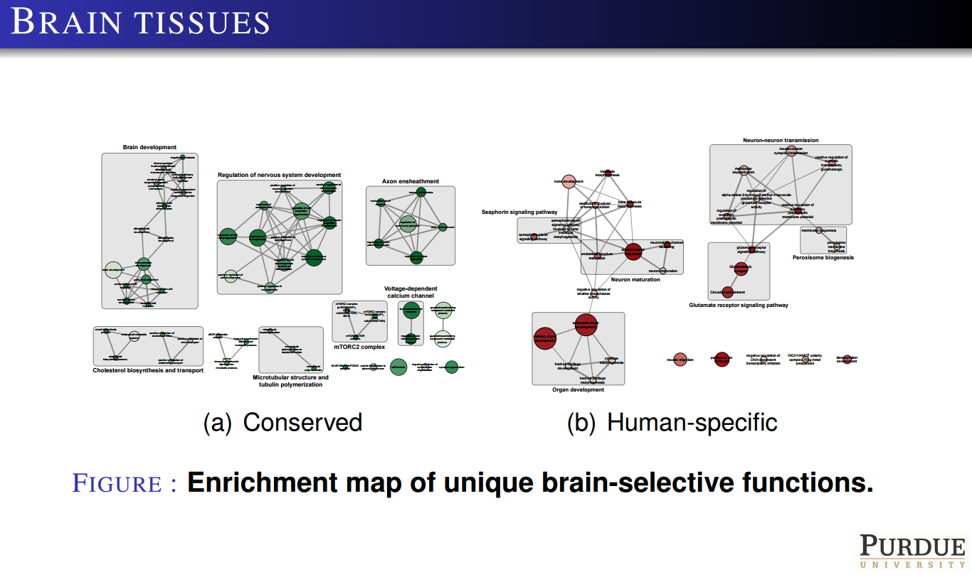

Slide 45
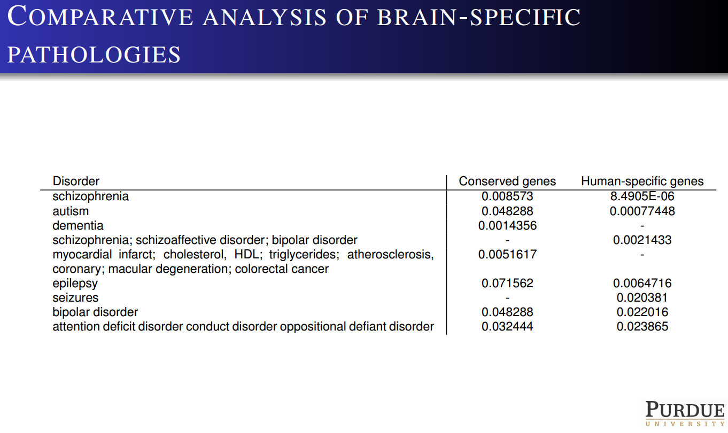

Slide 46
From Pathology to Drugs

Slide 47
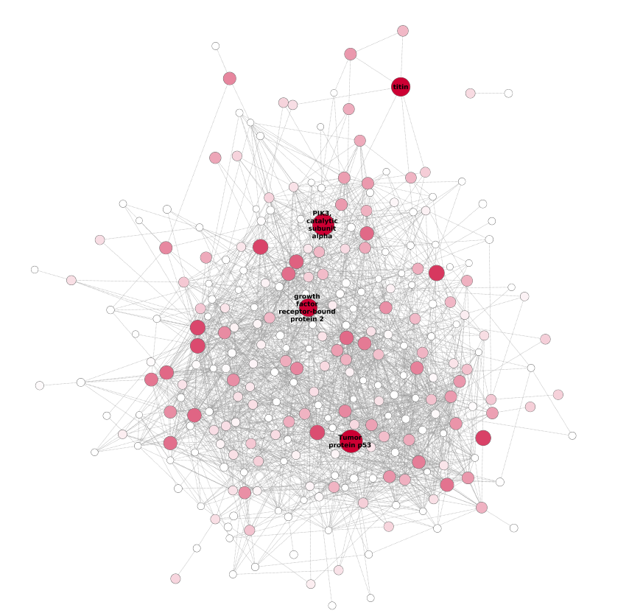
Predicting Targets Through Network Analysis
Breast-specific, protein-protein interaction network of predicted breast cancer genes

Slide 48
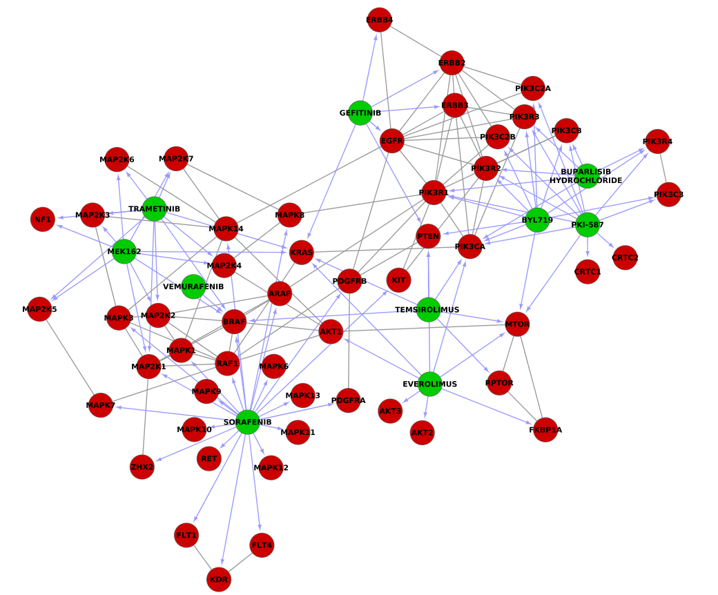
Drug-Protein Interactions in Breast Cancer
Drug-gene and protein-protein interactions for the most promising drugs in breast cancer

Slide 49
Conclusion
Tremendous advances have been made – the real excitement is only just beginning.
Thank You!

