Slide 1
Decoding the Network Footprint of Diseases
With increasing availability of data, there is significant activity directed towards correlating genomic, proteomic, metabolomic, and other footprints of disease/ phenotype.
These efforts include:
Associations of weak genomic signals with phenotype (groups of SNPs)
Correlation of expression signatures (microarray data)
Signatures in mass-spectrometry data
Identification of discriminating patterns in other forms of data (imaging, flow cytometry, etc.)

Slide 2
Understanding Cellular Aging
We have initiated an ambitious project aimed at mapping the network footprint of cellular aging and its correlation with degenerative diseases (Alzheimers, Parkinsons, Cancers, etc.)
Understanding pathways implicated in degenerative diseases holds the potential for novel interventions, drug design/ repurposing, and diagnostic/ prognostic markers.

Slide 3
Aging and Degenerative Diseases
This high-level goal is achieved through a number of specific technical objectives:
Mapping interactions associated with cellular aging (in yeast)
Identifying tissue types for which yeast is a suitable model organism (by understanding conservation of tissue-specific networks in yeast)
For these tissue types, identify key actors associated with degenerative diseases
Map these actors into the aging pathways to identify mechanisms associated with degenerative processes
Identify new targets for drug repurposing and design.

Slide 4
Progress: First Comprehensive Computationally Derived Aging Map
This map includes various forms of interactions, including protein interactions, gene regulations, post translational modifications, etc. The underlying structural information extraction technique relies on rigorous quantification of information flow from selected sources (TOR, SIR2). We make the full map available online.

Slide 5
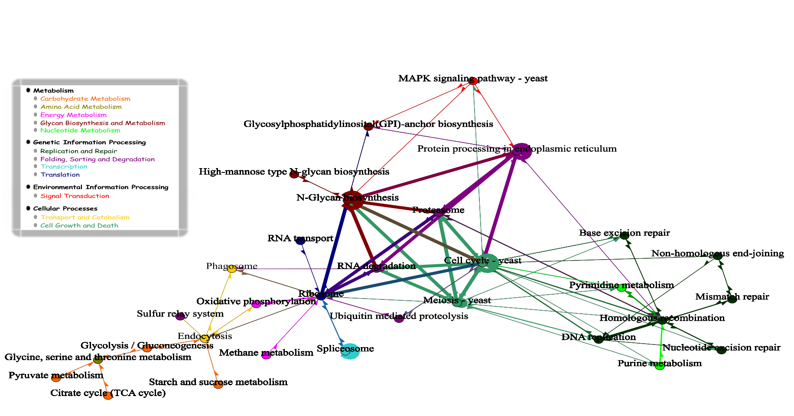
Progress: Understanding Pathway Interactions
Built from synthetic genetic interaction datasets, this map quantifies significant crosstalk across major cellular processes.

Slide 6
Progress: Identification and Mapping of Tissue-Specific Pathways
We have constructed detailed pathways for 78 human tissues
We have aligned these to the yeast interactome
We have derived methods to quantify the significance of these alignments (to answer the specific question – for what tissues is yeast a suitable model organism)
We are validating our findings and will release tissue specific alignment maps for yeast.

