Slide 1
Emerging Frontiers of
Science of Information
STC Strategic Workshop:
Introductory Remarks

Slide 2
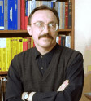
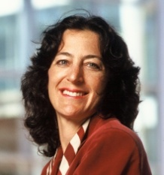
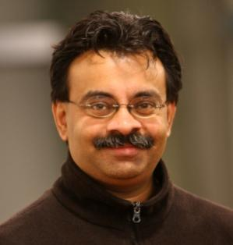
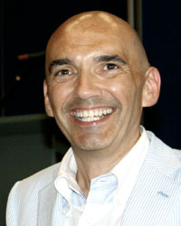
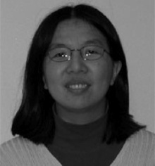
STC Team
Bryn Mawr College: D. Kumar
Howard University: C. Liu
MIT: M. Sudan (co-PI), P. Shor.
Purdue University (lead): W. Szpankowski (PI)
Princeton University: S. Verdu (co-PI)
Stanford University: A. Goldsmith (co-PI)
University of California, Berkeley: Bin Yu (co-PI)
University of California, San Diego: S. Subramaniam
UIUC: P.R. Kumar, O. Milenkovic.
Workshop Participants: M. Atallah, T. Coleman, C. Clifton, A. Grama, J. Neville, R. Rwebangira, J. Rice, V. Rego, M. Ward, T. Weissman.
Wojciech Szpankowski,
Purdue
Andrea Goldsmith,
Stanford
Madhu Sudan,
MIT
Sergio Verdú,
Princeton
Bin Yu,
U.C. Berkeley

Slide 3
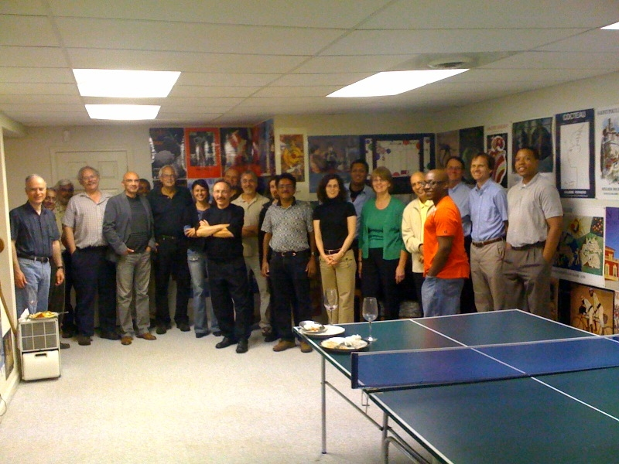
… the night before the NSF site visit

Slide 4
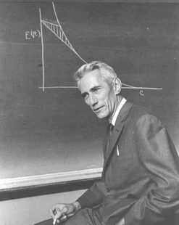
Shannon Legacy
The Information Revolution started in 1948, with the publication of:
A Mathematical Theory of Communication.
The digital age began.
Claude Shannon:
Shannon information quantifies the extent to which a recipient of data can reduce its statistical uncertainty.
“semantic aspects of communication are irrelevant . . .”
Applications Enabler/Driver:
CD, iPod, DVD, video games, Internet, Facebook, Google, . . .
Design Driver:
universal data compression, voiceband modems, CDMA, multiantenna, discrete denoising, space-time codes, cryptography, . . .

Slide 5
Post-Shannon Challenges
We aspire to extend classical Information Theory which paved the way for DVD, internet and CD to meet challenges of today posed by rapid advances in biology, modern communication, and knowledge extraction.
We need to extend traditional formalisms for information to include:
structure, time, space, and semantics,
and other aspects such as:
dynamical information, physical information, representation-invariant information, limited resources, complexity, and cooperation & dependency.

Slide 6
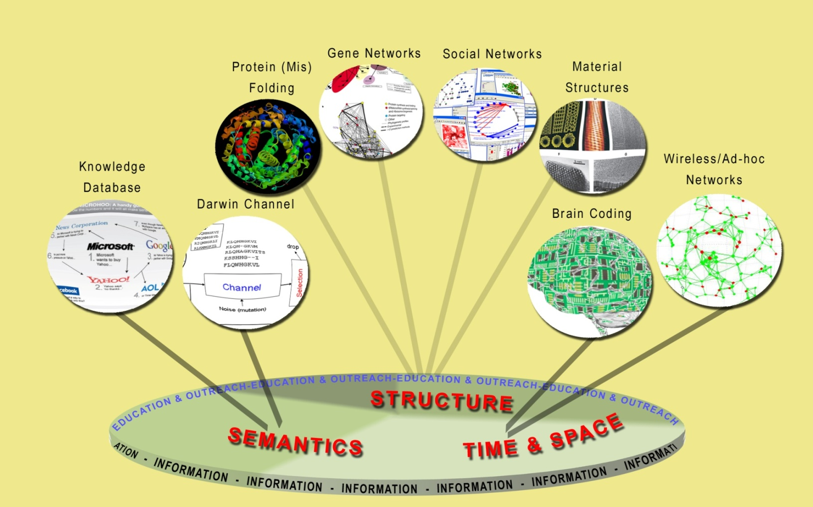
Science of Information
The overarching vision of the Center for Science of Information is to develop principles and human resources guiding the extraction, manipulation, and exchange of information, integrating space, time, structure, and semantics.

Slide 7
Mission and Center’s Goals
The STC Science of Information Center aims at integrating research and teaching activities aimed at investigating the role of information from various viewpoints: from the fundamental theoretical underpinnings of information to the science and engineering of novel information substrates, biological pathways, communication networks, economics, and complex social systems.
Some Specific Center’s Goals:
define core theoretical principles governing transfer of information,
develop meters and methods for information,
apply to problems in physical and social sciences, and engineering,
offer a venue for multi-disciplinary long-term collaborations,
explore effective ways to educate students,
train the next generation of researchers,
broaden participation of underrepresented groups,
transfer advances in research to education and industry.

Slide 8
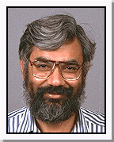
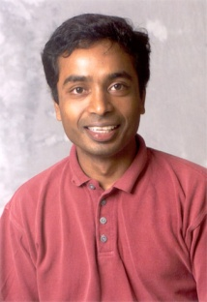
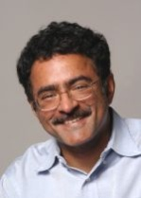
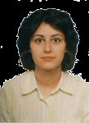
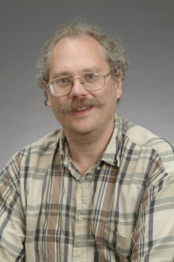
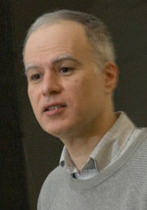
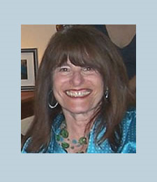
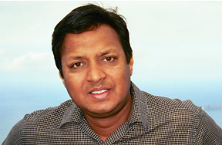
Thrust Areas and Leaders
1. Information Flow in Biology
2. Information Transfer in Communication
3. Knowledge:
Extraction, Computation & Physics
4. Education & Diversity

Slide 9
Knowledge Transfer
Industrial affiliate program in the form of consortium.
What Center brings and expects:
  Considerable intellectual resources
  Access to students and post-docs
  Access to intellectual property
  Shape center research agenda
  Solve real-world problems
  Industrial perspective
  Knowledge Transfer Director:
  Ananth Grama

Slide 10
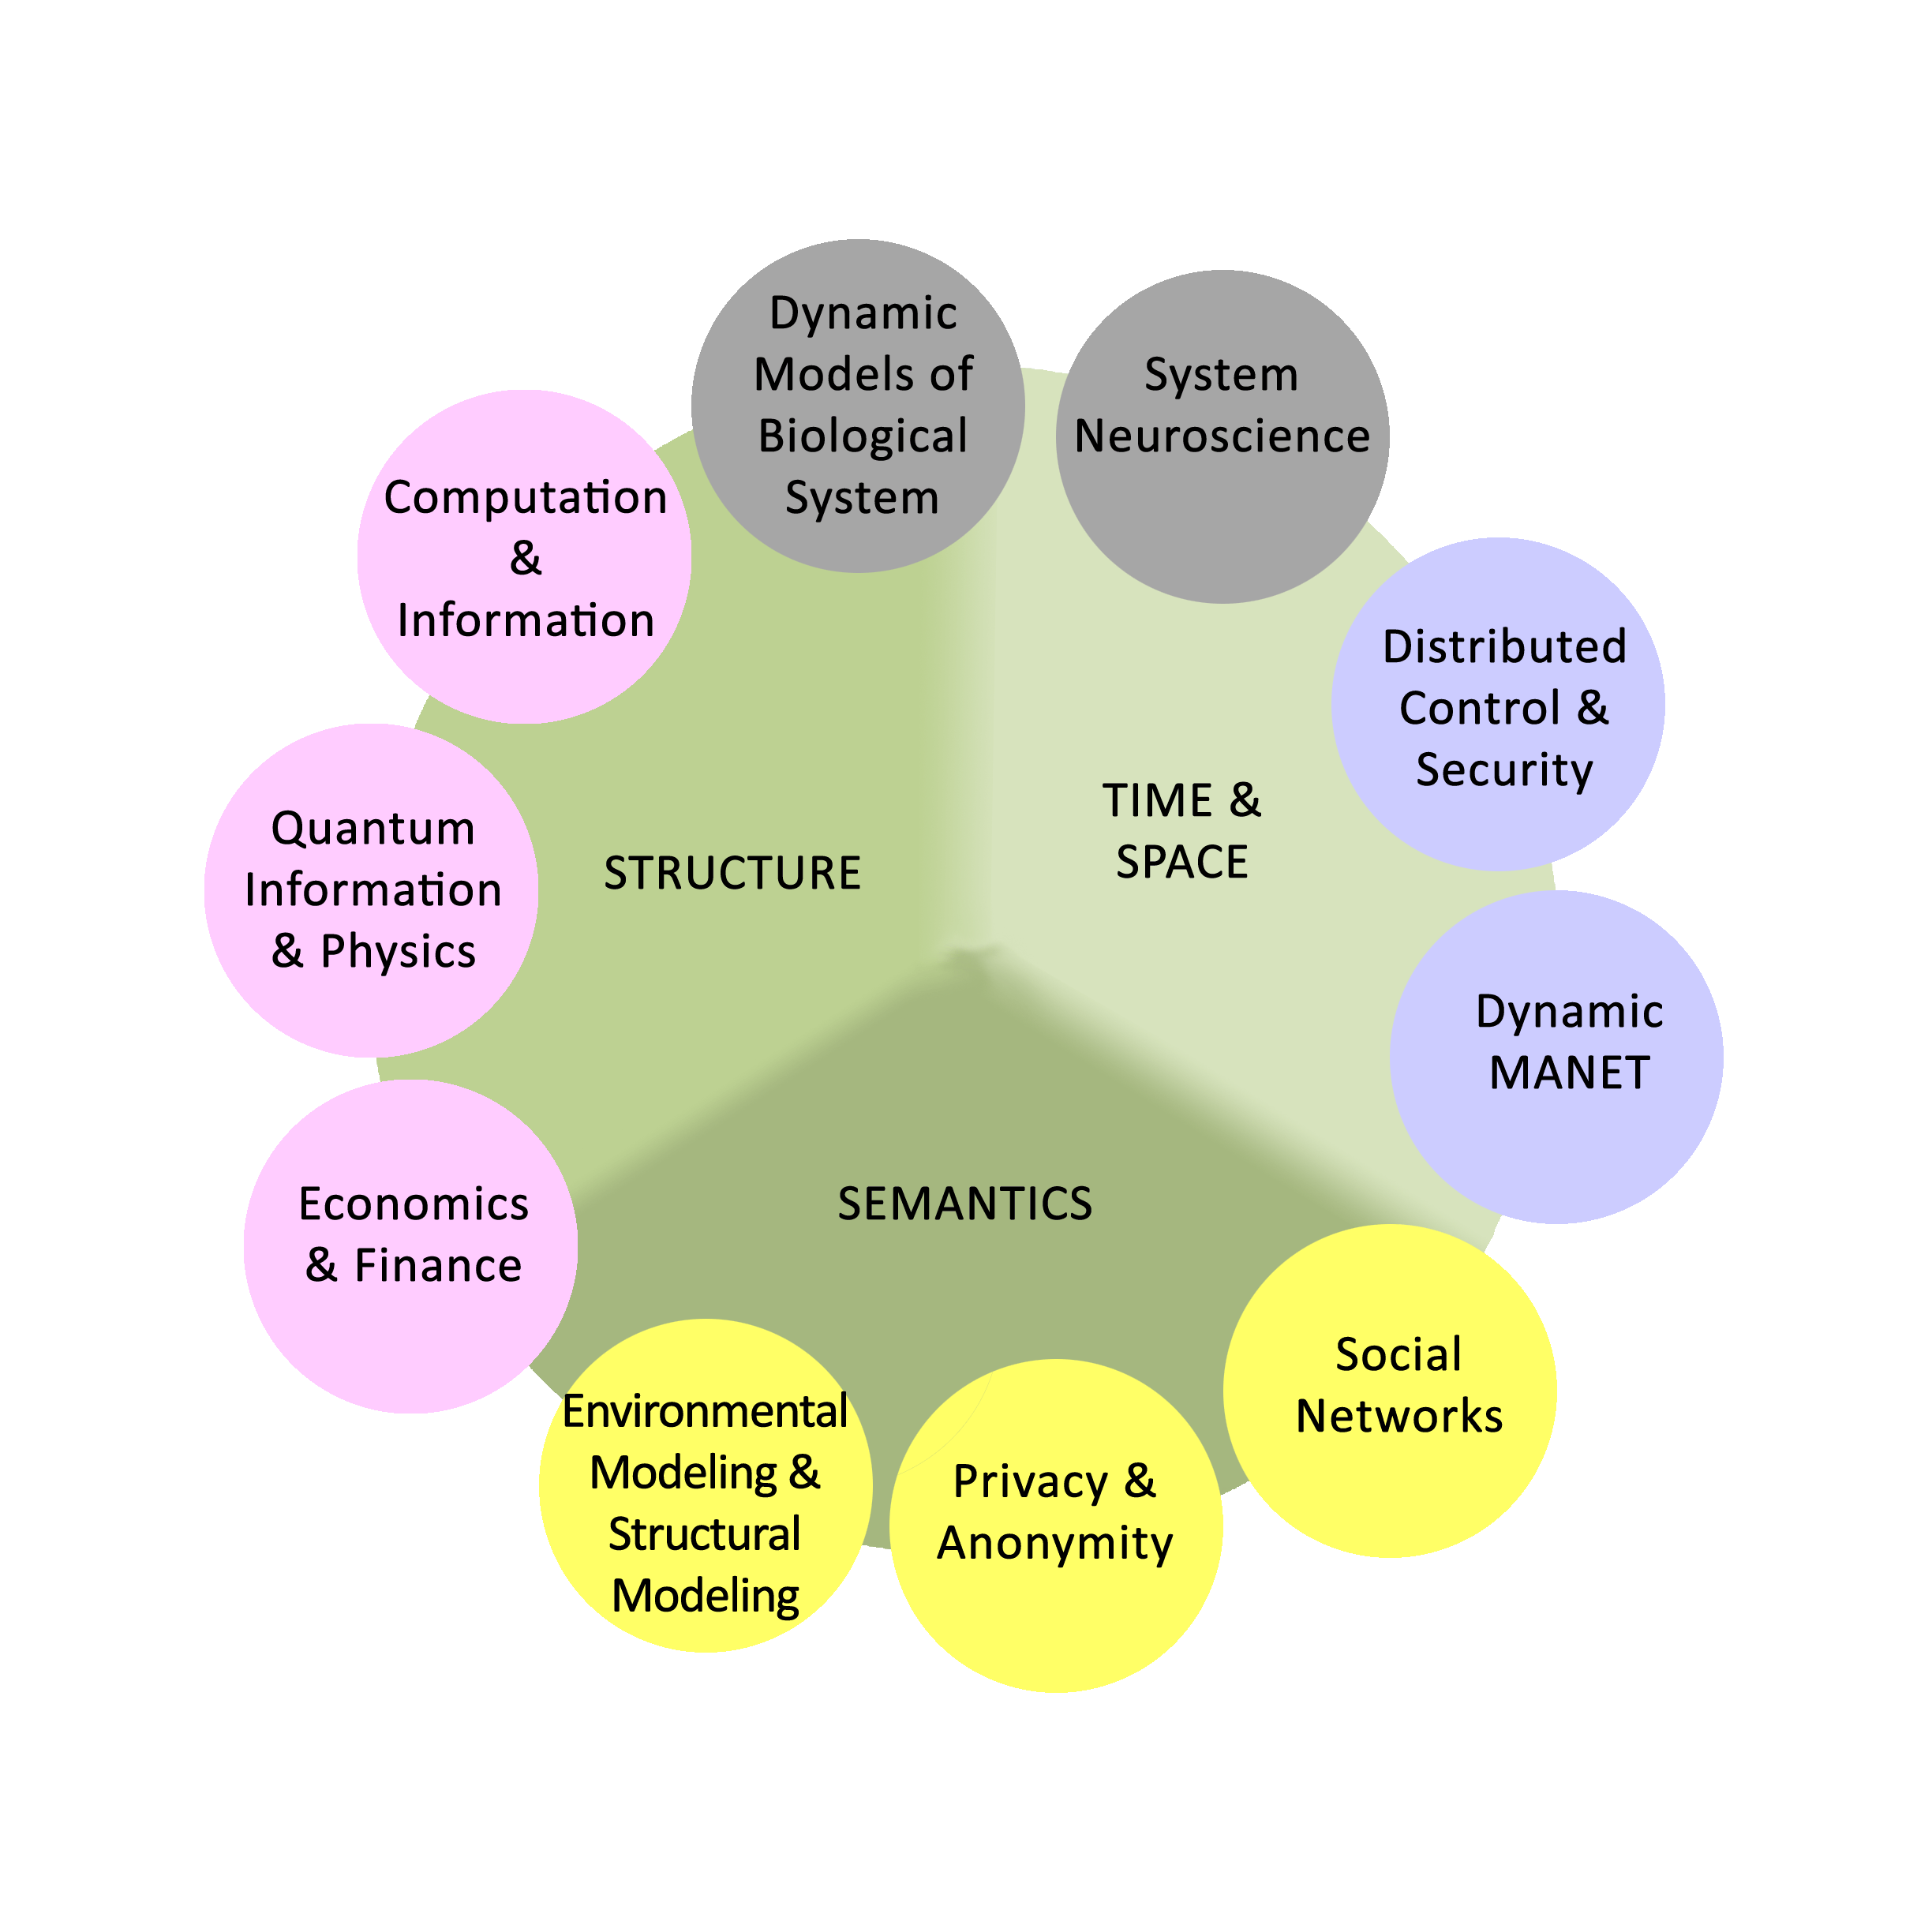
Synergies and Synthesis

Slide 11
Synergies and Synthesis
A comprehensive theory for quantifying, extracting, manipulating, and communicating information across complex systems must:
  be grounded in real-world applications
  must generalize to broad application domains
  must result in usable tools and techniques that advance the state of the art in respective scientific domains
  must themselves define a body of knowledge that motivates novel investigations and solutions

Slide 12
Management Structure
Vice President for Research
Purdue University
Executive Committee
P.R. Kumar, A. Goldsmith, D. Kumar, S.Subramaniam, M. Sudan, B. Yu, S. Verdu
Technical Director
W. Szpankowski
External Advisory Board
Managing Director
Internal Management Committee
V. Rego, J. Rice,
Z. Pizlo, D. Ramkrishna
Technical Thrusts
Education Director
Diversity Director
R. Hughes
Knowledge Transfer
A. Grama
Biology
S. Subramaniam
Communication
V. Anantharam
Knowledge
P. Shor

Slide 13
Why we are here?
  What will help us to be successful?
  (focus, focus, focus, interaction, collaboration)
  What challenges we will need to overcome?
  (communication, common language, timely accomplishments)
  How to accomplish collaboration between projects?
  (strong interaction between theory (methods) and applications)
  Accountability and Transparency

Slide 14
Plan for the First Year
Research
(a) Methods:
- temporal & spatial information
(e.g., how to define information in spatio-temporal space, wireless, biological temporal networks)
- structural information
(e.g., graph compression, LZ-based graph compression, definition of a structural compression, finding algebraic structure in data, understanding skewness of protein structure).
- knowledge extraction
(e.g., representation-invariant information, information with limited resources, quantum information)
(b) Applications
- communication
(e.g., wireless network capacity, ad hoc design, control-space-time, network coding, fundamental limits, how to transform information across unreliable wireless with bounded delays, how to account for overhead, how to measure temporal information)
- biology
(e.g., understanding skewness of protein structures, metabolic dynamic, data analysis and modeling, data reduction and knowledge extraction in biological networks, temporal coding in neuroscience)
Education:
Initiate undergrad courses in science of information
Invite 10 students for a summer program

