Slide 1
Emerging Frontiers of
Science of Information
Biology Thrust

Slide 2
Synergies and Synthesis
While Shannon’s theory addresses a number of problems in communication and storage systems, its generalization to complex scientific systems is limited, since it does not address, among others:
  Geometric structure & topology
  Temporal variation and constraints
  Context
  Resource constraints
  Granularity of information flow

Slide 3
Synergies and Synthesis
Beyond a general theory relating to information in scientific and social systems, domain specific modeling paradigms are essential. These include:
  Semantics
  Evolutionary Context
  Network Interference
  Knowledge Mapping

Slide 4
The Primary Shannon Coding Concept
Source
Source Encoder
Channel Encoder
Channel
User
Source Decoder
Channel Decoder
A channel defines a relationship between the transmitted message X and received message Y. This relationship does not determine Y as a function of X but only determines the statistics of Y given the value of X (the joint distribution of X and Y).
If a channel has capacity C then it is possible to send information over that channel with a rate arbitrarily close to, but never exceeding C with a probability of error arbitrarily small.
Shannon showed that this was possible to do by proving that there existed a sequence of codes whose rates approached C and whose probabilities of error approached zero.

Slide 5
Shannon and Information Flow
Message
Signal
Received Signal
Message
Information Source
Transmitter
Receiver
Destination
Noise Source
A generalized communication system, from Shannon (1948)

Slide 6
DNA Transcription as Communication
Received Signal
Completed RNA Sequence
Signal
RNA Sequence
Message
RNA Sequence
Message
Sequence
Information Source
DNA
Transmitter
RNA Polymerase
Receiver
RNA
Destination
Ribosome
Noise Source
Transcription Error, Mutation

Slide 7
Visual Processing as Communication
Received Signal
electrical
Signal
electro-chemical
Message
Spikes
Message
Image
Information Source
Sensory Input
Transmitter
Neuron
Receiver
Synapse
Destination
Visual Cortex
Noise Source
Physiological Physical

Slide 8
Post-Shannon
Shannon’s theory provides the basis for all modern-day communication systems. His original theory was point-to-point (both signal and noise).
BUT
Most information flow is network to network. Examples include
  Wireless networks
  Biological networks
  Neural networks
  Social Networks
  Sensor networks
After 60 years we are still very far from generalizing the theory to networks. Our center will focus on a common theory for network-centric information flow in complex scientific systems.

Slide 9
E.g. A Neural Network in the Human Brain
  There are ~ 10¹¹ neurons in the human brain. Most of them are formed between the ages of -1/2 and +1.
  Each neuron forms synapses with between 10 and 10⁵ others, resulting in a total of circa 10¹⁵ synapses.
  From age -1/2 to age +2, the number of synapses increases at net rate of a million per second, day and night; many are abandoned, too.
  It is believed that neuron and synapse formation rates drop rapidly after age 1 and age 2, respectively, but recent results show that they do not drop to zero.

Slide 10
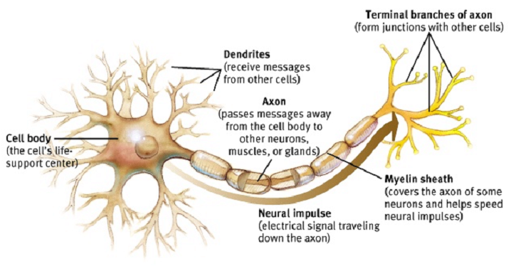
ARTIST’S CONCEPTION OF A NEURON

Slide 11
Multicasting
Viewed as a communication network, the human brain simultaneously multicasts 10¹¹ messages that have an average of 10⁴ recipients.
Every 2 ms a new binary digit is delivered to these 10¹¹ x 10⁴ = 10¹⁵ destinations; 2 ms later another petabit that depends on the outcome of processing the previous one has been multicast.
The Internet pales by comparison.

Slide 12
Post-Shannon
Shannon’s theory provides the basis for all modern-day communication systems. His original theory was point-to-point (both signal and noise).
BUT
Most information flow is network to network. Examples include
  Wireless networks
  Biological networks
  Neural networks
  Social Networks
  Sensor networks
After 60 years we are still very far from generalizing the theory to networks. Our center will focus on a common theory for network-centric information flow in complex scientific systems.

Slide 13
Post-Shannon
Shannon’s information theory provides the basis for all modern-day communication systems. His original theory assumes that communication is noise limited.
BUT
Many networks are interference, rather than noise-limited.
Examples include
  Wireless networks
  Neural networks
  Social Networks
  Sensor networks
After 60 years models that use signal characteristics and interference and not merely noise distributions are merely heuristic that use deterministic approximations. Our center will focus on a common theory dealing with signal interference models.

Slide 14
Post-Shannon
In Shannon’s information theory the channel is fixed
BUT
Channels are not fixed. They adapt their transition probabilities over eons, or over milliseconds, in response to the empirical distribution of the source. For e.g. future source data depends on past outputs to user.
Examples include
  Wireless networks
  Biological networks
  Neural networks
  Social Networks
  Sensor networks
Our center will focus on a common theory for channel adaptation to feed forward and feedback information flow.

Slide 15
A real life Channel: The Chromosome
Long block code, discrete alphabet, extensive redundancy, perhaps to control against the infiltration of errors.
But DNA enables two organisms to communicate; it’s designed for inter-organism communication.
DNA also controls gene expression, an intra-organism process, so a comprehensive theory of intra-organism communication, i.e. a channel theory is needed.

Slide 16
Post-Shannon
In Shannon’s information theory the context has to be pre-defined in the signal or in the noise explicitly. This make any theory not scalable.
BUT
In most information systems context is arguably the most important factor. For e.g. every biological system functions in context.
Other Examples include
  Wireless networks
  Biological networks
  Neural networks
  Social Networks
  Sensor networks
Our center will focus on a common theory of information for accommodating context and semantics.

Slide 17
Context is Key
For genetic information, the context includes
  Impact of cellular environment
  Impact of the context within the sequences themselves; are there larger patterns within the genetic code?
  Impact of multiple reading frames

Slide 18
Context is Key
For human information, the context includes
  Impact of the user’s physical environment
  Impact of the context in which a user interacts with information
  Impact of the user’s prior experiences
  Impact of the user’s beliefs about or models of the world

Slide 19
Post-Shannon
In Shannon’s information theory the context in a dynamical sense is not defined. This make any theory impossible to apply to time-dependent networks.
BUT
In most information systems context is dynamic. For e.g. every sensor network has dynamical and time-varying information.
Other Examples include
  Wireless networks
  Biological networks
  Neural networks
  Social Networks
  Sensor networks
Our center will focus on a common theory of information for taking into account dynamical nature of networks.

Slide 20
Sensor Network Operation
Cooperative communication
Data fusion
Routing
Basic goal: detection/identification of point or distributed sources subject to distortion constraints, and timely notification of end user

Slide 21
Context
Cooperative reception problem very similar to multi-node fusion
problem; same initiation procedure required to create the cluster, however we can choose channel code.
Cooperative transmission and reception similar to multi-target multi-
node fusion, but more can be done: beacons, space-time coding
Use to overcome gaps in network, communicate with devices
outside of sensor network (e.g. UAV)

Slide 22
Post-Shannon
Shannon’s information theory does not address the issue of processing in transmission, complexity, and an algorithmic theory of information.
BUT
In most information applications statistical and machine learning methods are deployed for this purpose, but they lack a precise metrics for information content. For e.g. de-noising in communication or data modeling in biology do not provide a metric of accuracy unless they map all input and output. The latter is not scalable.
Other Examples include
  Biological networks
  Neural networks
  Social Networks
  Sensor networks
Our center will focus on a new paradigm for estimation of information content in data reduction.

Slide 23
Statistical Modeling ―Traditional approach
Assumes that data has been generated as a sample from a population.
  Parametric
  Non parametric
Unknown distribution is then estimated using the data.
Minimization of some mean loss function.
  Maximum Likelihood
  Least squares
Works well when we understand the physics of the problem i.e. we know that there is some law generating the data + instrument noise.
If we do not understand the data generating process there is no way we can determine whether the given data set is sampled form a given distribution.
Data Mining | Image processing | Biopathway modeling

Slide 24
Getting around the Curse of false assumption…
We need a theory
Standard learning approaches work only partially since we do not know what are good priors?
A theory of learnable information and its transformation into knowledge would be immensely useful in life sciences.

