Slide 1
Emerging Frontiers of
Science of Information
STC Rationale & Goals

Slide 2
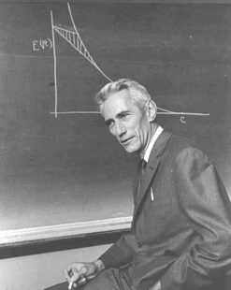
Shannon Legacy
The Information Revolution started in 1948, with the publication of:
A Mathematical Theory of Communication.
The digital age began.
Claude Shannon:
Shannon information quantifies the extent to which a recipient of data can reduce its statistical uncertainty.
“semantic aspects of communication are irrelevant . . .”
Applications Enabler/Driver:
CD, iPod, DVD, video games, Internet, Facebook, Google, . . .
Design Driver:
universal data compression, voiceband modems, CDMA, multiantenna, discrete denoising, space-time codes, cryptography, . . .

Slide 3
Post-Shannon Challenges
Classical Information Theory needs revisiting to meet new challenges of today: applications in biology, modern communication, knowledge extraction, economics and physics, . . . .
We need to extend traditional formalisms for information to include:
structure, time, space, and semantics,
and other aspects such as:
dynamical information, physical information, representation-invariant information, limited resources, complexity, and cooperation & dependency.

Slide 4
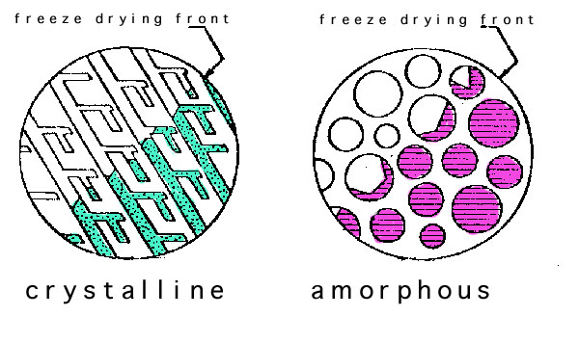
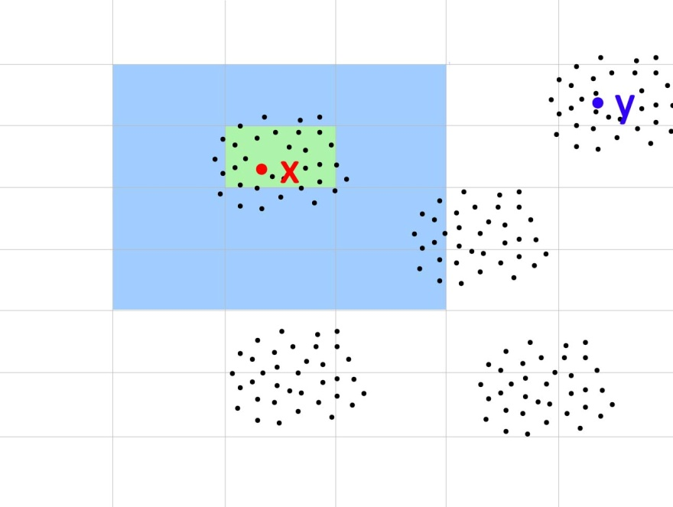
Post-Shannon Challenges
Structure:
Measures are needed for quantifying information embodied in structures (e.g., information in material structures, nanostructures, biomolecules, gene regulatory networks, protein interaction networks, social networks, financial transactions).
Time:
Classical Information Theory is at its weakest in dealing with problems of delay (e.g., information arriving late maybe useless or has less value).

Slide 5
Post-Shannon Challenges
Space:
In networks the spatially distributed components raise fundamental issues for information exchange because the available resources must be shared, allocated and re-used.
Semantics & Learnable information:
Data driven science focuses on extracting information from data. How much information can actually be extracted from a given data repository? How much knowledge is in Google’s database? Is there a general way to account for the meaning or semantics from data?

Slide 6
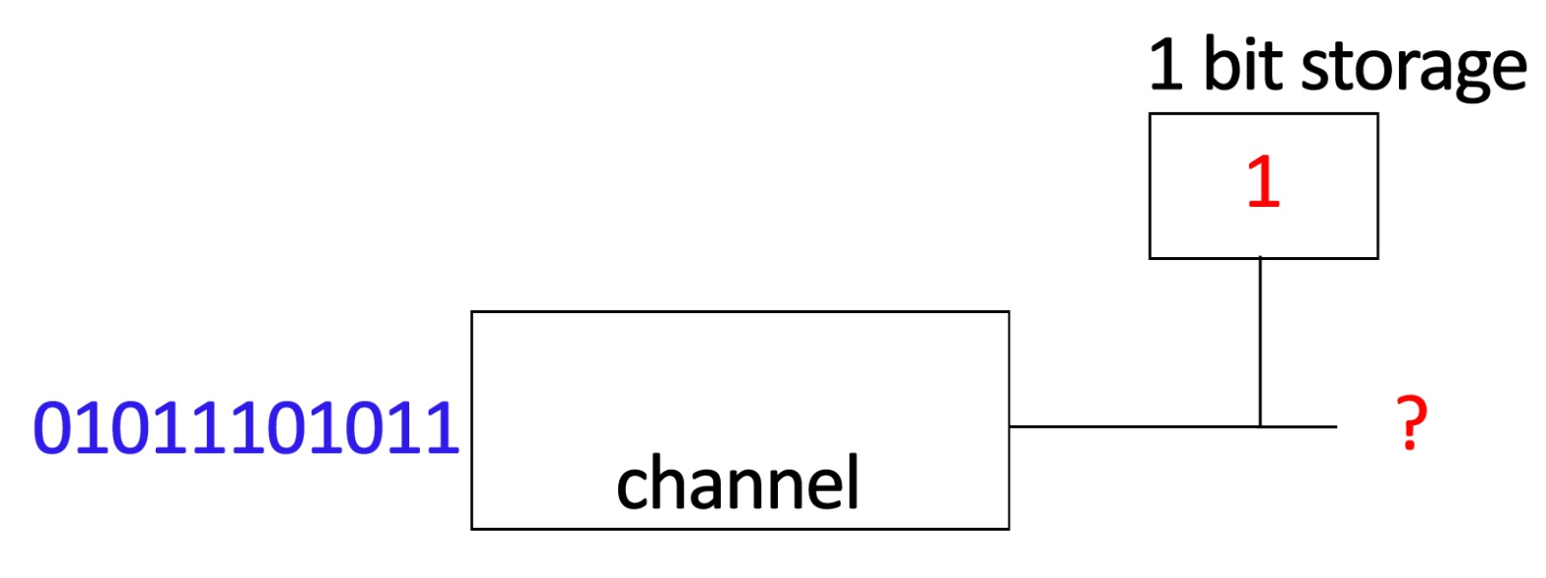
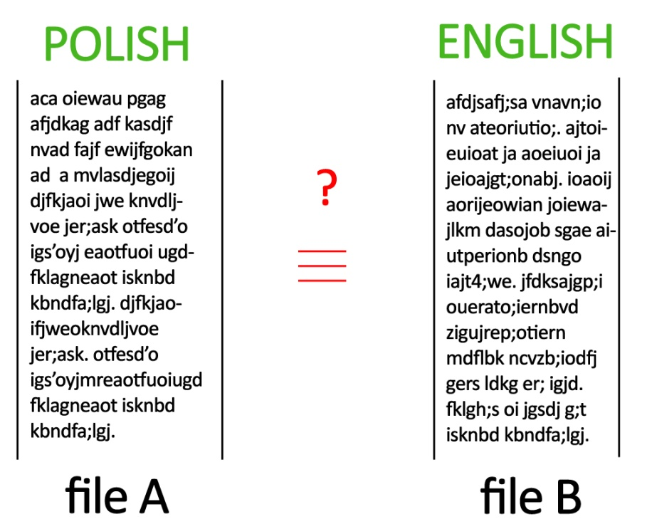
Post-Shannon Challenges
Other related aspects of information:
Limited Computational Resources: In many scenarios, information is limited by available computational resources (e.g., cell phone, living cell).
Representation-invariance: How to know whether two representations of the same information are information equivalent?
Cooperation: Often subsystems may be in conflict (e.g., denial of service) or in collusion (e.g., price fixing). How does cooperation impact information (nodes should cooperate in their own self-interest)?

Slide 7


Standing on the Shoulders of Giants . . .
Manfred Eigen (Nobel Prize, 1967)
“The differentiable characteristic of the living systems is Information. Information assures the controlled reproduction of all constituents, ensuring conservation of viability . . . . Information theory, pioneered by Claude Shannon, cannot answer this question . . . in principle, the answer was formulated 130 years ago by Charles Darwin.”
P. Nurse, (Nature, 2008, “Life, Logic, and Information”):
Focusing on information flow will help to understand better how cells and organisms work. . . . the generation of spatial and temporal order, cell memory and reproduction are not fully understood.

Slide 8
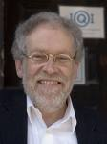

Standing on the Shoulders of Giants . . .
A. Zeilinger (Nature, 2005)
. . . reality and information are two sides of the same coin, that is, they are in a deep sense indistinguishable.
F. Brooks, Jr. (JACM, 2003, “Three Great Challenges . . .”):
We have no theory that gives us a metric for the Information embodied in structure . . . this is the most fundamental gap in the theoretical underpinning of Information and computer science.

Slide 9
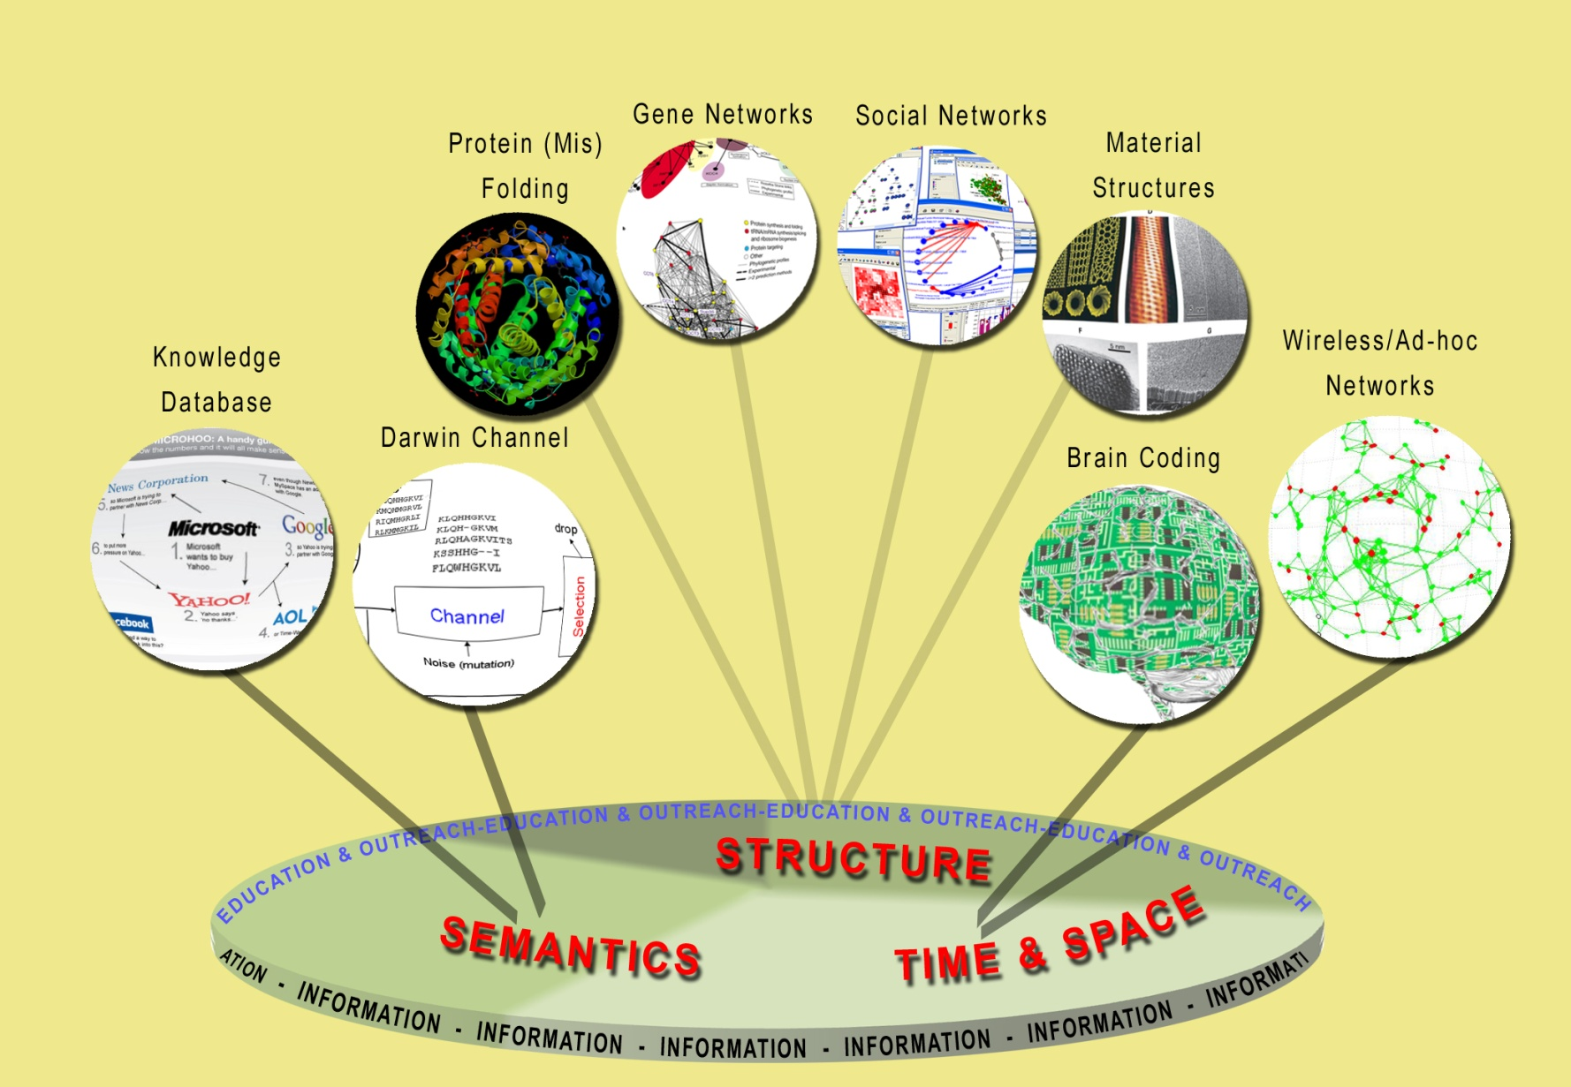
Science of Information
The overarching vision of the Center for Science of Information is to develop principles (and human resources) guiding the extraction, manipulation, and exchange of information, integrating space, time, structure, and semantics.

Slide 10
Goals of the Center
The STC Science of Information Center aims at integrating research and teaching activities aimed at investigating the role of information from various viewpoints: from the fundamental theoretical underpinnings of information to the science and engineering of novel information substrates, biological pathways, communication networks, economics, and complex social systems.
Center’s Goals:
define core theoretical principles governing transfer of information,
develop meters and methods for information,
apply to problems in physical and social sciences, and engineering,
offer a venue for multi-disciplinary long-term collaborations,
explore effective ways to educate students,
train the next generation of researchers,
broaden participation of underrepresented groups,
transfer advances in research to education and industry.

Slide 11

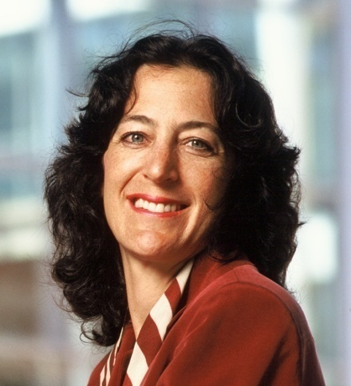
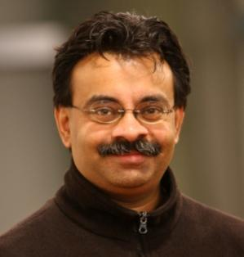
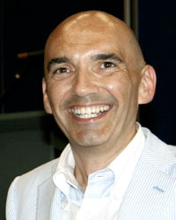
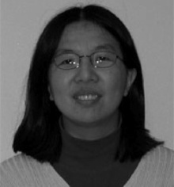
STC Team
Bryn Mawr College: D. Kumar
Howard University: C. Liu
MIT: M. Sudan (co-PI)
Purdue University (lead): W. Szpankowski (PI)
Princeton University: S. Verdu (co-PI)
Stanford University: A. Goldsmith (co-PI)
University of California, Berkeley: Bin Yu (co-PI)
University of California, San Diego: S. Subramaniam
University of Illinois, Urbana-Champaign: P.R. Kumar
National/Foreign Academies: Cover, Lynch, Flajolet,
Fung, Janson, Kumar, Ramkrishna, Rice, Rivest, Shor,
Sims, Verdu, Ziv;
Turing Award: Rivest
Shannon Award: Cover, Verdu, Ziv;
Nevanlinna Prize: Sudan, Shor
Wojciech Szpankowski,
Purdue
Andrea Goldsmith,
Stanford
Madhu Sudan,
MIT
Sergio Verdú,
Princeton
Bin Yu,
U.C. Berkeley

Slide 12
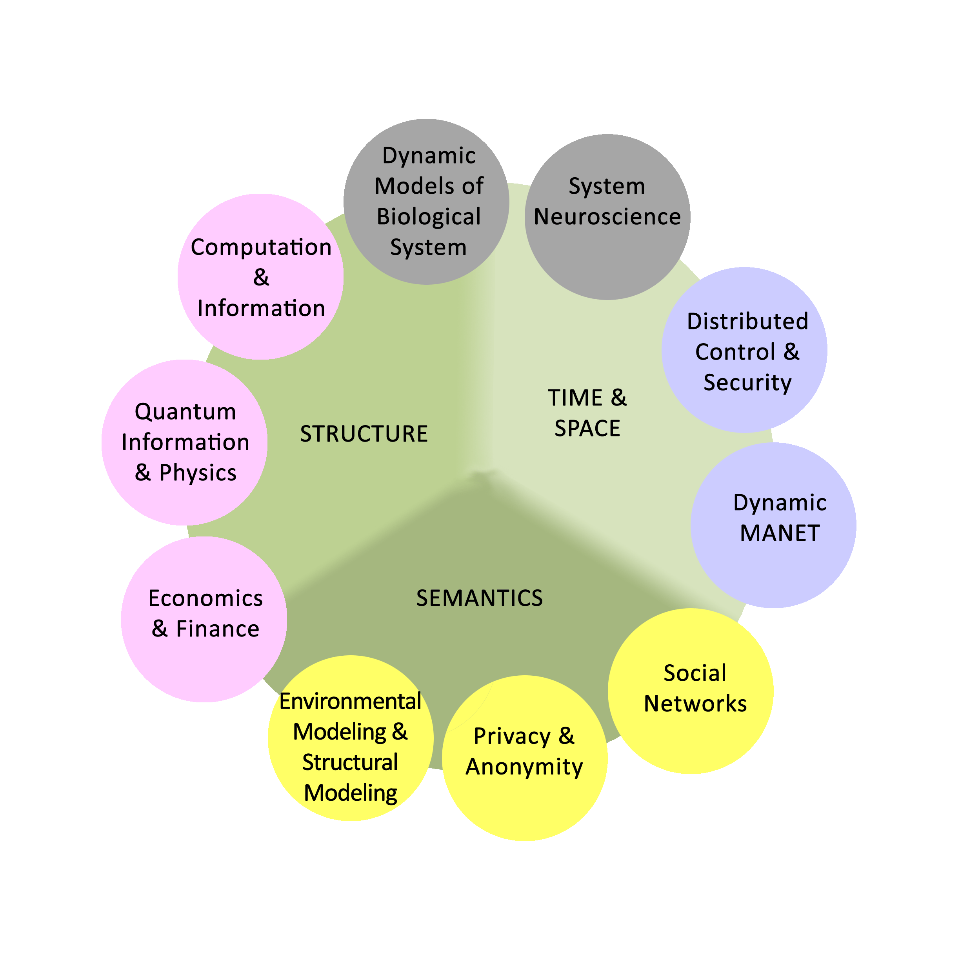
Synergies and Synthesis

Slide 13
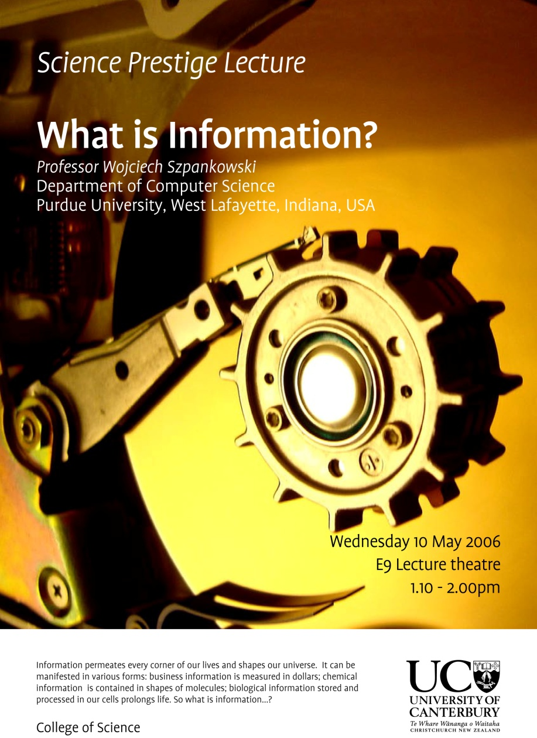
How Did it Start?

Slide 14
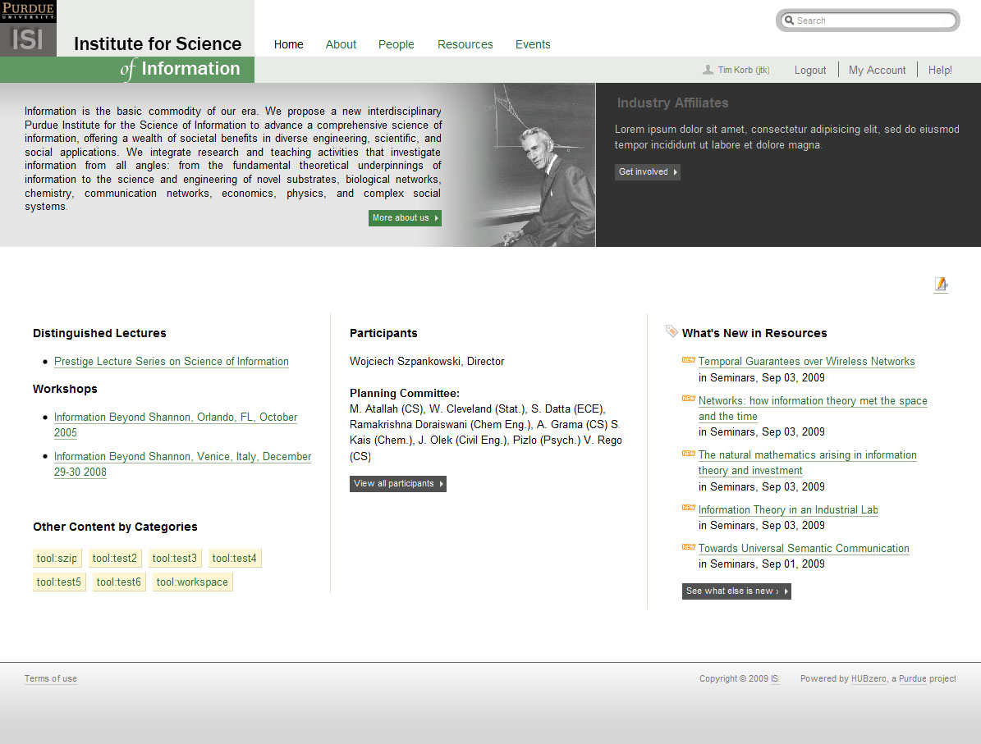
Institute for Science of Information

Slide 15
Emerging Frontiers of
Science of Information
Management Objectives,
Structure, and Operation

Slide 16
Management Objectives
To provide mechanisms for synergistic research and development of foundational principles, methods, and applications of post-Shannon information theory.
To educate and train the next generation of information sciences practitioners
To deeply engage students, researchers, and affiliated personnel from underrepresented groups in all aspects of the project.
To facilitate seamless transfer of knowledge to the broader academic and commercial world.

Slide 17
Management Goals:
Research and Development
Coordinate all projects to leverage research efforts across the Center
Constitute mechanisms for rewarding synergistic development, identifying promising research directions, terminating stagnant projects in a timely manner, and allocate resources accordingly.
Engage the broader scientific community to evolve our shared vision of information sciences
Involve the applications community to build up novel methods, formalisms, and products of the research and development plan
Develop an industrial outreach plan focused on timely dissemination of results to industry and enabling them to influence research and development efforts

Slide 18
Management Goals:
Education and Training
Engage students from K-12 to post-doctoral researchers in the emerging concepts associated with information science
Develop a coherent educational and diversity plan across various project sites focused on research involvement at all level
Develop a novel curriculum across project sites, integrating theory and applications of information science
Constitute mechanisms for initiating/ evaluating educational programs and their impact, as well as providing guidance and appropriate resources.
Train educators to maximize impact
Develop widely accessible instructional resources

Slide 19
Management Goals:
Diversity and Outreach
Utilize interdisciplinary opportunities to engage underrepresented groups in all aspects of research and education.
Effectively engage our partners to leverage their talent pool and train the next generation of researchers.
Leverage existing programs demonstrating the most effective strategies for diversity and outreach
Develop programs for outreach to untapped resources, including schools, community colleges, and industry.
Notes:
This could be split into two slides, one on diversity/outreach, and one on knowledge transfer, if combining makes these areas appear diminished in terms of goals.

Slide 20
Management Structure
Vice President for Research
Purdue University
Technical Director
Szpankowski
Managing Director
Kotterman*
External Advisory Board
Executive Committee
Internal Management
Committee
Technical Thrusts
Education and Human Resources Development
Diversity and Outreach
Knowledge Transfer
Structural goal: coordinate center activities, ensure availability of resources,
maintain accountability, and ensure achievement of all project goals

Slide 21
High-level management components and Functions

Slide 22
Management Structure
Vice President for Research
Purdue University
Vice President for Research
Purdue University
Responsible for administrative oversight of the project
Provides timely access to university facilities and resources
Provides a liaison to student programs and academic units
Ensures accountability to the National Science Foundation
Technical Director
Szpankowski
Managing Director
Kotterman*
External Advisory Board
Executive Committee
Internal Management
Committee
Technical Thrusts
Education and Human Resources Development
Diversity and Outreach
Knowledge Transfer

Slide 23
Management Structure
Vice President for Research
Purdue University
Technical Director
Szpankowski
Managing Director
Kotterman*
Technical Director
Szpankowski
Managing Director
Kotterman*
External Advisory Board
Executive Committee
Internal Management
Committee
Technical Director: The technical leader of the Center; establishes high-level goals and strategic directions; manages all center activities; coordinates and executes management decisions and advice from executive and advisory committees; point of contact with NSF
Managing Director: The administrative leader of the center; coordinates day-to-day center activities; works closely with the Technical Director to address all administrative issues that arise; leads the Internal Management Committee; key interface between the Executive and Internal Management Committees
Technical Thrusts
Education and Human Resources Development
Diversity and Outreach
Knowledge Transfer
Notes:
Anath mentioned in his talk that Purdue has experience with this type of managing director. Can we elaborate in the notes section of the slide?

Slide 24
Management Structure
Vice President for Research
Purdue University
Technical Director
Szpankowski
Managing Director
Kotterman*
External Advisory Board
Executive Committee
Executive Committee
Internal Management
Committee
Executive Committee: Provides executive oversight of the Center; guides progress and vision; coordinates efforts within and across thrusts; evaluates projects and mitigates risk; strategizes to maximize Center’s impact.
Technical Thrusts
Education and Human Resources Development
Diversity and Outreach
Knowledge Transfer

Slide 25
Management Structure
Vice President for Research
Purdue University
Technical Director
Szpankowski
Managing Director
Kotterman*
External Advisory Board
Executive Committee
Internal Management
Committee
Internal Management
Committee
Internal Management Committee: Responsible for day-to-day administration of and coordination within the center; monitors and facilities progress; ensures appropriate resources are available; raises concerns from PIs and user community to the Executive Committee
Technical Thrusts
Education and Human Resources Development
Diversity and Outreach
Knowledge Transfer

Slide 26
Management Structure
Vice President for Research
Purdue University
Technical Director
Szpankowski
Managing Director
Kotterman*
External Advisory Board
External Advisory Board
Executive Committee
Internal Management
Committee
External Advisory Committee: Annually reviews projects; provides high-level guidance on strategic issues; provides a channel for open dialogue with the wider community;
Technical Thrusts
Education and Human Resources Development
Diversity and Outreach
Knowledge Transfer

Slide 27
Detailed Management
Components and operation

Slide 28
Executive Committee
Composition:
  Center leadership
  Chair of the Executive Committee will not be the Director of the Center.
Coordination
  Monthly meetings conducted through telephone and/or video conference
  Senior personnel from projects and managing director will attend by invitation as needed.
  Meetings will manage new and ongoing projects; deal with issues that have arisen, and discuss possible future directions (fiscal and intellectual)
  Action items from meeting will be distributed within 24 hours.

Slide 29
Project Management
Projects within the Center will be managed by the Executive Committee via application management, solicitation, and assessment
Managing Applications:
  Track progress of each application
  Ensure progress on towards foundational aspects
  Terminate projects no longer relevant or demonstrating insufficient progress
  Evaluate the success of collaborative investigations.
Metrics for managing applications
  Publication of quality peer-reviewed papers, software tools, and infrastructure, vis-à-vis information measures
  Collaborations between investigators exemplified by joint publications and grants
  Development of educational material that illustrate fundamental developments in the domain
  Assessment of progress reports by the peers within the Center

Slide 30
Risk Assessment and Mitigation
Monthly meetings of executive committee will include dedicated discussion to risk assessment and mitigation strategys
Risk will be assessed on project progress, synergistic development, thrusts coordination, outreach and diversity, and knowledge transfer
  Risk assessment will be based on concrete metrics
  Mitigation strategies for at-risk areas will be developed, implemented, and monitored
  An EC member will be assigned to any at-risk area, with responsibility for monitoring mitigation, reporting progress, and making recommendations
Quarterly meetings will be held jointly between the EC and the IMC to discuss risk on all aspects of the project

Slide 31
Internal Management Committee
Reports to the Managing Director
Monitors internal progress and communication across the Center
Committee mission:
  Resolve day-to-day issues of the center without engaging executive committee
  Raise issues that are of concern among projects, and to the user community
  Provides a forum for coordinating the many ongoing efforts, thus minimizing redundancy, and sharing success strategies
  Informs Technical Director, Executive, and Advisory Committees of larger issues that may prove problematic to the success of the project.
Internal
Management
Committee
Managing
Director
Research
Applications
Implementation
Dissemination
Education
Outreach
Projects
Projects
User
Students
Training
User Community
Notes:
We should have some words behind this picture – can be added to notes section. Anath mentioned examples of internal management within Purdue – please put these in the notes section of this slide.

Slide 32
Coordinating Thrusts
Thrust coordination will be facilitated and monitored by the Technical and Managing Directors, with input from their committees.
Thrust leads will have monthly meetings (either in person, or over video conference) to ensure integration of their activities. These meetings will include the Technical and Managing Directors.
Industry representatives from partner companies will be invited to provide a broader perspective and facilitate knowledge transfer
Executive committee will monitor coordination (and associated outcomes), assess coordination risks, and propose mitigation strategies
Vice President for Research
Purdue University
Institutional Advisory Committee
Technical Director
Szpankowski
Managing Director
Kotterman*
Executive Committee
External Advisory Board
Technical Thrusts
Education and Human Resources Development
Diversity and Outreach
Knowledge Transfer

Slide 33
External Advisory Board
Composition: reflects diversity of scientific domains within the Center:
  The following were invited to join our EAC :
  I. Apostol (Amgen), J. Bruck (Caltech), P. Losiewicz (ONR), W. Massey (Princeton), A. Orlitsky (UCSD), K. Park (Georgia Tech), Y. Reznik (Qualcomm), B. Sedgewick (Adobe & Princeton), M. Weinberger (HPL).
Coordination
  External Advisory Board will receive quarterly progress reports from the Managing Director
  Will meet with the Center Director and the NSF Project Officer each year
  In-person meeting at the annual “all hands” meeting of the Center. This meeting will provide a forum for a high quality, detailed appraisal of the Center’s progress

Slide 34
External Advisory Board:
Progress Assessment
EAC will generate an annual report on the center’s progress for the Center Director and the NSF
  Will summarize assessment of the Center’s initiatives and make recommendations
Assessment and Metrics Include
  The adequacy of the synergistic development (metrics may include new collaborations, student exchanges, and interdisciplinary publications.)
  Infrastructure creation and its potential impact
  The reliability, robustness, and usability of tools and methods (metrics may user surveys, publication citations, and metrics on tool usage)
  The quality of the education and outreach component (metrics may include student surveys, diversity of program participants, statistics on outreach).
  The effectiveness of dissemination activities (metrics may include citation indices and plenary/invited talks of participants)
  Directions for Computer Science research related to Information Theory
  Recommendations for strategic recruitments
  Selection of new applications and termination of existing ones
Notes:
Shankar asks for more details on the assessment tools. I’ve added some, please feel free to modify or change.

Slide 35
Industry Interactions
Center should be influenced by relevant industries, and transfer its technology to them
The Executive Committee will provide the monitoring and oversight for these interactions, with input from the EAC
Mechanisms for interaction:
  Center will host CTO technology Summits and Roundtables
  Industrial visitors will be hosted by Center PIs in their laboratories
  We will work with our industrial partners and other companies to create student internships for student participants in the Center
  Technologists from relevant industry will be invited to a “Science of Information” research fair with student poster presentations. This will serve as a vehicle for both interaction and recruiting
Notes:
This could be merged with the slide on diversity/outreach to streamline, although combining may make these areas appear diminished in terms of goals.

Slide 36
Planning for Growth
Identifying Novel Directions, Selecting and Integrating New Applications:
  Recruiting: An open invitation to the entire information sciences and related applications communities
  Evaluation: By Director and Executive committee at the “All Hands” meeting, Metrics for selection will include significance/scope of the proposed application (25%), likelihood of impact (50%), and likelihood of success (25%).
  Integration: The Technical Director in consultation with the External Advisory Committee and NSF will collaborate with the PI of the new application to plan for transfer of resources to the new project.

Slide 37
Summary
Successful management of a large and diverse Center is challenging
Leadership roles have been established to break down this complex task into manageable and interworking pieces
Our management structure ensures coordination and accountability across all aspects of the Center’s mission
Our team has a proven track record of managing large projects; our structure and functional breakdown incorporates these prior experiences
The most obvious management risks have been identified, with multiple mechanism in place to assess and mitigate those risks.

Slide 38
Emerging Frontiers of
Science of Information
Budget Plans

Slide 39
Budget Summary
$5M/year is requested, including:
Student Support (33/year) Post Docs (8/year)
Faculty Support Visitors & Collaborators
Education Director Diversity Director
Managing Director Administrative Assistance
Travel Workshops
Advisory Committee Meetings
Cost Sharing: Students, Faculty Support, HUBZero,
Managing Director, Space

Slide 40
Management vs Research

Slide 41
Faculty vs Students

Slide 42
Total Project Cost

Slide 43
Split of NSF Funds

Slide 44
Emerging Frontiers of
Science of Information
Synergies and Synthesis

Slide 45
Synergies and Synthesis

Slide 46
Synergies and Synthesis
A comprehensive theory for quantifying, extracting, manipulating, and communicating information across complex systems must:
  be grounded in real-world applications
  must generalize to broad application domains
  must result in usable tools and techniques that advance the state of the art in respective scientific domains
  must themselves define a body of knowledge that motivates novel investigations and solutions.

Slide 47
Synergies and Synthesis
Motivated by problems in communication systems, Shannon addressed the following questions.
What is the fundamental limit on data compression?
Random processes have an irreducible complexity beyond which they can not be compressed (entropy H)
What is the limit on transmission rate?
Shannon showed that increasing transmission rate does not result in increased error rate as long as rate is below Channel Capacity

Slide 48
Synergies and Synthesis
While Shannon’s theory addresses a number of problems in communication and storage systems, its generalization to complex scientific systems is limited, since it does not address, among others:
  Geometric structure & topology
  Temporal variation and constraints
  Context
  Resource constraints
  Granularity of information flow

Slide 49
Synergies and Synthesis
Beyond a general theory relating to information in scientific and social systems, domain specific modeling paradigms are essential. These include:
  Semantics
  Evolutionary Context
  Network Interference
  Knowledge Mapping

Slide 50
The Primary Shannon Coding Concept
Source
Source Encoder
Channel Encoder
Channel
User
Source Decoder
Channel Decoder
A channel defines a relationship between the transmitted message X and received message Y. This relationship does not determine Y as a function of X but only determines the statistics of Y given the value of X (the joint distribution of X and Y).
If a channel has capacity C then it is possible to send information over that channel with a rate arbitrarily close to, but never exceeding C with a probability of error arbitrarily small.
Shannon showed that this was possible to do by proving that there existed a sequence of codes whose rates approached C and whose probabilities of error approached zero.

Slide 51
Shannon and Information Flow
Message
Signal
Received Signal
Message
Information Source
Transmitter
Receiver
Destination
Noise Source
A generalized communication system, from Shannon (1948)

Slide 52
DNA Transcription as Communication
Received Signal
Completed RNA Sequence
Signal
RNA Sequence
Message
RNA Sequence
Message
Sequence
Information Source
DNA
Transmitter
RNA Polymerase
Receiver
RNA
Destination
Ribosome
Noise Source
Transcription Error, Mutation

Slide 53
Visual Processing as Communication
Received Signal
electrical
Signal
electro-chemical
Message
Spikes
Message
Image
Information Source
Sensory Input
Transmitter
Neuron
Receiver
Synapse
Destination
Visual Cortex
Noise Source
Physiological Physical

Slide 54
Post-Shannon
Shannon’s theory provides the basis for all modern-day communication systems. His original theory was point-to-point (both signal and noise).
BUT
Most information flow is network to network. Examples include
  Wireless networks
  Biological networks
  Neural networks
  Social Networks
  Sensor networks
After 60 years we are still very far from generalizing the theory to networks. Our center will focus on a common theory for network-centric information flow in complex scientific systems.

Slide 55
E.g. A Neural Network in the Human Brain
  There are ~ 10¹¹ neurons in the human brain. Most of them are formed between the ages of -1/2 and +1.
  Each neuron forms synapses with between 10 and 10⁵ others, resulting in a total of circa 10¹⁵ synapses.
  From age -1/2 to age +2, the number of synapses increases at net rate of a million per second, day and night; many are abandoned, too.
  It is believed that neuron and synapse formation rates drop rapidly after age 1 and age 2, respectively, but recent results show that they do not drop to zero.

Slide 56
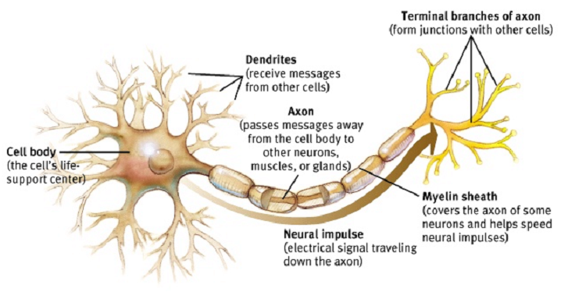
ARTIST’S CONCEPTION OF A NEURON

Slide 57
Multicasting
Viewed as a communication network, the human brain simultaneously multicasts 10¹¹ messages that have an average of 10⁴ recipients.
Every 2 ms a new binary digit is delivered to these 10¹¹ x 10⁴ = 10¹⁵ destinations; 2 ms later another petabit that depends on the outcome of processing the previous one has been multicast.
The Internet pales by comparison.

Slide 58
Post-Shannon
Shannon’s theory provides the basis for all modern-day communication systems. His original theory was point-to-point (both signal and noise).
BUT
Most information flow is network to network. Examples include
  Wireless networks
  Biological networks
  Neural networks
  Social Networks
  Sensor networks
After 60 years we are still very far from generalizing the theory to networks. Our center will focus on a common theory for network-centric information flow in complex scientific systems.

Slide 59
Post-Shannon
Shannon’s information theory provides the basis for all modern-day communication systems. His original theory assumes that communication is noise limited.
BUT
Many networks are interference, rather than noise-limited.
Examples include
  Wireless networks
  Neural networks
  Social Networks
  Sensor networks
After 60 years models that use signal characteristics and interference and not merely noise distributions are merely heuristic that use deterministic approximations. Our center will focus on a common theory dealing with signal interference models.

Slide 60
Post-Shannon
In Shannon’s information theory the channel is fixed
BUT
Channels are not fixed. They adapt their transition probabilities over eons, or over milliseconds, in response to the empirical distribution of the source. For e.g. future source data depends on past outputs to user.
Examples include
  Wireless networks
  Biological networks
  Neural networks
  Social Networks
  Sensor networks
Our center will focus on a common theory for channel adaptation to feed forward and feedback information flow.

Slide 61
A real life Channel: The Chromosome
Long block code, discrete alphabet, extensive redundancy, perhaps to control against the infiltration of errors.
But DNA enables two organisms to communicate; it’s designed for inter-organism communication.
DNA also controls gene expression, an intra-organism process, so a comprehensive theory of intra-organism communication, i.e. a channel theory is needed.

Slide 62
Post-Shannon
In Shannon’s information theory the context has to be pre-defined in the signal or in the noise explicitly. This make any theory not scalable.
BUT
In most information systems context is arguably the most important factor. For e.g. every biological system functions in context.
Other Examples include
  Wireless networks
  Biological networks
  Neural networks
  Social Networks
  Sensor networks
Our center will focus on a common theory of information for accommodating context and semantics.

Slide 63
Context is Key
For genetic information, the context includes
  Impact of cellular environment
  Impact of the context within the sequences themselves; are there larger patterns within the genetic code?
  Impact of multiple reading frames

Slide 64
Context is Key
For human information, the context includes
  Impact of the user’s physical environment
  Impact of the context in which a user interacts with information
  Impact of the user’s prior experiences
  Impact of the user’s beliefs about or models of the world

Slide 65
Post-Shannon
In Shannon’s information theory the context in a dynamical sense is not defined. This make any theory impossible to apply to time-dependent networks.
BUT
In most information systems context is dynamic. For e.g. every sensor network has dynamical and time-varying information.
Other Examples include
  Wireless networks
  Biological networks
  Neural networks
  Social Networks
  Sensor networks
Our center will focus on a common theory of information for taking into account dynamical nature of networks.

Slide 66
Sensor Network Operation
Cooperative communication
Data fusion
Routing
Basic goal: detection/identification of point or distributed sources subject to distortion constraints, and timely notification of end user

Slide 67
Context
Cooperative reception problem very similar to multi-node fusion
problem; same initiation procedure required to create the cluster, however we can choose channel code.
Cooperative transmission and reception similar to multi-target multi-
node fusion, but more can be done: beacons, space-time coding
Use to overcome gaps in network, communicate with devices
outside of sensor network (e.g. UAV)

Slide 68
Post-Shannon
Shannon’s information theory does not address the issue of processing in transmission, complexity, and an algorithmic theory of information.
BUT
In most information applications statistical and machine learning methods are deployed for this purpose, but they lack a precise metrics for information content. For e.g. de-noising in communication or data modeling in biology do not provide a metric of accuracy unless they map all input and output. The latter is not scalable.
Other Examples include
  Biological networks
  Neural networks
  Social Networks
  Sensor networks
Our center will focus on a new paradigm for estimation of information content in data reduction.

Slide 69
Statistical Modeling ―Traditional approach
Assumes that data has been generated as a sample from a population.
  Parametric
  Non parametric
Unknown distribution is then estimated using the data.
Minimization of some mean loss function.
  Maximum Likelihood
  Least squares
Works well when we understand the physics of the problem i.e. we know that there is some law generating the data + instrument noise.
If we do not understand the data generating process there is no way we can determine whether the given data set is sampled form a given distribution.
Data Mining | Image processing | Biopathway modeling

Slide 70
Getting around the Curse of false assumption…
We need a theory
Standard learning approaches work only partially since we do not know what are good priors?
A theory of learnable information and its transformation into knowledge would be immensely useful in life sciences.

Slide 71
Emerging Frontiers of
Science Information
Research: Introduction

Slide 72



What is Information*?
C. F. Von Weizsäcker:
“Information is only that which produces information” (relativity).
“Information is only that which is understood” (rationality)
“Information has no absolute meaning”.
R. Feynman:
“Information is not simply a physical property of a message: it is a property of the message and your knowledge about it.”
J. Wheeler:
“It from Bit.”
(what is fundamental is not waves and particles but Information.)
*Russell’s reply to Wittgenstein’s precept “whereof one cannot speak, therefore one must be silent” was “… Mr. Wittgenstein manages to say a good deal about what cannot be said.”
Notes:
∗Russell’s reply to Wittgenstein’s precept “whereof one cannot speak, therefore one must be silent” was
“. . . Mr. Wittgenstein manages to say a good deal about what cannot be said.”

Slide 73

An Attempt of a Definition
Data carries information if it can impact a recipient’s ability to achieve the objective of some activity within a given context and limited resources.
Event-Driven Paradigm:
System, State, Event, Context, Attributes,
Objective: Objective functional : maps system’s rules of conduct R and the context C into an objective space.
Definition 1. The amount of information (in a faultless scenario) I(E) carried by the event E in the context C as measured for a system with the rules of conduct R is
where the cost (weight, distance) is a function.

Slide 74

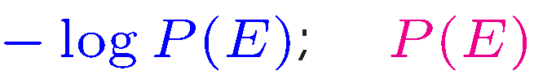


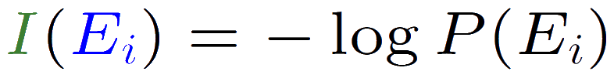

Shannon Information
In our setting, Shannon information can be described as:
Objective: statistical ignorance of the recipient;
statistical uncertainty of the recipient.
Cost: # binary decisions to describe ;
= being the probability of .
Context: the semantics of data is irrelevant . . .
Self-information for :
Average information:
Entropy:
Mutual Information: (faulty channel)
Shannon’s information is not absolute information since (prior knowledge) is a subjective property of the recipient.

Slide 75
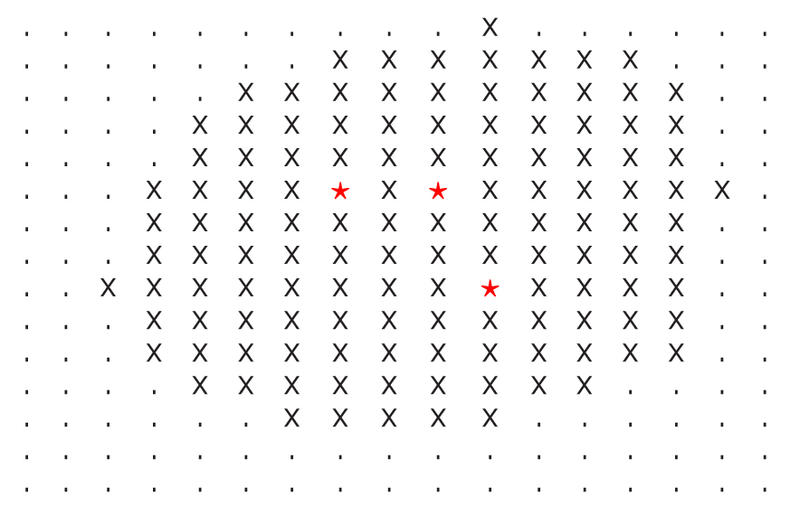
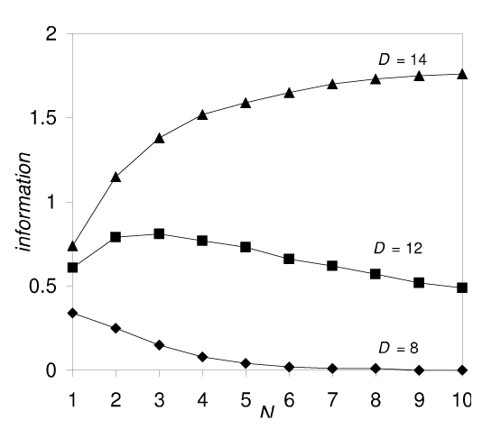
Example of Distributed Information
1. In an N-threshold secret sharing scheme, N subkeys of the decryption key roam among A × A stations:
(i) Event corresponds here to the reception of a part of a key.
(ii) Objective(R, C) is to decode the message.
2. By a protocol a station has access to a message if it sees all N subkeys which are within a distance D.
Note: Reception of a part of a key does not improve the ability to decrypt a text unless all keys are already in C.
3. Assume that the larger N, the more valuable the secrets. We define the amount of information as
I(E) = N × { # of stations having access}.

Slide 76
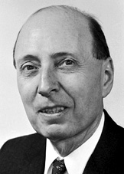





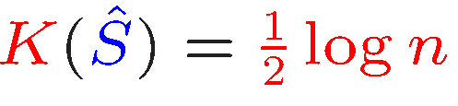

Learnable Information
How much useful information can be extracted from a data set?
Eugene Wigner:
Physics doesn’t describe nature.
Physics describes regularities among events . . .
1. Let S be a set representing regularity or summarizing properties of a sequence of length n (e.g., S is the number of 1 in ).
2. We can represent by:
(i) describing the set S that takes I(S) bits – we call it useful information;
(ii) position of in S that requires log|S| bits (complexity of ).
3. Kolmogorov Information: Define
Example: For being a binary sequence, let S be the type of that requires
bits, and

Slide 77


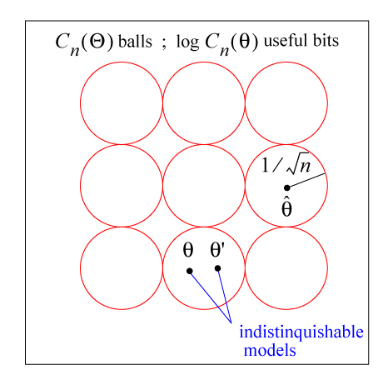






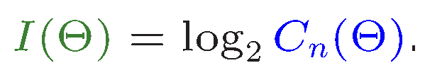
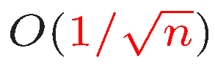
Statistically Learnable Information
set of -dimensional parameterized distributions. Let
be the ML estimator (demo).
Two models, say and are indistinguishable (have the same useful information) if the ML estimator with high probability declares both models are the same (i.e., and
are close).
The number of distinguishable distributions (i.e., ) summarizes then the learnable information and we denote it as:
Balasubramanian proved that the number of distinguishable balls of radius
is asymptotically equal to
How to extend it to non-conventional data such as: biological data, web data, topographical maps, environmental data, and medical data?

Slide 78


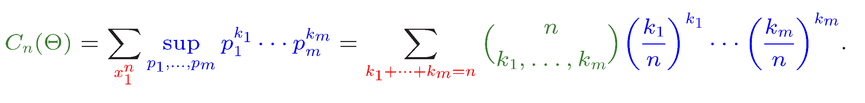
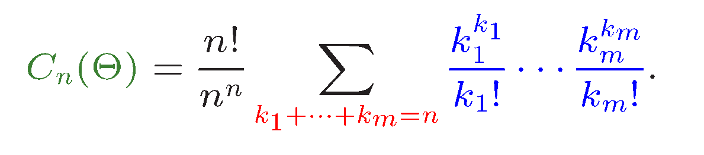
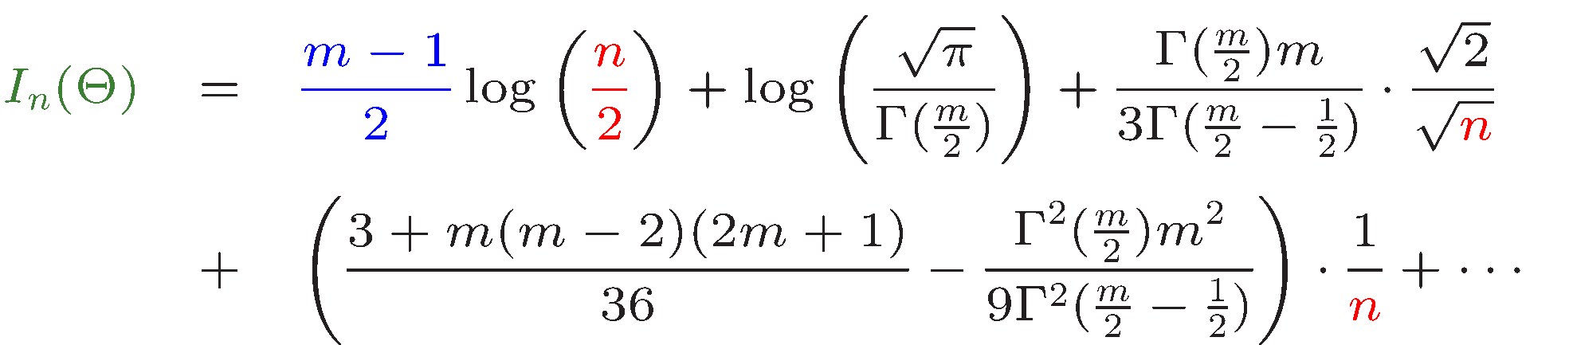
Memoryless Sources
Consider the minimax regret=useful information for memoryless sources of -ary alphabet, thus with Observe that
which becomes:
Using tree-generating functions and analytic information theory tools, we find (cf. Clarke & Barron, 1990, W.S., 1998)

Slide 79
Fundamental Research Issues
The proposed project explores:
modeling complex systems and development of analytical techniques for information flow (e.g., understanding Darwinian selection),
quantification and extraction of informative substructures (e.g., discovering functionally relevant structures in gene regulatory networks),
understanding of spatio-temporal coding (e.g., building more efficient ad hoc networks),
quantifying how one can trade off delay for capacity and how to exploit mobility (in wireless networks),

Slide 80
Fundamental Research Issues
knowledge discovery based on formal information-theoretic measures (e.g., finding semantically relevant information in unstructured repositories),
studying computational limits for information extraction,
data obfuscation and hiding as mechanisms for robustness (e.g., developing secure systems),
discovering principles of redundancy and fault tolerance (e.g., understanding the interplay between erasure coding and distributed system design).

Slide 81
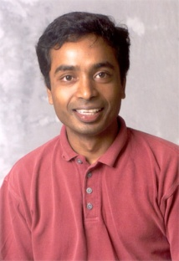
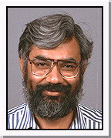
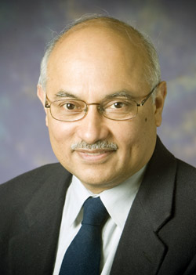
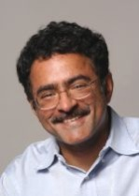
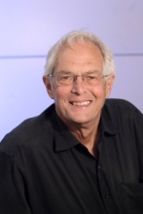
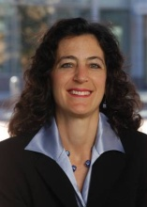
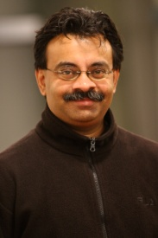
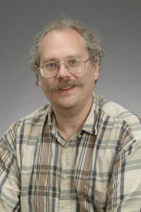
Future Presentation
Information Flow in Biological System
Information Transfer in Ubiquitous Networks
Knowledge Extraction:
Information, Computation, & Physics

Slide 82
Emerging Frontiers of
Science of Information
Research: Biology
Applications in Life Sciences

Slide 83
Information Theory and Life Sciences: Early Origins
“The Information Content and Error Rate of Living Things”
[Quastler and Dancoff, 1949]
Recognition of the role of information theoretic concepts in life sciences: Symposium on Information Theory in Biology, Gatlinburg, TN, Oct 29-31, 1956.

Slide 84
Information Theory and Life Sciences: Tempered Expectations
“Now, after 18 years of symposia and published articles on the subject, it is doubtful whether information theory has offered the experimental biologist anything more than vague insights and beguiling terminology.”
[Johnson, Science, 26 June, 1970]
“… that there are difficulties in defining information of a system composed of functionally interdependent units and channel information (entropy) to produce a functioning cell.”
[Linschitz, The Information Content of a Bacterial Cell, 1993]

Slide 85
Information Theory and Life Sciences: Renaissance
Biology is a data-rich discipline
  Large number of fully sequenced genomes
  Expression profiles of genes
  Metabolic pathways for diverse species
  Protein interaction / Gene regulation networks
  Small-molecule databases
  Folding trajectories, ligand binding sites
  Personalized / phenotype implicated data

Slide 86
Information Theory and Life Sciences: Renaissance
Biology is a data-driven science
Significant advances have been made through heroic one-off efforts at modeling, algorithm, and software design and implementation.
We must develop formal techniques for examining data, generating hypothesis, and validating them.

Slide 87
Information Theory and Life Sciences: Renaissance
Initial efforts focused on sequence conservation, gene finding, motifs, their structural and functional implications, evolution, and phylogeny.
Complemented by phenotype databases, significant advances have been made in understanding the genetic basis of disease through information theoretic methods and formalisms.

Slide 88
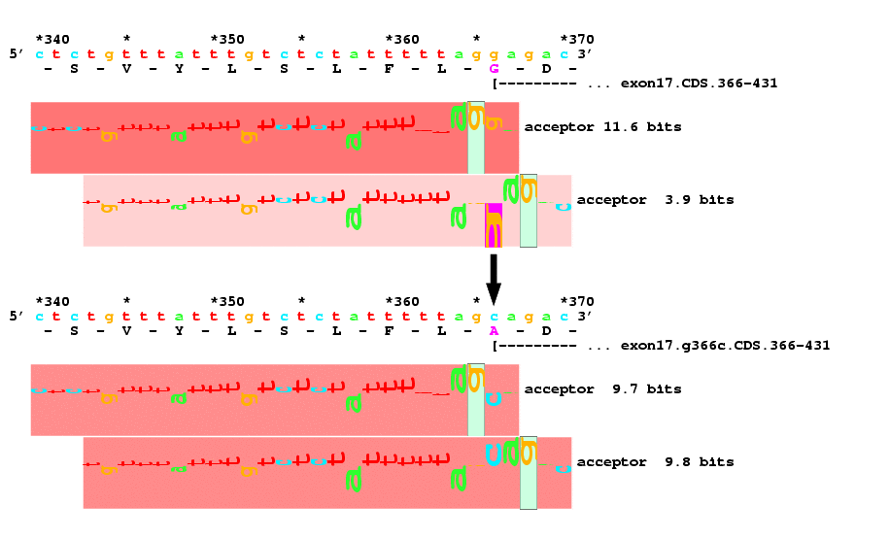
Information Theory and Life Sciences: Some Examples
A G/C mutation at location 366 in the ABCR gene is implicated in macular degeneration (glycene to alanine in exon 17). This was identified through information theoretic analysis of splice acceptors.
Allikmets et al., Gene 1998.

Slide 89
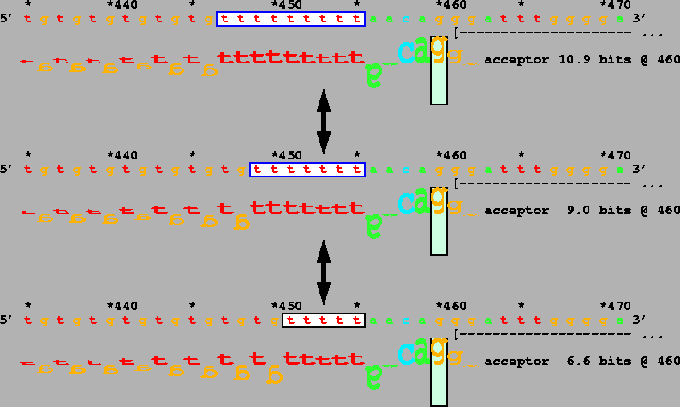
Information Theory and Life Sciences: Some Examples
Splicing varies among 3 common alleles that differ in length in the polymorphic polythymidine tract of the IVS 8 acceptor of the gene encoding the cystic fibrosis transmembrane regulator
Rogan et al., Human Mutation, 1998.

Slide 90
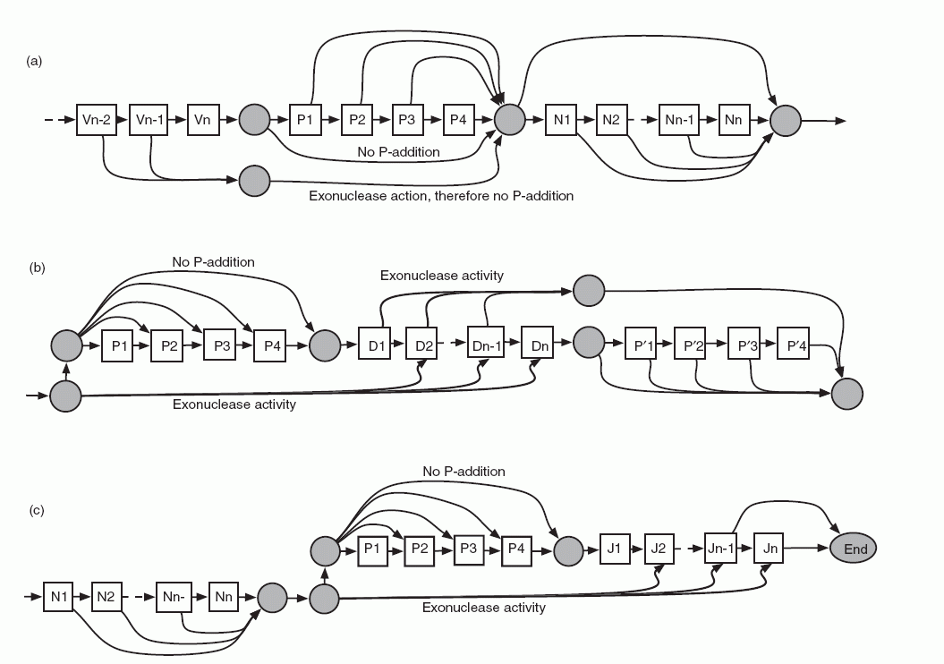
Information Theory and Life Sciences: Models and Methods
An HMM for IGHV, IGHD, IGHJ genes along with junction states for mutations in CLL.
Gaeta et al., Bioinformatics, 2007.

Slide 91
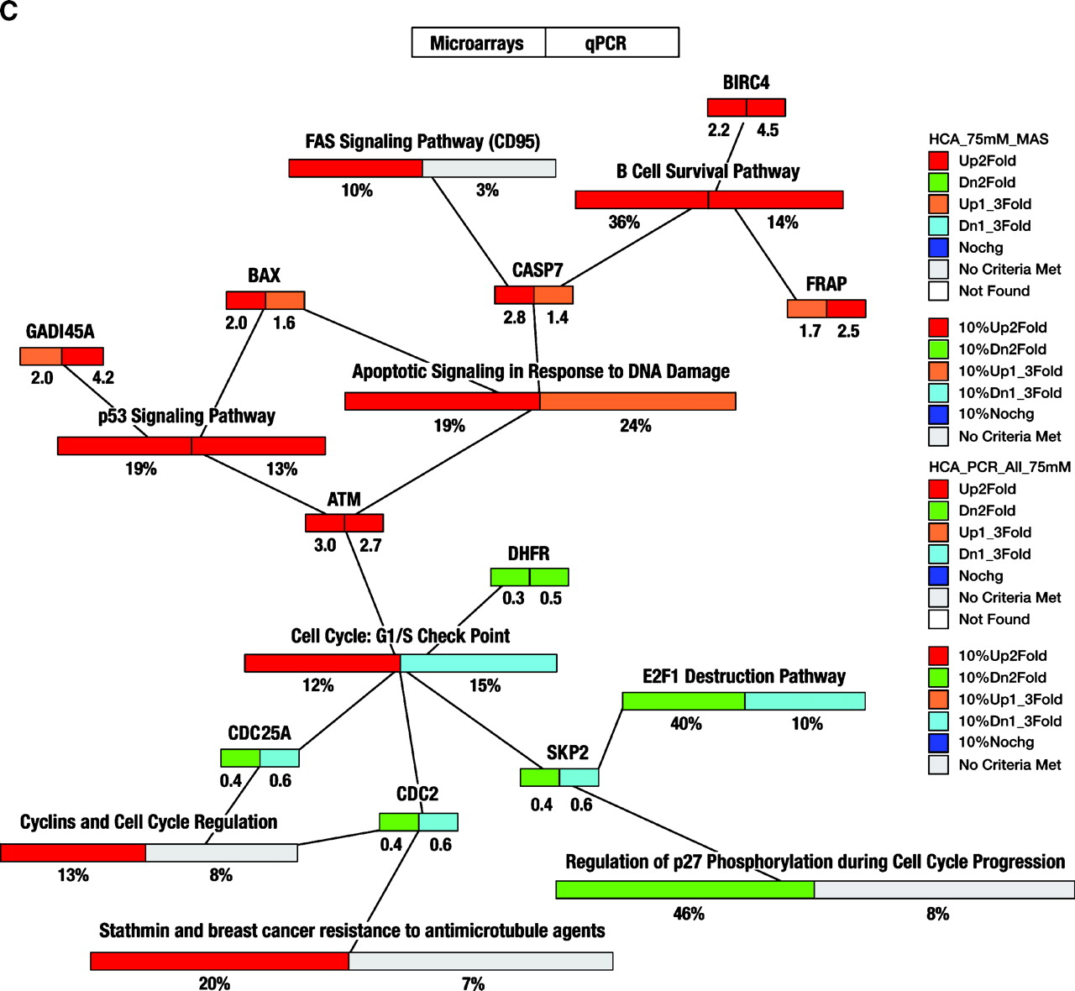
Information Theory and Life Sciences: Scratching the Surface
Enriched functional categories and pathways in colorectal cancer cell lines following treatment
Fatima et al. Cancer Epidemiol Biomarkers Prev 2008

Slide 92
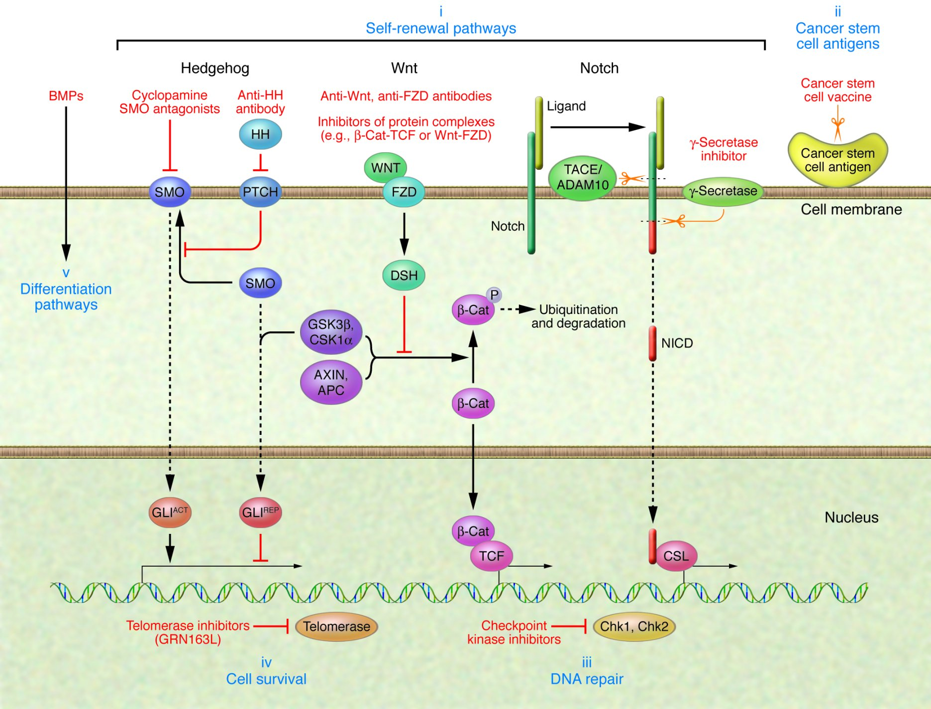
Information Theory and Life Sciences: Emerging Frontiers
Hedgehog (HH), Notch, and Wnt signaling are key stem cell self-renewal pathways that are deregulated in lung cancer and thus represent potential therapeutic targets
Sun et al., JCI 2007

Slide 93
Key Outstanding Challenges
Information in systems/networks
  Modularity and function-based information measures
  Comparative/ discriminant analysis
  Methods and validation
Spatio-temporal variations
  Scaling from molecular processes within the cell to entire populations
  Timescales ranging from femtosecond-scale ligand binding to eons

Slide 94
Key Outstanding Challenges
Information and context
  Tissue specific pathways
  Normal physiology versus pathology
Data transformation, reduction, and abstraction
  Data complexity, noise
  Signal transduction
  Models, manifestation, and granularity

Slide 95
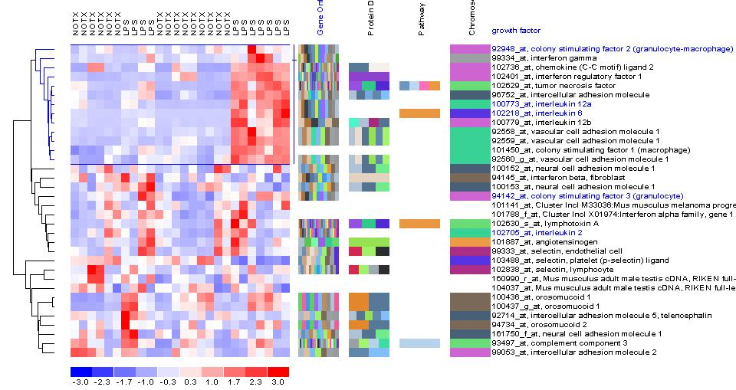
Information in Systems: Comparative Analysis
BM
TM
Mutual Information in Expression Profiles of Genes in response to NF/kB

Slide 96
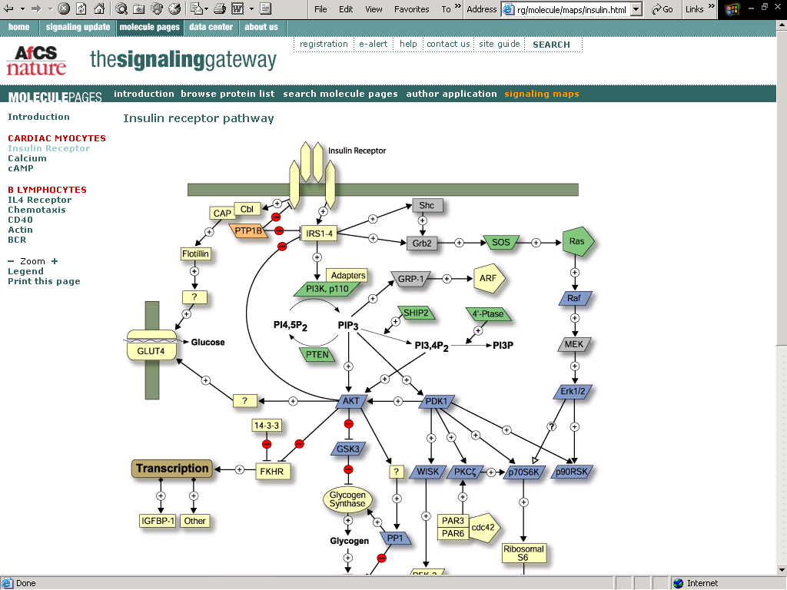
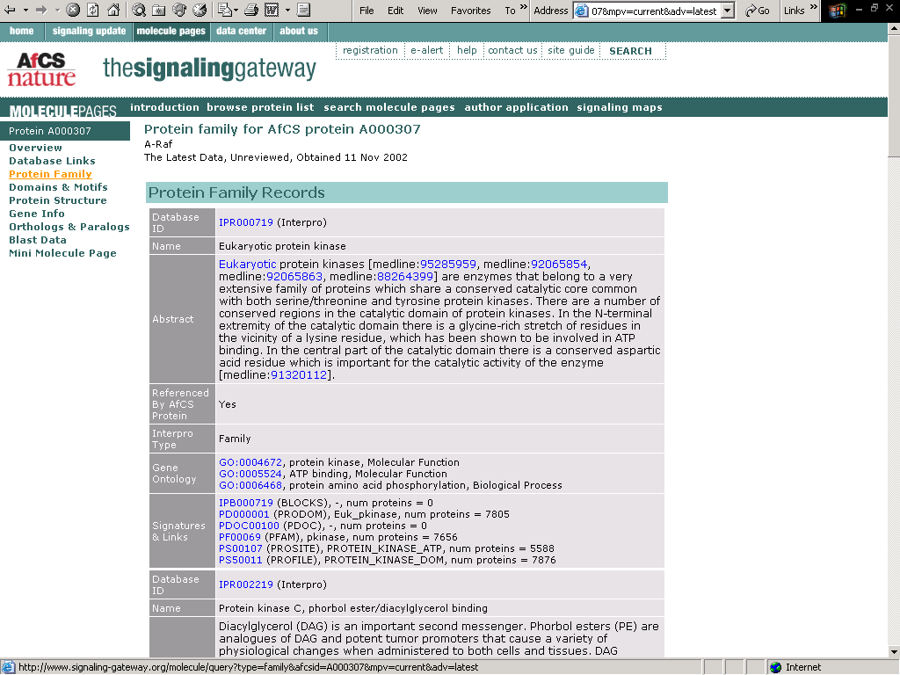
Alliance for Cellular Signaling

Slide 97
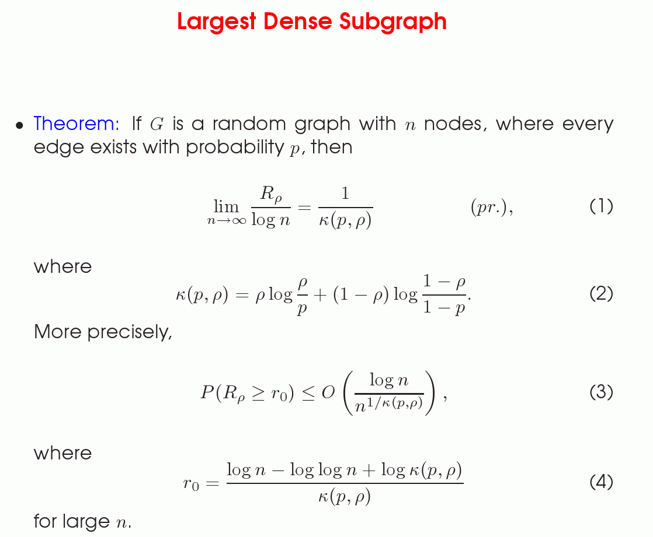
Information in Systems: Analytical Insights into Modularity
Early Efforts: Static analysis with space and time collapsed into a single point.
Extensions to dynamic networks with compartmentalization and coarse-graining are essential.

Slide 98
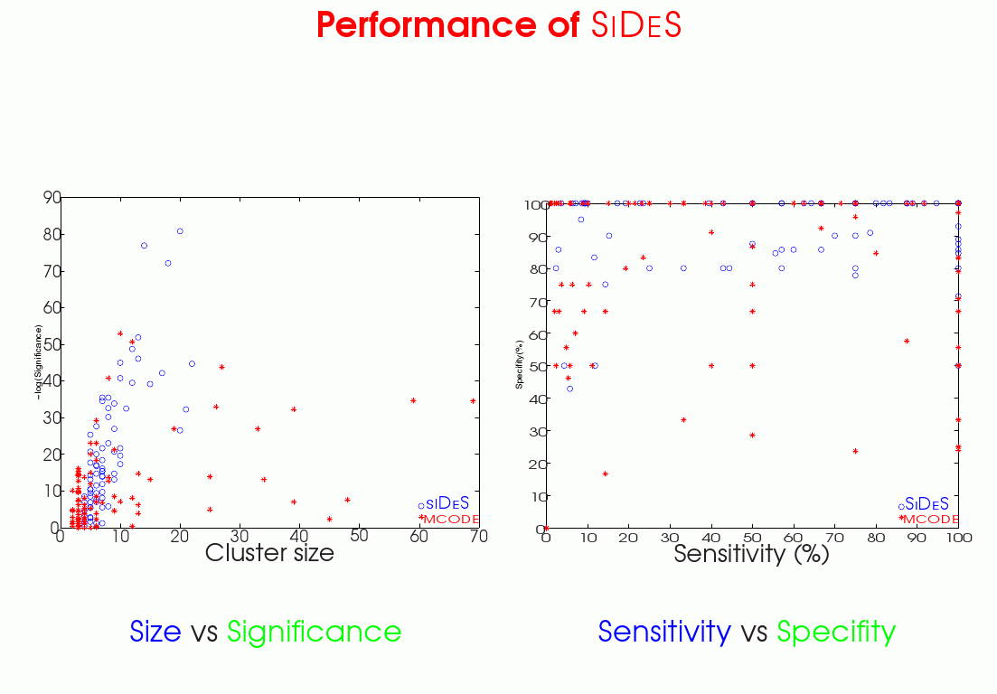
Information in Systems: Modularity

Slide 99
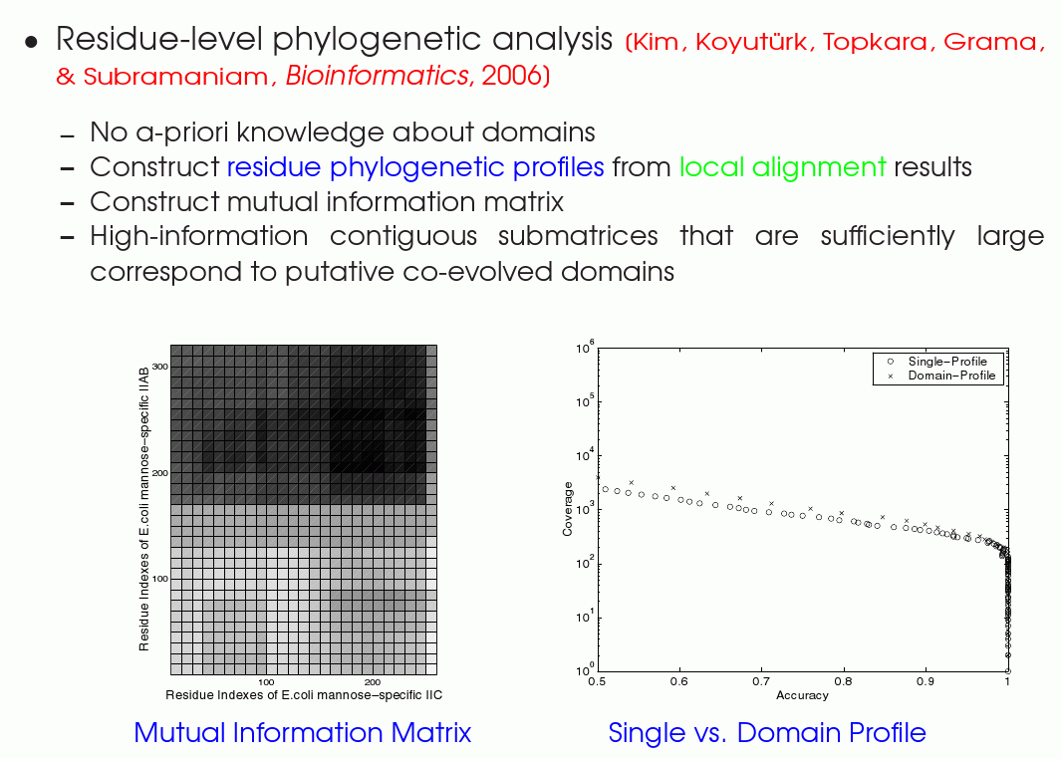
Information in Systems: System construction through mutual information

Slide 100
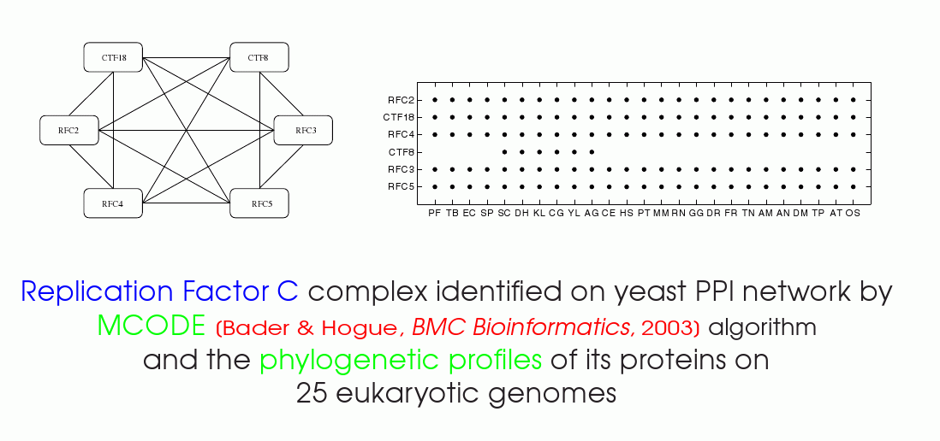
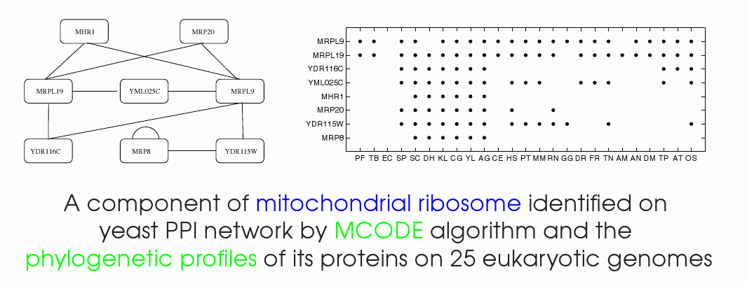
Spatio-temporal flow of information

Slide 101
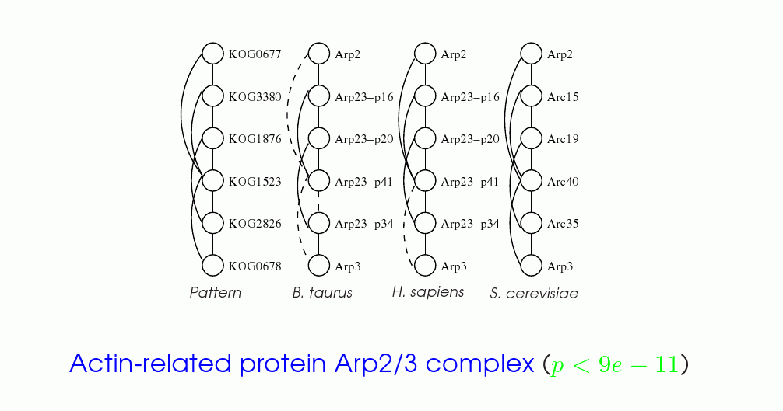
Scaling abstractions through information gain: from molecules to pathways/ macromachines

Slide 102
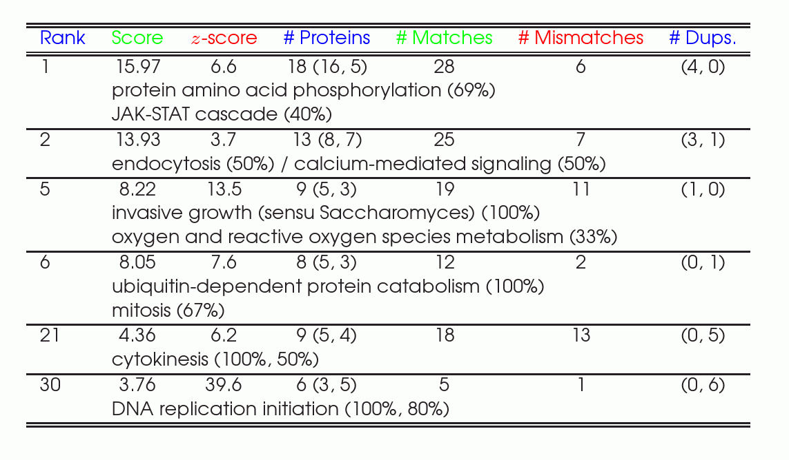
Information and phenotype: functional annotation through information Gain
Yeast vs. Fruit Fly alignment reveals a number of molecular machines

Slide 103

Pathways Analysis Toolkits

Slide 104


Frameworks and Portals
Over a million sessions and counting!

Slide 105
Science of Information and Life Sciences
Barely scratching the surface
Formidable challenges remain
Synergistic development is key
A marriage of inevitability!

Slide 106
Emerging Frontiers of
Science of Information
Research: Communication
Information Transfer in Networks

Slide 107
A historical view
Telegraphy is 172 years old
Telephony 133 years
Computers 64 years
Computer networks 39 years
Cell phones 36 years old
Today
25 years hence?
  10 year research
  program will set stage

Slide 108
Vision
Future wireless networks may be revolutionary by today’s standards
Sophisticated information transfer requirements
Collate information correlated in time as well as space, produced dynamically by sources
Network itself must be the information processing fabric
Rephrasing Marshall McLuhan
  Communication fabric will determine the message

Slide 109
Transformations
From
To
  Ad hoc design
  Simple radios
  Simulation based evaluation
  Fundamentals of single links
  Security as afterthought
  Wireline centric design
  Networks
  Scientific design
  New technologies
  Analytical understanding
  Fundamentals of networks
  Security from inside out
  Intelligent cross-layer design
  Systems

Slide 110
Shannon’s approach
Formulation of problem
Explore fundamental limits
Develop theoretical tools
Provide architectural guidance

Slide 111
Contributions of people in team
  The cut set bound
Multi-user detection and estimation
Information flow through queueing processes
Deterministic abstractions of networks
Diversity and multiplexing in MIMO
. . .

Slide 112
Several themes and problems …
Abstraction of the wireless physical layer which captures important PHY layer advances (cooperation, MIMO, beamforming, etc) in the right way for networks
Efficient distributed resource allocation for wireless networks
Multidimensional network QoS: Throughput, latency, reliability, security, robustness
Information fusion and network information processing
. . .

Slide 113

A theory of time-based QoS
How to transport information across an unreliable wireless network with bounded delays and specified throughput reliabilities?
Recent progress on collocated case
  fading channels
  general arrivals
  rate adaptation
  client utilities, etc
  admission control and scheduling
Multi-hop network
.
.
.
.
.
.
.
.
.
.
.
.
.
.
.
.
.
.
.
.
.
.
.
.
.
.
.
.
.
.
.
.
.
.
.
.
.
.
.
.
.
.
.
.
.
.
.
.
.
.
.
.
.
.
.
.
.
.
.
.
.
.

Slide 114
In-network information processing
Sensor networks are not data networks
  Nodes can process information
  Network coding
How should we process information in-network to compute and disseminate functions of interest?
Develop a complexity hierarchy
 | Collocated network: Mean, Mode, Type | Downloading all data from all nodes
 | Collocated network: Max | Random multi-hop network: Mean, Mode, Type
 | Random multi-hop network: Max

Slide 115




Architecture and operation of wireless networks
How should we design and operate wireless networks?
Advances in channels
Advances in large networks
Advances in abstractions
Notes:
The first slide is meant to illustrate that information transfer
in networks is basically a kind of flow on a dynamical system.
The top left figure indicates the traditional DMC network model
with the cut illustrating a barrier across which some information
flows. Note that, as opposed to the traditional view of independent
sources, one should think of the prior information available to the nodes before
communication starts as in general being dependent and the
aim of the communication is basically to arrive at a posterior
information state that allows the desired communication
primitives to be achieved (be they unicast, multicast, anycast,
computational primitives, semantic primitives or whatever).
The bottom left figure illustrates the traditional view of communication
primitives as achieving certain point to point rates of information
transfer. The figure on the right illustrates the dynamical systems viewpoint.
At the bottom of this figure the functional $\Phi$ describes the
set of achievable communication primitives as a functional of the
communication protocol (which gives the posterior information state
conditioned on the prior information state) and of the
class of prior information states for which the protocol is supposed to work.
This viewpoint has been developed in recent papers of Amin Aminzadeh
Gohari and VA and gives the currently best known outer bounds for
several classical communication problems (cut set bound, broadcast
channel, interference channel), in fact generalized in a natural way to
dependent sources in a way that is not easy to do using traditional
approaches. This viewpoint is amenable to substantial development
for more interesting (21-st century) communication primitives,
such as those listed above.

Slide 116


Information theoretic security
Physical layer security
Generating keys over public channels
Characterization of secrecy rates
Multi-layered code designs
Notes:
The second slide is meant to illustrate the problem of
information-theoretic security,
which can be viewed as a special kind of communication primitive,
if desired. In the bottom left figure, Alice and Bob are to create
a secret key to be hidden from Eve, starting with some prior
information state for Alice, Bob and Eve, and allowing for discussion
between Alice and Bob over a public channel (i.e. all parties can
hear perfectly what is said over this channel). The best current
upper and lower bounds for the secrecy rate in the most
widely studied versions of this problem belong to Amin Aminzadeh Gohari
and VA. The top right figure schematically illustrates that the direct
part schemes for these secrecy rates involve multi-layered
constructions. The development of constructive schemes
for 21-st century information transfer primitives over networks
is similarly expected to involve challenging multi-layered code design
problems.

Slide 117
Emerging Frontiers of
Science of Information
Research: Complexity & Quantum
Information, Computation & Physics

Slide 118
Information: 20th Century
Alice
Bob
Single channel of communication
  (one pair of communicators);
Perfect understanding at endpoints
Simple privacy concerns (maybe an eavesdropper)
Main concern:
  optimizing channel use; dealing with few errors.
Analogy: Compute flow across (well-behaved) canal.

Slide 119

Information: 21st Century
Complex Networks
Issues:
  Scale
  Heterogeniety
  Asynchronicity
  Individuality
STC Team’s focus: Computational & Physical Issues.
  Physical processes produce information.
  Computation mangles it.
Dams
Locks

Slide 120

Fundamental Issues
Information may be hard to extract:
  Knowledge ≠ Information;
  Enables cryptography;
  Enables possibility of blending privacy with utility.
Sample playgrounds:
  Electronic voting, Spam filtering.

Slide 121

Fundamental Issues (contd.)
Information distributed over network
Issues:
  Information replicated! Consistency?
  Information captures time! Synchronization?
  Information relates to geography! Localization? Spatial Routing?
Application domains:
  Wireless networks, sensor networks.

Slide 122
Fundamental Issues (contd.)
Semantics of Information
  Communication is not an end in itself, it is a means to achieving some goals.
  Semantics: Capture ability to achieve goals.
Current Investigation:
  What are goals of communication?
  What is (mis)understanding?
  What mechanisms reveal/resolve misunderstanding?

Slide 123


Information & (Quantum) Physics
Information embedded into physical media
Information acts on physical entities
Laws of physics , Laws of information
  Capacities of channels
  Quantifying entanglement
  Quantum error correction
  Learning quantum states
  Unforgeable quantum states ($$$)

Slide 124
Synergies
Information: Consequence of physical universe & mental processes.
Robust, unified, theory needed to understand/apply it better:
  STC team focus on theoretical aspects.
  Will influence/be influenced by its many applications: Biology, Massive Data, Society.

Slide 125
Emerging Frontiers of
Science of Information
Integrating Research & Education ― Developing Human Resources

Slide 126
A synergistic vision…
Science of Information provides:
Contexts and tools for problem solving
Interdisciplinary; relevant to student interests
Broad application of student’s major in workforce
“To reading, writing, and arithmetic we should add computational thinking to every child’s analytical ability.”
Jeannette Wing, NSF (CISE), CACM 2006
Notes:
Connect to PR Kumar’s talk:
increase in the effect of computing/information is everyday life yet there has been a decline in the number of CS majors…
More computers than people, over 2 billion PCs in use, > 10 billion CPU’s made
We’ve seen how the center will accomplish this in research, now we’ll discuss how this will happen in our education efforts.

Slide 127
Mission
Educate a new generation of interdisciplinary students about Science of Information
  Unified contexts, abstractions, models, analyses, methods, and applications of critical socio-economic importance.
Create a national/international model
  Materials, programs, resources for K to PostDoc adoption
Build effective academic, community, and industry contexts and relationships
  Training, leadership development, knowledge transfer

Slide 128
Goals
Target: very broad pipeline
50% of university students in Science of Information courses;
Diverse body of students
>20% from traditionally underrepresented groups
Low attrition of enrolled students
  Improved mentoring
  Topics and projects of interest to students
  Interdisciplinary relevance
  Job training
Notes:
Recruitment: How to get them…broaden the pipeline
Retention: How to keep them…Low Attrition

Slide 129
Impact
Increased number of students in computing and information courses and majors/minors
Enhanced involvement by students and faculty in extracurricular projects
Systematic, effective mentoring in research for underrepresented UG/G/Postdocs
Increased retention in information sciences

Slide 130
More Impacts
Educating a new generation
  Researchers and leaders
  Academia and industry
  Well-trained in Science of Information
  Many contexts for applications

Slide 131

Emphasis on Four Key Areas
Notes:
In addition to recruitment, retention, we also focus on career advancement and assistance in setting up peer groups and collaborations.

Slide 132
Some Motivation…

Slide 133

Interest in CS
Source: Higher Education Research Institute at UCLA, 2007

Slide 134

All Disciplines…
Source: Higher Education Research Institute at UCLA, 2005

Slide 135
Unifying Threads
Attract from a larger student body
Integrate modules into curriculum
  Computing is the underlying, unifying motivation
Early, mentored research experiences
Application-focused activities
Culminating with internships and job training

Slide 136
Broadening Participation
Focus on attracting students from:
  Chemistry, Computer Science, Economics, Engineering, Environmental Sciences, Life Sciences, Mathematics, Physics, Social Sciences, Statistics, etc. (>50% of all students)
60% of incoming students nationwide are females.
  Females are very talented at problem solving
  Females want a social context and impact from their major

Slide 137


Undergraduate Course Modules
Application focused
Apply Science of Information
Initial development for small groups outside traditional courses
Greater student buy-in
Immediate feedback
Outcome: Modules about Science of Information; student-focused case studies
EPICS sample projects
Greentrofit (Princeton)
Water Resources Management (Purdue)
Notes:
EPICS: Engineering Projects in Community Service
Greentrofit – retrofitting homes to improve energy efficiency. Estimates of savings based on air exchange rates, etc.
Water Resources Management – analyze impact over time/space of changes

Slide 138
Enhanced REU Programs
Annual “REU open house” at Princeton
  Recruiting opportunity
  Day trip from Bryn Mawr, Howard, MIT
Mentoring program for REU students
  Mentor: Graduate student at host institution
    Continuing contact following REU
  Supervising faculty from both home and host institution
Cross-institution visit days with nearby host institutions
Notes:
Mentoring activities will improve transition of undergraduates into graduate program
Graduate student mentors will learn innovative practices at mentee’s home institution through contact with home institution faculty supervisor.
Co-located hosts: Stanford/Berkeley, Purdue/Illinois, MIT/Princeton/Bryn Mawr/Howard may be possible

Slide 139
Focus on Limiting Attrition
A comprehensive Mentoring Plan that will pair undergraduate students with faculty, PostDoc, and graduate student mentors.
Close monitoring and support.
Curricular design driven by a focus on relevance of topics being studied.
Training, leadership development, and industry placement at all levels.
Notes:
Sharing of industry contacts through the center can improve employment opportunities, particularly for students at other than Tier-1 Research Institutions

Slide 140
High-School Recruiting
Develop and sponsor lectures/activities for summer programs
  STEM Academic Boot Camp (Purdue), SROP, Serendip, Science for College, IPRE, etc.
    Focus on at-risk groups
Early introduction, Center-managed follow-up to encourage continued interest

Slide 141
Curriculum Development
Undergraduate
Contextual, inspiring, and challenging materials
Increase interest in careers and graduate work
Develop modules, courses, and degree programs
Graduate
Discipline-specific
Purdue Computational Life Science Program: Information Theoretic
Approaches in Biology, Mathematical Modeling Techniques
Targeted, focused
Individual faculty will develop in relation to their research
Dissemination Through Hub
Model on MIT’s Open Courseware

Slide 142

An Introduction to Computing class
at Bryn Mawr (Fall 2009)

Slide 143
Building on Successes
10% of undergraduates in computing courses / semester
30% of these women are from underrepresented groups
35-40% of all Bryn Mawr graduates earn degrees in natural sciences and mathematics (vs 7% nationwide)!
New programs: Computer Science, Minor in Computational Methods
Several innovative courses
Rethinking existing courses & curricula

Slide 144
Partnership with Bryn Mawr & Howard
Innovative best-practices for recruitment and retention of a diverse student body.
Development, deployment and testing of all educational materials & resources.
Post-Doc training and mentoring program.
Partnerships with MSIs and area community colleges.
Over 10% of student body at Bryn Mawr is enrolls in CS courses each semester. The class of 2013 at Bryn Mawr has over 50% international students and students from underrepresented groups. All are women.
25 Bryn Mawr students will be receive SOI Fellowships from the Center.

Slide 145
Across Center Institutions
New Undergraduate Programs: Minor in Science of Information, Minor in Computational Methods, Minor in Informatics
Graduate Programs: Science of Information, Computational Science & Engineering
Several Innovative Courses: Science of Information, Emergence, Visualizing Information, Computational Models, Modeling Natural Processes, Biologically Inspired Computational Models of Learning, Information Retrieval, etc.
Prestige Lecture Series: Videos and materials
AccessGrid for real-time online discussions and remote lectures.

Slide 146
Management Structure
Director of Education (Purdue)
Director of Diversity (Bryn Mawr): Rhonda Hughes
Faculty Diversity Coordinator Todd Coleman (Illinois)
Faculty PostDoc Mentor (Purdue)
Additional Faculty Education & Diversity Coordinators:
Scott Aaronson (MIT), Christopher Clifton (Purdue),
Andrea Goldsmith (Stanford), Cari Kaufman (Berkeley), Sanjeev Kulkarni (Princeton), Deepak Kumar (Bryn Mawr), Chunmei Liu (Howard), Mark D. Ward (Purdue)

Slide 147
Emerging Frontiers of
Science of Information
Integrating Diversity

Slide 148




Diversity within the Team
Director of Diversity: Rhonda Hughes
  Prof, Mathematics, Bryn Mawr
  Co-Director, EDGE Program
Faculty Diversity Coordinator: Todd Coleman
  Asst Prof, ECE & Neuroscience, U. Illinois
  Co-PI, NSF NeuroEngineering IGERT (‘09-’14)
Co-PI: Andrea Goldsmith
  Professor, EE, Stanford
  President, Information Theory Society
  Inaugural Stanford Postdoc Mentoring Awardee
Co-PI: Bin Yu
  Dept Chair, Statistics, Berkeley

Slide 149
Diversity of Participating Faculty
Established faculty commitment to diversity
  2 Female Co-PI, 1 Hispanic Co-PI
  10 females
  3 African American
  2 Hispanic
  19 Asian/Pacific
Two partner institutions are URM-serving
  Not only at recruitment and outreach levels: partnering faculty already collaborate
Direct involvement of students in mentoring
  Faculty-student mentoring, peer mentoring, leadership development

Slide 150


Diversity Director
Rhonda Hughes: American Association for the Advancement of Science 2004 Lifetime Mentor Award
Helen Herrmann Professor of Mathematics at Bryn Mawr College
Hughes has helped 57 women and minority students earn graduate degrees in mathematics; 17 at the doctoral level
Co-Founder:
  Spelman-Bryn Mawr Summer Mathematics Program
  EDGE (Enhancing Diversity in Graduate Education: A Transition Program for Women in the Mathematical Sciences)

Slide 151
Diversity Objectives
Pipeline
  Community Colleges, Student/Faculty Liaisons
Recruitment
  Cross-Institutional Initiatives
Retention and Mentoring
  Student/Faculty Mentoring, Peer Mentoring
Professional Development
  Best Practice Workshops, Liaisons

Slide 152
Pipeline: Community Colleges
Community College Partnerships
  Montgomery, Prince George, Anne Arundel, and El Camino (feeders to Howard)
  Parkland College, (one of top Community Colleges in Nation – feeder to U. Illinois)
Alumni program for Science of Information
  Graduate students return to alma mater, recruit new students, discuss benefits and impacts
Faculty give semi-annual seminars
  Audience: honor students in information science

Slide 153


Recruitment: Partnering Institutions
URM Serving Institutions
  Howard U. (African-American)
  Bryn Mawr (Female)
Recruitment to Graduate Study
  Howard U. GENIUS precollege summer camp
  Bryn Mawr Science for College Program

Slide 154
Recruitment: Initiatives at Purdue
  STEM Academic Boot Camp (STEM ABC)
  Summer Research Opportunities Program (SROP)
Summer Undergraduate Research Fellowships (SURF)
  in cooperation w/ Intel
Purdue: Lead Institution for LSAMP/AGEP
  Louis Stokes Alliances for Minority Participation
  Alliance for Graduate Education and the Professoriate
GAANN graduate student fellowship program

Slide 155

Recruitment: Partner Institution Initiatives
UIUC’s IGERT outreach grant (Coleman: co-PI)
Stanford’s Summer Engineering Academy
MIT’s Minority Intro. to Engineering & Science
  Princeton’s Bill Massey co-founder of CAARMS
Berkeley’s Summer Research Opportunity Prog.
UCSD HHMI Biology Fellowships for minority students

Slide 156


Retention and Mentoring
New Initiative: Student-faculty mentorship program
  students assigned an alternative mentor plus their research advisor
  Mimics highly successful Information Theory Society Mentorship Program
Faculty aid students in NSF/NIH/NDSEG/Ford Foundation fellowship applications
Best-Practice Peer Mentoring: graduate students directly mentor undergraduate students

Slide 157

Professional Development
Best practices annual workshop with external peer leaders as potential speakers:
  Bill Massey (Princeton), co-founder of CAARMS
  Bob Gray (Stanford), Presidential PAESMEM winner for mentorship of females
  Sheila Hemami (Cornell), PI: ADVANCE
Topic: Science of Information
  In conjunction w/ annual ITSOC mentoring workshop

Slide 158


Liaisons
Example: Ron Brown Scholars Program
  20 scholarships annually,
  10,000 applicants, 1000 very strong
  100% college graduation rate
    >50% attend Ivy League Schools
    >50% attend grad school
    2 Rhodes Scholars, etc
  All partners schools recommended to buy list of top 1000 candidates
    (MIT, Stanford, UIUC already do)
  Coleman: an official Friend-of-program
  Community service, networking conferences, leadership development

Slide 159

Liaisons
Faculty/Student Attendance at Conferences for Recruitment/Networking
  NSBE/SHPE/SWE conferences
  CAARMS, Blackwell-Tapia Conf
  EDGE summer program for women in mathematics
Partnership with URM offices at peer institutions
  Diversity Director contacts each office: identifying most promising URMs in each class, offering application waivers to students

Slide 160





Industrial Initiatives
Coherent plan across institutions, specific targets
Extensive Corporate Partnership: this STC particularly attractive for students interested in academia and/or industry
External Assessment team will guide us in real time when our strategy perhaps should be fine-tuned

Slide 161




Curriculum
Leveraging high-impact nature of topic to attract diverse students
Application-oriented contexts to highlight relevance of the Science of Information to all communities
Coordinating STC curriculum with high school teachers and community colleges

Slide 162
Specific Metrics
25% increase of women vs baseline enrollment
50% increase of URM enrollment
Faculty placement of > 5 URMs from our Postdoc Program
> 30% URM students enrollment in STC summer programs
25 Bryn Mawr/Howard students receive SOI fellowships from STC

Slide 163
Emerging Frontiers of
Science of Information
Partnerships and
Knowledge Transfer

Slide 164
Targets
Broad Scientific Community
Industry*
Educational communities*
National laboratories
Underrepresented groups and institutions*
Civic and Government Agencies
  [ * Covered in other presentations ]

Slide 165
Target: Broad scientific community
Web accessible resources
  Major strength: Leadership in knowledge hubs and cyber-communities
Scholars in residence, student exchange
New curricula
Workshops
  Already organized two successful instances
  Grow to be independent and self-sustaining

Slide 166
Examples
NanoHUB
  90,000+ users (actively contribute content)
  1400 seminars and educational materials
  130 simulation tools
  Tools for web-based collaborative work
HUBzero
  Beyond NanoHUB (to 7 other disciplines)
  Proposal: SciHUB

Slide 167
SciHUB

Slide 168
Target: Government
National laboratories
  Build on extensive existing contacts
  Collaborative research
  Residence programs
Government agencies and civic groups
  Community projects
  EPICS model

Slide 169
Target: Entrepreneurship
Extensive multi-institutional support
  Technology incubators (space, infrastructure)
  Help with IP, funding, business plans, …
Benefit from partner strengths, e.g.,
  VC contacts: Berkeley, MIT, Stanford
Support from many states, e.g.,
  Indiana 21st Century Fund

Slide 170

Examples
RSA, Quantenna, Dune Netwks, Arxan, …

Slide 171










Target: Industry Affiliates
Mailbox/RFC: Applications, Problems, & Solution Paths
Advisory Board
Affiliates Workshop
Title
Focused Co-op/ Internship
Program
SOI
Scholar Exchange Program
Research Communications
Meetings & Conferences
National Labs

Slide 172
Emerging Frontiers of
Science of Information
Knowledge Transfer:
Industrial Collaboration

Slide 173
Information theory and industrial research
enabling technologies with many practical
applications in: computing, imaging, storage,
multimedia, communications...
Information theory: an enabler of the digital revolution
  data compression
  error-control coding
  cryptography
HP Labs has been committed to information theory research for many years, both theory and applications
  the rationale: not just enabling, but differentiating technologies
A formal framework for areas of science and engineering for which the notion of “information” is relevant
A recurring theme: applications of information theory beyond the traditional data compression/coding scenario
Science of information

Slide 174




Some examples
Input
Output
JPEG-LS:
from universal context modeling to a lossless image compression standard
DUDE (Discrete Universal DEnoiser):
from a formal setting for universal denoising
to actual image denoising algorithms
Error-correcting codes in nanotechnology:
the advantages of interdisciplinary research
2-D information theory:
looking into the future
of storage devices
compress
010010...
store,
transmit
010010...
de-
compress

Slide 175
A history of collaboration with this team
Faculty visits, interns, intellectual property...
  Berkeley (Tse)
  Princeton (Verdú)
  Purdue (Szpankowski)
  Stanford (Cover, Weissman)
  UIUC (Coleman)
These collaborations emphasize new problem settings formalized and solved with information-theoretic tools
Case studies:
  Denoising (Princeton, Stanford): dealing with noisy data
  Discovering interleaved patterns (Purdue): dealing with massive data sets

Slide 176
Discrete Universal DEnoising (DUDE)
discrete
source
discrete
memoryless
channel
(noise)
denoiser
The goal: upon observing , choose to optimize some fidelity criterion (e.g.: minimize number of symbol errors, squared distance, etc.)
Applications: image and video denoising, text correction, financial data denoising, DNA sequence analysis, wireless communications…

Slide 177
The DUDE algorithm
A denoising scheme that is
  universal (no prior knowledge or assumption on X)
  asymptotically optimal (approaches the performance of the best
  scheme that has full knowledge of the statistics of X)
  practical (low complexity)
Theoretical impact:
universal denoising is possible and can be accomplished in linear time
Practical impact: over 20 granted patents

Slide 178


Application: Image denoising
error rate=30% PSNR=10.7 dB
(``salt and pepper” noise)
dude-denoised PSNR=38.6 dB
Best previous result in the literature: PSNR = 35.6 dB @ error rate=30% [Chan,Ho&Nikolova, IEEE IP Oct’05]

Slide 179
Discovering interleaved patterns
Access pattern User 1:
X X X X X X X X X X X X X X X X X X X X X X X X X X X X X X X X
Access pattern User 2:
X X X X X X X X X X X X X X X X X X X X X X X X X X X X X X X X
But only one log file, with no correlation between users:
X X X X X X X X X X X X X X X X X X X X X X X X X X X X X X X ...
Can we detect the existence of two users?
Can we de-interleave the two streams?

Slide 180

The solution
New information-theoretic approach to an appropriately formalized version of the problem: minimum-description length (MDL) principle of statistical inference
  choose de-interleaving that minimizes total description of data + switch sequence
Results in breakthrough improvements over prior art
  sequence length vs. hit ratio

Slide 181
What next?
A principled approach extending classical information theory to knowledge discovery in massive data sets and the extraction of actionable information is still missing
what is an appropriate, unified set of abstractions
for these problems?

