Slide 1
Center for Science of Information
Knowledge Transfer and Industry Outreach

Slide 2
Knowledge Transfer: Mechanisms and Stakeholders
Science of Information Community
Broader Scientific Community
Education Community
Industry

Slide 3
Knowledge Transfer: Mechanisms and Stakeholders
http://soihub.org – Our Portal to the World
Intellectual Property
Outreach to Industry
Outreach through workshops and schools
Other efforts aimed at broad participation

Slide 4
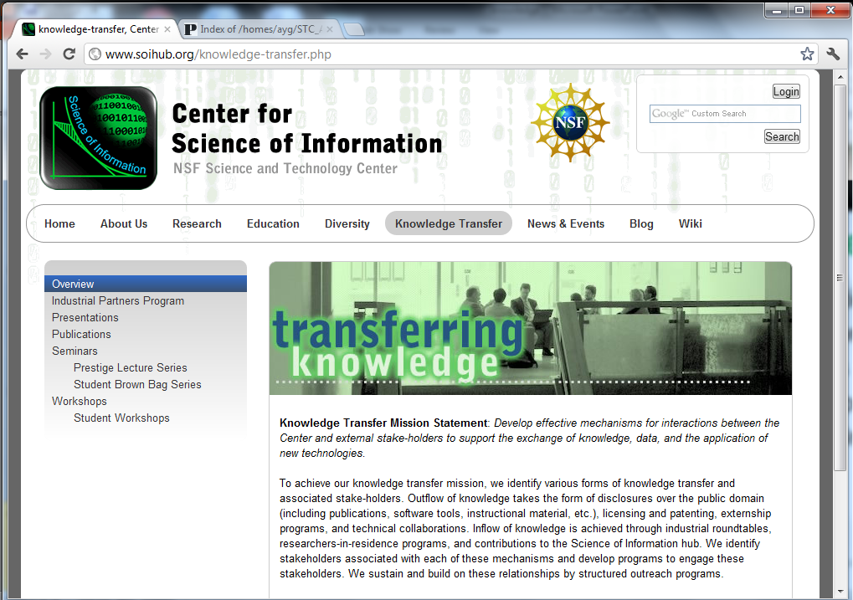
Soihub.org: Our Portal to the World
Presentations
Publications
Seminars
Workshops
Student Brown-Bag Series

Slide 5
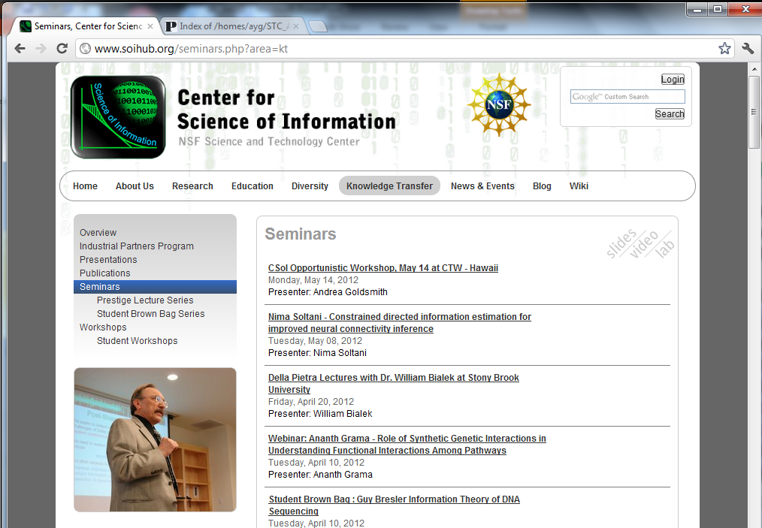
Soihub.org: Our Portal to the World
All lectures, brown-bag lunches are online live, and open to public.

Slide 6
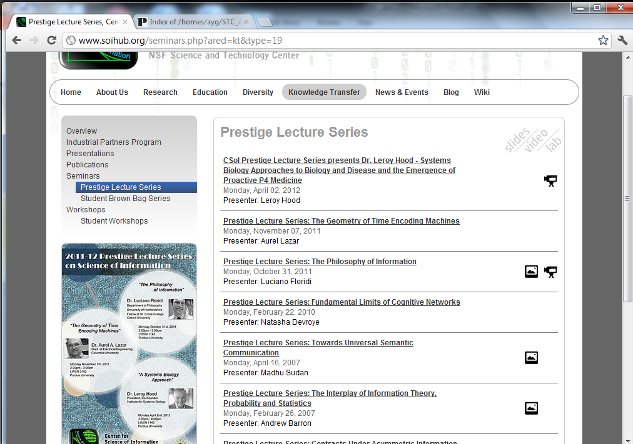
CSoI Prestige Lecture Series
Bringing industry and academic leaders to the Center.

Slide 7
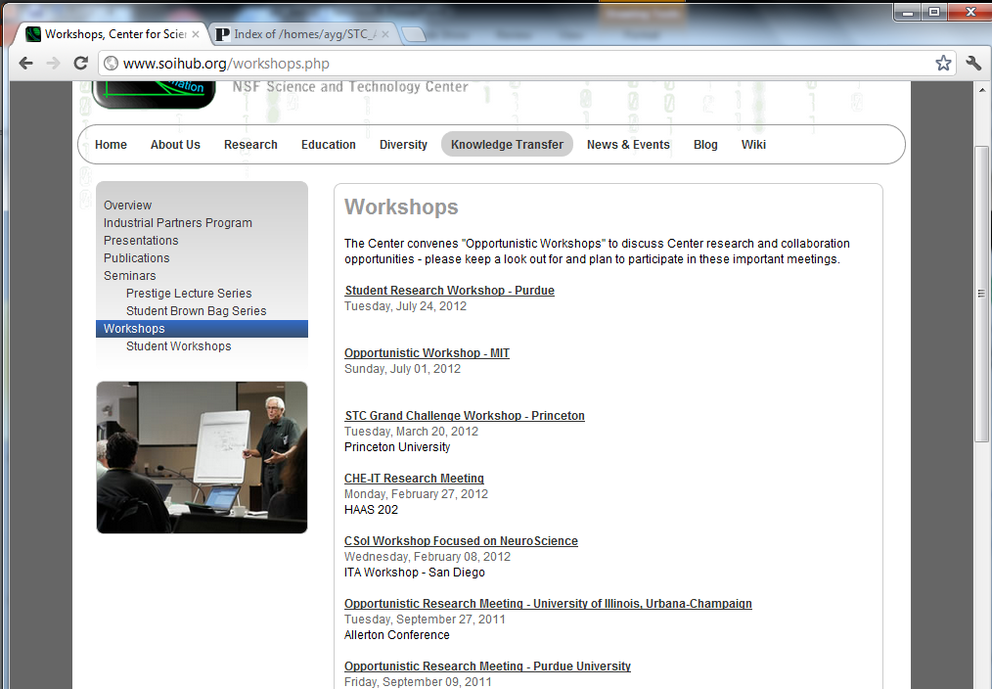
CSoI Workshop Series
Bringing students and researchers together for workshops

Slide 8
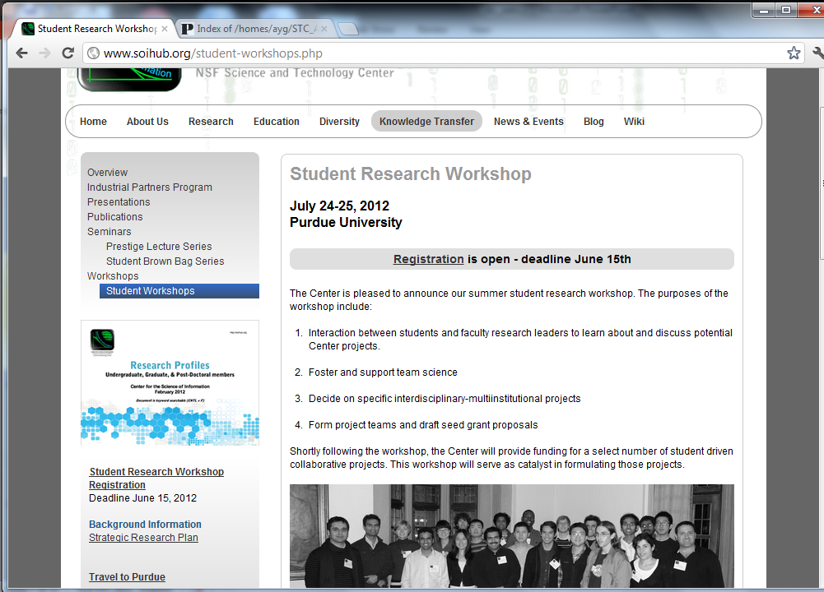
CSoI Student Workshops
Student-led workshops for center-wide interactions and collaborations

Slide 9
SoIHub: Continued Development
Soihub.org is fully functional. We continue to add new functionality and refining the site.
Wiki development and integration is complete. This provides seamless communication/collaboration tools within and outside of the Center.
Developing Computational Biology site – Integrating online project management tools for research community.
Soihub.org emphasizes events, news, video, Center resources, communications, E newsletter, presentations, and list of all Center personnel and connections to each person’s expertise.

Slide 10
Knowledge Transfer -- Education
Creating video based modules/ material available through you-tube channel targeting undergrads, grads, faculty and in-person training on how-to-use materials in the classroom (funded by NSF TUES grant)
Topics include probability theory, entropy, mathematical theory of communication, encoding and decoding, compression, and error correcting, among others.
Brown Bag Lunch – graduate student researchers share their individual research across the center on a monthly basis. Able to broadcast (live and recorded) over Adobe Connect.
All summer school lectures/tutorials are online (most popular educational content on site)

Slide 11
Reaching out to Industry
Externally sponsored research
Personnel exchange
Fellowships, internships, and other forms of support.

Slide 12
Industry Involvement
Partner | Title of Project | Center Participant
Eli Lilly | Bayesian Next Generation Sequencing Analysis Tools | Qi
Center researchers work closely with researchers at Eli Lilly on development of algorithms and tools for identifying novel somatic isoforms using tumor normal paired RNA-seq data.
Microsoft Res. | Characterizing Simplicity of Proofs in Program Verification | Jagannathan
To understand opportunities for proof reuse, optimization, and readability by precisely characterizing, in an information theoretic sense, simplicity measures in proof construction.
Hewlett Packard | Discrete Denoising | Weissman
Center researchers working with the information theory research group on the development of algorithms for recovering discrete data corrupted by discrete noise.

Slide 13
Industry Involvement
Huawei | Green Wireless | Goldsmith
Advising on the state-of-the-art in reducing energy consumption of backbone cellular infrastructure.
Ericsson | Learning for MIMO Cognitive Radio | Goldsmith
Collaboration (and personnel exchange) on blind null space learning in MIMO cognitive radios to allow them to coexist with primary users without interfering with them.
Microsoft Res. | Active Sampling Methods for Networks | Neville
Develop principled methods to learn predictive models for a partially observed network, while actively querying for information about unseen parts.
LLNL | Anomaly Detection for Dynamic Networks | Neville
Model node behavior in dynamic networks and their roles, and to automatically detect deviations from this behavior.

Slide 14
Industry Involvement
Google | Expertise Search in Complex Networks | Si
Integrate heterogeneous information sources to identify experts and expertise in networks.
Yahoo | An Integrated Probabilistic Model for Reach and Frequency | Si
Model the browsing behavior of web users for providing a predictive model for optimizing placement of online advertisements.
Abbott Labs | On Control of Crystal Morphology Towards Better Pharmaceutical Products | Doraiswami
Explore model-based control of supersaturation to manipulate crystal faces that increase bioavailability, and hence effectiveness of drugs.
HP | Lossless Compression for Large Alphabets | Szpankowski
Developing methodology to understand minimax redundancy for unbounded alphabets.

Slide 15
Industry Involvement
Google | Lossy Compression | Weissman
Working with members of the Google Geo team on image compression.
Samsung | Real-time and Limited Delay Compression and Error Correction | Weissman
Working with the Samsung Israel Research Lab on compression and error correction techniques with real-time constraints.

Slide 16
Industrial Partners Program
Excellent feedback from the first industry roundtable and from the EAB, leading to specific action items.
Follow-up meetings with a number of companies, more scheduled.
Negotiations with two organizations for funding specific initiatives at the Center.

Slide 17
Industry Involvement
Initiating a new Industry Leaders Seminar Series
Working with a number of companies on their problems, as they relate to the science of information.
Helping smaller companies frame their problems and assist them in SBIR/STTRs.

Slide 18
Thanks !
Questions?

