Slide 1
Exascale Computing: Challenges and Opportunities
Ahmed Sameh and Ananth Grama
NNSA/PRISM Center,
Purdue University

Slide 2
Path to Exascale
Hardware Evolution
Key Challenges for Hardware
System Software
  Runtime Systems
  Programming Interface/ Compilation Techniques
Algorithm Design
DoEs Efforts in Exascale Computing

Slide 3
Hardware Evolution
Processor/ Node Architecture
Coprocessors
  SIMD Units (GP GPUs)
  FPGAs
Memory/ I/O Considerations
Interconnects

Slide 4
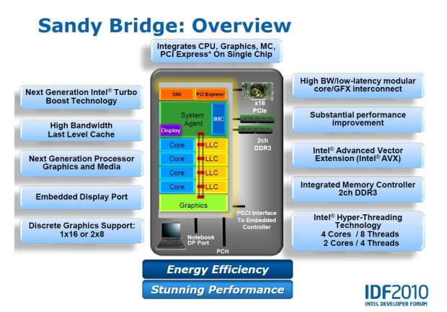
Processor/ Node Architectures
Intel Platforms: The Sandy Bridge Architecture
Up to 8 cores (16 threads), up to 3.8 GHz (turbo-boost), DDR3 1600 Memory at 51 GB/s, 64 KB L1 (3 cycles), 256 KB L2 (8 cycles), 20 MB L3.

Slide 5
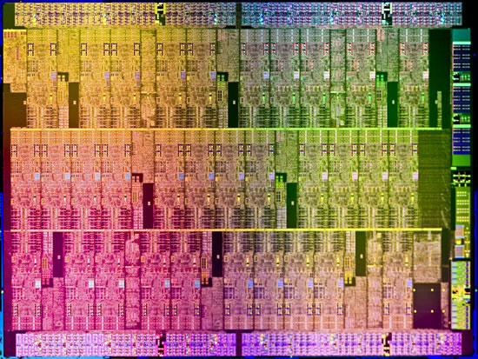
Processor/ Node Architectures
Intel Platforms: Knights Corner (MIC)
Over 50 cores, with each core operating at 1.2GHz, supported by 512-bit vector processing units, 8MB of cache, and four threads per core. It can be coupled with up to 2GB of GDDR5 memory. The chip uses the Sandy Bridge architecture, and will be manufactured using a 22nm process.

Slide 6
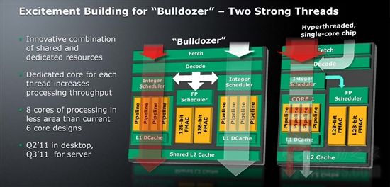
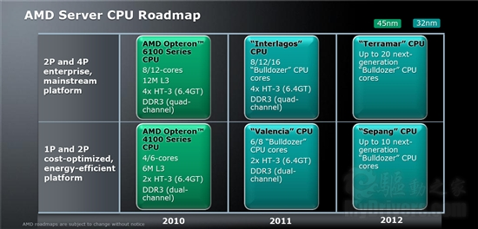
Processor/ Node Architectures
AMD Platforms

Slide 7
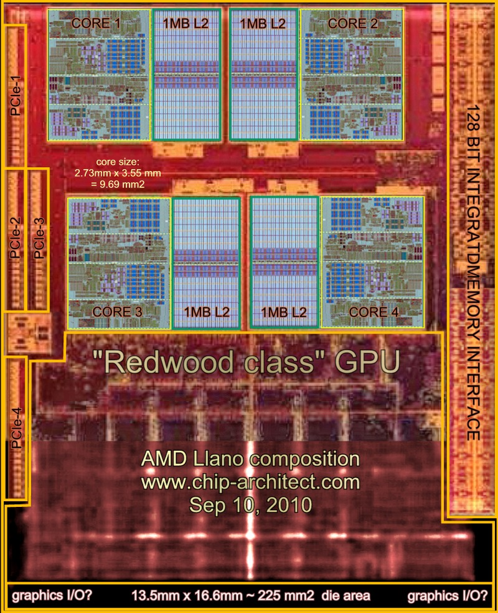
Processor/ Node Architectures
AMD Platforms: Llano APU
Four x86 Cores (Stars architecture), 1MB L2 on each core, GPU on chip with 480 stream processors.

Slide 8
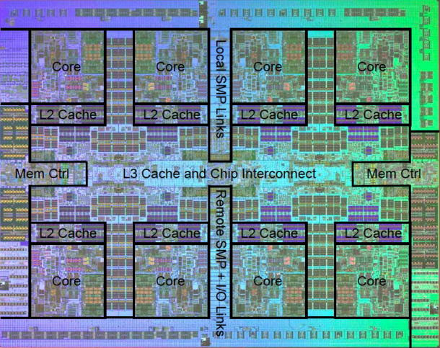
Processor/ Node Architectures
IBM Power 7.
Eight cores, up to 4.25 GHz, 32 threads, 32 KB L1 (2 cycles), 256 KB L2 (8 cycles), and 32 MB of L3 (embedded DRAM), up to 100 GB/s of memory bandwidth

Slide 9
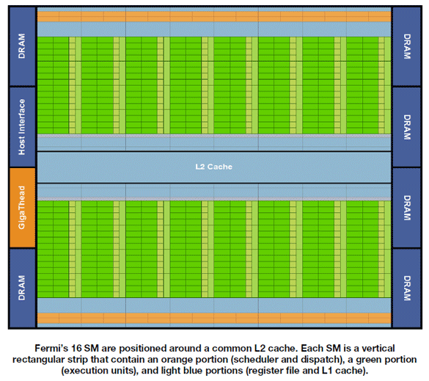
Coprocessor/GPU Architectures
nVidia Fermi (GeForce 590)/Kepler/Maxwell.
Sixteen streaming multiprocessors (SMs), each with 32 stream processors (512 CUDA cores), 48 KB/SM memory, 768KB L2, 772 MHz core, 3GB GDDR5, 1.6TFLOP peak

Slide 10
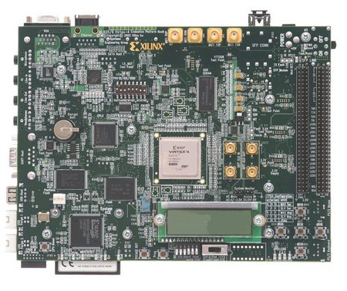
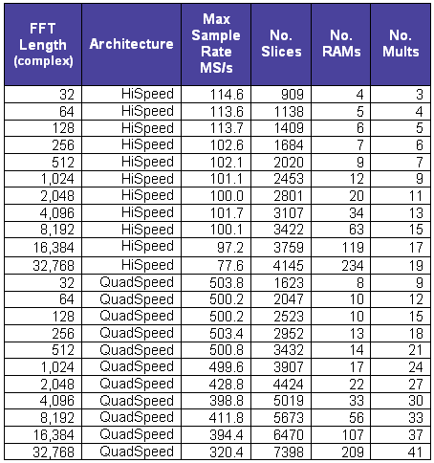
Coprocessor/FPGA Architectures
Xilinx/Altera/Lattice Semiconductor FPGAs typically interface to PCI/PCIe buses and can significantly accelerate compute-intensive applications by orders of magnitude.

Slide 11

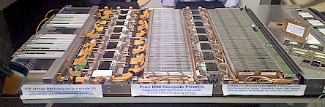
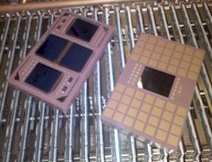
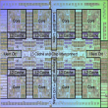
Petascale Parallel Architectures: Blue Waters
Blue Waters Building Block
32 IH server nodes
256 TF (peak)
32 TB memory
128 TB/s memory bw
4 Storage systems (>500 TB)
10 Tape drive connections
IH Server Node
8 QCM’s (256 cores)
8 TF (peak)
1 TB memory
4 TB/s memory bw
8 Hub chips
Power supplies
PCIe slots
Fully water cooled
Quad-chip Module
4 Power7 chips
128 GB memory
512 GB/s memory bw
1 TF (peak)
Hub Chip
1,128 GB/s bw
Power7 Chip
8 cores, 32 threads
L1, L2, L3 cache (32 MB)
Up to 256 GF (peak)
128 Gb/s memory bw
45 nm technology

Slide 12
Petascale Parallel Architectures: Blue Waters
Each MCM has a hub/switch chip.
The hub chip provides 192 GB/s to the directly connected POWER7 MCM; 336 GB/s to seven other nodes in the same drawer on copper connections; 240 GB/s to 24 nodes in the same supernode (composed of four drawers) on optical connections; 320 GB/s to other supernodes on optical connections; and 40 GB/s for general I/O, for a total of 1,128 GB/s peak bandwidth per hub chip.
System interconnect is a fully connected two-tier network. In the first tier, every node has a single hub/switch that is directly connected to the other 31 hub/switches in the same supernode. In the second tier, every supernode has a direct connection to every other supernode.

Slide 13
Petascale Parallel Architectures: Blue Waters
I/O and Data archive Systems
  Storage subsystems
    On-line disks: > 18 PB (usable)
    Archival tapes: Up to 500 PB
  Sustained disk transfer rate: > 1.5 TB/sec
  Fully integrated storage system: GPFS + HPSS

Slide 14
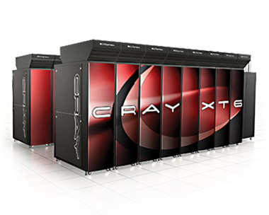
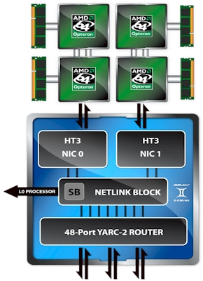
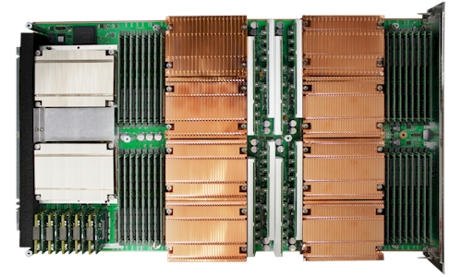
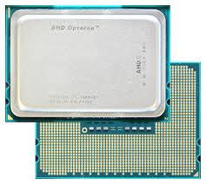
Petascale Parallel Architectures: XT6
Up to 192 cores (16 6100s) go into a rack, 2304 cores per system cabinet (12 racks) for 20 TFLOPS/cabinet. The largest current installation is a 20 cabinet installation at Edinburgh (roughly 360 TFLOPS).
Gemini Interconnect
Two Gemini interconnects on the left (which is the back of the blade), with four two-socket server nodes and their related memory banks

Slide 15
Current Petascale Platforms
ORNL NCSA LLNL
System Attribute Jag. (#1) Blue Wat. Sequoia
Vendor (Model) Cray (XT5) IBM (PERCS) IBM BG/Q
Processor AMD Opt. IBM Power7 PowerPC
Peak Perf. (PF) 2.3 ~10 ~20
Sustained Perf. (PF) ≳1
Cores/Chip 6 8 16
Processor Cores 224,256 >300,000 > 1.6M
Memory (TB) 299 ~1,200 ~1,600
On-line Disk Storage (PB) 5 >18 ~50
Disk Transfer (TB/sec) 0.24 >1.5 0.5-1.0
Archival Storage (PB) 20 up to 500
Dunning et al. 2010

Slide 16
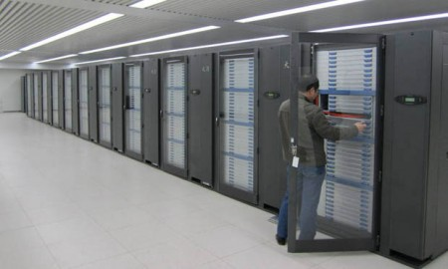
Heterogeneous Platforms: TianHe 1
14,336 Xeon X5670 processors and 7,168 Nvidia Tesla M2050 general purpose GPUs.
Theoretical peak performance of 4.701 petaFLOPS
112 cabinets, 12 storage cabinets, 6 communications cabinets, and 8 I/O cabinets.
Each cabinet is composed of four frames, each frame containing eight blades, plus a 16-port switching board.
Each blade is composed of two nodes, with each compute node containing two Xeon X5670 6-core processors and one Nvidia M2050 GPU processors.
2PB Disk and 262 TB RAM.
Arch interconnect links the server nodes together using optical-electric cables in a hybrid fat tree configuration.
The switch at the heart of Arch has a bi-directional bandwidth of 160 Gb/sec, a latency for a node hop of 1.57 microseconds, and an aggregate bandwidth of more than 61 Tb/sec.

Slide 17
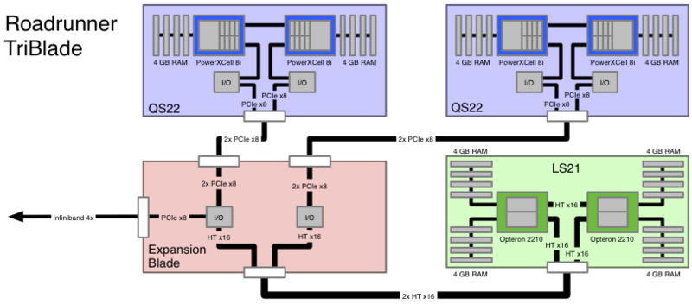
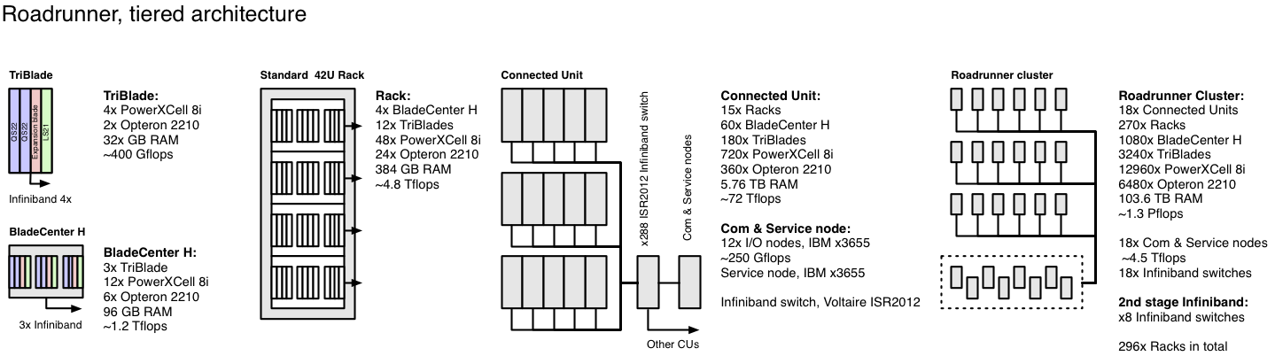
Heterogeneous Platforms: RoadRunner
13K Cell processors, 6500 Opteron 2210 processors, 103 TB RAM, 1.3 PFLOPS.

Slide 18
From 20 to 1000 PFLOPS
Several critical issues must be addressed in hardware, systems software, algorithms, and applications
  Power (GFLOPS/w)
  Fault Tolerance (MTBF and high component count)
  Runtime Systems, Programming Models, Compilation
  Scalable Algorithms
  Node Performance (esp. in view of limited memory)
  I/O (esp. in view of limited I/O bandwidth)
  Heterogeneity (application composition)
  Application Level Fault Tolerance
  (and many many others)

Slide 19
Exascale Hardware Challenges
DARPA Exascale Technology Study [Kogge et al.]
Evolutionary Strawmen
  “Heavyweight” Strawman based on commodity-derived microprocessors
  “Lightweight” Strawman based on custom microprocessors
Aggressive Strawman
  “Clean Sheet of Paper” CMOS Silicon

Slide 20
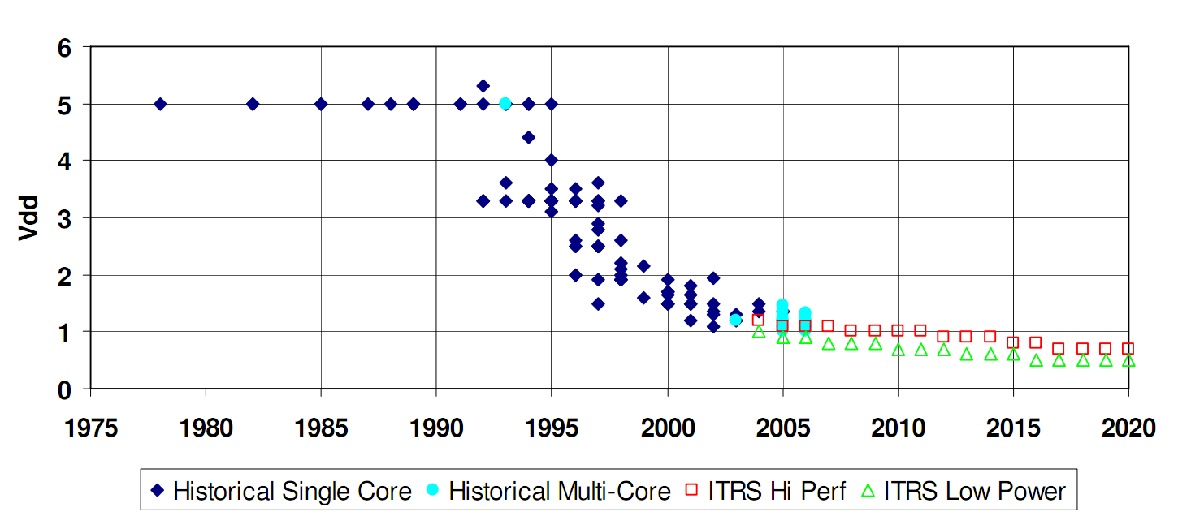
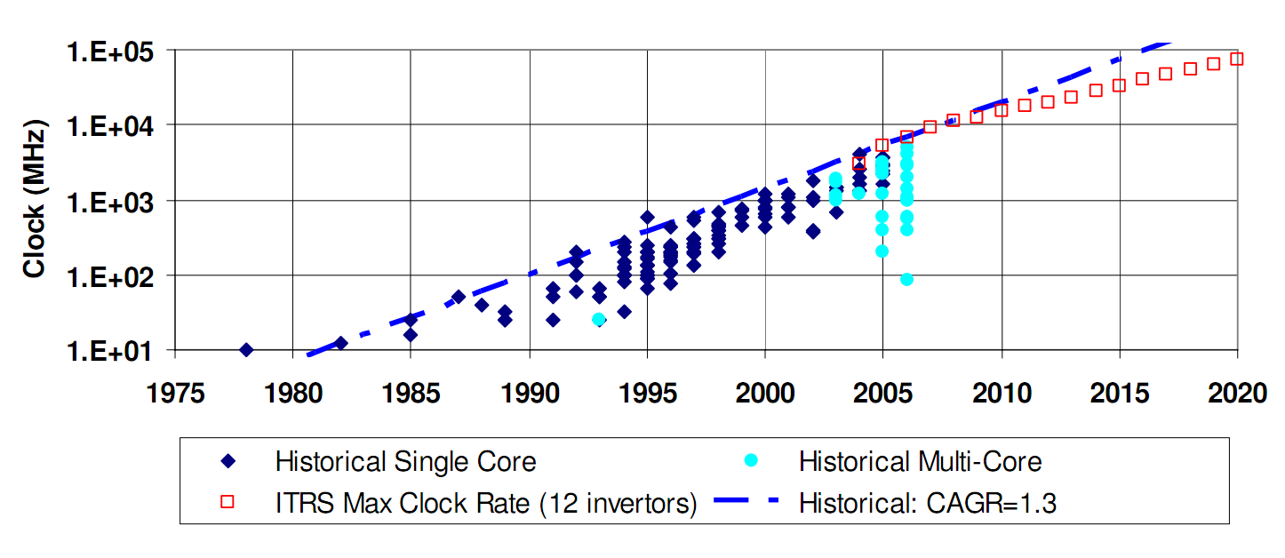
Exascale Hardware Challenges
Supply voltages are unlikely to reduce significantly.
Processor clocks are unlikely to increase significantly.

Slide 21
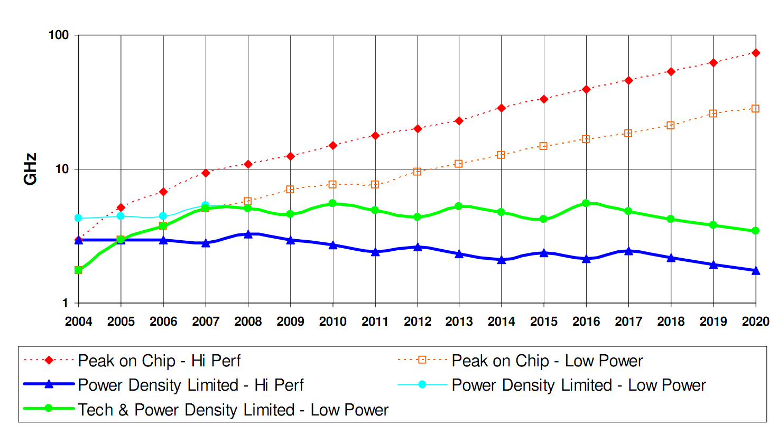
Exascale Hardware Challenges

Slide 22
Exascale Hardware Challenges
Silicon Area Distribution
Routers
Random
Memory
3%
8%
86%
Processors
Power Distribution
3%
Random
Memory
2%
9%
Routers
33%
Board Area Distribution
Memory
White
10%
Processors
Space
56%
50%
Processors
24%
Current HPC System Characteristics [Kogge]
Routers
Random
8%
8%

Slide 23
Exascale Hardware Challenges

Slide 24
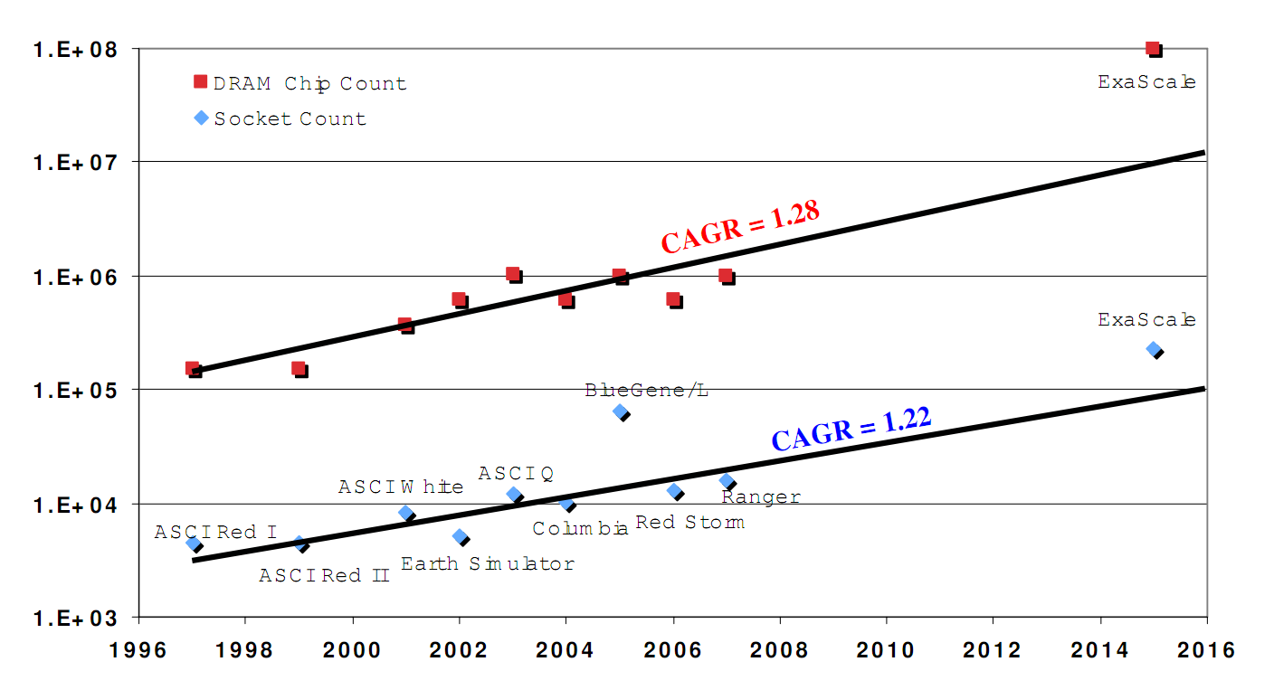
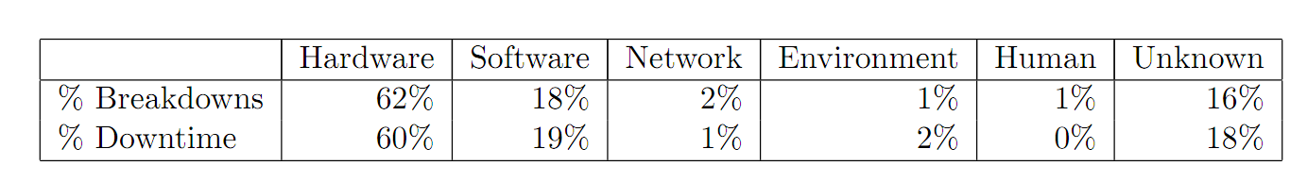
Faults and Fault Tolerance
Estimated chip counts in exascale systems
Failures in current terascale systems

Slide 25
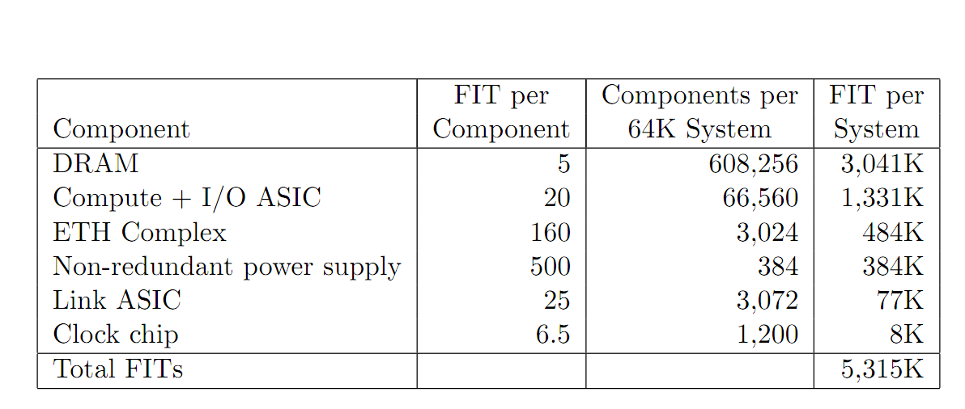
Faults and Fault Tolerance
Failures in time (10⁹ hours) for a current Blue-Gene system.

Slide 26
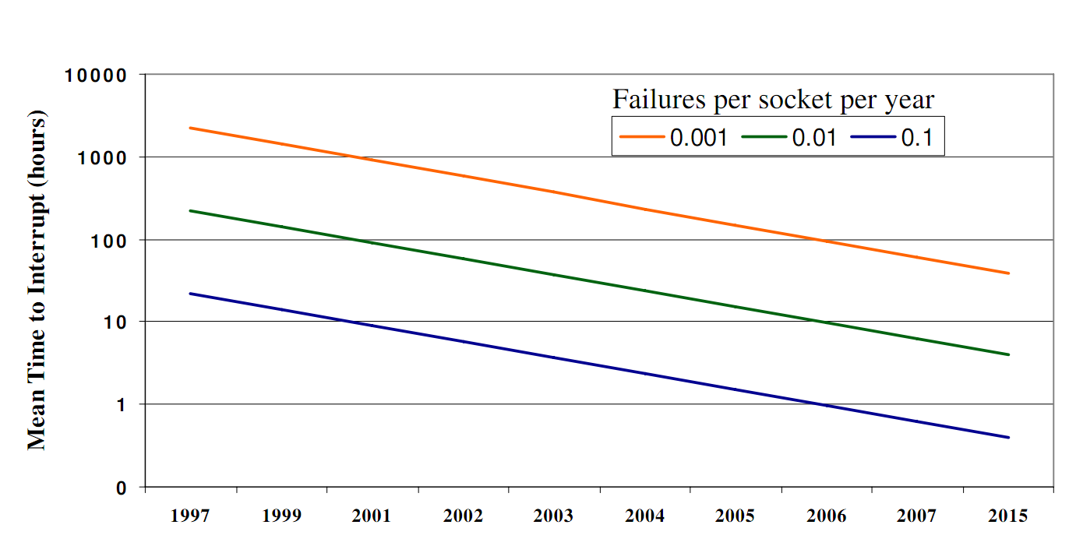
Faults and Fault Tolerance
Mean time to interrupt for a 220K socket system in 2015 results in a best case time of 24 mins!

Slide 27
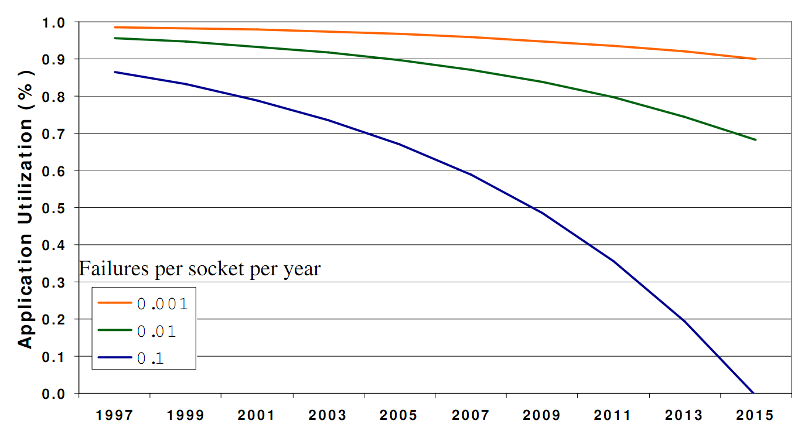
Faults and Fault Tolerance
At one socket failure on average every 10 years (!), application utilization drops to 0% at 220K sockets!

Slide 28
So what do we learn?
Power is a major consideration
Faults and fault tolerance are major issues
For these reasons, evolutionary path to exascale is unlikely to succeed
Constraints on power density constrain processor speed – thus emphasizing concurrency
Levels of concurrency needed to reach exascale are projected to be over 10⁹ cores.

Slide 29
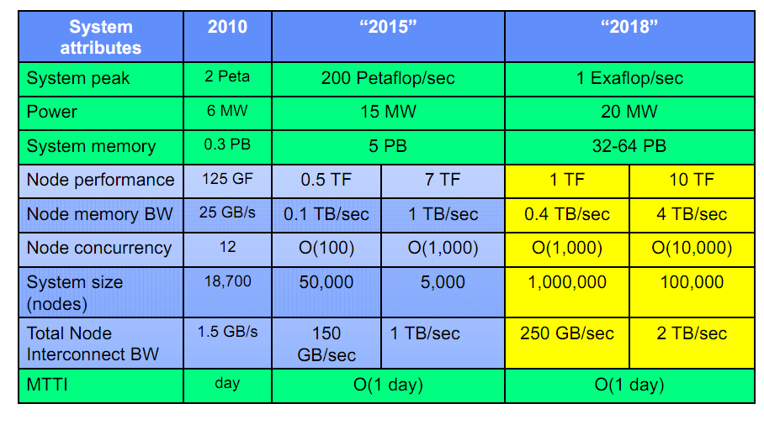
DoE’s View of Exascale Platforms

Slide 30
Exascale Computing Challenges
Programming Models, Compilers, and Runtime Systems
  Is CUDA/Pthreads/MPI the programming model of choice?
    Unlikely, considering heterogeneity
  Partitioned Global Arrays
  One Sided Communications (often underlie PGAs)
  Node Performance (autotuning libraries)
  Novel Models (fault-oblivious programming models)

Slide 31
Exascale Computing Challenges
Algorithms and Performance
  Need for extreme scalability (10⁸ cores and beyond)
    Consideration 0: Amdahl!
      Speedup is limited by 1/s, where s is the serial fraction of the computation
    Consideration 1: Useful work at each processor must amortize overhead
      Overhead (communication, synchronization) typically increases with number of processors
      In this case, constant work per processor (weak scaling) does not amortize overhead (resulting in reduced efficiency)

Slide 32
Exascale Computing Challenges
Algorithms and Performance: Scaling
  Memory constraints fundamentally limit scaling
    Emphasis on strong scaling performance
  Key challenges:
    Reducing global communications
    Increasing locality in a hierarchical fashion (off-chip, off-blade, off-rack, off-cluster)

Slide 33
Exascale Computing Challenges
Algorithms: Dealing with Faults
  Hardware and system software for fault tolerance may be inadequate (checkpointing in view of limited I/O bandwidth is infeasible)
  Application checkpointing may not be feasible either
  Can we design algorithms that are inherently oblivious to faults?

Slide 34
Exascale Computing Challenges
Input/Output, Data Analysis
  Constrained I/O bandwidth
  Unfavorable secondary storage/RAM ratio
  High latencies to remote disks
  Optimizations through system interconnect
  Integrated data analytics

Slide 35
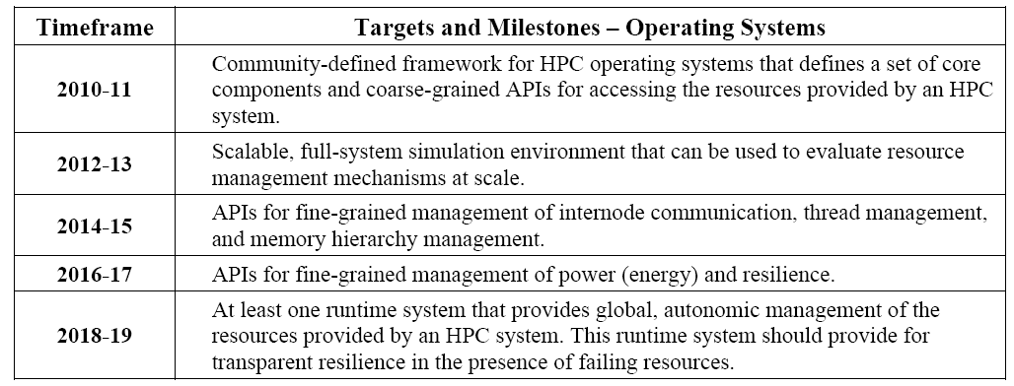
Exascale Computing Challenges www.exascale.org

Slide 36
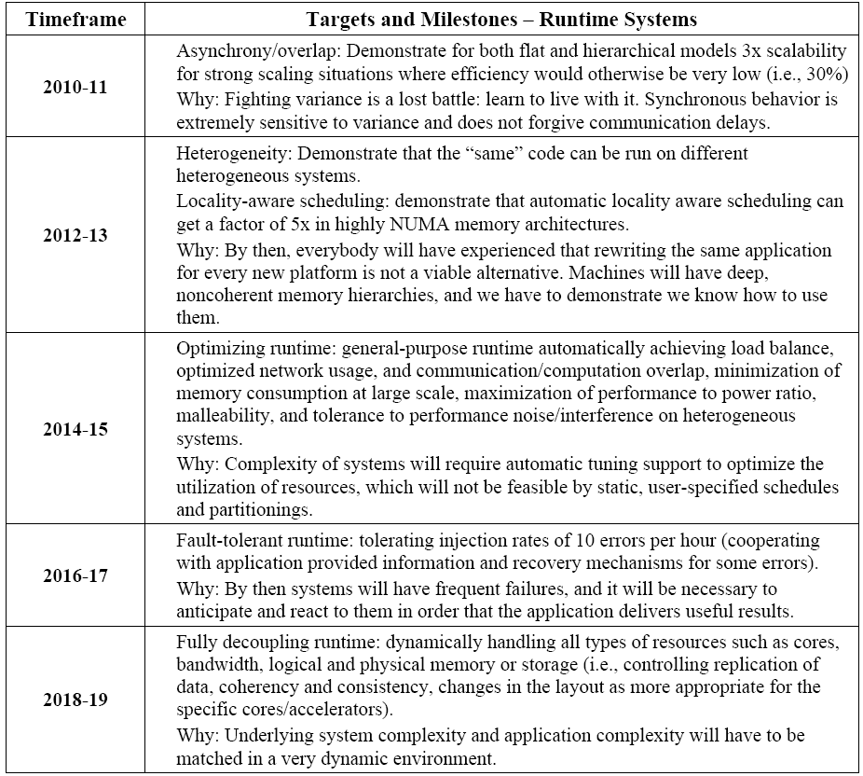
Exascale Computing Challenges

Slide 37
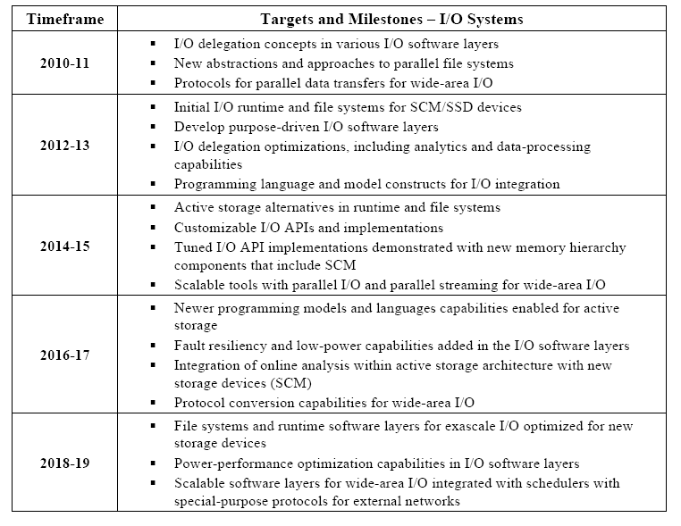
Exascale Computing Challenges

Slide 38
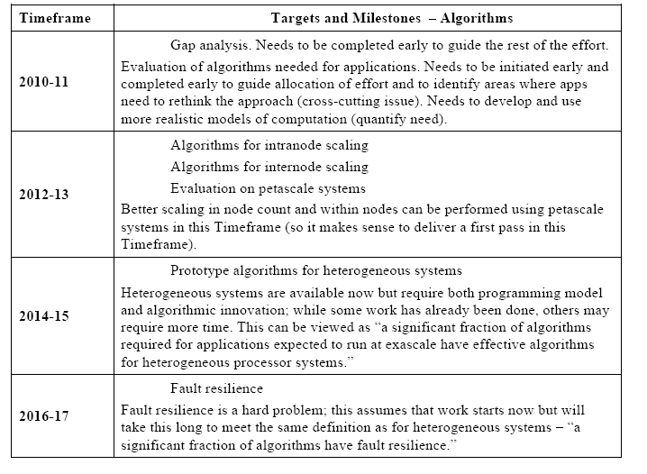
Exascale Computing Challenges

Slide 39
Exascale Consortia and Projects
DoE Workshops
  Challenges for the Understanding the Quantum Universe and the Role of Computing at the Extreme Scale (Dec ‘08)
  Forefront Questions in Nuclear Science and the Role of Computing at the Extreme Scale (Jan ‘09)
  Science Based Nuclear Energy Systems Enabled by Advanced Modeling and Simulation at the Extreme Scale (May ‘09)
  Opportunities in Biology at the Extreme Scale of Computing (Aug ‘09)
  Discovery in Basic Energy Sciences: The Role of Computing at the Extreme Scale (Aug ‘09)
  Architectures and Technology for Extreme Scale Computing (Dec ‘09)
    Cross-Cutting Technologies for Computing at the Exascale Workshop (Feb ‘10)
    The Role of Computing at the Extreme Scale/ National Security (Aug ‘10)
    http://www.er.doe.gov/ascr/ProgramDocuments/ProgDocs.html

Slide 40
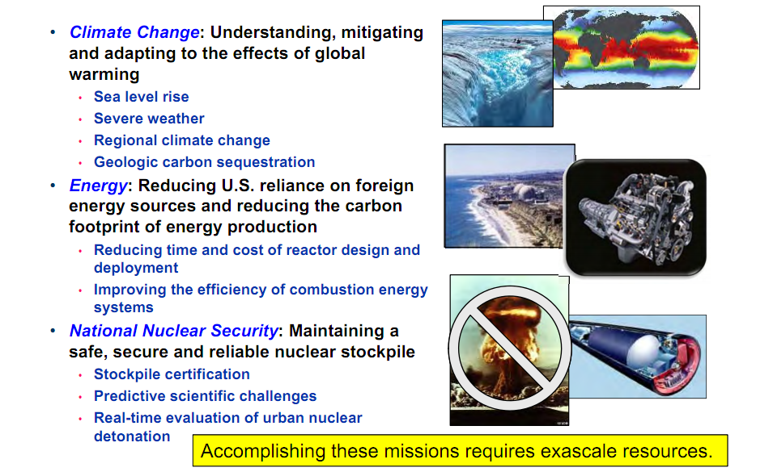
DoEs Exascale Investments: Driving Applications

Slide 41
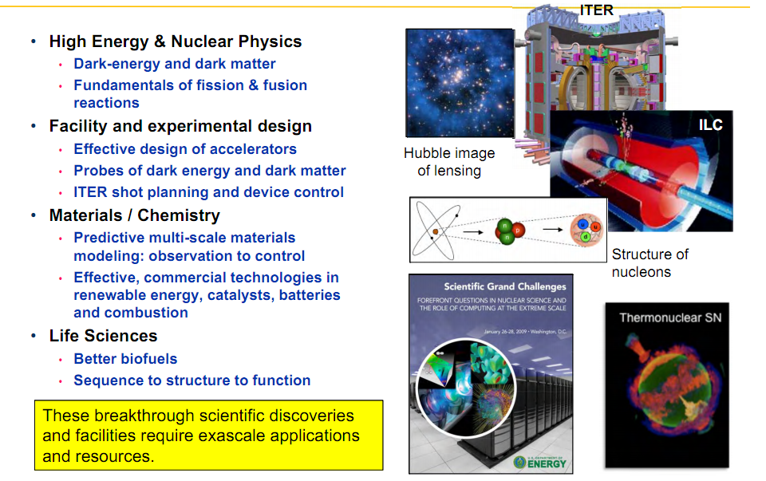
DoEs Exascale Investments: Driving Applications

Slide 42
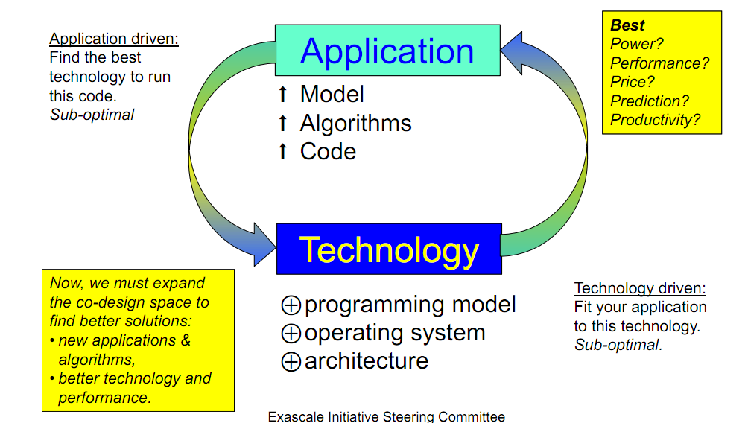
DoE’s Approach to Exascale Computations

Slide 43
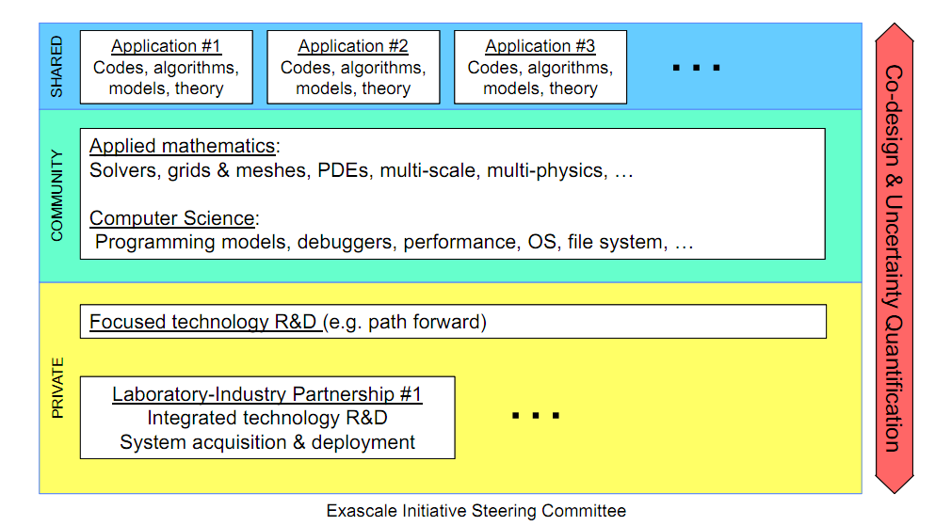
Scope of DoE’s Exascale Initiative

Slide 44

Budget 2012

Slide 45
Thank you!

