Slide 1
Reactive Molecular Dynamics: Progress Report
Hassan Metin Aktulga¹, Joseph Fogarty², Sagar Pandit², and Ananth Grama³
¹ Lawrence Berkeley Lab
² University of South Florida
³ Purdue University

Slide 2
Sequential Realization: SerialReax
Excellent per-timestep running time
efficient generation of neighbors lists
elimination of bond order derivative lists
cubic spline interpolation: for non-bonded interactions
highly optimized linear solver: for charge equilibration
Linear scaling memory footprint
fully dynamic and adaptive interaction lists
Related publication:
Reactive Molecular Dynamics: Numerical Methods and Algorithmic Techniques
H. M. Aktulga, S. A. Pandit, A. C. T. van Duin, A. Y. Grama
SIAM Journal on Scientific Computing (to appear)

Slide 3
Basic Solvers for QEq
Sample systems
bulk water: 6540 atoms, liquid
lipid bilayer system: 56,800 atoms, biological system
PETN crystal: 48,256 atoms, solid
Solvers: CG and GMRES
H has heavy diagonal: diagonal pre-conditioning
slowly evolving environment : extrapolation from prev. solutions
Poor Performance:
# of iterations = # of matrix-vector multiplications
actual running time in seconds
fraction of total computation time
tolerance level = 10⁻⁶
which is fairly satisfactory
due to cache effects
much worse at 10⁻¹⁰ tolerance level
more pronounced here

Slide 4
ILU-based preconditioning
ILU-based pre-conditioners: no fill-in, 10⁻² drop tolerance
effective (considering only the solve time)
no fill-in + threshold: nice scaling with system size
ILU factorization is expensive
bulk water system
cache effects are still evident
bilayer system
system/solver | time to compute preconditioner | solve time (s) | total time (s)
bulk water/ GMRES+ILU | 0.50 | 0.04 | 0.54
bulk water/ GMRES+diagonal | ~0 | 0.11 | 0.11

Slide 5
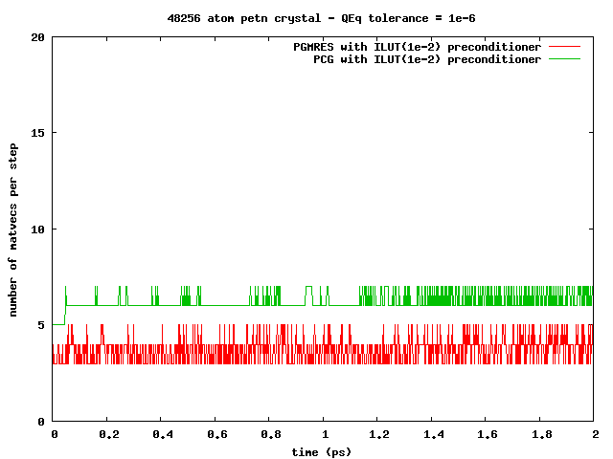
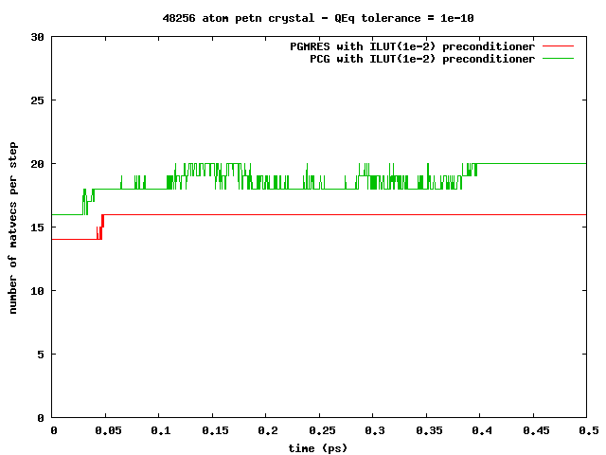
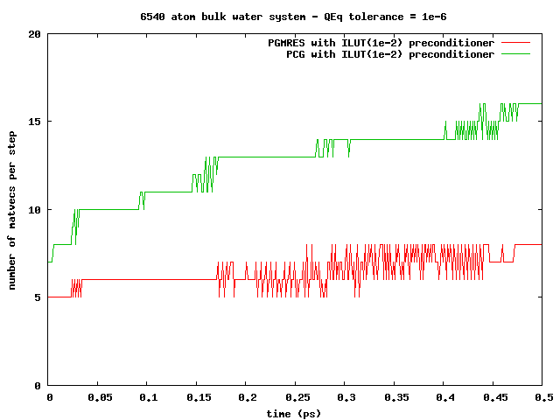
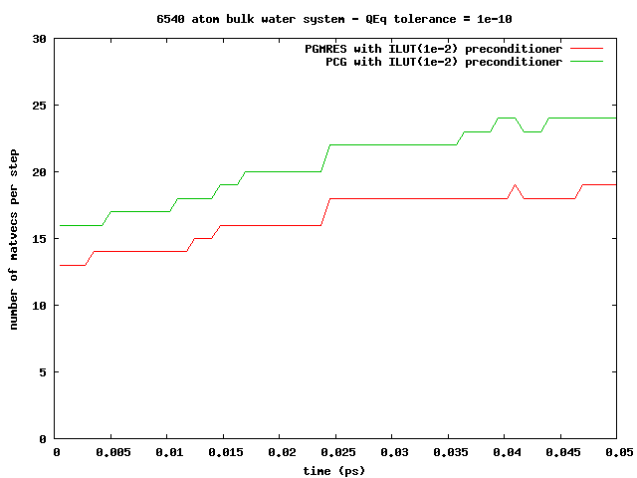
ILU-based preconditioning
Observation: can amortize the ILU factorization cost
slowly changing simulation environment ⇒re-usable pre-conditioners
PETN crystal:
solid, 1000s of steps!
Bulk water:
liquid, 10-100s of steps!

Slide 6
Memory Management
Compact data-structures
Dynamic and adaptive lists
initially: allocate after estimation
at every step: monitor & re-allocate if necessary
Low memory foot-print, linear scaling with system size
n-1
n
n-1
n
n-1’s data
n’s data
n-1’s data
n’s data
in CSR format
neighbors list
Qeq matrix
3-body intrs
reserved for n-1
reserved for n
in modified CSR
bonds list
hbonds list

Slide 7
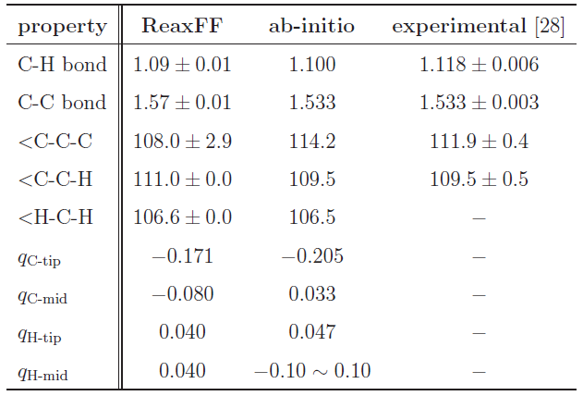
Validation
Hexane (C₆H₁₄) Structure Comparison
Excellent agreement!

Slide 8
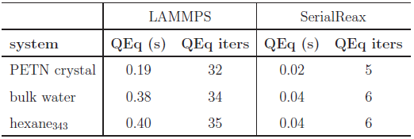
Comparison to LAMMPS-Reax
Time per time-step comparison
Qeq solver performance
Memory foot-print
different QEq formulations
similar results
LAMMPS:
CG / no preconditioner

Slide 9
Parallel Realization: PuReMD
Built on the SerialReax platform
Excellent per-timestep running time
Linear scaling memory footprint
Extends its capabilities to large systems, longer time-scales
Scalable algorithms and techniques
Demonstrated scaling to over 3K cores
Related publication:
Parallel Reactive Molecular Dynamics: Numerical Methods and Algorithmic Techniques
H. M. Aktulga, J. C. Fogarty, S. A. Pandit, A. Y. Grama
Parallel Computing (to appear)

Slide 10
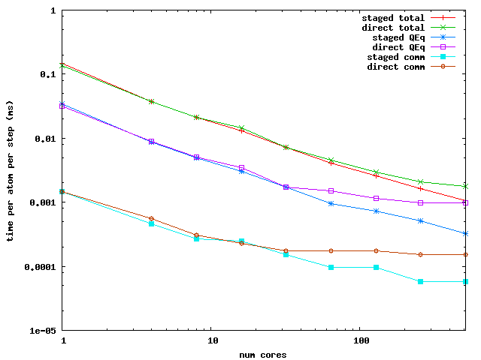
Parallelization: Messaging Performance
Performance Comparison: PuReMD with direct vs. staged messaging

Slide 11
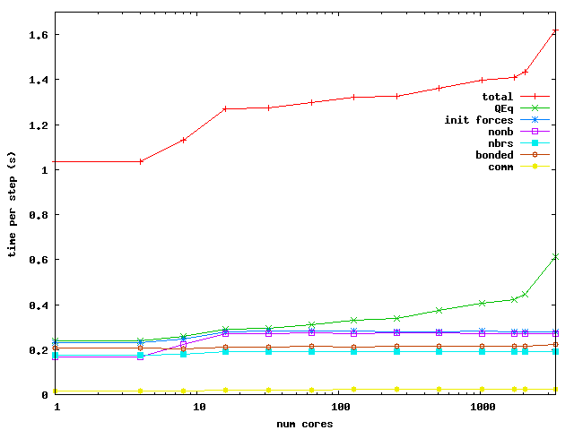
PuReMD: Weak Scaling
Bulk Water: 6540 atoms in a 40x40x40 A³ box / core

Slide 12
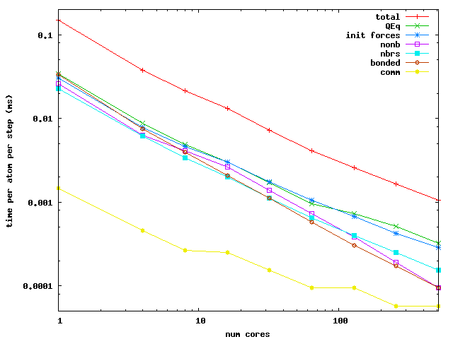
PuReMD: Strong Scaling
Bulk Water: 52320 atoms in a 80x80x80 A³ box

Slide 13
PuReMD: Integration Status
Purdue Reax fully integrated into LAMMPS (as of November 2010).
Active user and developer community.

Slide 14
Active LAMMPS-Reax User Community
Konstantin Shefov - Sankt-Peterburgskij Gosudarstvennyj Universitet
Camilo Calderon - Boston University
Ricardo Paupitz Barbosa dos Santos - Universidade Estadual de Maringa
Shawn Coleman - University of Arkansas
Paolo Valentini - University of Minnesota
Hengji Zhang - University of Texas at Dallas
Benjamin Jensen - Michigan Technological University
Xiao Dong Han - Beijing University
Robert Meissner - Fraunhofer Institute for Manufacturing Technology and Advanced Materials, Bremen
James Larentzos - High Performance Technologies, Inc. (HPTi)

Slide 15
Active LAMMPS-Reax User Community
Goddard et al., CalTech
Van Duin et al., PSU
Thompson, Plimpton, et al., Sandia
Pandit et al., USF
Buehler et al., MIT
Vashishtha et al., USC

Slide 16
Reax Forcefield Optimization
Utility of method dependent on fitness of forcefield
Reax requires high level of transferability - no site specific atom types
General Process:
Define parameters to be optimized
Choose training set systems and associated data
Define error between expected values and computed values
Minimize error by varying parameters

Slide 17
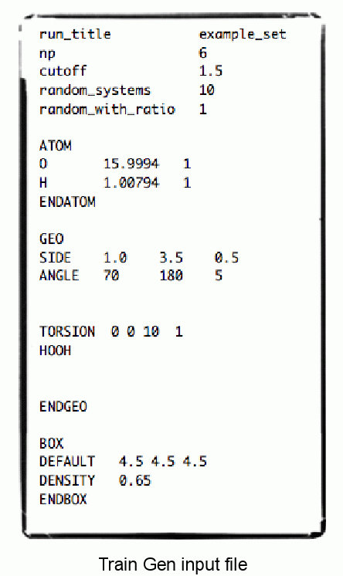
Reax Forcefield Optimization
Tool for automated generation of training sets
Input
Procedure
Generate Systems – Gaussian input files
Run various quantum calculations and geometry optimizations in Gaussian
Read Gaussian output and generate FFOpt input files

Slide 18
Training Set Generator (TrainGen): Systems
3-Body systems
Explore bond length and angle energy profiles
4-Body systems
For pre-optimized system, explore torsion energy profile
Random Systems
Randomly place atoms for a specified stoichiometric ratio and system size

Slide 19
TrainGen: Calculations
Single point energies using B3LYP for 3- and 4-body systems.
Geometry optimization followed by single point energy for random systems.
Multiple levels of increasing accuracy optimizations
Semi-empirical PM6 forcefield
B3LYP with increasing basis set size
For 3- and 4-body systems internal energies were compared
For random systems, internal energy, Mulliken partial charges, and Wiberg bond indices (bond order) were compared.

Slide 20
Force Field Optimizaiton: FFOpt
Automatic Force Field Refinement
Procedure:
Choose a parameter
Run simulations with parameter incremented, decremented, and unmodified.
Analyze results, compare with Gaussian data and generate an error value for each parameter value.
Fit a parabola, find the minimum, and analyze that value.
Choose parameter from among the four values.

Slide 21
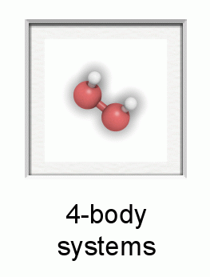
FFOpt: Status
All codes are developed and are currently being used.
FFOpt is running on systems with Oxygen and Hydrogen at this time (validation on water).

Slide 22
FFOpt: Forthcoming Developments
Validation of the refinement procedure
Full Optimization (multidimensional, highly nonlinear optimization)

