Slide 1
Center for
Science of Information
2012 External Advisory Board:
Overview & Management

Slide 2
Outline
Science of Information
Center Mission
  Integrated Research
  Education and Diversity
  Knowledge Transfer
  Future Activities
Management
  STC Team
  STC Staff
  Management Structure
Budget

Slide 3
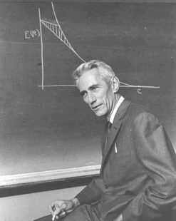
Shannon Legacy
The Information Revolution started in 1948, with the publication of:
A Mathematical Theory of Communication.
The digital age began.
Claude Shannon:
Shannon information quantifies the extent to which a recipient of data can reduce its statistical uncertainty.
“semantic aspects of communication are irrelevant . . .”
Applications Enabler/Driver:
CD, iPod, DVD, video games, Internet, Facebook, WiFi, mobile, Google, . .
Design Driver:
universal data compression, voiceband modems, CDMA, multiantenna, discrete denoising, space-time codes, cryptography, . . .

Slide 4
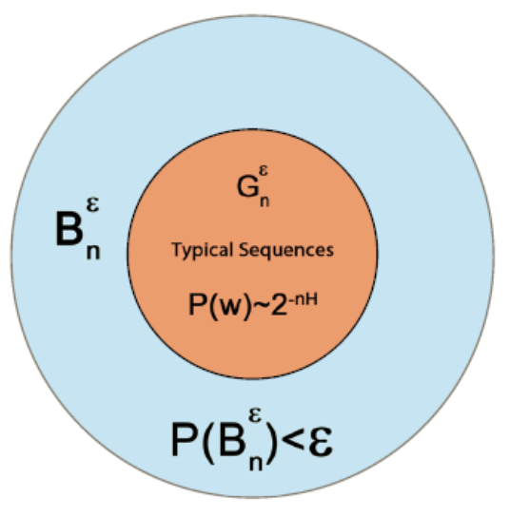
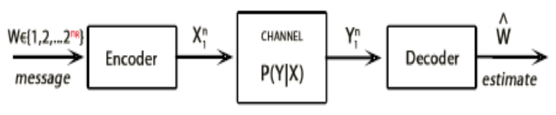
Three Theorems of Shannon
Theorem 1 & 3. [Shannon 1948; Lossless & Lossy Data Compression]
compression bit rate ≥ source entropy H(X)
for distortion level D:
lossy bit rate ≥ rate distortion function R(D)
Theorem 2. [Shannon 1948; Channel Coding]
In Shannon’s words:
It is possible to send information at the capacity through the channel with as small a frequency of errors as desired by proper (long) encoding. This statement is not true for any rate greater than the capacity.

Slide 5
Post-Shannon Challenges
Back from infinity: Extend Shannon findings to finite size data
structures (i.e., sequences, graphs), that is, develop information theory of
various data structures beyond first-order asymptotics.
Science of Information: Information Theory needs to meet new
challenges of current applications in
biology, communication, knowledge extraction, economics, …
In order to accomplish it we must understand new aspects of information in:
structure, time, space, and semantics,
and
dynamic information, limited resources, complexity, representation-invariant information, and cooperation & dependency.

Slide 6
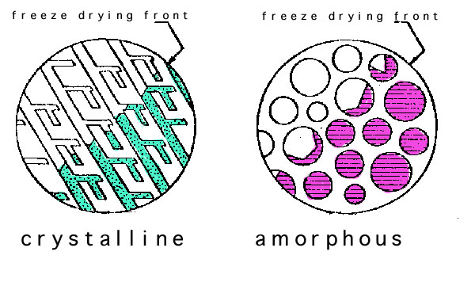
Post-Shannon Challenges
Structure:
Measures are needed for quantifying information embodied in structures (e.g., information in material structures, nanostructures, biomolecules, gene regulatory networks, protein networks, social networks, financial transactions).
Szpankowski & Choi : Information contained
in unlabeled graphs & universal graphical compression..
Grama & Subramaniam : quantifying role of noise and incomplete data in biological network reconstruction.
Neville: Outlining characteristics (e.g., weak dependence) sufficient for network models to be well-defined in the limit.
Yu & Qi: Finding distributions of latent structures in social networks.

Slide 7
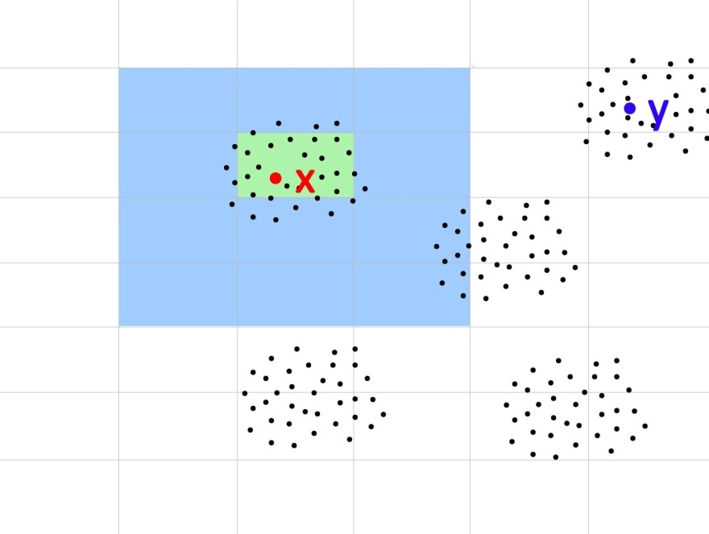
Post-Shannon Challenges
Time:
Classical Information Theory is at its weakest in
dealing with problems of delay (e.g., information
Arriving late may be useless of has less value).
Verdu & Polyanskiy : major breakthrough in extending Shannon capacity theorem to finite blocklength information theory.
Kumar: design reliable scheduling policies with delay
constraints for wireless networks.
Weissman : real time coding system to investigate the
impact of delay on expected distortion.
Subramaniam: reconstruct networks from dynamic biological data.
Ramkrishna: quantify fluxes in biological networks by
showing that enzyme metabolism is regulated by a survival strategy in controlling enzyme syntheses.
Space:
Bialek explores transmission of information in making spatial patterns in developing embryos – relation to
information capacity of a communication channel.

Slide 8
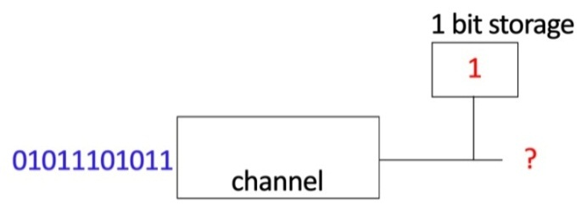
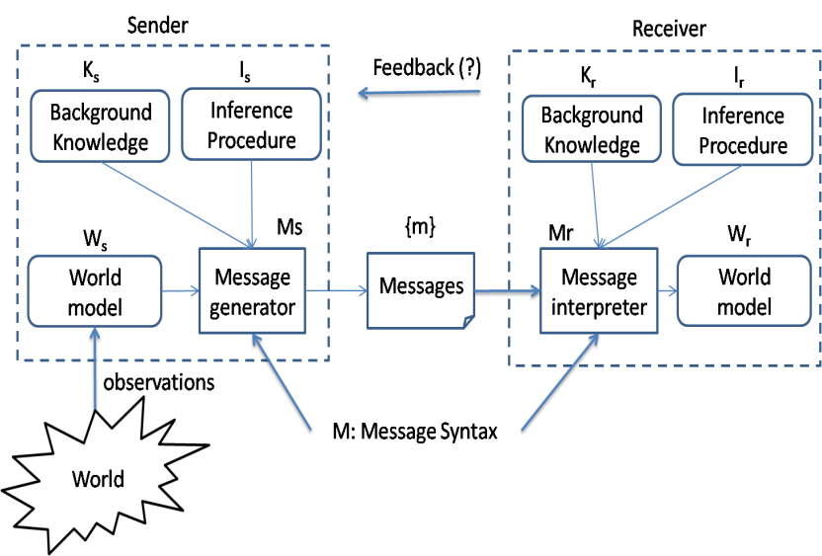
Post-Shannon Challenges
Limited Resources:
In many scenarios, information is limited by available computational resources (e.g., cell phone, living cell).
Bialek works on structure of molecular networks that optimize information flow, subject to constraints on the total number of molecules being used.
Verdu investigates the minimum energy per bit as a function of data length in Gaussian channels.
Semantics:
Is there a way to account for the meaning or
semantics of information?
Sudan argues that the meaning of information becomes relevant whenever there is diversity across communicating parties and when parties themselves evolve over time.

Slide 9
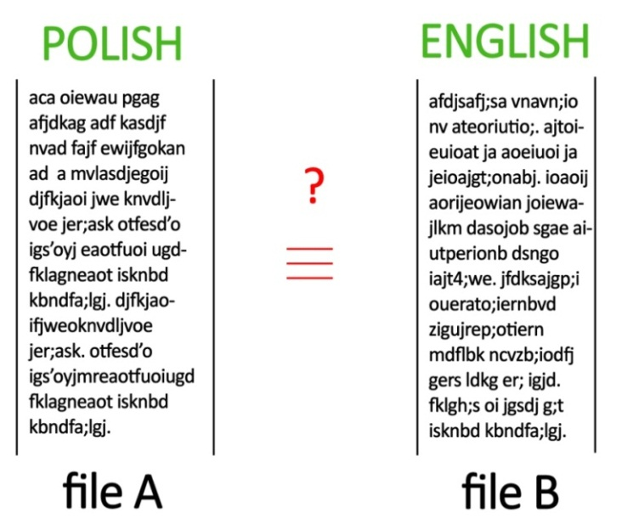
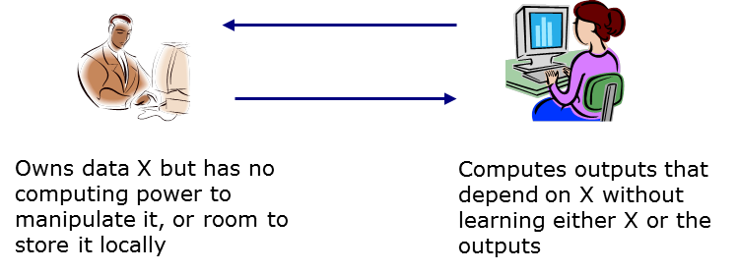
Post-Shannon Challenges
Representation-invariance:
How to know whether two representations of the
same information are information equivalent?
Learnable Information:
Data driven science focuses on extracting information from data. How much information can actually be extracted from a given data repository? How much knowledge is in Google's database?
Atallah investigates how to enable the untrusted remote server to store and manipulate the client's confidential data without learning it.
Clifton investigates differential privacy methods for graphs; to determine the conditions under which privacy is
practically achievable without rendering the data useless.

Slide 10
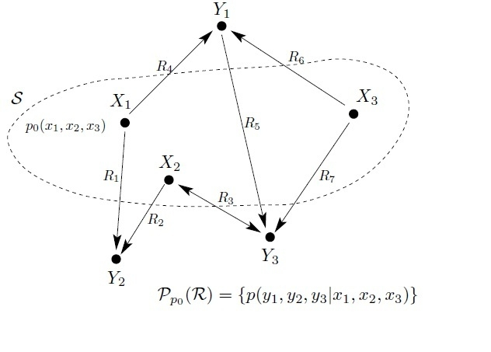

Post-Shannon Challenges
Cooperation & Dependency:
How does cooperation impact information (nodes should cooperate in their own self-interest)?
Cover initiates a theory of cooperation and coordination in networks, that is, they study the achievable joint distribution among network nodes, provided that the communication rates are given.
Dependency and rational expectation are critical ingredients in Sims' work on modern dynamic economic theory.
Coleman is studying statistical causality in neural systems by using Granger principles.
Quantum Information:
The flow of information in macroscopic systems and
microscopic systems may posses different characteristics.
Aaronson and Shor lead these investigations. Aaronson develops computational complexity of linear systems.

Slide 11


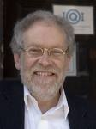
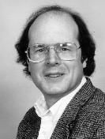
Standing on the Shoulders of Giants . . .
Manfred Eigen (Nobel Prize, 1967)
“The differentiable characteristic of the living systems is Information. Information theory, pioneered by Claude Shannon, cannot answer this question . . . in principle, the answer was formulated 130 years ago by Charles Darwin”.
P. Nurse, (Nature, 2008, “Life, Logic, and Information”):
Focusing on information flow will help to understand better how cells and organisms work. . . . spatial and temporal order, cell memory and reproduction are not fully understood.
A. Zeilinger (Nature, 2005)
. . . reality and information are two sides of the same coin, that is, they are in a deep sense indistinguishable.
C. Bennett (Logical depth, 1988):
``From the earliest days of information theory it has been appreciated that information is not a good message value.’’ … Value of message
lies in ``parts predictable only with difficulties, things that receiver could
figure out without being told …’’

Slide 12
Outline
Science of Information
Center Mission
  Integrated Research
  Education and Diversity
  Knowledge Transfer
  Future Activities
Management
  STC Team
  STC Staff
  Management Structure
Budget

Slide 13
Mission and Center Goals
Advance science and technology through a new quantitative understanding of the representation, communication and processing of information in biological, physical, social and engineering systems.
Some Specific Center’s Goals:
define core theoretical principles governing transfer of information,
develop metrics and methods for information,
apply to problems in physical and social sciences, and engineering,
offer a venue for multi-disciplinary long-term collaborations,
explore effective ways to educate students,
train the next generation of researchers,
broaden participation of underrepresented groups,
transfer advances in research to education and industry.

Slide 14
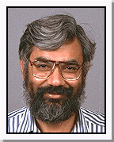
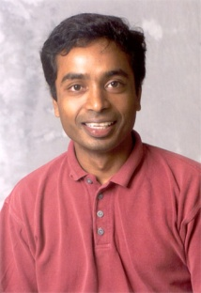
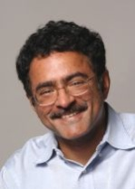
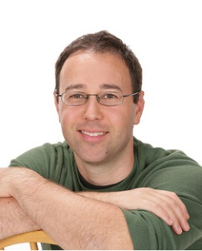
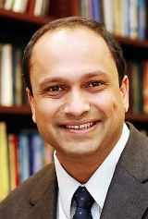
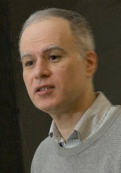
Integrated Research
Create a shared intellectual space, integral to the Center’s activities, providing a collaborative research environment that crosses disciplinary and institutional boundaries.
Research Thrusts:
1. Life Sciences
2. Communication
3. Knowledge Management
S. Subramaniam A. Grama
V. Anantharam T. Weissman
S. Kulkarni M. Atallah

Slide 15
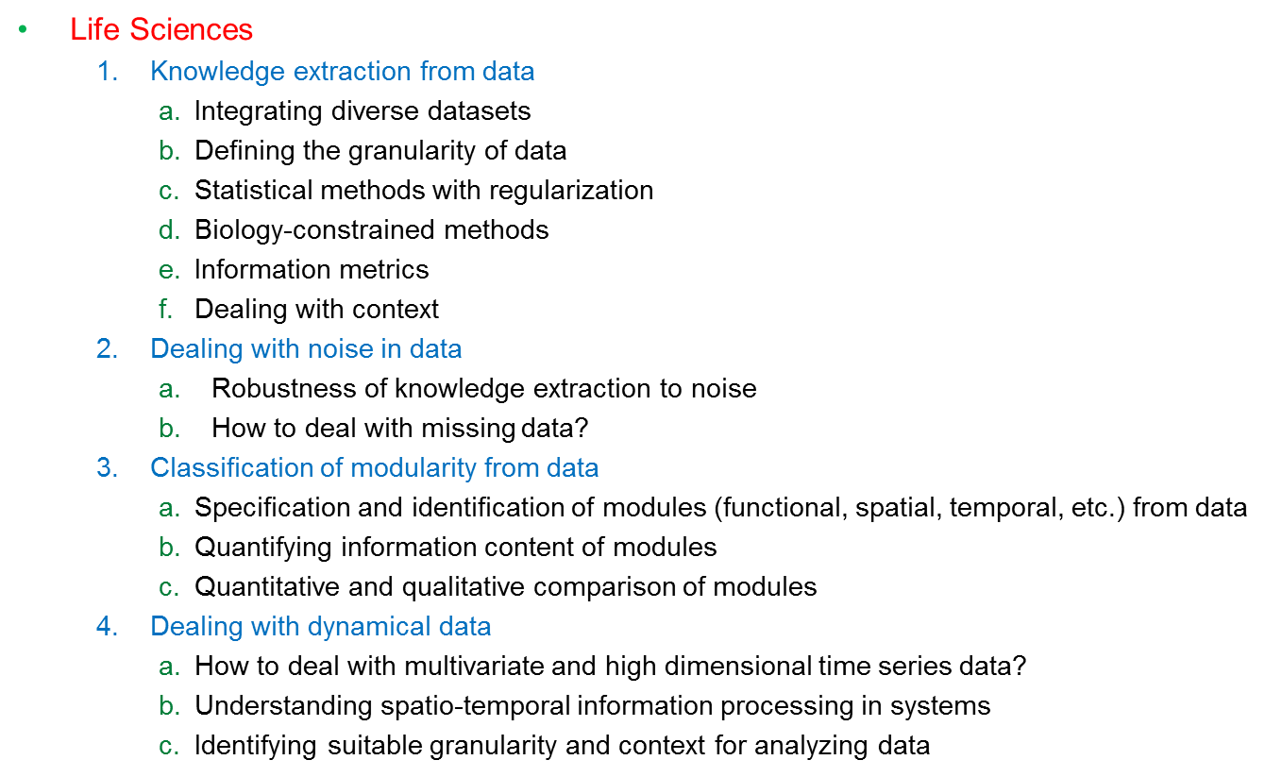
Life Science Thrust
(Berkeley, Princeton, Purdue, Stanford, UCSD)

Slide 16
Communication Thrust
Communication
  Delay in Information Theory
    Quantifying the temporal value of information
    Information theory for finite blocklengths
    Tradeoffs between delay, distortion, and reliability in feedback systems
  Information and computation
    Quantifying fundamental limits of in-network computation, and the computing capacity of networks for different functions
    Complexity of distributed computation in wireless and wired networks
    Information theoretic study of aggregation for scalable query processing in distributed databases
  New measures and notions of information
    Soft-information (beliefs) in rate distortion theory
    Semantics in information: framework, probabilistic modeling
    Modern communication networks
  Interface with life sciences thrust
    Furthering our information theoretic understanding of deletion, substitution, and insertion channels
    Information theoretic models for evolution
    Models for stimuli
    Communication models for intra-neuron signaling
    Models to predict the behavior of various systems, ranging from intra-cellular signaling, to tissues, individuals, colonies, and ecosystems
(Berkeley, MIT, Princeton, Purdue, Stanford, UIUC)

Slide 17
Knowledge Thrust
Knowledge Management (Berkeley, Bryn Mawr, MIT, Princeton, Purdue, Stanford,)
  Foundations of Learning, Inference, and Decision-Making
    Learnable information and information relevance
    Distributed learning
    Dynamics and control
    Robustness
  Privacy, Security, and Anonymity
    Collaborative versus competitive computing learning
    Scattered and hidden data
    Quantification
  Data Reduction
    Manifold learning
    Discovering relevant information
    Scalable methods
    Noisy, heterogeneous, distributed data
  Application thrusts
    Social networks
    Biological systems
    Economics
    Environmental modeling

Slide 18
Opportunistic Research Workshops
Kickoff Workshop – Chicago, IL – October 6-7, 2010 (28 STC participants and students)
1. Allerton Workshop, IL – September 28, 2010
(T. Coleman, S. Verdu, A. Goldsmith, P.R. Kumar, D. Tse, W. Szpankowski, students)
2. Stanford Workshop – Palo Alto, CA – January 24, 2011 (Princeton – Stanford –Berkeley)
(G. Bejerano, T. Cover, J. Gallant, A. Goldsmith, R. Rwebangira, G. Seroussi (HPL), W. Szpankowski, D. Tse, S. Verdu, M. Weinberger (HPL), T. Weissman, Bin Yu)
3. UC San Diego Workshop – February 11, 2011 (Berkeley – UCSD)
(O. Milenkovic, W. Szpankowski, S. Subramaniam, Bin Yu, students)
4. Princeton Workshop – May 13, 2011 (Princeton – Purdue)
(B. Bialek, Y. Baryshnikov, R. Rwebangira, C. Sims, W. Szpankowski, S. Verdu)
5. Purdue Workshop – September 9, 2011 (Berkeley – UCSD – Purdue)
6. Allerton Workshop – September 27, 2011 (Purdue –UIUC)
7. Future Workshops: UCSD, Stanford, MIT, …

Slide 19
Integrated Research - Metrics
Metrics for our integrative research efforts as developed for the strategic plan:
Formulate a small number of high-impact research problems.
Several problems were formulated during opportunistic workshops in life science and communication.
Identify two grand challenge problems in two years on a web bulletin board.
Big Question workshop is being planned for the Spring of 2012.
Conduct five investigator exchange visits for immersive activity
Several visits took place (e.g., Neville, P.R. Kumar, D. Kumar, Szpankowski, Verdu).
Initiate five new collaborations through joint supervision, student exchange, etc.
New collaboration: Ramkrishna leads Purdue, Berkeley and UCSD team. Subramaniam leads UCSD-Berkeley collaboration; Purdue & Berkeley (Neville & Yu); MIT-Princeton (Polyanskiy & Verdu); Stanford-Princeton (Weissman-Verdu)
Develop proposals for sustained external funding within five years.
Templeton Foundation considers funding science of information program; NSF TUES, AFOSR, etc.
Develop two pedagogical resources (e.g. books, survey, papers, lecture series) at the interface of applications and theory in two years.
Honors class, Prestige Lecture Series, summer schools.

Slide 20
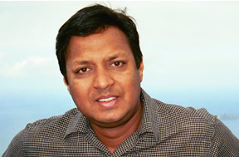
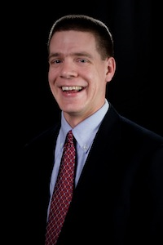
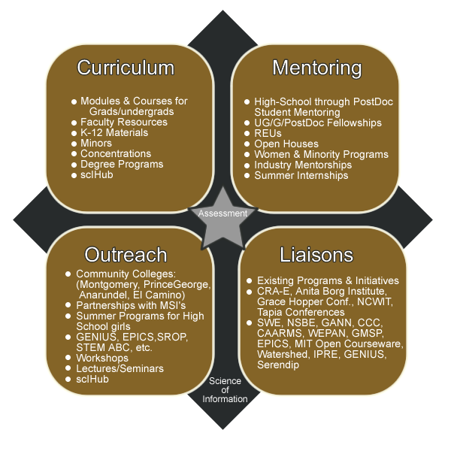
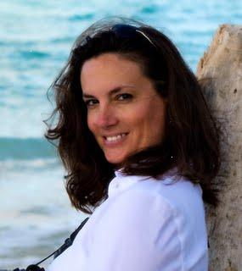
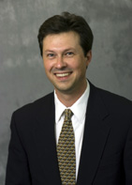
Education and Diversity
Integrate cutting-edge, multidisciplinary research and education efforts across the center to advance the training and diversity of the work force
D. Kumar
M. Ward
B. Gibson
B. Ladd
Summer School, Purdue, May 2011 (Stanford, 2012)
HONR 399: Intro to Science of Information

Slide 21
Knowledge Transfer
Develop effective mechanism for interactions between the center and external stakeholder to support the exchange of knowledge, data, and application of new technology.
Industrial affiliate program in the form of consortium:
  Considerable intellectual resources
  Access to students and post-docs
  Access to intellectual property
  Shape center research agenda
  Solve real-world problems
  Industrial perspective
  Knowledge Transfer Director: Ananth Grama
  (Industrial Workshop, Purdue, April, 2011)

Slide 22
Future Scheduled Activities
Two Center-wide post-docs
Semi-annual student workshops (students’ council)
Center-wide solicitation for collaborative research support
Annual summer school (Stanford, 2012, Purdue 2013, UCSD 2014)
Science of Information courses (at partner institutions 2012+)
CHANNELS Program (broadening participation with STEM)
Seminar series & workshops (virtual over the center; Prestige Lecture)
8. Big Question workshop (Spring 2012)

Slide 23
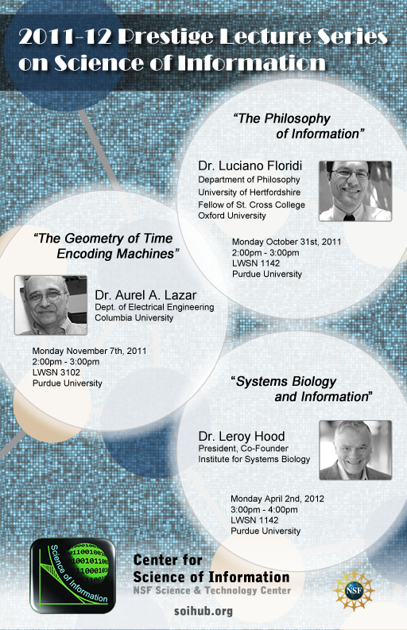
Prestige Lecture Series

Slide 24
Outline
Science of Information
Center Mission
  Integrated Research
  Education and Diversity
  Knowledge Transfer
  Future Activities
Management
  STC Team
  STC Staff
  Management Structure
Budget

Slide 25

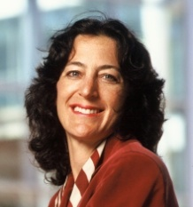
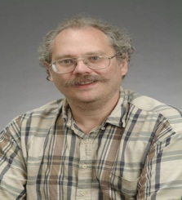
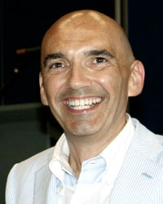
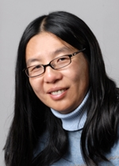
STC Team
Bryn Mawr College: D. Kumar
Howard University: C. Liu, L. Burge
MIT: P. Shor (co-PI), M. Sudan (Microsoft)
Purdue University (lead): W. Szpankowski (PI)
Princeton University: S. Verdu (co-PI)
Stanford University: A. Goldsmith (co-PI)
Texas A&M: P.R. Kumar
University of California, Berkeley: Bin Yu (co-PI)
University of California, San Diego: S. Subramaniam
UIUC: O. Milenkovic.
Wojciech Szpankowski,
Purdue
Andrea Goldsmith,
Stanford
Peter Shor,
MIT
Sergio Verdú,
Princeton
R. Aguilar, M. Atallah, C. Clifton, S. Datta, A. Grama, S. Jagannathan, A. Mathur, J. Neville, D. Ramkrishna, J. Rice, Z. Pizlo, L. Si, V. Rego, A. Qi, M. Ward, D. Blank, D. Xu, C. Liu, L. Burge, M. Garuba, S. Aaronson, N. Lynch, R. Rivest, Y. Polyanskiy, W. Bialek, S. Kulkarni, C. Sims, G. Bejerano, T. Cover, T. Weissman, V. Anantharam, J. Gallant, C. Kaufman, D. Tse,T.Coleman.
Bin Yu,
U.C. Berkeley

Slide 26
Center Participant Awards
Nobel Prize (Economics): Chris Sims
National Academies (NAS/NAE) -- Cover, Lynch, Kumar, Ramkrishna, Rice, Rivest, Shor, Sims, Verdu.
Turing award winner -- Rivest.
Shannon award winners -- Cover and Verdu.
Nevanlinna Prize (outstanding contributions in Mathematical Aspects of Information Sciences) -- Sudan and Shor.
Richard W. Hamming Medal – Cover and Verdu.
Humboldt Research Award -- Szpankowski.

Slide 27
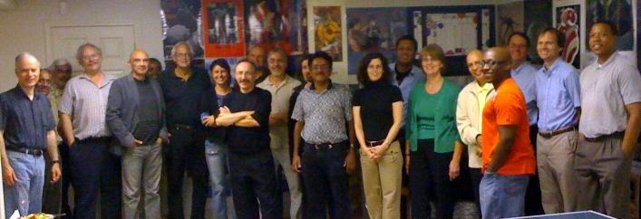
… the night before the first NSF site visit

Slide 28

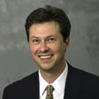

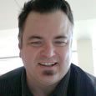
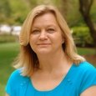
STC Staff
Director – Wojciech Szpankowski
Managing Director – Bob Brown
Education Director – Brent Ladd
Diversity Director – Barbara Gibson
Multimedia Specialist – Mike Atwell
Administrative Asst. – Mari-Ellyn Brock
Bob Brown
Managing Director
Education Director
Brent Ladd
Barbara Gibson,
Diversity Director
Multimedia Specialist
Mike Atwell
Administrative Asst.
Mari-Ellyn Brock

Slide 29
Management Objectives
To provide mechanisms for synergistic research and development of foundational principles, methods, and applications of post-Shannon information theory.
To educate and train the next generation of information sciences practitioners
To deeply engage students, researchers, and affiliated personnel from underrepresented groups in all aspects of the project.
To facilitate seamless transfer of knowledge to the broader academic and commercial world.

Slide 30
Management Structure
Vice President for Research
Purdue University
External Advisory Committee
J. Gibson, J. Bruck, M. Guzdial, J.F. Frias, A. Karlin, W. Levy, N. Shroff
Executive Committee
A. Grama, PR Kumar,
A. Goldsmith, D. Kumar,
S. Subramaniam, P. Shor,
S. Verdu, B. Yu
Director
Wojciech Szpankowski
Internal Management Committee
J. Rice, Z. Pizlo,
D. Ramkrishna, M.D. Ward
Associate Directors
A. Grama, D. Kumar, M. D. Ward
Managing Director
B. Brown
Multimedia Specialist
M. Atwell
Administrative Assistant
M.E. Brock
Technical Thrusts
Education
Director:
B.T. Ladd
Diversity
Director:
B. Gibson
Knowledge Transfer
A. Grama
Biology
S. Subrmaniam
Communication
T. Weissman
Knowledge
S. Kulkarni

Slide 31
Executive Committee
Composition:
  Advisory to the Center’s Director
  Center leadership
  Chair of the Executive Committee is not the Director of the Center.
Coordination:
  Often meetings conducted through telephone and/or video conference
  Senior personnel from projects and managing director attend by invitation as needed.
  Manage new and ongoing projects; deal with issues that have arisen, and discuss possible future directions (fiscal and intellectual)
  Action items from meeting are distributed within a week

Slide 32
Project Management
Projects within the Center are managed by the Center Director, Manager
and Executive Committee via management, solicitation, and assessment:
  Track progress of each project
  Ensure progress toward foundational aspects
  Terminate projects no longer relevant or demonstrating insufficient progress
  Evaluate the success of collaborative investigations.
Metrics (letter from ExC sent in December 2010)
  Publication of quality peer-reviewed papers
  Collaborations between investigators, e.g., joint publications and grants
  Development of educational material that illustrate fundamental developments in the domain
  Assessment of progress reports by the peers within the Center

Slide 33


Slide 34



Slide 35
External Advisory Board
Composition:
reflects diversity of scientific domains within the Center:
  J. Gibson (Chair), J. Bruck, M. Guzdial, J.F. Frias, C. Heegard, A. Karlin, W. Levy,
  N. Shroff
Coordination
  External Advisory Board receives annual progress reports from the Managing Director
  In-person meeting at the annual “all hands” meeting of the Center. This meeting provides a forum for a high quality, detailed appraisal of the Center’s progress (first meeting: August 2011)

Slide 36
Outline
Science of Information
Center Mission
  Integrated Research
  Education and Diversity
  Knowledge Transfer
  Future Activities
Management
  STC Team
  STC Staff
  Management Structure
Budget

Slide 37
Budget Summary
$5M/year:
Student Support (53+22) Post Docs (12)
Faculty Support (39) Visitors & Collaborators
Education Director Diversity Director
Managing Director Administrative Assistance
Travel Workshops
Advisory Committee Visitors, Speakers, etc
Summer School Collaborators
Cost Sharing: Students, Faculty Support, ITaP,
Managing Director, Space

Slide 38
Breakout of NSF Funding –Period 3

Slide 39
Faculty vs Students
39 research faculty, 53 graduate, 22 undergrads, 12 post-doc (101 total 2010-2011).
Center cohort (financially supported): 30 women (29.7%), 71 men (70%), 23 U.S. Citizens (30%), 10 minority (10%).

Slide 40
Period 1 Funding Model

Slide 41
Period 2 Funding Model

Slide 42
Period 3 Funding Model

Slide 43
Cost Sharing

