Slide 1
Center for Science of Information
STC Directors Meeting, Aug 2012
Center Highlights
Wojciech Szpankowski/ Ananth Grama

Slide 2
Outline
Center Overview
Center Mission
Integrated Research
Education and Diversity
Knowledge Transfer
Planned Activities

Slide 3
Post-Shannon Challenges
Science of Information: Information Theory needs to meet new
challenges of current applications in
biology, communication, knowledge extraction, economics, …
In order to accomplish it we must understand new aspects of information in:
structure, time, space, and semantics,
and
dynamic information, limited resources, complexity, representation-invariant information, and cooperation & dependency.

Slide 4
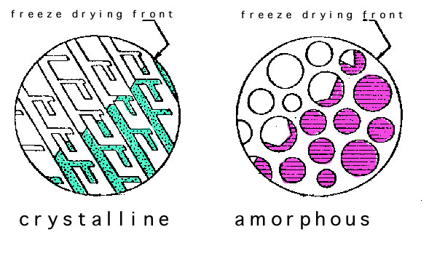
Post-Shannon Challenges
Structure:
Measures are needed for quantifying information embodied in structures (e.g., information in material structures, nanostructures, biomolecules, gene regulatory networks, protein networks, social networks, financial transactions).
Szpankowski & Choi : Information contained
in networks and universal graphical compression.
Grama & Subramaniam : quantifying role of noise and incomplete data in biological network reconstruction.
Neville: Defining characteristics (e.g., weak dependence) sufficient for network models to be well-defined in the limit.
Yu & Qi: Finding distributions of latent structures in social networks.

Slide 5
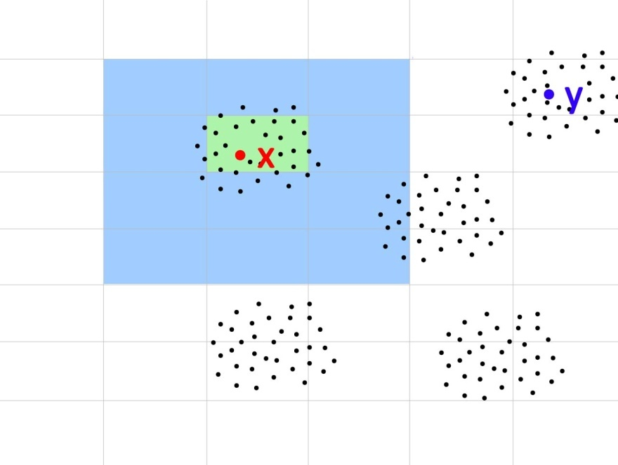
Post-Shannon Challenges
Time:
Classical Information Theory is at its weakest in
dealing with problems of delay (e.g., information
arriving late may be useless or have less value).
Verdu & Polyanskiy : major breakthrough in extending Shannon capacity theorem to finite blocklength information theory.
Kumar: design reliable scheduling policies with delay
constraints for wireless networks.
Weissman : real time coding system to investigate the
impact of delay on expected distortion.
Subramaniam: reconstruct networks from dynamic biological data.
Ramkrishna: quantify fluxes in biological networks by
showing that enzyme metabolism is regulated by a survival strategy in controlling enzyme syntheses.
Space:
Bialek: transmission of information in spatial patterns in developing embryos and its relation to information capacity of a communication channel.

Slide 6
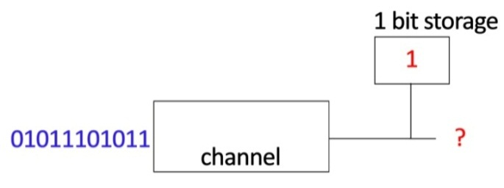
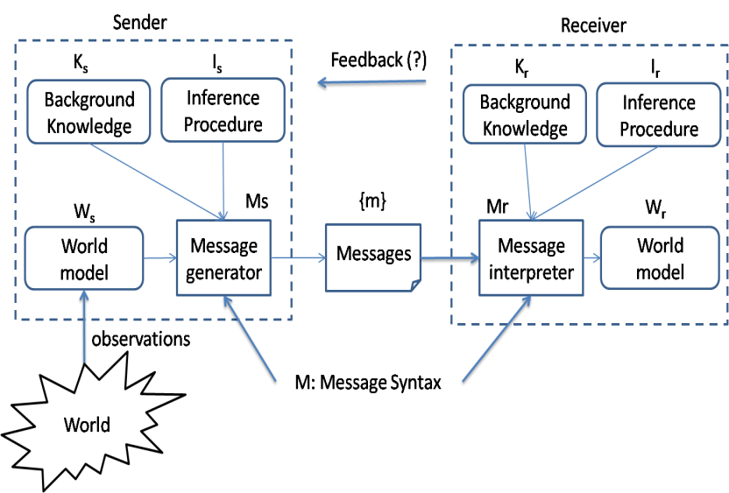
Post-Shannon Challenges
Limited Resources:
In many scenarios, information is limited by available computational resources (mobile devices, living cells).
Bialek: structure of molecular networks that optimize information flow, subject to constraints on the total number of molecules being used.
Verdu: minimum energy per bit as a function of data length in Gaussian channels.
Semantics:
Is there a way to account for the meaning or
semantics of information?
Sudan: meaning of information becomes relevant whenever there is diversity across communicating parties and when parties themselves evolve over time.

Slide 7
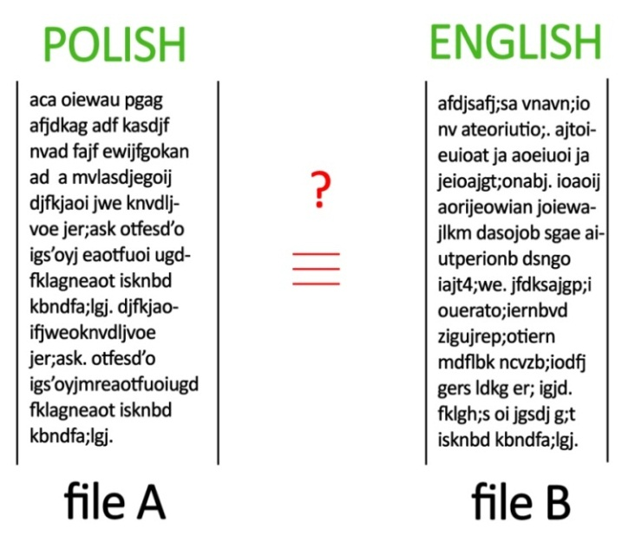
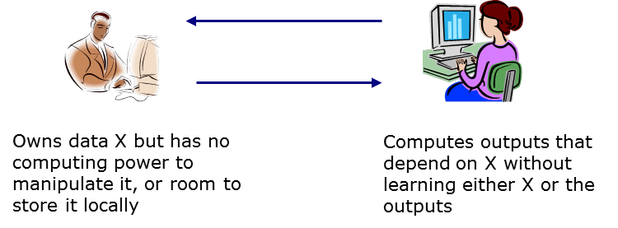
Post-Shannon Challenges
Representation-invariance:
How to know whether two representations of the
same information are information equivalent?
Learnable Information:
Data driven science focuses on extracting information from data. How much information can actually be extracted from a given data repository?
Atallah: enabling untrusted remote servers to store and manipulate clients’ confidential data without learning it.
Clifton: differential privacy methods for graphs; to determine the conditions under which privacy is practically achievable without rendering the data useless.

Slide 8
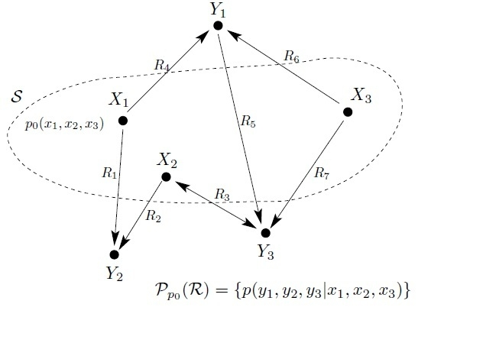
Post-Shannon Challenges
Cooperation & Dependency:
How does cooperation impact information (nodes should cooperate in their own self-interest)?
Cover: theory of cooperation and coordination in networks -- the achievable joint distribution among network nodes, provided that the communication rates are given.
Dependency and rational expectation are critical ingredients in Sims' work on modern dynamic economic theory.
Coleman: statistical causality in neural systems using Granger principles.
Quantum Information:
The flow of information in macroscopic systems and
microscopic systems may posses different characteristics.
Aaronson and Shor: computational complexity of linear systems.

Slide 9
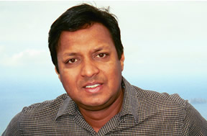
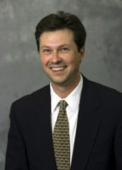
Education and Diversity
Integrate cutting-edge, multidisciplinary research and education efforts across the center to advance the training and diversity of the work force
D. Kumar
M. Ward
B. Gibson
B. Ladd
Summer School, Purdue, May 2011, Stanford, 2012
HONR 399: Intro to Science of Information

Slide 10
Education Programs
Student research teams seed grant competition
New courses (available online), summer schools, and student research presentations.
Student leadership council for input into various Center programs.
Topic modules (as part of NSF TUES grant for student learning and faculty use).
Center-wide postdoc program, postdoc/ junior faculty mentoring programs.

Slide 11
Diversity Initiatives
Center-wide undergraduate scholars program with emphasis on diversity.
Diversity initiatives through Prestige Lecture Series.
Developed a centralized diversity database to facilitate recruitment and placement with the Center.
Leadership team for Indiana Girls Collaborative project.

Slide 12
Knowledge Transfer
Develop effective mechanism for interactions between the center and external stakeholders to support the exchange of knowledge, data, and application of new technology.
Industrial interactions to support:
Access to students and post-docs
Access to intellectual property
Shape center research agenda
Solve real-world problems
Industrial perspective
(Industry Workshop, Industry Leaders Seminar)

Slide 13
Scheduled Activities
Semi-annual student workshops (students’ council)
Center-wide solicitation for collaborative research support
Annual summer school (Purdue 2013, UCSD 2014)
Science of Information courses (at partner institutions 2012+)
CHANNELS Program (broadening participation with STEM)
Seminar series & workshops (virtual over the center; Prestige Lecture)

Slide 14
Thank You.
For more information, please visit http://www.soihub.org

