Slide 1
PuReMD: A Reactive (ReaxFF) Molecular Dynamics Package
Hassan Metin Akgulta, Sagar Pandit, Joseph Fogarty, Ananth Grama ayg@cs.purdue.edu.
Acknowledgements: Department of Energy, National Science Foundation

Slide 2
Outline
Sequential Realization: SerialReax
  Algorithms and Numerical Techniques
  Validation
  Performance Characterization
Parallel Realization: PuReMD
  Parallelization: Algorithms and Techniques
  Performance and Scalability
Applications
  Strain Relaxation in Si/Ge/Si Nanobars
  Water-Silica Interface
  Oxidative Stress in Lipid Bilayers

Slide 3
Sequential Realization: SerialReax
Excellent per-timestep running time
  efficient generation of neighbors lists
  elimination of bond order derivative lists
  cubic spline interpolation: for non-bonded interactions
  highly optimized linear solver: for charge equilibration
Linear scaling memory footprint
  fully dynamic and adaptive interaction lists
Related publication:
Reactive Molecular Dynamics: Numerical Methods and Algorithmic Techniques
H. M. Aktulga, S. A. Pandit, A. C. T. van Duin, A. Y. Grama
SIAM Journal on Scientific Computing, 2012.

Slide 4
SerialReax Components
SerialReax
Initialization
Read input data
Initialize data structs
Neighbor Generation
3D-grid based O(n) neighbor generation
Several optimizations for improved performance
System
Geometry
Reallocate
Fully dynamic and adaptive memory management:
efficient use of resources
large systems on a single processor
Control
Parameters
Init Forces
Initialize the QEq coef matrix
Compute uncorr. bond orders
Generate H-bond lists
Force Field
Parameters
QEq
Large sparse linear system
PGMRES(50) or PCG
ILUT-based pre-conditioners
give good performance
Compute Bonds
Corrections are applied after all
uncorrected bonds are computed
Program Log
File
Bonded Interactions
Bonds
Lone pairs
Over/UnderCoord
Valence Angles
Hydrogen Bonds
Dihedral/ Torsion
vd Waals & electrostatics
Single pass over the
far nbr-list after
charges are updated
Interpolation with cubic
splines for nice speed-up
System Status
Update
Trajectory
Snapshots
Evolve the System
F_{total} = F_{nonbonded} + F_{bonded}
Update x & v with velocity Verlet
NVE, NVT and NPT ensembles

Slide 5
Generation of Neighbors List
atom list
3D Neighbors grid
atom list: reordered

Slide 6
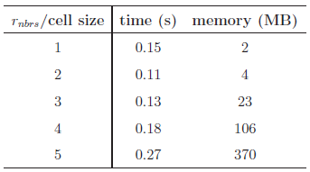
Neighbors List Optimizations
Size of the neighbor grid cell is important
  r_{nbrs}: neighbors cut-off distance
  set cell size to half the r_{nbrs}
Reordering reduces look-ups significantly
Atom to cell distance
Verlet lists for delayed re-neighboring
neighbors grid
No need to check these cells with reordering!
Looking for the neighbors of atoms in this box
Just need to look inside these cells
d
If d > r_{nbrs}, then no need to look into the cell

Slide 7
Elimination of Bond Order Derivative Lists
BO_{ij}: bond order between atoms i and j
  at the heart of all bonded interactions
dBO_{ij}/dr_{k}: derivative of BO_{ij} wrt. atom k
  non-zero for all k sharing a bond with i or j
  costly force computations, large memory space needed
Analogy
Eliminate dBO list
  delay computation of dBO terms
  accumulate force related coef. into CdBO_{ij}
  compute dBO_{ij}/dr_{k} at the end of the step
  f_{k} += CdBO_{ij} x dBO_{ij}/dr_{k}

Slide 8
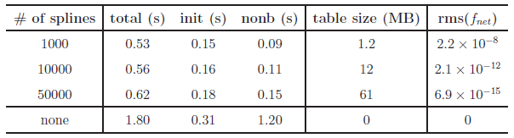
Look-up Tables
Expensive non-bonded force computations
  too many interactions: r_{nonb} ~ 10A vs. r_{bond} ~ 4-5A
  but simple, pair-wise interactions
Reduce non-bonded force computations
  create look-up tables
  cubic spline interpolation: for non-bonded energy & forces
Experiment with a 6540 atom bulk water system
Significant performance gain, high accuracy

Slide 9




Linear Solver for Charge Equilibration
QEq Method: used for equilibrating charges
  original QEq paper cited 600+ times
  approximation for distributing partial charges
  solution using Lagrange multipliers yields
    N = # of atoms
    H: NxN sparse matrix
    s & t fictitious charges: used to determine the actual charge q_{i}
Too expensive for direct methods → Iterative (Krylov sub-space) methods

Slide 10
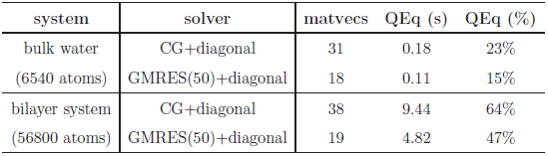
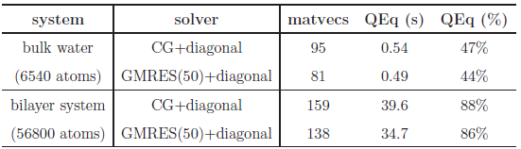
Basic Solvers for QEq
Sample systems
  bulk water: 6540 atoms, liquid
  lipid bilayer system: 56,800 atoms, biological system
  PETN crystal: 48,256 atoms, solid
Solvers: CG and GMRES
  H has heavy diagonal: diagonal pre-conditioning
  slowly evolving environment : extrapolation from prev. solutions
Poor Performance:
# of iterations = # of matrix-vector multiplications
actual running time in seconds
fraction of total computation time
tolerance level = 10⁻⁶
which is fairly satisfactory
due to cache effects
much worse at 10⁻¹⁰ tolerance level
more pronounced here

Slide 11
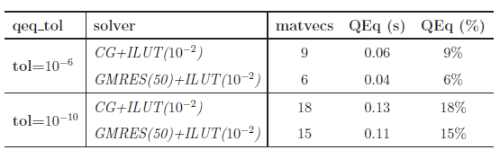
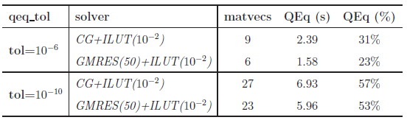
ILU-based preconditioning
ILU-based pre-conditioners: no fill-in, 10⁻² drop tolerance
  effective (considering only the solve time)
  no fill-in + threshold: nice scaling with system size
  ILU factorization is expensive
bulk water system
cache effects are still evident
bilayer system
system/solver | time to compute preconditioner | solve time (s) | total time (s)
bulk water/ GMRES+ILU | 0.50 | 0.04 | 0.54
bulk water/ GMRES+diagonal | ~0 | 0.11 | 0.11

Slide 12
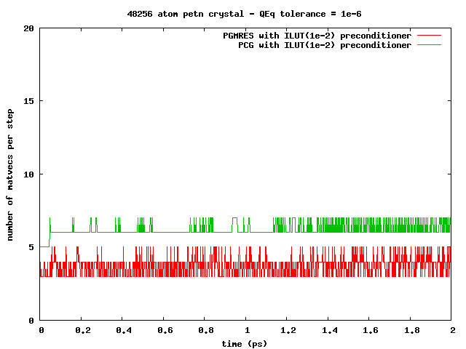
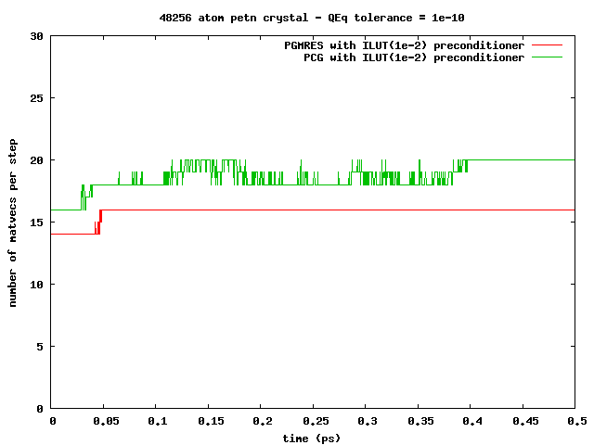
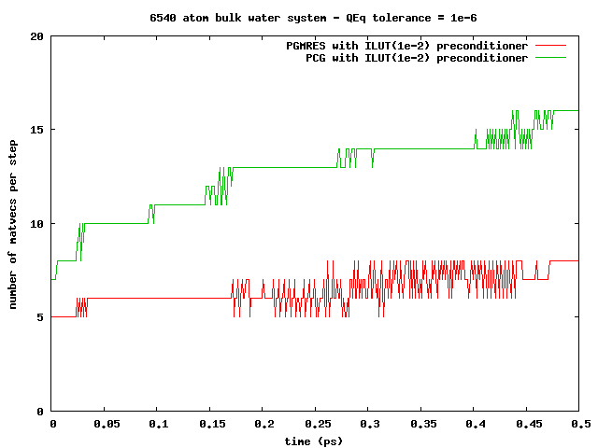
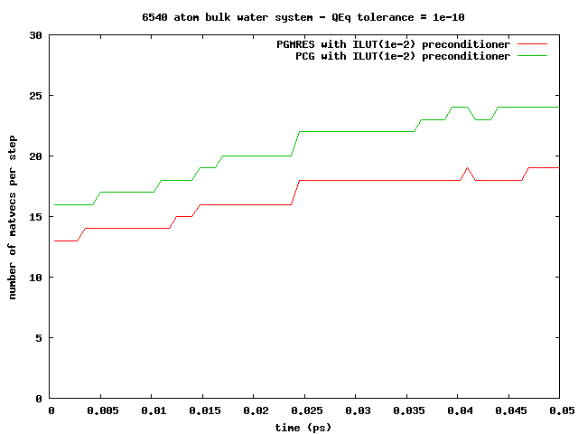
ILU-based preconditioning
Observation: can amortize the ILU factorization cost
slowly changing simulation environment ⇒re-usable pre-conditioners
PETN crystal:
solid, 1000s of steps!
Bulk water:
liquid, 10-100s of steps!

Slide 13
Memory Management
Compact data-structures
Dynamic and adaptive lists
  initially: allocate after estimation
  at every step: monitor & re-allocate if necessary
Low memory foot-print, linear scaling with system size
n-1
n
n-1
n
n-1’s data
n’s data
n-1’s data
n’s data
in CSR format
neighbors list
Qeq matrix
3-body intrs
reserved for n-1
reserved for n
in modified CSR
bonds list
hbonds list

Slide 14
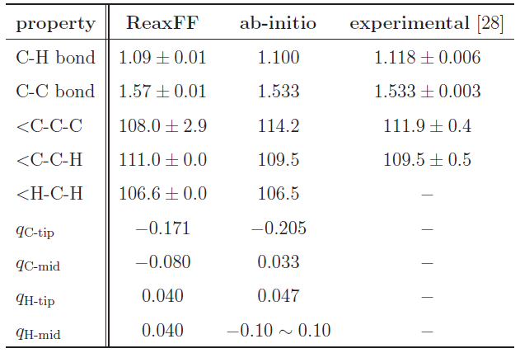
Validation
Hexane (C₆H₁₄) Structure Comparison
Excellent agreement!

Slide 15
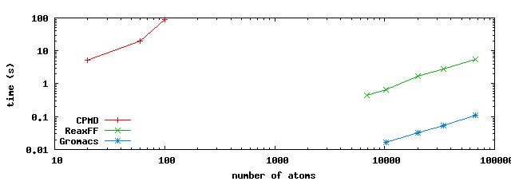
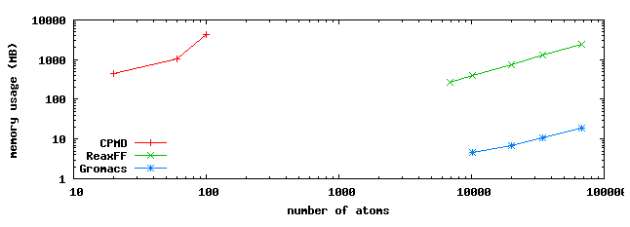
Comparison to MD Methods
Comparisons using hexane: systems of various sizes
  Ab-initio MD: CPMD
  Classical MD: GROMACS
  ReaxFF: SerialReax

Slide 16
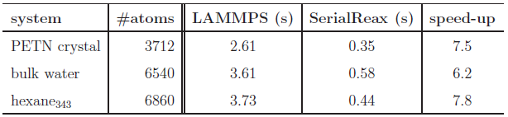
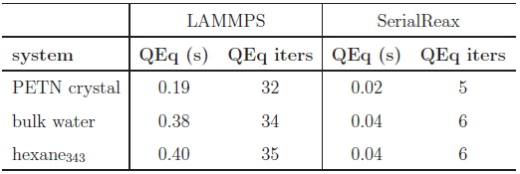
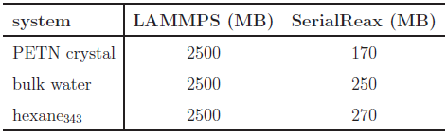
Comparison to LAMMPS-ReaxF
Time per time-step comparison
Qeq solver performance
Memory foot-print
different QEq formulations
similar results
LAMMPS:
CG / no preconditioner

Slide 17
Outline
Sequential Realization: SerialReax
  Algorithms and Numerical Techniques
  Validation
  Performance Characterization
Parallel Realization: PuReMD
  Parallelization: Algorithms and Techniques
  Performance and Scalability
Applications
  Strain Relaxation in Si/Ge/Si Nanobars
  Water-Silica Interface
  Oxidative Stress in Lipid Bilayers

Slide 18
Parallel Realization: PuReMD
Built on the SerialReax platform
  Excellent per-timestep running time
  Linear scaling memory footprint
Extends its capabilities to large systems, longer time-scales
  Scalable algorithms and techniques
  Demonstrated scaling to over 3K cores
Related publication:
Parallel Reactive Molecular Dynamics: Numerical Methods and Algorithmic Techniques
H. M. Aktulga, J. C. Fogarty, S. A. Pandit, A. Y. Grama
Parallel Computing, 2012.

Slide 19
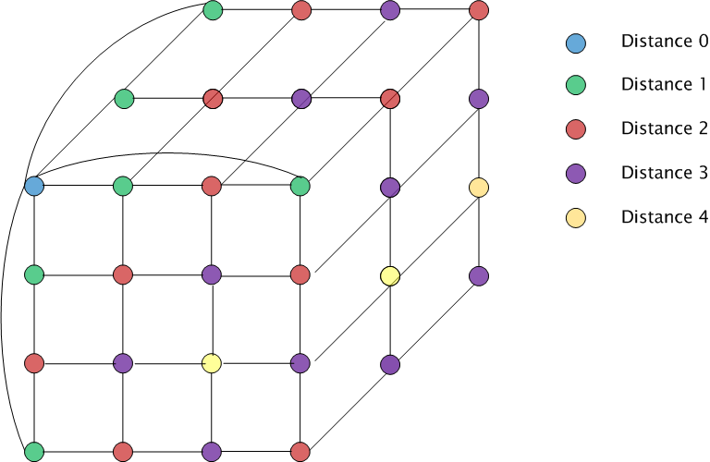
Parallelization: Decomposition
Domain decomposition: 3D torus

Slide 20
Parallelization: Outer-Shell
r
r
b
b
full shell
half shell
r/2
r
b
b
midpoint-shell
tower-plate shell

Slide 21
Parallelization: Outer-Shell
choose full-shell due to dynamic bonding despite the comm. overhead
r
r
b
b
full shell
half shell
r/2
r
b
b
midpoint-shell
tower-plate shell

Slide 22
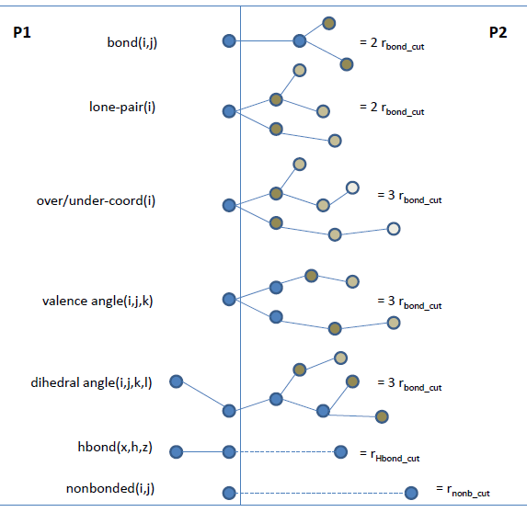
Parallelization: Boundary Interactions
r_{shell}= MAX (3xr_{bond_cut}, r_{hbond_cut}, r_{nonb_cut})

Slide 23
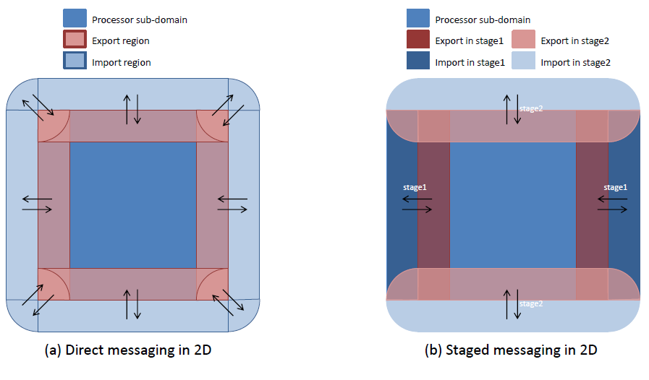
Parallelization: Messaging

Slide 24
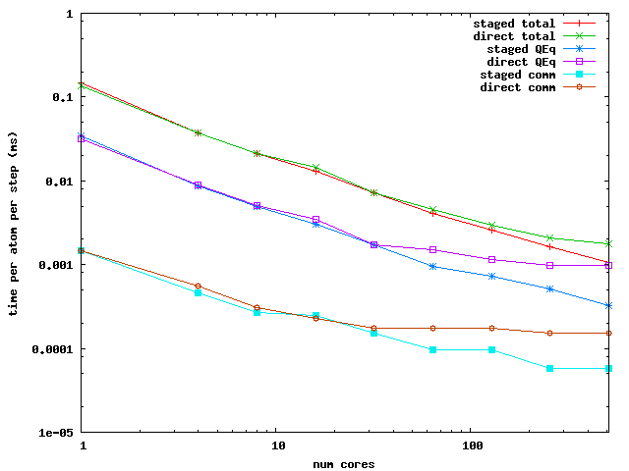
Parallelization: Messaging Performance
Performance Comparison: PuReMD with direct vs. staged messaging

Slide 25
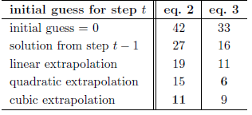
Parallelization: Optimizations
Truncate bond related computations
  double computation of bonds at the outer-shell
  hurts scalability as the sub-domain size shrinks
  trim all bonds that are further than 3 hops or more
Scalable parallel solver for the QEq problem
  GMRES/ILU factorization: not scalable
  use CG + diagonal pre-conditioning
  good initial guess:
  redundant computations: to avoid reverse communication
  iterate both systems together

Slide 26
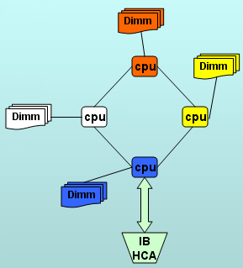
PuReMD: Performance and Scalability
Weak scaling test
Strong scaling test
Comparison to LAMMPS-REAX
Platform: Hera cluster at LLNL
  4 AMD Opterons/node -- 16 cores/node
  800 batch nodes – 10800 cores, 127 TFLOPS/sec
  32 GB memory / node
  Infiniband interconnect
  42nd on TOP500 list as of Nov 2009

Slide 27
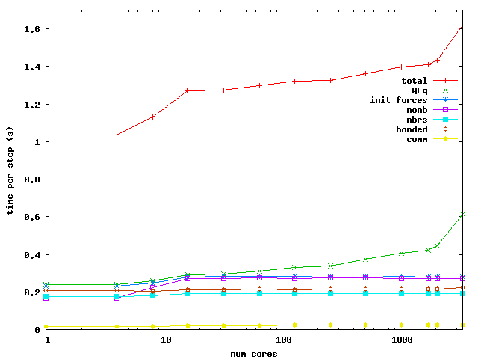
PuReMD: Weak Scaling
Bulk Water: 6540 atoms in a 40x40x40 A³ box / core

Slide 28
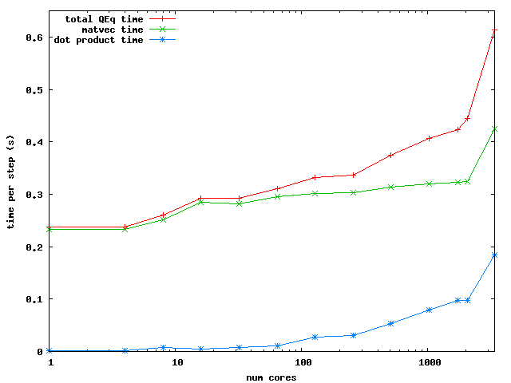
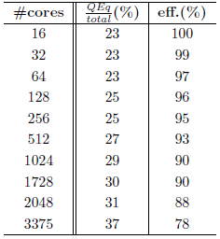
PuReMD: Weak Scaling
QEq Scaling
Efficiency

Slide 29
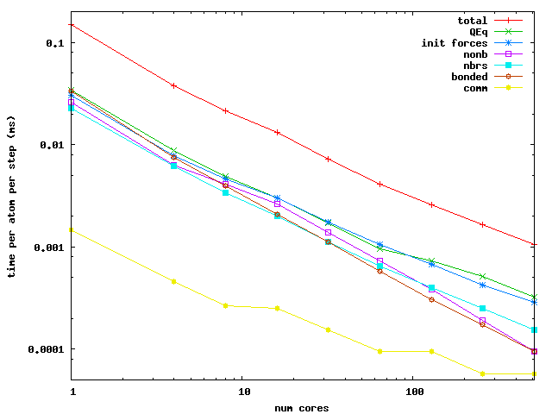
PuReMD: Strong Scaling
Bulk Water: 52320 atoms in a 80x80x80 A³ box

Slide 30
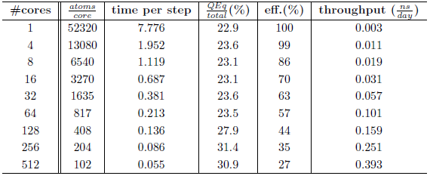
PuReMD: Strong Scaling
Efficiency and throughput

Slide 31
Outline
Sequential Realization: SerialReax
  Algorithms and Numerical Techniques
  Validation
  Performance Characterization
Parallel Realization: PuReMD
  Parallelization: Algorithms and Techniques
  Performance and Scalability
Validation Applications
  Strain Relaxation in Si/Ge/Si Nanobars
  Water-Silica Interface
  Oxidative Stress in Lipid Bilayers

Slide 32
LAMMPS-Reax/C User Community
Konstantin Shefov - Sankt-Peterburgskij Gosudarstvennyj Universitet
Camilo Calderon - Boston University
Ricardo Paupitz Barbosa dos Santos - Universidade Estadual de Maringa
Shawn Coleman - University of Arkansas
Paolo Valentini - University of Minnesota
Hengji Zhang - University of Texas at Dallas
Benjamin Jensen - Michigan Technological University
Xiao Dong Han - Beijing University
Robert Meissner - Fraunhofer Institute for Manufacturing Technology and Advanced Materials, Bremen
James Larentzos - High Performance Technologies, Inc. (HPTi)
Hegoi Manzano - Concrete Sustainability Hub, MIT
Olivier POLITANO - Laboratoire Interdisciplinaire Carnot de Bourgogne
Ti Leggett – University of Chicago

Slide 33
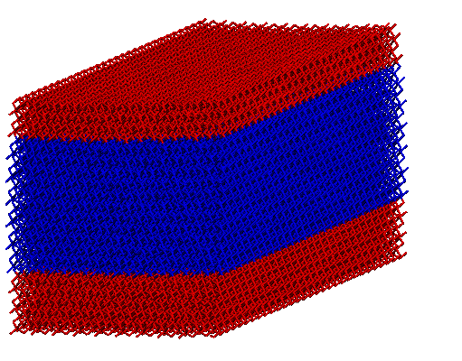
Si/Ge/Si nanoscale bars
Motivation
  Si/Ge/Si nanobars: ideal for MOSFETs
  as produced: biaxial strain, desirable: uniaxial
  design & production: understanding strain behavior is important
[001], Vertical
[010] , Longitudinal
[100], Transverse
Si
Height (H)
Ge
Related publication:
Strain relaxation in Si/Ge/Si nanoscale bars from molecular dynamics simulations
Y. Park, H.M. Aktulga, A.Y. Grama, A. Strachan
Journal of Applied Physics 106, 1 (2009)
Si
Periodic boundary
conditions
Width (W)

Slide 34
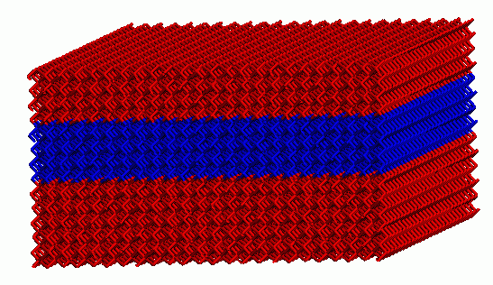
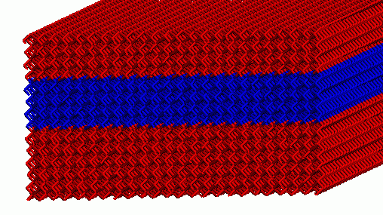
Si/Ge/Si nanoscale bars
Key Result:
When Ge section is roughly square shaped, it has almost uniaxial strain!
average strains for Si&Ge in each dimension
average transverse Ge strain
Ge
Si
Si
W = 20.09 nm
Simple strain model derived from MD results

Slide 35
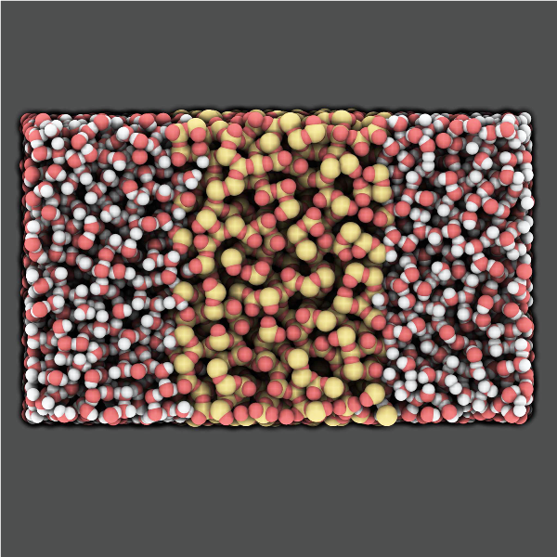
Water-Silica Interface
Motivation
  a-SiO2: widely used in nano-electronic devices
  also used in devices for in-vivo screening
  understanding interaction with water: critical for reliability of devices
Related publication:
A Reactive Simulation of the Silica-Water Interface
J. C. Fogarty, H. M. Aktulga, A. van Duin, A. Y. Grama, S. A. Pandit
Journal of Chemical Physics 132, 174704 (2010)

Slide 36
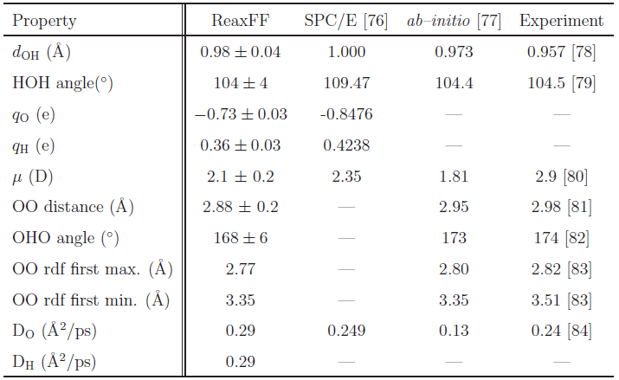
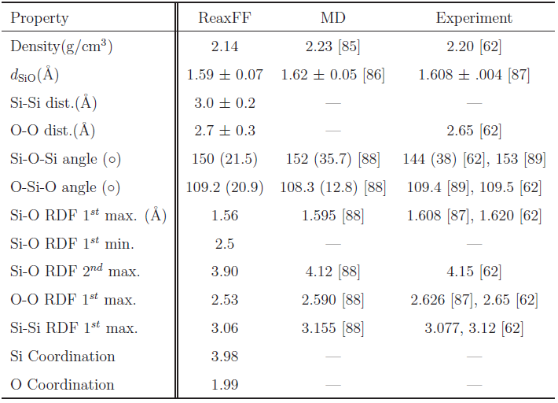
Water-Silica Interface
Water model validation
Silica model validation

Slide 37
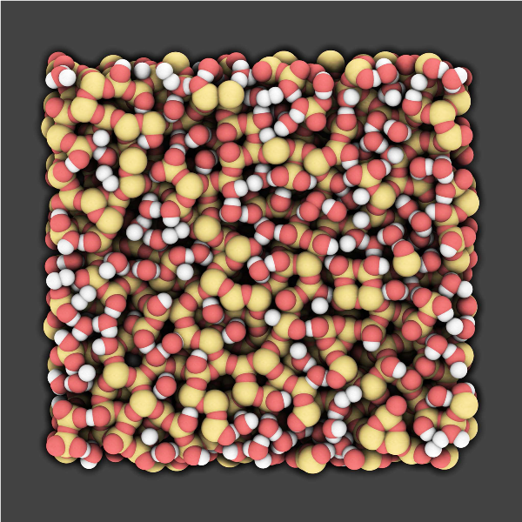
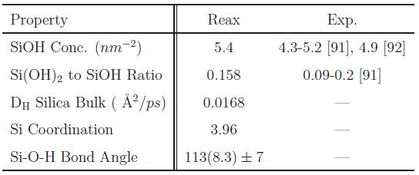
Water-Silica Interface
Key Result
Silica surface hydroxylation as evidenced by experiments is observed.
Proposed reaction:
H2O + 2Si + O ⇔ 2SiOH
Water
H
O
H
Silica
O
Si
O

Slide 38
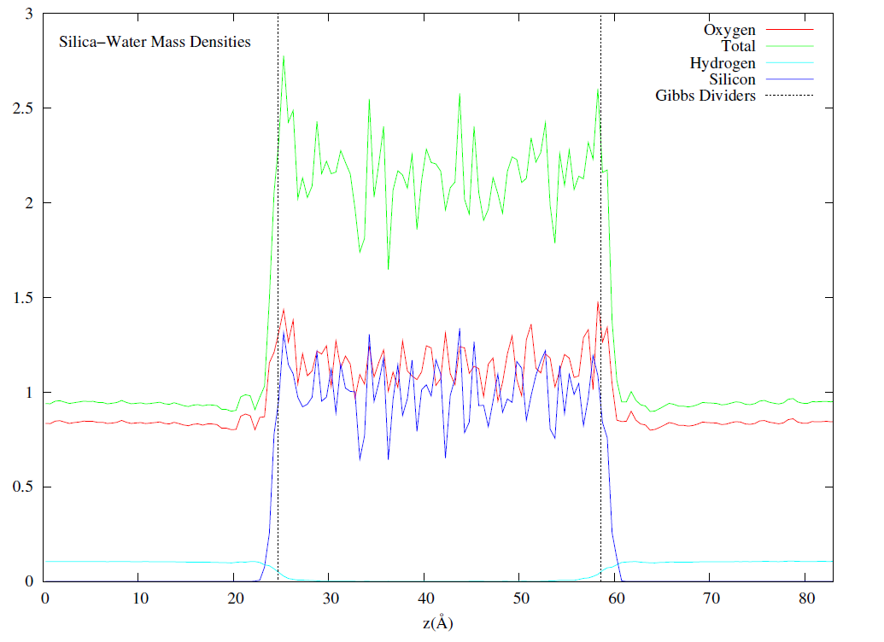
Water-Silica Interface
Key Result
Hydrogen penetration is observed: some H atoms penetrate through the slab.
Ab-initio simulations predict whole molecule penetration.
We propose: water is able to diffuse through a thin film of silica via hydrogen hopping, i.e., rather than diffusing as whole units, water molecules dissociate at the surface, and hydrogens diffuse through, combining with other dissociated water molecules at the other surface.

Slide 39
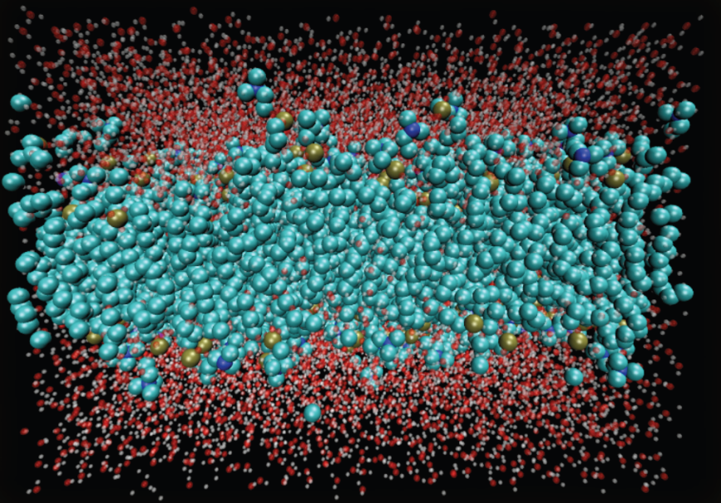
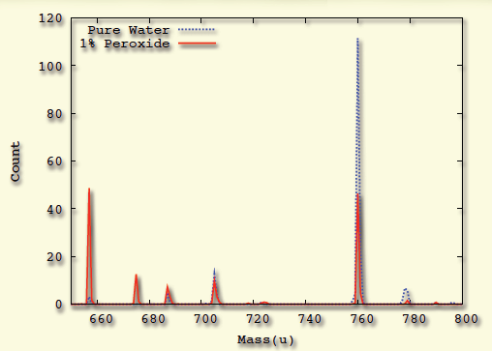
Oxidative Damage in Lipid Bilayers
Motivation
Modeling reactive processes in biological systems
ROS→ Oxidative stress→ Cancer & Aging
System Preparation
200 POPC lipid + 10,000 water molecules
and same system with 1% H₂O₂ mixed
Mass Spectograph:
Lipid molecule weighs 760 u
Key Result
Oxidative damage observed:
In pure water: 40% damaged
In 1% peroxide: 75% damaged

Slide 40
Conclusions
An efficient and scalable realization of ReaxFF through use of algorithmic and numerical techniques
Detailed performance characterization; comparison to other methods
Applications on various systems
LAMMPS/Reax/C and PuReMD strand-alone Reax implementations available over the public domain.

Slide 41
References
Reactive Molecular Dynamics: Numerical Methods and Algorithmic Techniques
  H. M. Aktulga, S. A. Pandit, A. C. T. van Duin, A. Y. Grama
  SIAM Journal on Scientific Computing (2012).
Parallel Reactive Molecular Dynamics: Numerical Methods and Algorithmic Techniques
  H. M. Aktulga, J. C. Fogarty, S. A. Pandit, A. Y. Grama
  Parallel Computing, to appear (2012).
Strain relaxation in Si/Ge/Si nanoscale bars from molecular dynamics simulations
  Y. Park, H.M. Aktulga, A.Y. Grama, A. Strachan
  Journal of Applied Physics 106, 1 (2009)
A Reactive Simulation of the Silica-Water Interface
  J. C. Fogarty, H. M. Aktulga, A. van Duin, A. Y. Grama, S. A. Pandit
  Journal of Chemical Physics 132, 174704 (2010)

