Slide 1
Emerging Frontiers of
Science of Information
NSF STC 2010

Slide 2
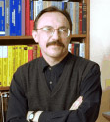
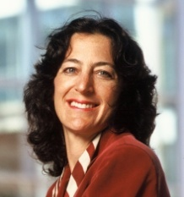
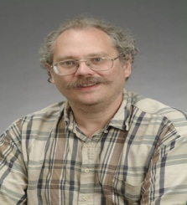
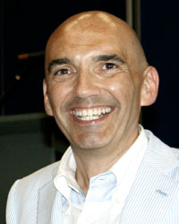
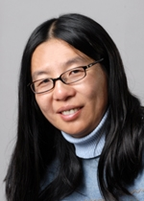
STC Team
Bryn Mawr College: D. Kumar
Howard University: C. Liu
MIT: M. Sudan (co-PI), P. Shor.
Purdue University (lead): W. Szpankowski (PI)
Princeton University: S. Verdu (co-PI)
Stanford University: A. Goldsmith (co-PI)
University of California, Berkeley: Bin Yu (co-PI)
University of California, San Diego: S. Subramaniam
UIUC: P.R. Kumar, O. Milenkovic.
Wojciech Szpankowski,
Purdue
Andrea Goldsmith,
Stanford
Peter Shor,
MIT
Sergio Verdú,
Princeton
Bin Yu,
U.C. Berkeley

Slide 3
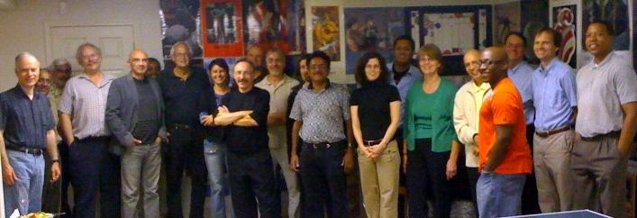
… the night before the NSF site visit

Slide 4
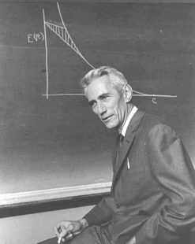
Shannon Legacy
The Information Revolution started in 1948, with the publication of:
A Mathematical Theory of Communication.
The digital age began.
Claude Shannon:
Shannon information quantifies the extent to which a recipient of data can reduce its statistical uncertainty.
“semantic aspects of communication are irrelevant . . .”
Applications Enabler/Driver:
CD, iPod, DVD, video games, Internet, Facebook, WiFi, mobile, Google, . .
Design Driver:
universal data compression, voiceband modems, CDMA, multiantenna, discrete denoising, space-time codes, cryptography, . . .

Slide 5
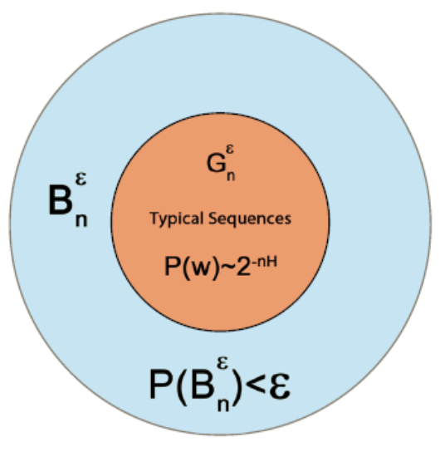
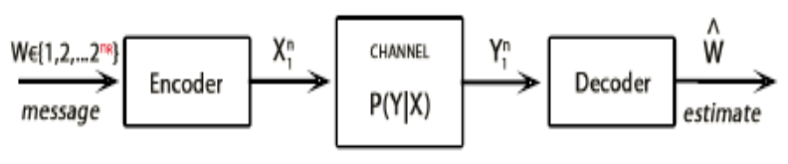
Three Theorems of Shannon
Theorem 1 & 3. [Shannon 1948; Lossless & Lossy Data Compression]
compression bit rate ≥ source entropy H(X)
for distortion level D:
lossy bit rate ≥ rate distortion function R(D)
Theorem 2. [Shannon 1948; Channel Coding ]
In Shannon’s words:
It is possible to send information at the capacity through the channel with as small a frequency of errors as desired by proper (long) encoding. This statement is not true for any rate greater than the capacity.

Slide 6
What is Information¹?
C. F. Von Weizs¨acker:
“Information is only that which produces information” (relativity). “Information is only that which is understood” (rationality).
“Information has no absolute meaning”.
Informally Speaking: A piece of data carries information if it can impact
a recipient’s ability to achieve the objective of some activity in a given
context within limited available resources.
Event-Driven Paradigm: Systems, State, Event, Context, Attributes,
Objective: Objective function objective(R,C) maps systems’ rule R and
context C in to an objective space.
Definition 1. The amount of information (in a faultless scenario) I(E) carried
by the event E in the context C as measured for a system with the rules of
conduct R is
I_{R,C}(E) = cost[objective_{R}(C(E)), objective_{R}(C(E) + E)]
where the cost (weight, distance) is a cost function.
¹Russell’s reply to Wittgenstein’s precept “whereof one cannot speak, therefore one must be silent” was “. . . Mr. Wittgenstein manages to say a good deal about what cannot be said.”

Slide 7
Post-Shannon Challenges
We aspire to extend classical Information Theory to meet challenges of today posed by rapid advances in biology, modern communication, and knowledge extraction.
We need to extend traditional formalisms for information to include:
structure, time, space, and semantics,
and other aspects such as:
dynamical information, physical information, representation-invariant information, limited resources, complexity, and cooperation & dependency.

Slide 8
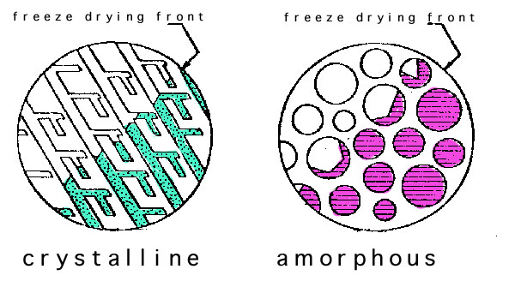
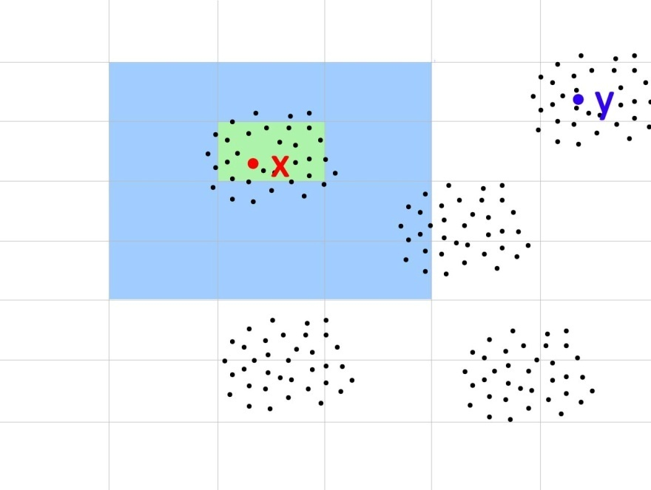
Post-Shannon Challenges
Structure:
Measures are needed for quantifying information embodied in structures (e.g., information in material structures, nanostructures, biomolecules, gene regulatory networks, protein networks, social networks, financial transactions).
Time & Space:
Classical Information Theory is at its weakest in dealing with problems of delay (e.g., information arriving late maybe useless or has less value).
Semantics & Learnable Information: How much information can be extracted for data repository? Is there a way to account for the meaning or semantics from data?

Slide 9
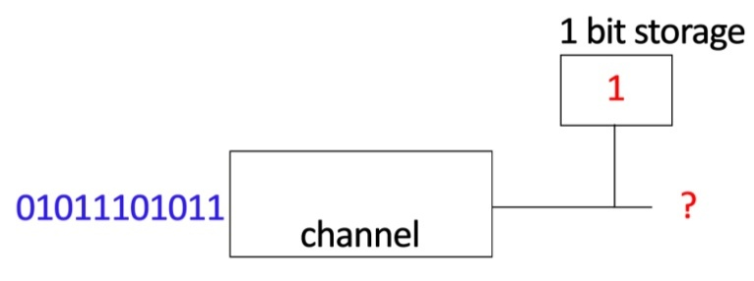
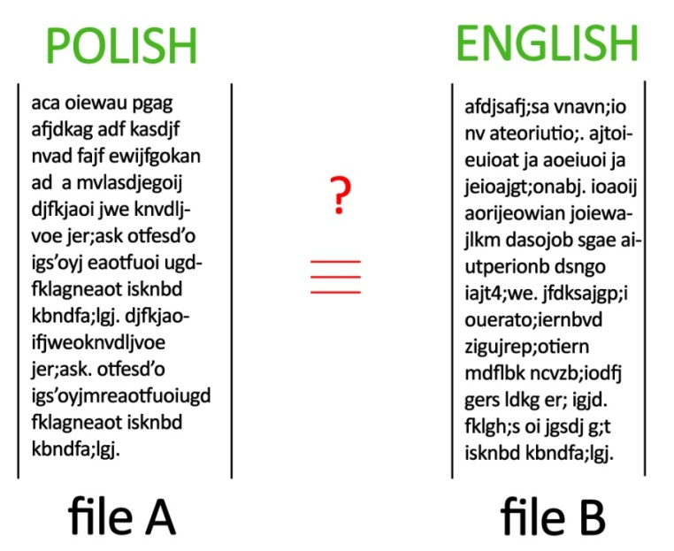
Post-Shannon Challenges
Other related aspects of information:
Limited Computational Resources: In many scenarios, information is limited by available computational resources (e.g., cell phone, living cell).
Representation-invariance: How to know whether two representations of the same information are information equivalent?
Cooperation: Often subsystems may be in conflict (e.g., denial of service) or in collusion (e.g., price fixing). How does cooperation impact information (nodes should cooperate in their own self-interest)?

Slide 10


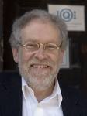
Standing on the Shoulders of Giants . . .
Manfred Eigen (Nobel Prize, 1967)
“The differentiable characteristic of the living systems is Information. Information assures the controlled reproduction of all constituents, ensuring conservation of viability . . . . Information theory, pioneered by Claude Shannon, cannot answer this question . . . in principle, the answer was formulated 130 years ago by Charles Darwin”.
P. Nurse, (Nature, 2008, “Life, Logic, and Information”):
Focusing on information flow will help to understand better how cells and organisms work. . . . the generation of spatial and temporal order, cell memory and reproduction are not fully understood.
A. Zeilinger (Nature, 2005)
. . . reality and information are two sides of the same coin, that is, they are in a deep sense indistinguishable

Slide 11
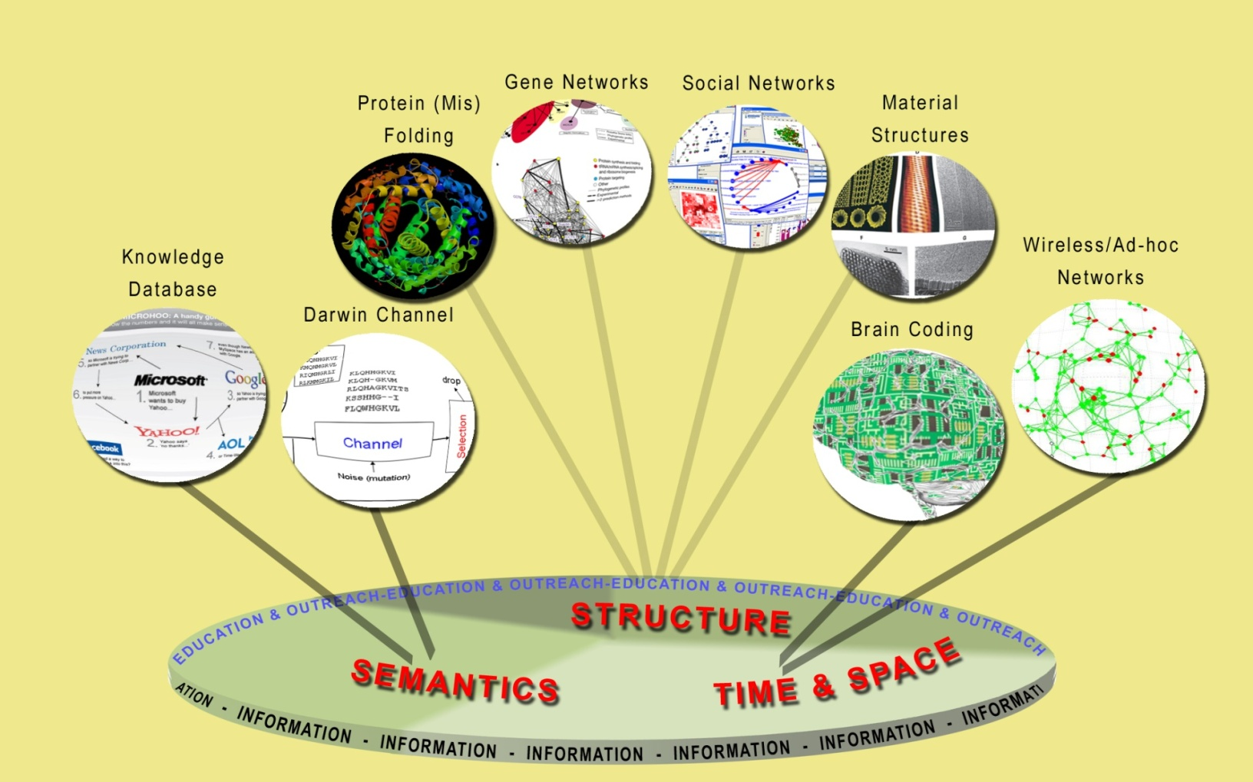
Science of Information
The overarching vision of the Center for Science of Information is to develop principles and human resources guiding the extraction, manipulation, and exchange of information, integrating space, time, structure, and semantics.

Slide 12
Mission and Center’s Goals
Advance science and technology through a new quantitative understanding of the representation, communication and processing of information in biological, physical, social and engineering systems.
Some Specific Center’s Goals:
define core theoretical principles governing transfer of information,
develop meters and methods for information,
apply to problems in physical and social sciences, and engineering,
offer a venue for multi-disciplinary long-term collaborations,
explore effective ways to educate students,
train the next generation of researchers,
broaden participation of underrepresented groups,
transfer advances in research to education and industry.

Slide 13
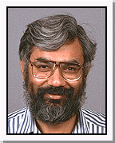
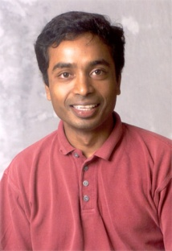
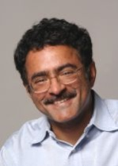
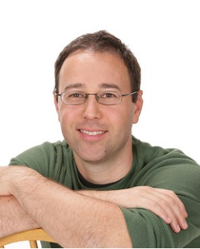
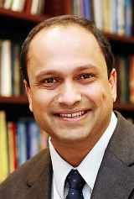
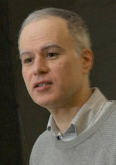
Integrated Research
Create a shared intellectual space, integral to the Center’s activities, providing a collaborative research environment that crosses disciplinary and institutional boundaries.
Research Thrusts:
1. Information Flow in Biology
2. Information Transfer in Communication
3. Knowledge:
Extraction, Computation & Physics
S. Subramaniam A. Grama
V. Anantharam T. Weissman
S. Kulkarni M. Atallah

Slide 14
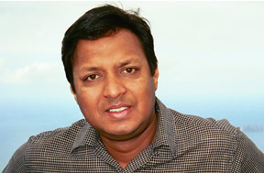
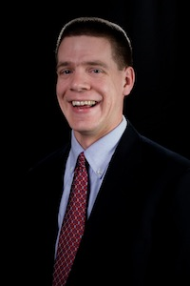
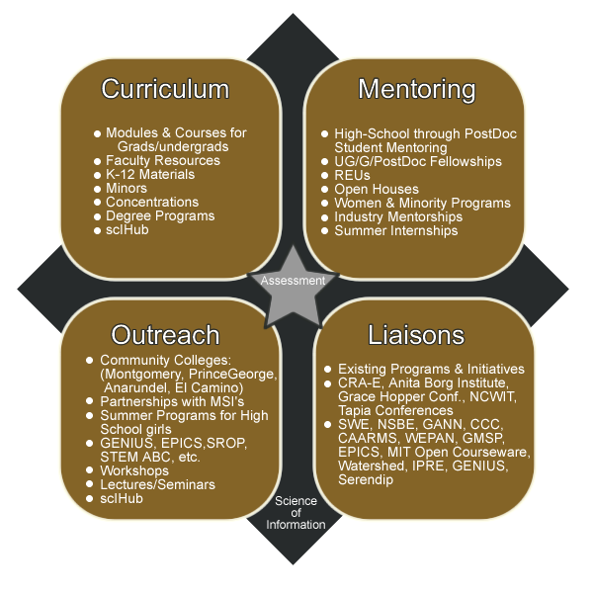
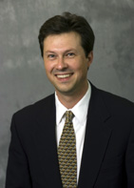
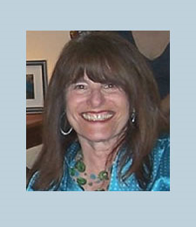
Education and Diversity
Integrate cutting-edge, multidisciplinary research and education efforts across the center to advance the training and diversity of the work force
D. Kumar
M. Ward
R. Hughes
B. Ladd

Slide 15
Knowledge Transfer
Develop effective mechanism for interactions between the center and external stakeholder to support the exchange of knowledge, data, and application of new technology.
Industrial affiliate program in the form of consortium:
  Considerable intellectual resources
  Access to students and post-docs
  Access to intellectual property
  Shape center research agenda
  Solve real-world problems
  Industrial perspective
  Knowledge Transfer Director: Ananth Grama

Slide 16
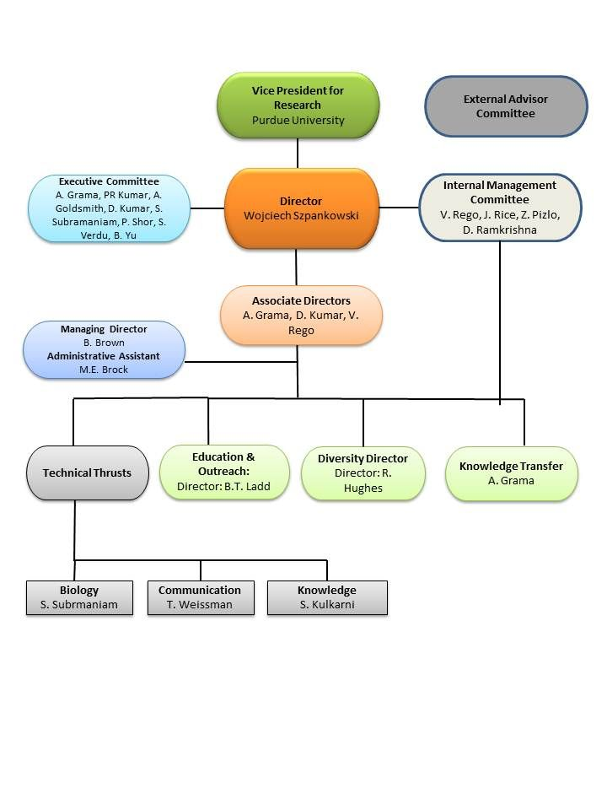
Management Structure

Slide 17
Strategic Plan for Center Research
Life Sciences
  Knowledge extraction from data
    Integrating diverse datasets
    Defining the granularity of data
    Statistical methods with regularization
    Biology-constrained methods
    Information metrics
    Dealing with context
  Dealing with noise in data
    Robustness of knowledge extraction to noise
    How to deal with missing data?
  Classification of modularity from data
    Specification and identification of modules (functional, spatial, temporal, etc.) from data
    Quantifying information content of modules
    Quantitative and qualitative comparison of modules
  Dealing with dynamical data
    How to deal with multivariate and high dimensional time series data?
    Understanding spatio-temporal information processing in systems
    Identifying suitable granularity and context for analyzing data

Slide 18
Strategic Plan for Center Research
Communication
  Delay in Information Theory
    Quantifying the temporal value of information
    Information theory for finite block lengths
    Tradeoffs between delay, distortion, and reliability in feedback systems
  Information and computation
    Quantifying fundamental limits of in-network computation, and the computing capacity of networks for different functions
    Complexity of distributed computation in wireless and wired networks
    Information theoretic study of aggregation for scalable query processing in distributed databases
  New measures and notions of information
    Soft-information (beliefs) in rate distortion theory
    Semantics in information: framework, probabilistic modeling
    Modern communication networks
  Interface with life sciences thrust
    Furthering our information theoretic understanding of deletion, substitution, and insertion channels
    Information theoretic models for evolution
    Models for stimuli
    Communication models for intra-neuron signaling
    Models to predict the behavior of various systems, ranging from intra-cellular signaling, to tissues, individuals, colonies, and ecosystems

Slide 19
Strategic Plan for Center Research
Knowledge Management
  Information science for collaborative computing and inference
  Semantic, goal-oriented, and communication
  Learning and inference in networks
  Environmental modeling and statistical emulation

