Slide 1
Scalable Data Collection in Sensor Networks
Asad Awan, Suresh Jagannathan, Ananth Grama,
Purdue University
Supported by the US National Science Foundation.

Slide 2
Project Context
Real-time control of structures through:
Sensing
Model Reduction and Control
Actuation
High-Fidelity Modeling of Structures
Comprehensive Validation

Slide 3
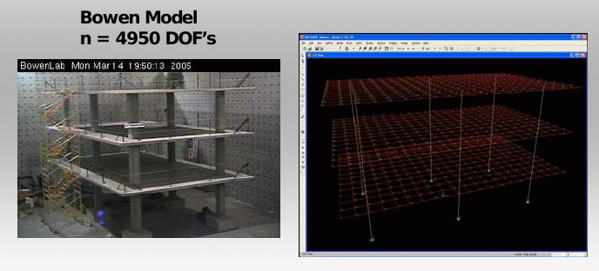
Model Reduction and Control

Slide 4
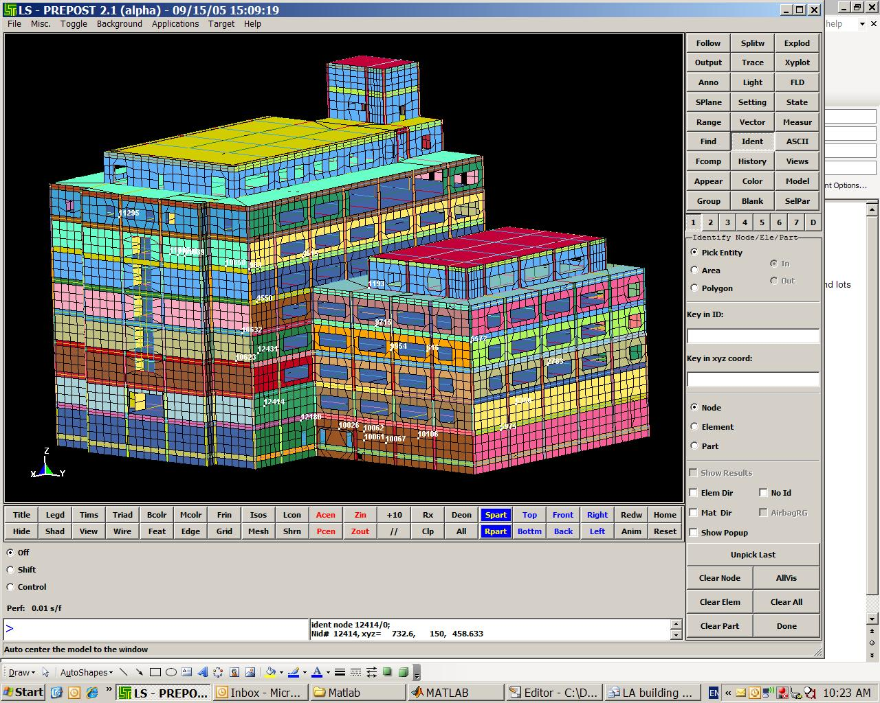
Model Reduction and Control

Slide 5
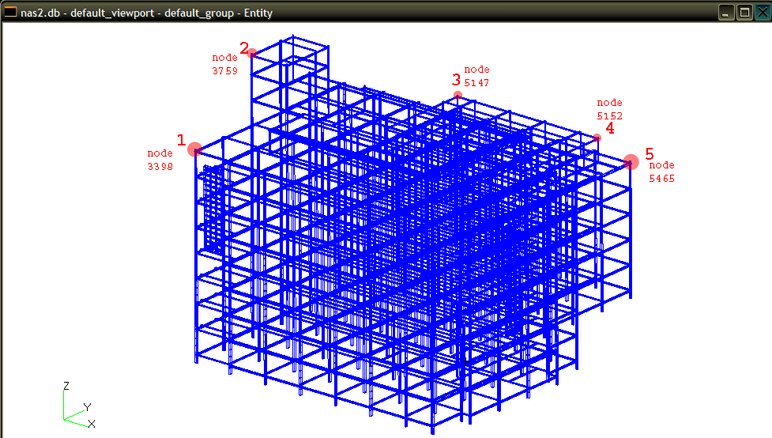
Model Reduction and Control

Slide 6
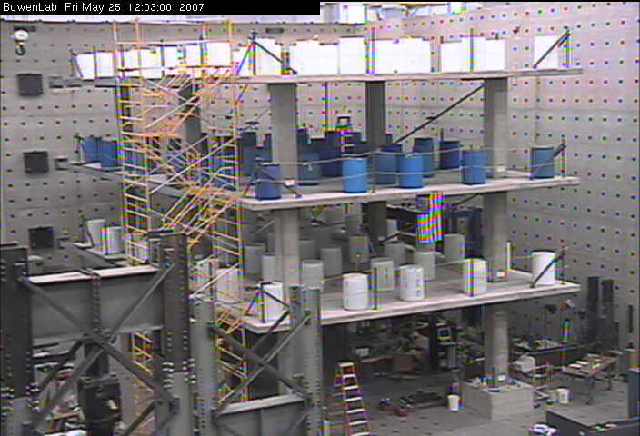
Validation Testbed: Bowen Lab for Structural Engineering

Slide 7

Validation Testbed: Bowen Lab for Structural Engineering

Slide 8
Building a Robust Sensing Infrastructure

Slide 9
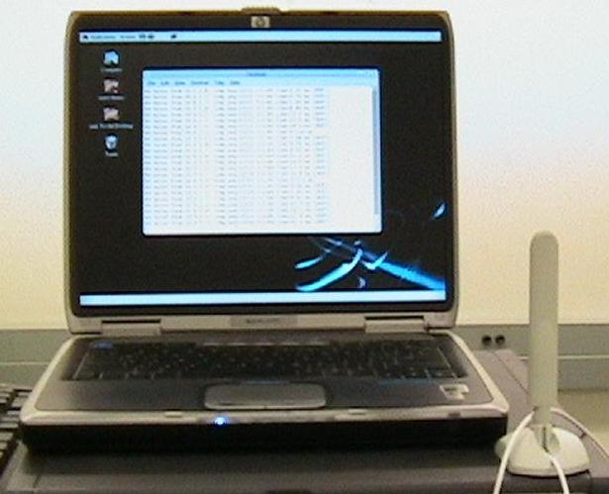
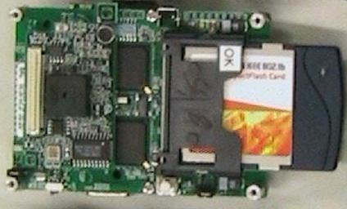
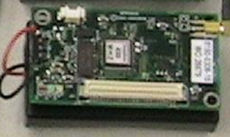
Demo
COSMOS = mPL + mOS
Declarative macroprogramming of “aggregate network”

Slide 10
Demo
accel
max
controller
Gate
Plotter
mPL program2
timer(100) → accel
accel → gate, max
max → controller
gate → plotter
controller → gate
mPL program1
timer(100) → accel
accel → plotter

Slide 11
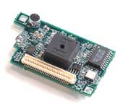
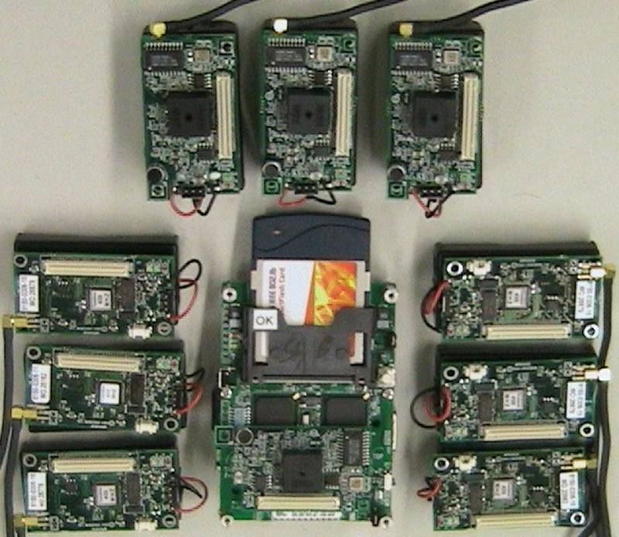
Wireless Sensor Networks
How does one engineer robust and efficient sensing and control applications?
Resource constrained nodes
Network capacity
Memory
Energy
Processing capability
Dynamic conditions
Communication losses
Network self-organization
Sensor events
Performance and scalability requirements
Heterogeneous nodes

Slide 12
Programming Sensor Networks
Send(d)
…
Recv(d)
Traditional approach:
“Network enabled” programs on each node
Complex messaging encodes network behavior
No abstraction of low-level details

Slide 13
Programming Models
Need high-level programming models that support
Flexibility and Expressiveness
Adding new processing operators
Routing – tree, neighborhood, geographical
Domain-specific optimizations (reliability, resilience, …)
…
Performance
Footprint of runtime support
High data rates
…
Robustness

Slide 14
The COSMOS Macroprogramming Environment
Program the network as a whole by specifying aggregate system behavior
Notes:
Keeping all these motivations in mind, we propose macroprogramming with cosmos. Macroporgramming entails programming aggregate system behavior rather than describing what each node must do.

Slide 15
Programming Model Overview
Describe aggregate system behavior in terms of dataflow and data processing
A program is an interaction assignment of functional components
Low-overhead primitive dataflow semantics
Asynchronous
Best effort
Notes:
As is used in several high performance distributed systems – we propose to describe aggregate behavior of the network in terms of dataflow & processing.
Our goals include factoring apps into reusable functional components.
Provide processing components. System components provide transparent high-level abstractions.
Support heterogeneity through a uniform programming model, however, need to capability-aware so that nodes in the network can be used based on their capability

Slide 16
Programming Model Overview
Factor applications into reusable functional components
Data processing components
Transparent abstractions over low-level details
accel
max
Reliable
delivery
controller
max
controller
timer
filter
FFT
display
filter
Congestion
mitigation
fft

Slide 17
Programming Model Overview
Program correctness
Assign types to inputs and outputs of FCs
Required interface and provided interface
Type checking

Slide 18
Programming Model Overview
Heterogeneity: Uniform programming model
Capability-aware abstractions
Aggregation primitives for nodes
@ sensor node:
accel
filter
max
@ fast cpu:
@ unique server:
FFT
display
controller
Notes:
As is used in several high performance distributed systems – we propose to describe aggregate behavior of the network in terms of dataflow & processing.
Our goals include factoring apps into reusable functional components.
Provide processing components. System components provide transparent high-level abstractions.
Support heterogeneity through a uniform programming model, however, need to capability-aware so that nodes in the network can be used based on their capability

Slide 19
The COSMOS Suite
Consists of
mPL programming language
Aggregate-system behavioral specification
mOS operating system
Low-footprint runtime for macroprograms
Dynamically instantiates applications
Node capability aware
Compilation infrastructure
Current implementation supports Mica2 and POSIX platforms

Slide 20
Functional Components
Elementary unit of execution
Safe concurrent execution
No side-effects from interrupts (on motes) : No locks
Multi-threading on resource rich nodes (POSIX) : Performance
Static state memory
Prevents non-deterministic behavior due to malloc failures
Leads to a lean memory management system in the OS
Dynamic dataflow handled by mOS
Reusable components
raw_t
Average
avg_t
avg_t

Slide 21
Functional Components
Programmatically:
Declaration in mPL language (pragma)
C code that implements the functionality
For an application developer only the declaration is important
Assumes a repository of implementation
Binaries compiled for different platforms
%fc_dplex: {
fcid = FCID_DPELX,
mcap = MCAP_SNODE,
in [ raw_t, raw_t ],
out [raw_t]
};
raw_t
dplex
raw_t
raw_t

Slide 22
Functional Components – C code
Integrate complex functionality using
only a few lines of C code

Slide 23
Functional Components
Extensions: transparent abstractions
Service FCs (SFCs)
Language FCs (LFCs)
SFCs
SFCs implement system services (e.g., network service) and exist independent of applications.
May be linked into the dataflow at instantiation
LFCs
Used to implement high-level abstractions that are spliced into the IA transparently during compile time

Slide 24
mPL: Interaction Assignment
timer(100) → accel
accel → filter[0], smax[0]
smax[0] → controller[0] | smax[1]
filter[0] → fft[0]
fft[0] → display
controller[0] ➔ filter[1]

Slide 25
Application Instantiation
Compiler generates an annotated IA
Each node receives a subgraph of the IA (based on capability)
Over the air (re)programming
Local dataflow established by mOS
Non-local FC communication bridged through the network SFC

Slide 26

Programming Model Overview
Routing is simply a transparent SFC
Instantiates distributed dataflow
For example, hierarchical tree routing
smax
filter
smax
smax
smax
filter
FFT
filter
smax
smax
display
smax
filter
smax
filter
smax
smax
FFT
filter
filter

Slide 27
High-Level Abstractions
Appear as contracts on dataflow paths
Enables semantics of dataflow bus
No modifications to runtime or compiler
Syntax:
Name property =const,[in:stream,...][exception:stream,...][out:stream,...]
Implemented in LFCs identified by Name-property pair

Slide 28
High-Level Abstractions
Example: Type translation adapter:
buffering to reassemble packets based on time-window: buffer LFC
filter[0] → (buffer len=FFT_LEN out:fft[0])
filter
filter
buffer
FFT
filter

Slide 29
High-Level Abstractions
Other Examples: Dataflow path QoS.
Reliability of packets
Priority of data
Forward error correction, channel coding
Congestion avoidance/mitigation

Slide 30
Low-footprint Dataflow Primitive
Data driven model
Runtime Constructs:
Data channels implemented as output queues:
No single message queue bottleneck → concurrency
No runtime lookups and associated failure modes
Minimizes memory required by queue data
Constructs for synchronization of inputs

Slide 31
Efficient Concurrency and Locking
mOS supports both multi-threaded and non-preemptive environments
Motes have non-preemptive scheduling
Locking through disabling interrupts
On resource rich nodes
Multi-threading: concurrent FC execution
Scope of locks: interacting FCs

Slide 32
Experimental Evaluation
Micro evaluation for Mica2
CPU overhead
Higher CPU utilization than TinyOS
Slightly better than SOS
COSMOS provides macroprogramming with a low footprint
Plus other significant optimizations

Slide 33
Experimental Evaluation: Heterogeneous Scaling
Experimental Setup:
1 to 10 Mica2 motes
(7.3MHz, 4KB RAM, 128KB P-ROM, CC1K radio)
0 to 2 Intel ARM Stargates
(433MHz SARM, 64MB SDRAM, Linux 2.4.19,
802.11b + Mica2 interface)
1 workstation
(Pentium 4, Linux 2.6.17, 802.11a/b/g + Mica2 interface)

Slide 34
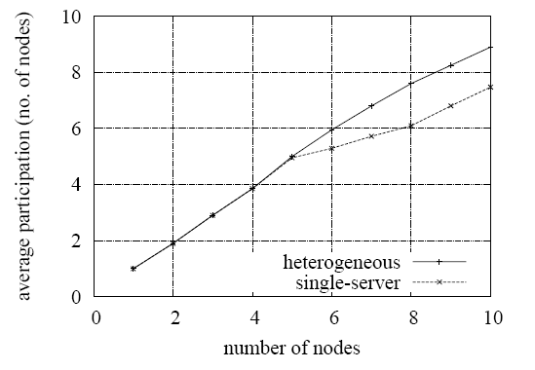
Experimental Evaluation
Heterogeneous networks yield higher performance
Decreased latencies
Less congestion
Fewer losses (shorter distances)
COSMOS enables performance by vertical integration in heterogeneous networks
… And ease of programming

Slide 35
Experimental Evaluation
Reprogramming:
IA description sent as messages
Describing each component and its connections
Size of messages is small ~ 11 to 13 Byte
→ Number of inputs and outputs
Only 10s of messages per application
COSMOS, by design, allows low-overhead reprogramming

Slide 36
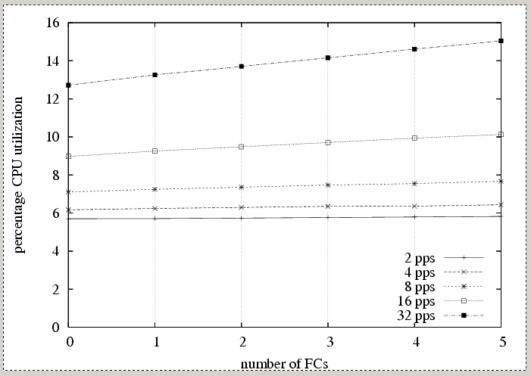
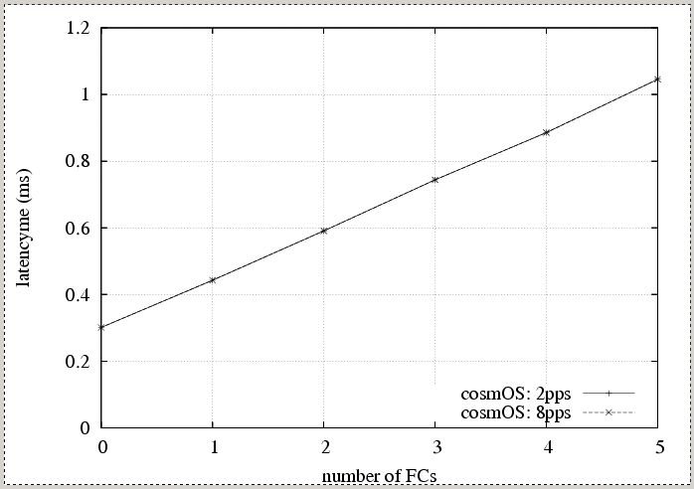
Experimental Evaluation
Effect of adding FCs
Adding FCs on the dataflow path has low-overhead:
Supports highly modular applications
through low-footprint management of FCs

Slide 37
Verifiable Sensing Applications
Sensor networks require long-term autonomic execution
Network dynamics require adaptability
Management of conflicting trade-offs
Dependencies between components

Slide 38
Verifiable Applications Using DECAL
Declarative concurrent programming model based on logic of actions
Control over resource utilization through state abstractions
Simplified programming of distributed protocols
Temporal logic invariants to enable verification
Verification of component interactions

Slide 39
Programming Model Overview
Applications can read and affect system state via a set of abstraction variables
Each stream has an isolated view of system:
Allows independent development of streams
Enforce arbitration on the use of physical resources
Actions cause state transitions.
They specify local node’s sensing, data processing, data forwarding behavior
Guards trigger the action if a pre-condition is met by the state
Max-accel :stream
s
s f
action1
state
Local
variables
s’
s
s g
System state abs variables
action2
s’
• • •
information
network
control
Runtime

Slide 40
Programming Model
Concurrent programming abstraction
Actions are triggered whenever the pre-conditions are met
Logic of actions (Lamport)
We have developed protocols (routing, collaborative rate control) that span 100s of line of C code, in only 15-30 lines
System state abstractions enable development of adaptive applications
Actions are enabled based on the live state of the system
High-level declarative programming
Pre-conditions are logic expressions
Actions are specified in terms of state transitions: S → S’

Slide 41
Programming Model
State abstraction selection
Comprehensive list of information and control variables relevant to sensor network development
Key abstractions
Ingress and egress buffer management
Observe load and congestion conditions
Observe dynamic routing organization, packet losses
Enables radio power management
Enables load conditioning, windowed buffering and aggregation, data prioritization
Ease of programming using whole buffer operations (there exists, for all) and logic expressions
Power management
Packet transport (e.g., acknowledgements, attributes)

Slide 42
Distributed Coordination Primitives
Variable type : feedback variable
Writing to a variable of this type results in a local-wireless broadcast of the value
Var : FbVar(int a, int b) // declaration
If due to an action: Var != Var’ then broadcast value of Var’
Obviates control messaging
Ported routing protocol from ~400 lines of C code to 20 lines
Safety in implementing control protocols
Low-overhead implementation

Slide 43
Declaring Actions
Generic guard expressions
Guard( Tag, pre-conditions… , [filters,] post-conditions…) : label
Tag determines default pre and post conditions
Common operations are abstracted
Example, processing (and removal) of data from ingress buffer, sorting buffers, handling feedback variables
Default post-conditions enforce correct usage and semantics
.

Slide 44
Declaring Actions
Example Load-shedding:
Example tree-routing:
.

Slide 45
Declaring Invariants
Users can provide invariants using temporal logic expressions
Users can provide assertions on values
Verification proves that a program meets invariants

Slide 46
Reusable Components
Components implement policies and protocols
Exports invocable interface
Reads stream’s state variables
Enables concurrent execution
Exports local variables
Can implement control protocols
using private local variables
Example: congestion control component
Reads length of ingress and egress buffers
Exports the rate at which the local node should send data (rate control policy)
Uses private feedback variables to announce congestion to neighboring nodes (interference aware back pressure protocol)
If successors are congested decreases local rate (fair rate control protocol)
CC
comp
Local
vars
Local
vars
photo : stream
State
vars

Slide 47
Composition Verification
Components verify that its invocation behaves correctly
Monitor state variables
Pre-conditions to match violation and trigger corrective action or raise assertion failure
Monitor user actions using guard declaration tags
e.g., congestion control component: monitor Guard(InsertEB, …)
Monitor data insertions into the egress buffer and check that they respect the rate decided by fair rate control protocol
Component users verify that the values exported by components meet application objective
e.g., congestion control user: invariant □ (rate > min_rate)
If minimum rate is required → use components that guarantee minimum rate
Correct component implementation: exponential back off + scheduling on-off periods of neighboring nodes
Most “monitor” expressions required only during verification process ➔ Efficient runtime code

Slide 48
Program Synthesis
User program
Components
Synthesis
Engine
TLA+ Spec
C code
gcc
Runtime
Library
TLC Model
checker
Binary

Slide 49
Program Synthesis
Verification by converting code to TLA+ and model-checking using TLC
Invariants specified as temporal logic expressions
Model checking checks by state space exploration
Liveness properties (e.g., pre-conditions are eventually true)
Safety properties (e.g., type checking, buffer overflows)
Decal language semantics (e.g., action post-conditions conformity)
User provided invariants, deadlock detection
Model checking is tractable
Domain-knowledge built in the DECAL language
Additional model reduction techniques

Slide 50
Code Generation and Runtime
Declarative programming can generate efficient platform optimized code
Scheduling of enabled actions
e.g., prioritize data forwarding, load shedding
Inlining actions
Each action is a scheduled function
Minimize scheduling overheads by inlining actions
Key runtime isolation features
Network isolation
Prevent high rate data applications from swamping low rate (yet critical messaging)
Each stream has independent ingress and egress buffer
Network stack provides round robin service
Radio power management
Radio is the key power consumer
Runtime provides isolation by prioritizing QoS of demanding flows even at higher energy cost
e.g., Low rate / low power during periods of uninteresting sensor data
High rate on data from high priority stream

Slide 51
Scalable Data Collection
How do we collect data from densely instrumented environments?
Compression typically based on correlations.
Correlated data can be stored as an index into the codebook (database).
Notes:
Also shows the relevance to distributed systems at large

Slide 52
Scalable Data Collection
Correlation based compression:
Each sensor determines (previously) sensed data within prescribed error
Sensor data is replaced by reference to previously sensed value
Notes:
Also shows the relevance to distributed systems at large

Slide 53
Scalable Data Collection
Correlation based compression:
Who computes correlations (everyone)?
What is the overhead of computing correlations?
What is the associated ordering, since we maintain reference to previous values?
Must this order be static?
What happens if we have network updates/errors?
Notes:
Also shows the relevance to distributed systems at large

Slide 54
Scalable Data Collection
Correlation based compression (existing solution):
Cluster leaders compute correlations
All nodes send data to cluster leaders
Cluster leaders correlate data and send compressed streams onwards
Transmission order is not important
Notes:
Also shows the relevance to distributed systems at large

Slide 55
Scalable Data Collection
Correlation based compression (existing solution):
Complexity is approximately:
nk_{h} + n_{c}k_{s}
n is number of nodes, k_{c} is avg. number of hops from source to cluster head, n_{c} is the average number of compressed data items and k_{s} is the average number of hops from cluster heads to sink.
Notes:
Also shows the relevance to distributed systems at large

Slide 56
Scalable Data Collection
Proposed Solution:
Collocate sensing and compression
Use broadcast media of sensor networks to compress data locally
Each node determines whether it can correlate data to other nodes in the neighborhood
How can we do this without everyone communicating?
Notes:
Also shows the relevance to distributed systems at large

Slide 57
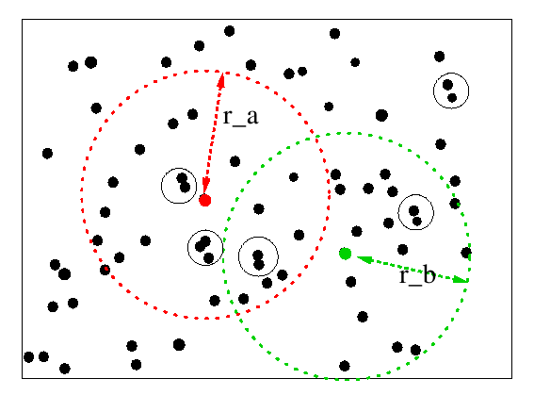
Spatial Neighborhood (SN)
Correlation within a spatial region:

Slide 58
Spatial Neighborhood (SN)
Key Results:
Compression of SN approaches joint entropy
Network overhead of SN grows as O(n-R) + O(n_{c}k)
Here, R is a measure of redundancy, n_{c} is the number of number of data packets, and k is the avg. number of hops from source to sink.

Slide 59
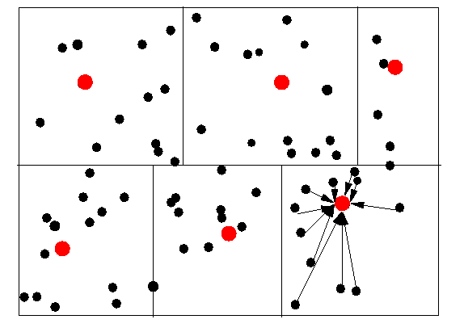
Partitioning Model (PT)
Partition nodes into domains

Slide 60
Partitioning Model (PT)
Each node sends data to cluster head
Cluster head correlates data and sends it to sink
Data rate of PT approaches sums of joint entropies of clusters

Slide 61
SNP Protocol
In the SN model, each node needs data from its neighbors
We need an ordering of nodes
SNP induces such an ordering based on spatial relationships

Slide 62
SNP Protocol
Partition time into intervals of user-defined epochs
Within each allocated epoch, a node transmits (or suppresses its transmission)
SNP designates selected spatially distant nodes to initiate linearization
These nodes broadcast an initiate message and other nodes pick their epoch based on their distance from closest initiator (with a random perturbation)

Slide 63
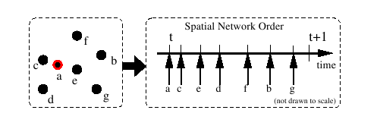
SNP Protocol

Slide 64
SNP Protocol
Spatial Network Ordering in this manner:
Is resilient to node insertions and departures
Provides relative synchronization and has lower overhead
Is independent of radio range and does not suffer from hidden terminals
Minimizes collisions by providing TDM slotting

Slide 65
SNP Protocol
A model-based prediction function is used to correlate data from current and previous iterates
Correlation radius is captured in two sets (predecessors and successors)
Broadcast is suppressed if predicted value is within error tolerance
Messages are buffered to optimize throughput with timing constraints.

Slide 66
Experimental Evaluation
SNP on Mica2 using COSMOS
Source-to-sink through tree routing
Lab testbed of 25 nodes
Two sensor data traces seeded at nodes
Trace A: Sonoma forest deployment
Trace B: Introducing sharp perturbations in Trace A.

Slide 67
Experimental Evaluation
Implemented SNP, PT, and SDC (simple data collection with no in-network compression)
Routing tree is fixed for repeatability
Autoregressive moving average based prediction for spatio-temporal correlation

Slide 68
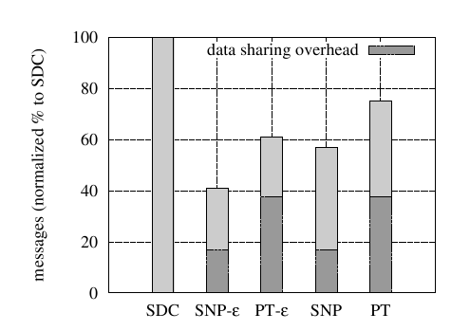
SNP Performance
SNP and PT vs. baseline SDC (Trace A)

Slide 69
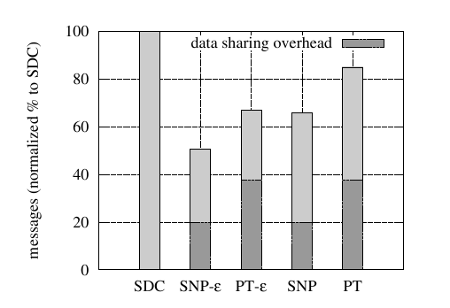
SNP Performance
SNP and PT vs. baseline SDC (Trace B)

Slide 70
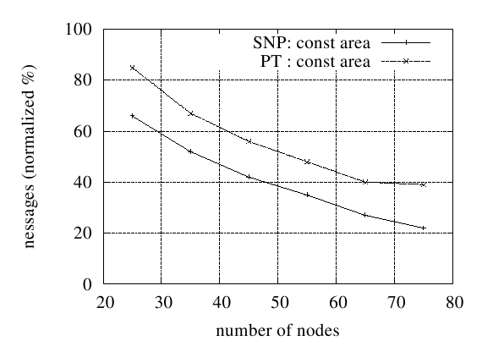
SNP Performance
Effect of increasing node density

Slide 71
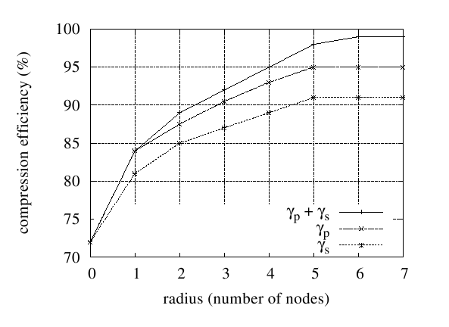
SNP Performance
Effect of number of members in predecessor and successor sets

Slide 72
Concluding Remarks
SNP is a lean application independent in-network compression scheme
Formal quantification of SNP performance and its near-optimality

Slide 73
Related Work
TinyOS
Low footprint: applications and OS are tightly coupled
Nice to program an OS, difficult to program applications
Scripting languages TinyScript*, Mottle*, SNACK
Maté – application specific virtual machine
Event driven bytecode modules run over an interpreter
Domain specific interpreter
Very low cost updates of modules
Easy to program using simple scripting languages*
Flexible? Expressive?

Slide 74
Related Work
TinyDB
Specify system behavior using SQL queries
It is a macroprogramming application
Lack of flexibility
Adding delivery reliability?
Adding congestion control?
How to deal with perturbations?
Difficult to add new operators
Heavy footprint
Restricts scope to low-data rate apps
Highly coupled with routing
Resilience issues

Slide 75
Related Work
High level macroprogramming languages
Functional and intermediate programming languages
Region stream, abstract regions, HOOD, TML (DTM)
Programming interface is restrictive and system mechanisms can not be tuned
No mature implementations exist, no performance evaluation is available
Compile down to native OS: can compile down to COSMOS applications

Slide 76
Related Work
SOS
Interacting modules compose an application
OS and modules are loosely coupled
Modules can be individually updated: low cost
Larger number of runtime failure modes
TinyOS and SOS are both node operating systems

Slide 77
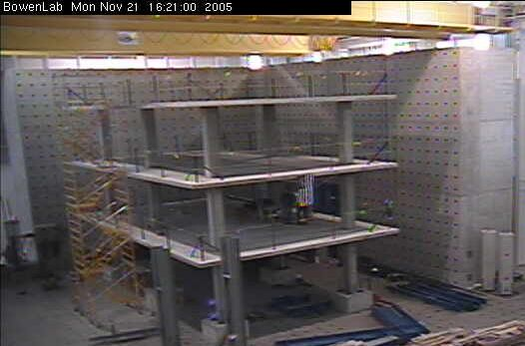
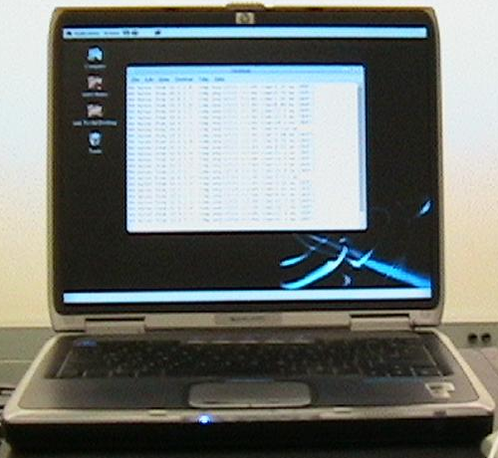

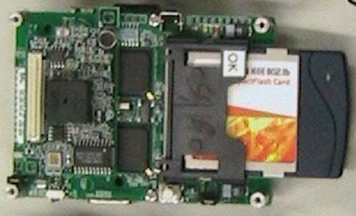
WSN @ BOWEN
Pilot deployment at BOWEN labs
ECN Net
MICA2 motes with
ADXL 202
FM 433MHz
802.11b
Peer-to-Peer
Internet
Laser attached
via serial port to
Stargate computers
Currently laser readings
can be viewed for from
anywhere over the Internet
(conditioned on firewall settings)

Slide 78
Related Work
Dynamic resource allocation
Impala
Rich routing protocols
Rich software adaptation subsystem
Aimed at resource rich nodes
SORA
Self-organized resource allocation architecture
Complimentary to our work

Slide 79
Programming Model Overview
Over-the-air programming
Send components (borrowed from SOS)
Send IA subgraphs (low-overhead)
…and reprogramming
accel
smax
smax
display
timer
filter
FFT
controller
Notes:
As is used in several high performance distributed systems – we propose to describe aggregate behavior of the network in terms of dataflow & processing.
Our goals include factoring apps into reusable functional components.
Provide processing components. System components provide transparent high-level abstractions.
Support heterogeneity through a uniform programming model, however, need to capability-aware so that nodes in the network can be used based on their capability

Slide 80
OS Design
Each node has a static OS kernel
Consists of platform dependent and platform independent layers
Each node runs service modules
Each node runs a subset of the components that compose a macro-application
Updateable
User space
Services
Services
App FC
App FC
App FC
Platform Independent Kernel
Static OS
Kernel
Hardware Abstraction Layer
HW Drivers
HW Drivers
HW Drivers

Slide 81
Implementation
Implementations for Mica2 and POSIX (on Linux)
Mica2:
Non-preemptive function pointer scheduler
Dynamic memory management
POSIX:
Multi-threading using POSIX threads and underlying scheduler
The OS exists as library calls and a single management thread

Slide 82
FC-mOS Interaction
FC parameters: cp_param_t, bq_node, index
Runtime parameters
Status of input queue
Non-blocking system calls e.g., out_data()
Return values
“commands” to manage the input queues
Commit
Transfer to output
Wait for more data (on same or different queue)

Slide 83
Base mPL LANGUAGE
Sections:
Enumerations
Declarations
Instances
Mapping constraints
IA Description
Contracts
Implemented using Lex & Yacc

Slide 84
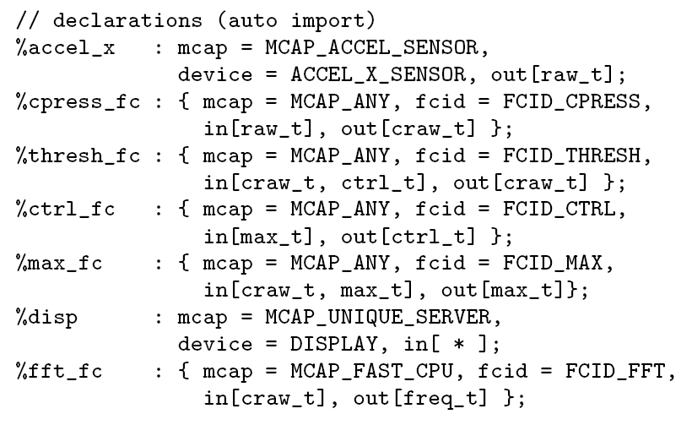
Declarations

Slide 85
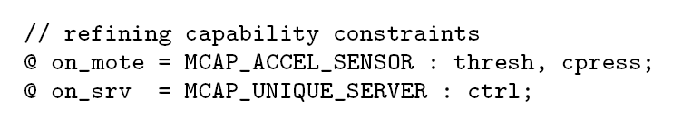
Instances & MCAP refinements

Slide 86
WSN @ BOWEN
Pilot deployment at BOWEN labs
ECN Net
MICA2 motes with
ADXL 202
FM 433MHz
802.11b
Peer-to-Peer
Internet
Laser attached
via serial port to
Stargate computers
Currently laser readings
can be viewed for from
anywhere over the Internet
(conditioned on firewall settings)

Slide 87
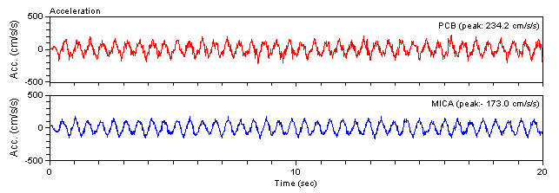
Evaluation
Remote sensing application
T(10)
A()
raw_t
raw_t
Compress
raw_t
*
FS

Slide 88
Extensibility
Core of the OS is platform independent
New devices can be easily added by implementing simple device port interface functions
Communication with external applications by writing a virtual device driver
Complex devices can use an additional service to perform low-level interactions

Slide 89
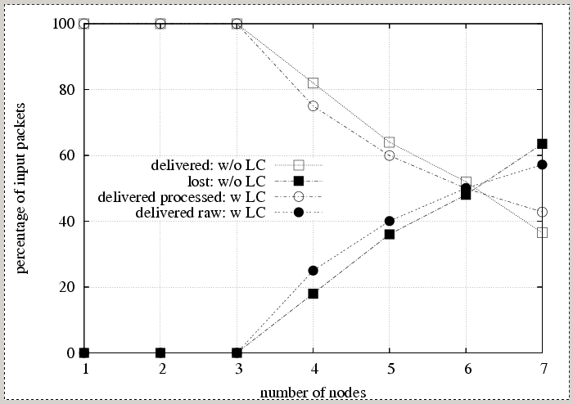
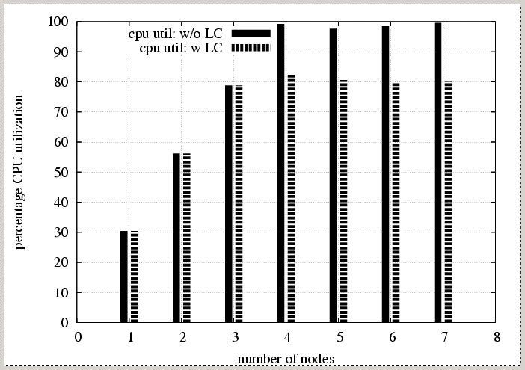
Evaluation
Load conditioning
A 3pps FC on a processing node
1pps per node received at processing node
Load conditioning enables efficient adaptation and
self-organization in dynamic environments

Slide 90
Example

