Slide 1
Center for
Science of Information
Big Data Applications in Life Sciences
University of Hawaii, Aug 2015
Ananth Grama
ayg@cs.purdue.edu

Slide 2
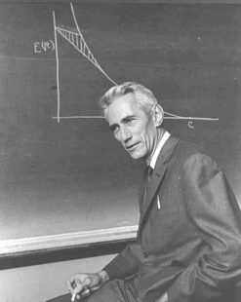
What is Science of Information?
Claude Shannon laid the foundation of information theory, demonstrating that problems of data transmission and compression (i.e., reliably reproducing data) can be precisely modeled formulated, and analyzed.
SCIENCE OF INFORMATION builds on Shannon’s principles to address key challenges in understanding information that nowadays is not only communicated but also acquired, curated, organized, aggregated, managed, processed, suitably abstracted and represented, analyzed, inferred, valued, secured, and used in various scientific, engineering, and socio-economic processes.
CSoI MISSION: Advance science and technology through a new quantitative understanding of the representation, communication and processing of information in biological, physical, social and engineering systems.

Slide 3
Center’s Goals
Extend Information Theory to meet new challenges in
biology, economics, data & social sciences, and distributed systems.
Understand new aspects of information (embedded) in
structure, time, space, semantics,
dynamic information, limited resources, complexity, representation-invariant information, and cooperation & dependency.
Georg Cantor (1845-1918):
“In re mathematica ars proponendi questionem pluris facienda est quam solvendi ”
(In mathematics the art of proposing a question must be held of higher value than solving it.)

Slide 4
Big Data in Life Sciences
Clinical Data
  Sequences, Expression/ Transcriptional data
  Phenotypic Screens
  Imaging Data (3D+time)
Organism-, Individual-, and Pathology-Specific Data
  Structures, Genomes, Interactomes
  Tissue- and Phenotype Specific Data
Pharmaco-Genomic Data
  Drug Molecule Databases
  Drug-Biomolecule Interaction Screens

Slide 5
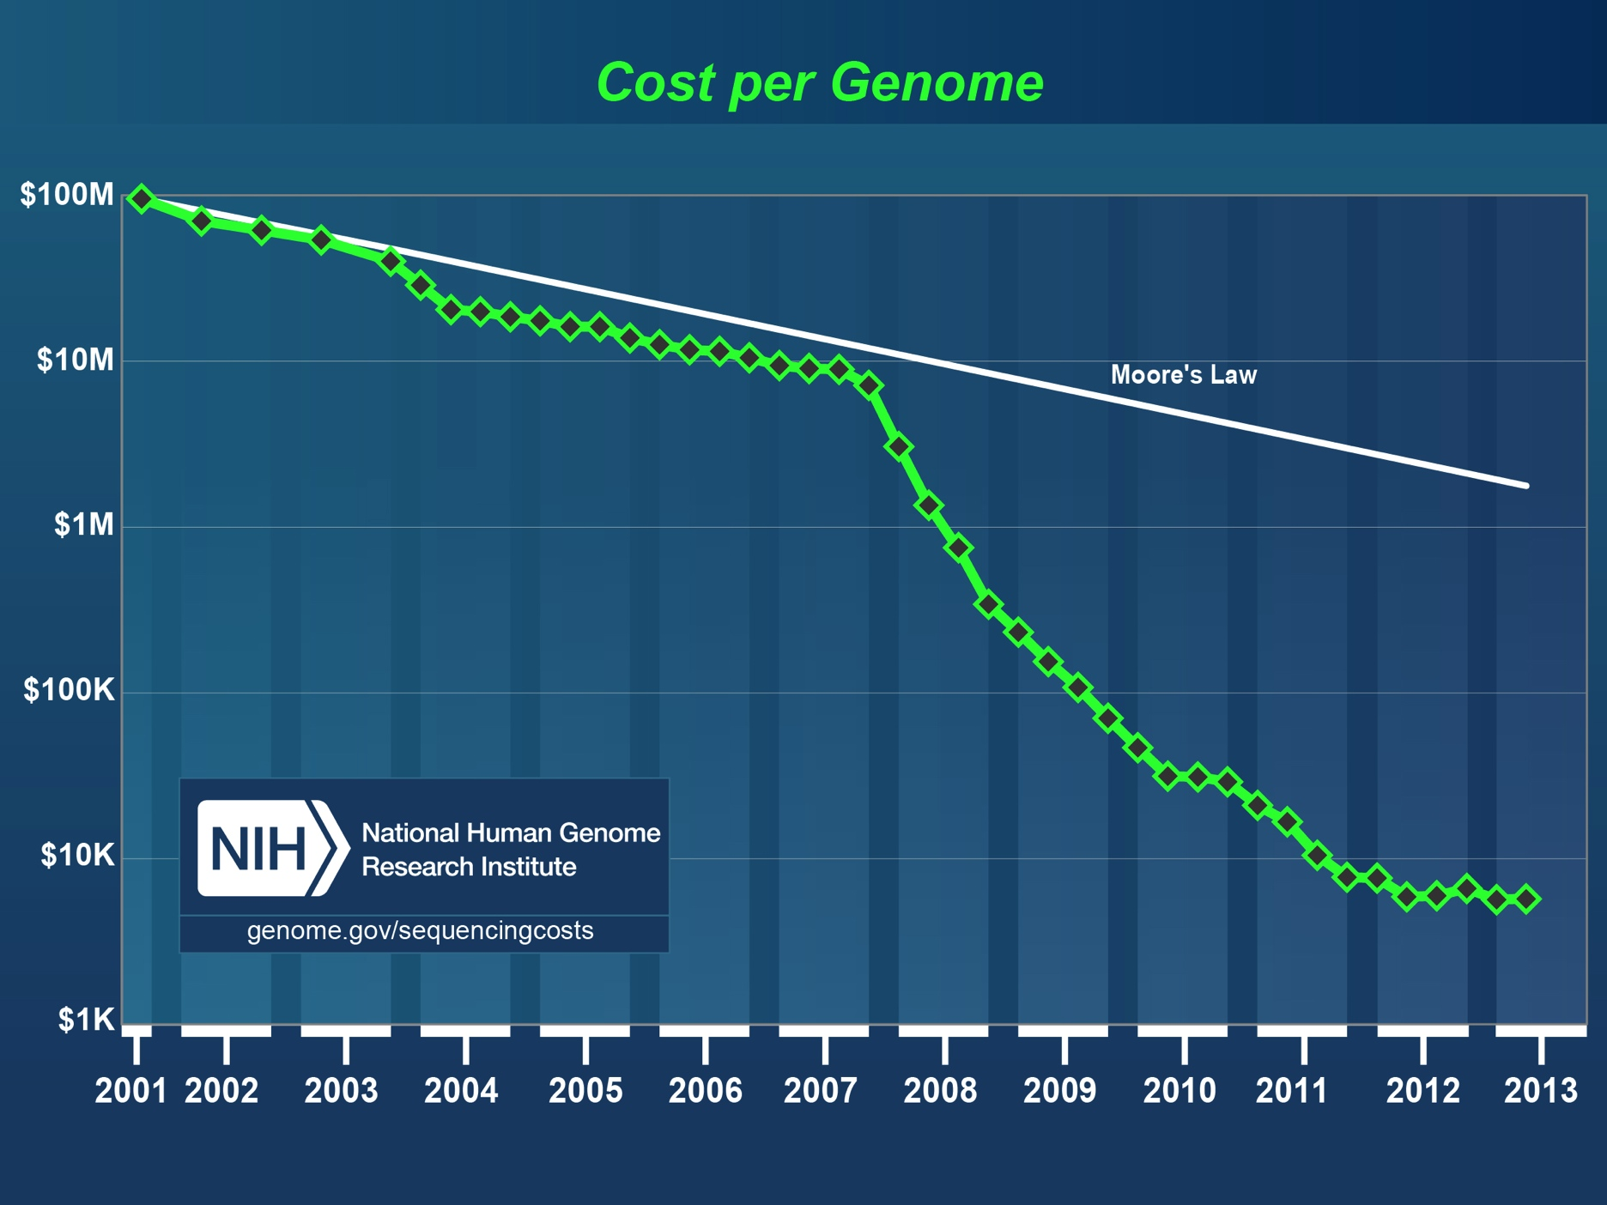
High throughput sequencing revolution
Notes:
Faster than Moore;s Law
Implication to the IT community

Slide 6
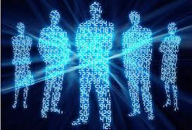
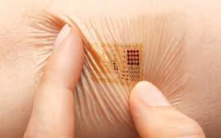
Sensors and Measurements
The Digital Human
Phenotypic Readout

Slide 7
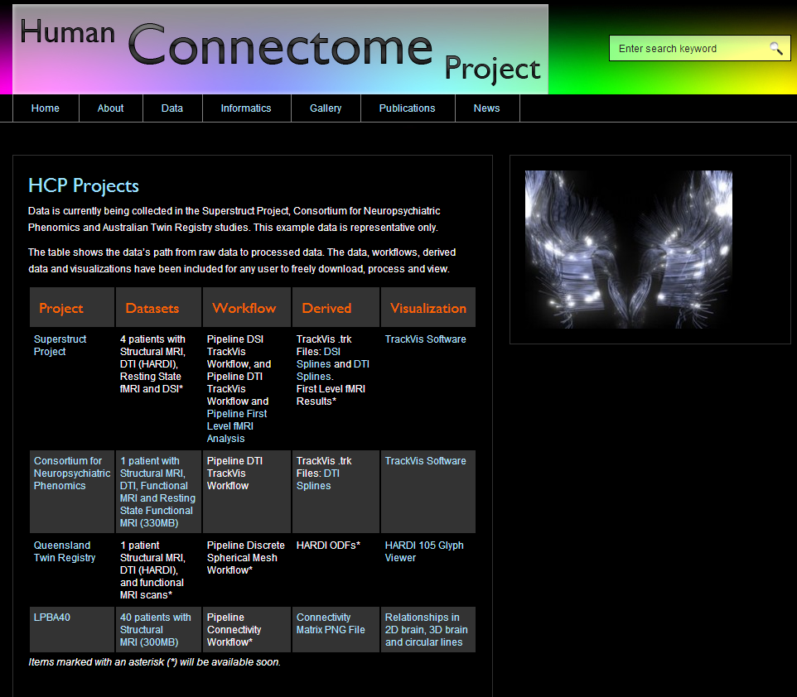
Imaging Databases

Slide 8
Some Key Results
Limits of Sequencing
From Sequences to Structures
From Structure/ Expression to Networks
From Networks to Function
From Function to Pathology
From Pathology to Drugs

Slide 9
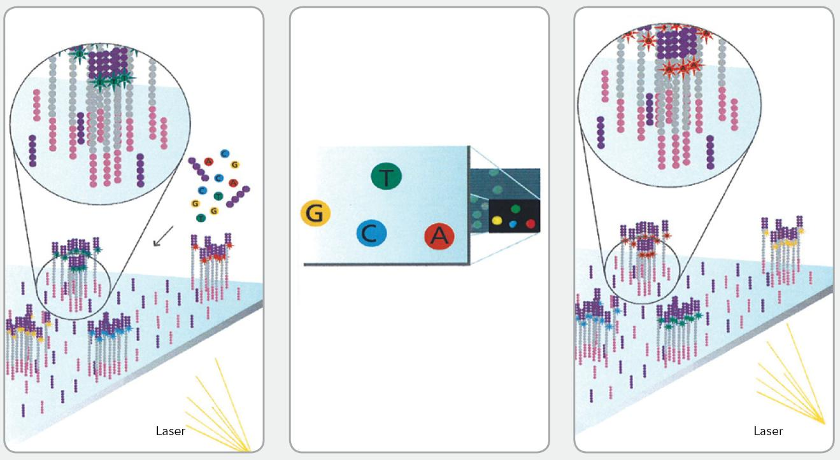
Shotgun sequencing

Slide 10
Assembly as a Software Engineering Problem
A single sequencing experiment can generate 100’s of millions of reads, 10’s to 100’s gigabytes of data.
Primary concerns are to minimize time and memory requirements.
No guarantee on optimality of assembly quality and in fact no optimality criterion at all.
Notes:
Include a paper with many authors

Slide 11

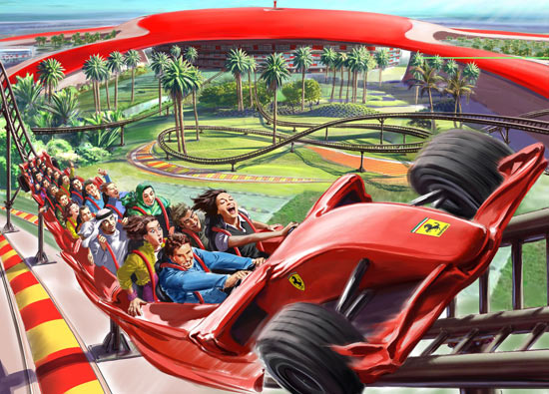
Repeats Make Jigsaw Puzzles Difficult

Slide 12
Critical Read Length L_{critical}
Minimum read length needed to assemble a genome even with infinite coverage depth.
A measure of repeat complexity of the genome from the point of view of assembly.

Slide 13
Fundamental limits and algorithms
normalized
# of reads
(coverage
depth)
greedy
deBruijn
lower bound
simpleBridging
length
multiBridging
Human Chr 19
Build 37
Lander-Waterman coverage
Notes:
4. Multibridging is the algorithm we propose, which is nearly optimal, at least for chromosome 19. Did we get lucky?

Slide 14
GAGE Benchmark Datasets
http://gage.cbcb.umd.edu/
Rhodobacter sphaeroides
Staphylococcus aureus
Human Chromosome14
G = 4,603,060
G = 2,903,081
G = 88,289,540
L_{critical}
L_{critical}
L_{critical}
lower bound
multiBridging
lower bound
multiBridging
lower bound
multiBridging
Notes:
What about the lower bound?

Slide 15
ShannonRNA: Real Data
RNA sample from Human Embryonic Stem Cell
Read length=50, 135 Million read
Long+short-read assembly as a proxy for ground truth. (Au et al, PNAS 2013)

Slide 16
ShannonRNA: Real Data
Recovery rate by transcript abundance
False positive rate
ShannonRNA
Coverage Depth of Transcripts

Slide 17
ShannonRNA Resolves More Complex Splicing Structures
Recovery rate by splicing complexity
ShannonRNA
Fraction of Transcripts reconstructed
Splicing Complexity

Slide 18
From Sequences to Structures:
The Protein Folding Channel

Slide 19
Why So Few Protein Folds?
Protein Folds in Nature
Probability of protein folds vs. sequence rank

Slide 20

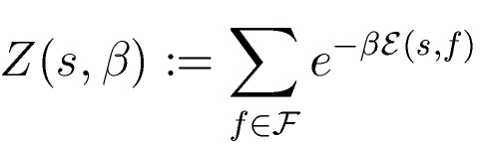
Information-Theoretic Model
s
protein-fold
channel
f
HPHHPPHPHHPPHHPH
Optimal input distribution from Blahut-Arimoto algorithm:

Slide 21











Protein-Protein Channel
: set of self-avoiding walks of length
: Energy of a walk over sequence :
We conjecture that:
is free energy, and
(by subadditivity of ).
Phase transition of the free energy (hence of the capacity ):

Slide 22
From Structure/ Expression to Networks

Slide 23
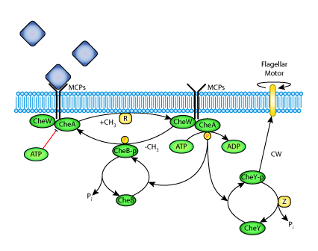
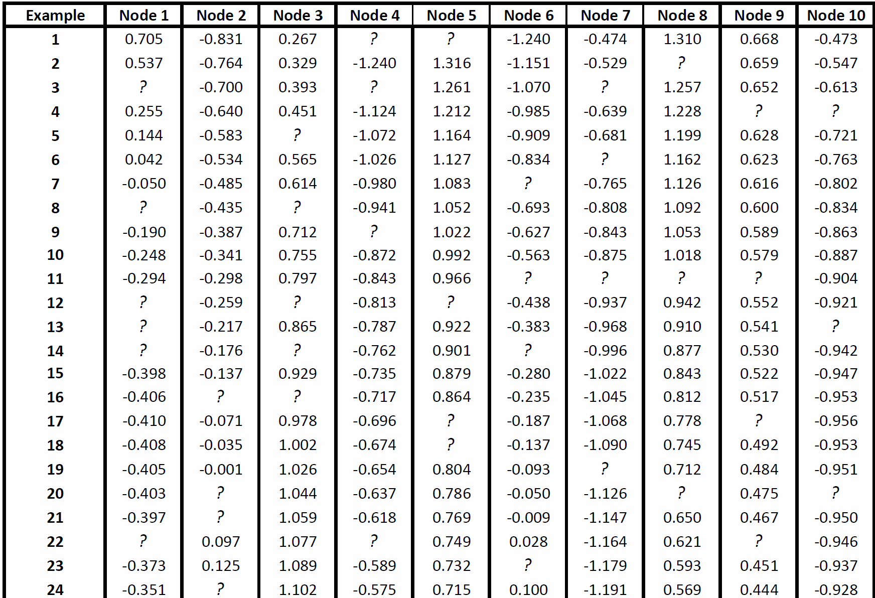
Data-driven network reconstruction of biological systems
  Derive relationships between input/output data
  Represent the relationships as a network
Experiments/Measurements
Notes:
Different slide same message. Maybe one of the simulated pic.

Slide 24
LINEAR REGRESSION
Goal: Building a linear-relationship based model
X: input data (m samples by n inputs)
  y: output data (m samples by 1 output column)
  X: zero mean, unit standard deviation; y: zero-mean
  b: model coefficients: translates into the edges in the network
  e: normal random noise with zero mean
  Ordinary Least Squares solution:
  Formulation for dynamical systems:

Slide 25
STATISTICAL SIGNIFICANCE TESTING
Most coefficients non-zero, a mathematical artifact
Perform statistical significance testing
Compute the standard deviation on the coefficients
Ratio
Coefficient is significant (different from zero) if:
* Krämer, Nicole, and Masashi Sugiyama. "The degrees of freedom of partial least squares regression." Journal of the American Statistical Association106.494 (2011): 697-705.

Slide 26
OUR APPROACH: DPLASSO
PLS
Model
LASSO
Reconstructed Network

Slide 27
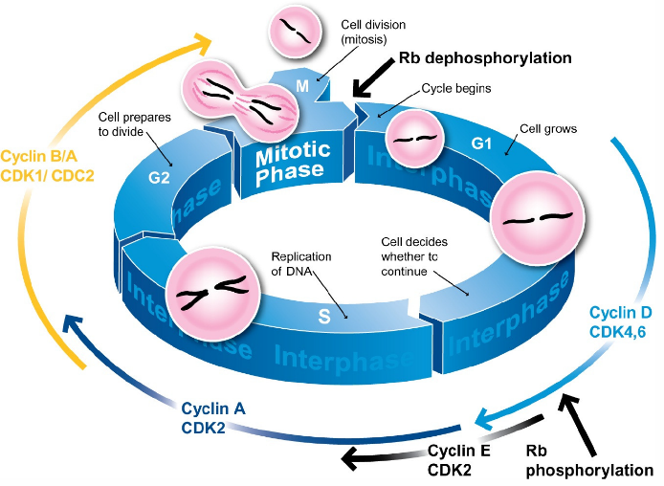
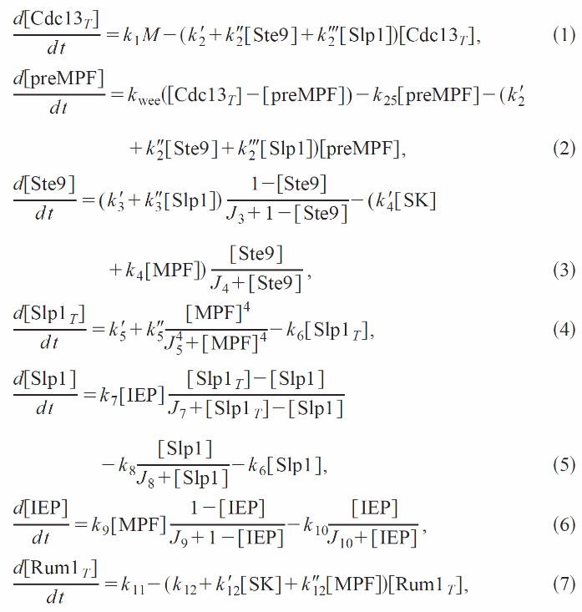
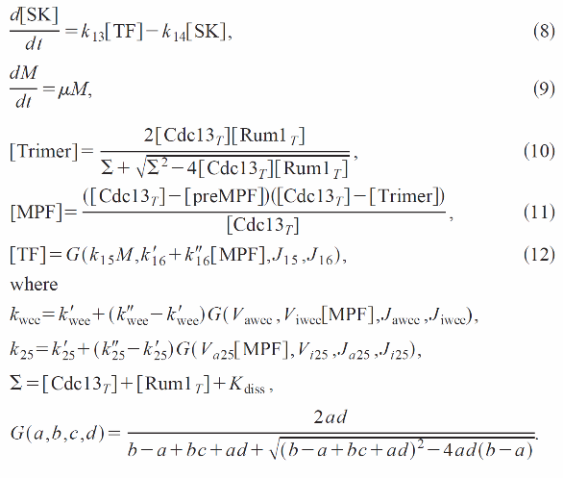
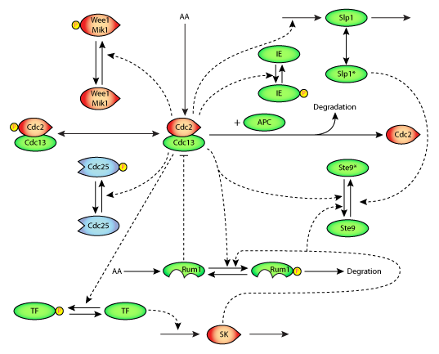
YEAST CELL DIVISION
  Experimental dataset generated via well-known nonlinear model of a cell division cycle of fission yeast. The model is dynamic with 9 state variables.
* Novak, Bela, et al. "Mathematical model of the cell division cycle of fission yeast." Chaos: An Interdisciplinary Journal of Nonlinear Science 11.1 (2001): 277-286.

Slide 28
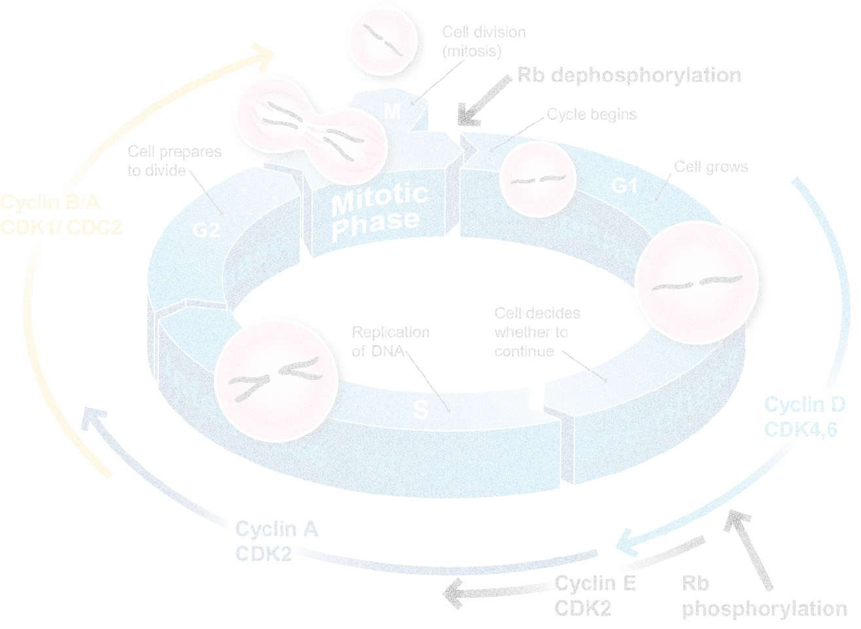
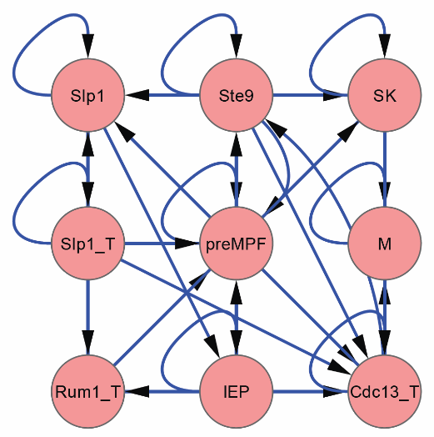
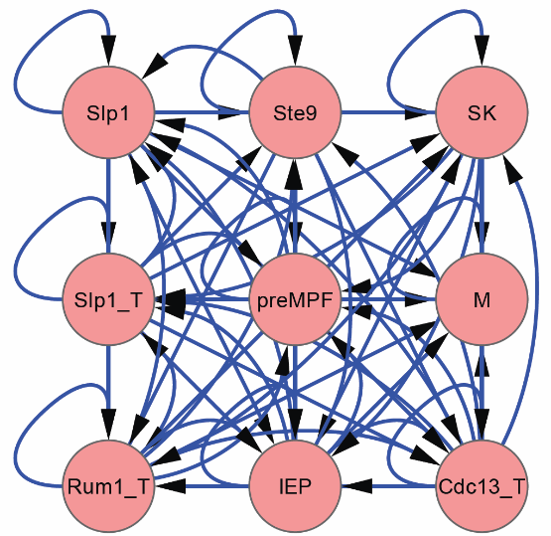
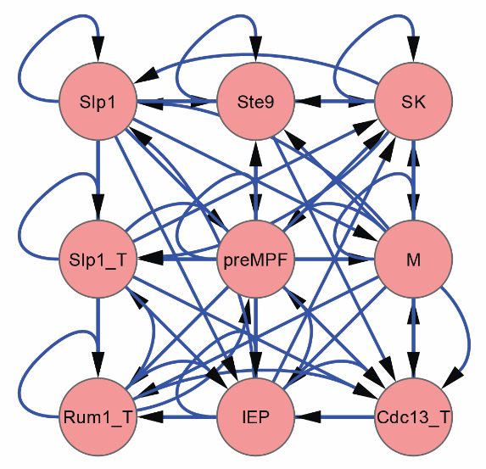
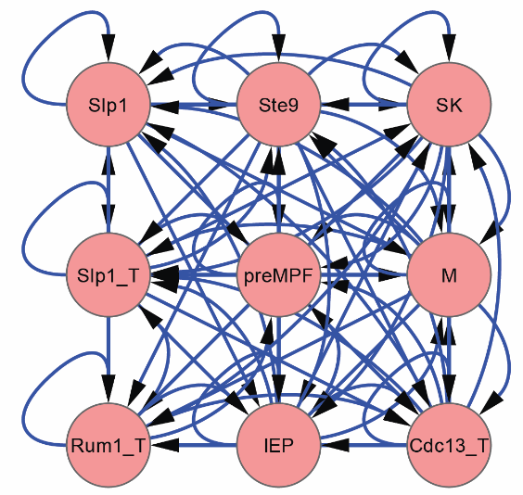
CELL DIVISION CYCLE
True Network (Cell Division Cycle)
Missing in DPLASSO!
PLS
DPLASSO
LASSO

Slide 29
NONLINEARITY IN A BIOSYSTEM
Notes:
Use chemotaxis example

Slide 30
PERFORMANCE COMPARISON:
SENSITIVITY, ACCURACY, SPECIFICITY, PRECISION
Metrics have been evaluated compared for 3 different models:
  Pure Linear
  Pure Nonlinear
  Hybrid (Linear + Nonlinear)
Network size: 22
Noise: 5%
Significance level: 0.6
# linear connections
# nonlinear connections
Which output is it?
Comparison of performance of the methods on different models for sample output.
Model/Metric | Hybrid | Linear | Nonlinear
TP | 4 | 1 | 3
TN | 249 | 15 | 225
FP | 20 | 5 | 21
FN | 2 | 5 | 3
Sensitivity | 0.67 | 0.17 | 0.50
Specificity | 0.93 | 0.75 | 0.91
Accuracy | 0.92 | 0.62 | 0.90
Notes:
Highlight main things in the results.
Choose an output with more nonlinear terms

Slide 31
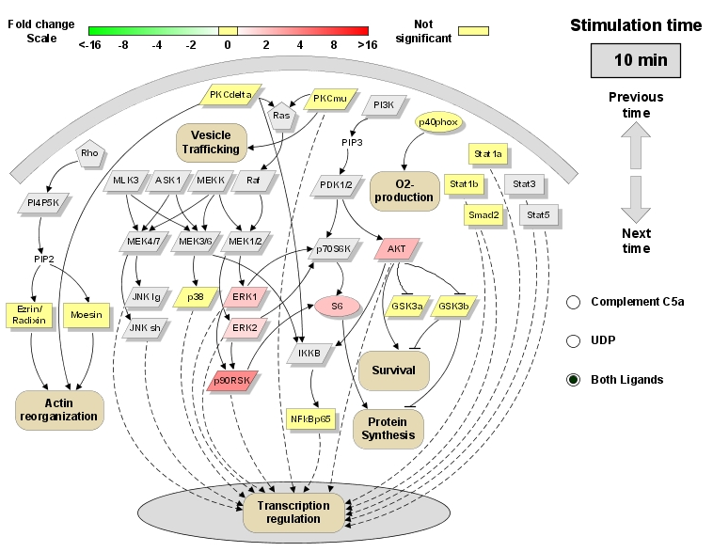

Time-Varying Causal Inference

Slide 32
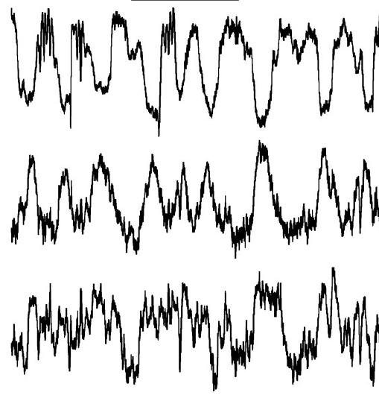
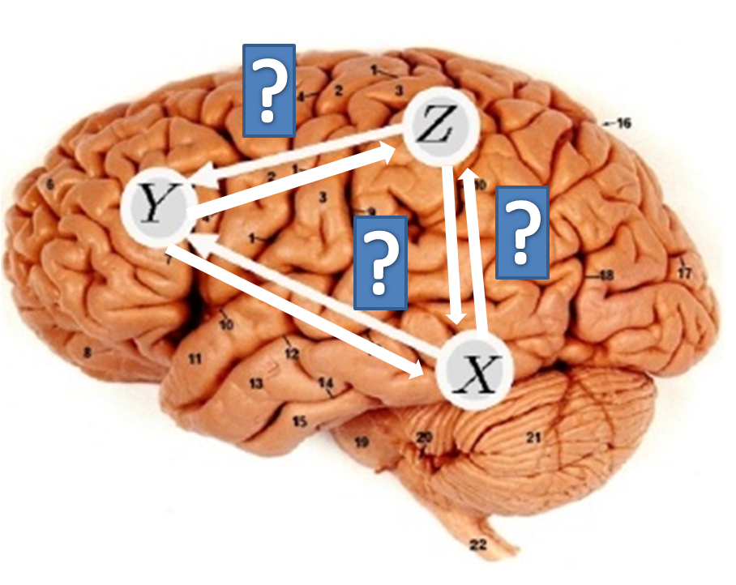
Granger’s Notion of Causality
We say that X is causing Y if we are better able to predict the future of Y using all available information than if the information apart from the past of X had been used
Granger (Granger, 1969) was first introduced in econometric research to analyze the relationships and influences among macroeconomic time series (e.g. income, exchange rate, etc). It is based on the assumption that a cause cannot ever occur after its effect. Therefore, temporal relationships as delay or precedence may contain information about causality.

Slide 33
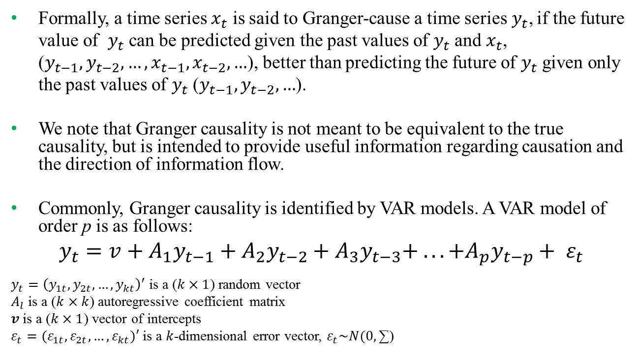
Approach: Granger Causality
Formally, a time series $x_{t}$ is said to Granger-cause a time series$y_{t}$, if the future value of $y_{t}$ can be predicted given the past values of $y_{t}$ and $x_{t}$, ($y_{t−1},y_{t−2},…, x_{t−1},x_{t−2},…$), better than predicting the future of $y_{t}$ given only the past values of $y_{t}$ ($y_{t−1},y_{t−2},…$).
We note that Granger causality is not meant to be equivalent to the true causality, but is intended to provide useful information regarding causation and the direction of information flow.
Commonly, Granger causality is identified by VAR models. A VAR model of order p is as follows:
$$y_{t}=v+A_{1}y_{t−1}+A_{2}y_{t−2}+A_{3}y_{t−3}+ . . . +A_{p}y_{t−p}+ ε_{t}$$
$y_{t}={\left(y_{1t},y_{2t},…,y_{kt}\right)}^{′}$ is a ($k×1$) random vector
$A_{l}$ is a ($k×k$) autoregressive coefficient matrix
$v$ is a ($k×1$) vector of intercepts
$ε_{t}=(ε_{1t},ε_{2t},…,ε_{kt})′$ is a $k$-dimensional error vector, $ε_{t}\sim N(0,\text{∑)}$

Slide 34
  Application of VAR Model to Phosphoproteomic Data
Data:
Time-course data on the level of phosphorylation of proteins in RAW 264.7 macrophages in response to stimuli, provided by the Alliance for Cellular Signaling (AfCS).
Fold change measurements of 17 phosphoproteins at 1,3,10 and 30 minutes, in response to treatments with 22 single ligands and their double ligand combinations (western blot method)
Data Processing:
Interpolated data using linear interpolation with steps of one minute.
Excluded the last sample (at 30 min) in the original data

Slide 35
Temporal Evolution of the Phosphoprotein Network
Fig. 5. Time-dependent cascade of the phosphoprotein signaling network in RAW 264.7 macrophages in three stages. (a) Reconstructed network in stage 1 related to [1-4] minute interval. (b) Reconstructed network in stage 2 related to [3-7] minute interval. (c) Reconstructed network in stage 3 related to [6-10] minute interval.

Slide 36
From Networks to Phenotype

Slide 37
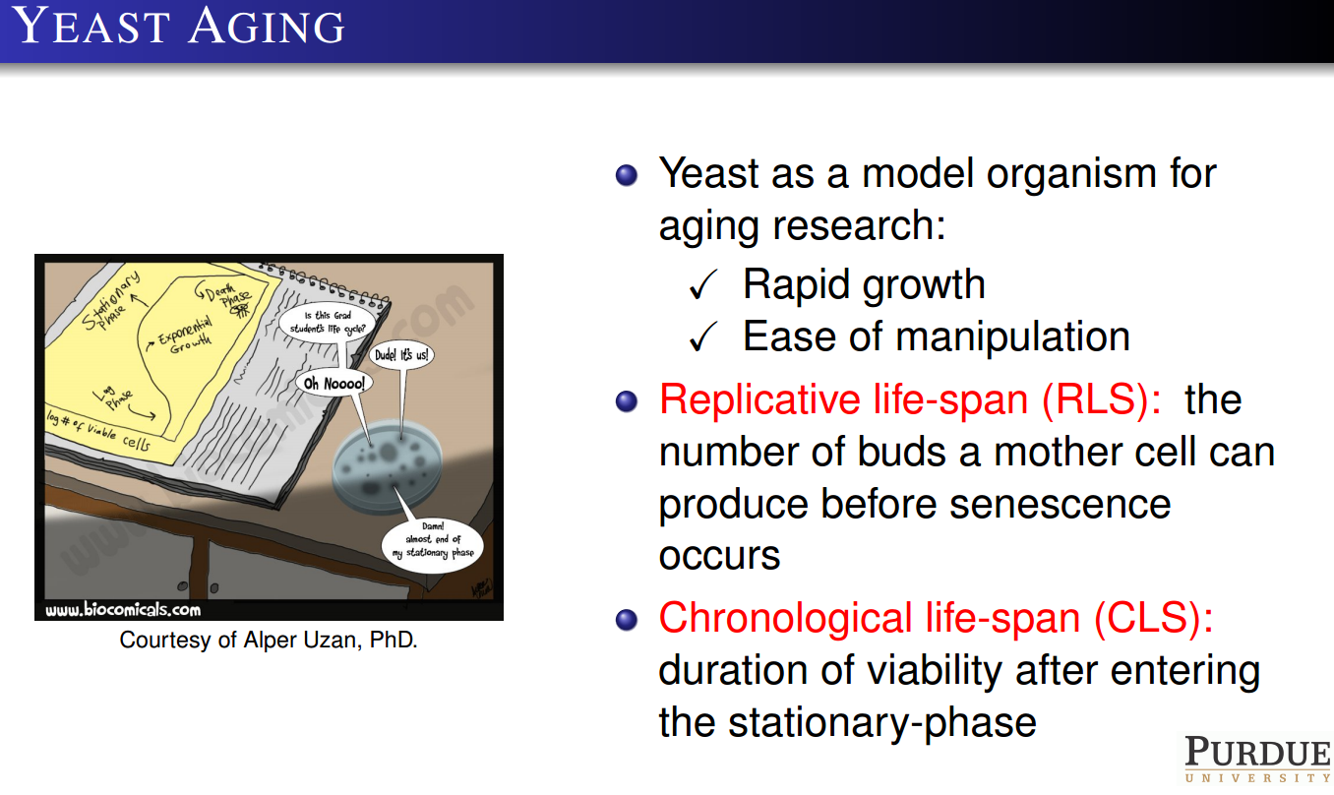

Slide 38
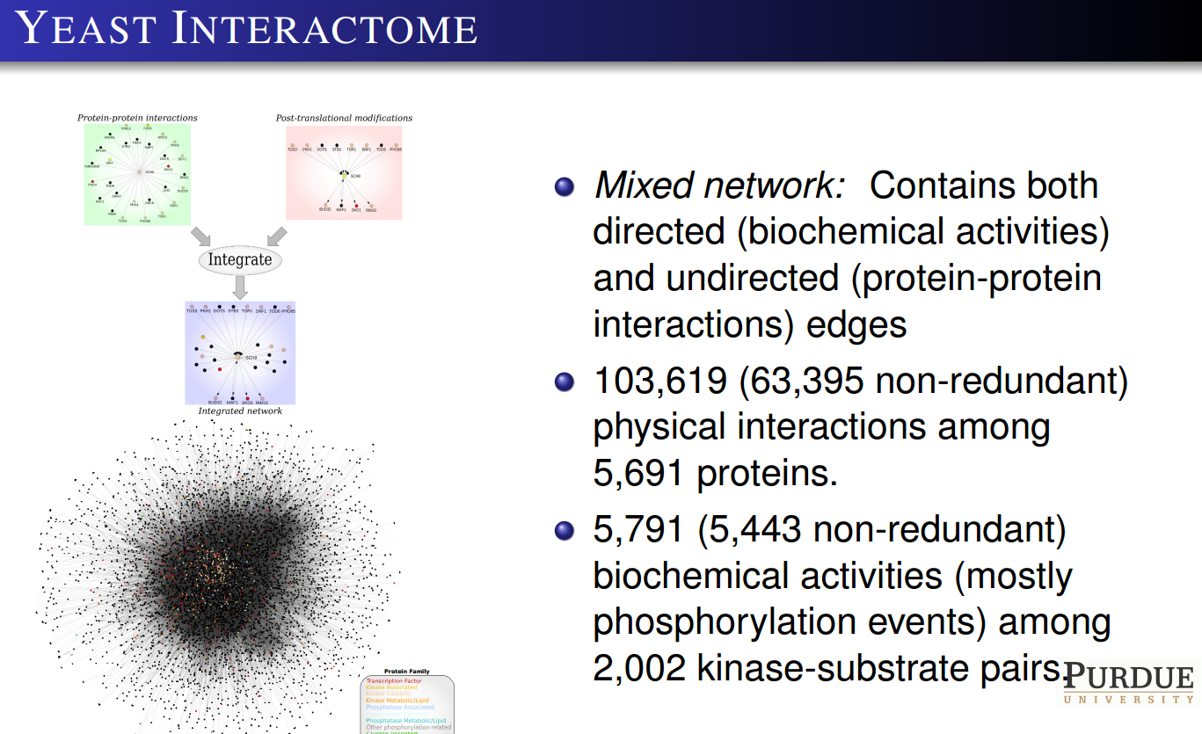

Slide 39
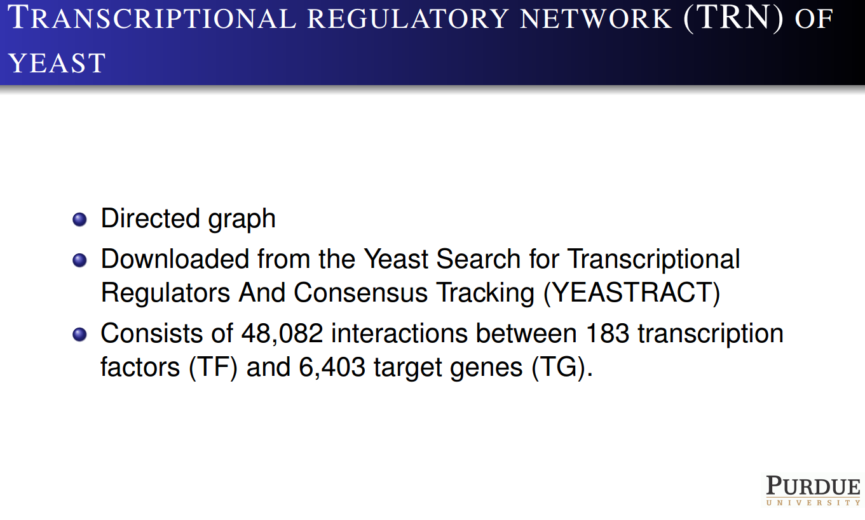

Slide 40
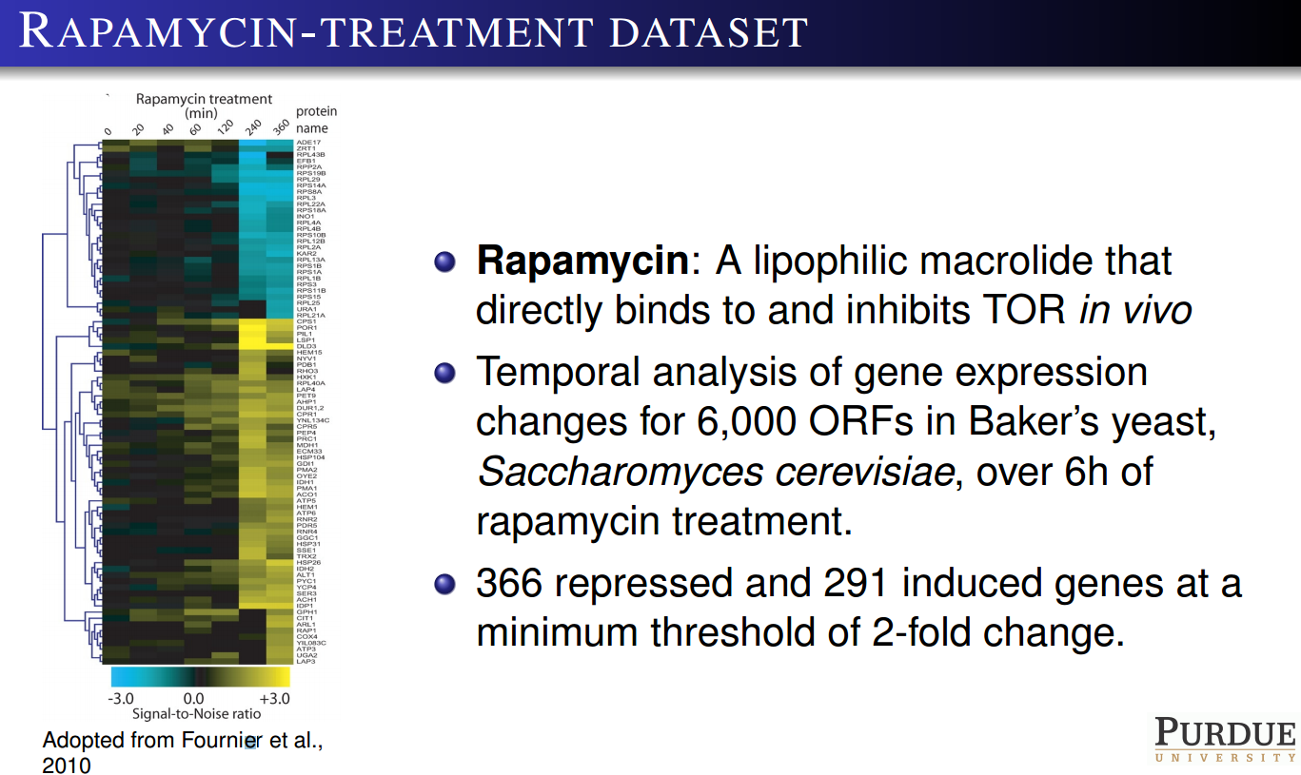

Slide 41
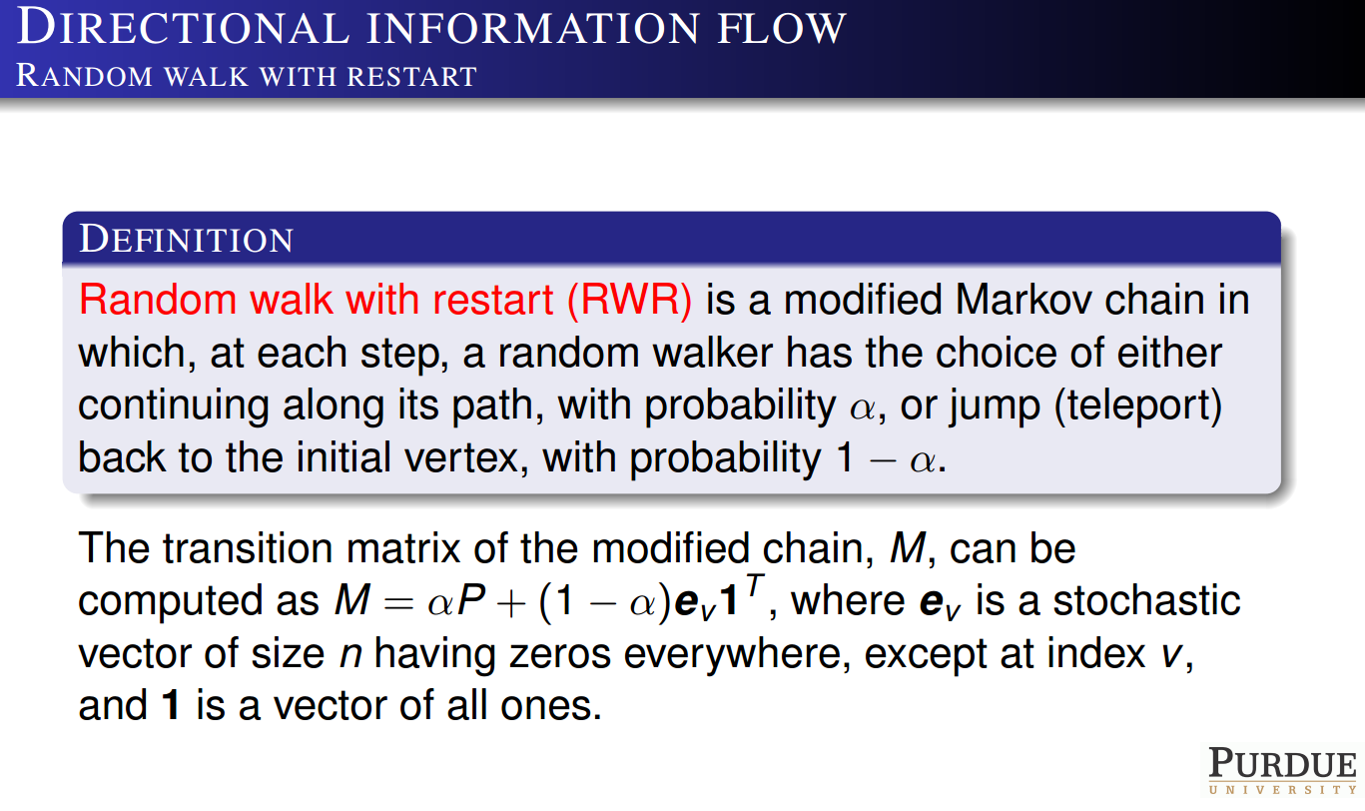

Slide 42
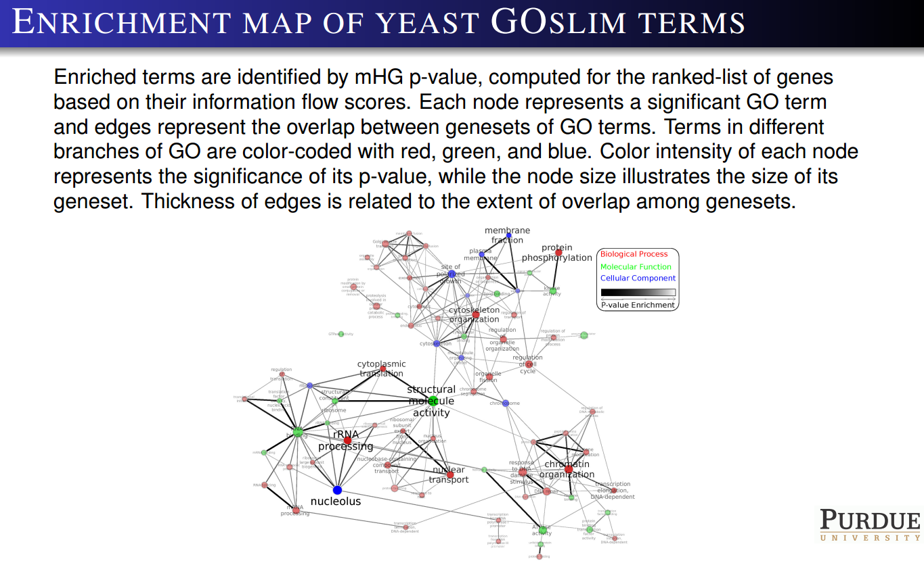

Slide 43
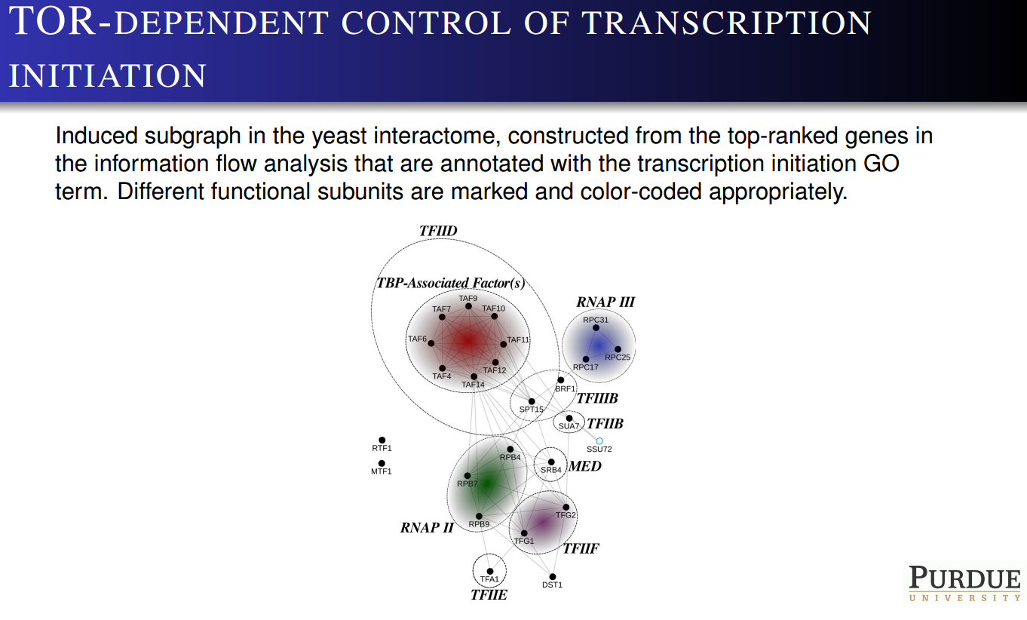

Slide 44
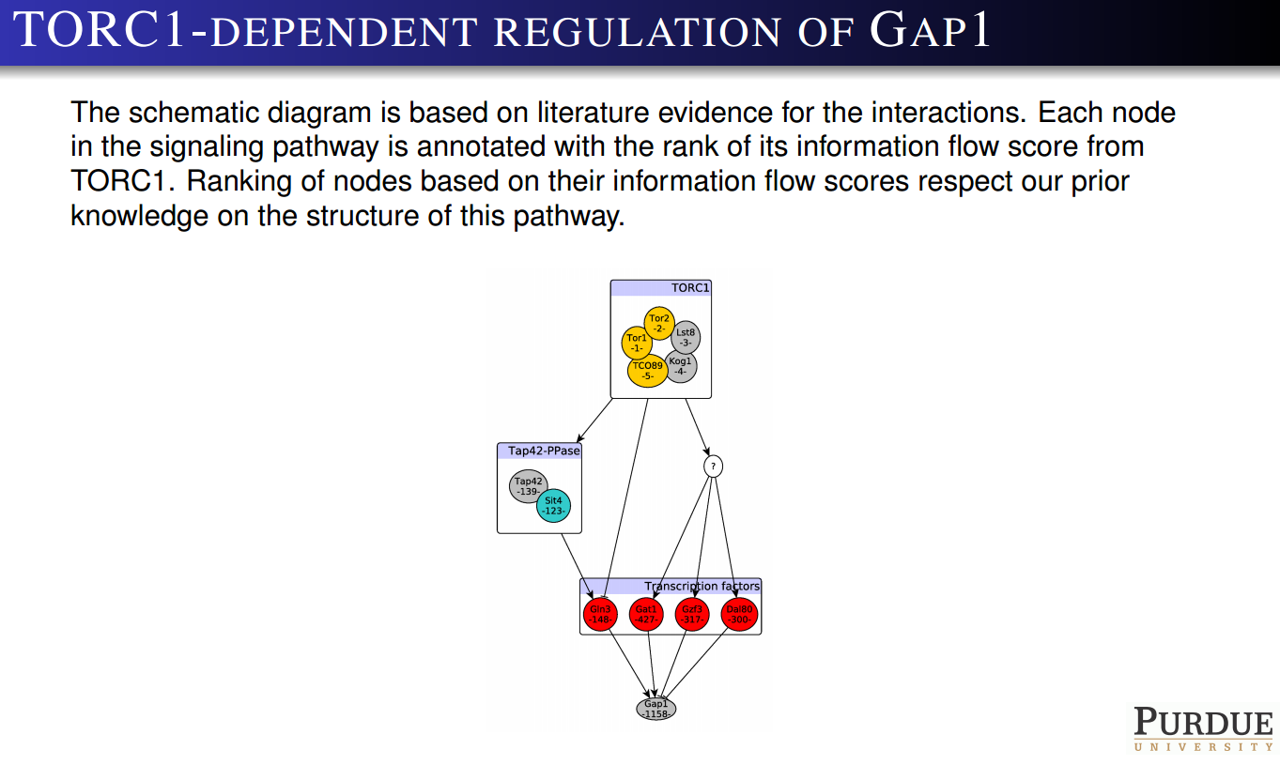

Slide 45
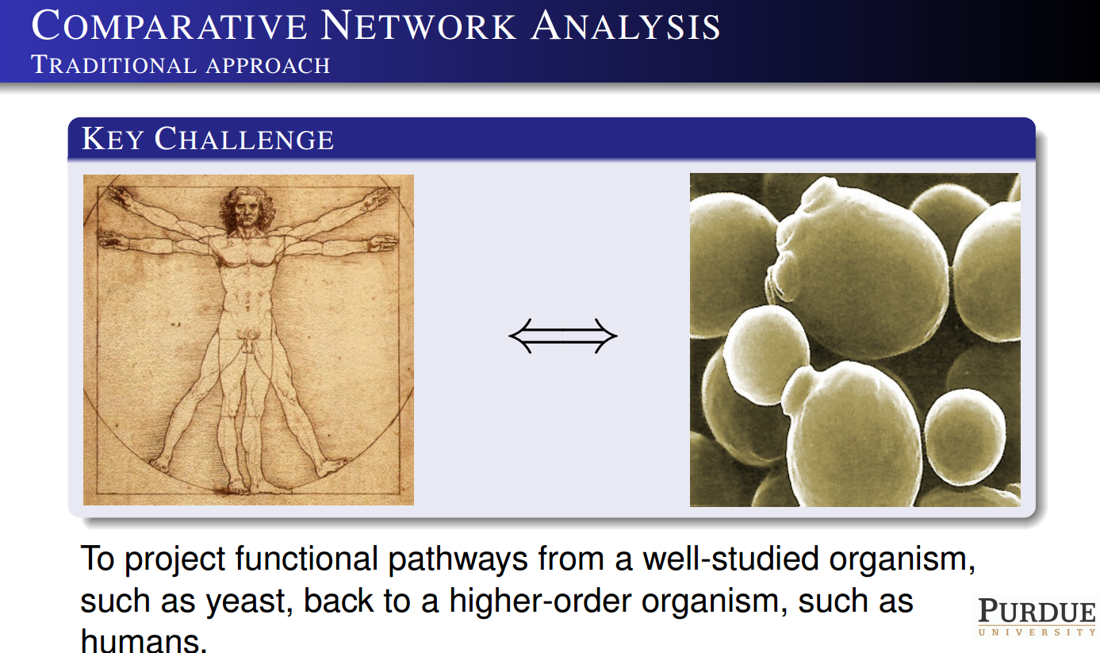

Slide 46
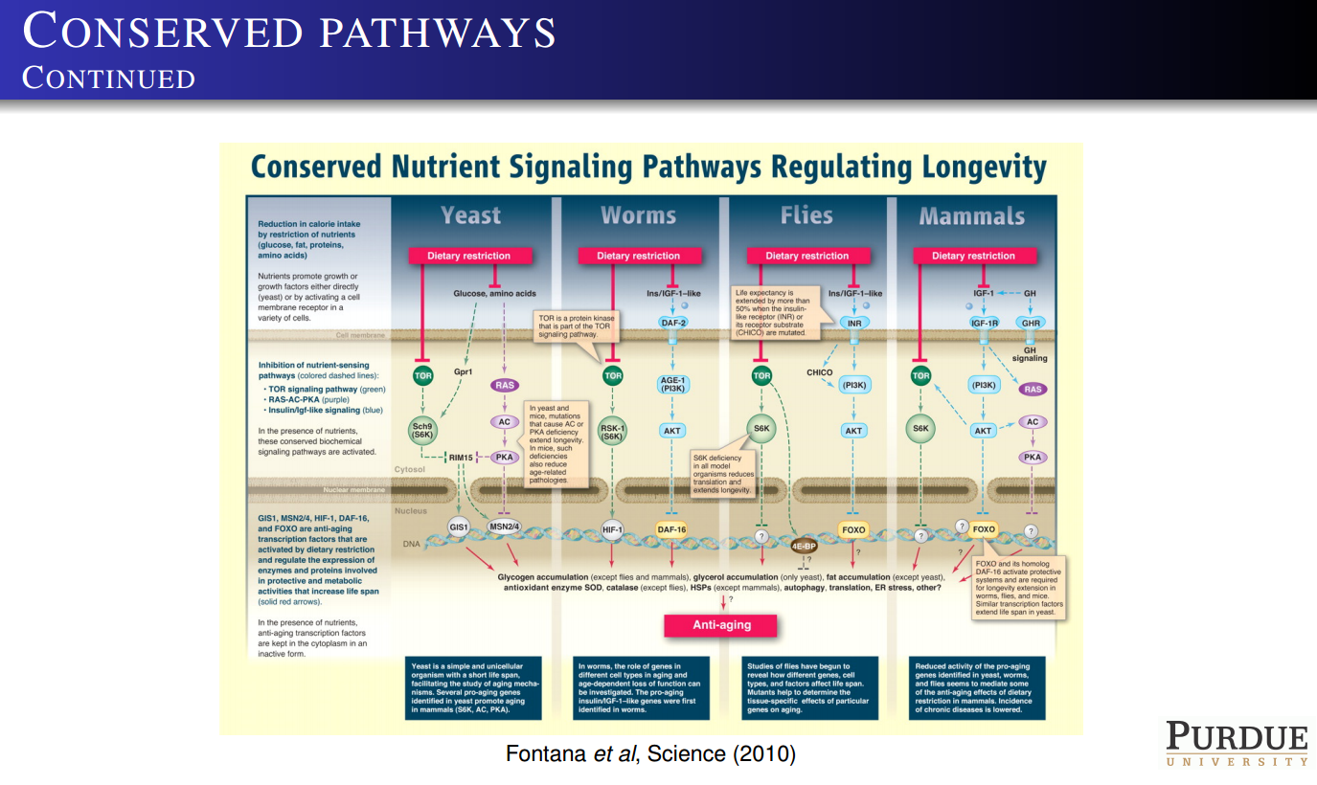

Slide 47
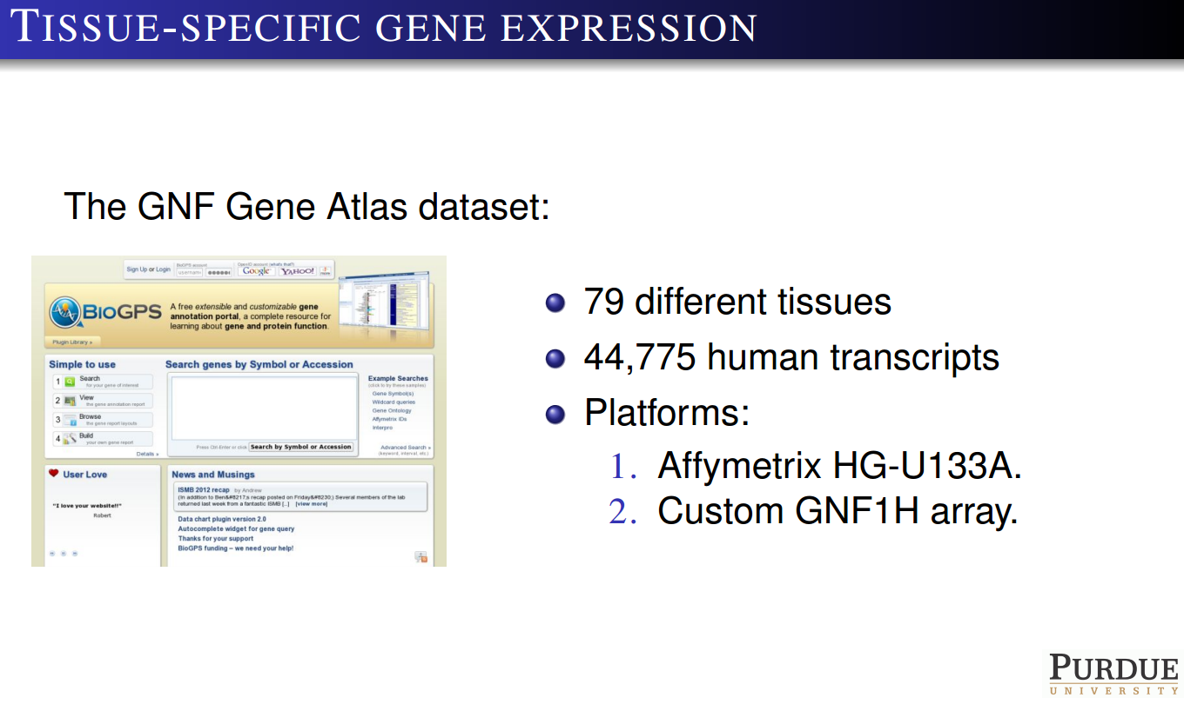

Slide 48
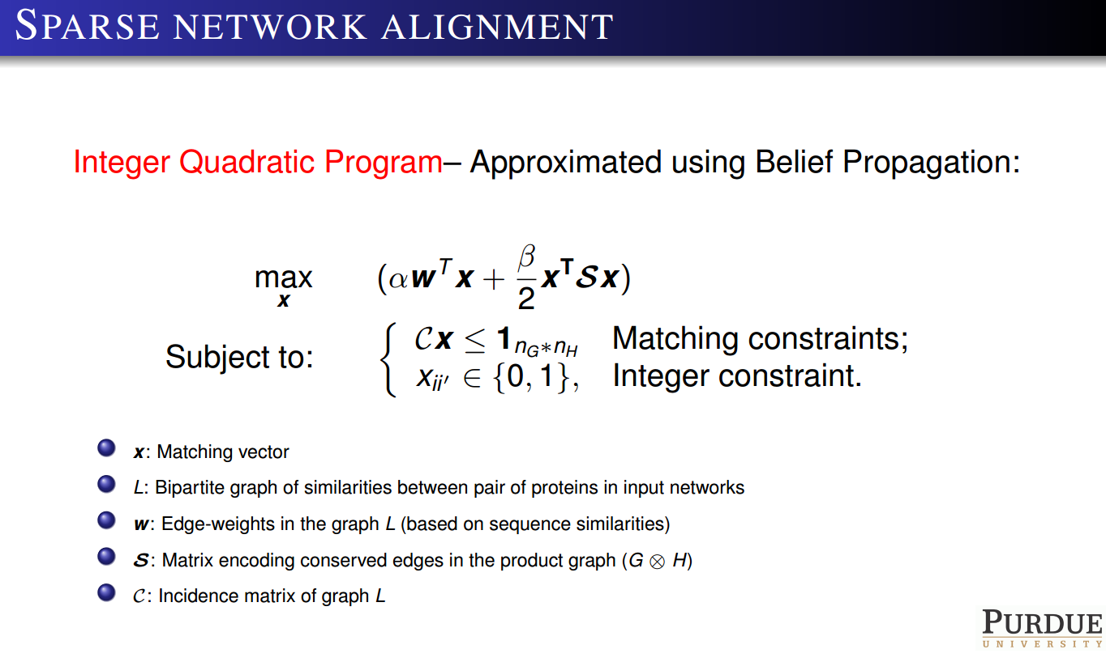

Slide 49
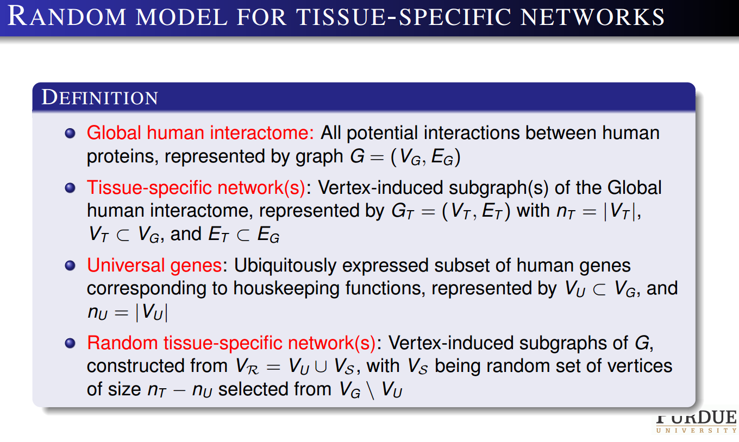

Slide 50
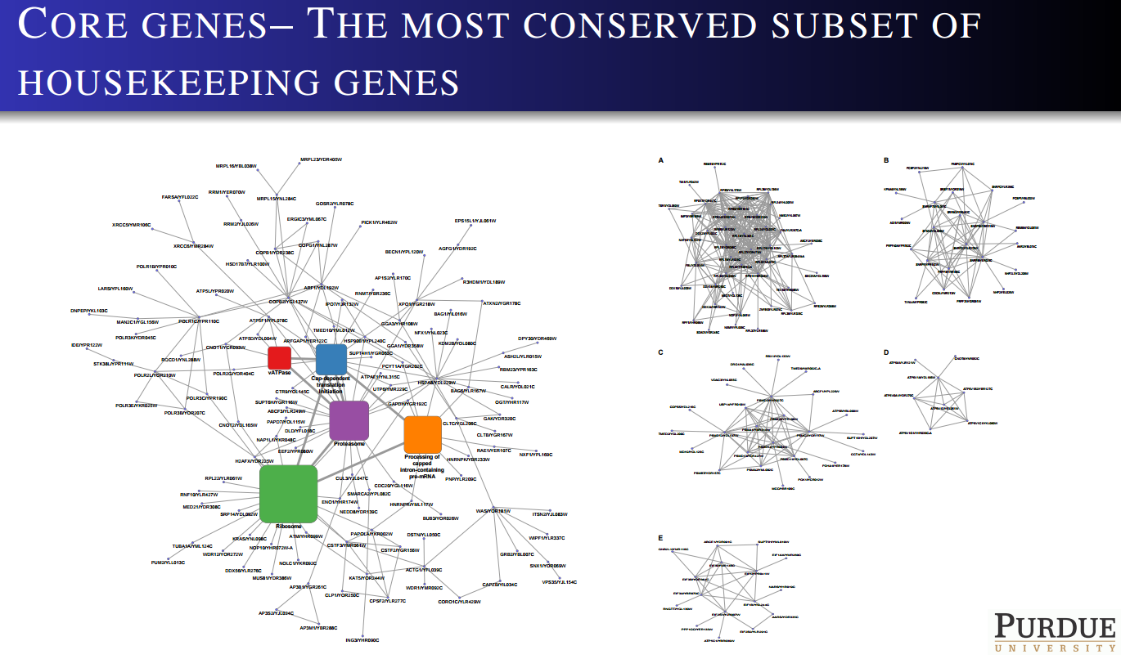

Slide 51
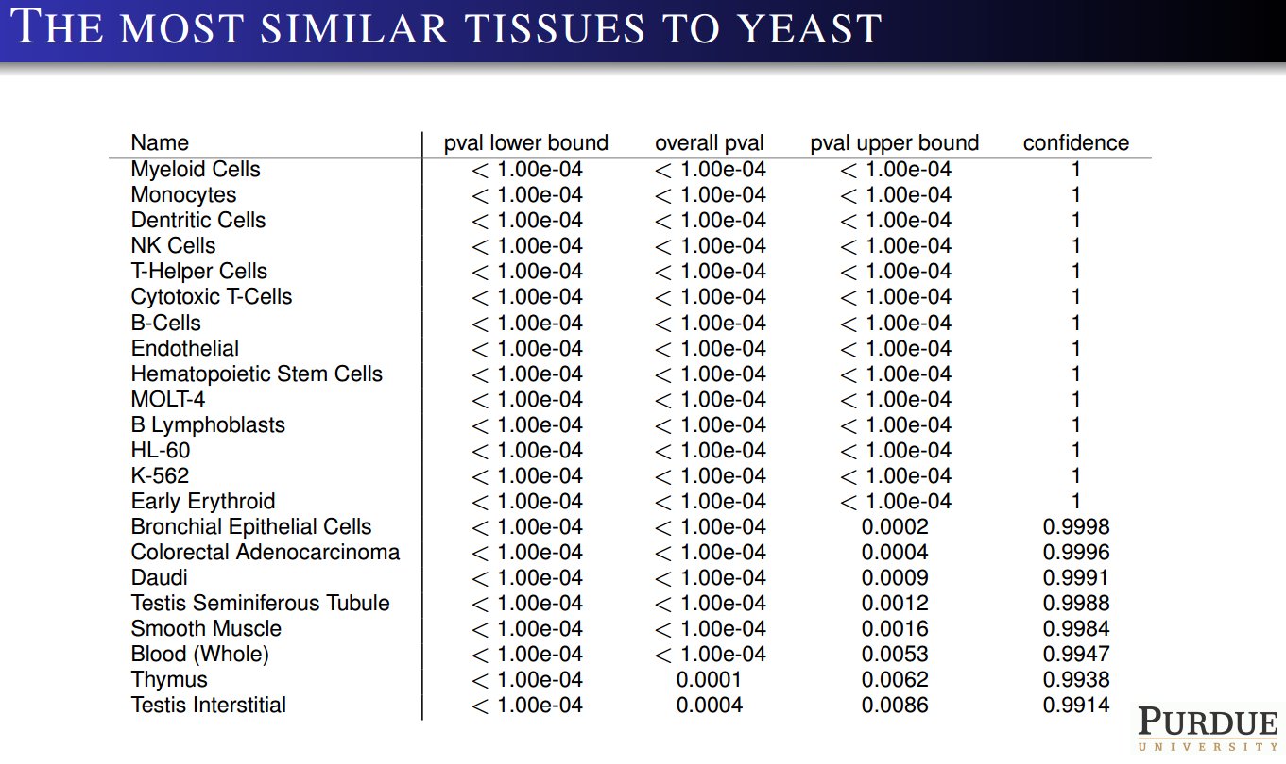

Slide 52
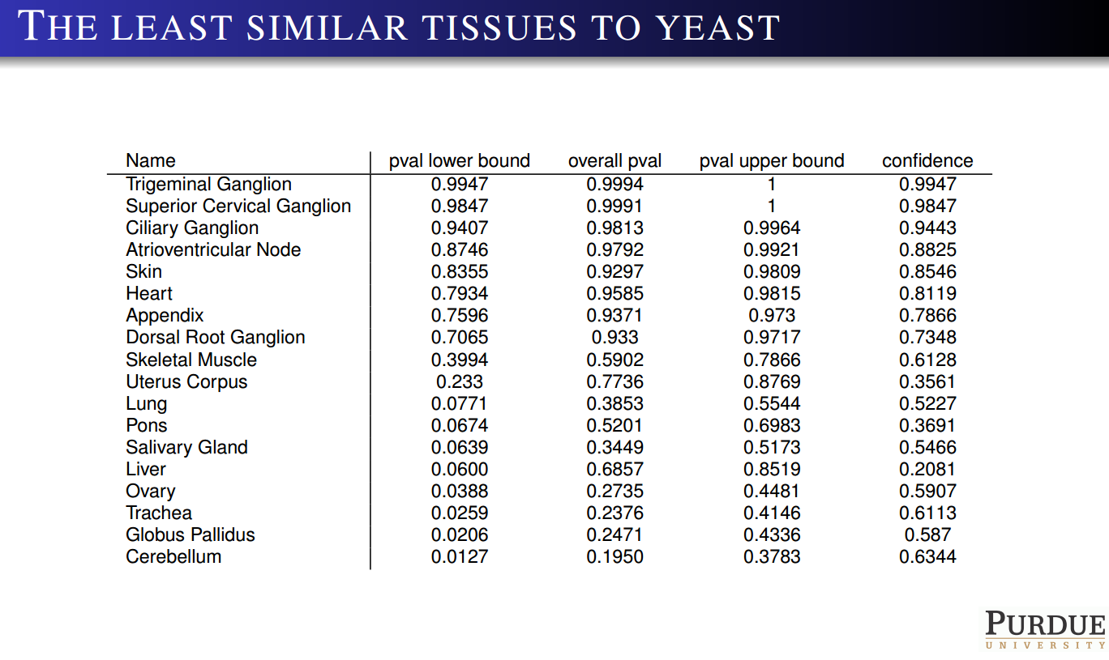

Slide 53
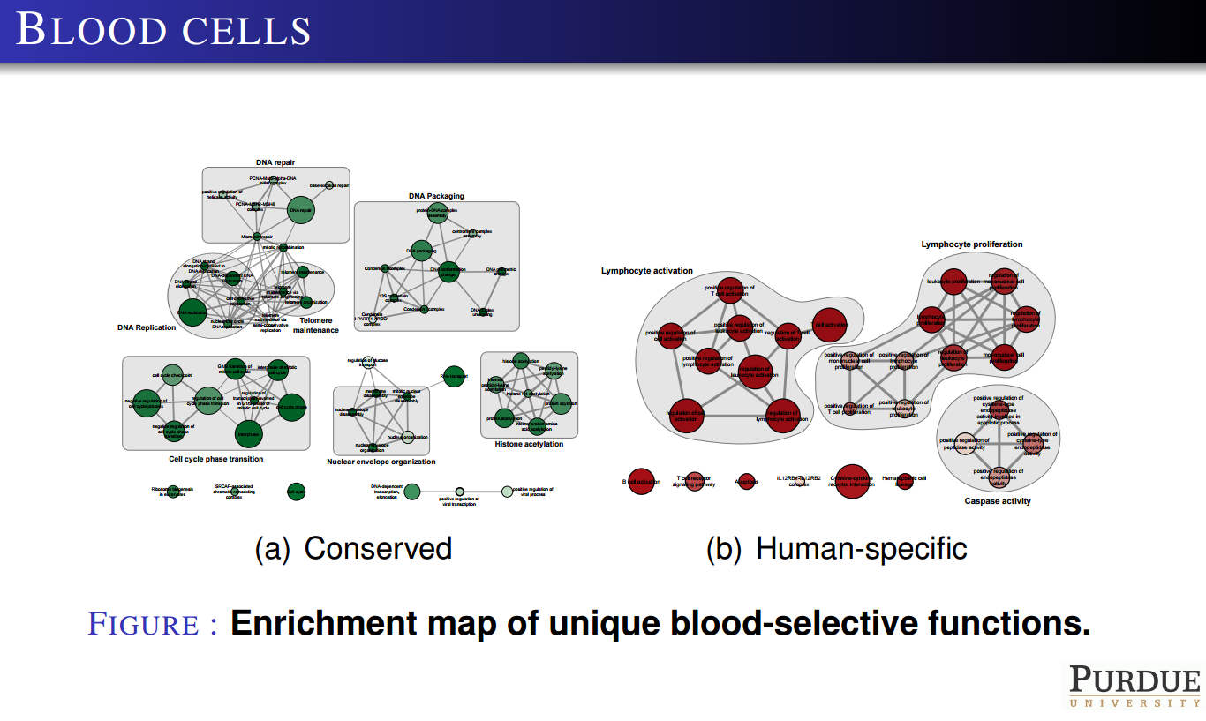

Slide 54
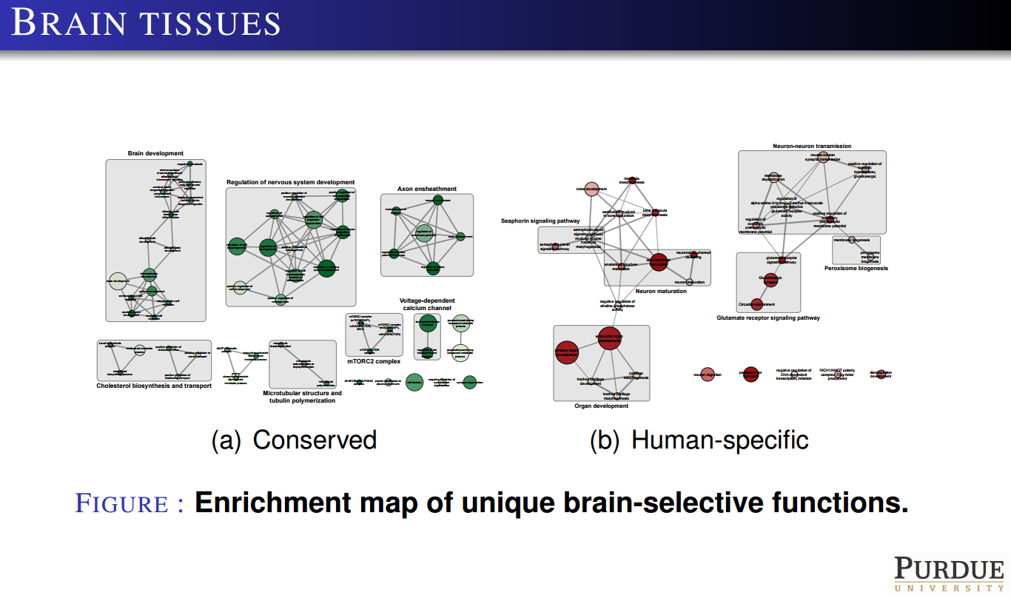

Slide 55
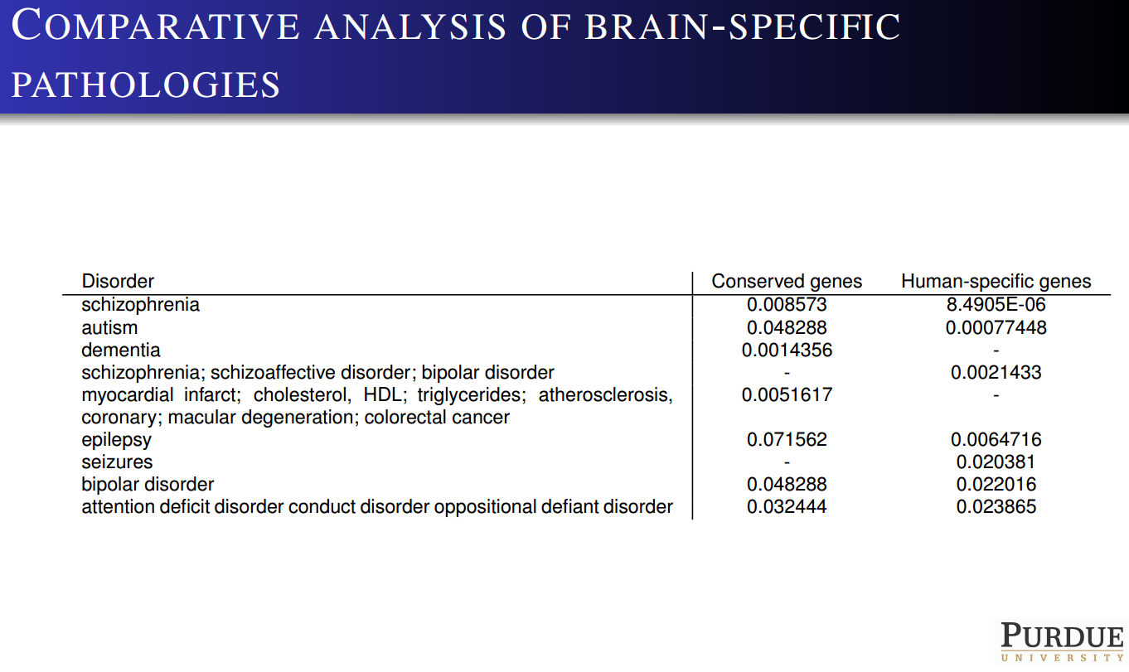

Slide 56
From Pathology to Drugs

Slide 57
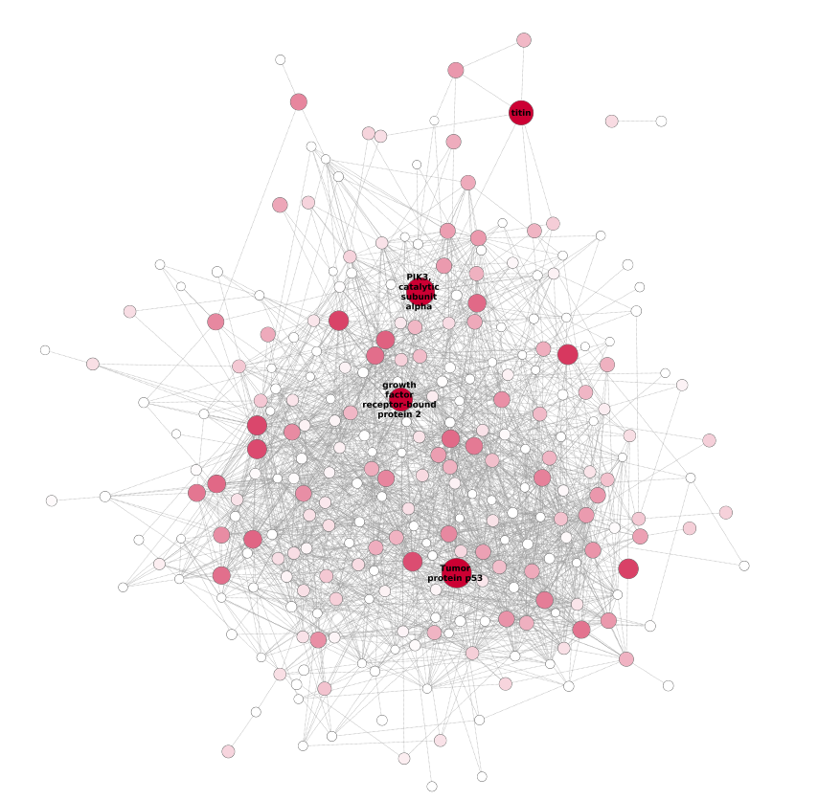
Predicting Targets Through Network Analysis
Breast-specific, protein-protein interaction network of predicted breast cancer genes

Slide 58
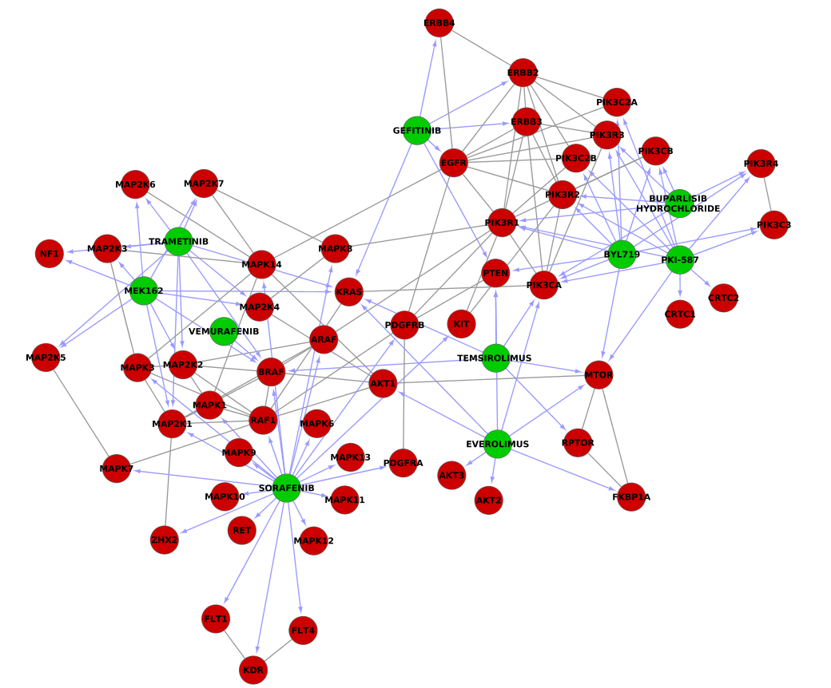
Drug-Protein Interactions in Breast Cancer
Drug-gene and protein-protein interactions for the most promising drugs in breast cancer

Slide 59
Conclusion
This is just the very beginning
There are tremendous challenges and opportunities that await.
Thank You!

