Slide 1
Theme D: Systems Infrastructure for Open Markets
Goal: to enhance food traceability and to deter counterfeiting
Coupling DNA profiling and densely instrumented food supply chains with a distributed ledger (or blockchain) framework
Challenge: the current commercial inclinations towards building blockchains inside and at the periphery of organizational boundaries have inherent limitations
We aim to design and develop an open multi-vendor permissioned blockchain platform offering a powerful trade-off between privacy, traceability, and performance

Slide 2
Technical Challenges
The key technical challenges in accomplishing overall goal are:
Blockchains can mitigate, but do not entirely solve the problem of uniquely associating identities to assets
Multi-vendor blockchain information should not be ubiquitously accessible across the platforms and should be protected from competitors
Employing generic privacy solutions can be prohibitively expensive

Slide 3
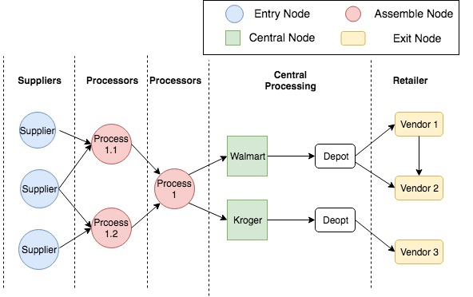
Technical Challenges
Possible Counterfeit Opportunity

Slide 4
Technical Approach (1 of 3)
Our approach to these problems is:
multi-vendor permissioned blockchain platform
Permissionless Blockchain | Permissioned Blockchain
Anyone can join, read, write, and govern (validate, commit, and regulate) | Only authorized participant can join, read, and write
Functions as an overlay network over the Internet | Only a selected few govern (validate)
Proof of work, stake, etc. to deal with Sybil attacks | Employ strong identity and requires n-party consensus protocols (BFT, Libra)
Slow, Low Scalability | Fast, High Scalability

Slide 5
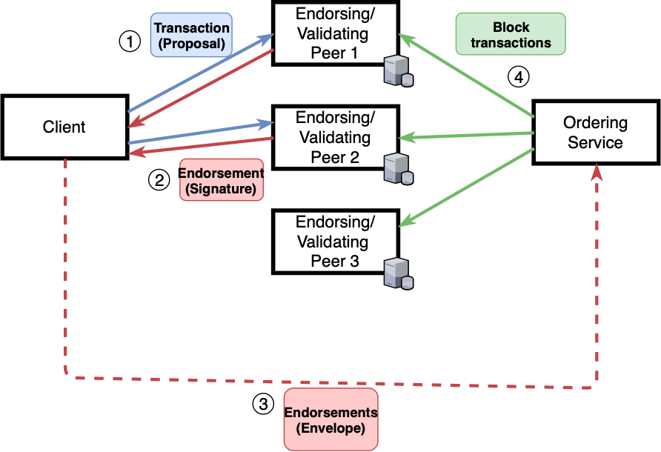
Technical Approach (1 of 3)
The Execute-Order-Validate approach + Endorsement policies of Hyperledger Fabric is ideally suited for the problem
Scalability
Control over the write ops

Slide 6
Technical Approach (2 of 3)
Understanding privacy, access control requirements
Kroger will like to make sure that an item with same id was not transferred to Walmart

Slide 7
Technical Approach (3 of 3)
Realizing achieve those using cryptographic and distributed computing techniques
Secure Multi-party Computation (MPC)
Non-collusion assumption
Covert adversary
Non-interactive Zero-knowledge proofs (of knowledge) (NIZK)
One-wayness, trapdoor permutation
Meta-data hiding communication

Slide 8
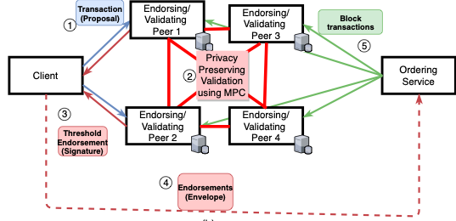
Technical Approach (3 of 3)
Endorsing nodes performs MPC to validate transactions and create private blockchain writes

Slide 9
Related Research and Novelty of Proposed Approach
Federated blockchains / Blockchain for Supply-chains
Privacy problems are ignored assuming that blockchainsare not ‘public’
Privacy issues against competitors/insiders are ignored
With all nodes inhouse, the chain manipulations can be possible
Current NIZK-based solutions are cryptocurrencies are not suitable for supply-chains
Robustness guarantees are not available for the current MPC systems
Current meta-data hiding communication solutions such as Tor are not acceptable to the industrial settings

Slide 10
Novelty of Proposed Approach
Innovation in the MPC space
Asynchronous MPC systems with linear communication complexity
Optimizing MPC pre-processing towards making computation constant round
Developing combinations of NIZK and MPC operations towards optimizing performance
Innovations in the meta-data hiding space
Meta-data hiding solutions for the permissioned setting

Slide 11
Theme Outcomes
Privacy-preserving Multi-supply-chain Blockchain with applicability beyond food supply-chain
Robust, Efficient MPC Protocols and Systems with applicability to secure computation in general
Meta-data hiding communication protocols tailored for the consortium scenarios

Slide 12
Interaction With Other Themes
Theme A: Utilizing DNA profiling
When available, our system will utilize DNA watermarks as stronger IDs
Theme B: Supply-chain Optimizations
End-to-end traceability, Forward/backward Historical Queries can be highly beneficial towards optimizing supply-chains
Theme C: Realizing the virtual payment/incentive system
Our blockchain solution will be ideally suited for realizing and experimenting with the incentive mechanism

