Slide 1
Theme C: Incentive Mechanisms for Participation
Overall Goals
Design simple algorithms (e.g. auctions, multi-round games), where the inputs are provided by correlated strategic agents (e.g. by a network of supply chains), and the result is truthful, max. welfare, etc.
Design mechanisms for dynamic environments, where the actors are myopic and have asymmetric, limited information, and are subject to external forces (weather)
Incentivize players to strategically experiment & learn from data generated by players with incentives.
Challenges
Policies and mechanisms are highly dynamic and must adapt to intrinsic and extrinsic factors to the network, such as changes in weather, prices.
Small versus big players: big players (e.g. companies) are consortia of small players; their interests are correlated but not identical
In general, incentive compatible mechanisms do not compose well.
Notes:
Opt. mechanisms are complex… the results are brittle to assumptions …

Slide 2
Problem setup for dynamics on networks
Goal. Study dynamics on networks, where agents repeatedly adapt to the previous state of the world.
Challenge.
Players may take repeated myopic decisions that are in their best interest in the short term, but not the long term (e.g. each agent acts based on local information from its neighborhood).
Some myopic actions – e.g. cutting production costs in places difficult to observe – can lead to suboptimal products or the market unraveling completely over time.
Approaches.
Model production markets where players are connected, design and study classes of mechanisms that lead to growth of the market in the long run under different types of behavior of the players (e.g. regret minimization, multiplicative weight updates, proportional updates).
Notes:
This challenge appears when you can’t control everything. Why not use a centralized solution? We can’t do that ☺ -- Even if you are Walmart and could make a market, you still can’t get all information.

Slide 3
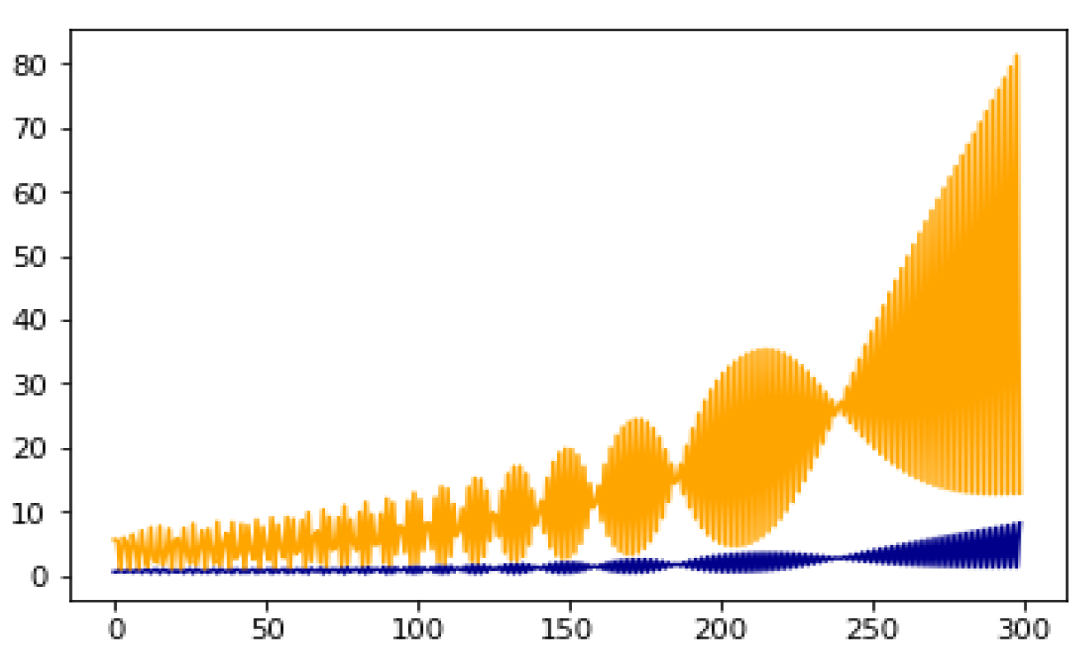
Our prior work on production markets
Setup
Set of n producers, each makes good according to their production function
The players bid on the goods at the market, exchange their goods for other goods they need, then use the bundles acquired for the next production.
A simple dynamic is proportional response, where players update their bids proportionally to how useful the investments were in the past round.
Main result.
This dynamic leads to growth of the market in the long term (whenever growth is possible) but also creates unbounded inequality, i.e. very rich and very poor players emerge over time.
Notes:
This model assumes each player makes one good and cannot switch.
David: Slide Maker
Players split money into bids. These are investments, this is the Shapley-Shubic (trading posts); players purchase goods, they invest based on how well investments based on how well the last round went.
Open questions – how to update bids. Concave production. Diminishing returns, etc. Digital goods… related to Lotka-Voltera model.

Slide 4
Oceanic markets with big and small players are challenging
Goal.
Study market games with small versus big players: big players (e.g. companies) are consortia of small players; their interests are correlated but not identical.
Related literature on theory of “oceanic games” (starting with Milnor and Shapley ‘77)
Example. Parametric cooperation
Let cooperation parameter λ can model how aligned the interests of two small players are.
Say Alice and Bob are dividing some land. Alice has value v_{A} for her piece and Bob has v_{B} for his, then Alice’s utility for this allocation is u_{A} = v_{A} + λ v_{B.}
If Alice and Bob have partially aligned interests (e.g. form a community), this could be modeled by λ=½, so Alice’s utility is u_{A} = v_{A} + ½ v_{B}.
In auction allocations and rent division, these are unexplored dimensions of the problem. (λ = 0 is independent, λ = 1 is fully cooperative, λ = -1 is zero-sum)
Research directions
Resource allocation (auctions, markets) and learning problems where players are not independent of each other (e.g. have correlated utilities, are big vs small).
Notes:
Resource allocation -> Rent division,

Slide 5
Cooperation can have tremendously beneficial effects, which need to be encouraged
Goal.
Design mechanisms that incentivize players to experiment – too much competition between players can reduce risk tolerance.
Example and our prior work.
Companies acquiring data and experimenting with different strategies for their products, too much competition makes players risk-adverse as failure is heavily penalized.
Formalized as multiple players learning at the same time in the bandit model.
When the decision is between a risky action and a predictable one, competing players (playing a zero sum game) explore less than a single player, while cooperating players explore more.
Research directions
How should market mechanisms be set up so that players explore at the correct rate? What learning algorithms should the players use? (e.g. poly-time problems vs. NP-hard)
What happens when people hide information from competitors?
Notes:
Still a lot of work on bandit algorithms; in these scenarios, there are questions about algorithms people should use. We want poly-time algorithms.
- Food we need to predictable.

Slide 6
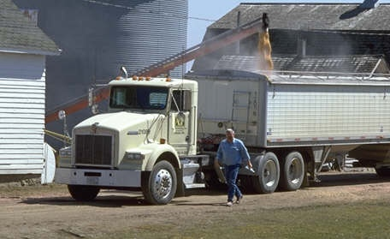
Incentives to share rewards and move distributions require innovative mechanisms
Given a complex supply chain or distribution system, who should pay for a contamination scenario?
Extensive local testing at each node may be too expensive.
Idea: limited local testing and group testing
Desiderata: low sample complexity, low interaction, the testing preserves the incentives.
Mechanisms that influence global distribution
How can one design a mechanism M (e.g. a system of prices, rewards, fines), so that by repeatedly applying M the population moves from the initial distribution to the desired distribution?
This problem requires modelling the feedback of participants to a mechanism, (e.g. networks of polya urn-like processes).
Notes:
Setting 1: This would look at limits of various scenarios that might influence future policy.

Slide 7
Auctions in the wild
This setting requires auctions and markets for selling products, but optimal auction theory cannot always be used to allocate resources:
Sellers don’t have entire distributions of valuations as is assumed in optimal auction theory, but can use information from past sales (e.g. prices at which corn was sold). Mechanisms must be designed from samples.
The market is inherently dynamic -- e.g. a participant may be unable to deliver the target production due to extrinsic factors (weather). This can require designing contracts between buyers and sellers. How should auctions be designed with contracts?
We want polynomial time, economic efficiency, revenue and welfare guarantees.
Optimal mechanisms can be very complex and hard to use – which will inhibit adoption. Addressing this will require us to understand tradeoffs between efficiency and “simplicity” (or complexity – computational, communication, posted prices versus auctions).

Slide 8
Measuring properties in networks of strategic agents from samples.
Application-based example.
Based on resources allocated to them, farmers adjust their production or level of effort made. Would like to learn their incentives and valuations.
Put simply, what is possible to infer from a reluctant supply chain based on the samples we observe.
CS Formalism.
Infer valuations of the players from their responses (actions) to a mechanism. We will start by assuming players are Bayesian or learning from data and minimizing regret over time.
When the agents form a network, infer properties of a network from samples, such as the edge weights (this is typically studied when the nodes are not strategic).

