Slide 1

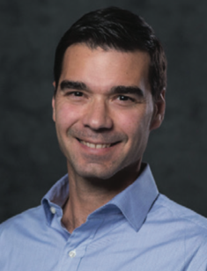

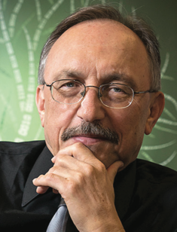
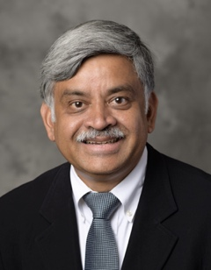
A Computational Approach to Provenance, Efficiency, Effectiveness, and Quality of Food Systems

Slide 2
Overview
Project Motivation
Computational Challenges and Project Themes
Education, Broadening Participation and Broader Impacts
Management Structure

Slide 3
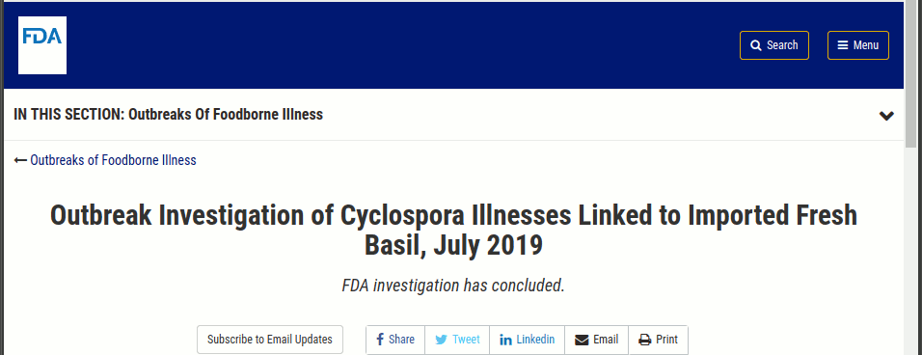




Motivation: Safety of Food Systems is a Massive Problem
In the US, Centers for Disease Control and Prevention estimates 48 million cases of foodborne illnesses, 128,000 hospitalizations, and 3,000 deaths, with a cost of $152 billion in medical expenses, lost productivity and business, lawsuits, and compromised branding.
Globally, the annual numbers are 600 million cases, 230,000 deaths from foodborne diarrheal disease, and over 33 million disability adjusted life years!

Slide 4
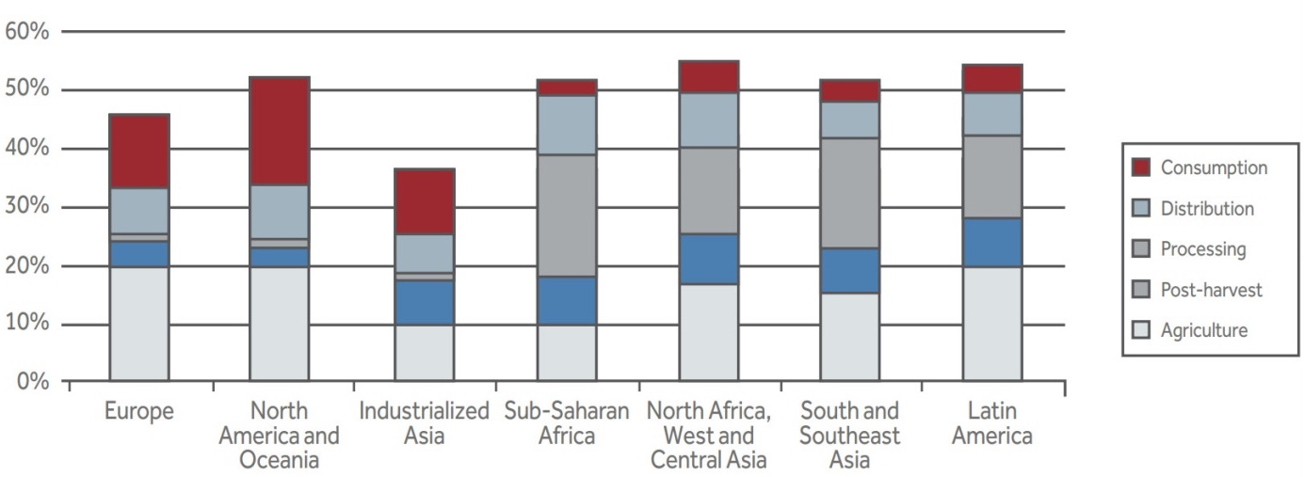
Motivation: Waste in Food Networks is a Challenge
An estimated 20 billion pounds of produce is lost on US farms each year.
Estimates indicate that $7-15.4 billion worth of fresh produce spoils in the supply chain annually before reaching the consumer in the US. This corresponds to approximately 12.3% of fruits and 11.6% of vegetables.
The consumer then accounts for an additional 19% of fruit and 22% of vegetable losses.
All this, while one-sixth of Americans do not have enough food to eat; worldwide over 795 million people suffer from hunger, and the prevalence of undernourishment has been rising.
60%
50%
Consumption
40%
Distribution
30%
Processing
20%
Post-harvest
10%
Agriculture
0%
Eur.
North Amer.
Asia
SS Africa
N Africa
SE
Asia
Latin
Amer.
Source: Food and Agriculture Organization

Slide 5

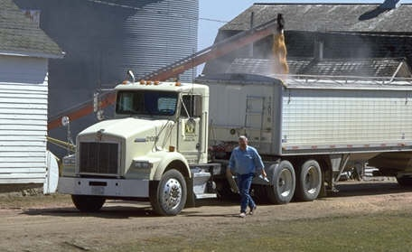

Motivation: Food Quality and Nutrition is a Challenge
Fresh produce, on average, spends up to 50% of its shelf-life (typically 21 days from harvest to consumption) in the supply chain! This has significant impact on quality and nutritional value. Supply chain conditions (e.g., cold chains) strongly determine quality.
Supply chains are highly fragmented with little (highly asymmetric) information flow across various entities (the EU recently passed guidelines for price transparency across supply chains).

Slide 6
The goal of this project is to bring disruptive innovation through computing to food safety, quality, distribution, and production.
Computing Challenges
Food Waste
Optimization
Supply Chains
Blockchain
Phenotyping
Actionable Analytics
Mechanism Design
Watermarking
Safety
Provenance

Slide 7
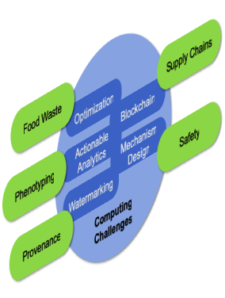
The goal of this project is to bring disruptive innovation through computing to food safety, quality, distribution, and production.
Our Computer Science Lens will enable us to address these issues as well as bring improved methodology and insights to computing
Novel computational techniques for food provenance
Use of large-scale instrumentation for supply chain modeling and optimization
Incentive mechanisms for participation across the supply chain
Integrated blockchains for an open marketplace for producers, processors, distributors, retailers, and consumers
Use of provenance information combined with seed, field management, and weather data to comprehensively map quality and productivity.
Computer Science
Food Systems

Slide 8
Theme A: Computational Approaches to End-to-End Food Provenance
Goal
To design and develop novel computational models and methods that allow robust and high resolution provenance for produce
Challenges
Design of DNA barcodes that are minimal, robust to perturbations (both local and global), can be read back easily, and are constrained to specific regions of the DNA
Use of intrinsic sequence features (simple sequence repeats) as barcodes
Design of low-cost shallow sequencing, deconvolution, and mapping algorithms
Connections
Theme B. Optimization of traceback accuracy
Theme D. Mapping product to entities in the blockchain ledger
Theme E. Virtual phenotyping

Slide 9
Theme A: Computational Approaches to End-to-End Food Provenance
CS Challenges. Sequence Modeling, Barcode Design, Readback Algorithms
Design of optimal barcodes for rapid and inexpensive detection, traceback, and audit
Analytical proofs of uniqueness of barcodes for real models of DNA sequences
Ensuring robustness through (constrained) distribution of barcodes over the sequence in the presence of point mutations, hybridization, and other common perturbations
Establishing minimality of barcodes with constraints on uniqueness and robustness
Maximizing traceback accuracy through maximally distant barcodes
Establishing feasibility of use of intrinsic sequence features as barcodes
Analyzing sequence depth in the context of repeat complexity of the DNA sequence for inexpensive readback
These challenges pose significant problems in sequence modeling, analyses, and design of associated methods.

Slide 10
Theme B: Food Supply Chain Modeling and Optimization
Goal
Develop mathematical programming models to: (i) optimize supply chain architecture; (ii) determine location of tracking devices; and (iii) determine optimal responses to contamination events.
Challenges
The mathematical programming models are a natural approach to model such systems, but might only be able to represent a partial, distorted view of the system.
Understanding whether approximately optimal solutions can still be reached in such settings is a major open problem.
Understanding how to approximate the optimal solution in a distributed setting, where each actor optimizes over his own set of constraints is also a major challenge.
Connections
Theme C. Design mechanisms to incentivize the actors of the supply chain to reveal information about the system.

Slide 11
Theme B: Food Supply Chain Modeling and Optimization
CS Challenges. Solve optimization problems with missing or noisy variables or constraints or objective function in a distributed manner.
Let G be the underlying (unknown) optimization problem and G’ be the observed, severely perturbed, one. Characterize (i) whether the feasible sets of G and G’ significantly overlap, and (ii) whether the optimal solutions of G and G’ are close.
Difficult even for Linear Programs; related work goes under the name sensitivity analysis. Very open for convex optimization.
Related problem. In the presence of noise, early stopping of iterative optimization algorithms might lead to better generalization via implicit regularization.
Related problem. In the distributed version of the problem, each actor might be able to locally solve an optimization problem with access to all his constraints/variables. What is the minimal information that each actor should globally reveal in order to (at least approximately) solve the overall optimization problem?

Slide 12
Theme C: Incentive Mechanisms for Participation
Goal
Design algorithms (e.g. auctions, multi-round games), where the inputs are provided by correlated strategic agents (e.g. by a network of supply chains), and the result is truthful, max. welfare, etc.
Design mechanisms for dynamic environments, where the actors are myopic and have asymmetric, limited information, and are subject to external forces (weather, pricing, trade)
Challenges
In general, incentive compatible mechanisms do not compose.
Myopic actors and limited, asymmetric information environments complicate mechanisms to achieve a desirable global solution.
Connections
Theme B. Supply chain models and sensing mechanisms will influence modeling assumptions in this theme.
Theme D. Blockchain models can be used to ensure privacy.
Notes:
Design and study the complexity of algorithms on networks, the dynamics obtained when agents repeatedly interact, and the learning problems in this context (e.g. how to backpropagate errors so that agents learn to behave well in the long term, or the sample complexity of learning network properties).

Slide 13
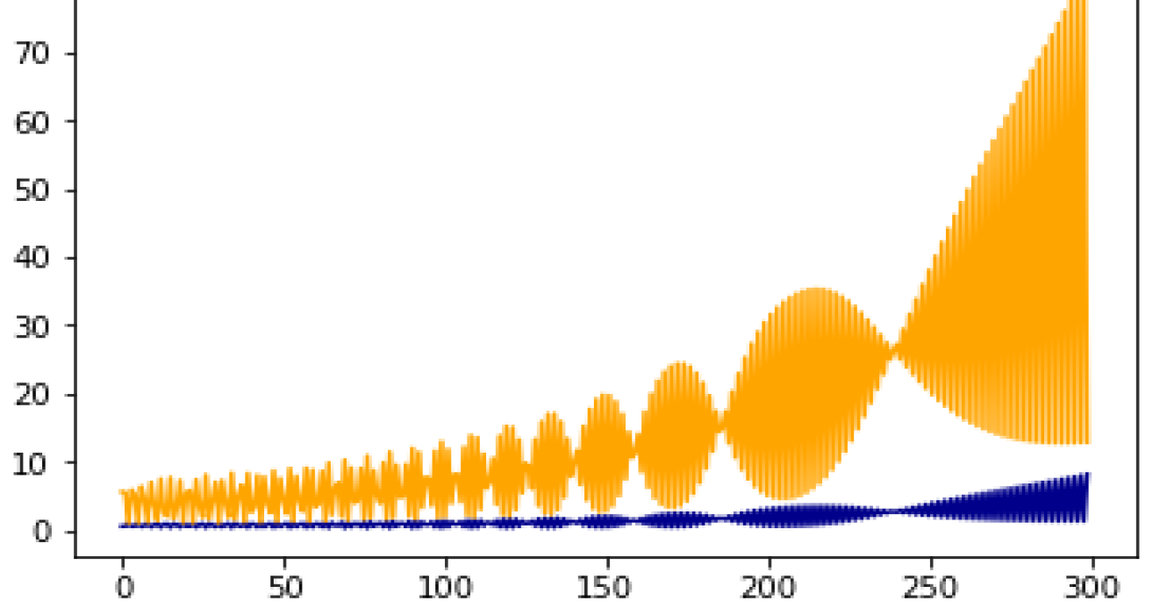
Theme C: Incentive Mechanisms for Participation
CS Challenges. Dynamics on networks of
interacting agents, where agents continually adapt
to the observed state of the world
Myopic actions – e.g. cutting production costs in places difficult to
observe – can lead to suboptimal products or the market unraveling
completely over time.
Results are highly dependent on information assimilation methods
including regret minimization, multiplicative weight updates,
proportional updates.
How to measure properties of these networks when we assume entities are strategic.
Oceanic games model scenarios where there are big and small players.
This results in complex market games and learning problems where players are not independent of each other (e.g. have correlated utilities, are big vs small).

Slide 14
Theme D: Systems Infrastructure for Open Markets
Goal
To design and develop an open multi-vendor blockchain platform offering a powerful trade-off between privacy, traceability, and performance.
Challenges
Current vertically integrated provenance solutions cannot account for cross-vendor transactions by players without a trusted facilitator (such as IBM) and remain vulnerable to cross-vendor counterfeiting.
Multi-vendor blockchain information should not be ubiquitously accessible across the platforms and should be protected from competitors.
Incentive mechanism for supply-chain players to join and participate in the distributed ledger needs to be combined with the provenance ledger.
Connections
Theme A. DNA profiles provide strong identities.
Theme C. Incentive system for fair participation.

Slide 15
Theme D: Systems Infrastructure for Open Markets
CS Challenges.
In multi-vendor environments, it may not be acceptable to supply-chain processes that their business processes are visible across the platform.
This suggests a secure distributed validation architecture that offers acceptable agreement between processes using execute-order-validate (EOV) processing of Hyperledger.
Most multi-vendor distributed ledger information should not be ubiquitously accessible across the platform and should be protected from competitors.
This type of privacy is novel and has not been formalized.
Beyond EOV, we will achieve it using innovative solutions based combinations of secure multi-party computation (MPC) and non-interactive zero-knowledge proofs (NIZK).

Slide 16
Theme E: Scalable Phenotyping Through Large-Scale Data Integration
Goal
To build scalable data analysis pipelines to address simple and complex questions about what impacts end-product phenotypes.
Challenges
Field management data is sparse & high dimensional with strong spatiotemporal effects (weather).
Food quality phenotypes – taste and nutrition – are results of extremely complex systems spanning seed-to-store.
Data on food safety and microbial contamination is typically very incomplete due to legal and privacy issues.
The community needs data and information to support possible hypotheses and not black box solutions.
Connections
Theme A. Provenance data provided by watermarking
Theme B. Supply chain flows influence quality

Slide 17
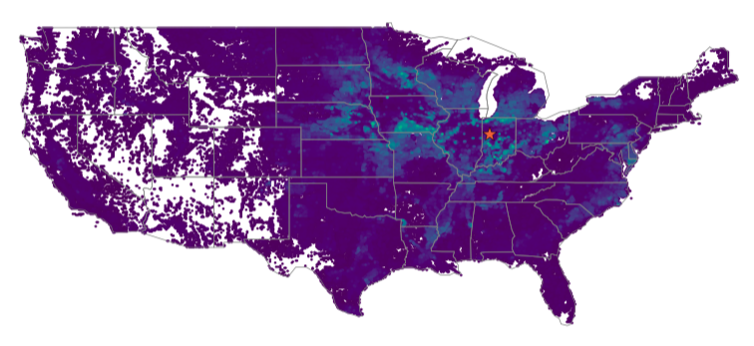
Theme E: Scalable Phenotyping Through Large-Scale Data Integration
CS Challenges. Hypothesis generation
Graph and tensor-based local search (random-walk / PageRank / eigenvector) approaches will be used to generate non-trivial hypotheses for future experiments.
There is no state of the art on using these with the types of complex mixtures (low-rank + sparse) models of data we need.
Higher-order expansions of data are extremely useful to find subtle and tunable insights into the data and in terms of new hypotheses
Matrix completion and imputation are needed to missing data and outliers
Our goal is to build algorithms that work in order of the size of the input dataset, not the intermediate (expanded) graph.
RandNLA and tensors will be an enabling technique.
All of the analysis and results must be explainable in terms of raw data (fully reified).
Graph-based local search for agricultural regions similar to West Lafayette

Slide 18
Our research themes are decoupled in failure and intertwined in success and help make the whole greater than the sum of the parts.
Computing Challenges
Food Waste
Optimization
Supply Chains
Blockchain
Phenotyping
Actionable Analytics
Mechanism Design
Watermarking
Safety
Provenance
Important new intersections of areas within computing
New connections at the interface between computing and food systems
New possibilities for how computation can be a subtrate to improve our food systems
Notes:
Important new intersections of areas within computing
New connections at the interface between computing and food systems
New possibilities for how computation can be a subtrate to improve our food systems

Slide 19
Educational Programs

Slide 20
Broadening Participation

Slide 21
Broader Impacts of the Proposed Work
Local Farm Communities
Education programs, training programs, and computational resources
Farming, Food Processing, Supply Chain, and Retail Communities
Exchange of data, models, tools, and optimization techniques
Policymakers and NGOs
Guiding policy and informed regulation
International Partners
Collaborations with stakeholders in India, Kenya, Bangladesh, Cambodia on best practices in data collection and use
Broader Scientific Community
Computer Science communities to motivate new modeling paradigms, problems, and solutions.
Food science communities to motivate new problems and solutions.

Slide 22

Broader Impacts of the Proposed Work
CropHub. Repository for all technical and educational material.
The research platform focusing on datasets, software tools, and research artifacts
The education platform, focusing on modules and instructional material;
Outreach platform, focusing on workshops, tutorials, and meetings aimed at professionals, policy-makers, and NGOs; and
Broadening participation platform, for recruitment, mentoring, and assessment of BPC programs.
Built using Purdue’s
unique HubZero platform.
https://soihub.org
https://nanohub.org
https://hubzero.org

Slide 23
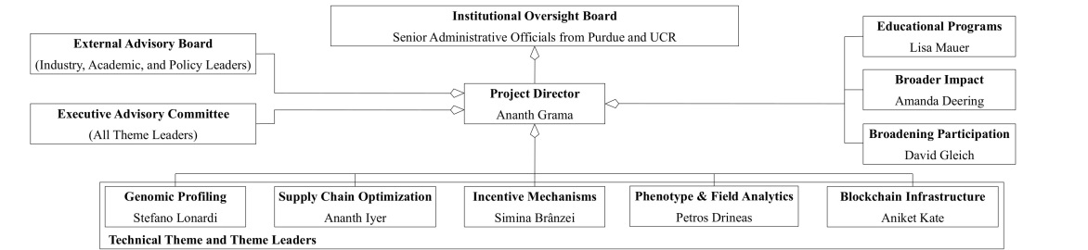
Institutional Oversight Board
Senior Officials from Purdue & UCR
Broadening Part.
David Gleich
External Advisory Board
Project Director - Ananth Grama
Education
Lisa Mauer
Executive Committee
Broader Impacts Amanda Deering
Genomic Profiling Stefano Lonardi
Supply Chain Opt. Ananth Iyer
Incentive Mech. Simina Brânzei
Blockchain
Aniket Kate
Phenotyping
Petros Drineas
Project Management Structure

Slide 24
Project Contingencies
Personnel contingencies
The project is led by Ananth Grama.
David Gleich and Petros Drineas serve as Associate Directors of the project.
All other project teams have sufficient extra personnel to handle unforeseen contingencies.
Technical contingencies
Each of the thrusts has formulated technical contingency plans (see proposal).
Institutional contingencies
The project is primarily housed at Purdue, thus largely minimizing contingencies due to partnerships and collaborations across institutions.

Slide 25
A Computational Approach to Provenance, Efficiency, Effectiveness, and Quality of Food Systems
Computing Challenges
Food Waste
Optimization
Supply Chains
Blockchain
Phenotyping
Actionable Analytics
Mechanism Design
Watermarking
Safety
Provenance

