Slide 1
Institutional Infrastructure for Proposed Project
A number of existing centers and institutes at Purdue provide complementary resources for the proposed effort:
Center for Science of Information (CSoI): A Science and Technology Center of National Science Foundation
Wabash Heartland Innovation Network (WHIN): A large center funded by Lilly Foundation
Feed the Future Innovation Lab for Food Safety: A center funded by USAID
Purdue TERRA Field Phenomics for Biofuel Trait Discovery: A center funded by US Department of Energy
Safe Produce Indiana Program
HubZero

Slide 2
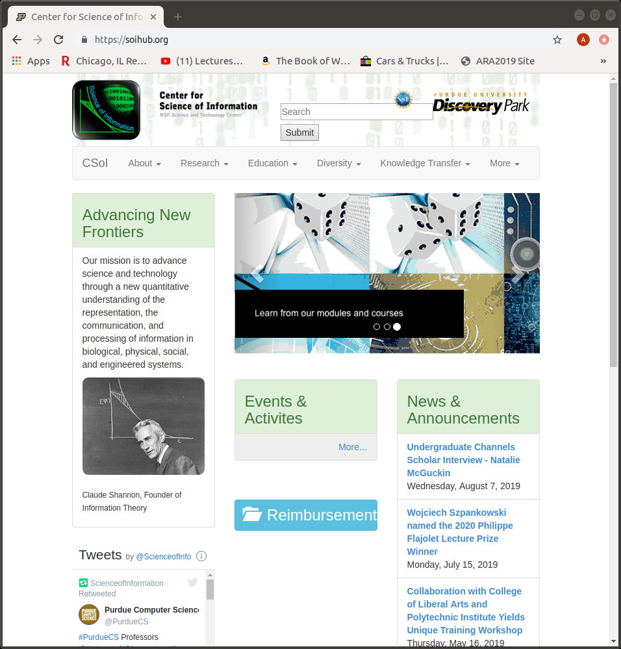
Center for Science of Information (CSoI)
What the Center does?
CSoI focuses on developing models and methods focused on information in higher order structures, incorporating elements of space, time, context, representation invariance, collusion and competition. It also has a vibrant education and outreach program.
How will the proposed effort benefit?
CSoI will
contribute models and methods for randomized approaches, privacy, and analytics.
share best practices in management.
help bootstrap the education and outreach platform.
help with design and maintenance of CropHub.

Slide 3
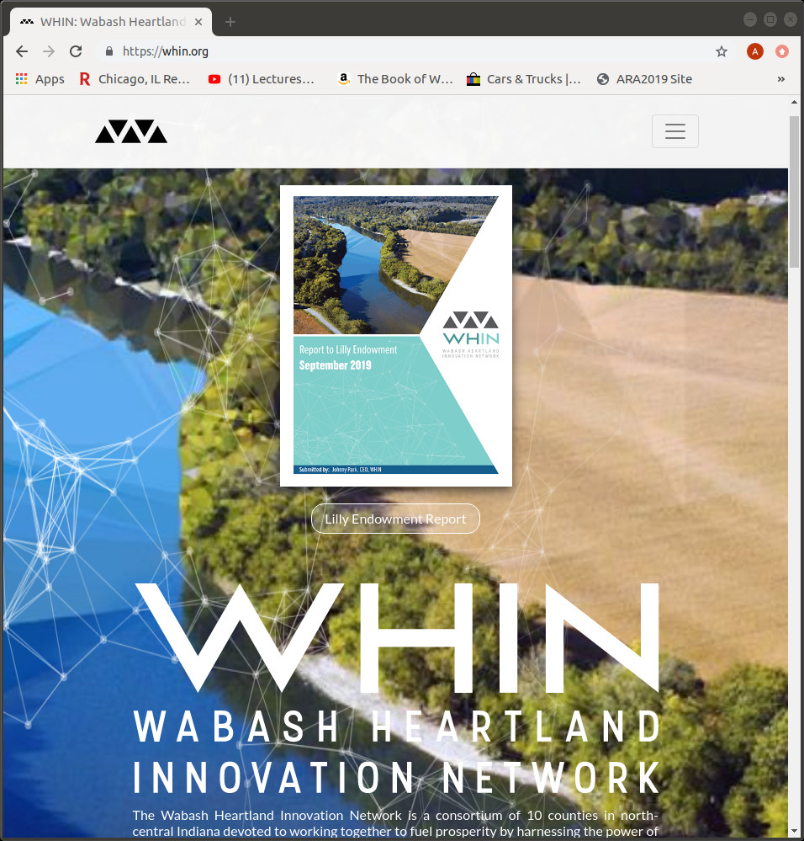
Wabash Heartland Innovation Network (WHIN)
What the Network does?
The Wabash Heartland Innovation Network is a consortium of 10 counties in North-Central Indiana deploying Internet-enabled sensors in support of digital agriculture and next-generation manufacturing.
How will the proposed effort benefit?
WHIN will
provide detailed field management data, including moisture content, fertilizer use, weather data, and yield for over 100 fields in the 10-county region.
evaluate software solutions developed by the proposed Center and their potential for deployment.
will interface between the proposed Center and the Network’s clients.

Slide 4
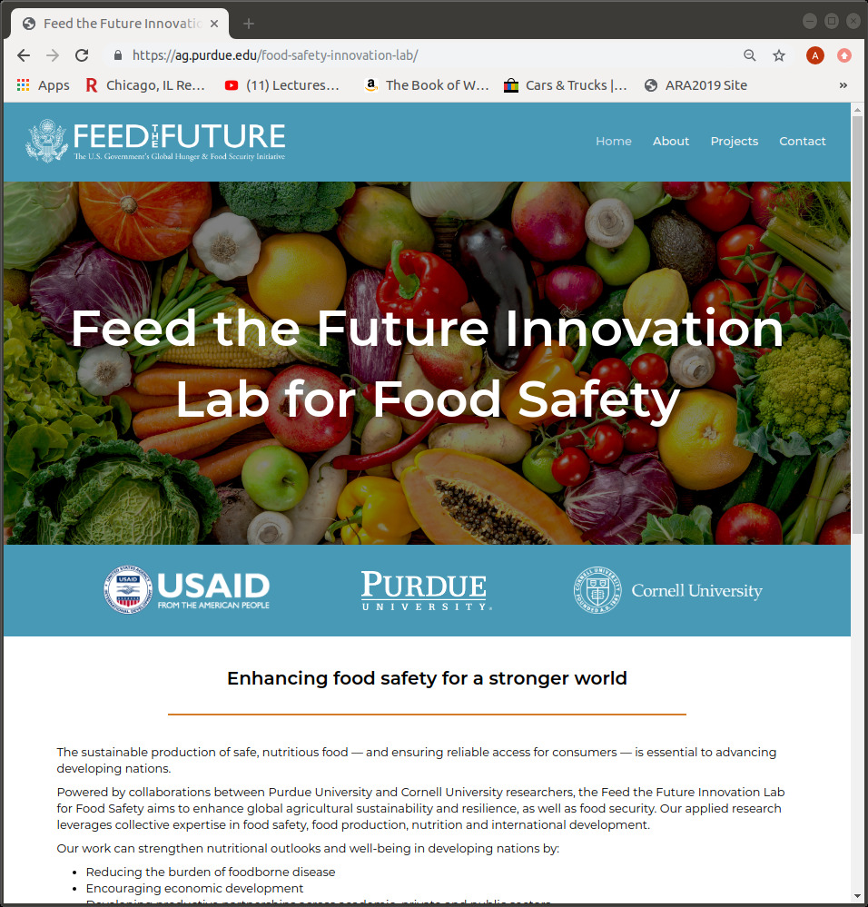
Feed the Future Innovation Lab (FFIL) for Food Safety
What the Lab does?
The lab focuses on post-harvest segment of the value chain. This is achieved through development and use of on-farm drying and storage technologies, coupled with food processing innovations and mechanisms of dissemination that link farmers to markets.
How will the proposed effort benefit?
FFIL will
provide data from its target populations in Bangladesh, Cambodia, Ethiopia, Kenya and Senegal.
Assess solutions developed by the proposed Center in these international contexts.
Provide international outreach scope for the proposed Center.

Slide 5
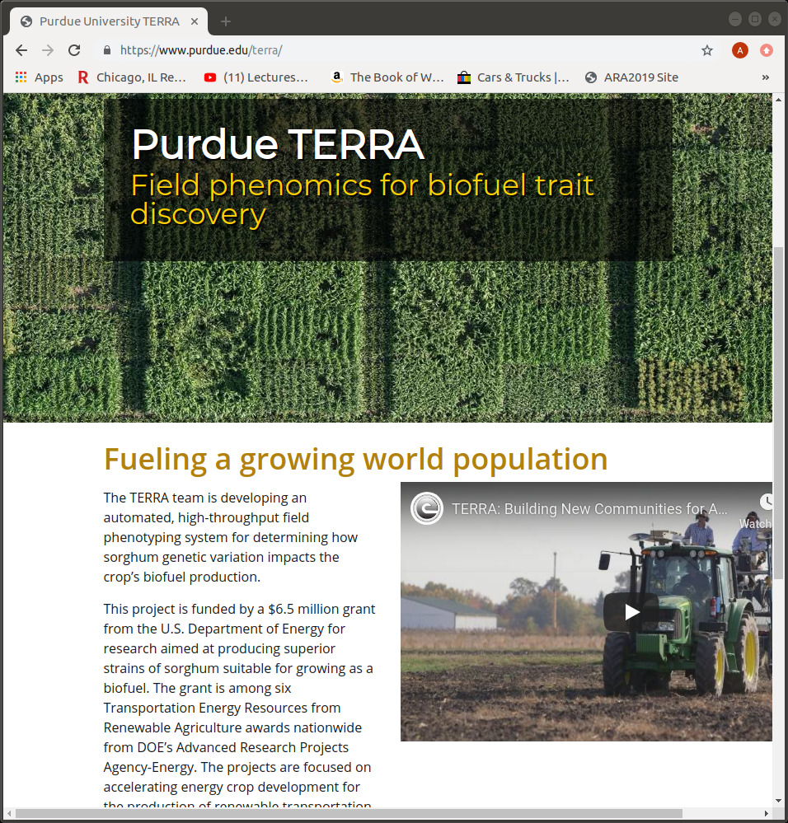
Field Phenomics for Biofuel Trait Discovery (FPBT)
What the Lab does?
The TERRA team is developing an automated, high-throughput field phenotyping system for determining how sorghum genetic variation impacts the crop’s biofuel production.
How will the proposed effort benefit?
FPBT will
provide data from sorghum fields, including field management, genomic data, and weather data.
The proposed Center will test its phenotype mapping and hypothesis generation methods on this data.
FPBT will evaluate phenotyping hypotheses generated by the proposed Center in the field.

Slide 6
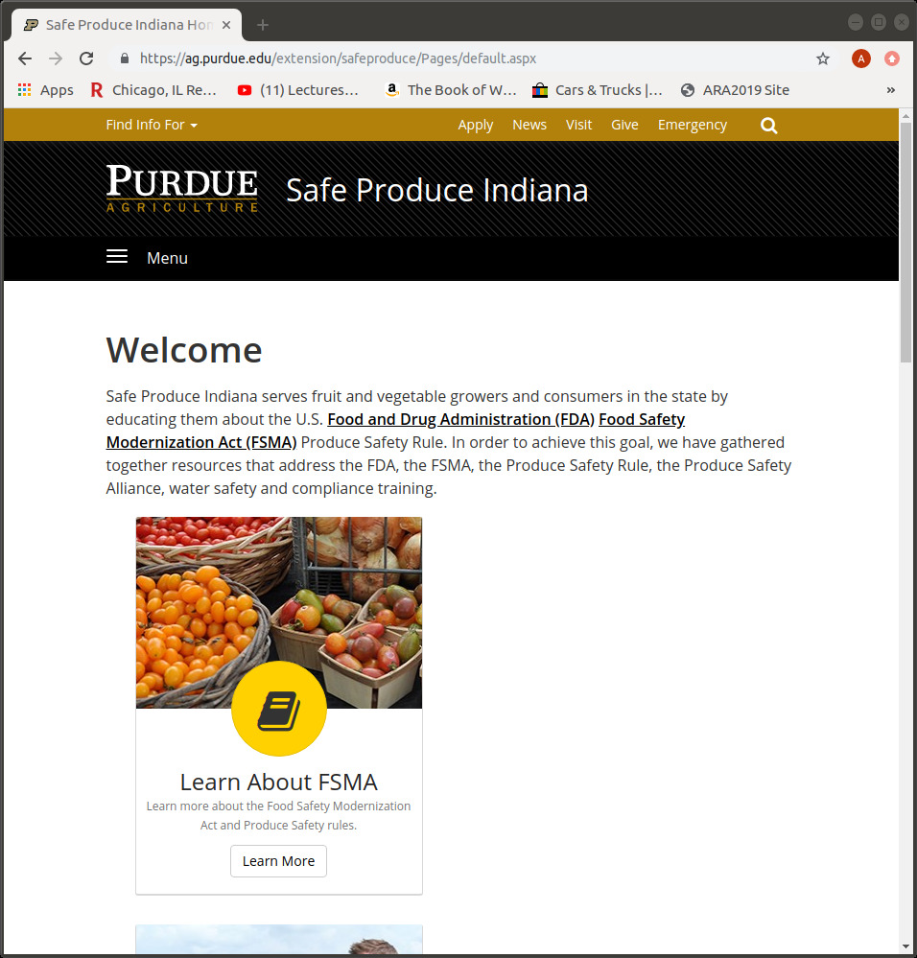
Safe Produce Indiana Program (SPI)
What the Program does?
Safe Produce Indiana serves fruit and vegetable growers and consumers in the state by educating them about the U.S. FDA Food Safety Modernization Act (FSMA) Produce Safety Rules. It curates resources that address the Produce Safety Rule, established the Produce Safety Alliance, and provides water safety and compliance training.​
How will the proposed effort benefit?
SPI will
coordinate outreach efforts to various entities in the fresh food chain – from growers to policy-makers.
help organize workshops for the proposed Center.
widely disseminate educational material from the proposed Center.

Slide 7
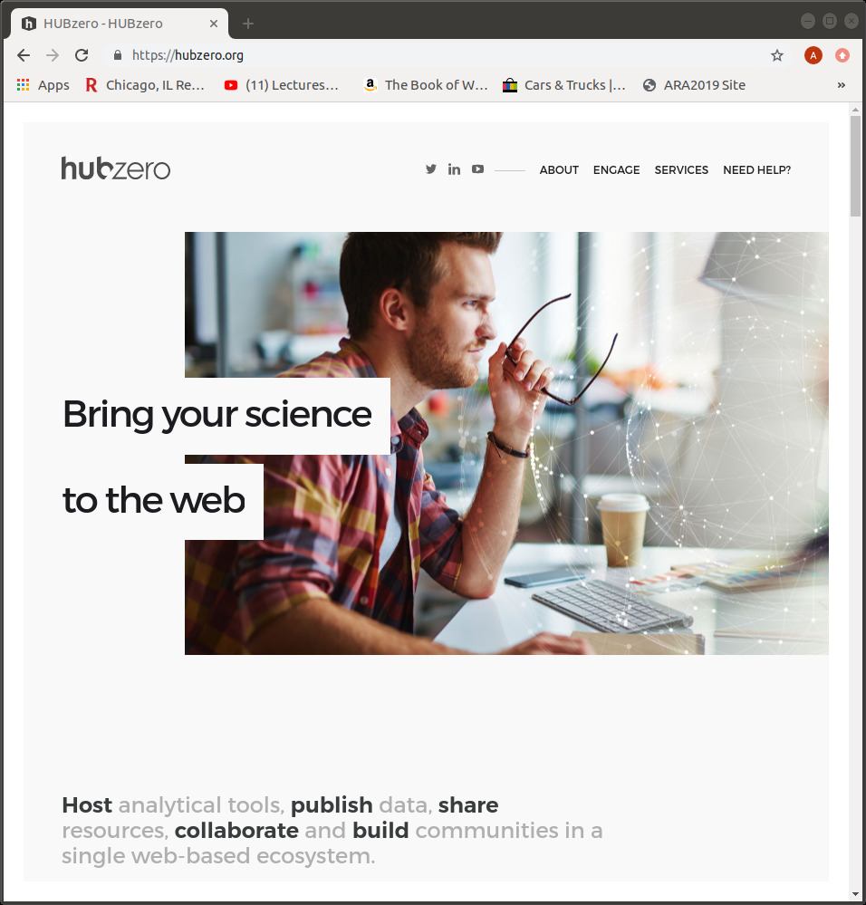
Purdue HubZero
What the Project does?
HubZero is the world leading platform for developing scientific computing resource hubs. HubZero technology currently hosts over 60 science hubs, reaching over 2M individuals.​
How will the proposed effort benefit?
HubZero will
provide support to initiate CropHub.
help with design of CropHub, share best practices on optimizing user experience, and assist in publishing resources on CropHub.
help in interfacing CropHub with other community resources.
assist in assessment of CropHub.

