Slide 1
Center for
Science of Information
Knowledge Transfer and Outreach

Slide 2
Knowledge Transfer: Objectives
Industry and Broader Community Outreach
Educational Initiatives
International Partnerships
Knowledge Transfer Through Human Resources Development
Joint Projects and Grants
Planned Activities

Slide 3
Knowledge Transfer to Industry and Broader Community
A sequence of (highly successful) meetings.
  National Academies Workshop: August 3-5, Research Workshop, Challenges and Opportunities for the Science of Information, Irvine, CA
  The Seventh Workshop on Information Theoretic Methods in Science and Engineering, July 05, 2014 - Monday, July 07, 2014, Waikiki, Hawaii
  Charles River Science of Information Day – MIT, April 28, 2014, Ray and Maria Stata Center, MIT
  UIUC/Purdue Science of Information Day - UIUC Campus, April 11, 2014, CSL, University of Illinois
  Texas A&M Science of Information Days, April 03, 2014 - Friday, April 04, 2014, Texas A&M University

Slide 4
Knowledge Transfer to Industry and Broader Community
  Invited Session at Princeton University's 48th Annual Conference on Information Sciences and Systems (CISS), March 19 - 21, 2014, Princeton University
  CSoI Reception and Research Presentation at ITA Workshop, San Diego, February 11, 2014, Catamaran Hotel and Resort, San Diego
  Info-Metrics Conference: Information, Instability,and Fragility in Networks, November 15, 2013, University of Colorado – Boulder
  UC Berkeley / Stanford - New Directions in the Science of Information, November 04, 2013, The David Brower Center, 2150 Allston Way, Berkeley, CA 94704

Slide 5
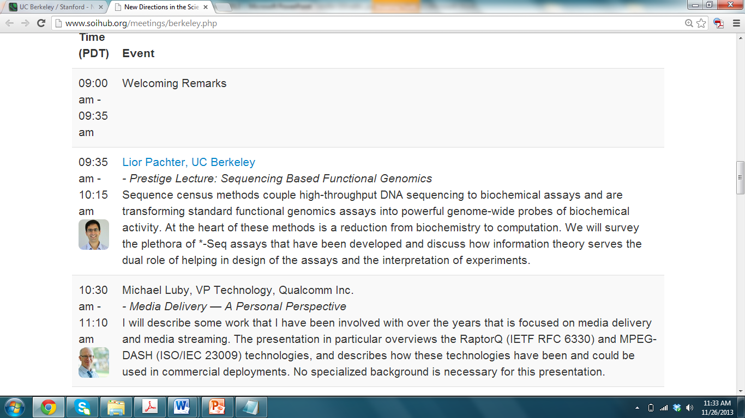
Knowledge Transfer: Science of Information Day at Berkeley, Nov 4

Slide 6
Knowledge Transfer: Science of Information Day at Berkeley, Nov 4
Over 100 attendees, including representatives from industry, graduate students, and faculty.
Four lectures (including a keynote by Dr. Michael Luby, VP of Research at Qualcomm)
Poster session/ competition.
Number of new interactions seeded at the meeting.

Slide 7
Industry Meetings
CSoI-Lucent Collaborative Research Meeting (Sept 5)
  Approximately 24 participants from Lucent and the Center
  Talks focused on defining challenges of common interest (particularly in communications and scalable data management).
  Multiple collaborations were seeded from this meeting, along with internship opportunities for students and other personnel exchanges.

Slide 8
Industry Meetings
Industry Roundtable, Chicago, Sept 30
  Representatives from a number of companies (Lucent, Motorola Mobility, John Deere, Technicolor, Hewlett Packard).
  Talks by Center researchers as well as Industry participants.
  Number of tangible problems identified and collaborations seeded.

Slide 9
Knowledge Transfer to Industry – Other acvitivies
Over 100 invited lectures to industry, US-based, and international institutions.
Research results from Center efforts transferred to a number of companies.
Technical advisory boards of Centers and Companies.
Large number of student interns.
A number of Center students have now graduated and have taken positions at research labs as well as top educational institutions.

Slide 10
International Collaborations and Partnerships
Center researchers have a large number of international collaborations.
Three formal partnerships have been initiated – LINCS France, Govt. of Colombia, and ETH Switzerland.

Slide 11
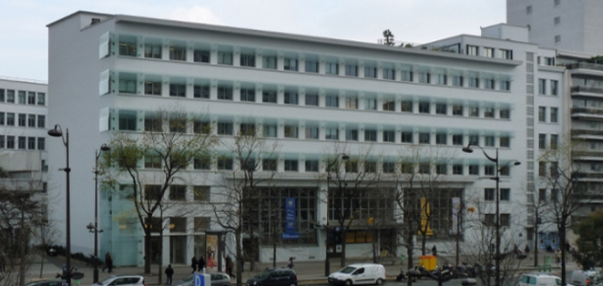
CSoI- LINCS France
The formal collaboration with Laboratory of Information, Network and Communication Sciences (LINCS) involves:
Cross reference all on-line talks and workshops.
Participate in centers' sponsored workshops, including in the co-organization of workshops.
Opportunities to visit these institutions to start collaborations. P.R. Kumar, Venkat Anantharam
Students will be locally sponsored for short research visits – Summer 2014
Centers will leverage their agenda by jointly submitting projects for industry collaboration and funding.

Slide 12
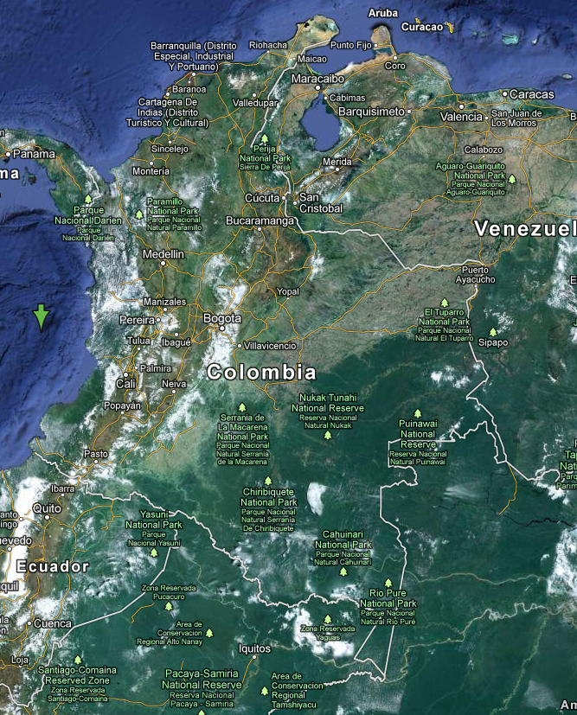
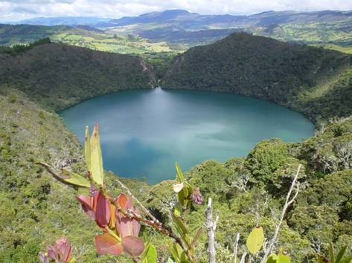
CSoI-Colombia
Collaboration includes the following aspects:
Making educational materials accessible to students in Colombia: translation into Spanish, dissemination from hubs in Colombia, and instructor development.
Personnel exchanges: Ex: Juan Lalinde (faculty) attended summer school and will spend portion of sabbatical at the Center.
Research interactions. The Government of Colombia has considerable interest in cataloging and federating all data relating to its biodiversity. CSoI will help Universities and Government Agencies in Colombia set up data repositories, frameworks for interoperability, and support for analytics.

Slide 13

ETH Zurich
A cooperative agreement provides the framework for strong collaborations, including:
Personnel Exchanges: Faculty and students will have opportunties for visiting and spending time at partner institutions.
Joint Projects: Partner institutions will provide infrastructure for seeding, and support for executing joint projects.
Cross-listing Seminars and Publications: Partner institutions will make an effort at cross-listing seminars and publications across institutions.

Slide 14
Other Educational and Outreach Activities
Over 175 talks at various institutions
Summer school in partnership with IEEE IT Society
    Over 160 participants, including faculty development workshop on teaching topics related to Science of Information
Strategic educational partnerships (Rose Hulman, OHSU, CMU, CMOP)

Slide 15
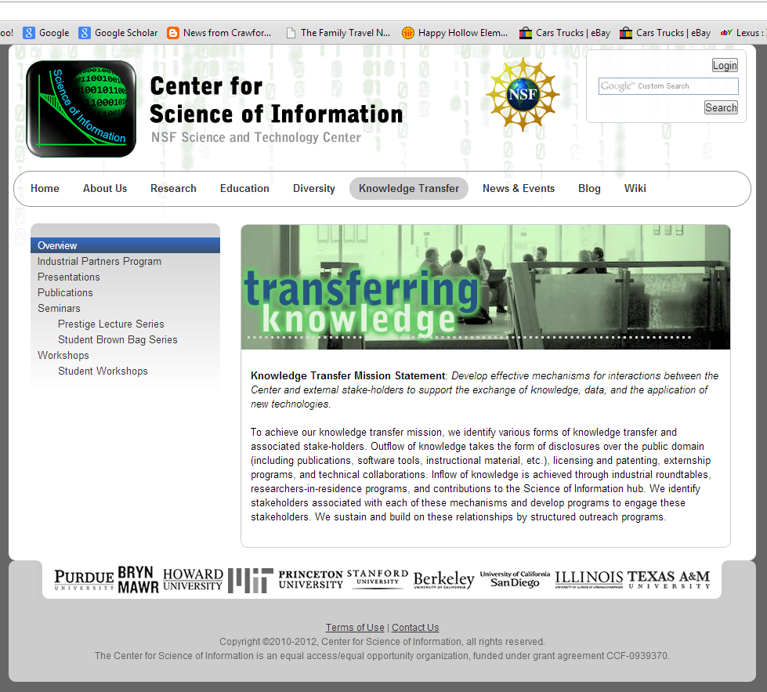
Soihub.org: Our Portal to the World

Slide 16
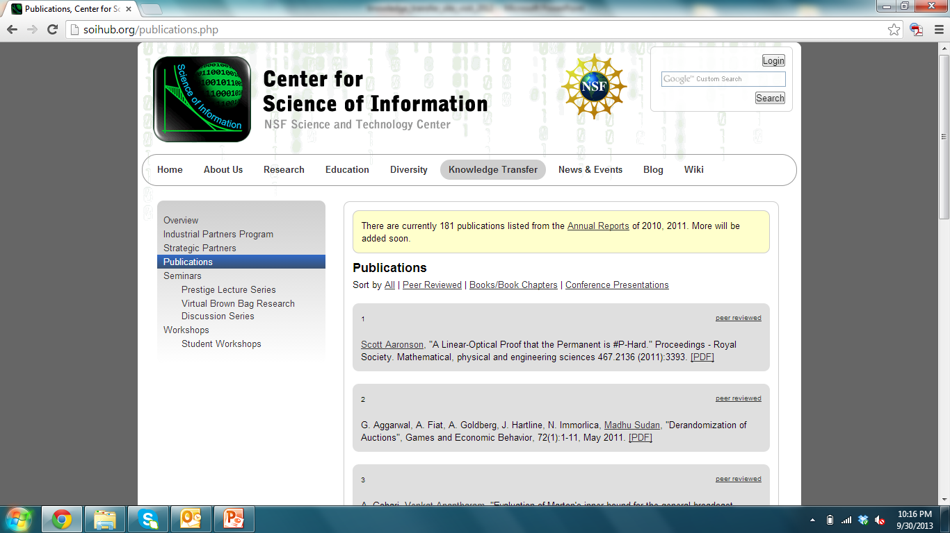
Soihub.org: Our Portal to the World
Presentations
Publications
Seminars
Workshops
Student Brown-Bag Series
Course work

Slide 17
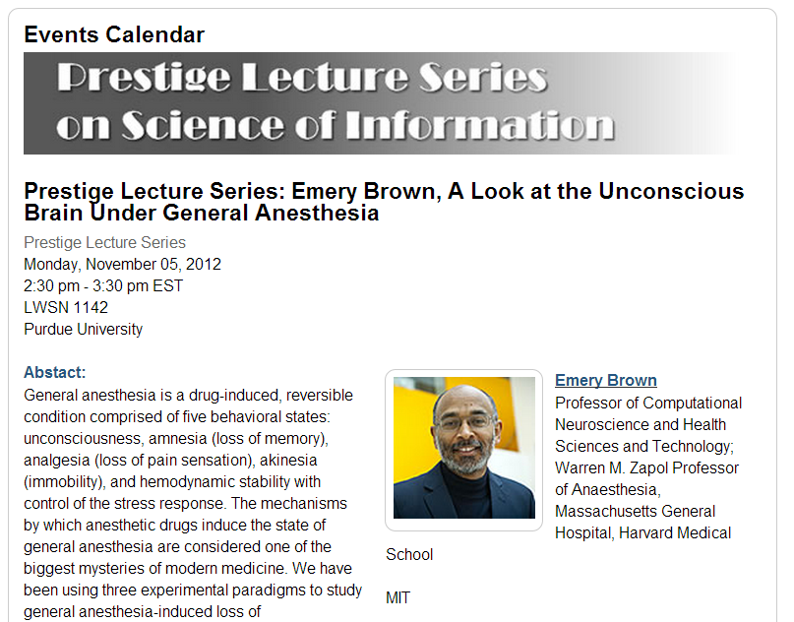
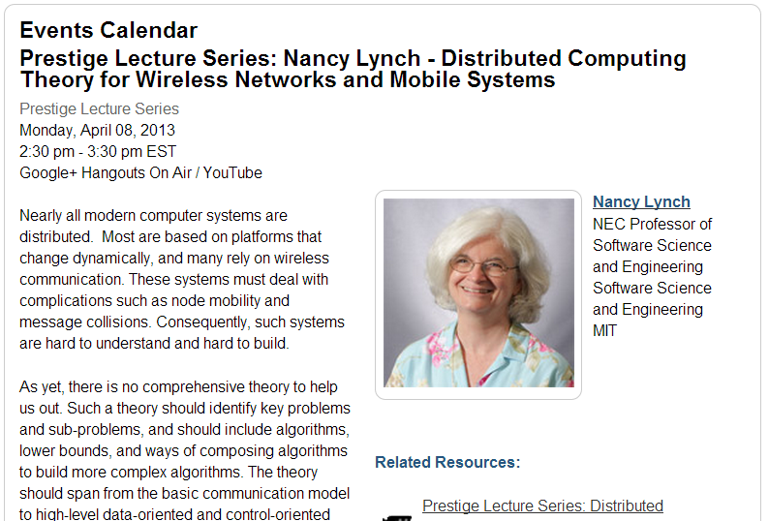
Soihub.org: Our Portal to the World

Slide 18
Soihub.org: Our Portal to the World
Nov. 1, 2012 - Oct. 31, 2013*
17,254 Visits
Of these, 10,129 were Unique Visitors
57.47% were New Visits
Visitors come from all over the world with 121 countries/territories represented
Top 10 Countries by Visits
1. United States 12,562
2. India 640
3. Germany 374
4. China 323
5. Canada 264
6. France 197
7. UK 192
8. Poland 144
9. Iran 143
10. Colombia 94
Notes:
*Thru Sept. 29th, 2013
Although the pageviews are a little less some other metrics are encouraging,

Slide 19





Social Media Properties
Nov. 1, 2012 - Oct. 31, 2013*
Facebook
“Likes” increased 147%
Nov. 1, 2012 Likes: 53
Sept. 27, 2013 Likes: 131
Google+
Group initiated this year
YouTube
“Views” increased 117%
Video Views: 5,729
Twitter
Tweets: 259
Following: 190
Followers: 70
LinkedIn
CSoI Group Created
Notes:
*Thru Sept. 29th, 2013
Although the page views are a little less some other metrics are encouraging,

Slide 20
Outcomes
Industry activities have resulted in large number of funded projects (totaling over $1M) directly attributable to Center research.
Large number of personnel exchanges.
International partnerships.
Strong educational impact.

Slide 21
Funded Projects from Industry
Funding Company | Project Title | Investigator | Amount (in thousands of $)
Microsoft Research | Active Sampling in Networks | J. Neville | 25
LLNL | Modeling Graph Dynamics for Anomaly Detection | J. Neville | 25
Intel Corp. | Wireless Video Delivery | P. R. Kumar | 100
National Instruments | Wireless Medium Access Control | P. R. Kumar | 16
Huawei Tech. | Non-coherent Communication Schemes for Multiuser Massive MIMO Systems | Goldsmith | 70
CableLabs | Cognitive Massive MIMO Wireless Networks | Goldsmith | 75
NEC | Cloud-based Architectures for Future Cellular Systems | Goldsmith | 40
Samsung | Heterogeneous Networks with Multiple Radios | Goldsmith | 20

Slide 22
Funded Projects from Industry
Funding Company | Project Title | Investigator | Amount (in thousands of $)
Xerox | Km-Resolution Aerosol Retrieval Based on Remote Sensing Images | B. Yu | 30/yr
Deutsche Telekom | Distributed Learning and Collective Decision-Making | S. Kulkarni | 346
Google | Huds up Display to Manage Healthcare for Users with Diabetes | T. Coleman | 25
Yahoo! | An integrated Probabilistic Model for Reach and Frequency | L. Si | 15
Google | Expertise Search in Complex Information Network | L. Si | 60
IBM | Big Data for Information Security | Qi | 100

Slide 23
Funded Projects from Industry
Funding Company | Project Title | Investigator | Amount (in thousands of $)
Lilly | Isoform Detection Based on Massive RNA-sequencing Data for Hepatocellular Carcinoma | Qi | 160
Microsoft Res. | Network Models for Bioinformatics | A. Qi | 100
IEDC | INDURE: Indiana Database of University Research Expertise | L. Si | 150

Slide 24
Other Projects from Industry
Partner | Title of Project | Center Participant
Microsoft Res. | Characterizing Simplicity of Proofs in Program Verification | Jagannathan
To understand opportunities for proof reuse, optimization, and readability by precisely characterizing, in an information theoretic sense, simplicity measures in proof construction.
Huawei | Green Wireless | Goldsmith
Advising on the state-of-the-art in reducing energy consumption of backbone cellular infrastructure.
Ericsson | Learning for MIMO Cognitive Radio | Goldsmith
Collaboration (and personnel exchange) on blind null space learning in MIMO cognitive radios to allow them to coexist with primary users without interfering with them.

Slide 25
Knowledge Transfer to Industry
Abbott Labs | On Control of Crystal Morphology Towards Better Pharmaceutical Products | Doraiswami
Explore model-based control of super-saturation to manipulate crystal faces that increase bioavailability, and hence effectiveness of drugs.
HP | Lossless Compression for Large Alphabets | Szpankowski
Developing methodology to understand minimax redundancy for unbounded alphabets.
Google | Lossy Compression | Weissman
Working with members of the Google Geo team on image compression.
Samsung | Real-time and Limited Delay Compression and Error Correction | Weissman
Working with the Samsung Israel Research Lab on compression and error correction techniques with real-time constraints.

Slide 26
Knowledge Transfer to Industry
Alcatel-Lucent | Research Collaboration | Verdu
Collaboration with Alcatel-Lucent Bell Laboratories.
Rome Lab | Partnership | Atallah
External Partnership with Rome Lab, Rome, NY.
Pacific Biosciences | Collaboration | Tse
Sequence analysis and assembly techniques.

Slide 27
Personnel Exchanges: Student Internships
Student Name | Home Institution | Organization | Topic
D. Harris | Howard | Montclair St. U. | REU
Y. Zhu | Purdue | Google | Data Analysis for Online Shopping
N. Soltani | Stanford | Technicolor | EEG as Biometric Feedback
G. Bresler | Berkeley | Qualcomm | Time Synchronization Protocol for Ad-hoc Networks
G. Kumar | Stanford | TI | Noise Pre-processing of Videos
C. Task | Purdue | Sandia | MapReduce-Based Analysis of Social Networks
C. Cabrera | Bryn-Mawr | Montclair St. U | REU
M. Forbes | MIT | MSR
B. Asadi | UCSD | AOL | Network Reconstruction of Web Content
S. Kamath | Berkeley | Jane St. Capital | Trading Strategies

Slide 28
Personnel Exchanges: Student Internships
Student Name | Home Institution | Organization | Topic
S. Shang | Princeton | Telekom Labs. | Privacy Preserving Recommendation Systems
D. Zhang | Purdue | IBM Research | Large Scale Data Analysis and Insider Threat Detection
Z. Zhang | Princeton | Deutsche Telekom | Augmented Reality
P. Ritchey | Purdue | Microsemi | LLVM Compiler Enhancements
H. Li | Berkeley | MSR
A. Manolakos | Stanford | Qualcomm

Slide 29
Comparison with Metrics
Increase the number of industry funded projects by 3 for 2014 and by 7 for 2015 [Significantly Exceeded Goal]
Organize and convene the industrial advisory board meeting [Initiated at the Chicago Industry Roundtable]
Develop and make available a complete online course in science of information along with supporting educational modules [Significantly Exceeded Goal]
Develop, continually improve, and increase use of the Science of Information website each year [Access Statistics Demonstrate Success]
Institute and build upon the Center’s research and graduate student seminar series [Vibrant Community of Center Students and Others Created]
Develop international collaborations and partnerships [Three International Partnerships Formalized, Others in the works]
Establish student internship opportunities/sponsored fellowships [Large number of opportunities created]

Slide 30
Planned Activities
August 4-8, Summer School, at UCSD.
As part of our embedded diversity initiatives in educational programming, the Center will present a panel discussion on mentoring at the Summer School. Title: “The Academic Family of Robert M. Gray: a panel discussion on the importance of mentoring”
August 5-6, Faculty Teaching Science of Information Workshop, at UCSD
August 18-20, National STC Meetings, Ft. Collins, CO
September 11-14, Channels Scholars Fall Event at Purdue (research talks, tips on applying to graduate school, networking opportunities, etc.)

Slide 31
Planned Activities
Fall 2014, Course development work in progress end of Fall semester – 10 courses for Center, ~18 new modules to add to learning HUB
  CSoI Course: Data Science – Bryn Mawr College and Olin College
  CSoI Course: Information in Cell Signaling – Villanova
  CSoI Course: Data 101 – Rutgers University
  CSoI Course: Advanced Science of Information – Carnegie Mellon
  CSoI Course: Network Coding – Texas A&M
  CSoI Course: Intro to Science of Information – EAFIT, Colombia
  CSoI Courses: Probability and Data Analysis Applications – Purdue
  CSoI Course: Intro to Science of Information – Howard University
  CSoI Course: Science of Information, Big Data Analysis – UNC System
  CSoI Online Short Courses: Probability Theory and Mathematical Theory of Communication – Center Learning Hub – World-Wide Enrollment
New Series of 18 Online Modules Added to Learning Hub

Slide 32
Planned Activites
Fall 2014, Special Issue of “Proceedings of the IEEE” – completed spring of 2015.
Multiple special issues for “Foundations and Trends in Communications and Information Theory” are in process.
Channels Scholars Recruiting Initiative (to identify and recruit promising underrepresented undergraduates for the Scholars program)
October 2014, Channels Scholars Virtual Research Round Robin – student presentations
October 2014, Solicit applications for next CSoI Postdoctoral Fellow search

Slide 33
Planned Activities
October 31 - November 1, Recent Innovations in Info-Metrics Conference – Jointly with American University Info-Metrics Institute
November 2014, Channels Scholars Virtual Research Round Robin – student presentations
December 8-10
  NSF Site Visit
  All Hands meeting
  CSoI Student Meetings and Poster Session

Slide 34
Thank You.

