Slide 1
Computational Science and Engineering @ Purdue:
Ananth Grama
Director, Computational Science and Engineering
Professor of Computer Science.

Slide 2
CSE@PURDUE
One of the premier programs in the country (ranked in the top five by the Chronicle of Higher Education, 2007; most recent ranking available)
One of the largest programs world-wide with over 100 affiliated faculty and 140 graduate students
CSE faculty contribute in leadership roles to some of the largest research efforts on campus (DoE PRISM, CSoI NSF STC, NEES), along with many other interdisciplinary efforts
CSE faculty have been supported by several federal educational grants as well.
CSE students provide critical expertise to a broad set of projects

Slide 3
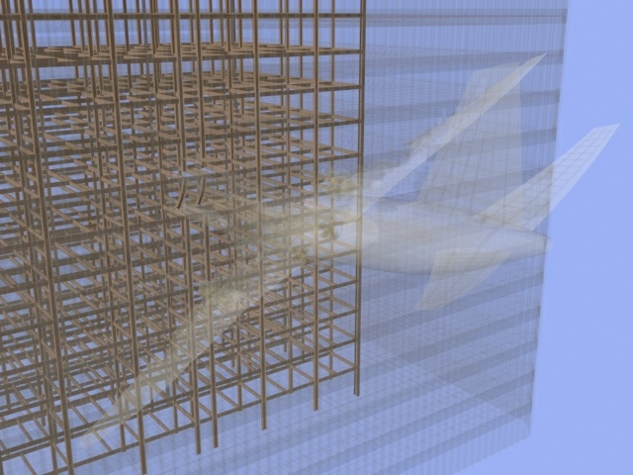
CSE and Civil Engineering
Structural Modeling

Slide 4
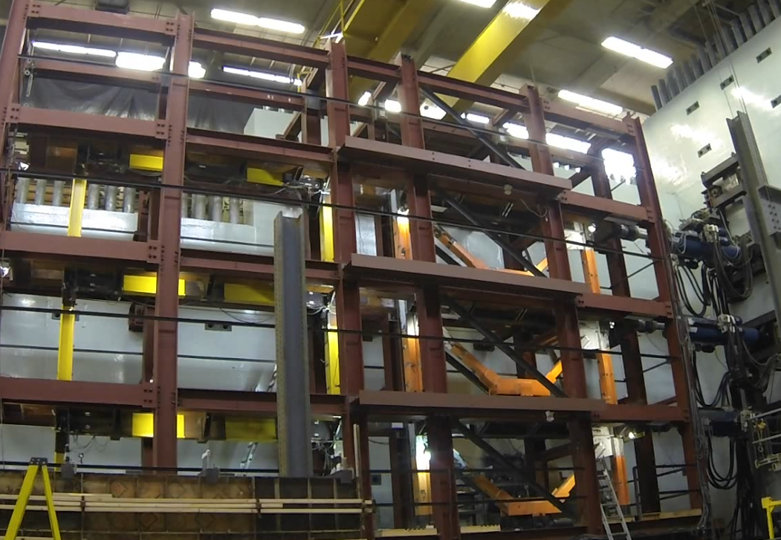
CSE and Civil Engineering
Real-time Control of Structures

Slide 5
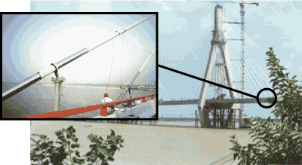
CSE and Civil Engineering
Semi-active control.

Slide 6
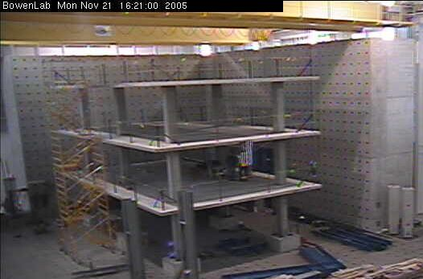
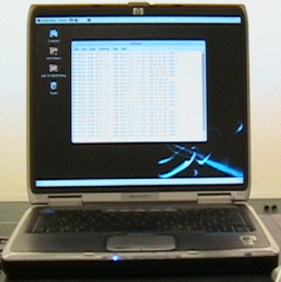
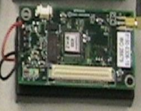
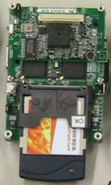
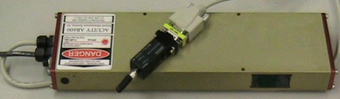
CSE and Civil Engineering
Pilot deployment at BOWEN labs
ECN Net
MICA2 motes with
ADXL 202
FM 433MHz
802.11b
Peer-to-Peer
Internet
Laser attached
via serial port to
Stargate computers
Currently laser readings
can be viewed for from
anywhere over the Internet
(conditioned on firewall settings)

Slide 7
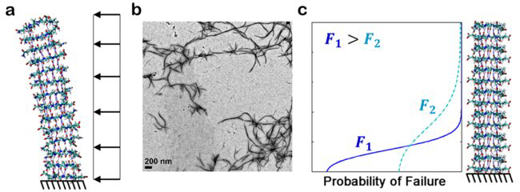
CSE and Civil Engineering
Materials Modeling and Design

Slide 8
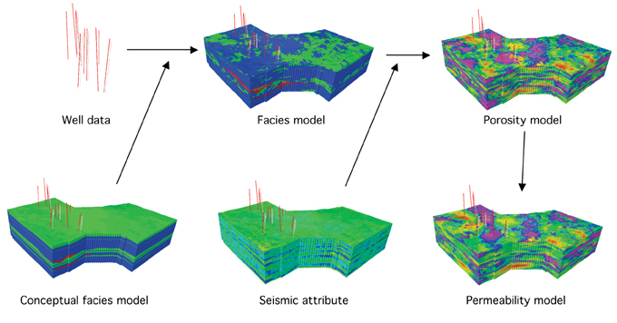
CSE and EAPS
Reservoir Modeling (Courtesy: EPMag)

Slide 9
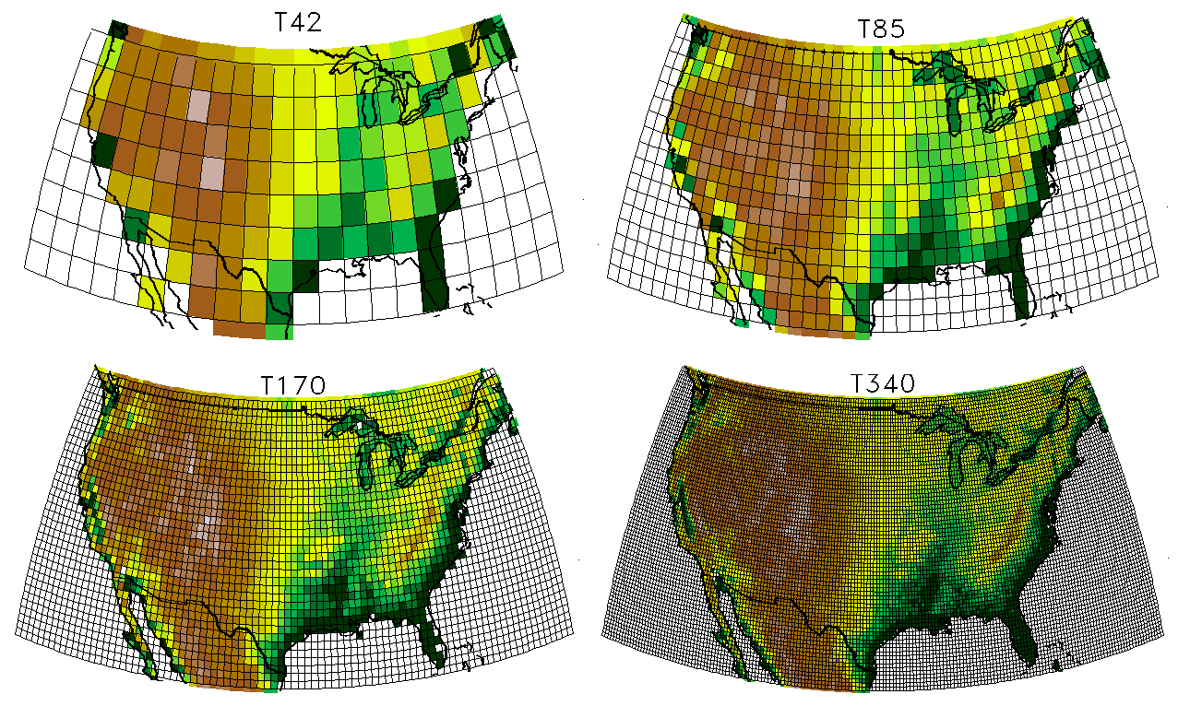
CSE and EAPS
Climate/ Weather Modeling (Courtesy: UCAR)

Slide 10
CSE and CE/EAPS
Tremendous challenges in “Big Data”
  Large amounts of satellite imagery
  Simulation data
  Earth observation data
  Data relating to human factors

Slide 11
CSE and CE/EAPS
Numerical Linear Algebra
  Eigenvalue problems/ diagonalization
  Linear/ non-linear system solvers
High Performance Computing Techniques
  Novel architectures
Dealing with large datasets
  Image processing
  Scalable analytics

Slide 12
CSE Admissions
Eligibility
  Enrolled graduate students in one of CSE affiliated departments at Purdue University
Apply Now
  Contact CSE faculty in your department
    http://www.gradschool.purdue.edu/cse/academics/faculty.cfm
  Fill out registration form
    PDF form available at http://www.gradschool.purdue.edu/cse/admissions/applying.cfm
  Email registration form with your CSE Representative’s approval to CSE Office
  Receive acceptance email with your first audit and guidelines for concentration requirements

Slide 13
Curriculum Requirements
Master’s Degree
  Course Requirements
    2 Core Courses and 1 Relevant Courses
    Grade of B or higher
    http://www.gradschool.purdue.edu/cse/academics/curriculumrequirements/core.cfm
  Seminar Requirements
    Attend 2 semesters of CSE seminars
    Minimum of 3 seminars required per semester
  Plan of Study
    Fill in concentration code “CMEN” on your Plan of Study
    CMEN – Computational Science and Engineering for School of Engineering
  *PhD Continuing Students should fill out “Change of Status Form” to continue CSE concentration on PhD. It will allow CSE Office to use your master courses toward your PhD and keep track of your new seminar attendance.

Slide 14
Curriculum Requirements
Doctoral Degree
  Course Requirements
    2 Core Courses and 2 Relevant Courses
    Grade of B or higher
    http://www.gradschool.purdue.edu/cse/academics/curriculumrequirements/core.cfm
    http://www.gradschool.purdue.edu/cse/academics/curriculumrequirements/relevant.cfm
  Seminar Requirements
    Attend 4 semesters of CSE seminars
    Minimum of 3 seminars required per semester
  Plan of Study
    Fill in concentration code “CMEN” on your Plan of Study
    CMEN – Computational Science and Engineering for School of Engineering

Slide 15
Core Courses
Introduction to Computational Science
Numerical Methods
High Performance Computing
Artificial Intelligence, Analytics
Scientific Visualization
Optimization

Slide 16
Elective Courses
Large number of computationally oriented courses across the campus.

Slide 17
Questions
Profs. Ayhan Irfanoglu and Robert Nowack
Ms. Anita Park
apark@purdue.edu
Ananth Grama
ayg@purdue.edu

