Slide 1
Computational Science and Engineering @ Purdue: Ananth Grama Director, Computational Science and Engineering Professor of Computer Science. Anita Park Coordinator, Computational Science and Engineering.

Slide 2
Some History
CSE is one of the top-ranked academic programs at Purdue
Initiated in 1994, with Prof. T. Downar of Nuclear Engineering as one of the original founders
Has grown significantly over the past 20 years!

Slide 3
Current State of Program
One of the premier programs in the country (ranked in the top five by the Chronicle of Higher Education, 2007; most recent ranking available)
One of the largest programs world-wide with over 100 affiliated faculty and 140 graduate students
CSE faculty contribute in leadership roles to some of the largest research efforts on campus (DoE PRISM, CSoI NSF STC, NEES), along with many other interdisciplinary efforts
CSE faculty have been supported by two US Department of Education GAANN grants over the past eight years.
CSE students provide critical expertise to a broad set of projects

Slide 4
CSE and Nuclear Engineering
Courtesy James Vary, IA State.

Slide 5
CSE and Nuclear Engineering

Slide 6
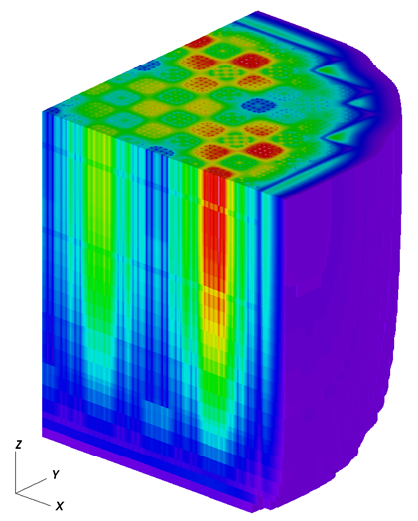
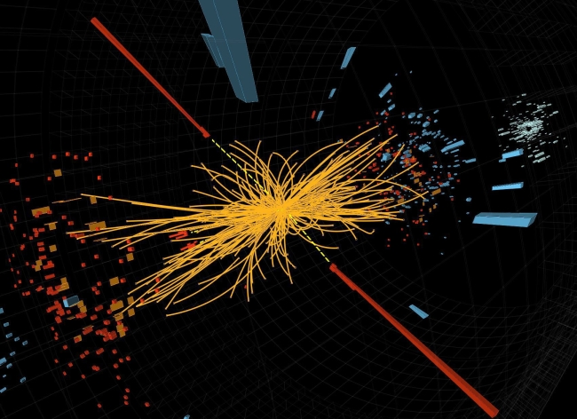
CSE and Nuclear Engineering

Slide 7
CSE and Nuclear Engineering
Numerical Linear Algebra
Eigenvalue problems/ diagonalization
Linear/ non-linear system solvers
High Performance Computing Techniques
Novel architectures
Dealing with large datasets
Image processing
Scalable analytics

Slide 8
CSE Admissions
Eligibility
Enrolled graduate students in one of CSE affiliated departments at Purdue University
Apply Now
Contact CSE faculty in your department
http://www.gradschool.purdue.edu/cse/academics/faculty.cfm
Fill out registration form
PDF form available at http://www.gradschool.purdue.edu/cse/admissions/applying.cfm
Email registration form with your CSE Representative’s approval to CSE Office
Receive acceptance email with your first audit and guidelines for concentration requirements

Slide 9
Curriculum Requirements
Master’s Degree
Course Requirements
2 Core Courses and 1 Relevant Courses
Grade of B or higher
http://www.gradschool.purdue.edu/cse/academics/curriculumrequirements/core.cfm
Seminar Requirements
Attend 2 semesters of CSE seminars
Minimum of 3 seminars required per semester
Plan of Study
Fill in concentration code “CMEN” on your Plan of Study
CMEN – Computational Science and Engineering for School of Engineering
*PhD Continuing Students should fill out “Change of Status Form” to continue CSE concentration on PhD. It will allow CSE Office to use your master courses toward your PhD and keep track of your new seminar attendance.

Slide 10
Curriculum Requirements
Doctoral Degree
Course Requirements
2 Core Courses and 2 Relevant Courses
Grade of B or higher
http://www.gradschool.purdue.edu/cse/academics/curriculumrequirements/core.cfm
http://www.gradschool.purdue.edu/cse/academics/curriculumrequirements/relevant.cfm
Seminar Requirements
Attend 4 semesters of CSE seminars
Minimum of 3 seminars required per semester
Plan of Study
Fill in concentration code “CMEN” on your Plan of Study
CMEN – Computational Science and Engineering for School of Engineering

Slide 11
Core Courses
Introduction to Computational Science
Numerical Methods
High Performance Computing
Artificial Intelligence, Analytics
Scientific Visualization
Optimization

Slide 12
Elective Courses
Large number of computationally oriented courses across the campus.

Slide 13
Questions
Ms. Anita Park
apark@purdue.edu
Ananth Grama
ayg@purdue.edu

