Slide 1
CSE@PURDUE
Overview of Policies and Guidelines
Ananth Grama,
Director, Computational Science and Engineering,
Professor of Computer Science.

Slide 2
Welcome!
To all new students in the CSE program, Welcome!
CSE@Purdue has a proud and long history:
One of the highest ranked, largest, and oldest programs in the world.
Rich tradition of multidisciplinary research and “big science/ engineering”.
Highly successful alumni.
Your biggest resource is the broader CSE community – your peer students and faculty. Use them!

Slide 3
CSE@Purdue: Big Science
PRISM: Prediction of Reliability, Integrity, and Survivability of Microsystems.
An NNSA Center of the Department of Emergy

Slide 4
CSE@Purdue: Big Science
Center for Science of Information.
A Science and Technology Center of the National Science Foundation.

Slide 5
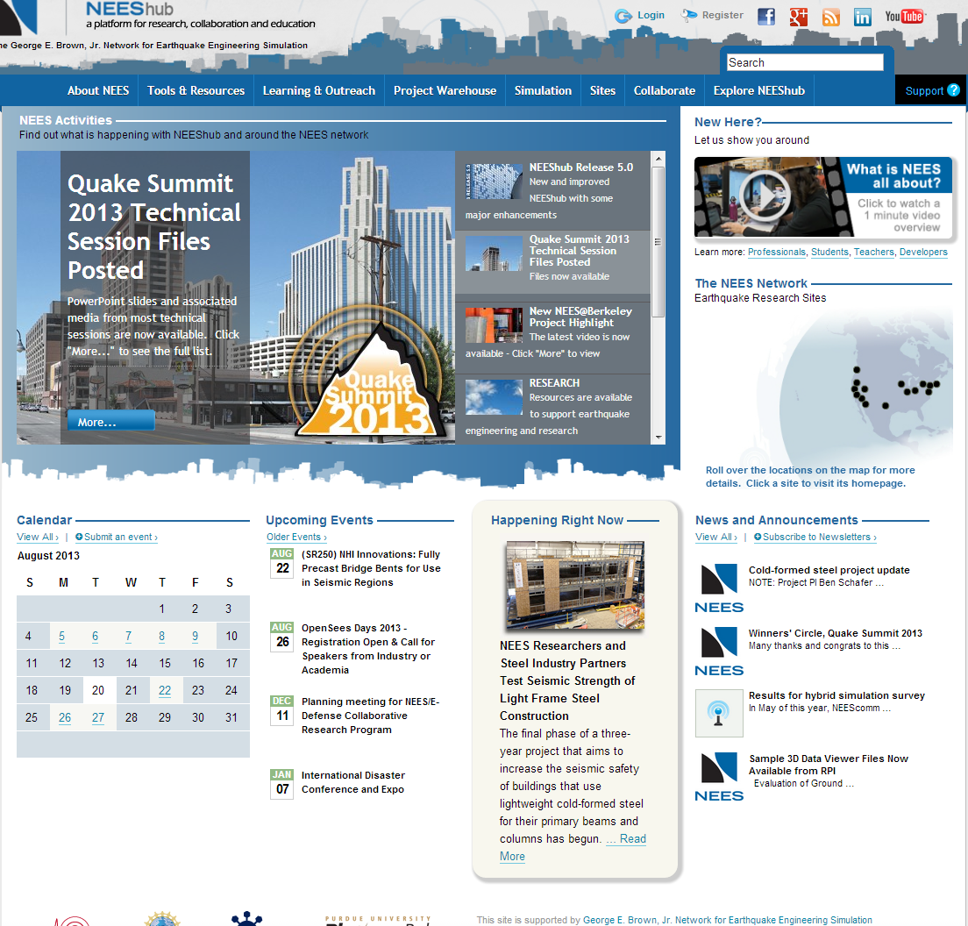
CSE@Purdue: Big Science
George E Brown Jr. Network for Earthquake Engineering Simulation

Slide 6
CSE@Purdue: Big Science
Network for Computational Nanotechnology

Slide 7
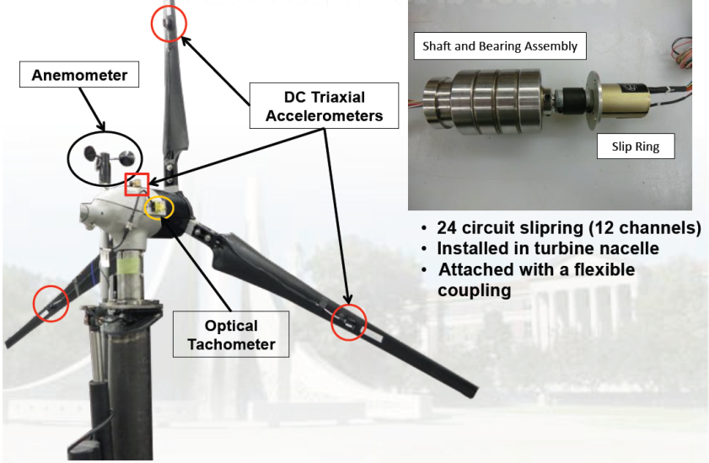
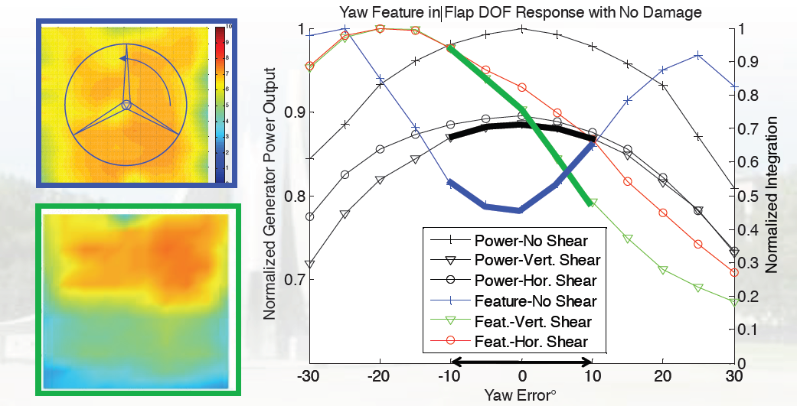
CSE@Purdue- Project Highlights
Modeling and real-time control of wind turbines.

Slide 8
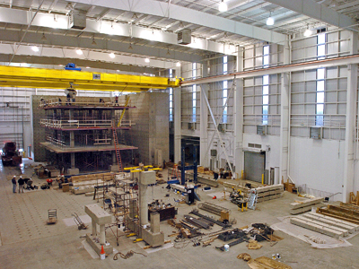
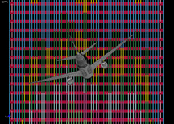
CSE@Purdue -- Highlights
Testing and simulation of large structures.

Slide 9
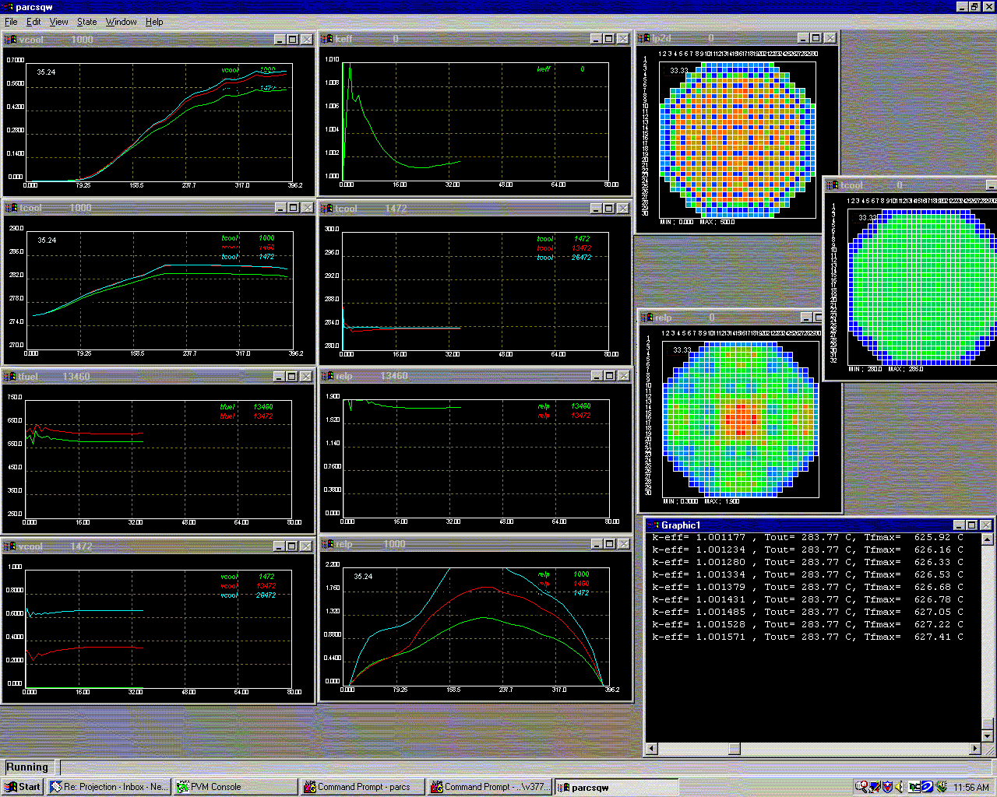
CSE@Purdue -- Highlights
Purdue Advanced Reactor Core Simulator

Slide 10
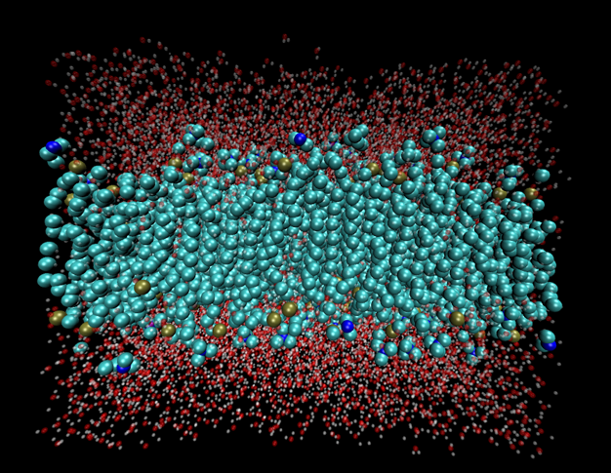
CSE@Purdue -- Highlights
Atomistic Modeling

Slide 11
CSE@Purdue -- Highlights

Slide 12
CSE/ CLS Policy Update
Need to schedule a seminar talk for Fall 2013? Please contact us at the earliest possible.
Taking courses – select courses from CSE website only. This site maintains the most up-to-date version of required and optional courses.
Grading policy – B or higher for both MS and PhD
Continuing on to PhD from MS
New form on the CSE/CLS website
Distance learning students
Seminar requirement waived
Report required (approved by CSE advisor and CSE Director)

Slide 13
CSE/CLS website updates
Curriculum requirements
Course list
Seminar & plan of study
Student Life
Research spotlight – Please consider contributing highlights to this segment. It would give you excellent visibility.

Slide 14
CSE/CLS Notes
CSE/CLS Audit
Beginning summer 2013, an audit is performed to monitor CSE students’ status
Letter of Certificate of Completion
By request only
Blackboard
Blackboard has been launched from Spring 2013.
Keep track of your attendance and grade.

Slide 15
CSE/CLS Events – Past and Future
Summary of Events held in Spring/summer 2013
Spring Events
Spring Reception
SIAM Purdue
Summer Events
Sponsored summer school programs
Center for Science Information - Information Theory Summer School
VSCSE – Data Intensive
VSCSE – Proven Algorithmic Techniques for Many-Core Processors
Please pay attention to CSE emails!

Slide 16
CSE/CLS Upcoming Events
CSLT
Social call-out
Student recruiting
Seminar events
Meeting arrangements with guest speaker
Course list update
Special programs by invitation from other computing organizations

