Slide 1
Emerging Frontiers of
Science of Information
NSF STC 2010: A Status Report

Slide 2
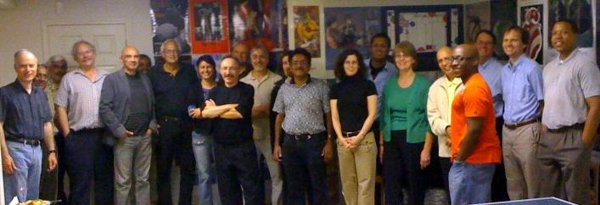
… The Team

Slide 3
Science of Information
We aim to extend classical Information Theory to meet challenges posed by rapid advances in biology, modern communication, and knowledge extraction.
We extend traditional formalisms for information to include:
structure, time, space, and semantics,
and other aspects such as:
dynamical information, physical information, representation-invariant information, limited resources, complexity, and cooperation & dependency.

Slide 4
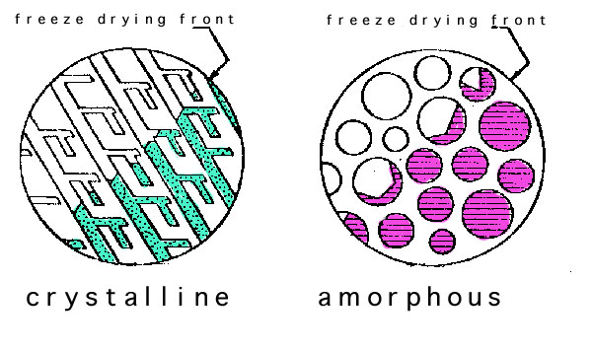
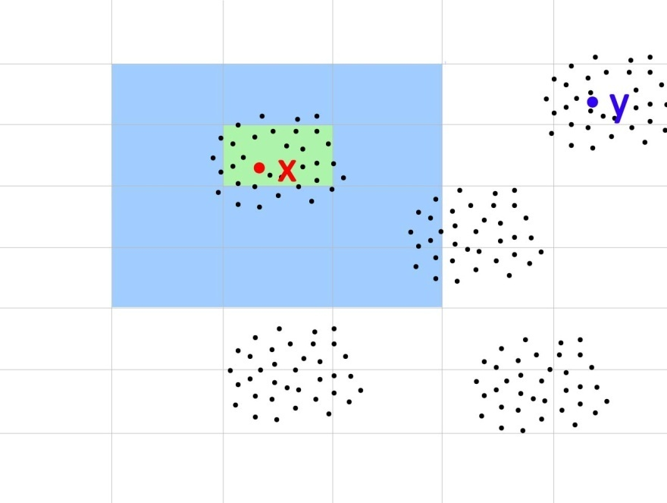
Post-Shannon Challenges
Structure:
Measures are needed for quantifying information embodied in structures (e.g., information in material structures, nanostructures, biomolecules, gene regulatory networks, protein networks, social networks, financial transactions).
Time & Space:
Classical Information Theory is at its weakest in dealing with problems of delay (e.g., information arriving late maybe useless or has less value).
Semantics & Learnable Information: How much information can be extracted for data repository? Is there a way to account for the meaning or semantics from data?

Slide 5
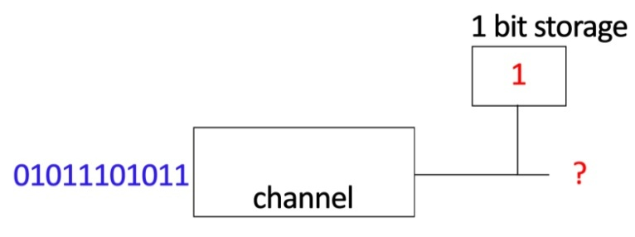
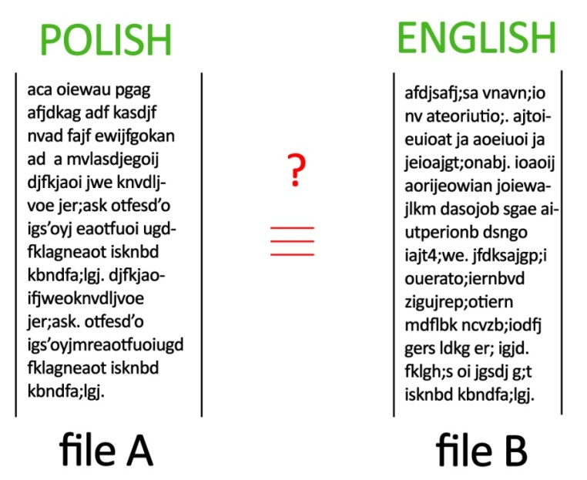
Post-Shannon Challenges
Other related aspects of information:
Limited Computational Resources: In many scenarios, information is limited by available computational resources (e.g., cell phone, living cell).
Representation-invariance: How to know whether two representations of the same information are information equivalent?
Cooperation: Often subsystems may be in conflict (e.g., denial of service) or in collusion (e.g., price fixing). How does cooperation impact information (nodes should cooperate in their own self-interest)?

Slide 6
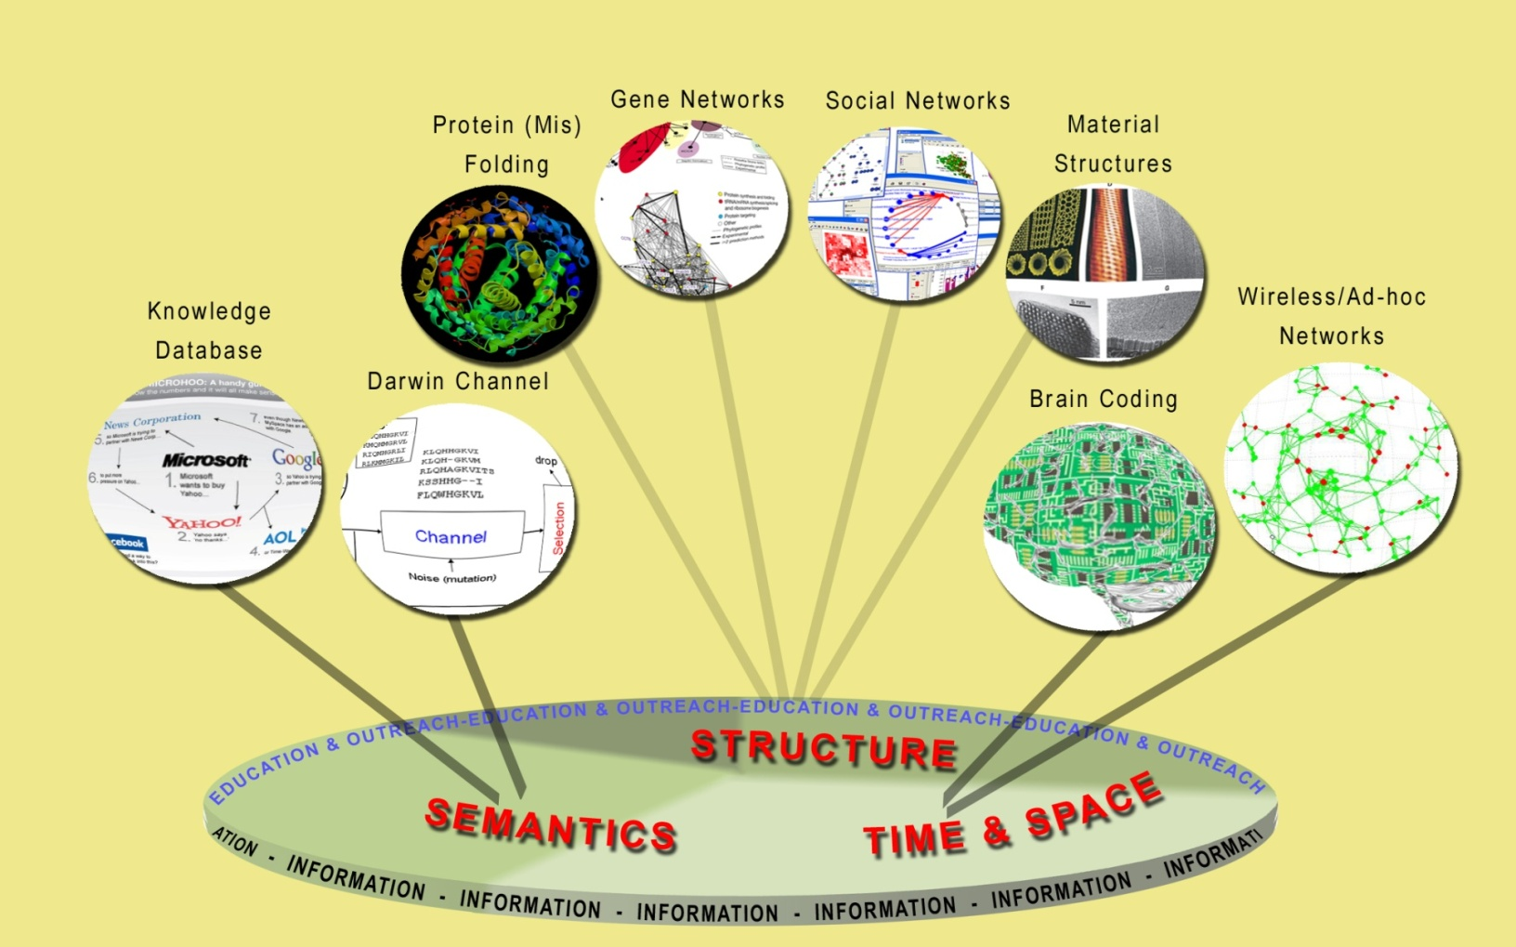
Science of Information
The overarching vision of the Center for Science of Information is to develop principles and human resources guiding the extraction, manipulation, and exchange of information, integrating space, time, structure, and semantics.

Slide 7
Mission and Center’s Goals
Advance science and technology through a new quantitative understanding of the representation, communication and processing of information in biological, physical, social and engineering systems.
Some Specific Goals:
define core theoretical principles governing transfer of information,
develop meters and methods for information,
apply to problems in physical and social sciences, and engineering,
offer a venue for multi-disciplinary long-term collaborations,
explore effective ways to educate students,
train the next generation of researchers,
broaden participation of underrepresented groups,
transfer advances in research to education and industry.

Slide 8
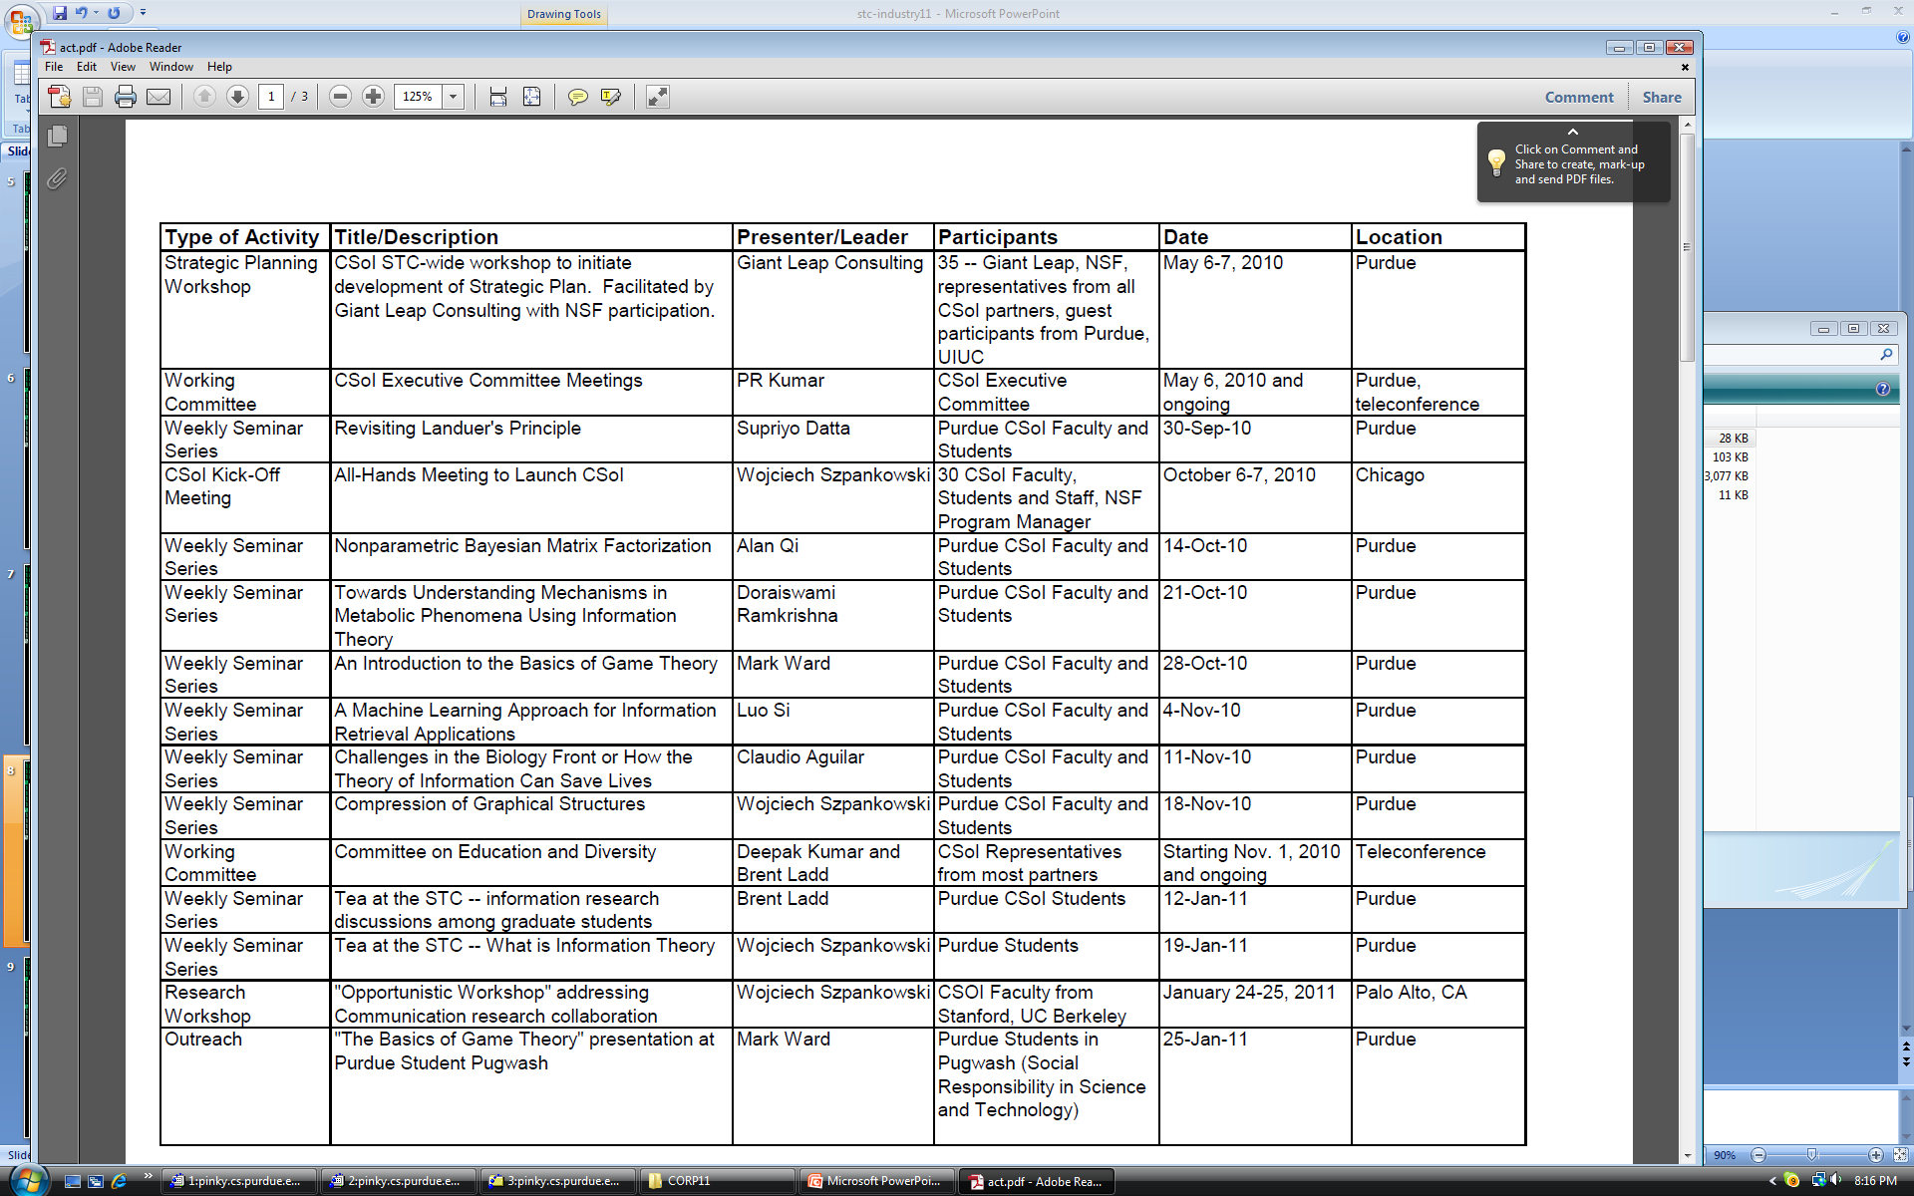
Activities

Slide 9
Activities

Slide 10
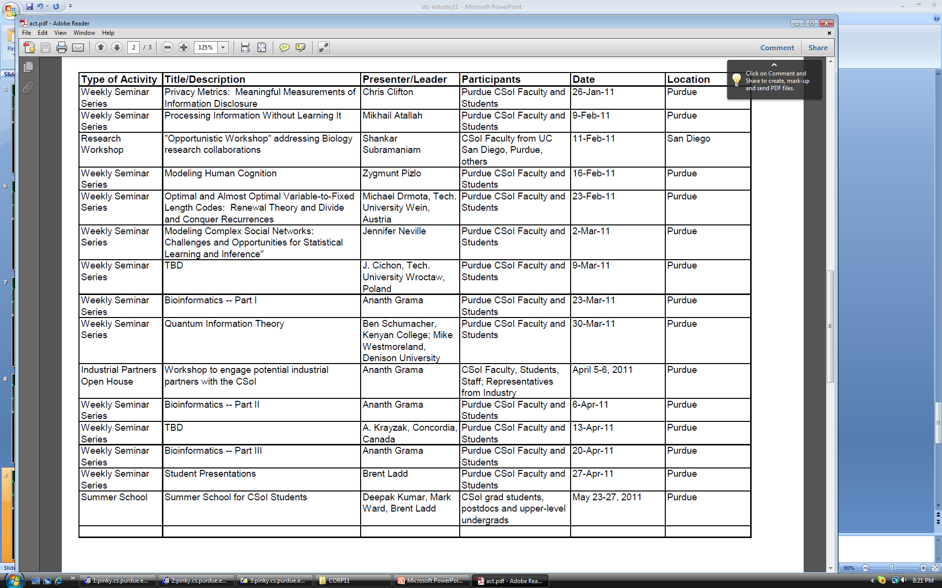
Activities

Slide 11
Activities

Slide 12
Knowledge Transfer
Develop effective mechanism for interactions between the center and external stakeholders to support the exchange of knowledge, data, and application of new technology.
Industrial affiliate program in the form of consortium:
  Considerable intellectual resources
  Access to students and post-docs
  Access to intellectual property
  Shape center research agenda
  Solve real-world problems
  Industrial perspective

Slide 13
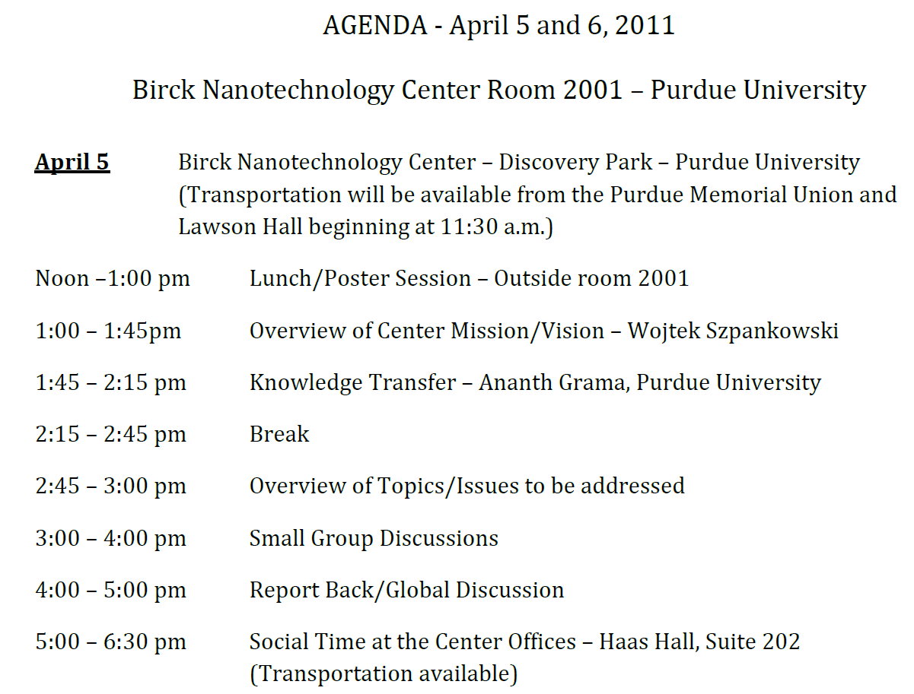
Industry Open House – Apr 5/6

Slide 14
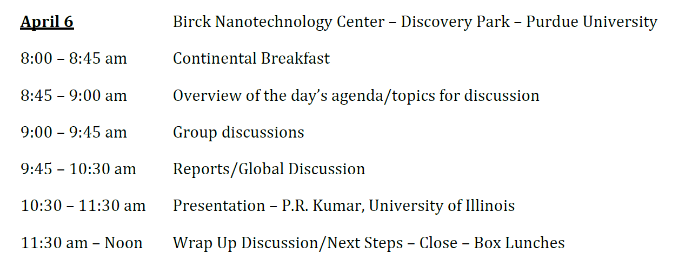
Industry Open-House

Slide 15
Industrial Involvement
Critical to the success of the center
Please consider getting involved
Please attend the industry open house if possible
If you would like more information, please contact:
    Mr. Robert Brown, Managing Director,
    Center for Science of Information.
    bobbrown@purdue.edu, http://www.soihub.org

