Slide 1
Emerging Frontiers of
Science of Information
Industry Open House

Slide 2
Core Competencies
Modeling, analysis, and algorithms for complex systems (next generation of information theory)
Applications in communications and storage systems
Massive data handling (data to information to knowledge) in diverse environments
Complex systems in life sciences

Slide 3
Core Competencies
Modeling and Analysis of Complex Systems
  Formal meters and methods for information in
    Structure (Szpankowski et al.)
    Networks (Tse et al.)
    Semantics (Sudan et al.)
    Space and Time (Verdu et al.)
    Quantum Systems (Shor et al.)

Slide 4
Core Competencies
Communication and Storage Systems
  Coding Theory (Verdu et al., Goldsmith et al.)
  Redundancy in Codes (Szpankoswki et al.)
  Ad-Hoc Networks (Kumar et al.)
  Data Compression (Cover et al.)
  Reliability in Distributed Systems (Lynch et al.)
  Reliable Storage Systems (Jagannathan et al.)

Slide 5
Core Competencies
Large Scale Data Analysis
  Network Modeling and Analysis (Ananthram et al.)
  Social Networks (Neville, Qi, et al.)
  Privacy Concerns in Data Analysis (Clifton et al.)
  Secure Multiparty Computations (Atallah et al.)
  Learnable Information (Yu et al.)

Slide 6
Core Competencies
Applications
  Systems Biology Models (Subramaniam et al.)
  Neuronal Systems (Bialek, Gallant et al.)
  Imaging Systems and Analysis (Aguillar et al.)
  Economics (Sims et al.)
  Algorithms and Analysis (Grama, Szpankowski et al.)

Slide 7
Center Mission and Goals
Research and development
Education and Outreach
Diversity
Knowledge Transfer

Slide 8
Industry Roundtable Mission
Industry and labs have an extremely important role to play in the Center’s mission
The roundtable aims to precisely define these roles, and to put in place mechanisms for effective engagement and accomplishment of the activities.

Slide 9
Industrial Partners Program
Involving industry in fundamental ways in all aspects of research and development, with a view to:
Defining research avenues of particular interest to industry.
Transition Center research products to industry in a timely manner.
IP development.
Provide mechanisms for targeted research investment by industry.
Personnel exchanges (scholar in residence from Industrial Labs, faculty sabbaticals, etc.).
Human resource development.

Slide 10
Industrial Partners: Center’s Role
Access to unparalleled intellectual resources
Access to well-qualified students and researchers
Access to intellectual property
Opportunity to shape the Center’s research agenda
Externship and researchers in residence programs
Access to highly qualified and diverse research pool

Slide 11
Industrial Partners: Partner Role
Complementary expertise
Infrastructure (operational infrastructure), data (ranging from life sciences data to traffic traces from network infrastructure), and perspective (emerging problems, real-life context).
Avenues for channeling IP to the Market
Opportunities for Center Personnel.

Slide 12
Partner Benefits
Attendance at annual research review meetings/retreats to review recent, unpublished, research results.
Attendance at NSF-organized annual meetings of all the STC Centers.
Electronic access to copies of all Consortium publications, including theses and papers appearing in peer reviewed literature, as they are submitted.
First-hand interaction/ access to the Consortium student/ researcher pool, a potential source of technical collaborators as well as interns and future employees.

Slide 13
Partner Benefits
Corporate Members will have the opportunity to participate in the discussion and provide advice regarding proposed research topics of the Consortium through representation on the Industrial Advisory Board.
The right to use, by Corporate Member for its internal research and evaluation, all reports, data, and information made available by the Consortium, so long as Confidential Information is suitably protected.
Early access to intellectual property developed by the Consortium as a result of the Core Projects.
The opportunity to support Sponsored Projects with the Academic Partner(s) after mutual agreement.

Slide 14
Industry Openhouse
Goal: Develop effective mechanism for interactions between the center and external stakeholders to support the exchange of knowledge, data, and application of new technology.
Key Questions:
  Research and Development: how can we establish effective bilateral exchanges
  Education: How can partners influence and leverage the Center’s educational program?
  Diversity: How can partners help in building a diverse and highly qualified work-force?
  Technology Transfer: IP issues, licensing templates, etc.

Slide 15
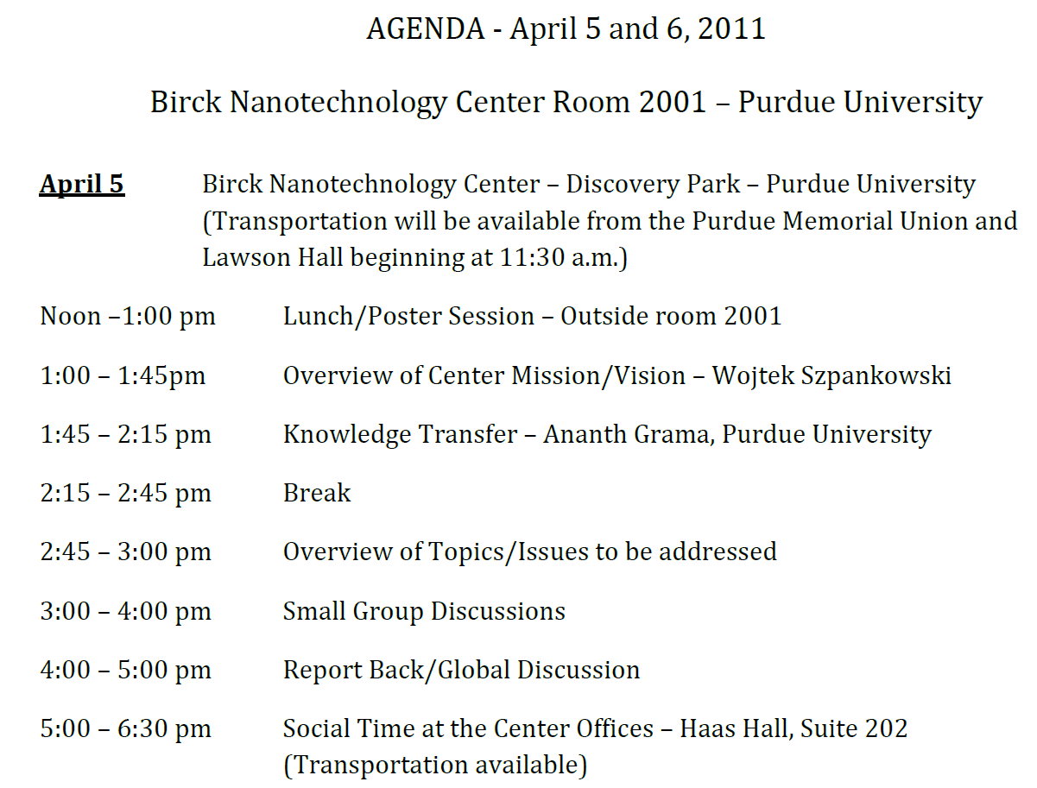
Industry Open House – Apr 5/6

Slide 16
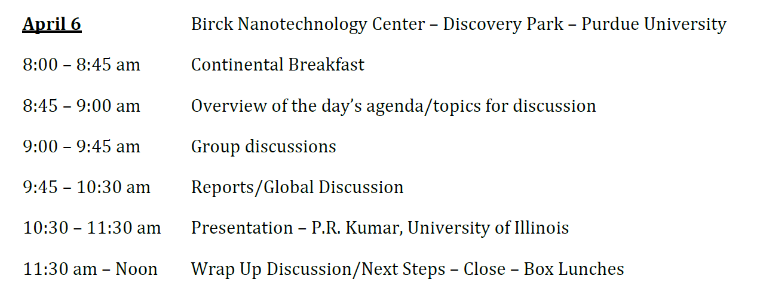
Industry Open-House

Slide 17
Industrial Involvement
Critical to the success of the center
    Mr. Robert Brown, Managing Director,
    Center for Science of Information.
    bobbrown@purdue.edu, http://www.soihub.org

