Slide 1
Orchestrating on-line learning computations in a distributed stream processing engine
Naresh Rapolu
Purdue University

Slide 2
Learn a model and use it ..
Approach 1:
Input data
Learn the
Model (Offline)
Use the model (online)
Client Requests
Delay
Hadoop, Mahout, Presto
(Heavy-weight)
HBase, Cassandra,
(Key-Value stores)
Approach 2:
Learn model (online)
Input data
Client Requests
Model
Use model (online)
Integrated Distributed Key-Value store with a stream processing engine
(Cassandra/HBase with Storm)

Slide 3
Applications demanding online learning
Online ad-serving platform
Model refined continuously using
Temporal parameters: recent clicks on other ads / pages
Spatial parameters: location check-ins, related searches.
Real time sentiment classification
Opinion about a breaking event.
Model built using:
Twitter feed, facebook posts, blogs.
Read time document similarity measurement (Supervised Semantic Indexing)
Correlating tweets from different languages.
Correlating hashtags with event descriptors.

Slide 4
Statistical methods for online learning
Stochastic Gradient Descent (SGD) is the most popular, scalable method for online learning.

Slide 5
Parallelization strategy for SGD
Distributed mini-batch technique [Dekel, Gilad, Xiao, 2012]:
Update parameters using an averaged gradient from “b” examples; “b” is the mini-batch size.
Reduces the variance in updates.
Asymptotically optimal if “b” ~ O(m^p), where p belongs-to (0, ½]
Averaging the gradients through a distributed all-reduce operator.
Proof available only for smooth, convex loss functions.

Slide 6
Applications of Interest: Supervised Semantic Indexing (SSI) [Bing et.al, ‘10]
Minimize the loss function (f)
Convex optimization using SGD
For n = 30K, model size = size-of (W) ~ 900 million entries.
Training considers pairs of documents – lots of training examples; demands distributed execution.
n = feature-set size
q = query document
W = weight matrix (n x n)
d⁺ = positive document
d⁻ = negative document
F = 1 – q*W*d⁺ + q*W*d⁻
W = W + L( q* d + q*d⁻ )

Slide 7
SSI – Non-convex formulation
Low rank approximation of W
Non convex optimization using SGD
Model size reduced. For n = 30k and r = 200, model-size = 12M entries
However, no mathematical proof when using parallel Mini-batch formulation.
W = U^{T} * V
Entries: U ~ (n x r) and V ~ (r x n)
F = 1 – q*U^{T} * V*d⁺ + q*U^{T} * V *d⁻
U = U + l*V*(d+ - d-)*q
V = V + l*U*q* (d⁺ - d⁻)^{T}

Slide 8
Another application: Matrix factorization using DSGD [Gemulla, Haas, Nijkamp, Sismannis ‘2011]
Users
Worker Node
x
U₁
U₂
U₃
A1
B1
C1
M_{A}
A1
A2
A3
M_{A}
U₁
Movies
M_{B}
B1
B2
B3
Mc
C1
C2
C3
A2
B2
C2
A3
B3
C3
M_{B}
U₂
M_{c}
U₃
A1
A2
A3
A1
A2
A3
B1
B2
B3
B1
B2
B3
Data placement on worker nodes
C1
C2
C3
C1
C2
C3
Strata of a 3x3 matrix

Slide 9
Another application: Matrix factorization using DSGD [Gemulla, Haas, Nijkamp, Sismannis ‘2011]
Users
Worker Node
x
U₁
U₂
U₃
A1
B1
C1
M_{A}
A1
A2
A3
M_{A}
U₁
Movies
M_{B}
B1
B2
B3
Mc
C1
C2
C3
A2
B2
C2
A3
B3
C3
M_{B}
U₂
M_{c}
U₃
A1
A2
A3
A1
A2
A3
B1
B2
B3
B1
B2
B3
Computation on worker nodes
C1
C2
C3
C1
C2
C3
Strata of a 3x3 matrix

Slide 10
Another application: Matrix factorization using DSGD [Gemulla, Haas, Nijkamp, Sismannis ‘2011]
Users
Worker Node
x
U₁
U₂
U₃
A1
B1
C1
M_{A}
A1
A2
A3
M_{A}
U₁
M_{A}
M_{c}
Movies
M_{B}
B1
B2
B3
Mc
C1
C2
C3
A2
B2
C2
A3
B3
C3
M_{A}
U₂
M_{c}
U₃
M_{B}
A1
A2
A3
A1
A2
A3
B1
B2
B3
B1
B2
B3
Demands intelligent communication
among worker nodes
C1
C2
C3
C1
C2
C3
Strata of a 3x3 matrix

Slide 11
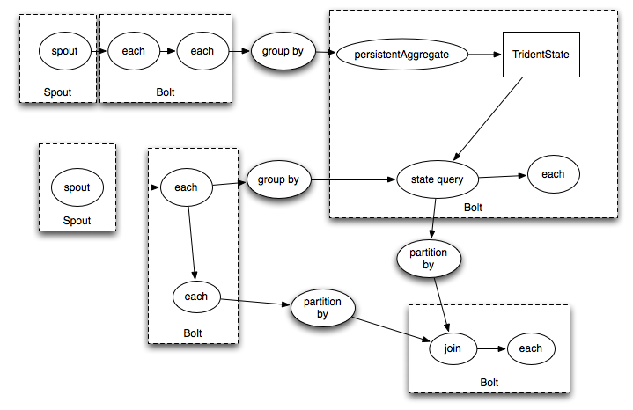
Introduction to STORM
Storm: Stream processing engine built at Twitter.
Executes topologies – DAG of operators (spouts and bolts)

Slide 12
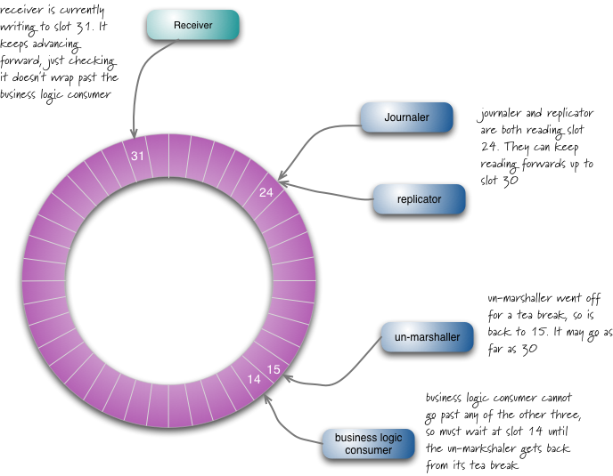
Core component of Storm: LMAX Disruptor
Every operator in Storm uses LMAX Disruptor to process events.
LMAX Disruptor:
Event-driven, asynchronous, producer/consumer queues.
Built for ultra low-latency trading by a Wall Street firm.
Uses custom lock-free data-structures.

Slide 13
System architecture: Storm with Vowpal Wabbit (SGD).
Spouts are the individual nodes in the distributed key-value store.
Client requests for model and data
Distributed Storage (Key-Value store)
Training Examples
V W
V W
V W
Storm topology with VW operators overlaid on cluster nodes
All Reduce
topology
STORM
VW

Slide 14
Limitations of naïve integration: Storm with Vowpal Wabbit (SGD).
Long reduction times when the model is large – network bandwidth becomes the bottleneck.
Static topologies do not adjust to transient network bandwidth variations (e.g., in the cloud).
Training Examples
V W
V W
V W
Static topologies do not adjust to transient network BW.
Long reduc-tion times
All Reduce
topology
VW

Slide 15
Limitations of naïve integration: Storm with Vowpal Wabbit (SGD).
Impedance mismatch between synchronous reductions and asynchronous execution engine (LMAX Disruptor)
Full barrier leads to timeouts of incoming messages leading to wasted queue resources
Training Examples
V W
V W
V W
Static topologies do not exploit transient network BW.
Long reduc-tion times
All Reduce
topology
VW

Slide 16
Contributions: Designed a controller for orchestration of online learning computations.
Controller dynamically schedules reductions and forces rate control and routing on input data streams.
Client requests for model and data
Distributed Key-Value store
Training Examples
Routers
Controller
V W
V W
V W
V W
Dynamic topologies whose event-rate per operator is controlled
Network
aware
tree
topology
VW
VW
VW

Slide 17
Controller Design: Async Reductions
Schedules asynchronous reductions (staggered butterfly) while forcing rate control (blacklisting reducers).
Training Examples
Routers
Controller
V W
V W
V W
V W
Dynamic topologies whose event-rate per operator is controlled
Staggered
Butterfly
VW
VW
VW
VW
VW
VW
VW
VW

Slide 18
Controller Design: Async Reductions
Schedules asynchronous reductions (staggered butterfly) while forcing rate control (blacklisting reducers).
Training Examples
Routers
Controller
V W
V W
V W
V W
Dynamic topologies whose event-rate per operator is controlled
Staggered
Butterfly
VW
VW
VW
VW
VW
VW
VW
VW

Slide 19
Controller Design: Async Reductions
Schedules asynchronous reductions (staggered butterfly) while forcing rate control (blacklisting reducers).
Training Examples
Routers
Controller
V W
V W
V W
V W
Dynamic topologies whose event-rate per operator is controlled
Staggered
Butterfly
VW
VW
VW
VW
VW
VW
VW
VW

Slide 20
Controller Design: Dynamic mapping of virtual overlay to physical operators
Controller uses operator metrics to decide on dynamic mapping and schedule reductions.
Metrics: Model sparsity triggers new reduction; Latency and throughput of individual operators (scale-in/scale-out)
Controller
Determine new
mapping of virtual
to physical operators.
Send new routing map
to routers
Collect metrics and
acks for previous
reductions
V W
V W
V W
V W
VW
VW
Disable routes,
and schedule
Reductions on
model-diffs
Routers
VW

Slide 21
Controller Design: More metrics and more decisions
Metrics: Interference among various topologies. Heart-beat messages to detect operator failures.
Decisions: Re-scheduling long standing operators on heterogeneous clusters based on model type. (E.g., LDA is suited for GPUs). State check-pointing for fault-recovery.
Controller
Determine new
mapping of virtual
to physical operators.
Send new routing map
to routers
Collect metrics and
acks for previous
reductions
V W
V W
V W
V W
VW
VW
Disable routes,
and schedule
reductions.
Routers
VW

Slide 22
Controller design: Proactive data movement and skew-tolerance
Track data-blocks and proactively move them between operators.
Skew tolerance through dynamic load balancing.
Intelligent communication among
worker nodes
Frequent users
Users
A1
B1
C1
x
U₁
U₂
U₃
M_{A}
U₁
M_{A}
M_{c}
M_{A}
A1
A2
A3
Movies
M_{B}
B1
B2
B3
A2
B2
C2
A3
B3
C3
Mc
C1
C2
C3
M_{A}
U₂
M_{c}
U₃
M_{B}

Slide 23
Preliminary Results – Storm AllReduce versus Async Butterfly
Small scale experiment (4 Nodes running SSI)
More than 30% improvement in throughput (learning-rate) due to controlled reductions.
Many more experiments in the pipeline.

Slide 24
Future work
Fine-grained instrumentation and performance measurement of the middleware.
Effect of asynchronous reductions on model accuracy.
Develop comprehensive controller model incorporating multiple, diverse metrics.
Propose mechanisms for synchronizing multiple controllers responsible for different topologies.
Propose mechanisms for synchronizing the controller with the main Storm scheduler.
Study other applications using SGD kernel.

