Slide 1
Analyzing Sequences

Slide 2
Sequences: An Evolutionary Perspective
Evolution occurs through a set of modifications to the DNA
These modifications include point mutations, insertions, deletions, and rearrangements
Seemingly diverse species (say mice and humans) share significant similarity (80-90%) in their genes
The locations of genes may themselves be scrambled

Slide 3
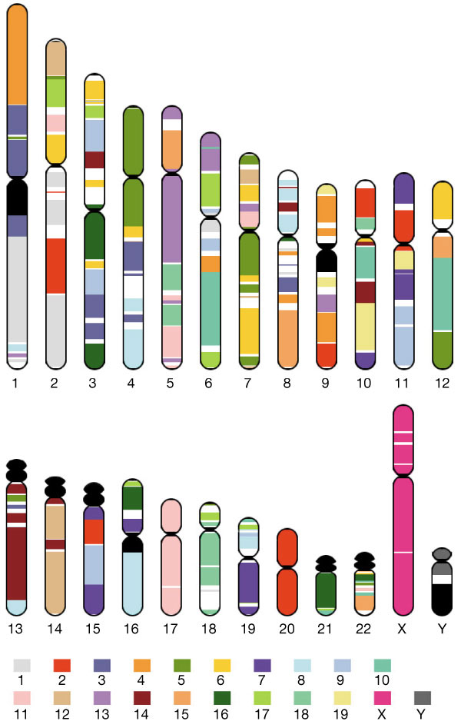
Chromosomal Rearrangements
Mouse genome mappings to human genome.

Slide 4
Mouse Genome
Mouse genome 2.5 Gb vs human 2.9 Gb
Can identify regions of synteny between mouse and human for 90% of genome.
Both genomes have ~30,000 genes
99% of mouse genes have a human homolog (and vice versa)
Some genes appear to have evolved more quickly than random chance (immunity and reproduction).

Slide 5
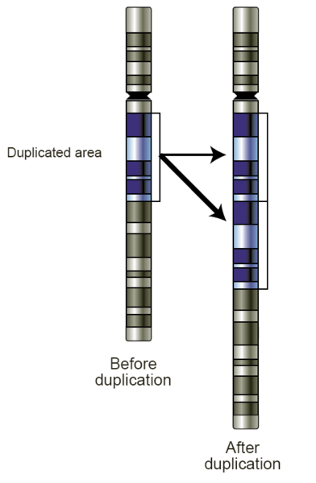
Gene Duplication
Gene duplication has important evolutionary implications
Duplicated genes are not subject to evolutionary pressures
Therefore they can accumulate mutations faster (and consequently lead to specialization)

Slide 6
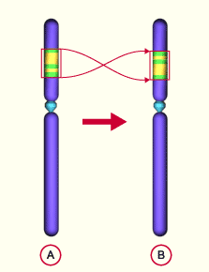
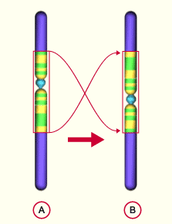
Inversions
Para and pericentric inversions

Slide 7
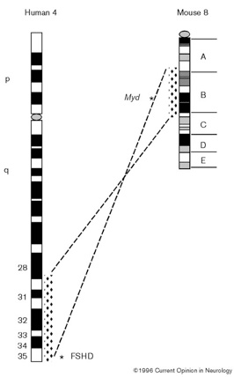
Transposition
A group of conserved genes appears in a transposed fashion at a different location

Slide 8
Comparing Sequences
Define distance between two sequences as the number of mutations that would result in the second string, starting from the first
  ACGGCGTGCTTTAGAACATAG
  AAGGCGTGCTTTAGAACATAG
  AAGGCGTGCGTTAGAACATAG
  ACGGCGTGCGTAAGGACAATAG

Slide 9
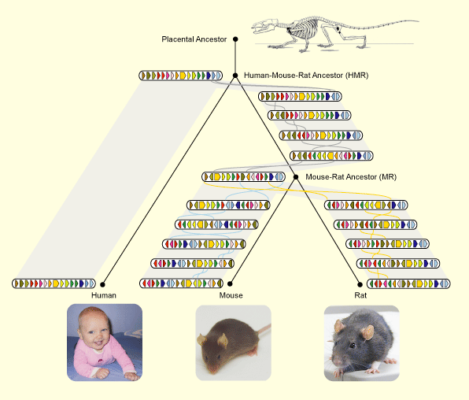
Evolution and Edit Distances

Slide 10
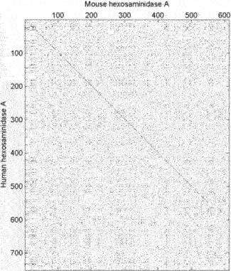
Plotting Genome Rearrangements
Diagonals imply direct alignment
Reverse diagonals imply inverse alignment

Slide 11
How do we get sequences?
Sanger sequencing:
  Gel electrophoresis is process of separating a mixture of molecules in a gel media by application of an electric field.
  In general, DNA molecules with similar lengths migrate same distance.
  First cut DNA at each base: A, C, G, T.
  Then run gel and read off sequence

Slide 12
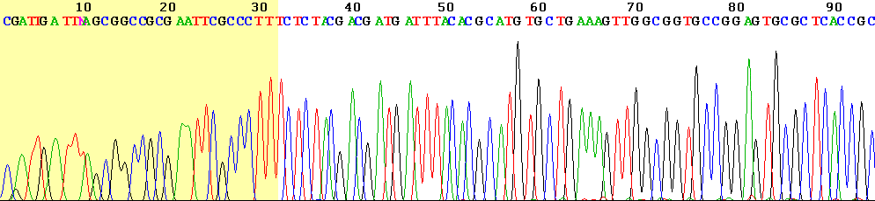
Sanger Sequencing

Slide 13
Pyrosequencing
The single-stranded PCR products to be sequenced are added to microtiter wells together with sequencing primer.
Nucleotides A, C, G and T are added sequentially to each well together with the enzyme and substrate mixture.
Incorporation of a nucleotide in the growing DNA-strand results in the production of one molecule of pyrophosphate (PPi). PPi is quantitatively converted into visible light by an enzyme mixture containing luciferase.
The light signal emitted is detected by a CCD camera and seen as a peak in the pyrogram.

