Slide 1
Social ties and checkin sites: Connections and latent structures in Location Based Social Networks
Sudhir Kylasa, Giorgos Kollias, and Ananth Grama

Slide 2
Overview
Introduction
Related research and significant contributions
Terminology and notation
Analyzing social connectivity and shared checkins
Experimental results
Future work, Q & A

Slide 3
Introduction
What are Location Based Social Networks (LBSN’s) ?
  Social networks where nodes (people/ entities) are annotated with attributes, one of which can be interpreted as a physical location. For instance Facebook, Google+, Twitter, Call Data Records etc.
  Attributes can be checkin sites, age, profession, etc.
  In this work we are primarily interested in checkin sites and their relationship to edges (social links).

Slide 4
Introduction
LBSN’s provide a rich data model for analysis and interpretation.
Can be abstracted into disparate views – e.g., users and locations, locations and events, users and users.
These views can reveal latent structures in the underlying networks.
These structures can be leveraged for enhancing user experience, optimizing flow of influence and information.

Slide 5
Introduction: Summary of Contributions
Using a Bayesian approach, we assess the relationship between checkin locations and social connectivity.
We present a model and method for deconvolution of social networks into layers using discrete intervals of shared checkins.
We show that these layers behave differently with respect to various attributes. For example checkin sites can be used to deconvolve the network into layers with different strengths of ties.

Slide 6
Related research
Existing research can be broadly classified into following categories
  Analysis of spatial properties
  Prediction of user attributes from social context
  Prediction of attributes of social ties (e.g., mobility patterns, physical distance)
  Prediction of social ties based on sptio-temporal aspects of social networks

Slide 7
Related research
Analysis of spatial properties
  Physical distance as controlling factor of connectivity. Demonstrating power-law relationship with various exponents - Illenberger et al., Kaltenbrunner et al.
  Heterogeneity of social triads as a function of distance and probability of a link in social triads – Scalleto et al.
  Social ties in highly connected groups tend to span short physical distances - Volkovich et al., McGhee et al.
  Nature of checkin locations (venues) in the context of social ties (uses venue triads as opposed to social triads) – Pelechrinis and Krishnamurthy

Slide 8
Related research
Prediction of user attributes from social context
  Prediction of user location from readily available data from the underlying network – Rout et al.
  Power-law distribution for predicting social ties and clustering to assign home locations – Jahanbaksh et al.
  Spatio-temporal mining algorithms and analysis of status updates are used to study relationships between people and locations – Abrol et al., Cheng et al.

Slide 9
Related research
Prediction of attributes of social ties
  Human mobility patterns and their proximity in social networks to predict social ties – Wang et al.
  Detecting geographic communities in mobile social networks – Hu et al.
  Bio-diversity as a factor of link formation along with common checkin in 2-hop,…, n-hop networks – Scellato et al.

Slide 10
Related research
Prediction of social ties based on temporal aspects
  Human geographic movements in relation to social ties to predict future checkins – Cho et al.
  Checkin dynamics to study spatio-temporal patterns of user mobility – Noulas et al.
  User demographics, time of checkins, past checkins are analyzed to predict social ties – Chang et al.

Slide 11
Related research
We study the relationship between checkin locations and social tie and vice-versa
Our research primarily studies the impact of nodal attributes (checkin information) on the aggregate structure and function of the network

Slide 12
Terminology and Notation
C_{k} | : | Event that two users share k checkin locations
F | : | Event that two users are friends
Pr(C_{k}) | : | Probability of two users sharing k checkin locations
Pr(F) | : | Probability of two users being friends (existence of an edge)
Pr(C_{k}|F) | : | Probability of two users sharing k checkin locations given that they are friends
Pr(F|C_{k}) | : | Probability of two users being friends given that they are sharing k checkin locations

Slide 13
Terminology and Notation
Social Graph : G_{f} = <V_{f}, E_{f}>,
  |V_{f}.| = n, |E_{f}| = f
  Undirected edges <u_{i}, u_{j}> E_{f}.
  A_{f}, a nxn matrix, A_{f}[I,j] = 1 iff <u_{i}, u_{j}> E_{f.}
Checkin Graph: G_{c} = <(V_{c1}, V_{c2}), E_{c}>.
  Bipartite graph with edges <u_{i}, l_{j}> E_{c,} connecting a user u_{i} U(=V_{c1}) with any of its checkin locations l_{j} C(=V_{c2}).
  |C| = m.
  A_{c}[i,j] = 1 iff u_{i} has a checkin l_{j}.
Pr(F) = f/^{n}C₂.
Pr(C_{k}) = fraction of entries in matrix A_{c} * A_{c}^{T} with value k

Slide 14
Analyzing social connectivity and shared checkins
What is the relationship between social graph and checkin graph?
How does shared checkins among a pair of randomly selected users effect their social connectivity?
Conversely, do social ties imply statistically large number of shared checkins?

Slide 15
Analyzing social connectivity and shared checkins
Users in networks display varying degree of social interactions leading to varying number of shared checkins.
Homophily implies that users form social bonds with other users who are similar to themselves.
Socialization and social influence play a pivotal role in forming social ties as well as functioning of the network (influence, information flow, forming new edges, etc.).

Slide 16
Analyzing social connectivity and shared checkins
Proposition 1: Pr(C_{k}|F) is not significant for nodes sharing large numbers of shared checkins, k. Pr(F|C_{k}) is significant for pairs of users that share large number of checkin locations.
Using Bayes rule the terms Pr(F|C_{k}) and Pr(C_{k}|F) are related as follows:
Pr(C_{k}|F) = Pr(F|C_{k}) * Pr(C_{k}) / Pr(F)

Slide 17
Analyzing social connectivity and shared checkins
Pr(C_{k}|F) > Pr(C_{k}), this is because of homphily
This leads to Pr(F|C_{k}) > Pr(F)
Pr(C_{k}) is expected to decrease for large k
Pr(C_{k}) is shaped by the distribution of user degree in graph G_{c}.

Slide 18
Analyzing social connectivity and shared checkins
Triadic closure: if two people have a common friend then there is an increased likelihood that they will become friends themselves.
Based on the principles of opportunity, incentive, and trust.
More opportunities, latent stress between social ties that do not form a triangle and relatively high induced trust in a social triad.

Slide 19
Analyzing social connectivity and shared checkins
There exists a statistical dependence between G_{c} and G_{f} because of triadic closure.
An edge in G_{f}, <u_{i}, u_{j}>, correlates to number of paths of length 2 in G_{c} .
Leverage the properties of one network to partition the other, and explore potential correlations between these partition-inducing properties.

Slide 20
Analyzing social connectivity and shared checkins
Partition G_{f} into sub-networks using discrete intervals of shared checkins (k = 0, 1 <= k <= 5, k > 5).
Analyze triadic closure of these partitions.
Clustering coefficient, is the number of triangles in which a given node participates.
Measure of how close to a clique a neighborhood is.

Slide 21
Analyzing social connectivity and shared checkins
Proposition 2: Social connections that share large number of shared checkins tend to be strongly clustered.
Proposition 3: Social connections that share fewer shared checkins tend to be less clustered, compared to the underlying network.

Slide 22
Experimental Results
Characteristics of the datasets:
Dataset | Unique Checkins | Unique Users | Social Edges
Brightkite | 1, 104, 692 | 50, 686 | 194, 090
Gowalla | 4, 017, 525 | 107, 067 | 456, 760
Yelp | 961, 076 | 70, 817 | 151, 516
Geohash is used to encode the locations for brightkite and Gowalla datasets. Yelp dataset’s locations are used in its existing form.

Slide 23
Experimental Results – Prop 1
Brightkite
Gowalla
Yelp
Probability of k shared checkin locations given social connectivity – Pr(C_{k}/F)
k <= 5 | Brightkite | Gowalla | Yelp
% (C_{k}|F) | 96.9 | 98.9 | 92.8
% (C_{k}) | 99.8 | 99.9 | 93.1
 | Brightkite | Gowalla | Yelp
Social ties | 1.38 | 1.16 | 1.39
Arbitrary user pairs | 0.13 | 0.07 | 0.76
Percentage of user pairs that share atmost 5 shared checkins
Average shared checkins for three datasets

Slide 24
Experimental Results – Prop 1
Brightkite
Gowalla
Yelp
Probability of social connectivity given k shared checkin locations – Pr(F/C_{k})
Dataset | k < 10 | 10 <= k <= 20 | k > 20
Brightkite | 0.001 | 0.01 | 0.065
Gowalla | 0.004 | 0.017 | 0.098
Yep | 0.0007 | 0.049 | 0.139
Pr(F|C_{k}) for three datasets for ranges of shared checkins

Slide 25
Experimental Results: Prop 2
Clustering coefficients of three datasets with discrete intervals of shared checkins
Brightkite dataset
k= 0
1<=k<=5
k > 5
Gowalla dataset
k = 0
1<=k<=5
k > 5
Yelp dataset

Slide 26
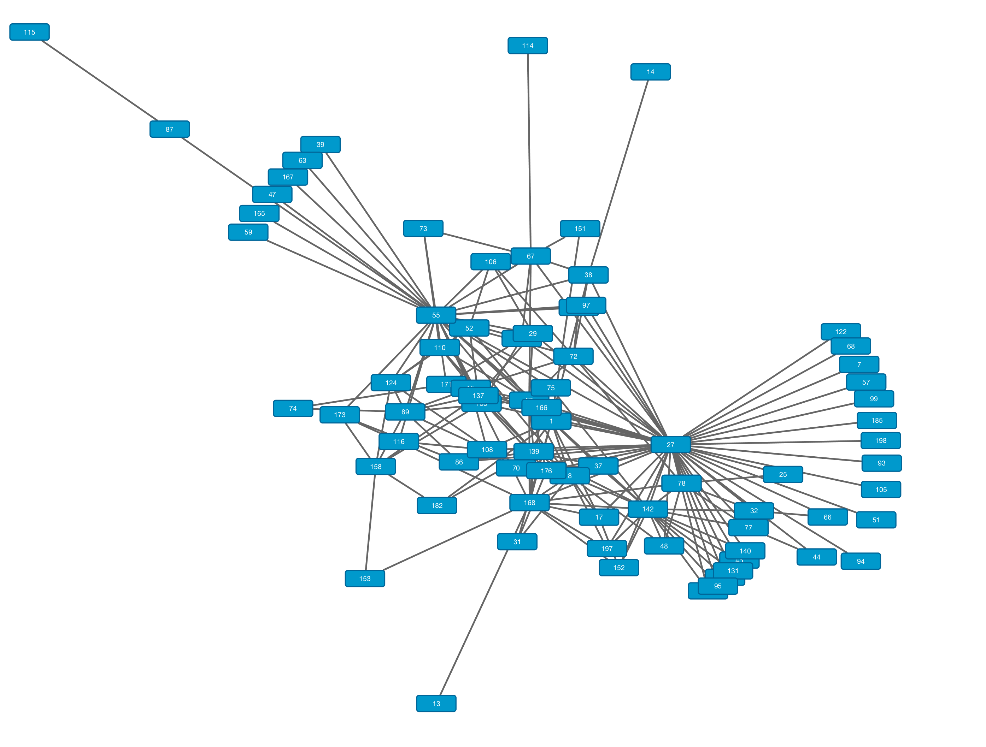
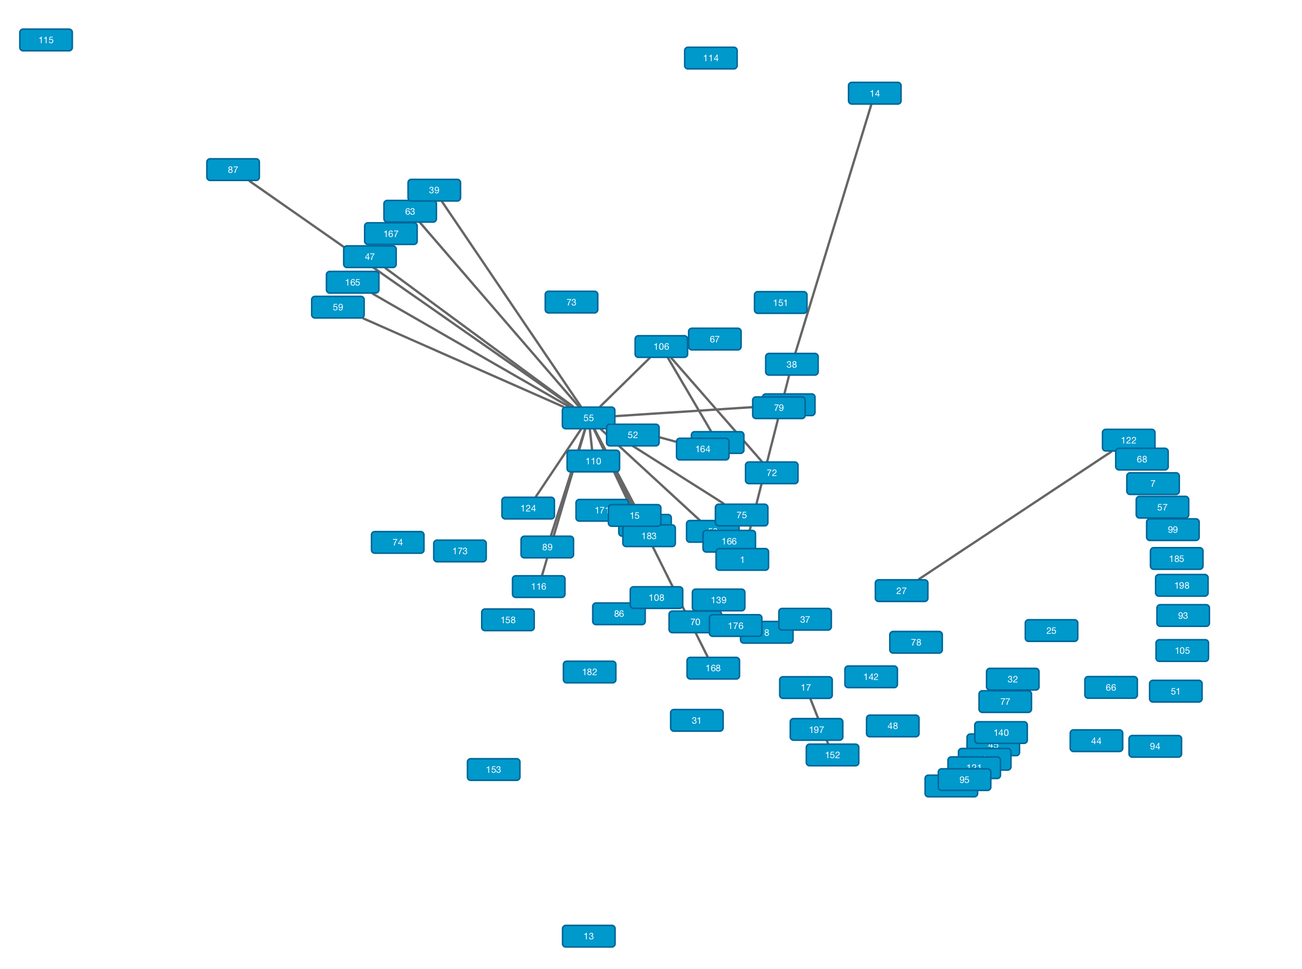
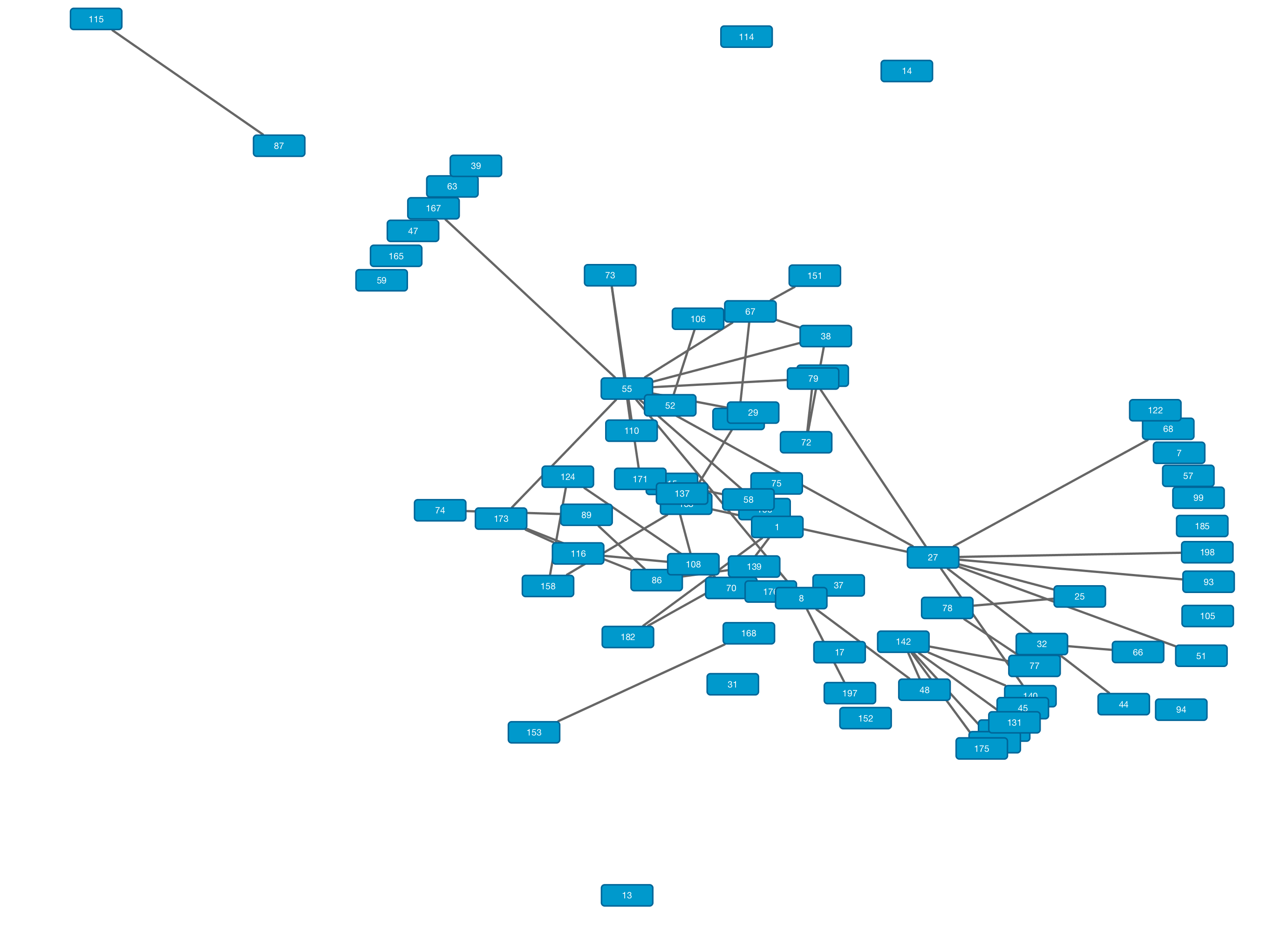
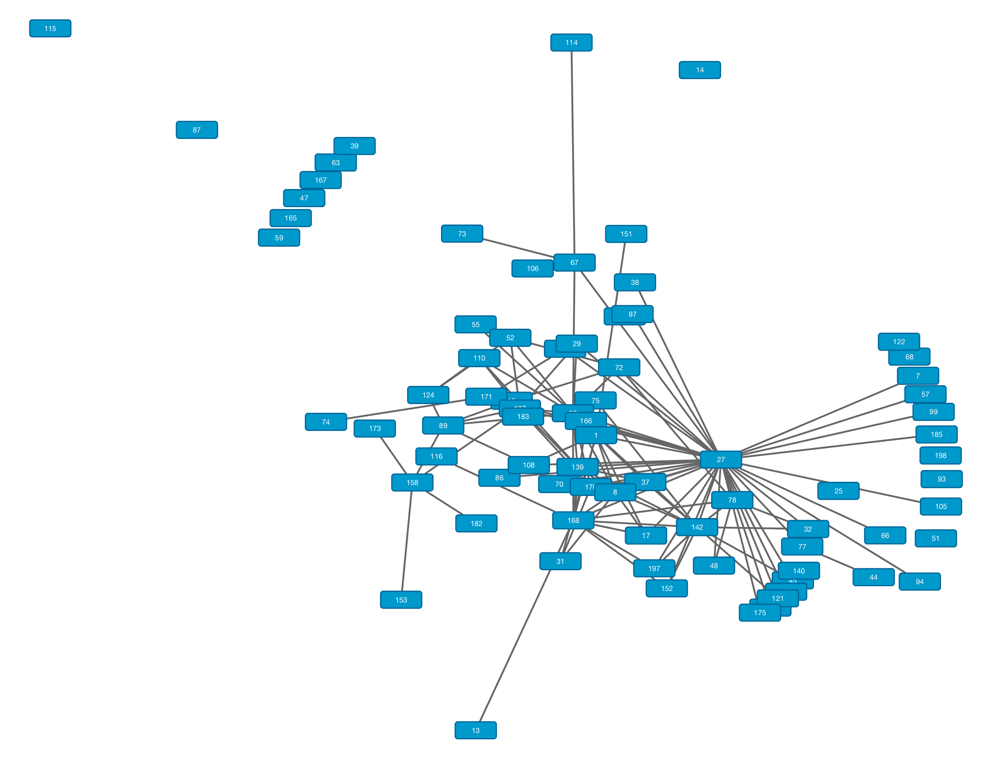
Experimental Results – Prop 2
Yelp Subgraph
Edges sharing no checkin locations – Yelp subgraph
Edges sharing between 1 and 5 locations – Yelp subgraph
Edges sharing more than 5 locations – Yelp subgraph

Slide 27
Experimental Results – Prop 3
Clustering coefficient of nodes sharing at-most one checkin location
Brightkite
Gowalla
Yelp
Clustering coefficients of underlying network
Brightkite
Gowalla
Yelp

Slide 28
Concluding Remarks
We put forth and validated a number of hypotheses relating to LBSNs.
Using statistical methods and real-world data, we relate checkins to social ties and groups of users.
We use checkin frequencies and social ties to identify latent structures and show these how these structures correlate with different network properties.

Slide 29
Thank you !!!
Q & A
Discussion

