Slide 1
Query Processing Techniques for Big Spatial-Keyword Data
Ahmed Mahmood Walid G. Aref
Department of Computer Science
Purdue University

Slide 2
Disclaimer
The focus of this tutorial is on spatial-keyword support in big data systems
Related tutorials:
  Cong et al., Querying Geo-Textual Data: Spatial Keyword Queries and Beyond, SIGMOD 2016
  Mokbel et al., Microblogs Data Management Systems: Querying, Analysis, and Visualization, SIGMOD 2016

Slide 3
Outline
Introduction and Background
Querying Spatial-Keyword Data
Spatial-Keyword Big Data Processing
  Indexing in Spatial-Keyword Big Data Systems
Case Studies
Future Research Directions

Slide 4
Introduction and Background
The Scale of Spatial-Keyword Data
Spatial-Keyword Applications

Slide 5
Big Spatial-Keyword Data
Huge amounts of spatial-keyword data are being generated
  Location-aware devices, e.g., smart-phones
  Social networks
  Micro-blogging applications
Spatial-keyword objects are composed of:
  Geo-location
  Textual content, i.e., set of keywords
  Other attributes, e.g., timestamp, user identifier

Slide 6






Spatial-Keyword Data is Everywhere

Slide 7
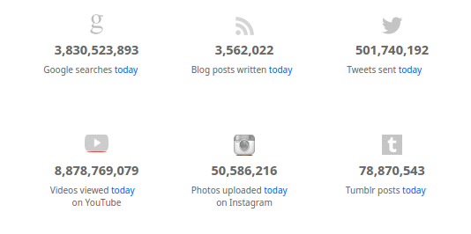
The Scale of Spatial-Keyword Data
http://www.internetlivestats.com/

Slide 8






General Purpose Big Data Systems
These systems are not equipped with spatial-keyword-specific indexing and query processing algorithms

Slide 9
Introduction and Background
The Scale of Spatial-Keyword Data
Spatial-Keyword Applications

Slide 10

Ad Targeting
Online location-based advertising campaigns
Location-based advertising, e.g., mobile e-coupons
Also known as location-aware publish/subscribe systems
Notes:
Shopsavvy app

Slide 11
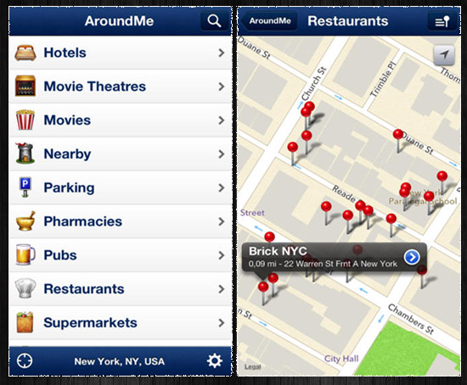
Identification of Nearby Attractions

Slide 12
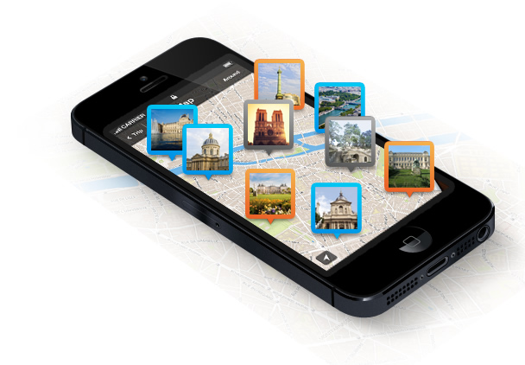
Trip Planning
A tourist wants to identify groups of points that are close to each other

Slide 13
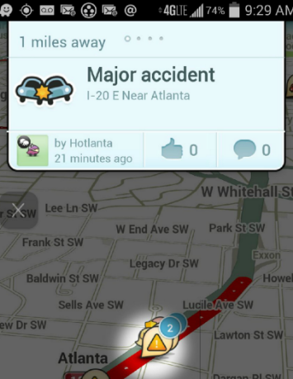
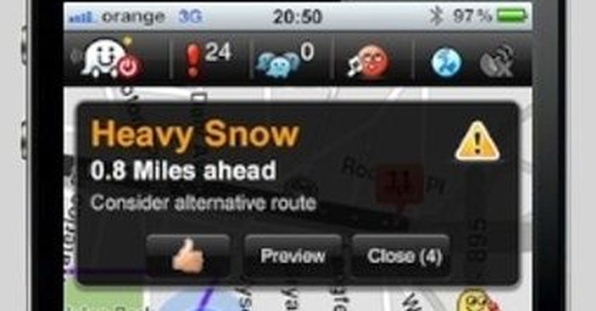
Traffic and Navigation Systems
Waze

Slide 14
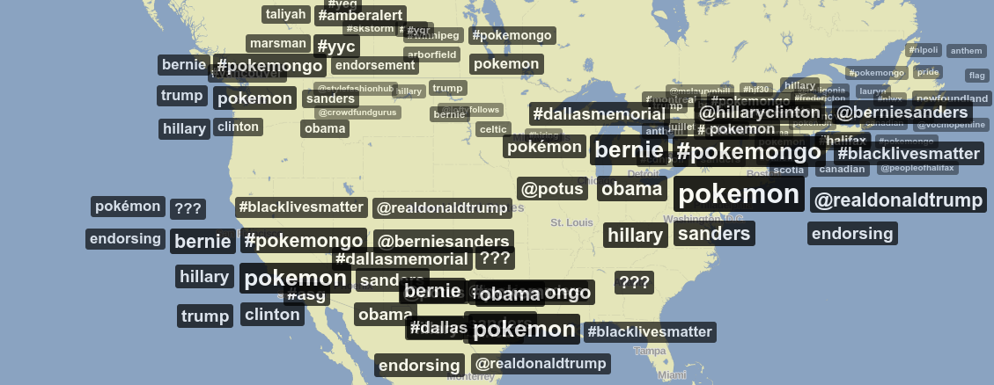
Micro-Blogs Analysis
https://www.trendsmap.com/

Slide 15
Outline
Introduction and Background
Querying Spatial-Keyword Data
Spatial-Keyword Big Data Processing
  Indexing in Spatial-Keyword Big Data Systems
Case Studies
Future Research Directions

Slide 16
Querying Spatial-Keyword Data
Spatial-Keyword Queries
Spatial-Keyword Query Languages

Slide 17

The Spatial-Keyword Filter Query
Identifies objects located inside the spatial range of the query and matches the textual criteria of the query
q2: free, coffee
o1: free, coffee, tea
o2: food
q3: café, sale
q1: (coffee, sale )or (tea)

Slide 18
The Spatial-Keyword Top-K Query
Retrieve the top-k spatial-keyword objects ranked based on a function of:
  Distance between the object and the query location
  Similarity between the keywords of the object and the query
Example: Find the top three tuples that have any of the keywords: restaurant, seafood
o2: seafood, restaurant
2
o1:restaurant, cafe
3
q1: seafood, restaurant
o3:tea, juice
1
o4:Iphone, Samsung
o5: seafood,
restaurant
Notes:
Tourist looking for seafood restaurants while walking a city

Slide 19
The Boolean-kNN Query
A special version of the spatial-keyword top-K query
  Identify all objects that contain the query keywords
  Rank these objects based on the distance between objects and the location of the query

Slide 20
The m-Closest Keywords (mCK) Query
Identify the group of spatial-keyword objects that collectively cover a set of keywords and have a minimum diameter
Cinema
Restaurant
Cafe
Zhang et al., Keyword search in spatial databases: Towards searching by document, ICDE 2009
Zhang et al., Locating mapped resources in web 2.0, ICDE 2010
Guo et al., Efficient algorithms for answering the m-closest keywords query, SIGMOD 2015
Notes:
Zhang et al. Keyword search in spatial databases: Towards searching by document. ICDE 2009.
Zhang et al. Locating mapped resources in web 2.0. ICDE 2010.
18
Guo et al. Efficient algorithms for answering the m-closest keywords query. SIGMOD’15

Slide 21
The Collective Spatial-Keyword Group Query (CoSKQ)
Find a group of objects that collectively cover the keywords of the query and minimize a function of:
  The distance between the query and the group
  The distances among the objects in the group
Cinema
Restaurant
Cafe
Cao et al., Efficient processing of spatial group keyword queries, TODS 2015
Notes:
Cao, Xin, et al. "Efficient processing of spatial group keyword queries." ACM Transactions on Database Systems (TODS) 40.2 (2015): 13.s
(1) We aim to find a group of objects χ that cover the keywords in q such that the sum
of their spatial distances to the query is minimized.
(2) We aim to find a group of objects χ that cover the keywords in q such that the sum
of the maximum distance between an object in χ and q and the maximum distance
between two objects in χ is minimized.
(3) We aim to find a group of objects χ that cover the keywords in q such that the sum
of the minimum distance between an object in χ and q and the maximum distance
between two objects in χ is minimized.

Slide 22
The Top-k Groups Query
Identify multiple groups of spatial-keyword objects that collectively cover the keywords of the query
Groups are ranked based on a function of:
  The distance of the group to the location of the query
  The distances among the objects in the group
  The multiplicity of objects covering the same keywords
A group may contain multiple objects covering the same keyword
Cinema
Restaurant
Cafe
1
2
3
Skovsgaard et al., Finding top-k relevant groups of spatial web objects, VLDBJ.2015
Notes:
Skovsgaard, Anders, and Christian S. Jensen. "Finding top-k relevant groups of spatial web objects." The VLDB Journal 24.4 (2015): 537-555.

Slide 23
Reverse Spatial-Keyword Top-K Query
Identify the query focal points that have a certain spatial-keyword object
  in their top-k spatial-keyword relevant list, or
  within a specific spatial-keyword threshold
Helps identify objects influenced with the addition of new spatial-keyword objects
Lu et al., Reverse Spatial and Textual k Nearest Neighbor Search, SIGMOD.2011
Choudhury et al., Maximizing bichromatic reverse spatial and textual k-NN queries, VLDB.2016
Notes:
Lu et al. Reverse Spatial and Textual k Nearest Neighbor Search. SIGMOD, 2011
Choudhury et al. Maximizing bichromatic reverse spatial and textual k-NN queries. VLDB’16
Thanks Farhana for the slide

Slide 24
Variations of Spatial-Keyword Queries
Spatial-Keyword Similarity Join
Spatial-Keyword Skyline Query
Spatial-Keyword queries over road-networks
Continuous queries over spatial-keyword data streams
Direction-aware spatial-keyword filter query

Slide 25
Querying Spatial-Keyword Data
Spatial-Keyword Queries
Spatial-Keyword Query Languages

Slide 26
Querying Spatial-Keyword Data
Spatial-Keyword Queries
Spatial-Keyword Query Languages
  GNIP
  MQL
  Atlas

Slide 27

GNIP PowerTrack
Commercial social analytics tool that provides spatial-keyword filtering rules:
  Exact keyword match
    "happy birthday"
  Substring match
    contains: day
  Approximate match
    "happy birthday"~3 (Means: Allow up to 3 typos)
  Spatial range search
    point_radius:[x, y, radius]
  Compositions of filtering rules (e.g., conjunctions of disjunctions)
    (happy OR party) (holiday OR house OR "new year's eve") point_radius:[-105.27346517 40.01924738 10.0mi] lang:en -(birthday OR democratic OR republican)
http://support.gnip.com/apis/powertrack/rules.html
Notes:
http://support.gnip.com/apis/powertrack/rules.html

Slide 28
Querying Spatial-Keyword Data
Spatial-Keyword Queries
Spatial-Keyword Query Languages
  Gnip
  MQL
  Atlas

Slide 29
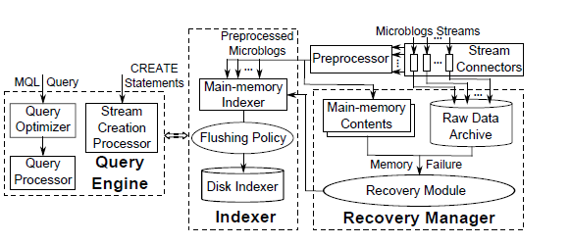
MQL Micro-Blogs Query Language
A micro-blogs management system along with a micro-blogs query language
Magdy et.al., Towards a microblogs data management system, MDM 2015
Notes:
A. Magdy and M. F. Mokbel. Towards a microblogs data management system. In MDM, volume 1, pages 271{278, 2015.

Slide 30
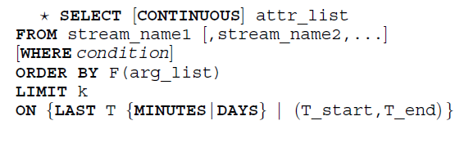
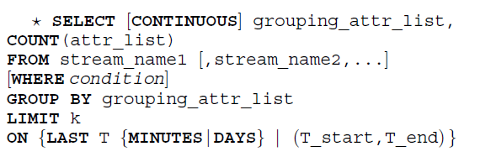
MQL Micro-Blogs Query Language

Slide 31
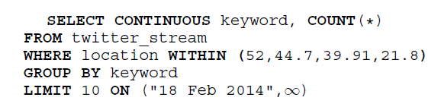
MQL Micro-Blogs Query Language
Example: Retrieve the most frequent 10 keywords from tweets in Ukraine since February 18, 2014:

Slide 32
Querying Spatial-Keyword Data
Spatial-Keyword Queries
Spatial-Keyword Query Languages
  Gnip
  MQL
  Atlas

Slide 33
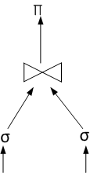
The Atlas Query Language:
Spatial-Keyword Extensions to SQL
Design building-block operators that can be composed to realize complex spatial-keyword queries
  Similar to the relational SELECT, PROJECT, JOIN building-block operators
Mahmood et al., Atlas: on the expression of spatial-keyword
group queries using extended relational constructs, SIGSPATIAL, 2016
Notes:
Mahmood, Ahmed R., et al. "Atlas: on the expression of spatial-keyword group queries using extended relational constructs." Proceedings of the 24th ACM SIGSPATIAL International Conference on Advances in Geographic Information Systems. ACM, 2016.

Slide 34
The Specification of Atlas
SELECT {*|attr1 [AS alias][,attr2,..]}
FROM source_name1 [,source_ name2, …]
[WHERE condition]
[ORDER BY F(arg_list)]
[LIMIT {k|condition}]
SELECT grp_attr1[AS alias][,grp_attr2,..}, AGGR_F [AS alias](attr_list)
FROM source_name1 [,source_ name2, …]
[WHERE condition]
[PARTITION BY grp_att_list AS grp_alias]
[ORDER BY F(grp_arg_list)]
[LIMIT k]
[HAVING grp_condition]

Slide 35
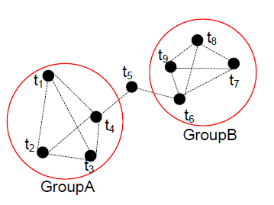
Spatial-keyword Grouping Operators
CONDITIONAL LIMIT
  Retrieves a list of items until a condition is satisfied
PARTITION BY
  Similar to the traditional group-by, yet returns the group tuples (not aggregates over the groups)
WITHIN_DIST(D)
  Identifies groups of tuples such that the distance between every pair of tuples within a group is upper-bounded by D

Slide 36
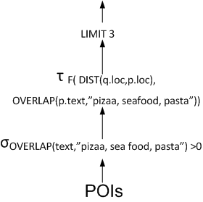
Example 1: Spatial-Keyword TOP-K Query
Retrieve the top-k spatial-keyword objects ranked by a function of:
  Distance between the object and the query location
  Similarity between the keywords of the object and the query
Example: Find the top three tuples that have any of the keywords: pizza, seafood, pasta
SELECT * FROM source S
WHERE OVERLAP(S.txt, “pizza, seafood, pasta”)>0
ORDER BY F(DIST(S.loc, q.loc), OVERLAP (S.txt, “pizza, seafood, pasta”))
LIMIT 3

Slide 37
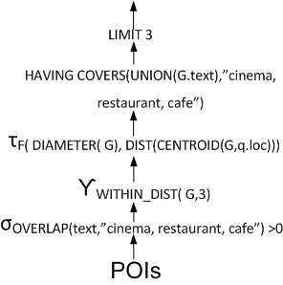
Example 2: Spatial-Keyword Group Query
Find groups of objects that collectively contain the keywords “cinema, restaurant, cafe” such that objects in a group are within 3 miles of each other. The groups are to be ranked by a function of the groups’ inter-object distances and the distance from each of the groups to a specific location
SELECT * FROM source S
WHERE OVERLAP(S.txt, “cinema, restaurant, cafe”)>0
PARTITION BY WITHIN_DIST(S.loc,3) AS G
ORDER BY F(DIAMETER(G), DIST(CENTROID(G),q.loc))
HAVING CONTAINS(UNION(G.txt), “cinema, restaurant, cafe”)
LIMIT 3

Slide 38
Other Languages
Separate support of spatial-only or text-only queries
Commercial extensions of RDBMs, e.g.,
  Oracle Spatial
  Full-text Search in SQLServer
Academic extensions
  Spatial-only extensions
  Full-text search extensions

Slide 39
Outline
Introduction and Background
Querying Spatial-Keyword Data
Spatial-Keyword Big Data Processing
  Indexing in Spatial-Keyword Big Data Systems
Case Studies
Future Research Directions

Slide 40
Outline
Introduction and Background
Querying Spatial-Keyword Data
Spatial-Keyword Big Data Processing
  Indexing in Spatial-Keyword Big Data Systems
Case Studies
Future Research Directions

Slide 41
Approaches for Spatial-Keyword Big Data Processing
Application on top of existing big data system
Extension of existing big data systems
Dedicated spatial-keyword big data systems

Slide 42
Boolean kNN Processing over MapReduce
Data Division
A map-reduce application to answer the Boolean kNN spatial-keyword query over unstructured data
Attributes Extraction
Map Phase
Keyword Check
Distance Computation
Partition and Sorting
Reduce
Result Generation
Li et al., Evaluating spatial keyword queries under the mapreduce framework, DASFAA 2012
Notes:
Map
Partition file
Extract oid, text, spatial
Check if the keywords match the query
And calculate the distance between the object and the query location
Using a kind of bucket sort, where all distances are partitioned into ranges and buckets
Reduce
Locally Sort candidate objects according to distance
Retrieve the final results either
Then data within buckets are sort

Slide 43
Processing m-Closest Spatial Keyword Group
Producing approximate answers
Use MapReduce
Use graph (or road network) distances (in contrast to Euclidean distance)
Find nodes that collectively cover the query keywords
Edges between nodes should have total minimum weight
➔ Finding the group Steiner tree
  Offline graph partitioning:
    Partitions are overlapping
    Training phase with queries to estimate the maximum path length in any query answer
  Online MapReduce search
Hao et al., Efficient keyword search on graphs using mapreduce, Big Data, 2015
Notes:
1) Offline graph partitioning
A fundamental issue in designing SOverlaping approach is to decide the degree of overlapping.
calculate the overlapping threshold based on the central limit theorem (CLT)
and the three-sigma rule (or 68-95-99.7 rule) in probability
theory. The CLT states that, given a certain condition, the mean
of a sufficiently large number of independent random variables
approximately follows normal distribution.
with 99.7% probability, the score of the longest
path in the top-K solution for any given query Q is less than
τQ

Slide 44
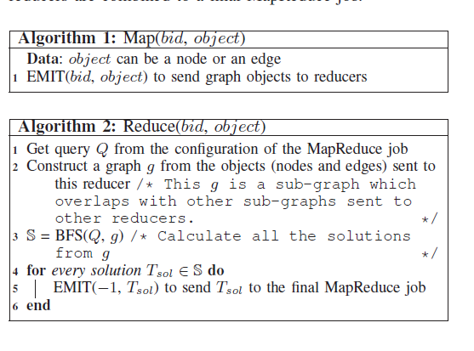
Processing m-Closest Spatial Keyword Group
Hao et al., Efficient keyword search on graphs using mapreduce, Big Data, 2015
Notes:
1) Offline graph partitioning
A fundamental issue in designing SOverlaping approach is to decide the degree of overlapping.
calculate the overlapping threshold based on the central limit theorem (CLT)
and the three-sigma rule (or 68-95-99.7 rule) in probability
theory. The CLT states that, given a certain condition, the mean
of a sufficiently large number of independent random variables
approximately follows normal distribution.
with 99.7% probability, the score of the longest
path in the top-K solution for any given query Q is less than
τQ

Slide 45
Spatial-Keyword KNN Join over WSNs
Wireless Sensor Networks (WSNs) are used to monitor the environment
  Set R = {r₁, r₂, ... , r_{u}} of locations and their corresponding keywords
  Sensor set S = {s_{l}, s₂, ... , s_{v}}
Given a fixed number k and a text similarity threshold
For each point r ϵ R:
  Find k-nearest sensors {s₁,s₂,.. s_{k}} not exceeding the text similarity threshold
Offload the processing of the join to the cloud
  Save processing power and battery life of WSN nodes
  Use Hadoop MapReduce to perform the join
ᶿ
Yang et al., Cloud-assisted spatio-textual k nearest neighbor joins in sensor networks, INISCom 2015
Notes:
Yang, Mingyang, et al. "Cloud-assisted spatio-textual k nearest neighbor joins in sensor networks." Industrial Networks and Intelligent Systems (INISCom), 2015 1st International Conference on. IEEE, 2015.
This work proposes a Map reduce algorithm
The algorithms is composed from two map reduce tasks
The first job builds an inverted index on sensor data
The second job read the inverted index for every keyword and sorts candidates based on the spatial distance
Text similairty is the edit distance
The first job is a preprocessing job. It
constructs inverted indices for the sensor set S. The second
job is used for queries. It filters out text-similar sensors for
each query point, and refines these candidates to outputs the
final query results.

Slide 46
Spatial-Keyword KNN Join over WSNs
Preprocessing phase:
  Using MapReduce, build an inverted index over the sensor set S
Query processing phase:
  Using MapReduce, read the set R
  For every query r in R:
    Use the inverted index to find the relevant sensors
    Then, identify the kNN sensors

Slide 47
Approaches for Spatial-Keyword Big Data Processing
Application on top of existing big data system
Extension of existing big data systems
Dedicated spatial-keyword big data systems

Slide 48
ModiSENSE
Platform for discovering points of interest and trending events from spatial-keyword social data
  HBase as a storage layer
  MapReduce as a processing platform
Mytilinis et al., Modissense: A distributed spatio-temporal and textual processing platform for social networking services, SIGMOD 2015
Notes:
Mytilinis, Ioannis, et al. "Modissense: A distributed spatio-temporal and textual processing platform for social networking services." Proceedings of the 2015 ACM SIGMOD International Conference on Management of Data. ACM, 2015
• Socially enhanced search of Points of Interest (POIs) based on criteria such as user location, automatic sentiment extraction of a user’s social media friends preferences or a combination of the above.
• Automatic discovery of new POIs and trending events, i.e., spontaneous gatherings of people in a specific location, such as concerts, traffic jams etc.
• Inference of the user’s semantic trajectory through the combination of her GPS traces with background information such as maps, check-ins, user comments, etc.
• Semi-Automatic extraction of a user’s daily activities in the form of a blog
.

Slide 49
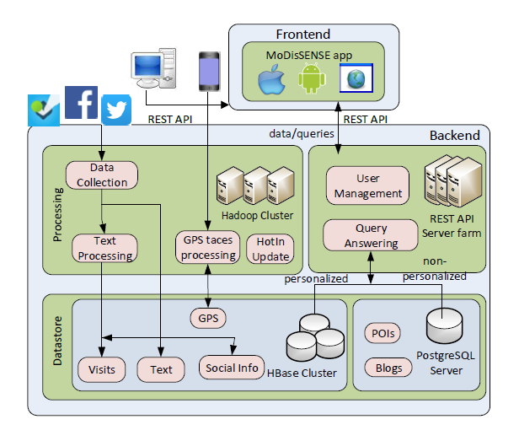
ModiSENSE
Notes:
Mytilinis, Ioannis, et al. "Modissense: A distributed spatio-temporal and textual processing platform for social networking services." Proceedings of the 2015 ACM SIGMOD International Conference on Management of Data. ACM, 2015.
A social, geo-location system built on top of a distributed bigdata enabled platform.
Datastore Repositories
POI Repository. It contains all the information MoDisSENSE
needs to know about POIs. The name of a POI, location, the keywords it and the
hotness/interest metrics are all stored in this repositoryWhile POI repository low insert/update rates, handle heavy, random access read loads. PostgreSQL
Social Info Repository. This is a HBase-resident table where social graph information is held. For each MoDisSENSE user and for each connected social network, the list of friends is persisted.
Text Repository.
most demanding disk space NoSQL cluster cluster nodes. The Text repository holds all the collected comments and reviews about POIs.
Visits Repository
HBase table. Every time a MoDisSENSE user or a user’s social friend visits a POI, a visit struct indexed by user and time is added to the repository.
GPS Traces Repository
HBase.
Blogs Repository.
semantic trajectory to be a timestamped sequence of POIs summarizing user’s activity
during the day.
As POIs, blogs are frequently queried
by users but they do not have to deal with heavy updates
and thus are stored as a PostgreSQL resident table.
Processing Modules
User Management Module.
* user authentication
Data Collection Module.
* parrallel tasks to scan and collect data from workers
Text Processing Module.
*Sentiment analaysis on all textual data collected from data collection module
Event Detection Module.
*a hadoop map-reduce clustering DBSCAN clustering algorithm,
process the gps in parrallel to find traces with high density
HotIn Update Module.
*detection module that uses a map reduce job to scan all visits in the last time period
and aggreagtes these visits to POIs
Query Answering Module.
inputs
• a bounding box on the map
• a list of keywords
• a list of social network friends (personalized)
• a time window
• results sorting criteria
• the number of results to be returned

Slide 50
Tornado
Adaptive and Distributed System for Spatial-Keyword Stream Processing
  Extend the general purpose Storm streaming system
  Distribute the input streams to multiple worker processes
Mahmood et al., Tornado: A distributed spatio-textual stream processing system, PVLDB 2015

Slide 51
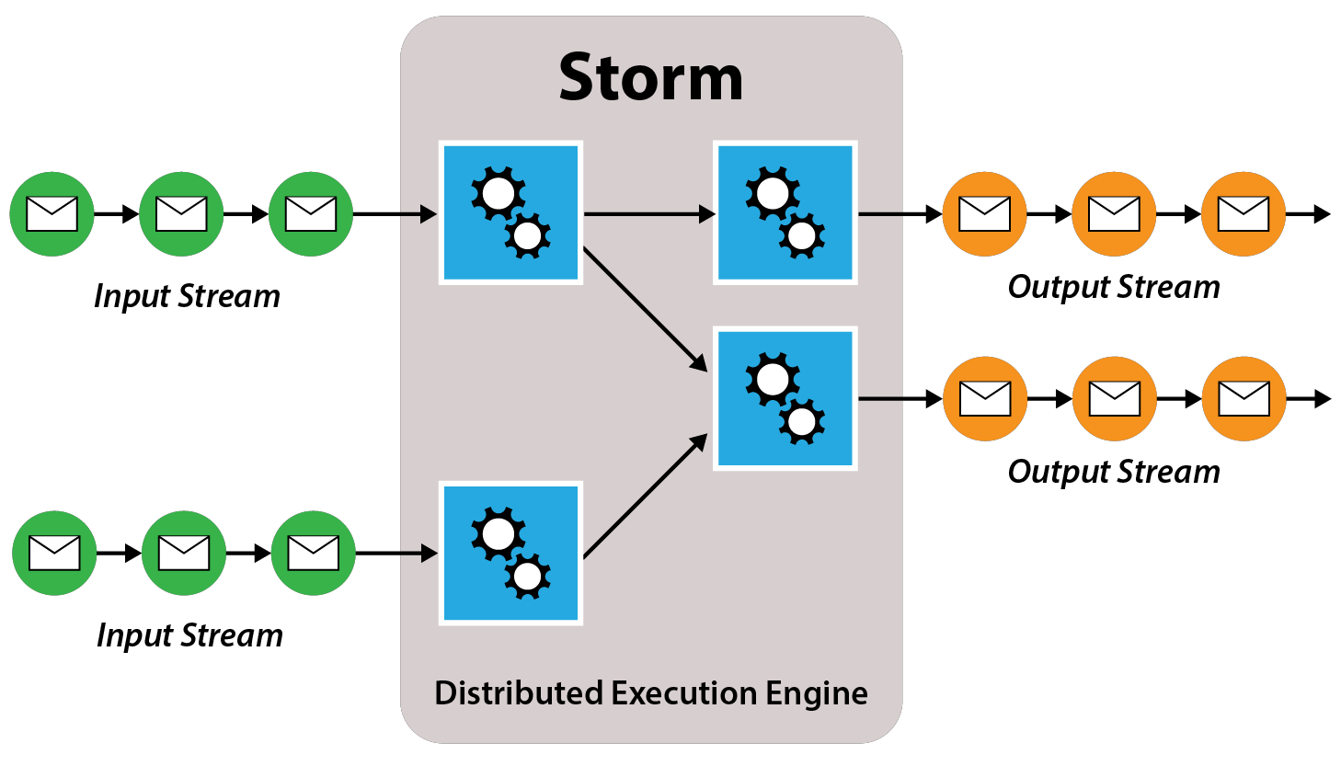
The Storm Streaming System
http://www.business-software.com/wp-content/uploads/2014/09/Storm.png

Slide 52
Tornado
Data
Source
Query
Source
Tornado
Spatial-Keyword Routing Layer
Evaluator
Evaluator
Evaluator
Worker
Worker
Mahmood et al., Tornado: A distributed spatio-textual stream processing system, PVLDB 2015

Slide 53
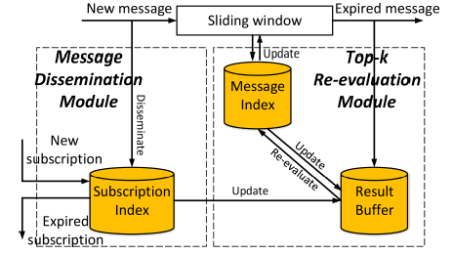
DSkype
Answering continuous top-k spatial-keyword queries
A distributed version of the SKYPE system
  Centralized system for the processing top-k spatial-keyword queries
Wang et al., Top-k spatial-keyword publish/subscribe over sliding window., VLDB journal 2016
Notes:
Wang, Xiang, et al. "Top-k spatial-keyword publish/subscribe over sliding window." The VLDB Journal (2016): 1-26.
Extends storm the streaming system
Uses a global partitioning and local indexing for the continuous top-k queries

Slide 54
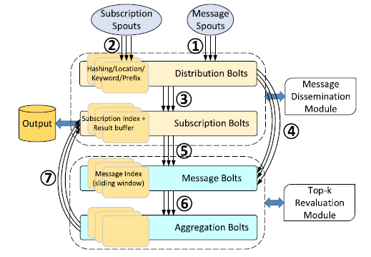
DSkype
Extends the Storm streaming system
Wang et al., Top-k spatial-keyword publish/subscribe over sliding window., VLDB journal 2016
Notes:
Wang, Xiang, et al. "Top-k spatial-keyword publish/subscribe over sliding window." The VLDB Journal (2016): 1-26.
Extends storm the streaming system
Uses a global partitioning and local indexing for the continuous top-k queries

Slide 55
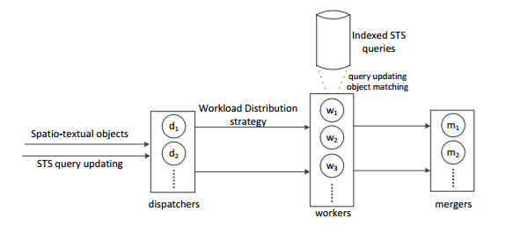
PS²Stream
Distributed publish/subscribe system
Extends the storm streaming system
Chen et al., Distributed Publish/Subscribe Query Processing on the Spatio-Textual Data Stream, ICDE 2017

Slide 56
Big Spatial-Keyword
Processing Approaches
Application on top of existing big data system
Extension of existing big data systems
Dedicated spatial-keyword big data systems
Notes:
In this section, we highlight some of the spatial-keyword systems that handle huge amounts of big spatial keyword data

Slide 57
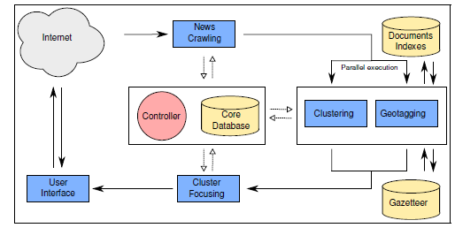
NewsStand
Web news aggregation and geotagging
Teitler et al., NewsStand: A new view on news, SIGSPATIAL 2008
Notes:
A system for aggregation of news atricles based on location proximity
Modular design
*multiple instances of the same module can be running in parallel
And modules work independtly
Master module→ orcastrates the processing of independent modules, master assigns tasks to slave modules and keeps track of atricles though out moduels
Maintains a core relational database that keeps track of atticles troughout the modules
Crawling module
Collect and identify new articles into the systen
Geotagging modules
Identifies main feature keywords in the document, and matches it with a gazetteer database from the geographic names dataset, solves disambiguate in names
Clustering
Groups all news atricles describing the same event into the same cluster
User interface
Cluster focus
If there are multiple locations associated with an event. Identify the main location(s) assocaited to the story and what locations do not contribute

Slide 58
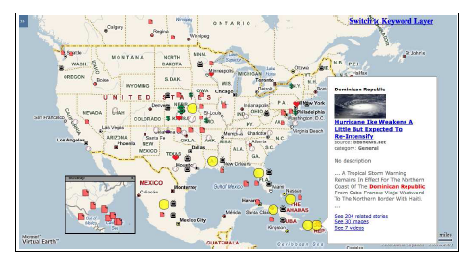
NewsStand
Notes:
Teitler, Benjamin E., et al. "NewsStand: A new view on news." Proceedings of the 16th ACM SIGSPATIAL 2008.

Slide 59
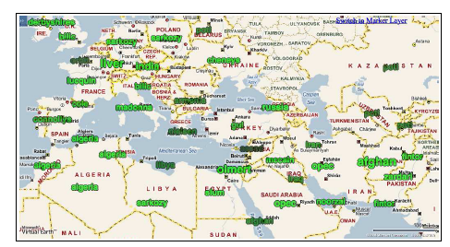
NewsStand
Notes:
Teitler, Benjamin E., et al. "NewsStand: A new view on news." Proceedings of the 16th ACM SIGSPATIAL 2008.

Slide 60
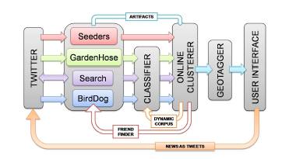
TwitterStand
Detection of news from Twitter
Sankaranarayanan et al., Twitterstand: news in tweets, SIGSPATIAL 2009
Notes:
Sankaranarayanan, Jagan, et al. "Twitterstand: news in tweets." Proceedings of the 17th acm sigspatial international conference on advances in geographic information systems. ACM, 2009.
Identification of news from tweets
the identitie of the contributors/reporters are not known in advance
and there may be many of them. Furthermore, tweets are not sent according to a schedule, noisy, error, tweets may not be relevant for public, arrive at a high rate. Needs to indeify ppl who talk about news mainly
Modules of twitter stand
Input
Seeds: handpicked ppl who mainly talk about news, official stats blogs, news networks that post news on twitter
Twitter garden hose: a sample of the entire twitter data (very noisy)
Birddogs: a service to get feeds from 20000 users
Twitter search and track: identify a set of continously changing 40 keywords to get retireve tweets from twitter
Classfier:
To filter tweets that talk about news from tweets, that do not talk about news using a Bayes classifer, remove as many tweets that can never have any news
Online clustering:
Cluster news tweets that belong to the same topic
Geotagging
Assign clusters of tweets to releavant spatial locations, using the content of the tweet and location of the user who tweeted it and the meta data of the tweet itself

Slide 61
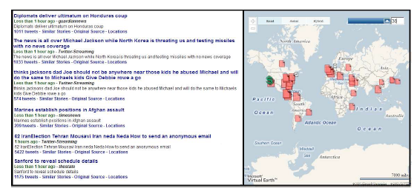
TwitterStand

Slide 62
TAGHREED
Answers spatial-keyword queries over micro-blogs including:
  Spatial-keyword filter
  Top-k frequent keywords
  Top-k active users
  Top-k famous users
  Aggregates over micro-blogs
  Top-k languages used while tweeting
Magdy et al., Taghreed: A System for Querying, Analyzing, and Visualizing Geotagged Microblogs, SIGSPATIAL 2014
Notes:
A. Magdy et al, “Taghreed: A System for Querying, Analyzing, and Visualizing Geotagged Microblogs”, ICDE 2015
Does not extend any specific big data system
A distributed system for the processing of queries over micro-blogs
Uses main memory and disk-based indexing
Uses indexes on time, space and text,
Uses replication for recovery management
. Keyword search. Within given spatial and temporal
ranges, find all microblogs that contain certain keywords.
2. Top-k frequent keywords. Within given spatial
and temporal ranges, find the most frequent k keywords,
for a given integer k.
3. Top-k active users. Within given spatial and
temporal ranges, find the most k active users, for a
given integer k. Active users are defined as the users
who have posted the largest number of microblogs in
the query spatio-temporal range.
4. Top-k famous users. Within given spatial and
temporal ranges, find the most k famous users, for a
given integer k. Famous users are defined as the users
having the largest number of followers. The query
answer is selected from users whose home locations
lie in the query spatial range and have posted at least
one microblog during the query temporal range.
5. Daily aggregates. Within given spatial and temporal
ranges, find the number of microblogs in each day.
Joint collective queries. Within given spatial and
temporal ranges, find the answer of all the previous
queries collectively.
7. Top-k used languages. Within given spatial and
temporal ranges, find the most k used languages, for a
given integer k.

Slide 63
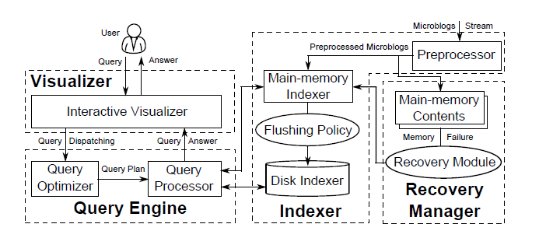
TAGHREED

Slide 64
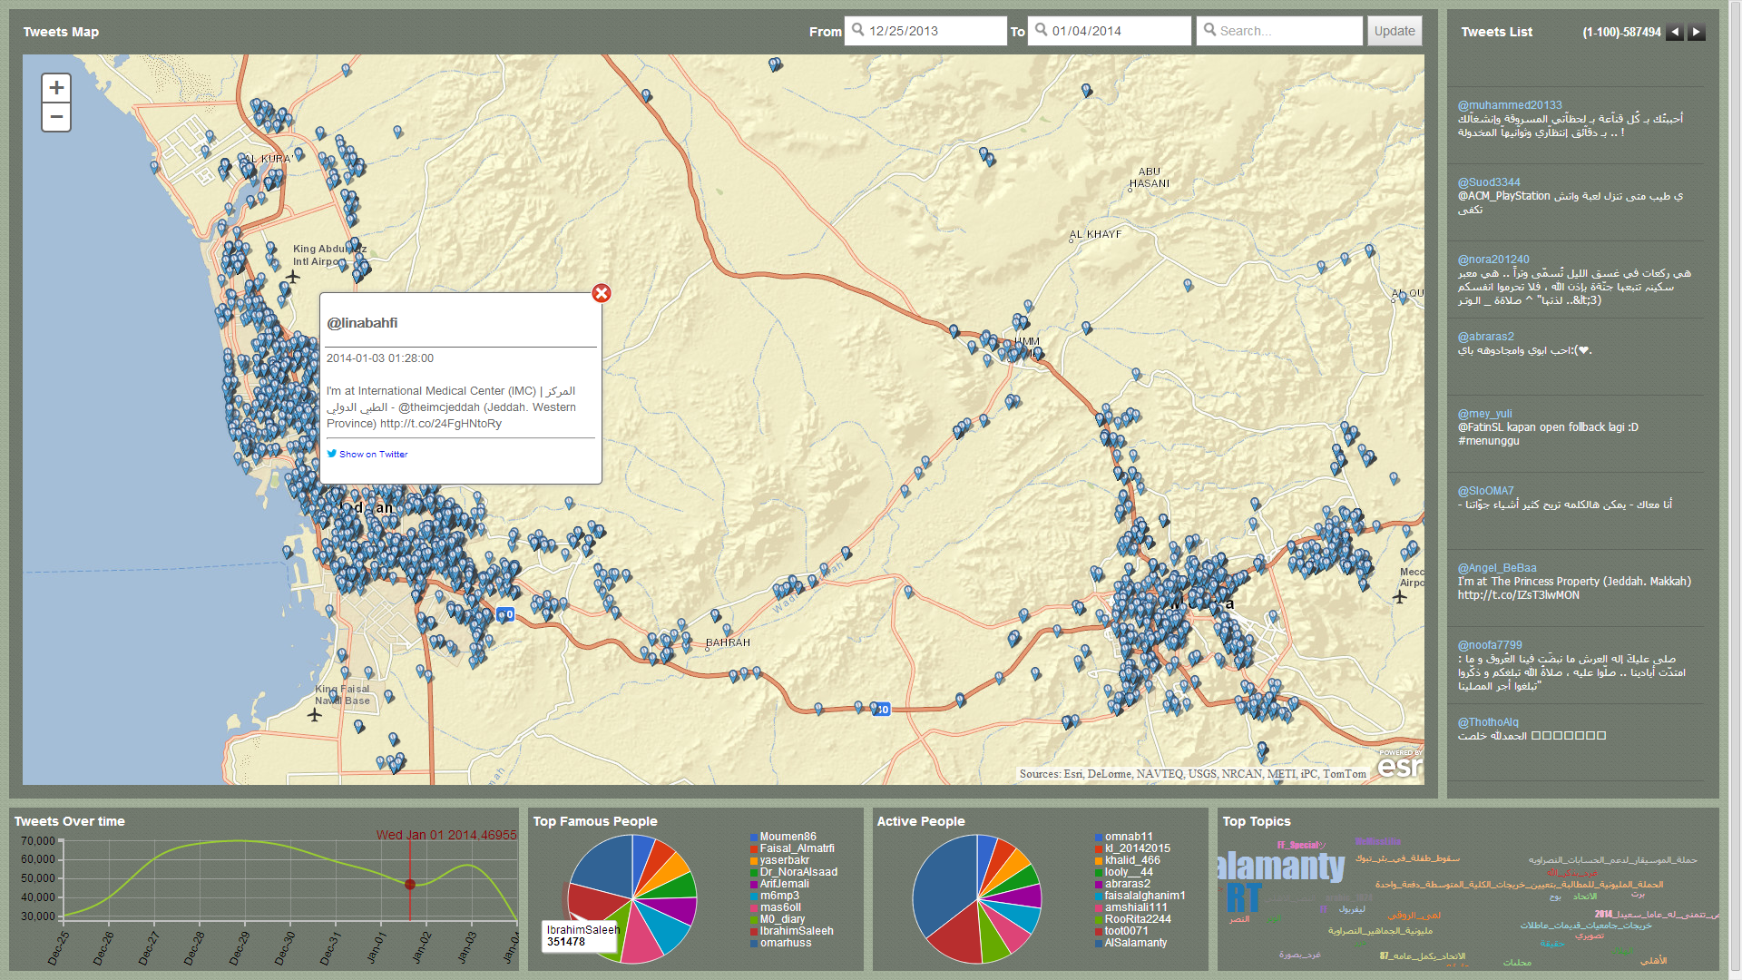
TAGHREED
Notes:
A. Magdy et al, “Taghreed: A System for Querying, Analyzing, and Visualizing Geotagged Microblogs”, ICDE 2015

Slide 65
Outline
Introduction and Background
Querying Spatial-Keyword Data
Spatial-Keyword Big Data Processing
  Indexing in Spatial-Keyword Big Data Systems
Case Studies
Future Research Directions

Slide 66
  Indexing in Spatial-Keyword Big Data Systems
Spatial-only indexing with text filtering on the fly
Inverted indexing
Hybrid structures
Data streams partitioning

Slide 67
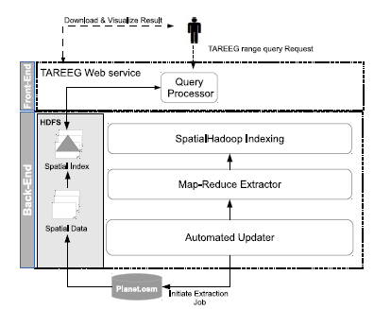
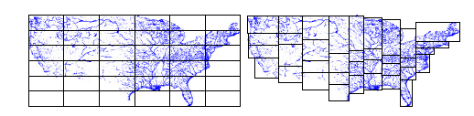
TAREEG
A service for the extraction of spatial data
Uses spatial-only indexing from SpatialHadoop
Performs text filtering on the fly
Alarabi et al., TAREEG: a MapReduce-based web service for extracting spatial data from OpenStreetMap, SIGMOD 2014
Eldawy et al., Spatialhadoop: A mapreduce framework for spatial data, ICDE 2015
Notes:
Indexing in spatial hadoop is partitioning of files in HDFS
Either grid-based or R-tree based
A system for the extraction of map objects from open street map
TAREEG, it first executes that query on
the master file to retrieve partitions that overlap the range
query. For each matching partition, the records in the corresponding
data file are compared to the query range and
all matching records are stored as part of the answer. Since
in R+-tree some records overlapping multiple partitions are
replicated, a post processing duplicate avoidance step is executed
to ensure the correctness of the answer as described

Slide 68
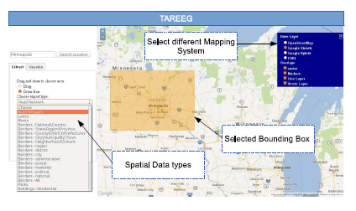
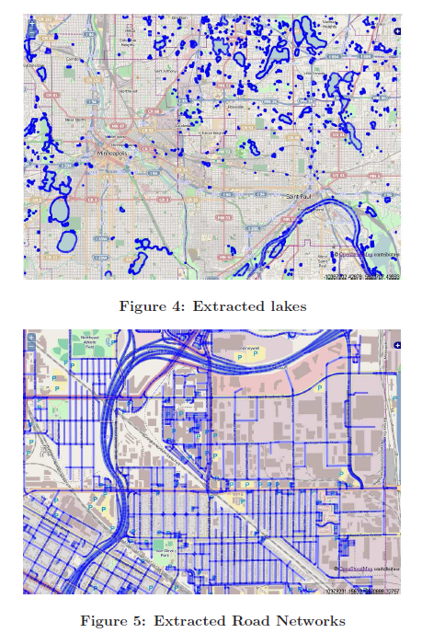
TAREEG

Slide 69
  Indexing in Spatial-Keyword Big Data Systems
Spatial-only indexing with text filtering on the fly
Inverted indexing
Hybrid structures
Data streams partitioning

Slide 70
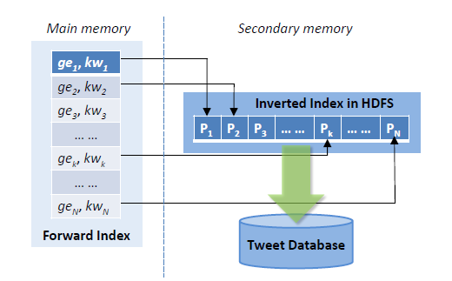
Top-K User Search
Identifies users that make relevant and popular tweets
  Uses an inverted index of tweets in HDFS
  Uses a quad-tree and keywords to get the key for the inverted index
    2 bits per quad-tree level
      00,01,10,11
Jiang et al., Finding top-k local users in geo-tagged social media data, ICDE 2015
Notes:
Jiang, Jinling, et al. "Finding top-k local users in geo-tagged social media data." Data Engineering (ICDE), 2015 IEEE 31st International Conference on. IEEE, 2015.
This work identifies the top-k individuals within a specific location and have the top-k textually relevant to the keywords of the index
For example find the best babysitters in west lafaytte indiana
Worries about keyword relevance, spatial proximity, high arrival rate of tweets
This is a batch processing system
A user is a top-user when he make relevant and popular tweets
A popular tweet has many ppl re-tweeting and responding to it
Tweets are ranked by textual relevance, spatial distance to the querym, and keyword relevance
Users are ranked based on the sum, or maximum relevance score of their tweets
L
Stores tweets in HDFS
Uses a relational database to store metadata about tweets, id,timestamp, retweets and replies
Builds an spatial keyword index in HDFS
The spatial strucutres is based on a quad tree, for every child in a level in the quad tree is assigned 2 bits , 00, 01, 10, 11
Then for a specific number of levels every child is assigned long code following is path from root to leaf e.g., 011101101110 1110 001
Then this bit code is encoded using 30 characters a-z and from 1-9 and represented as a string
Range queries are processed by producing the geohashes for the area covered by the range of the query
The forward index is stored in main memory
Then an entry in the foreward index points to posting list of tweets stored in HDFS
In summary this index uses a hybrid index (spatial geohash in main memory), and an inverted index on HDFS,
Then we they have a forward index which is a hashtable of key (geohash, and keyword)

Slide 71
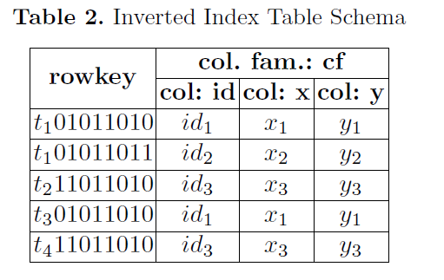
ST-HBase
Extends HBase with spatial-keyword indexes
  Answers spatial-keyword filter queries
  Key is the keyword, and z-order value of the location of the object
STbHI: Spatial and Textual Based Hybrid Index Index
Ma et al., St-hbase a scalable data management system for massive geo-tagged objects, WAIM 2013
Notes:
Ma, Youzhong, Yu Zhang, and Xiaofeng Meng. "St-hbase: a scalable data management system for massive geo-tagged objects." International Conference on Web-Age Information Management. Springer Berlin Heidelberg, 2013.
Indexing is performed based on an inverted index table
The key to the inverted list is the <termid, and z-order value of objects>
Insertion
Insert objects to KD tree
Insert objects to the inverted list table using the inverted table key
Query processing
If range of query small, identify the z-order cells and query the inverted table directly based on the z-order values
If range a little larger, get min and max z-order values, use a range search over the table
If the range is very large and we will have a lot of false positives, use the KD-tree to find subranges and reduce false postivies

Slide 72
  Indexing in Spatial-Keyword Big Data Systems
Spatial-only indexing with text filtering on the fly
Inverted indexing
Hybrid structures
Data streams partitioning

Slide 73
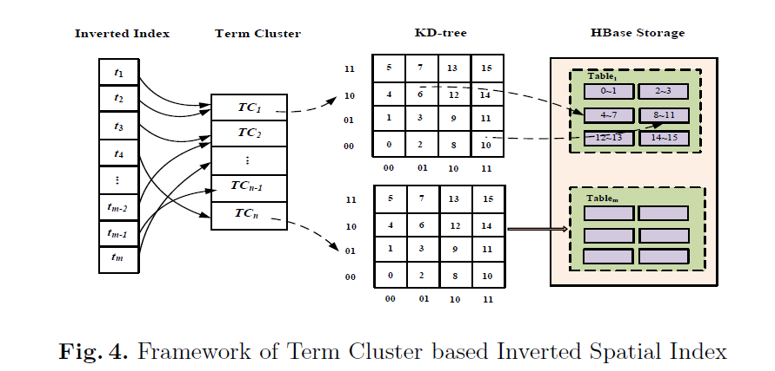
ST-HBase
Uses clusters of keywords to avoid inserting the same object multiple times different keywords
TCbISI: Term Cluster Based Inverted Spatial Index`
Ma et al., St-hbase: a scalable data management system for massive geo-tagged objects, WAIM 2013
Notes:
An object as a single location and multiple keywords, using the previous index increeases the space and make it diffcult for processing queries with large spatial ranges and
To avoid inserting the same object multiple times for as it has multiple keyword
The co-occurrence of keywords is studied and terms that occur together are clustered
Then entries belonging to a cluster are spatially indexed using a KD-tree
Entries are stored in an Hbase table using the z-order from the KD tree

Slide 74
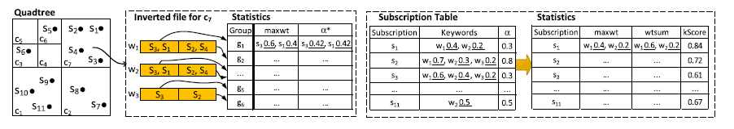
DSkype
A global distribution mechanism across multiple processes
  Various techniques for global distribution
  E.g., Random or spatial-only
Local spatial-keyword indexing
Wang et al., Top-k spatial-keyword publish/subscribe over sliding window, VLDB journal 2016
Notes:
Quadtree structure integrated
with inverted file in each leaf cell,
For each registered subscription,
we store its detailed information
and relevant statistics in a subscription table,
And insert it into a leaf cell of Quadtree based on its spatial
location.
Note that in Quadtree, we only store the
subscription id referring to its detailed information in subscription
table. Within each leaf cell, an inverted file is built
upon all the subscriptions inside the cell. Then each posting
list in inverted file is further partitioned into groups
based on the subscription preference α∗ to enable group
pruning. Each group is also associated with some statistics
mentioned above. Finally, to facilitate early termination, the
subscriptions within each group are ordered based on their
kScore∗.

Slide 75
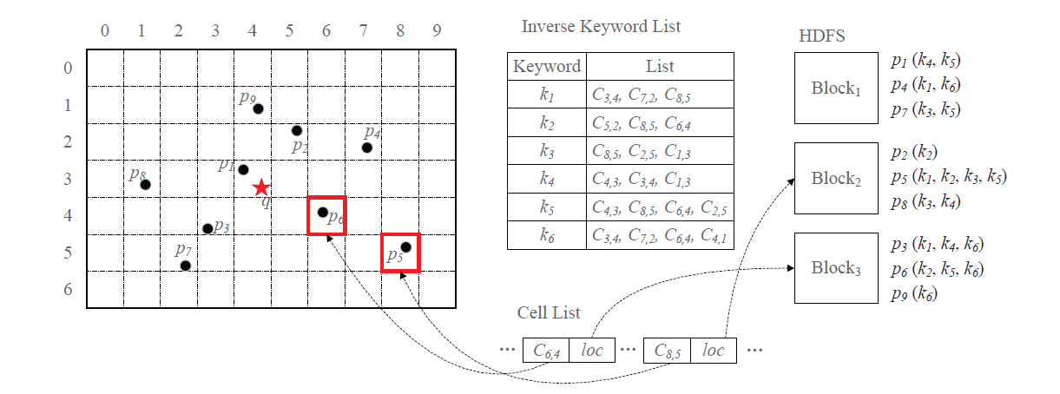
CoSKQ on RDD-Based Systems (Spark)
Grid-based indexing of spatial-keyword data for answering the collective spatial-keyword group query
He et al., Scalable collective spatial keyword query, ICDE workshops 2015
Notes:
He, Peijun, et al. "Scalable collective spatial keyword query." Data Engineering Workshops (ICDEW), 2015 31st IEEE International Conference on. IEEE, 2015.
Query has a spatial location and a set of keywords find a set of items S that minimizes a specific cost
Combination of the maximum distance from q to o and
the maximum distance between oi and oj ;
• Maximum distance between oi and oj , and;
• Combination of the distances from q to o
Inverted keyword list, keeps track of grid cells per keyword
Cell list keeps a pointer for every cell to the HDFS block where its data objects are stored
grid-based two-stage solution on top of spark
*Partitioning Objects into Grid cell
* build an inverted list on top of grid cells
* an entry in the cell list points to the HDFS block containing data points

Slide 76
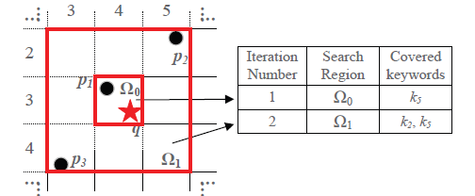
CoSKQ on RDD-Based Systems (Spark)
Use indexes to avoid reading cells that do not contribute to the answer
Notes:
Intsead of reading all data to execute the algorithm use the indexing to prune cells that do not contribute to the result
After you read the data, then you use the Cao algorithm for answering this algorithm

Slide 77
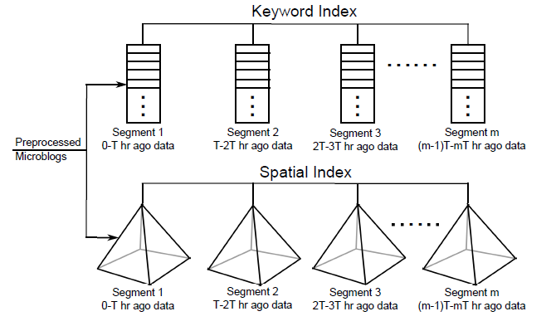
TAGHREED
Uses main-memory and disk indexes for micro-blogs
Magdy et al., Taghreed: A System for Querying, Analyzing, and Visualizing Geotagged Microblogs, ICDE 2015

Slide 78
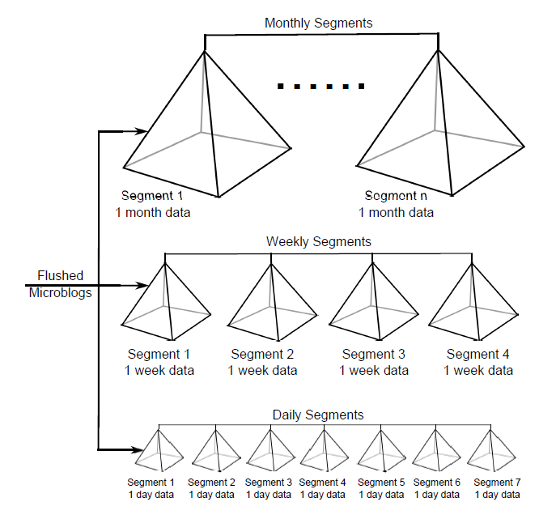
TAGHREED

Slide 79
  Indexing in Spatial-Keyword Big Data Systems
Spatial-only indexing with text filtering on the fly
Inverted indexing
Hybrid structures
Data streams partitioning

Slide 80
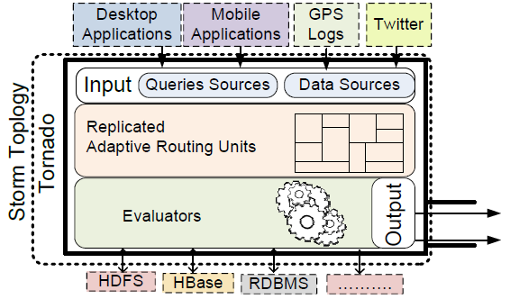
Tornado
Mahmood et al., Tornado: A distributed spatio-textual stream processing system, PVLDB 2015
Notes:
Global and local

Slide 81
Tornado
Partition the space into non-overlapping rectangles
Data
Source
Query
Source
A
B
A
B
A
B
The Routing
Layer
D
D
D
C
C
C
E
F
E
F
E
F
Routing Unit
Routing Unit
Routing Unit
Evaluators
A
B
C
D
E
F
Notes:
The global routing layer ensures distribution and collocation of
Within evalautor a gird index with an inverted list is maintained

Slide 82
Outline
Introduction and Background
Querying Spatial-Keyword Data
Spatial-Keyword Big Data Processing
  Indexing in Spatial-Keyword Big Data Systems
Case Studies
Future Research Directions

Slide 83
Disks
A system for the distributed processing of spatial-keyword group query on road networks
  Partitions the road network into node-disjoint sub-graphs
  Data partitions are indexed in HDFS
  Query processing is performed using Hadoop MapReduce
Luo et al., DISKs: a system for distributed spatial group keyword search on road networks, PVLDB 2012
Luo et al., Distributed Spatial Keyword Querying on Road Networks, EDBT 2014
Notes:
Luo, Siqiang, et al. "DISKs: a system for distributed spatial group keyword search on road networks." Proceedings of the VLDB Endowment 5.12 (2012): 1966-1969.
Luo, Siqiang, et al. "Distributed Spatial Keyword Querying on Road Networks." EDBT. 2014.
The Indexer takes partitions and portal nodes as arguments,
and outputs NPD-index. NPD-index is composed
of N components, each of which corresponds to a partition.
Each component contains two structures, which we
call Distance-List (DL) and Short-Cut (SC), respectively.
We proceed to describe DL and SC via Fig. 2.
DL is a search tree on the nodes of the road network,
where each leaf node of the search tree is tagged with distances
between this node and part of the portal nodes of
partition P, as shown in Fig. 2. Here, A1 is a leaf node of
the DL search tree corresponding to partition P. We say
that a portal node p in P is effective (e.g., C, D and E in
the figure) with respect to A1, if any shortest path2 between
A1 and p goes through only one node in P, which is p itself
here. Our interesting finding is that only the distances between
A1 and its effective portal nodes need to be recorded
in DL for query processing.
Given a group of keywords X and
a distance r, an SGKS returns locations on a road network,
such that for each returned location p, there exists a set
of nodes (on the road network), which are located within a
network distance r from p and collectively contains X.

Slide 84
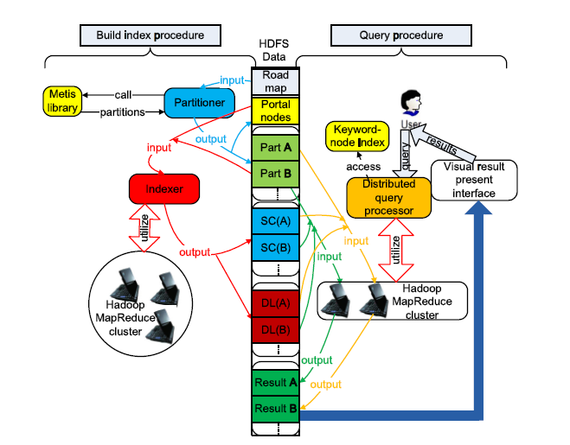
Disks
Notes:
Luo, Siqiang, et al. "DISKs: a system for distributed spatial group keyword search on road networks." Proceedings of the VLDB Endowment 5.12 (2012): 1966-1969.
Luo, Siqiang, et al. "Distributed Spatial Keyword Querying on Road Networks." EDBT. 2014.

Slide 85
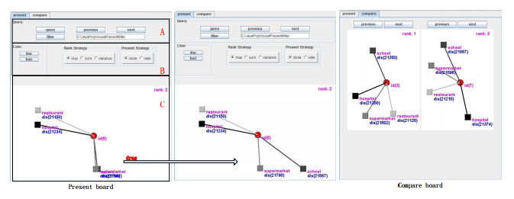
Disks

Slide 86
TerraFly sksOpen
TerraFly is a system for querying and visualizing geo-spatial data
  Serves worldwide web map requests over 125 countries
  Supports various overlays, e.g., street names, roads, restaurants, services, and demographic data
TerraFly sksOpen
  An indexing and query engine for processing Top-k spatial-keyword queries
Lu et al., sksOpen: efficient indexing, querying, and visualization of geo-spatial big data, ICMLA 2013
Zhang et al.,Terrafly geocloud: an online spatial data analysis and visualization system, TIST 2015
Notes:
Lu, Yun, et al. "sksOpen: efficient indexing, querying, and visualization of geo-spatial big data." Machine Learning and Applications (ICMLA), 2013 12th International Conference on. Vol. 2. IEEE, 2013.
Zhang, Mingjin, et al. "Terrafly geocloud: an online spatial data analysis and visualization system." ACM Transactions on Intelligent Systems and Technology (TIST) 6.3 (2015): 34.
Based on SKSopen

Slide 87
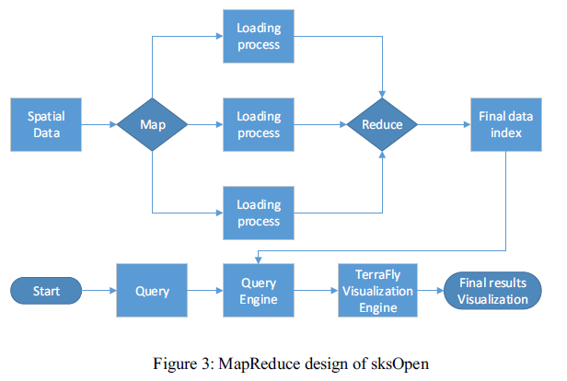
TerraFly sksOpen
To answer top-k spatial keyword queries, TerraFly builds spatial-keyword indexes using MapReduce

Slide 88
Nimbus
A tuning service for twitter analysis
Provides an API for testing the quality of twitter filters
Uses the GNIP PowerTrack query language
Uses a database of tweets to check if a twitter filter retrieves only relevant tweets
Measures the hit ratio of a specific tweet filter
Lai et al., Nimbus: tuning filters service on Tweet streams, Big Data 2015
Notes:
Allows users to tune filters before putting them in production
Consider quersing asking about the Target store or the Guess brand

Slide 89
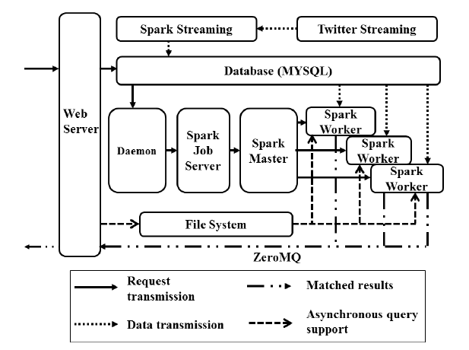
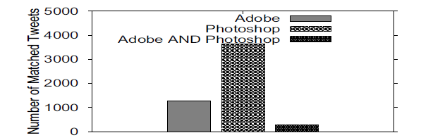
Nimbus
Notes:
Lai, Chien-An, et al. "Nimbus: tuning filters service on Tweet streams." Big Data (BigData Congress), 2015 IEEE International Congress on. IEEE, 2015.
Get 1% of twitter streaming firehose
Spark streaming to discretuze tweets into small batches
Batches inserted into database
Extaxt text, langauage, geo-location from tweet
When queries arrive, they are executed on the database of tweets using the spark framework

Slide 90
Outline
Introduction and Background
Querying Spatial-Keyword Data
Spatial-Keyword Big Data Processing
  Indexing in Spatial-Keyword Big Data Systems
Case Studies
Future Research Directions

Slide 91
Future Research Directions
Load-Balancing
Benchmarking
Pipelined Evaluation
Big Spatio-Temporal-keyword Processing

Slide 92
Load-Balancing in Big Spatial-Keyword Systems
Spatial-keyword workload varies over time
Big spatial-keyword systems need to be adaptive and elastic

Slide 93
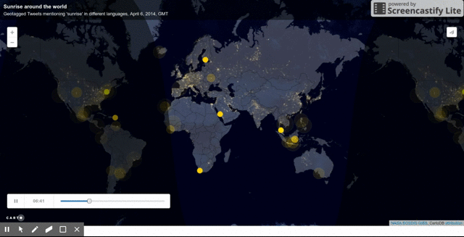
http://www.vox.com/a/internet-maps
Notes:
http://www.vox.com/a/internet-maps

Slide 94
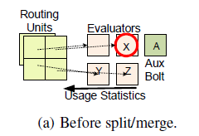
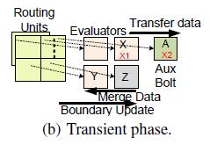
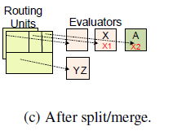
Load-Balancing in Tornado
Mahmood et al., Tornado: A distributed spatio-textual stream processing system, PVLDB 2015

Slide 95
Load-Balancing in Big Spatial-Keyword Systems
Load-balancing and adaptivity for batch, disk-based, and memory-based systems need to be addressed
Need to account for the various types of spatial-keyword queries
  Need to consider the overhead in processing complex spatial-keyword queries

Slide 96
Future Research Directions
Load-Balancing
Benchmarking
Pipelined Evaluation
Big Spatio-Temporal-keyword Processing

Slide 97
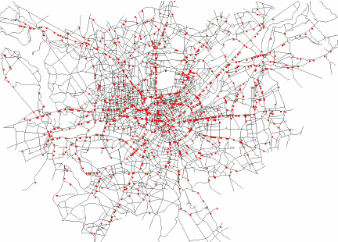
Benchmarking Big Spatial-Keyword Systems
Spatial-only benchmarks
  Jackpine
  BerlinMOD
Relational benchmarks
  TPC-H
http://csng.cs.toronto.edu/projects/20
http://dna.fernuni-hagen.de/secondo/BerlinMOD/BerlinMOD.html
Notes:
http://csng.cs.toronto.edu/projects/20
http://dna.fernuni-hagen.de/secondo/BerlinMOD/BerlinMOD.html

Slide 98
Benchmarking Big Spatial-Keyword Systems
Existing spatial-keyword benchmarks
  Limited set of queries
  Specific use cases, e.g., social-network analysis
Chen et al., Spatial keyword query processing: An experimental evaluation, PVLDB 2013
Panda et al., Performance Evaluation of Social Network Using Data Mining Techniques, Computational Social Networks 2012
Notes:
L. Chen, G. Cong, C. S. Jensen, and D. Wu. Spatial
keyword query processing: An experimental
evaluation. In PVLDB, volume 6, pages 217{228, 2013.
Panda, Mrutyunjaya, et al. "Performance Evaluation of Social Network Using Data Mining Techniques." Computational Social Networks. Springer London, 2012. 25-49.

Slide 99
Benchmarking Big Spatial-Keyword Systems
Large spatial-keyword datasets
Support of a wide range of spatial-keyword queries
Support of several evaluation scenarios
  Batch
  Streaming

Slide 100
Future Research Directions
Load-Balancing
Benchmarking
Pipelined Evaluation
Big Spatio-Temporal-keyword Processing

Slide 101
Pipelined Evaluation of
Big Spatial-keyword Queries
Design building-block operators that can be composed to realize complex spatial-keyword queries
  Similar to the relational SELECT, PROJECT, JOIN building-block operators

Slide 102
Future Research Directions
Load-Balancing
Benchmarking
Pipelined Evaluation
Big Spatio-Temporal-keyword Processing

Slide 103
Big Spatio-Temporal-keyword Processing
Spatial-keyword data are often associated with temporal attributes
  Time-stamp of tweets
Need to investigate
  Indexing
  Processing
  Query processing and query languages

Slide 104

Thank you

