Slide 1
Preparing and Delivering a Technical Presentation
Aditya Mathur
ISTD
Feb 7, 2014
Click here for a source for this presentation

Slide 2
Purpose
Share my thoughts on:
How to prepare a technical presentation
How to deliver a prepared presentation

Slide 3
Prepare!

Slide 4
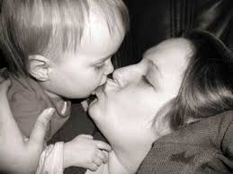
KISS: A Fundamental principle
Keep It Simple Stupid!

Slide 5
Key questions
Who is your audience?
Purpose of your presentation?
What would you like to achieve?

Slide 6
And prepare
Structure your presentation
Practice (rehearse)
“It takes a lot of preparation to deliver an impromptu speech!”.. Mark Twain

Slide 7
A slide: This?
TextTextTextTextTextTextTextTextText
TextTextTextTextTextTextTextTextText
TextTextTextTextTextTextTextTextText
TextTextTextTextTextTextTextTextText
TextTextTextTextTextTextTextTextText
TextTextTextTextTextTextTextTextText
TextTextTextTextTextTextTextTextText
TextTextTextTextTextTextTextTextText
TextTextTextTextTextTextTextTextText
TextTextTextTextTextTextTextTextText
TextTextTextTextTextTextTextTextText
TextTextTextTextTextTextTextTextText
TextTextTextTextTextTextTextTextText
TextTextTextTextTextTextTextTextText

Slide 8
May I use some text?
Sure.

Slide 9
A slide: Or this?

Slide 10
Legible?
Sure.
Less than 18pt: Unacceptable.
20pt or more: Preferred
But not ugly!

Slide 11
I love bullets!
Bullet blue
Bullet green
Bullet small
Bullet large
Bullet imported
Bullet exported
Bullet unused
Bullet used
Bullet banned
Bullet wet
Bullet iron
Bullet steel
Bullet rubber
Bullet hard rubber
Bullet soft
Bullet hard

Slide 12
I love bullets: but should I control my urge!
Bullet red
Bullet green
Bullet blue

Slide 13
Oops!
There is a mistak. But is it minr?

Slide 14
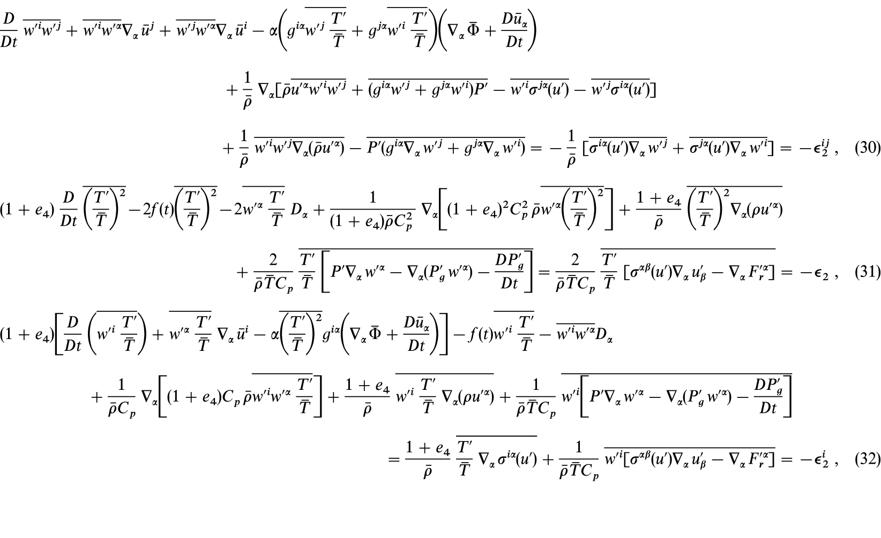
Mathematics!!
Hey…audience will love you for your genius!
Oh Yeah!

Slide 15
Mathematics: If you must
Go slowly over each equation.
Explain all terms and the purpose of the equation.
Be aware that a large portion of the audience might go off to sleep while you explain the math.
Even the mathematicians amongst the audience might sleep or go out to lighten themselves!.
Audience might tolerate you.

Slide 16
Deliver

Slide 17
Where to look?

Slide 18
Speak (too) softly?

Slide 19
Or (too) loudly?

Slide 20
Or just right?

Slide 21
Language?

Slide 22
Engage the audience
What am I doing? Synchronize.

Slide 23
Time for questions?

Slide 24
Summary
What did we cover?
Lessons

Slide 25
References
Did we use someone’s work?
Are there closely related publications?

Slide 26
Too little time to present?

Slide 27
Thank you!
Want to laugh and learn to make “terrible” power point presentations?
Click here.

