Slide 1
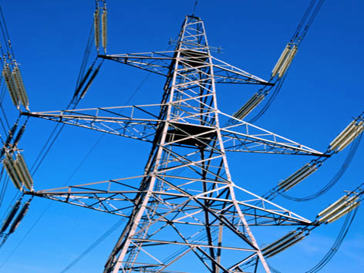
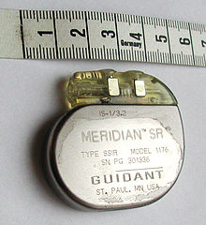
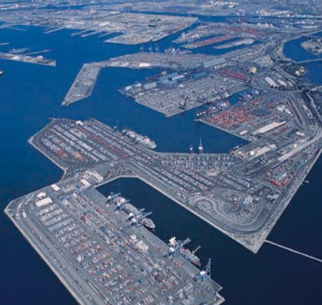
Challenges in Protecting Critical National Infrastructure from Cyber Attacks
Singapore University of Technology and Design
Aditya P Mathur
Keynote@Confluence 2013
Amity University, India
September 27, 2013
Notes:
http://www.istockphoto.com/stock-illustration-17912107-game-world.php?st=d56805a (temperature 1100K)

Slide 2
Attacks
2001: Queensland Australia, 264,000 gallons of sewage released in rivers and parks.
2006: Harrisburg water filtering plant, Harrisburg, USA, intruder planted malware that could affect plant’s water treatment operations.
2007: Tehama colusa canal, Willows, CA, USA; damaged computer to divert water from the Sacremento river
2008: Stuxnet: Aimed at the Iranian nuclear enrichment plant
2012: North Pole Toys: Aimed at a toy manufacturing company

Slide 3
Questions of interest
What is a Cyber Physical System (CPS)?
What are the key challenges in securing CPS?
Are there any fundamental design principles that ought to be used when designing or upgrading a CPS?

Slide 4
CPS: An abstract view
Monitoring and
Control [SCADA, PLC,
HMI, etc.] system
Plant
Data and control

Slide 5
CPS: Examples
Water treatment and distribution
Healthcare: Pacemaker, defibrillator, insulin pump, etc.
Energy: Power generation, distribution, smart metering
Transportation: Driverless cars, networked traffic systems, etc.

Slide 6
Laboratory CPS: At SUTD

Slide 7
CPS: Systems View
x: system state
Physical System
Actuator
Sensor
y: system
output
u:control
input
Control System
Estimation and
control
: Network
x_{k+1}=Ax_{k}+Bu_{k}
y_{k}=Cx_{k}+v_{k}

Slide 8
CPS Network-based Attacks
Physical System
Actuator
Sensor
y’ not y:
Sensor
compromised
u’ not u
controller
compromised
Control System
Network
jammed
Controller
compromised

Slide 9
Existing Techniques
Authentication
Digital signatures
Prevention
Access control
Intrusion detection

Slide 10
Attacks on CPS: Challenge 1
Physical System
Actuator
Sensor
y’ not y:
Sensor
compromised
Control System
How to detect?
How to control given that data corruption is detected?

Slide 11
Attacks on CPS-Challenge 2
Physical System
Actuator
Sensor
Control System
u’ not u
controller
compromised
Controller compromised
How to safeguard the physical system?

Slide 12
Attacks on CPS-Challenge 3
Physical System
Actuator
Sensor
u’ not u
controller
channel
compromised
Control System
Control channel compromised
How to safeguard the physical system?

Slide 13
Design Principles: Just a few for now
Use a failure based design method to identify critical components that ought to be protected against cyber attacks.
Include an orthogonal protection system using Intelligent Checkers [Sabaliauskaite-Mathur, CSP2013].

Slide 14
Questions?

Slide 15
References [Sample]
Secure Control: Towards Survivable Cyber-Physical Systems. Alvaro A. Ca ́rdenas Saurabh Amin Shankar Sastry, The 28th International Conference on Distributed Computing Systems Workshop, IEEE 2008.
Common Cybersecurity Vulnerabilities in Industrial Control Systems. US Department of Homeland Security. May 2011.
Cyber-Physical Systems Security for Smart Grid. White Paper. Manimaran Govindarasu, Adam Hann, and Peter Sauer. February 2012.
Improving the Security and Privacy of Implantable Medical Devices, William H. Maisel and Tadayoshi Kohno, New England Journal of Medicine 362(13):1164-1166, April 2010.
Guide to Industrial Control Systems (ICS) Security. Keith Stouffer, Joe Falco, and Karen Scarfone. NIST. 800-02. June 2011.

