Slide 1

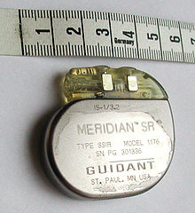
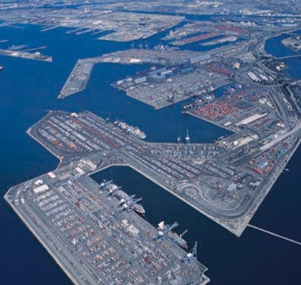
Cyber Physical Systems: Security and Safety
Singapore University of Technology and Design
Aditya P Mathur
International Workshop on Information Security (IWIS-2012)
December 15, 2012
Notes:
http://www.istockphoto.com/stock-illustration-17912107-game-world.php?st=d56805a (temperature 1100K)

Slide 2
Questions of interest
What is a CPS?
What are the security issues in CPS and how do they differ from those in traditional information systems?
To what extent can a CPS be secured against cyber crime?
Are there some fundamental design principles that ought to be used when designing or upgrading a CPS?
What are the curricular ramifications of CPS security?

Slide 3
Coverage
CPS examples and concerns, components, abstraction, incidents
Traditional versus CPS security
Industrial control systems
Two real-life incidents: Toys and Iran
Control systems: basics
Case studies: Medical devices and Irrigation Systems
CPS: design principles, research and educational needs

Slide 4
Cyber Physical Systems: Examples

Slide 5
Shipping
Several countries and cities in the world have some of the world's busiest ports and large transshipment hubs.
For example, PSA Singapore Terminals are connected by 200 shipping lines to 600 ports in 123 countries, with daily sailings to every major port of call in the world.

Slide 6
Healthcare
Singapore offers Asia's best healthcare system, and its standard of medical practice ranks among the best in the world.
The Joint Commission International (JCI) has accredited 11 hospitals and three medical centers in Singapore.

Slide 7
Infocomm
Singapore today ranks as the second most network-ready country in the world and the first in Asia, according to the World Economic Forum's Global Information Technology Report 2010/2011.

Slide 8
Energy
“Today, Singapore is the undisputed oil hub in Asia and is one of the world’s top three export refining centers....”

Slide 9
Smart Grid - Overview

Slide 10
Smart Grid – Smart Metering

Slide 11
Smart Metering Privacy Issue (1)

Slide 12
Smart Metering Privacy Issue (2)

Slide 13
Privacy is not Secrecy

Slide 14
Privacy versus Secrecy

Slide 15
Possible Solutions
Robust Smart Metering Design with privacy constraints
Utility-Privacy Tradeoff Design
Privacy Invasion Detection/Prevention
Data masking
Data Anonymisation

Slide 16
Other Potential Concerns:

Slide 17
CPS Vulnerability
Are your energy, healthcare, water, shipping, transportation systems vulnerable to network attacks?
What, if any, are the vulnerabilities in such systems?
When exploited, how might such vulnerabilities affect people?

Slide 18
CPS Control systems
Are the control systems in your large and critical CPSs systems robust enough to withstand deception attacks?
Are these control systems programmed to withstand denial of service attacks?

Slide 19

Surviving from Physical attacks
What happens if we lose part, or even most of the computing systems?
Will redundancy alone solve the problem?
How to measure and quantify of resilience of current systems?
How to ensure high availability of CPS?

Slide 20
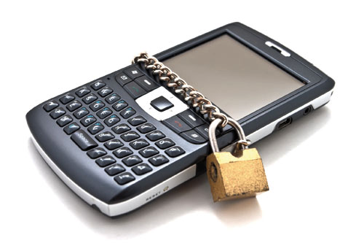
Defending Against Device Capture Attack
Physical devices in CPS systems may be captured, compromised and released back by adversaries.
How to identify and ameliorate the system damage with trusted hardware but potentially untrusted/modified software?

Slide 21
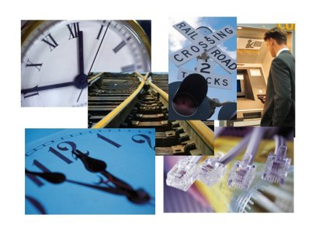
Real-Time Security in CPS
CPS often requires real-time responses to physical processes
Little Study on how attacks affect the real-time properties of CPS
How to guarantee real-time requirements under attack?

Slide 22
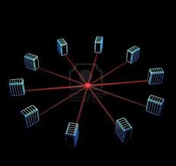
Concurrency in CPS
CPS is concurrent in nature, running both cyber and physical processes
Little research on handling large-scale concurrent systems

Slide 23

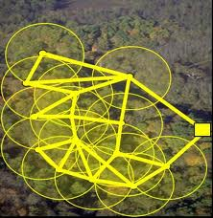
Collaboration and Isolation
CPS needs to effectively isolate attackers while maintaining collaborations among different, distributed system components
How to avoid cascading failures while minimizing system performance degradation?

Slide 24
Cyber Physical System: Components

Slide 25
CPS: Greenhouse

Slide 26
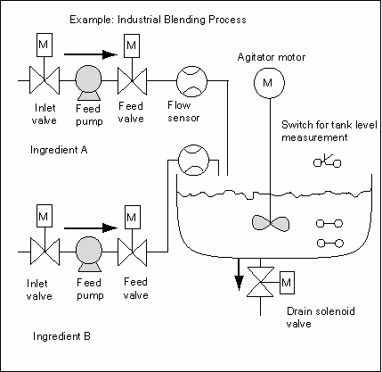
CPS: Blending process

Slide 27
CPS Other examples
Pacemaker
ICD (Implantable Cardiovascular Defibrillator)
Insulin pump
Neuro-stimulators

Slide 28
Cyber Physical Systems: Abstraction

Slide 29
CPS: Component view

Slide 30
CPS: Systems View
x: state
Physical System
Actuator
Sensor
y
u: input
Control System
Estimation and control
: Network

Slide 31
CPS Network-based Attacks
Physical System
Actuator
Sensor
y’ not y:
Sensor
compromised
u’ not u
controller
compromised
Control System
Network
jammed

Slide 32
Existing Techniques
Authentication
Digital signatures
Access control
Intrusion detection

Slide 33
Enhancement of existing approaches
How deception and DoS attacks affect application layer performance (e.g., estimation and control)?
Intrusion detection and deception attacks in control systems?
What if a human is not in the loop for intrusion detection?

Slide 34
CPS incident statistics

Slide 35
CPS incident databases
BCIT Industry security incident database→TOFINO
http://www.tofinosecurity.com/
Wurldtech: http://www.wurldtech.com/
Cyber incidents involving control systems, Robert Turk, October 2005, Idaho National Laboratory, INL/EXT-05-00671
http://www.tofinosecurity.com/blog/2012-scada-security-predictions-how-did-eric-byres-do

Slide 36
Sample CPS incidents
Over 500 SCADA vulnerabilities found in 2011
2010: Stuxnet [http://www.tofinosecurity.com/stuxnet-central]
2010: Night Dragon, Duqu, Nitro
Nov 2012: kAndyKAn3 worm attacks North Pole Toys

Slide 37
CPS incident report statistics
Empirical Analysis of publicly disclosed ICS vulnerabilities since 2001” by Sean McBride

Slide 38
CPS incident (more) statistics
42% of all incidences were conducted by means of mobile malware
61% of the perpetrators originated from external sources
43% of perpetrators were malware authors

Slide 39
Traditional versus CPS security

Slide 40
Traditional
Confidentiality: Ability to maintain secrecy from unauthorized users.
Integrity: Trustworthiness of data received; lack of this leads to deception.
Availability: Ability of the system being accessible

Slide 41
CPS
Timeliness: responsiveness, freshness of data
Availability: unexpected outages
Integrity: genuine data displayed and received by the controller
Confidentiality: Information regarding SCADA not available to any unauthorized individual
Graceful degradation
Ref: A Taxonomy of Cyber Attacks on SCADA Systems, Zhu et al., UC Berkeley.

Slide 42
Industrial Control Systems

Slide 43
SCADA
Supervisory Control and Data Acquisition System
It is an industrial control system that consists of RTUs, PLCs, and HMIs to control an industrial process.
Use: Manufacturing, power generation, fabrication, oil and gas pipelines, etc.

Slide 44
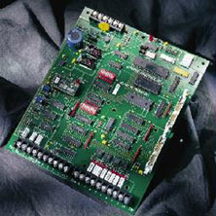
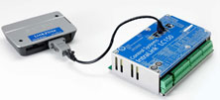
RTU
Microprocessor controlled Remote Terminal/Telemetry Unit
Interface between physical objects and a SCADA.
Transmits telemetry data to SCADA. Example: water quality.
Siemens LC150 Pump Control Telemetry Unit

Slide 45
PLC
Programmable Logic Controller
A computer to control the operation of electro-mechanical devices such as pumps, motors, switches
Hard real-time system
Programs stored in non-volatile memory, battery backup
Programmed using State Logic, Basic, C:
IEC 61131-3 programming standard
Siemens S7-mEC embedded controller

Slide 46
PLC Programming
Programs stored in non-volatile memory, battery backup
Programmed using IEC 61131-3 programming standard
Languages: graphical (e.g., Ladder diagram) and textual (e.g., Structured Text, Sequential Function Charts)
Ref: http://www.rtaautomation.com/iec61131-3/
http://www.dogwoodvalleypress.com/uploads/excerpts/03192005214421.pdf

Slide 47
PLC Ladder Logic Diagram
Rung 1
Rung 2
Rung 3
Timer, counter, sequencer etc.

Slide 48
PLC Ladder Logic Example
Pilot light PL2 is to be ON when selector switch SS2 is closed, push-button PB4 is closed and limit switch LS3 is open.
Series connection
PL2=SS2 (AND) PB4 (AND) LS3

Slide 49
PLC Scan
PLC program is scanned continuously while reading the state of physical inputs and setting the state of the physical outputs.
Scan time for one cycle is between 0-200ms.
Larger scan times might miss transient events.

Slide 50
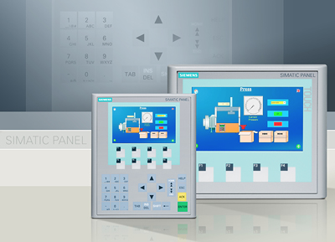
HMI
Human Machine Interface
Operator panel to display and control of system/device state
Programming software: Example: WinCC from Siemens

Slide 51
SDR
Software Defined Radio
Radio communication system that has the traditional hardware components implemented in software. These include mixers, filters, amplifiers, modulator/demodulator, etc.

Slide 52
Network Security in CPS: Siemens Approach
Use the notion of “cell protection.”
Divide plant network into “automation cells.” Inside such a cell all devices are able to communicate with each other.
Access is controlled at the entrance to each cell using a hardware device
Communication with the outside world is via VPN-protected channel.

Slide 53
CPS Survivability
Despite these techniques, systems continue to be compromised.
How can a CPS continue to function above a given threshold in the presence of attacks?

Slide 54
Two stories:
North Pole Toys
Stuxnet

Slide 55
North Pole Toys: Basics
On-line retailer.
Carries specialized toys generally not found elsewhere.
Process: Toy Assembly, Toy Packaging and Toy Shipping
2011: Replaced the old manufacturing system with new automated industrial control system.
Files are carried on USB sticks from main server to the workshop; air gap established

Slide 56
North Pole Toys: Attack
Day before Thanksgiving 2011…….
Instead of one toy per box, multiple toys were being placed.
Some empty boxes were being wrapped.
Initial suspicion: Incorrect PLC code; but the code found to be correct.
Discovery: kAndyKAn3 worm had infected the PLC and the main office computers.

Slide 57
Stuxnet

Slide 58
Uranium and its isotopes
Uranium: Naturally occurring radioactive element
Uranium 238: 99.2739 - 99.2752%
Uranium 235: 0.7198 - 0.7202%
Uranium 234: 0.0050 - 0.0059%

Slide 59
Uranium 235
Only isotope found in nature in any appreciable quantities; is fissile, i.e., can be broken apart by thermal neutrons.

Slide 60
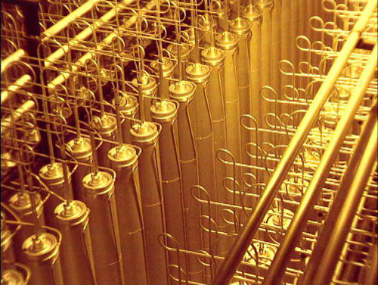
Uranium enrichment: Basis
Exploit mass difference (238 versus 235)
Produce UF₆
http://www.world-nuclear.org/info/inf28.html

Slide 61
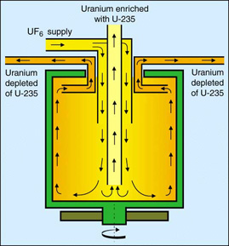
Uranium enrichment: Zippe Centrifuge
Use centrifuges (rapidly revolving cylinders); pulsating magnetic field applied to the rotor; bottom is heated; rotation in vacuum
Heavier U238 atoms down and outward
Lighter U235 atoms move towards center and are collected
http://en.wikipedia.org/wiki/Zippe-type_centrifuge
Banks of centrifuges used to get the desired amount of U325.
geoinfo.nmt.edu/resources/uranium/enrichment.html

Slide 62
Iranian nuclear enrichment plant
About 8700 centrifuges installed; replacement rate of 10% per year (approximately 800/yr);
Intl Atomic Energy Commission found over 1000-2000 removed from cascades in a few months!!
What happened?

Slide 63
Malware suspicion
June 17, 2010: A computer belonging to an Iranian a customer of VirusBlokAda was caught in a reboot loop.
It was found that the virus was using a zero-day vulnerability to spread.

Slide 64
Stuxnet Spread: .LNK file via USB
Microsoft informed; the virus named Stuxnet using the file names found in the virus (.stub and MrxNet.sys)
The .LNK file drops a new copy of Stuxnet onto other systems
It also drops a rootkit which is used to hide the Stuxnet routines.
Some driver files used a certificate stolen from a company in Taiwan.

Slide 65
Stuxnet Spread: Vulnerabilities exploited
Print spooler
Windows keyboard file
Task Scheduler file
Static password (Cyber) coded by Siemens into Step 7 software

Slide 66
Stuxnet..cut short a long story
Designed to target Simatic WinCC Step7 software from Siemens.
A malicious DLL file intercepted commands from Step 7 to PLC that controlled frequency converters; replaced them by their own commands; the screen showed only valid commands.
Stuxnet searched for a specific value—2C CB 00 01, 9500H, 7050; codes used in Profibus communication standard.
The two 1-word codes were of frequency converters made in Finland and Iran.

Slide 67
Stuxnet..finally
The STL code sent 47F and 1 (command to start the frequency converter and set value to 1 ).
Stuxnet strategy:
Stay quiet for 2-weeks; increase the frequency of the converters to 1,410Hz for 15 minutes; restore them to a normal frequency of 1,064Hz for for 27 days; drop the frequency down to 2Hz for 50 minutes.
Repeat above.

Slide 68
Control Systems: Basics
Secure control: towards survivable cyber physical systems, Amin et al.,

Slide 69
Linear feedback system
x_{k+1}=Ax_{k}+w_{k}
y_{k}=Cx_{k}+v_{k}
x: state vector
A: state matrix
B: Input matrix
C: Output matrix
D: Feedforward matrix
u: Control input
Y: System output
w: state noise and
v: measurement noise vectors
Problem: How to ensure optimal state estimation under noisy measurements?
Gaussian random noise, zero mean and Q and R, both >0 as covariance

Slide 70
Linear feedback system: discrete version
x_{k+1}=Ax_{k}+w_{k}
w: state noise and
v: measurement noise vectors
y_{k}=Cx_{k}+v_{k}
Problem: How to ensure optimal state estimation under noisy measurements?
Gaussian random noise, zero mean and Q and R, both >0 as covariance.
Assumption: (A;C) is detectable and (A;Q) is stabilizable,
the estimation error covariance of the Kalman filter converges to a unique steady state value from any initial condition.

Slide 71
Linear feedback system: robustness
x_{k+1}=Ax_{k}+w_{k}
w: state noise and
v: measurement noise vectors
y_{k}=Cx_{k}+v_{k}
Every raw measurement of y might not arrive at the controller (estimator), e.g., due to network congestion.
Hence Kalman filters are needed that take into account packet losses (history of packet losses).
Do we know the characteristic of packet losses when under attack (QoS parameters)?
Perhaps consider state of the communications network as a stochastic event and develop new filtering techniques.

Slide 72
Fault tolerant control (FTC)
Goal: Maintain stability and acceptable behavior in the presence of component faults by applying physical and/or analytical redundancies.
Passive FTC: Consider a fixed set of fault configurations and design the system to detect and compensate for these.
Example: Control in the presence of sensor malfunction.
Active FTC: Estimate state and fault parameters using measurements and control data and reconfigure the system using different control law.

Slide 73
PID Controller
P: Proportional
I: Integral:
D: Derivative
e: Error
u: Control input
Y: System output
Proportionality constants control the rise time, overshoot, settling time, and the steady state error of system output Y.

Slide 74
Proportional Controller
Always a steady state error.
Error decreases with increasing gain.
Tendency to oscillate increases with increasing gain.

Slide 75
PID Controller
Steady state error vanishes.
Tendency to oscillate increases with increasing K_{D}=1/T_{i}, i.e., decreasing T_{i}.
Tendency to oscillate increases with increasing gain.

Slide 76
PID Controller
KP and KI selected for oscillatory system.
Damping increases with increasing T_{d} (K_{D}=1/T_{d}).
Derivative term is ineffective when T_{d} is larger than about 1/6th of the period .

Slide 77
Attacks on Implantable Medical Devices
Halperin et al, 2008 IEEE SS&P, pp129 -142

Slide 78
CPS: Medical Device Attack
Pumps can be hijacked by hacking radio signals.
Then the device could be switched off
Dangerous dose of medicine could be delivered
Security alerts could be disabled
Implanted device
175kHz
Parameter/algorithm
update computer

Slide 79
CPS: Medical Device Attack Procedure
Reverse engineer the transmissions:
Capture RF transmission [175kHz].
Oscilloscope allowed identification of transmissions from ICD to ICD Programmer.
RF traces analyzed using Matlab and GNU Radio toolchain to obtain symbols and bits.
This led to the discovery of the ICD –programmer communications protocol.

Slide 80
CPS: Medical Device Attack Procedure
Eavesdropping with a software radio:
Built an eavesdropper using GNU radio library.
Establish transaction timeline.
Decoding not needed; meaning of transactions were deciphered by observing the order in which the programmer acquired the information from the ICD.

Slide 81
CPS: Medical Device Attacks
ICD-Programmer Communications:
Halperin et al, 2008 IEEE SS&P, pp129 -142

Slide 82
CPS: Medical Device: Attacks
Using Universal Software Radio Peripheral and BasicTX board, several attacks were possible.
Air gap of a few centimeters..
Replay attack: ICT set to a known state, replay the desired transmission and then evaluate the ICD state. .
Halperin et al, 2008 IEEE SS&P, pp129 -142

Slide 83
CPS: Medical Device: Attacks
Triggering ICD identification: Auto-identification trace was replayed leading to identical responses from the ICD.
Disclosing patient data: Auto-identification followed by interrogation command makes the ICD respond with patient name, diagnosis, and other details.
Halperin et al, 2008 IEEE SS&P, pp129 -142

Slide 84
CPS: Medical Device: Attacks
Disclosing cardiac data: Replaying the start of the interrogation command sequence causes the ICD to transmit cardiac data.
Changing therapies: Therapies could be turned off by replaying captures where the programmer turns off the therapies. Once done, the ICD does not respond to dangerous cardiac conditions.
Halperin et al, 2008 IEEE SS&P, pp129 -142

Slide 85
Securing Medical Devices: Encryption?
Should the communications between the programmer and the ICD be encrypted?
Halperin et al, 2008 IEEE SS&P, pp129 -142

Slide 86
Securing Medical Devices: Zero power approaches
Zero-power notification: Alert patient when security-sensitive event occurs; do so by harvesting induced RF to wirelessly power a piezo-element [built on WISP: Wireless Identification Sensing Platform]
Zero-power authentication: Harvest RF energy to power cryptographically strong protocol to authenticate requests from the programmer. [Challenge-response protocol]
Sensible key-exchange: Combine ZPN and ZPA for vibration-based key distribution.
Halperin et al, 2008 IEEE SS&P, pp129 -142

Slide 87
CPS: Medical Device: Protocol
K_{M}: master key (Programmer)
I: IMD serial number
K=f(KM, I); IMD key
f: pseudorandom function
RC5: Block cipher
GPIO: General Purpose IO port
Nonce: Fixed in this implementation
Halperin et al, 2008 IEEE SS&P, pp129 -142

Slide 88
CPS: Medical Device: Protocol
Programmer
WISP
IMD
Authenticate
1
I(dentity) and N(once)
2
3
Compute
f(K_{M},I)
R=RC5(K, N)
4
5
R’=RC5(K, N)
(R’==R)=>
GPIO high
6
Halperin et al, 2008 IEEE SS&P, pp129 -142

Slide 89
CPS: Medical Device: Key management
Open problem for implantable devices
Halperin et al, 2008 IEEE SS&P, pp129 -142

Slide 90
CPS: Medical Device Attack: Results
Halperin et al, 2008 IEEE SS&P, pp129 -142

Slide 91
Deception Attacks on Irrigation Systems
On Cyber Security for Networked Control Systems, Amin, Saurabh, Ph.D., UNIVERSITY OF CALIFORNIA, BERKELEY, 2011, 198 pages; 3473864

Slide 92
The Gignac irrigation canal

Slide 93
SCADA in irrigation: Physical attacks
Solar panels stolen affecting radio communications
Damaged monitoring bridge that hosts gate controllers
Installing additional pumps

Slide 94
SCADA in irrigation: Other incidents
Tehama colusa canal, Willows, CA, USA
Maroochy water breach, near Brisbane, Australia
Harrisburg water filtering plant, Harrisburg, PA, USA

Slide 95
SCADA in irrigation
level
SCADA
policies
velocity
Control
Signals (radio)
Hydraulic
structures
Motorized gates and
controllers

Slide 96
Irrigation canal model
Gates
m: Number of canal pools
T, X: Cross section width and length of each pool (m)
V: Average cross-sectional velocity (m/s)
Y: Water depth
P: Offtake; lateral outflow (m²/s)
U_{i-1}, U_{i}: Opening of upstream and downstream gates

Slide 97
Irrigation canal: Shallow Water Eqns
g: gravity (m/s²)
S_{f} : friction slope
S_{b} : bed slope (m/m)

Slide 98
Irrigation canal: Control actions
U_{i-1} and U_{i}: can be changed by controlling the actuators: Y: Known upstream and downstream
Yi(0, t) and Yi(X,t): known measurements
Upstream and downstream discharge:

Slide 99
Irrigation canal: Boundary conditions
Upstream and downstream discharge:
Intermediate gates discharge:

Slide 100
Irrigation canal: Feedback actions
Change in gate openings u_{i}(t)
Boundary control actions are decentralized and local to each canal pool; computed using local water level measurements.

Slide 101
Irrigation canal: Water withdrawal attack
J_{i}: Number of offtakes from pool i
Lateral flow along the length of the ith pool:
Indicator for j^{th} offtake in i^{th} canal:
Total lateral withdrawal from i^{th} canal:

Slide 102
Irrigation canal: Water withdrawal attack
Adversary can affect withdrawal from one or more of the J_{i} offtakes in canal i.
Water is withdrawn by discretely opening and closing the offtake gates.
Thus, the offtake withdrawal vector switches between different modes Q={1, 2,….N}.

Slide 103
Irrigation canal: sensor deception attack
Adversary can affect sensor readings for upstream Yi(0, t) and Yi(X,t) and gate opening Ui(t)
This leads to a transformed water level and gate openings.

Slide 104
Irrigation canal: Experiments

Slide 105
Irrigation canal: Experiments

Slide 106
CPS Design Principles

Slide 107
Aspects to consider
Adversary models: Restrict the scope; but overly restrictive assumptions will likely limit their aplicability e.g., in DoS attacks.
Trust models: Trust in human users and devices, e.g., sensors and actuators
“Under attack” behavior: Detection and graceful degradation.
Independence in component design: Redundant authentication mechanisms that are indepenent of each other

Slide 108
Potential research directions and educational needs

Slide 109
CPS Gaps?
Study the overall design of selected critical CPS infrastructures and determine security gaps and their impact on functionality and safety of Singapore population.

Slide 110
CPS Modeling: Network models
What is the state space of reach node (a subsystem)?
What are the constraints across node-states?
If and how could an attacker violate the constraints?

Slide 111
CPS [Supply chain] Monitoring
How could nodes in a supply chain-- with Singapore as a node-- be compromised?
Are the existing intrusion detection tools adequate for monitoring attacks across a supply chain?
What monitoring tools are need to check the “health” of a supply chain given the possibility of an network attack?

Slide 112
CPS Attack scenarios
Are there attacks different from the existing ones that could sabotage a supply chain or any CPS?
How to defend against any such attacks?

Slide 113
CPS Control Robustness
How to design controllers that could continue to function in the presence of deception and denial of service attacks?

Slide 114
CPS Access Control
Are RBAC and TRBAC models for access control adequate for large distributed CPS and global supply chains?

Slide 115
CPS: Theoretical Foundations
Control theoretic [e.g., work at Berkeley]
Game theoretic [e.g., work at UT Arlington]
Verification and testing techniques[e.g., work at Purdue]
Specification-based [e.g., work at UIUC]

Slide 116
CPS: Educational needs
Traditional IT security:
Cryptography, networks, OS, and other CS subjects
CPS security:
Interdisciplinary education needed;
Background in controls, game theory, industrial automation;
Domain background
Most importantly:
Ability to acquire the necessary background through self learning

Slide 117
Summary
What is a CPS?
Why existing techniques for the detection and prevention of information-related attacks might be inadequate in CPS?
What research directions Singapore ought to consider to ensure the functionality of its CPS and consequently the safety of its people?

Slide 118
References [Sample]
Secure Control: Towards Survivable Cyber-Physical Systems. Alvaro A. Ca ́rdenas Saurabh Amin Shankar Sastry, The 28th International Conference on Distributed Computing Systems Workshop, IEEE 2008.
Common Cybersecurity Vulnerabilities in Industrial Control Systems. US Department of Homeland Security. May 2011.
Cyber-Physical Systems Security for Smart Grid. White Paper. Manimaran Govindarasu, Adam Hann, and Peter Sauer. February 2012.
Improving the Security and Privacy of Implantable Medical Devices, William H. Maisel and Tadayoshi Kohno, New England Journal of Medicine 362(13):1164-1166, April 2010.
Guide to Industrial Control Systems (ICS) Security. Keith Stouffer, Joe Falco, and Karen Scarfone. NIST. 800-02. June 2011.

