Slide 1
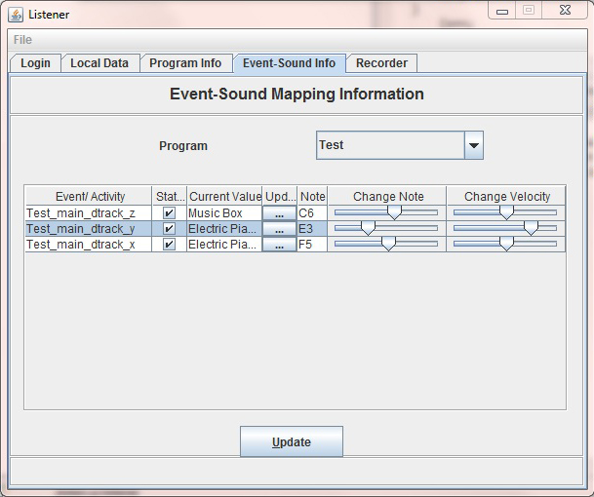
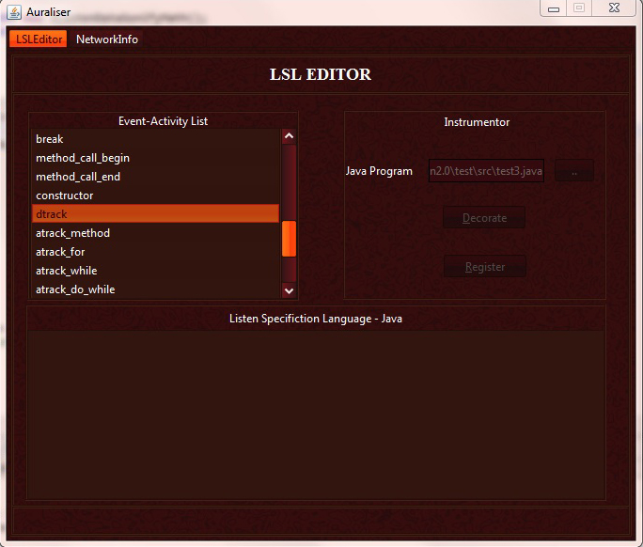
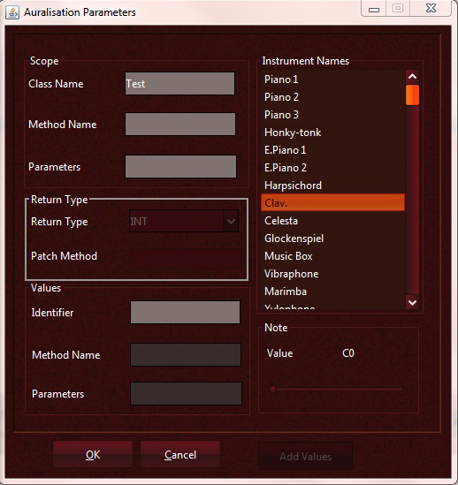
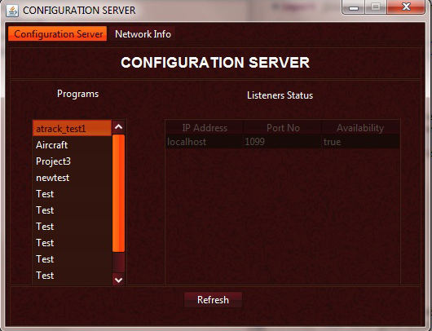
Project Listen/JListen
Program and Data Auralization (Sonification) project
Principal Investigator: Aditya P. Mathur
Computer Science Department, Purdue University
Introduction
Listener
Brief Project History
Program auralization refers to the act of adding sounds to a program so that when the program executes the sounds added are played back. Doing so assists in the analysis of runtime behavior of the auralized program.
JListen is a toolset for the auralisation of Java programs. Using this toolset, a programmer can specify the activities and events in a Java program to be auralised. The activities and events to be auralized are specified using a specification in a language named Listen Specification Language (LSL) designed by Dave Boardman and Aditya Mathur originally for the LSL/C system. Based on an LSL specification, code is added to a given Java program. When executed this code plays back sounds as and the specified events and activities occur. The prototype described here implements the overall architecture of this toolset.
Configuration server is the main server that processes the requests from the Auraliser and the Listener; Users use the Auraliser to submit their code, the Auraliser then processes and registers the code in the Configuration server. The Listener then accesses to the Configuration server to get the information from the code and begin to listen.
The Listener is the main component which is used to listen to the running program. After logging in the Configuration Server, the Listener will get the detail information of ready-to-listened programs and setup the listening arguments. While a program is running, it will send the current sound events to the Configuration Server which will transport it to the Listener, and finally, the Listener will generate the music based on sound events.Users can dynamic adjust the sound arguments in the panels to change the notes, volume, instruments or anything else.Another feature of the Listener is listening to local data without connecting with the Configuration Server. This feature is advised from data import module of XSonify.
April 28, 1994: Listen/C 1.0 (Dave Boardman with assistance from Bob Liu, Geoff Greene, and Jack Lowry)
May 30, 1995: Listen/C 2.0 (Cary Supalo, Sriram, Nate Nystrom, Katrina Pakan, Leo Rijadi, Vivek Khandelwal)
December 19, 1995: Listen/C 3.0 (Cary, Sriram, Nate Nystrom, Katrina, and Leo)
Fall of 2003: JListen 1.0 (S. A. Ashok, Chris Kanich (Purdue), K. R. Jayaram, K E Dorai, Khemraj Sharma, Meenali Rungta, Prashanth Ganesh, Sanjay Kulhari, Shubra Pradeep, Sundaresan R, Vaibhav Ranjan)
Spring of 2004: JListen 1.2 (R. Jagdish Prasath with Gopinath) at BITS, Pilani.
Spring 2012: JListen 2.0 in progress now.
UML
Auraliser
The Auraliser is charge for decorating the java code that was previous submitted by user and register coding in configuration server. The Listener cannot directly listen to the source code until the source code is decorated. The procedure of decorating is composed of two steps. Firstly, the Auraliser uses LSL language to parse the source code and generate specifications. After that, basing on those specifications, the Auraliser generates actual java code which information will be sent to the Listener through generate sounds.
Configuration Server
The Configuration Server is charge for processing the requests from the Auraliser and the Listener. The requests from the Auraliser include the sound information (Volume, instrument, speed) and the corresponding event information. The Configuration Server stores the sound and the event information on “.PL” file. This “.PL” file is uploaded whenever a program from the Auraliser has registered at the Configuration Server.Whenever a listener logs in, the Configuration Server will send back a list which contains the sound and the event information of registered programs.The Configuration is also charge for managing all the Listeners. Administrator can view the details (Ip address, port number) of currently connected Listeners.
Perspective
As the importance of multimedia grows, we envisage increasing use of sound as an output medium. Examples of use of sound are virtual reality systems, simulations, video games, education for the visually-handicapped computer users and data analysis systems. In most of these applications sound is emitted during the execution of an application when an event occurs or during an activity. The JListen systems have been designed to help in performing these tasks in a friendly environment on a PC, Mac, or a workstation. The current version of JListen can be used for auralizing JAVA programs on workstations. We used JListen to conduct experiments in understanding program behavior, testing and debugging, classroom teaching, and development of software for the blind.

