Slide 1
Model-Based API Testing in C#
Peter Shier
Microsoft Corporation

Slide 2
Goal of This Project
Learn about model-based testing

Slide 3
What You’ll Learn Along the Way
.NET Framework and the C# language
Relational database fundamentals
SQL Server fundamentals
ADO.NET – C# API for database access
SpecExplorer – a model-based testing tool
Challenges of API testing

Slide 4
What You’ll Really Learn
How to break down a large problem and produce useful results on a limited schedule within a team

Slide 5
.NET Framework
Software application development and deployment framework
UI, threading, synchronization, data access, crypto, web apps, networking, common data types, reflection, custom attributes
Apps run in a virtual managed environment: Common Language Runtime (CLR)
Loading, execution, memory management, security, exception handling, etc.
Languages compiled into intermediate language that can be JIT compiled at runtime or pre-compiled at install-time
Current languages: C#, F#, VB, C++, Cobol, Fortran, JScript, Python, Ruby, Lisp, Pascal, Java, Ada, and more

Slide 6
C#
General purpose object-oriented language evolved from C++ to take advantage of .NET environment.
Syntax and semantics similar to C++
Strong type checking, array bounds checking, automatic garbage collection
Generics, anonymous methods, iterators, implicit types, auto-implemented object properties, interfaces (but no multiple inheritance), type reflection, custom attributes, try/catch/finally, no globals, nullable types, and much more.

Slide 7
Relational Databases
Store data in tables called relations
Relations contain tuples (rows)
Tuples contain attributes (columns)
Attributes are defined on a domain (data type and range of acceptable valuables)
A key defines an attribute as identifying a tuple.
A primary key is uniquely identifying.
Relationships defined between tables via keys
Structured Query Language (SQL) used to describe subsets of data for query, insertion, deletion. Example:
SELECT * FROM Customers WHERE Customers.Name=“Smith”
Relational Database Management System (RDBMS) is software that manages a relational database and controls access to it. Examples:
Microsoft SQL Server, Oracle, MySQL, IBM DB2, Informix, Sybase

Slide 8
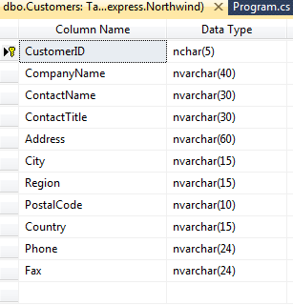

Slide 9
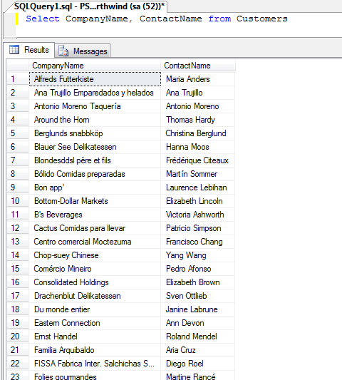

Slide 10
SQL Server
Microsoft’s RDBMS product
Runs on any version of Windows including embedded systems
SQL Server Express is standalone free version you can use for this project
Uses a publicly documented protocol for client server communication (Tabular Data Stream)
Numerous APIs for client application access: ODBC, OLE DB, ADO, ADO.NET, JDBC, PHP

Slide 11
ADO.NET
.NET API for data access
Uses plug-in provider model for access to any data source
Semantics for access to relational and XML data
Supports disconnected access model
Providers for: SQL Server, Oracle, DB2, Sybase, MySQL, and more
Generic providers for ODBC and OLE DB

Slide 12
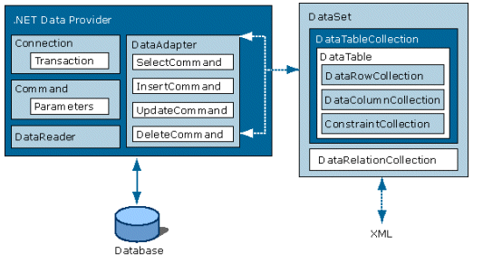
ADO.NET Object Model

Slide 13
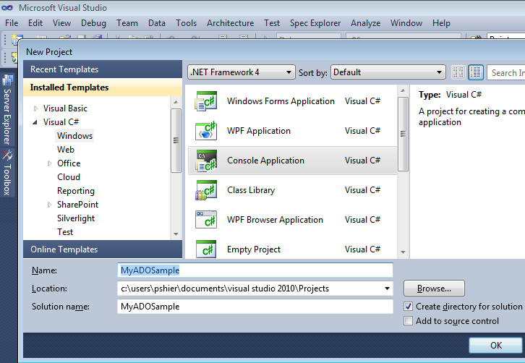

Slide 14
using System;
using System.Text;
using System.Data;
using System.Data.SqlClient;
namespace ADOSimpleSample
{
class Program
{
static void Main(string[] args)
{
SqlConnection connection = new SqlConnection("server=.\\sqlexpress;Trusted_Connection=yes;database=Northwind");
SqlCommand command = new SqlCommand("SELECT CompanyName, ContactName FROM Customers", connection);
SqlDataAdapter myDataAdapter = new SqlDataAdapter(command);
DataSet myDataSet = new DataSet();
myDataAdapter.Fill(myDataSet);
DataTable myDataTable = myDataSet.Tables[0];
foreach (DataRow dataRow in myDataTable.Rows)
{
Console.WriteLine("CompanyName: {0}. Contact: {1}",
dataRow["CompanyName"], dataRow["ContactName"]);
}
}
}
}

Slide 15
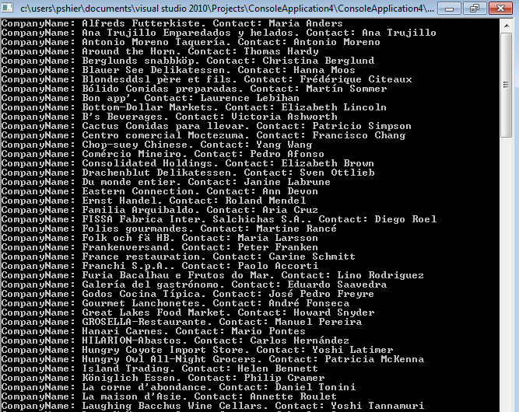

Slide 16
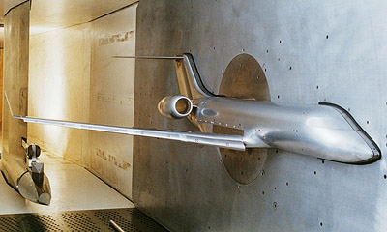
Model-Based Testing

Slide 17
Modeling in Science and Engineering
A model
Is an abstraction of the system from a particular perspective
Supports investigation, construction and prediction
Is not necessarily comprehensive
Can be expressed as a table, graphical diagram, formal notation, etc.
Notes:
]’

Slide 18
Does Software Really Need Modeling?
Argument against modeling | Response
The effort to change and adapt software systems compared to mechanical or physical systems is low. Modeling is not worth the effort. | Surveys show that (at least) around 15% of commercial, multi-million dollar software projects fail catastrophically.
Software systems are so diverse and complex that they cannot be modeled. | Modeling is about abstraction. Creating a model never amounts to creating the full system.
Modeling software is hard and beyond the scope of average software engineers. | Modeling requires skills similar to programming. It also requires good tools.
Notes:
Look at major high visibility failures of last year: Facebook, Twitter under load, Skype, BofA, Cellcom, Apple alarm bugs, Apple attenna

Slide 19
Modeling Styles and Notations
Software Models
Structure
Class Diagrams
Component Diagrams
Behavior
Interaction Based
State Based
Use Cases
Sequence
Diagrams
Guarded Update Machines (Code)
State Diagrams
Traces/Patterns
Focus of this class

Slide 20
Behavioral Modeling
Action
A visible action of the system
Can be stimulus or response
Trace
A sequence of actions
Behavior
A set of traces describing the allowed or observed behavior of a system

Slide 21
Spec Explorer 2010 Technology Breakdown
Model programs
Guarded state update rules
Rich object-oriented model state (collections, object graphs)
Language-agnostic (based on .NET intermediate language interpretation)
Trace patterns
Regular-expression-like language to represent scenarios
Slicing of model program by composition
Symbolic state exploration and test generation
Expands parameters using combinatorial interaction testing
Extracts a finite interface automaton (IA) from composed model
Traverses IA to generate standalone test code
Integrated into Visual Studio 2010

Slide 22
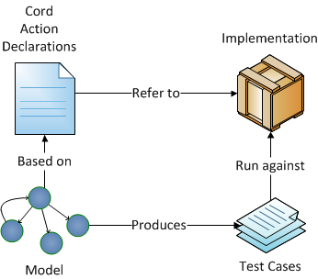
Direct Connection

Slide 23

Problem Space: Digital Watch
Two display modes
Date and time
Timer
Three buttons
Mode
Always enabled
Start/stop timer
Only in timer mode
Starts/stops timer
Reset/Lap timer
Only in timer mode:
Timer running: lap (un)freeze
Timer stopped: reset to zero
The rest is abstracted out (We only describe parts of the UI)
reset/lap
mode
start/stop

Slide 24
Actions
One action per button
One action allows to check whether the timer is reset
i.e. whether time value is currently 0:00
Note: the system has only limited testability/diagnosibility
Action declarations in Spec Explorer
action static void Stopwatch.ModeButton();
action static void Stopwatch.StartStopButton();
action static void Stopwatch.ResetLapButton();
action static bool Stopwatch.IsTimerReset();
action static void Stopwatch.Initialize();

Slide 25
Traces
Which of the following traces are valid (are in the behavior)?
Assumption: initially the stopwatch is displaying the time and the timer is reset
T1: ModeButton; ModeButton; IsTimerReset/true
T2: ModeButton; IsTimerReset/true; StartStopButton; IsTimerReset/true
T3: ModeButton; StartStopButton; ModeButton; ModeButton; IsTimerReset/false
T4: ModeButton; StartStopButton; ResetLapButton; IsTimerReset/true
T4: <empty>

Slide 26
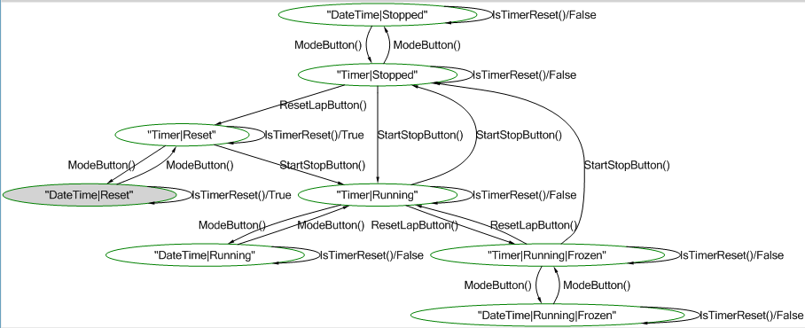
Concise representation of all traces
Result of model exploration
Initial state
Notes:
Grey is initial state

Slide 27
Spec Explorer Configuration
config Config
{
action static void Stopwatch.ModeButton();
action static void Stopwatch.StartStopButton();
action static void Stopwatch.ResetLapButton();
action static bool Stopwatch.IsTimerReset();
action static void Stopwatch.Initialize();
}
machine Model() : Config
{
construct model program from Config
where scope = "StopwatchModel"
}
Notes:
Construct model program creates an explorable model from the complete model definition.

Slide 28
C# Model
static class Model
{
public enum TimerMode
{ Reset, Running, Stopped }
static bool displayTimer = false;
static TimerMode timerMode =
TimerMode.Reset;
static bool timerFrozen = false;
[Rule]
static void StartStopButton()
{
Condition.IsTrue(displayTimer);
if (timerMode == TimerMode.Running)
{
timerMode = TimerMode.Stopped;
timerFrozen = false;
}
else
timerMode = TimerMode.Running;
}
[Rule]
static void ModeButton()
{
displayTimer = !displayTimer;
}
[Rule]
static void ResetLapButton()
{
Condition.IsTrue(displayTimer);
Condition.IsFalse
(timerMode == TimerMode.Reset);
if (timerMode == TimerMode.Running)
timerFrozen = !timerFrozen;
else
timerMode = TimerMode.Reset;
}
[Rule]
static bool IsTimerReset()
{
return timerMode == TimerMode.Reset;
}
}

Slide 29
The goal of Model-Based Testing
To check whether an implementation conforms to the modeled behavior
(set of traces)
How big is the set of traces for Stopwatch?
Infinite!
How many tests do we need for Stopwatch?
The “test selection” problem
Test selection is not complete (testing never is)
Strategies for test selection
Select a coverage criterion for the model graph
We usually select “transition coverage”
Slice the model to extract interesting cases (next session)
Notes:
Can’t do path coverage because paths are infinite.

Slide 30
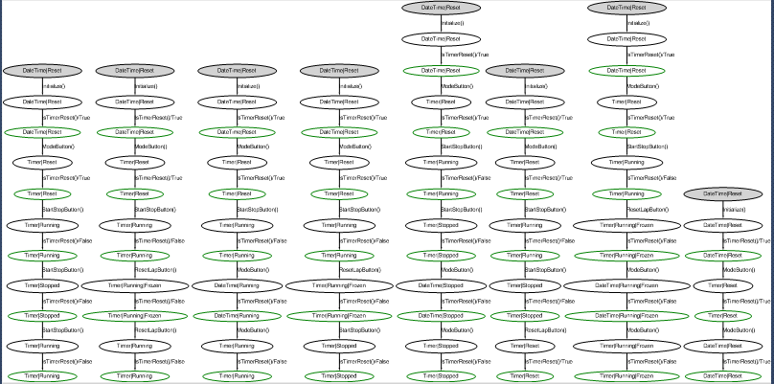
Generated test cases (short tests strategy)
machine TestSuite() : Config
{
construct test cases
where strategy = "shorttests"
for Initialize;Model
}

Slide 31
Your Assignment
Pick an aspect of the ADO.NET API
Create a model of it with SpecExplorer
Generate and run tests from your model
Present an overview of:
Your chosen API subset
Your model
A generated test case
Express your opinion on model-based testing vs. other approaches for API testing

Slide 32
Questions
How to contact me: pshier@microsoft.com
Links to learning materials in project definition doc.

