Slide 1
Quiz 12 March 25, 2019

Slide 2
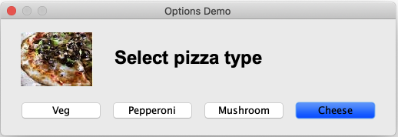
The window below is created using the following code snippet:
What will be printed if the window to the left is closed by clicking on the red colored close button on top left?
int select=JOptionPane.showOptionDialog(…);
System.out.println(select);
-1
0
1
2
Correct answer

