Slide 1
CS 18000 Problem Solving and Object Oriented Programming Spring 2019
Section LE2
Week 5: Lecture 8 February 4. 2019
Slides updated: 12:17pm, February 4. 2019
Aditya Mathur
Professor, Department of Computer Science
Purdue University
West Lafayette, IN, USA
ps://www.cs.purdue.edu/homes/apm/courses/CS180_Java/CS180Spring2019/

Slide 2
Review
Repetitive computation
Loop design: while-statement
Loop design: for-statement

Slide 3
This week
Arrays: Declaration, creation, initialization
Data analysis: min, max, average, sort

Slide 4
Request and Announcement
Posts on campuswire
Extra Supplementary Instruction session:
Wednesday, February 6 from 5:30 to 6:20pm WALC B093.
Problem solving session:
Sunday Feb 10, 2019. 6pm LWSN 3102
All are welcome

Slide 5
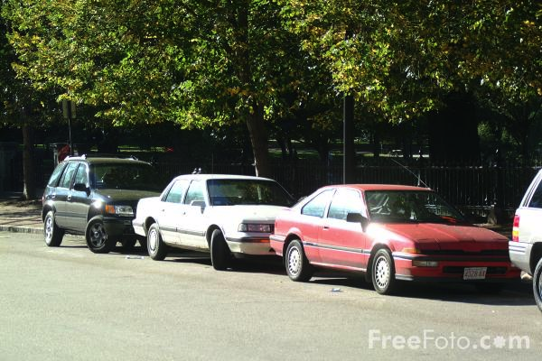
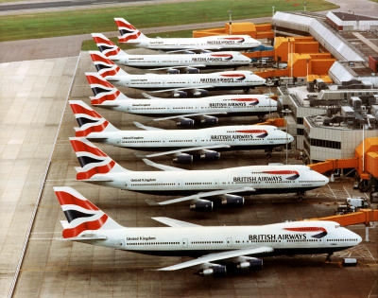
Arrays

Slide 6
Arrays: What are these?
A homogeneous collection of variables and objects. All elements of an array are of the same type.
Examples:
Array of integers where each integer represents the age of a patient.
Array of cars where each element of the array denotes a specific car.
Array of flowers where each element of the array denotes a flower.

Slide 7
Arrays: When to use?
When there is a need to retain data in memory for efficient processing. Data is created once and used many times.
Examples:
Array of flights: Search for a specific flight
Array of cars: Search for a specific car, or find the average price.
Array of laptops: find the cheapest laptop

Slide 8
Declaring an Array
Indicates age is an array variable
int [] age;
/* age refers to an array of integers; e.g. age of people in a database*/
double [] weight;
/* weight refers to an array of doubles; e.g. weights of items shipped*/
String [] name;
/* name refers to an array of elements each of type String; e.g., names of people in a database*/

Slide 9
Declaring an Array of objects [More on this in week 6]
Bird [] bird;
/* Bird refers to a class; bird is an array where each element is an object of type Bird. */
Aircraft [] fleet;
/* Aircraft refers to a class; fleet is an array where each element is an object of type Aircraft. */

Slide 10
Creating an Array
int [] age=new int[10];
/* age is an array of 10 elements each of type int*/
double [] weight=new double[100];
/* weight is an array of 100 elements each of type double*/
String [] name=new String[15];
/* name is an array of 15 elements each of type String*/
Aircraft [] fleet=new Aircraft[150];
/* fleet is an array of 150 elements each of type Aircraft*/

Slide 11
Single dimensional array: Example
int [] cloudyDays=new int [12] // average cloudy days/month
Anchorage, Alaska
0 1 2 3 4 5 6 7 8 9 10 11
[19 18 18 18 20 20 22 21 21 21 20 21 ]
Index
Data
cloudyDays[0]
cloudyDays[5]
cloudyDays[11]

Slide 12
Accessing an array element: general syntax
Name of the array
Index, starts from 0, must be an int
name [expression]
Note: First element of an array is located at index 0.
Examples:
age[i]; // 0<=i<10
fleet[k]; // 0<=k<150
weight[i+j]; // 0<=(i+j)<100

Slide 13
Accessing an array element
int [] age=new int[10];
int p= age[5]; /* p gets element at index 5 of array age*/
double [] weight=new double[100];
double hisWeight=weight[i]; /* hisWeight gets the element of weight at index i*/

Slide 14
Assigning a value to an array element
int [] age=new int[10];
age[i]=15; /* (i+1)^{th} element of age becomes 15. */
int [] age={-15, 20, 30} // All elements initialized
double [] weight=new double[100];
weight[k]=weight[k]-10; /* (k+1)^{th} element of the weight is decremented by 10.*/

Slide 15
Iterating through elements of an array
In many problems we need to iterate through all or a few of the elements of an array.
Such an iteration is accomplished by using a for or a while loop.

Slide 16
Problem 1: Initialize an array of elements
// Initialize an array of n elements to random numbers // between 0 and 1.
final int n=100;// Array size double [] rnum=new double [n]; // Create array to hold numbers
for( int i=0; i<n; i++){
rnum[i]=Math.random() // Initialize the ith element } // End of for

Slide 17
Problem 2: Initialize an array (read from keyboard)
Scanner s=new Scanner(System.in);
int [] a=new int [10];
for( i=0; i<10; i++){
a[i]=s.nextInt(); // Sets a[i] to number entered.
} // End of for

Slide 18
Problem 3: Find average of numbers in an array
final int n=100;// Array size double [] rnum=new double [n]; // Create array to hold numbers
for( int i=0; i<n; i++){
rnum[i]=Math.random() // Initialize the ith element } // End of for
double sum=0.0; // Initialize sum. for( int i=0; i<n; i++){
sum-sum+rnum[i]; // Add the ith element to sum } // End of for
double average=sum/n;

Slide 19
Problem 4: Count positives (including 0) and negatives.
int sum=0; int [] a={-2, 12, 30, -4, 90};
int pos=0, neg=0; // Initialize counts.
for(int i=0; i<a.length; i++){
if(a[i]>=0){
pos=pos+1; // Increment positive count
}else{
neg=neg+1; // Increment negative count
}
}// End of for
i++ is equivalent to i=i+1;

Slide 20
Problem 5: Search in an array: Step 1 initialize
String [] wList={"Emilio", "Semion", ”Ziggy"}; Scanner s=new Scanner (System.in);
String wanted=s.next(); // Get name to be searched
boolean found=false; // Not yet found

Slide 21
Problem 5: Search in an array: Step 2 set up loop
boolean found=false; // Not yet found
int next=0; // Points to the first element in wanted list
while(???) {
if(wanted.equals(wList[nextItem])) // Compare
found=true; // If equal then we have found the wanted!
else
next=next+1; // else point to the next item on the list
}//End of loop

Slide 22
Problem 5: Search in an array: Step 3 complete loop condition
int next=0; // Points to the first element in wanted list
boolean found=false; // Not yet found
while(next<wList.length&&!found) {
if(wanted.equals(wList[next])){ // Compare
found=true; // If equal then we have found the wanted! }else{
next=next+1; // else point to the next item on the list
}
}//End of loop

Slide 23
Problem 5: Search in an array: Display output
if(found)
System.out.println(wanted+ " exists in database");
else
System.out.println(wanted+ " not in database")
} // End of program

Slide 24
Problem 6: Sort an array in ascending order
Example:
Input array of integers: [5 4 -1 2]
Sorted array of integers: [-1 2 4 5]

Slide 25
Problem 6: Sort algorithm: Bubble sort (Compare and exchange)
Pass 1
Step
1
2
3
End of pass 1
5
4
-1
2
4
5
-1
2
4
-1
5
2
4
-1
2
5
Total 3 steps in Pass 1
Pass 2
Step
1
2
End of pass 2
4
-1
2
5
-1
4
2
5
-1
2
4
5
Total 2 steps in Pass 2

Slide 26
Problem 6: Sort algorithm: Bubble sort
Pass 3
Step
1
End of pass 2
-1
2
4
5
-1
2
4
5
Total 1 step in Pass 3

Slide 27
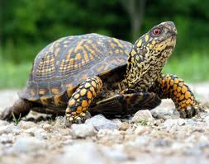
Problem 6: Sort algorithm: Bubble sort: Analysis
Given: Array of n elements
Number of passes needed:
Number of steps (comparisons) in
Pass 1:
Pass 2:
.
.
Pass i:
Total number of steps:

Slide 28
Problem 6: Sort algorithm: Bubble sort: Warning
Bubble sort is not a recommended algorithm for large arrays (e.g. an array of, say, 100 elements).
Better algorithms:
Insertion sort
Merge sort
Quick sort
Challenge: Code the bubble sort algorithm (on your own).

Slide 29
Arrays: Multidimensional

Slide 30
Example
MEAN MONTHLY CLOUDY DAYS IN ARIZONA
0
1
2
3
4
5
6
7
8
9
10
11
FLAGSTAFF 12 11 12 9 7 4 9 8 5 7 8 11
PHOENIX 10 9 8 6 3 2 4 4 3 4 6 9
TUCSON 10 9 9 6 4 3 9 7 4 5 6 10
WINSLOW 12 10 9 7 5 4 8 6 4 6 8 10
YUMA 9 6 6 4 2 1 3 3 2 3 5 8
J F M A M J J A S O N D
0
1
2
3
4
rows
columns
int [][] cloudyDays=new int [5][12]
What is the value of cloudyDays[1,8]?

Slide 31
Arrays: Typical errors
Index out of bounds [Run time error]
int [] a=new int [10];
a[i]=x; // i is greater than 9 or less than 0
Element not initialized [Compile time error]
String [] name;
name[i]=“Bob”; // element not initialized

Slide 32
Week 5: February 4-8, 2019
Hope you enjoyed this week!

