Slide 1
CS 18000 Problem Solving and Object Oriented Programming Spring 2019
Section LE2
Week 12: Lecture 24, April 8. 2019
Slides updated: 3pm, April 8, 2019
Aditya Mathur
Professor, Department of Computer Science
Purdue University
West Lafayette, IN, USA
https://www.cs.purdue.edu/homes/apm/courses/CS180_Java/CS180Spring2019/

Slide 2
This week
Complete the GUI from previous week
Polymorphism:
Review: Inheritance
Static
Dynamic

Slide 3
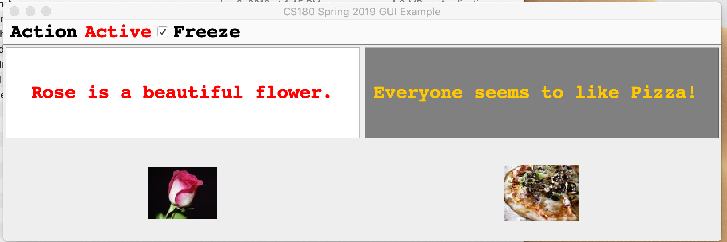
Widget and Listener Illustration
Text changed but will not
any longer as change is frozen
JCheckBox

Slide 4
Inheritance
A common feature of OO languages
Enables code reuse
Example: The JButton class
java.lang.Object
java.awt.Component
java.awt.Container
javax.swing.JComponent
javax.swing.AbstractButton
javax.swing.JButton
toString(), equals()
Inherits from
add()
Can be used
by a JButton
object

Slide 5
Polymorphism
Poly: Many
Morph:
“Change smoothly from one image to another by small gradual steps using computer animation techniques”
Polymorphism:
The condition of occurring in several different forms.
Source: Oxford living Dictionary

Slide 6
Inheritance: Questions
Can a child class re-use methods in parent class?
Can a child class re-define methods already in the parent class?
Can a child class re-define instance variables already in the parent class?
Can an object of a child class be “upcast” to an object of parent class?
Can an object of a parent class be “downcast” to an object of child class?
Can a method signature be changed in a class and a different method with the same name be defined
Let us answer these questions using the notion of “polymorphism” in Java.

Slide 7
Polymorphism in Programming Languages
Polymorphism:
A feature of a programming language that allows routines to use variables of different types at different times.
Static polymorphism
Compiler can determine, at compile time, which method is called.
Dynamic polymorphism
Method call is determined at run time.

Slide 8
Static Polymorphism: Method overloading
public class Pizza { String type; ArrayList<String> toppings=new ArrayList<String>(10); Pizza(){ type="Cheese";} Pizza(String type){this.type=type;} Pizza(String type, ArrayList<String> t){ this.type=type; toppings=t; } public void print(){ System.out.println("Pizza ordered: "+type); if (toppings.size()==0){ System.out.println("Toppings: None "); }else{ System.out.println("Toppings: "+toppings); } } }// End of class Pizza
Method with the same name appears multiple times but with different signatures.

Slide 9
Static Polymorphism: Method overloading
import java.util.*; public class StaticPoly {
public static void main(String [] args){ ArrayList<String> toppings = new ArrayList<String>(); toppings.add("Mushroom"); toppings.add("Pineapple"); toppings.add("Black OLives"); Pizza p1 = new Pizza(); Pizza p2 = new Pizza("Pepperoni"); Pizza p3 = new Pizza("Pepperoni", toppings); p1.print(); p2.print(); p3.print(); } }// End of class

Slide 10
Dynamic Polymorphism: Method overriding
Redefine a method from the parent class.
Use @Override to indicate that a method from parent class is being overridden.
import java.util.*; public class PizzaJazz extends Pizza { PizzaJazz(String type, ArrayList<String> t) { this.type = type; toppings = t; } @Override public void print(){ System.out.println("Eating pizza makes you intelligent."); super.print(); } }
Pizza p3 = new PizzaJazz("Pepperoni", toppings); p3.print();

Slide 11
Upcasting
Casting an object of a sub-class to its super-class.
This is allowed in Java.

Slide 12
Upcasting Example
public class Pizza { Pizza(){ System.out.println("Pizza created."); } public void eat(Pizza p){ System.out.println("Eating generic pizza."); } }
public class Pepperoni extends Pizza{ public void eat(){ System.out.println("Eating pepperoni Pizza."); } }
public class Cast { public static void main(String[] args){ Pepperoni p=new Pepperoni(); p.eat(); Pizza q= (Pizza)p; q.eat(p); } }

Slide 13
Downcasting
Casting an object of a super-class to its sub-class.
Not allowed unless the object being downcast was created using a subclass.
Pizza p3 = new PizzaJazz("Pepperoni", toppings);PizzaJazz("Pepperoni", toppings); PizzaJazz p4=(Pizza)p3;
Not allowed

Slide 14
Live demo

Slide 15
Create Your Own Pizza
Pizza
Pepperoni
Mushroom
Generic
Toppings
addToppings ()
removeToppings ()

Slide 16
Quiz: 04/1/2019

