Slide 1
CS 18000 Problem Solving and Object Oriented Programming Spring 2019
Section LE2
Week 11: Lecture 23, April 3. 2019
Slides updated: 10:17am, April 3, 2019
Aditya Mathur
Professor, Department of Computer Science
Purdue University
West Lafayette, IN, USA
https://www.cs.purdue.edu/homes/apm/courses/CS180_Java/CS180Spring2019/

Slide 2
Today
Review: JFrame, JButton,JTextField, etc
Creating a more advanced GUI:
Menus, panels, buttons, checkboxes
Adding listeners
MouseListener

Slide 3
Review
JFrame: size, layout, font
JTextField: Set text
JButton: Add ActionListener
When a user performs an action on that widget, a method in the attached listener is invoked.

Slide 4
Live demo-2

Slide 5
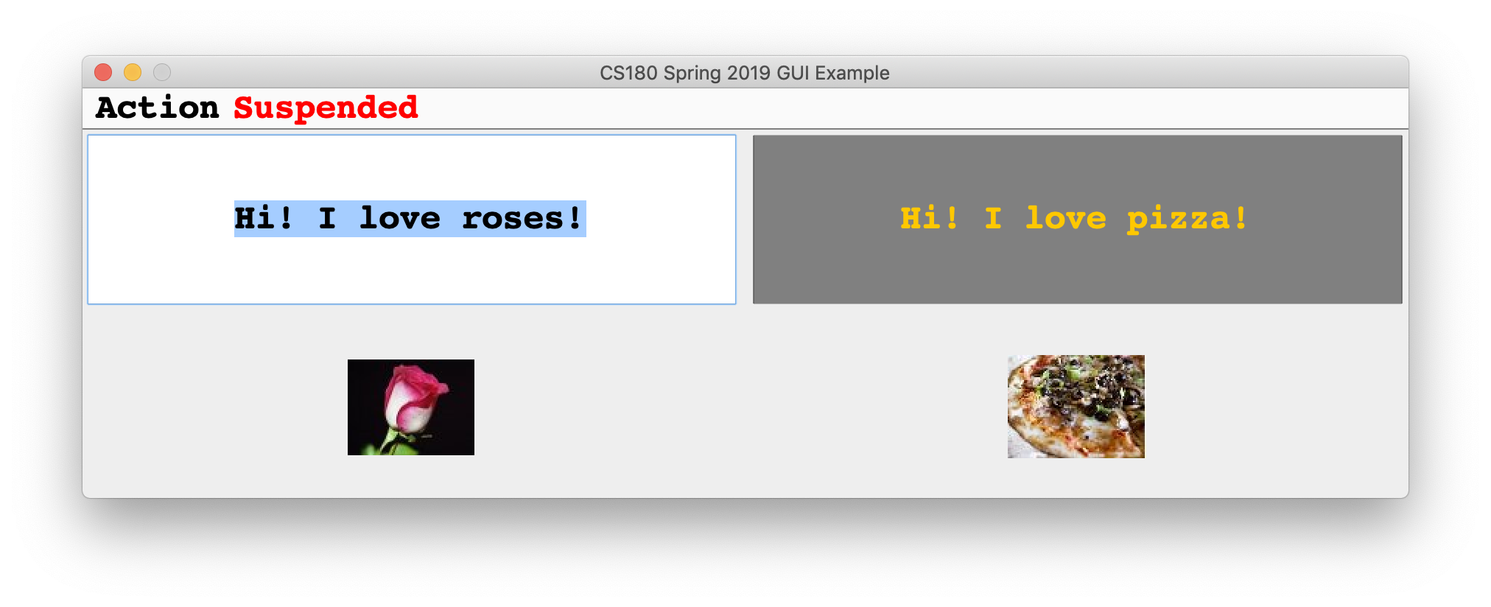
Widget and Listener Illustration
Write a program to generate the following GUI and the interactions as explained next.
JLabel
JTextField
JFrame
JMenu
JMenuBar
JLabel with ImageIcon

Slide 6
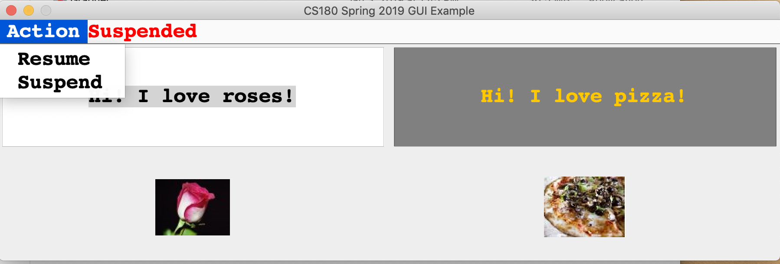
Widget and Listener Illustration
Menu Selection
JMenuItem

Slide 7
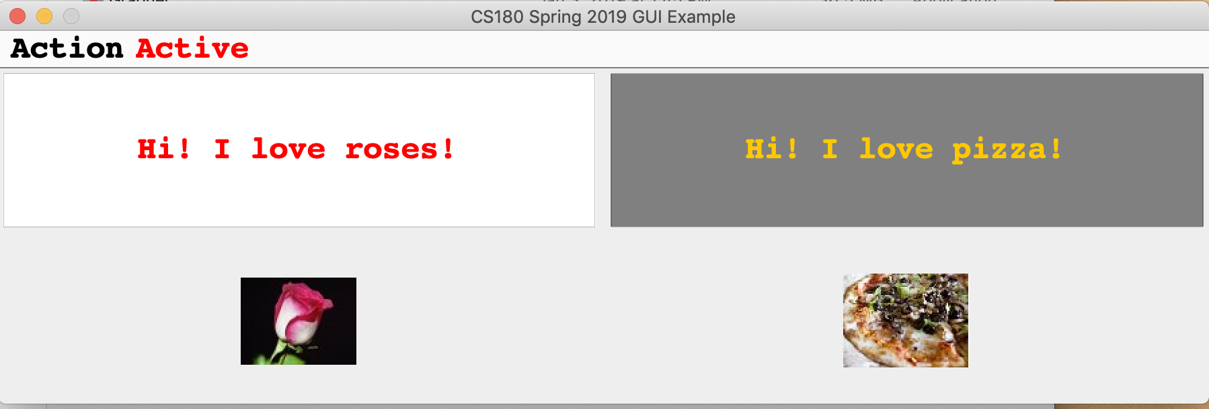
Widget and Listener Illustration
Status indicator
Status change from
suspended to Active
Mouse enter and exit
will now change the text.

Slide 8
Widget and Listener Illustration
Added a Freeze feature: JCheckbox
Text changed but will not
any longer as change is frozen
JCheckBox

Slide 9
Quiz: 04/03/2019

