Slide 1
CS 18000 Problem Solving and Object Oriented Programming Spring 2019
Section LE2
Week 11: Lecture 22, April 1. 2019
Slides updated: 5:43pm, April 1, 2019
Aditya Mathur
Professor, Department of Computer Science
Purdue University
West Lafayette, IN, USA
https://www.cs.purdue.edu/homes/apm/courses/CS180_Java/CS180Spring2019/

Slide 2
Today
Review: Interfaces and abstract classes
Creating a simple GUI:
Frames, panels, buttons, textfields, checkboxes, etc.
Adding listeners
ActionListener, MouseListener

Slide 3
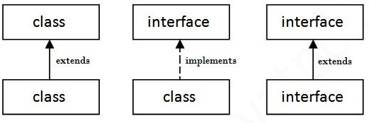
Interface
Blueprint for a class
Cannot be instantiated
Contains abstract methods
All methods must be implemented before an interface can be used

Slide 4
Interface: Examples for use in GUI design
ActionListener
void actionPerformed(ActionEvent e)
MouseListener
void mouseClicked(MouseEvent e)
void mouseEntered(MouseEvent e)
void mouseExited(MouseEvent e)
void mousePressed(MouseEvent e)
void mouseReleased(MouseEvent e)

Slide 5
Abstract class
Blueprint for a class
Cannot be instantiated
Contains a mix of abstract and implemented methods
All methods need not be implemented before an abstract class is used
Example: MouseAdapter
void mouseClicked(MouseEvent e)
void mouseEntered(MouseEvent e)
void mouseExited(MouseEvent e)
void mousePressed(MouseEvent e)
void mouseReleased(MouseEvent e)
Empty methods; implement only those that you need.

Slide 6
Action Listeners
Java provides several “event” listeners.
A listener is attached to a widget.
When a user performs an action on that widget, a method in the attached listener is invoked.
When using a listener interface, you need to write this method. Note: you need to write ALL methods when using an interface.
When using an abstract listener class, you have the option of writing none or more methods.

Slide 7
Events and Listeners
Event
Source
Event Listener

Slide 8
Events
Action event: clicking on an item
Container event: removing or adding an item
Key event: Key press/release
Window event: Window close, activated, etc.
Mouse event: Mouse press, release, click, etc

Slide 9
Sample Listeners
ActionListener
MouseListener
There are about 40 event listeners in Java!
WOW!
MouseAdapter
MenuListener

Slide 10
Live demo-1

Slide 11
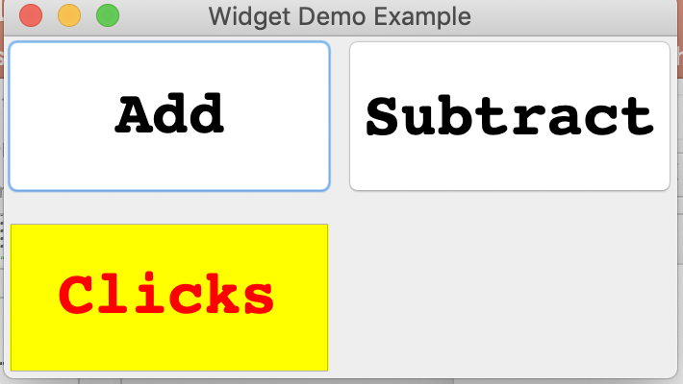
Widget and Listener Illustration
Write a program to generate the following GUI and the interactions explained next.
JButton
2x2 Grid Layout
JFrame
JTextField

Slide 12
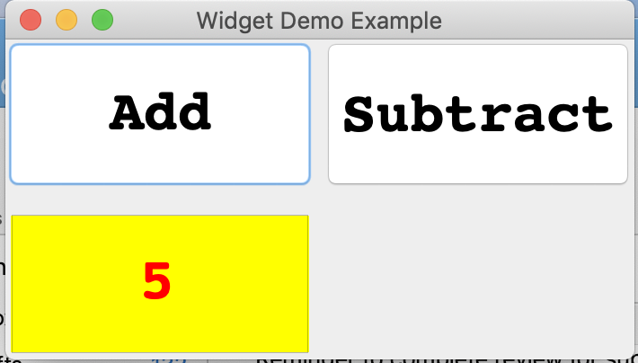
Interaction 1: Counting clicks
Add button clicked 5 times

Slide 13
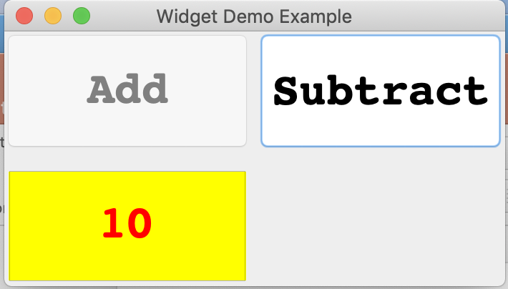
Interaction 2: Cannot count more than 10!
Button disabled
..because Add clicked
more than 10 times

Slide 14
Interaction 3: Subtract; button enabled
Program similar behavior for Subtract.
Button enabled
Subtract clicked

Slide 15
Live demo-2

Slide 16
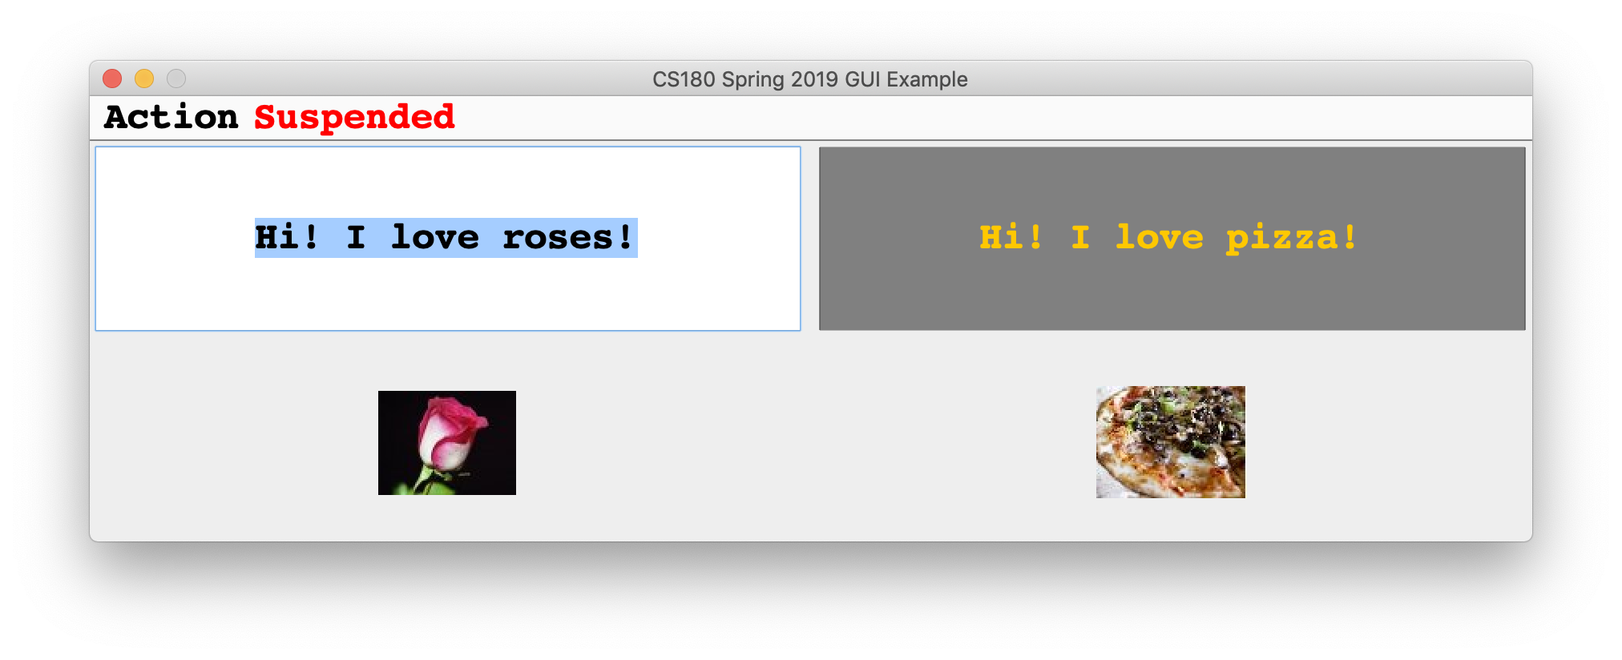
Widget and Listener Illustration
Write a program to generate the following GUI and the interactions as explained next.
JLabel
JTextField
JFrame
JMenu
JMenuBar
JLabel with ImageIcon

Slide 17
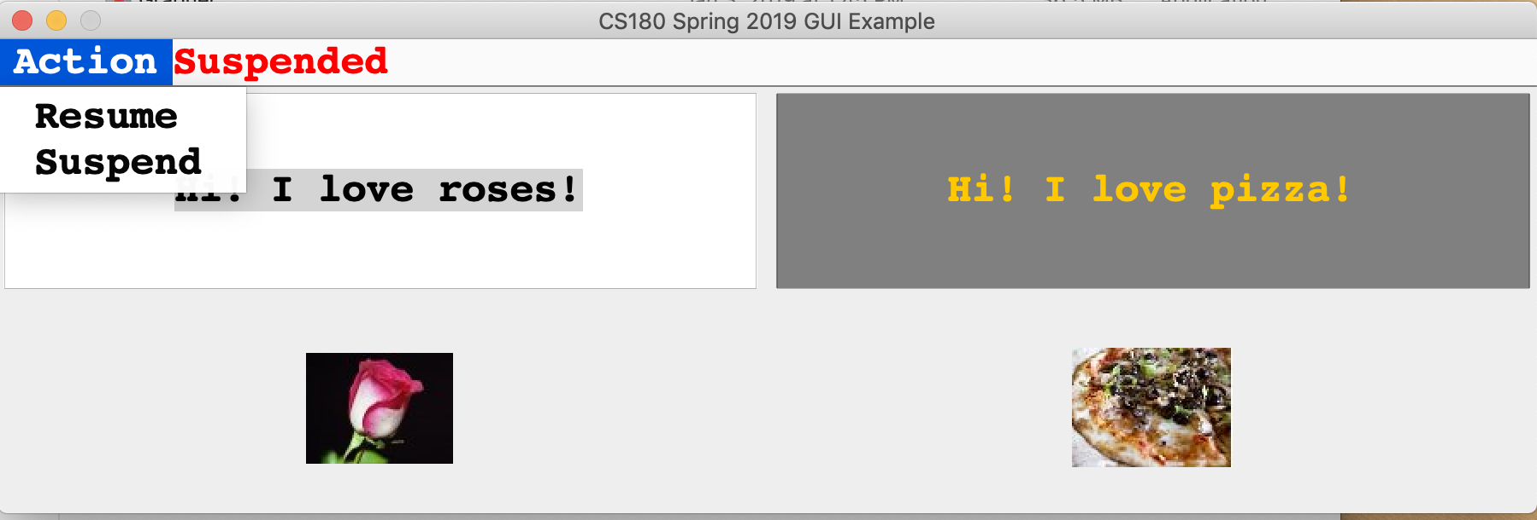
Widget and Listener Illustration
Menu Selection
JMenuItem

Slide 18
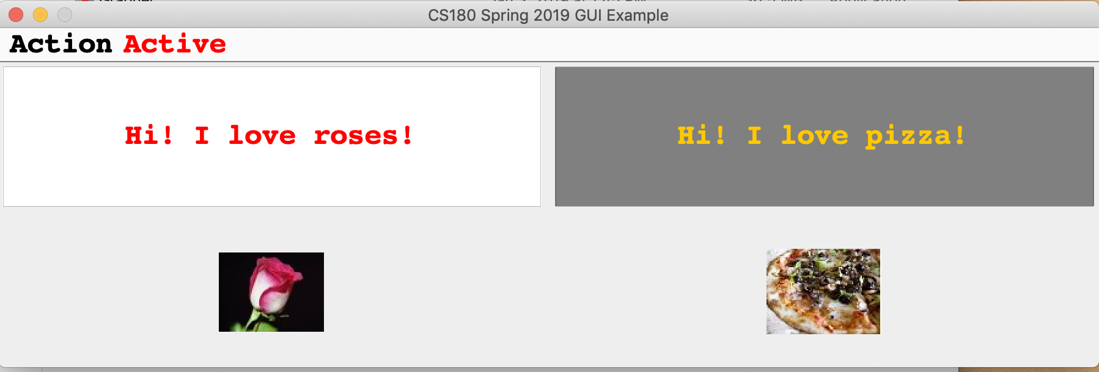
Widget and Listener Illustration
Status indicator
Status change from
suspended to Active
Mouse enter and exit
will now change the text.

Slide 19
Widget and Listener Illustration
Added a Freeze feature: JCheckbox
Text changed but will not
any longer as change is frozen
JCheckBox

Slide 20
Quiz: 04/1/2019

