Slide 1
CS 18000 Problem Solving and Object Oriented Programming Spring 2019
Section LE2
Week 10: Lecture 21, March 27. 2019
Slides updated: 9:30am, March 27, 2019
Aditya Mathur
Professor, Department of Computer Science
Purdue University
West Lafayette, IN, USA
https://www.cs.purdue.edu/homes/apm/courses/CS180Spring2019/

Slide 2
Today
(Continued) Interaction through Graphical User Interfaces (GUIs)
JFileChooser
JOptionPane (extend and complete the program from Monday)

Slide 3
JFileChooser

Slide 4
JFileChooser
Enables navigation across the file system on your computer
Creates a dialog
Modal dialog
https://docs.oracle.com/javase/tutorial/uiswing/components/filechooser.html

Slide 5
JFileChooser: The dialog
// Create a file chooser object
JFileChooser fc=new JFileChooser();
// Open the (open) dialog and check the status of user action
parent
int response=fc.showOpenDialog(null);
// Open the (save) dialog and check the status of user action
int response=fc.showSaveDialog(null);

Slide 6
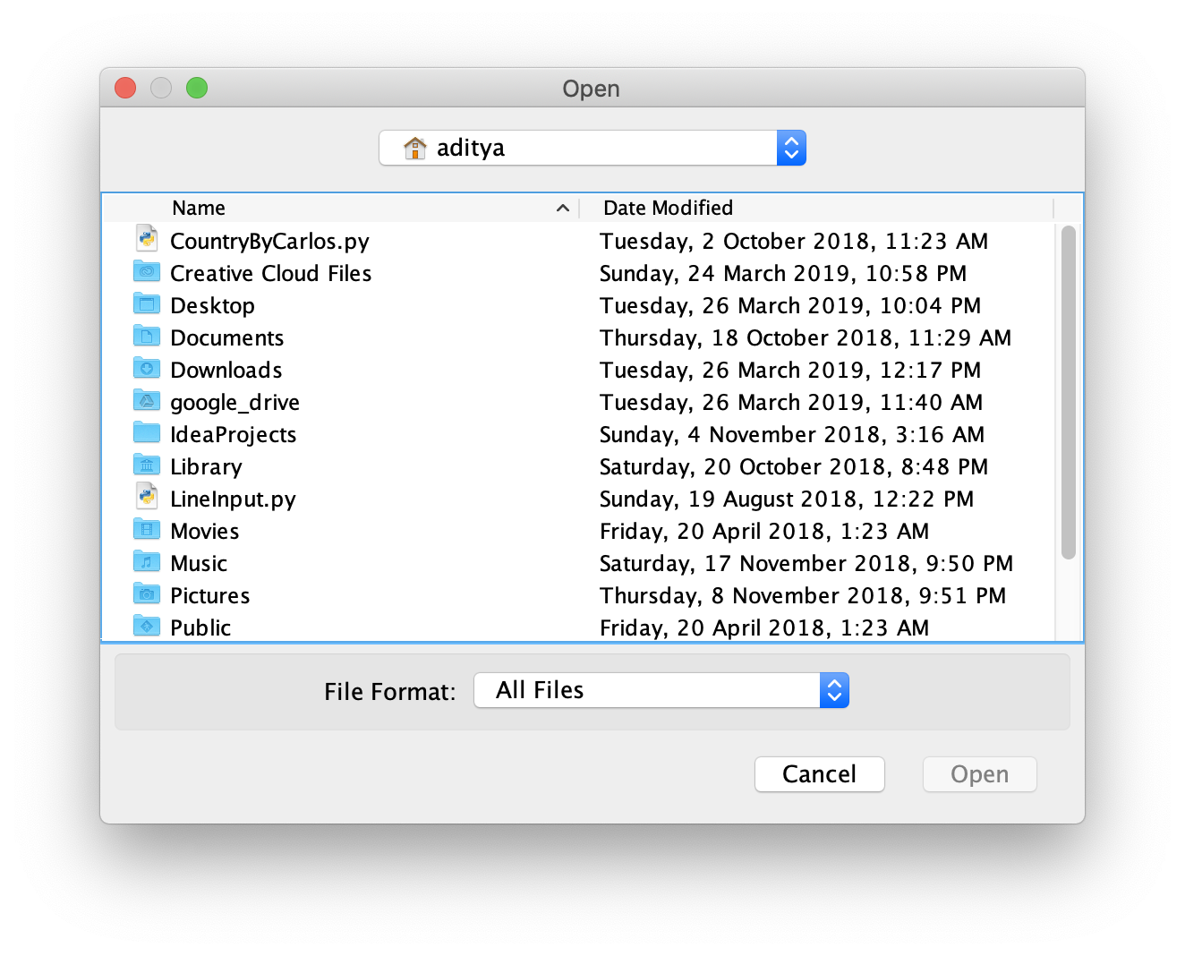
JFileChooser: Sample (Open) dialog

Slide 7
JFileChooser: Check user response
// If the user has selected a file to open then the return value will be equal to
JFileChooser.APPROVE_OPTION.
if (response==JFileChooser.APPROVE_OPTION){
File selectedFile=fc.getAbsolutePath();

Slide 8
JFileChooser: Obtain file path or name
// Get selected file object
File fileObject=fc.getSelectedFile();
// Get file path
String filePath=selectedFile.getAbsolutePath();
// Get file name
String fileName=selectedFile.getName();

Slide 9
JFileChooser: Customization
// Show only directories
fc.setFileSelectionMode(JFileChooser.DIRECTORIES_ONLY);
// Filter

Slide 10
Live demo [Pre-programmed]
180PizzaGrab

Slide 11
Select pizza data file

Slide 12
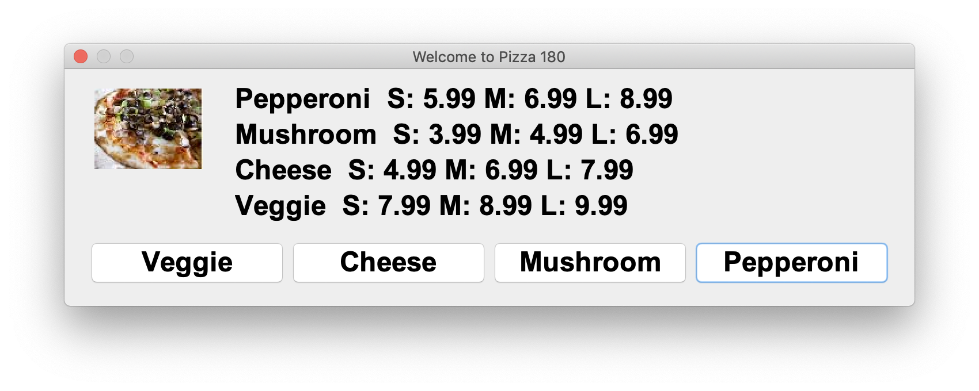
Select pizza

Slide 13
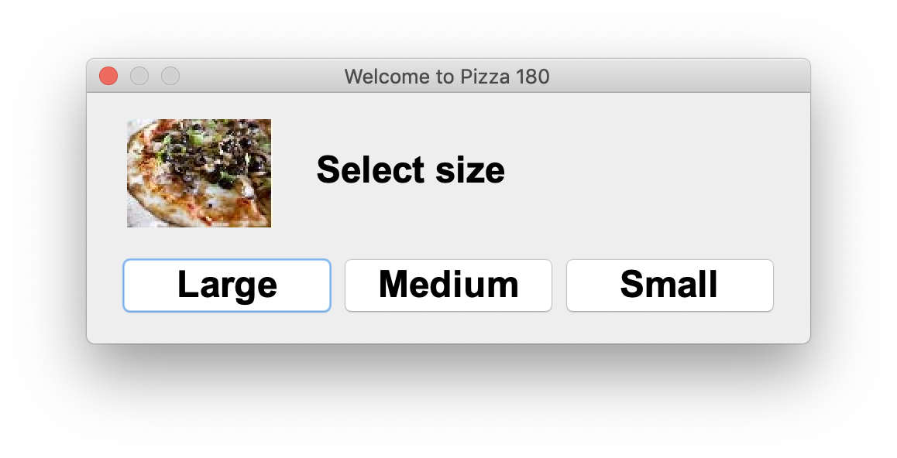
Select size

Slide 14
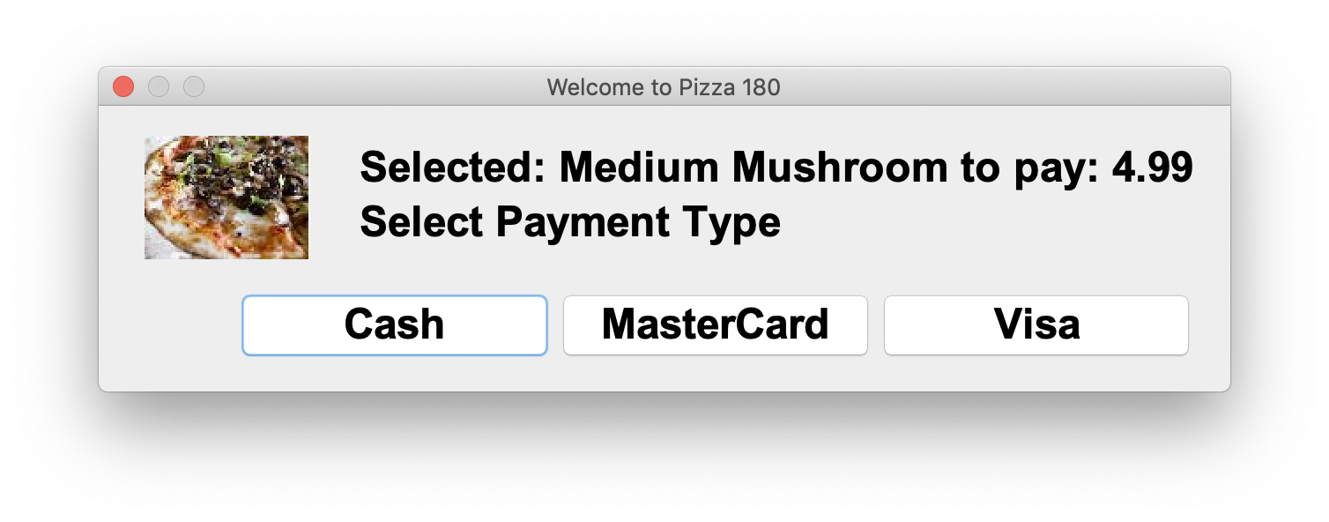
Select payment type

Slide 15
Eat!

Slide 16
Quiz: 03/27/2019

