Slide 1
CS 18000 Problem Solving and Object Oriented Programming Spring 2019
Section LE2
Week 10: Lecture 20, March 25. 2019
Slides updated: 10:06am, March 25, 2019
Aditya Mathur
Professor, Department of Computer Science
Purdue University
West Lafayette, IN, USA
https://www.cs.purdue.edu/homes/apm/courses/CS180Spring2019/

Slide 2
Today
Interaction through Graphical User Interfaces (GUIs)
JOptionPane

Slide 3
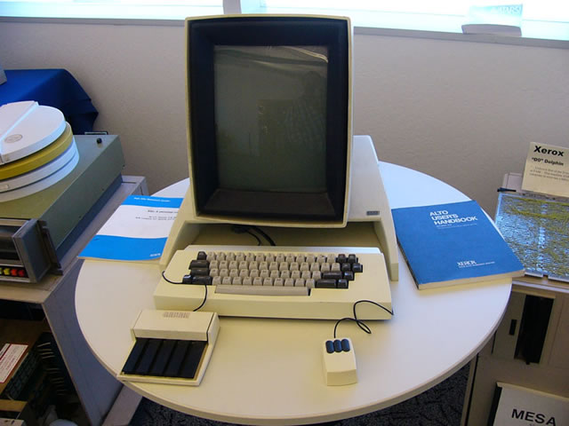
Xerox Alto [~1974]

Slide 4
Apple Mac [~1984]

Slide 5
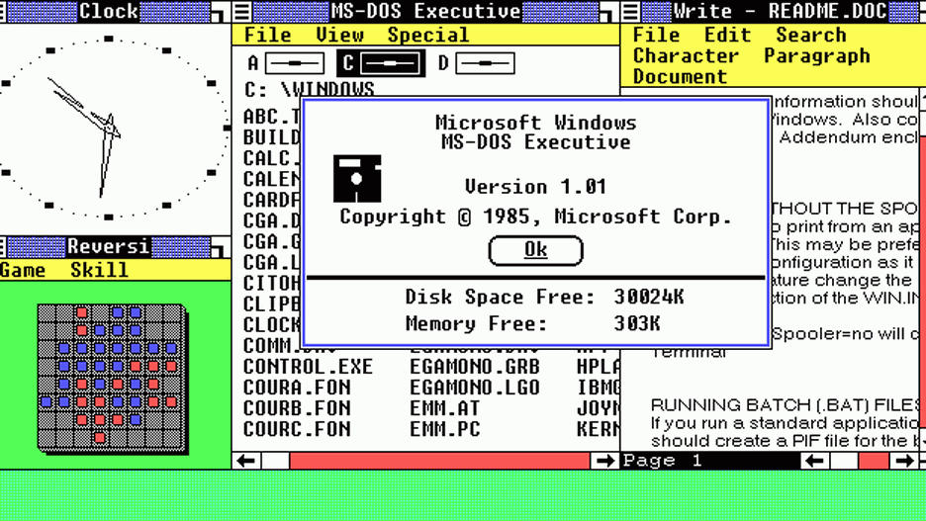
Microsoft Windows [~1985]

Slide 6
Graphical User Interface [GUI]
Enables interaction with apps through graphical elements such as buttons, textboxes, and other items known as “widgets.”
Developed at Xerox Palo Alto research center based on ideas from Ivan Sutherland and others in the 60’s.
Easy to use, when designed well.
Designing a GUI and implementing it are two different activities.
Our focus is more on implementation.

Slide 7
Java swing library
java.lang.Object
java.awt.Component
java.awt.Container
javax.swing.JComponent
javax.swing.JOptionPane

Slide 8
JOptionPane

Slide 9
JOptionPane
Used for creating simple (interactive) dialogs
Easy to use
Dialogs of different types; customizable
All dialogs are “modal”
https://docs.oracle.com/javase/tutorial/uiswing/components/dialog.html#dialogdemo

Slide 10
JOptionPane: Methods
Method
JOptionPane.showxxxDialog(parameters);
Method Name | Description
showConfirmDialog | Asks a confirming question, e.g., yes/no/cancel.
showInputDialog | Prompt for some input.
showMessageDialog | Tell the user about something that has happened.
showOptionDialog | Unifies the above

Slide 11
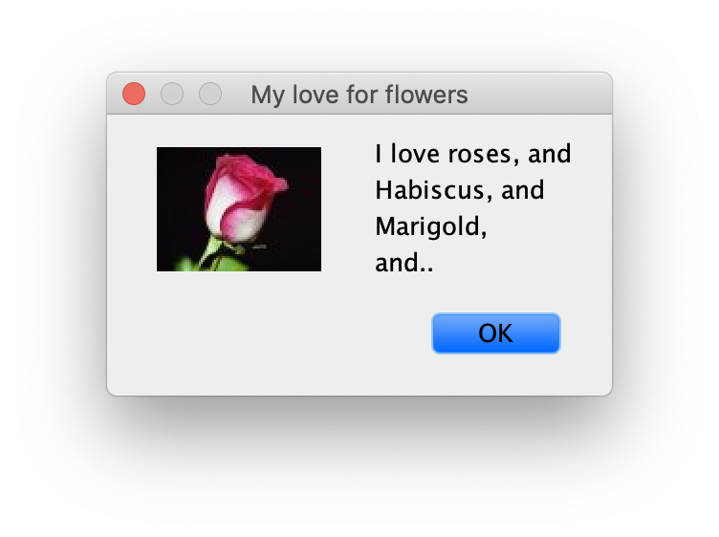
JOptionPane: Parts of a Dialog
Title
Message
Icon
Button

Slide 12
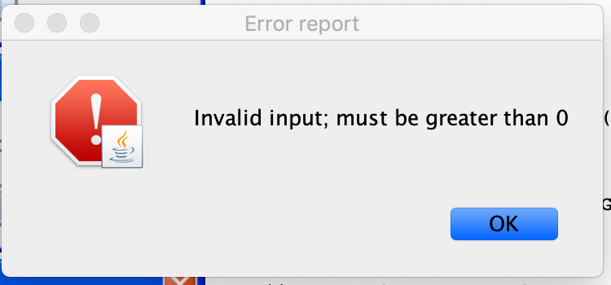
JOptionPane: Error Message
String msg=“Invalid input; must be greater than 0”;
int msgType=JOPtionPane.ERROR_MESSAGE;
String title=“Error report”;
JOptionPane.showMessageDialog(null, msg, title, msgType);

Slide 13
JOptionPane: Information Message
ImageIcon img=new ImageIcon("rose.jpg"); Object []text={"I love roses, and", "Habiscus, and", "Marigold,", "and.."}; int msgType=JOptionPane.INFORMATION_MESSAGE; String title="My love for flowers";
JOptionPane.showInternalMessageDialog(null, text, title, msgType, img);

Slide 14
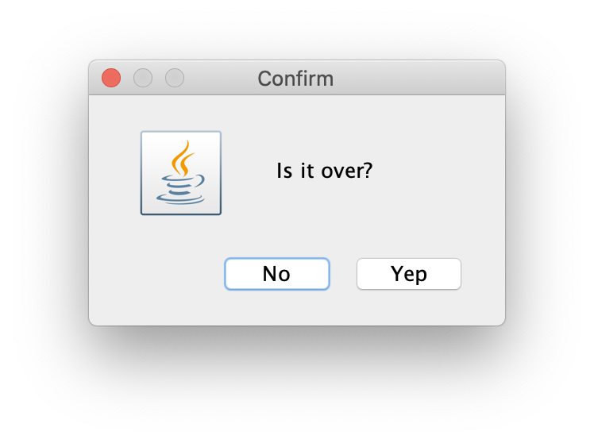
JOptionPane: Confirm Message: Customized button text
Object []options={”Yep”, “No”}; int msgType=JOptionPane.YES_NO_OPTION;
String title=”Confirm";
String msg=”Is it over?";
int n=JOptionPane.showOptionDialog(null, msg, title, optType, msgType, null, options, options[1]);

Slide 15
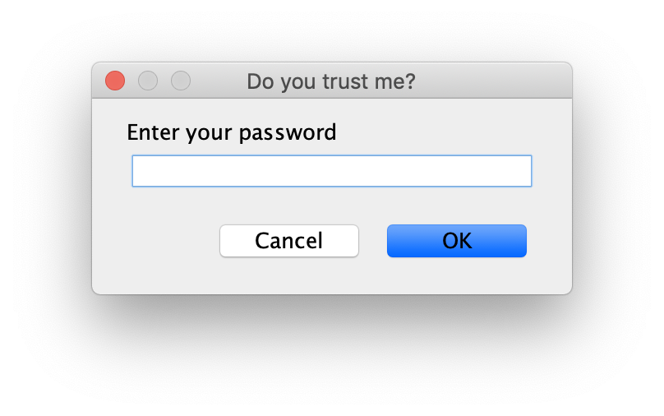
JOptionPane: Input message
int msgType=JOptionPane.PLAIN_MESSAGE; String title="Do you trust me?"; String msg="Enter your password"; String p=(String)JOptionPane.showInputDialog(null, msg,title, msgType);

Slide 16
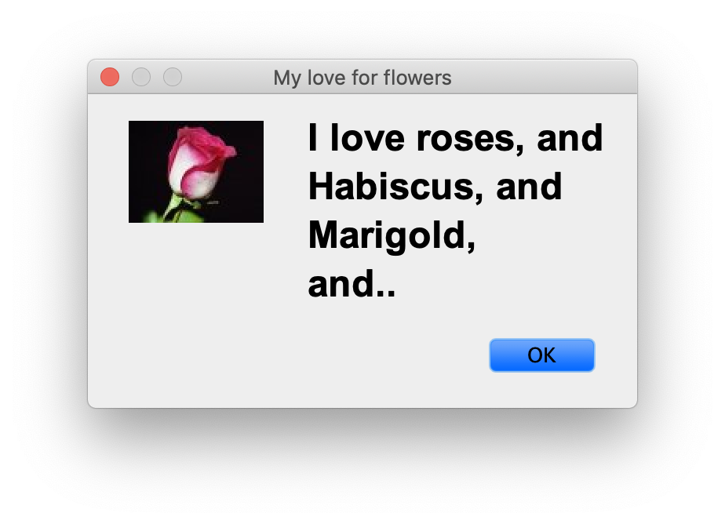
JOptionPane: Customization
Icon
Buttons
Fonts
Window size

Slide 17
JOptionPane: Font
UIManager.put("OptionPane.messageFont", new Font("Arial", Font.BOLD, 24));

Slide 18
JOptionPane: Window size
UIManager.put("OptionPane.minimumSize", new Dimension(w, h));

Slide 19
Live demo

Slide 20
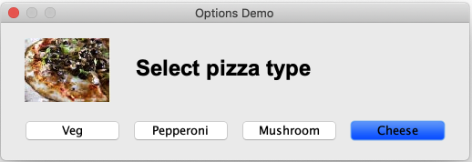
Select your pizza
Write a program to generate the following dialog.
Print the selected pizza on console.

Slide 21
Quiz: 03/25/2019

