Slide 1

CS49000-Introduction to AR/VR
Lecture 2: History and Definitions of VR
Instructor: Aniket Bera

Slide 2
Virtual Reality Definition
What is virtual reality?
  Virtual –
    being in essence or effect, but not in fact
    Example VRAM
  Reality –
    the state or quality of being real. Something that exists independently of ideas concerning it. Something that constitutes a real or actual thing as distinguished from something that is merely apparent.

Slide 3
Define VR
Take a few minutes and write a 1-2 sentence definition.
  What are the important components?
Burdea:
Virtual reality is a high-end user-computer interface that involves real-time simulation and interactions through multiple sensorial channels. These sensorial modalities are visual, auditory, tactile, smell, and taste.
Notes:
Burdea: Professor at Rutgers.

Slide 4
Burdea’s 3 I’s of VR
Interactivity – user impacts world
  Define
  Channels
Immersion – believing you are there
  Define
  What contributes to it?
Imagination – user ‘buying’ into the experience
  Examples
  Why is this necessary?

Slide 5
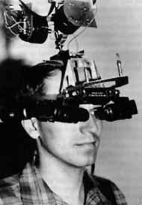
Ivan Sutherland’s The Ultimate Display
“Don’t think of that thing as a screen, think of it as a window, a window through which one looks into a virtual world. The challenge to computer graphics is to make that virtual world look real, sound real, move and respond to interaction in real time, and even feel real.”

Slide 6
Introduction to Virtual Reality (VR)
VR is an experiential medium.
It has a convergence of computer and power, which combines with advances in image processing, tracking mechanisms and intuitive human computer communication.
One important feature of VR is the real time interaction, which means that a computer is able to detect user’s input and change the virtual environment spontaneously.

Slide 7
Introduction to Virtual Reality (VR)
It is a new computational paradigm that fundamentally redefines the interface between humans and computers.
It has emerged as a next generation human computer interface that stimulates a realistic environment and has the potential to change the way human interacts with the computer.

Slide 8
Terminologies Related to VR
Artificial Reality
Computer Generated Environment
Computer Simulated Environment
Cyberspace
Spatial Immersion
Synthetic Environment
Synthetic experience
Virtual Environment
Virtual presence
Virtual Worlds
Visually coupled system

Slide 9
Definitions of Virtual Reality
Webster’s New Universal Unabridged Dictionary (1989):
Virtual - “being in essence of effect, but not in fact”.
It has been applied computing, for example when a computer system requires more RAM than is available, memory is expanded virtually by use of disk storage (virtual memory).
Reality - “The state of being real. Something that exists independently of ideas concerning it”.
A place that exists and can be experienced.

Slide 10
Definitions of Virtual Reality
Sutherland (1965) - “Don’t think of that thing as a screen, think of it as a window, a window through which one looks into a virtual world. The challenge to computer graphics is to make that virtual world look real, sound real, move and respond to interaction in real time, and even feel real.”
Aukstakalnis & Blatner (1992) - “VR is a way for human to visualise, manipulate and interact with computers and extremely complex data”.
Bjelland & Rlevy (1994) - VR arises from some basic senses of sight, sound, touch and smell that are created by artificial means.

Slide 11
Definitions of Virtual Reality
Von Schweber & Von Schweber (1995) - “Virtual reality lets you navigate and view a world of three dimensions in real time, with six degrees of freedom. In essence, virtual reality is clone of physical reality.”
Isdale (1998) - “VR as being a collection of technologies and hi-tech devices e.g. Head Mounted Display HMD, 3D-Stereophonic Audio, Motion Sensors, Cyber Glove etc”.
Brooks (1999) - “an experience .. in which the user is effectively immersed in a responsive virtual world”.

Slide 12
Definitions of Virtual Reality
Zeltzer (1992) - Explains VR through the AIP Cube (Autonomy, Interaction, Presence).
Zeltzer assumes that any virtual environment has three components:
    A set of models/objects or processes.
    A means of modifying the states of these models.
    A range of sensory modalities to allow the participant to experience the virtual environment.

Slide 13
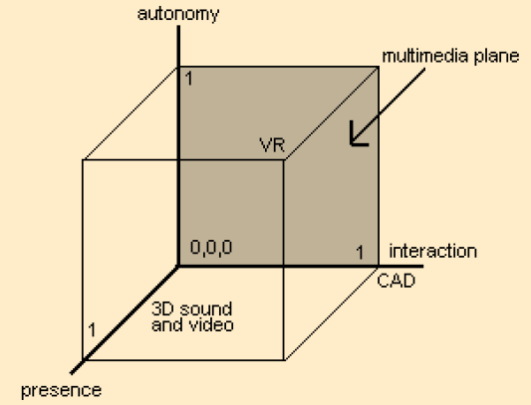
Zeltzer AIP Cube

Slide 14
Zeltzer AIP Cube
Autonomy: Qualitative measure of the virtual object’s ability to react to events and stimuli.
  For no reaction, autonomy = 0
  For fully comprehensive reaction, autonomy = 1.
  Scaling between 0 and 1 in this context is purely qualitative.

Slide 15
Zeltzer AIP Cube
Interaction: The degree of access to the parameters or variables of an object.
  For no real time control of variables, interaction = 0.
  For real time control of variables, interaction = 1.
Whilst modern VE systems are capable of a high degree of interaction, the complexity of an application may inhibit or prevent interaction.
Presence: A crude measure of the fidelity of the sensory input and output channels. Presence is affected by the application of the VE.

Slide 16
Zeltzer AIP Cube
The point (0,0,0) represents very early graphics systems
  programmed in non-real-time batch mode
  no interactivity
Diagonally opposite, at (1,1,1) is ideal virtual reality
  maximum autonomy, interaction and presence
  so good that you wouldn’t realise it wasn’t real
The point (0,1,0) can sometimes be achieved today
  user can control all the variables of some objects in real time

Slide 17
Zeltzer AIP Cube
The point (0,1,1) represents experiencing a high degree of interactivity and presence
  Some environments support regions close to this
  many VE’s lack autonomy, though this is changing with the increasing use of physically based models and autonomous agents.
The point (1,0,1) represents a high degree of presence and autonomy
  a VE where the viewer is a passive observer but is fully immersed
  may be able to modify the viewpoint, but no objects should respond to a change in the viewpoint
  an IMAX film with stereo glasses & sound could possibly be considered here.

Slide 18
Properties of VR
Synthetically generated environment
  Computers, 3D, real-time
Sensory feedback
  I/O devices
Interaction, moving
  In time
  In space
  In scale
Immersion
  Being there

Slide 19
Goal of Virtual Reality
The goal is to remove the distinctions between the system and user’s environment.
Ideally, user is presented with a make believe world created by the system.
The real world must be realistic that it allows the user to interact with it in a natural manner.
However, this goal is yet to be achieved due to the current limitations in hardware and software technology.

Slide 20
Features of VR
A medium of communication.
Requires physical immersion.
Provides synthetic sensory simulation.
Mentally immerse the user.
Interactivity and its captivating power contributes to the feelings of immersion, of being part of the action on the screen, that the user experiences.

Slide 21
How does VR deliver information?
Human being have five (5) senses.
Based on current VR system, it can be concluded that three major senses are tackled by most VR system are:
  Vision
  Hearing
  Touch
Senses | Percentage
Vision | 70%
Hearing | 20%
Smell | 5%
Touch | 4%
Taste | 1%
Mazuryk & Gervaultz (1996) shows the percentages of information that goes to human brain through human senses.

Slide 22
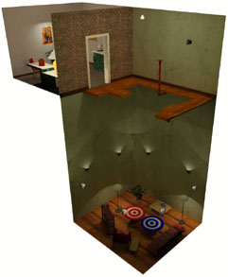
Key Elements of Virtual Reality Experience
Virtual World - content of a given medium
  screen play, script, etc.
  actors performing the play allows us to experience the virtual world
Immersion – sensation of being in an environment
  mental immersion – suspension of disbelief
  physical immersion – bodily entering the medium
  Related to presence – (mentally immersed) the participant’s sensation of being in the virtual environment (Slater)
Walking Experiment at
UNC – Chapel Hill

Slide 23
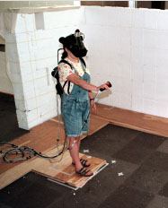
Key Elements of Virtual Reality Experience
Sensory Feedback – information about the virtual world is presented to the participant’s senses
  Visual (most common)
  Audio
  Touch
Interactivity – the virtual world responds to the user’s actions.
  Computer makes this possible
  Real-time
Walking Experiment at
UNC – Chapel Hill

Slide 24
Why VR?
In groups – develop a set of guidelines for when to apply VR to a problem
Give three examples of applications that fit your definition, and three examples of common misconceptions.

Slide 25
Given these points… are these VR experiences?
Virtual World
Immersion
Sensory Feedback
Interactivity
Create a table and decide how these items stack up as VR or not:
  ZORK
  Choose Your Own Adventure
  Quake 3
  Shrek (The movie)
  747 Flight Simulator
  Microsoft Flight Simulator 2004 (on a PC)
  Where the Red Fern Grows

Slide 26
What are the primary intellectual components that create a virtual environment?
Hardware / Technology
User’s Perspective (the environment that is experienced)
System Software Design
Interaction Techniques

Slide 27
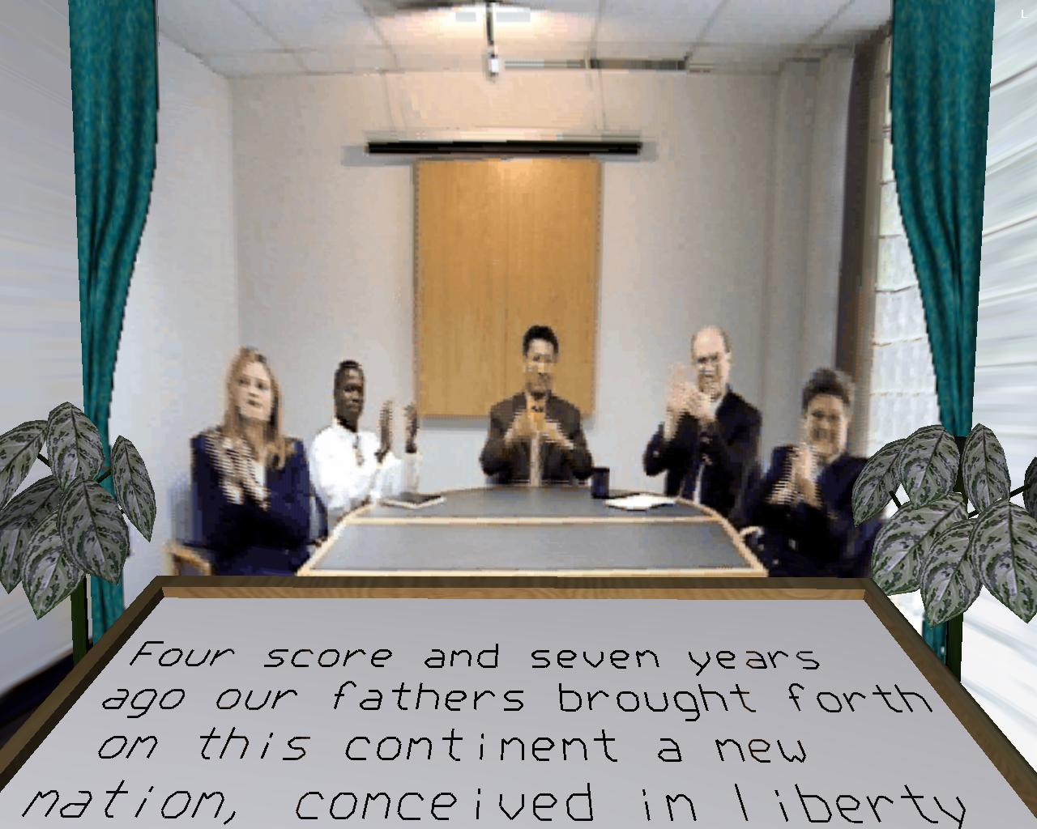
User’s perspective
Setting
Objects in world
Other participants
Active/Passive
  Factory Simulation
  Architectural Walkthrough

Slide 28
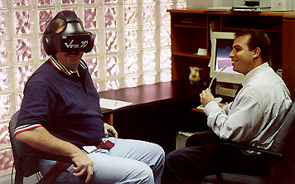
Hardware / Technology
What display modalities and technologies will I use?
What sensor modalities and technologies will I use?
What is my computation environment?
How many active users do I wish to accommodate?

Slide 29
System Software Design
Software structures that run the virtual environment
  Rendering group
    Graphics, audio, haptic
  Sensor polling group
    Separately poll each sensor hardware subsystem
  Computation group
    Manage the state of the environment

Slide 30
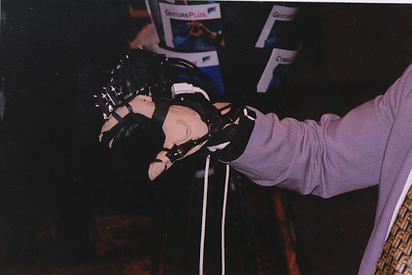
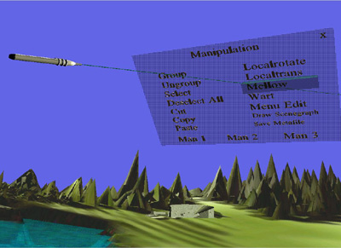
Interaction Techniques
Do I interact with the environment?
How do I interact with the environment?
Not the same as what devices I use

Slide 31
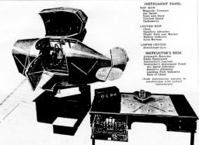
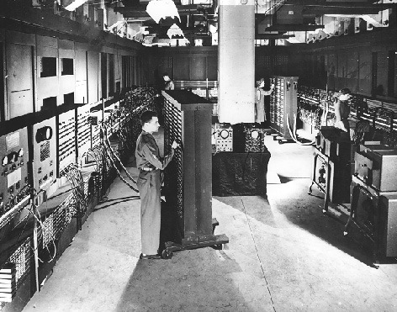
Evolution of VR
1916 - U.S. Patent 1,183,492 for a head-based periscope display is awarded to Albert B. Pratt
1929 - Edward Link develops a simple mechanical flight simulator known as ‘penguin’ trainers to train pilots at a stationary (indoor) location. The trainee can learn to fly using instrument replicas in the cockpit of the trainer.
1946 - The first electronic digital computer, the ENIAC, developed at the University of Pennsylvania, is delivered to the U.S. Army.

Slide 32
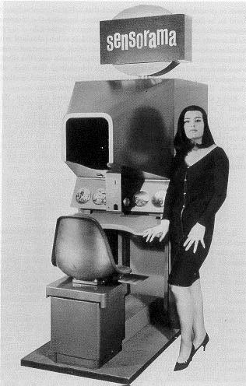
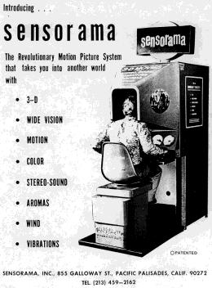
Evolution of VR
1956 - Morton Heilig develops Sensorama, a multimodal experience display system. A single person would perceive the pre-recorded experience (e.g. a motorcylce ride through Manhattan), via sights, sound, smell, vibration, and wind.

Slide 33
Evolution of VR
1960 - Morton Heilig receives a U.S. Patent for a Stereoscopic-Television Apparatus for Individual Use, which bears a striking similarity to HMDs of the 1990s and even included mechanisms for the display of aural and olfactory sensations as well as visual.

Slide 34
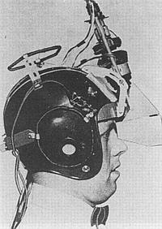
Evolution of VR
1961 - Comeau & Bryan created an HMD for use as a head-movement-following remote video camera viewing system.
They went on to start the company Telefactor Corp. based on their research in telepresence.

Slide 35
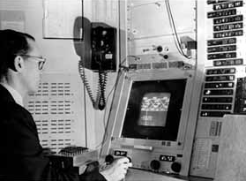
Evolution of VR
1963 - MIT PhD student Ivan Sutherland introduces the world to interactive computer graphics with his Sketchpad application.
Sutherland’s work uses a light pen to perform selection and drawing interaction, in addition to keyboard input.

Slide 36
Evolution of VR
1965-68 Sutherland’s inventions, the Ultimate Display
  A window to virtual world
  Head-Mounted Display
  Tracking of head
  Control of a remote camera
  Synthetic 3D graphics
  ”It is a looking glass into mathematical wonderland”
  Includes kinesthetic (haptic) as well as visual stimuli

Slide 37
Evolution of VR
1977 - Aspen Movie Map was created at MIT
A crude virtual simulation of Aspen, Colorado in which users could wander the streets in one of three modes
  summer, winter, and polygons
The first two were based on photographs
  The researchers actually photographed every possible movement
The third was a basic 3D model of the city

Slide 38
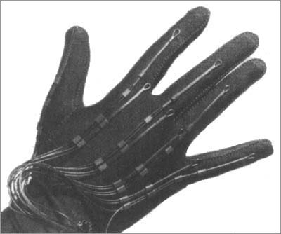
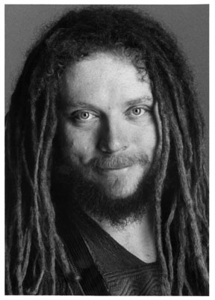
Evolution of VR
1985 - Jaron Lanier developed and patented the “DataGlove” and founded VPL Research
1989 - Jaron Lanier is generally credited with coining the term “Virtual Reality” and being the first to commercialize Virtual Reality.

Slide 39
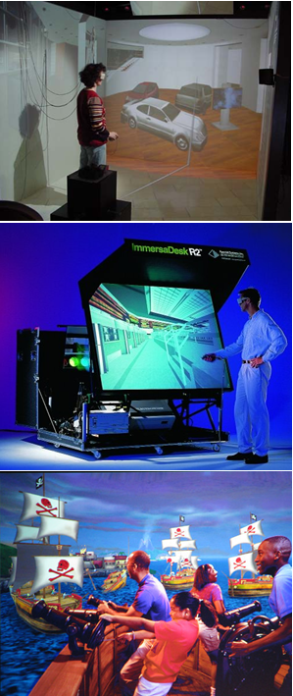
Evolution of VR
1993 - The prototype CAVE developed by Carolina Cruz-Neira et al. at the University of Illinois, Chicago, and presented at SIGGRAPH in 1993.
1995 - EVL introduces ImmersaDesk (single-screen projection VR system).
1998 - Disney opens the first Disney Quest featuring interactive VR experiences with HMDs, projection displays, sound, and haptic feedback.

Slide 40
Video: History of VR
Link: https://www.youtube.com/watch?v=hDWfsIbBtwE

