Slide 1
Introduction To VR/AR - CS 490/590 Spring 2023
Aniket Bera
Associate Professor in Computer Science
Director of IDEAS Lab
ab@cs.purdue.edu
IDEAS
LAB

Slide 2
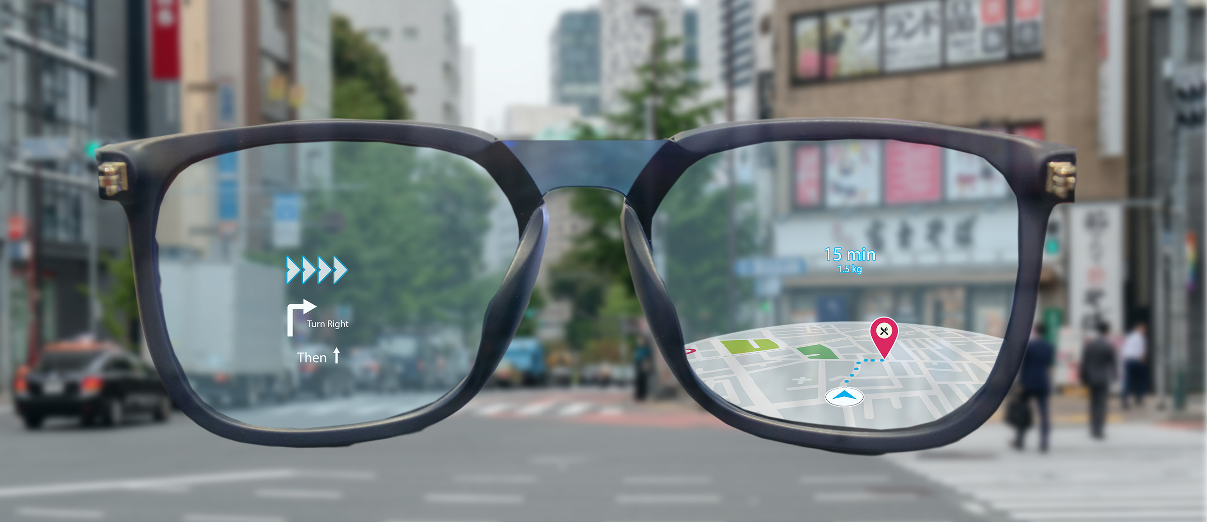
What is VR/AR/XR?

Slide 3
VR/AR
Creating the World
2
Interaction
3
Sensing the World
1

Slide 4
VR/AR
Computer Graphics
2
Hardware
3
Computer Vision
1

Slide 5
Why a class on AR/VR?

Slide 6
The focus of this class!
Computer Graphics
2
Hardware
3
Computer Vision
1

Slide 7
Couse Goals!
Learn basics of Computer Vision and Graphics relevant for AR/VR.
Learn techniques to design efficient and interactive AR/VR scenarios.
Project?
Have Fun!!

Slide 8
About IDEAS

Slide 9
Broader Goal
Enable agents to not only better understand human behaviors, psychology, and intent but also to assist and enable more collaborative and socially-aware interactions
Notes:
So, we want to enable robots and other intelligent agents to not only better understand human behaviors, psychology, and intent but also to assist and enable more collaborative and socially aware interactions.
Depending on level the interaction, let’s break down behavior understanding part into different levels.

Slide 10
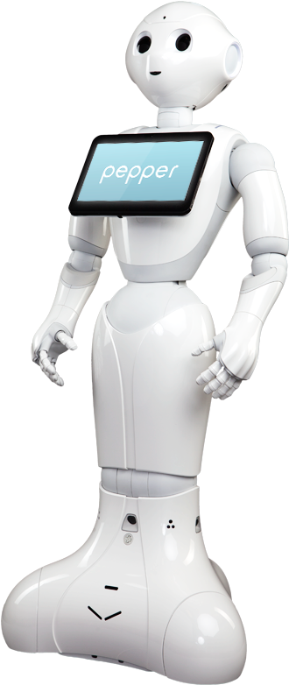
Agent?
Social Robot
Virtual Character
Robotics
Graphics/VR

Slide 11
Body Language, Motion Understanding
Understanding
Notes:
For a robot moving a crowd, it should be able to understand and predict the trajectory of pedestrians so it can navigate efficiently. We want to learn and understand the person's body language, including expressions, gestures, gaits, and others.

Slide 12
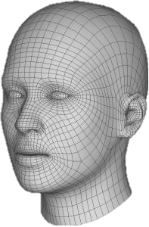
Multi-Modal Affect: Face, Speech, Content
Understanding
Notes:
It should not only learn from what you say, but it should be able to “read your mind” using your facial expressions or your tone of voice.

Slide 13
Multimodal and Context-Sensitive Affect Learning
Understanding
[Mittal, Bera et al. 2019, 2020, 2021]
[Bhattacharya , Bera et al. 2018, 2019, 2020]
[Guhan, Bera et al. 2021]
[Banerjee, Bera et al. 2022]

Slide 14
Affect-based Response
Response
Hey! You look sad, are you okay?
Can I help you?
Notes:
Last but not least, our agents should also react and interact with an appropriate behavioral response.

Slide 15
Response
Simulate intelligent, interactive, and immersive human-like agents who can also express, behave and move like us?
Body expands and
arms jerk at “furious”
swift arm stretch
on “excited”
body collapse,
arms drop on
“bored”
Whether in tech or finance, sports or the service industry, every day we seem to hear another story about an abuse of power or another grossly inappropriate workplace behavior. People are furious!
As a product developer, I started my process of research. I was very excited to find that there was a product out there called the clean birth kit.
… out into a wider space beyond. I was, I believe, ecologically bored.
15

