Slide 2
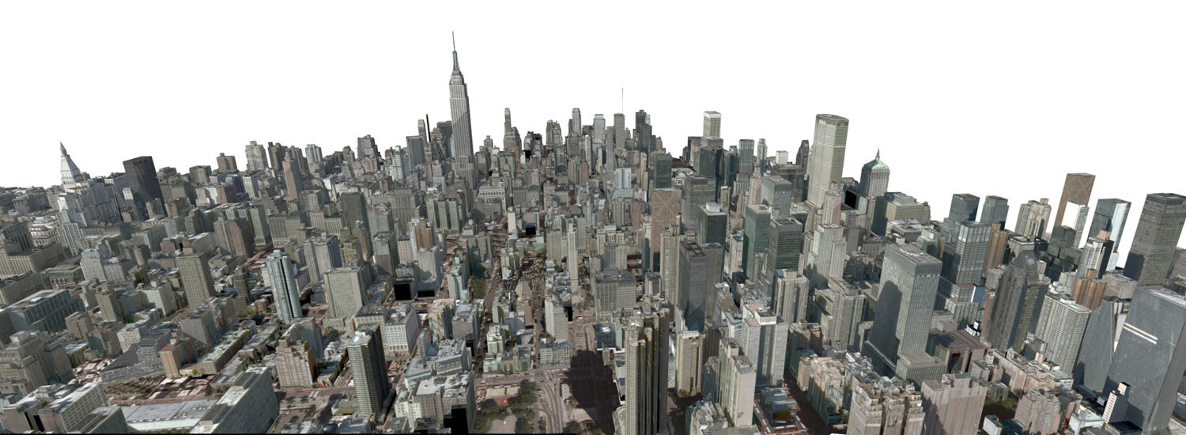
GLUNCH – SIGGRAPH 2016!
Ilke Demir, 07.09.16

Slide 3
Sessions
Procedural modeling
Meshes
Meshes & fields
Shape signature
Fabricating structure & appearance
Computational design of structures, shapes, and sound
Correspondence & mapping
Deformable surface design

Slide 4
Sessions
Procedural modeling
Meshes
Meshes & fields
Shape signature
Fabricating structure & appearance
Computational design of structures, shapes, and sound
Correspondence & mapping
Deformable surface design

Slide 5
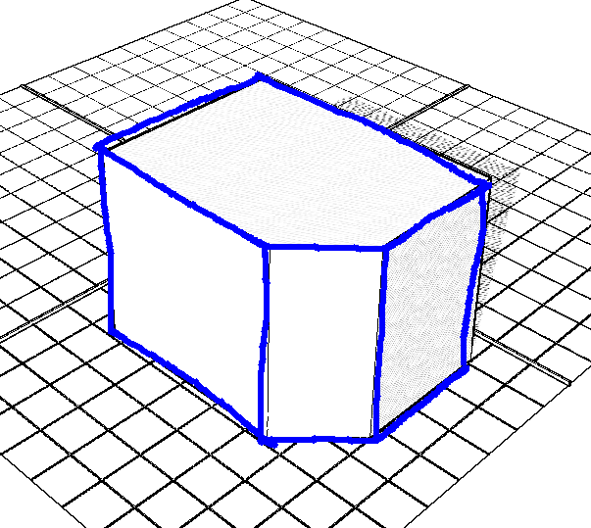
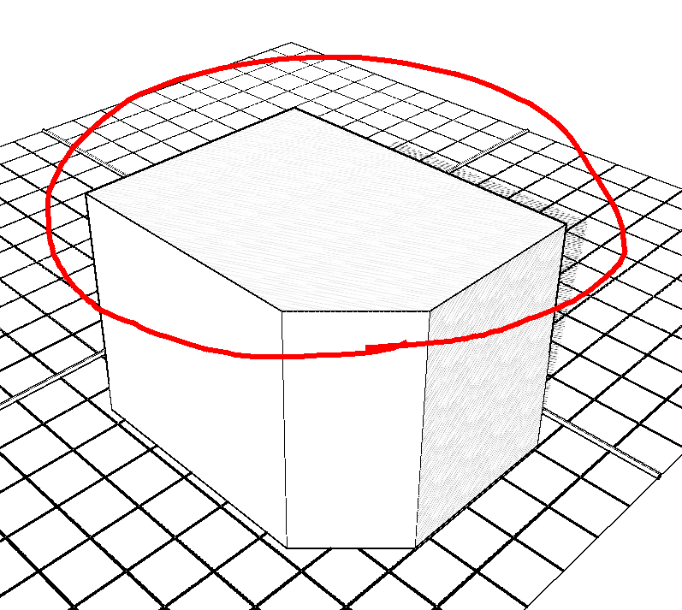
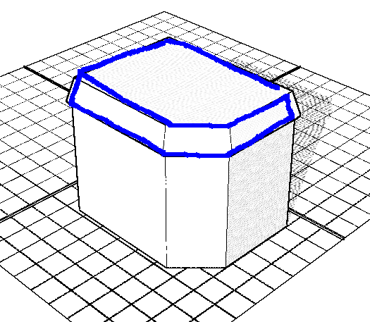
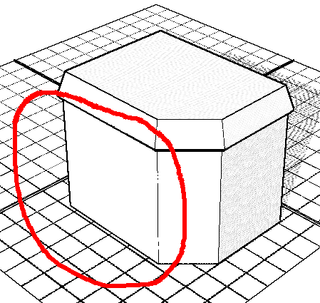
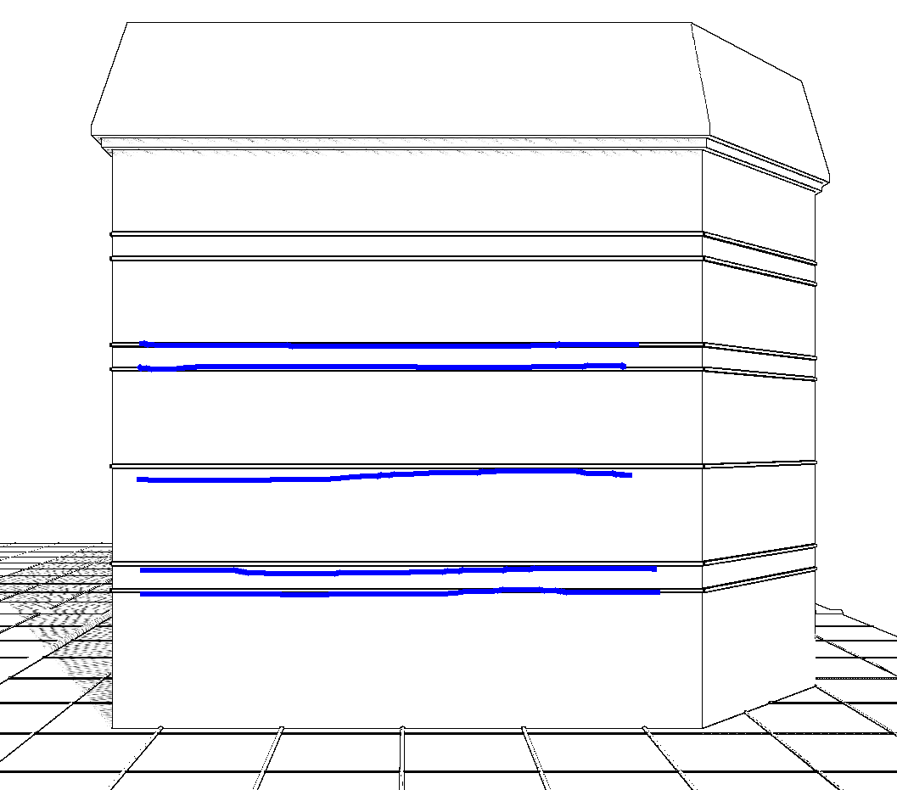
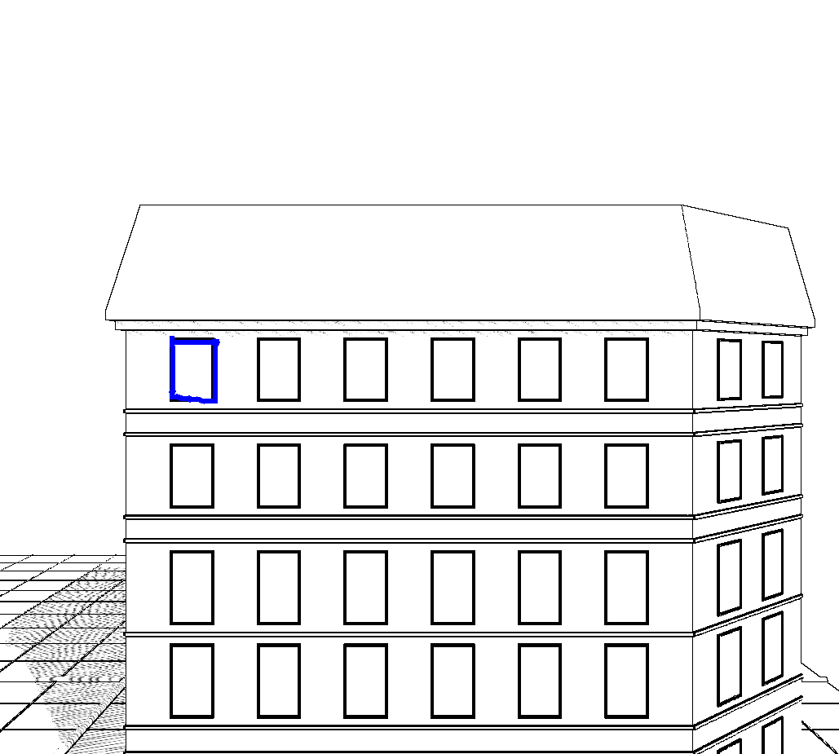
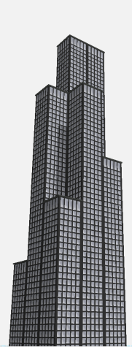
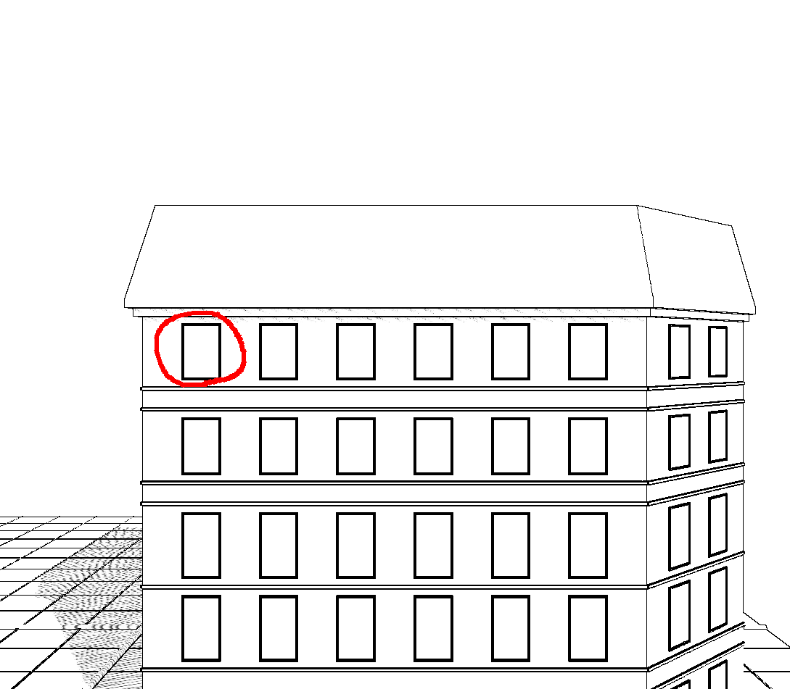
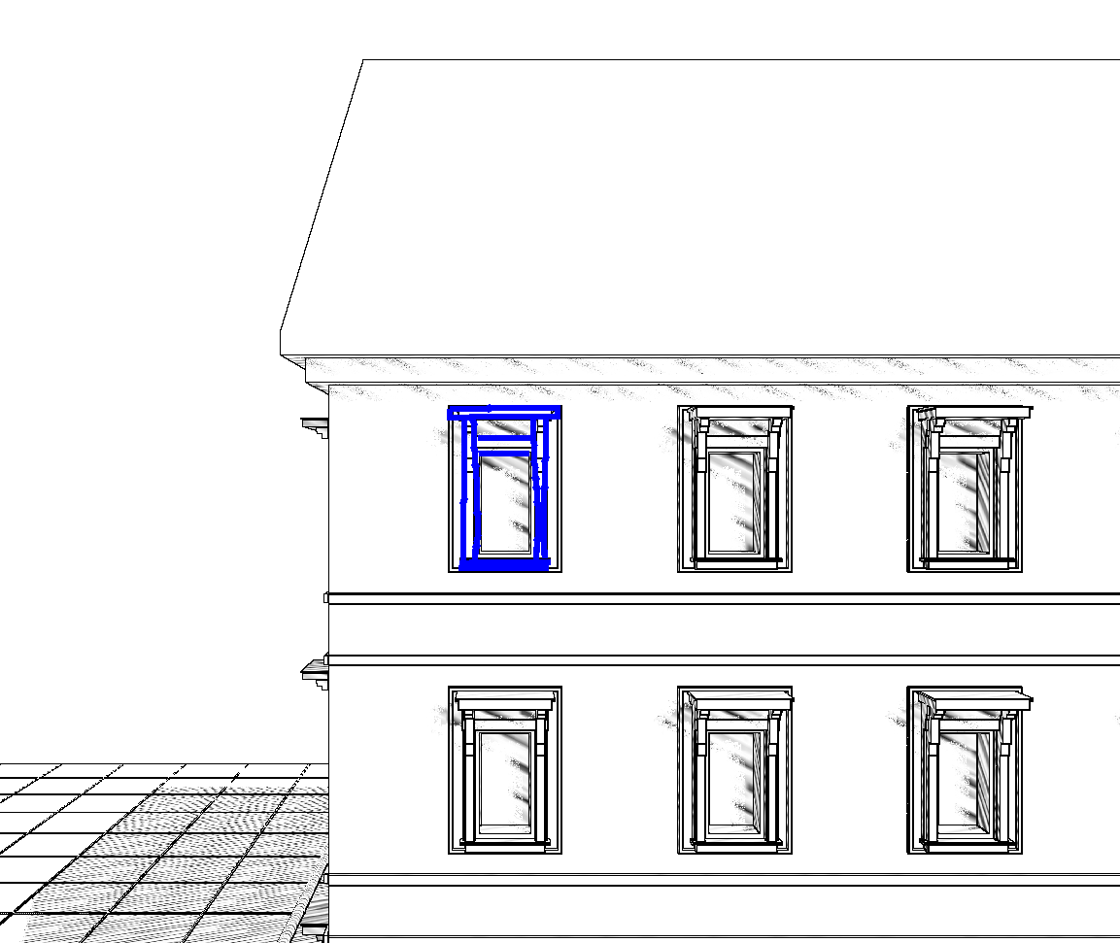
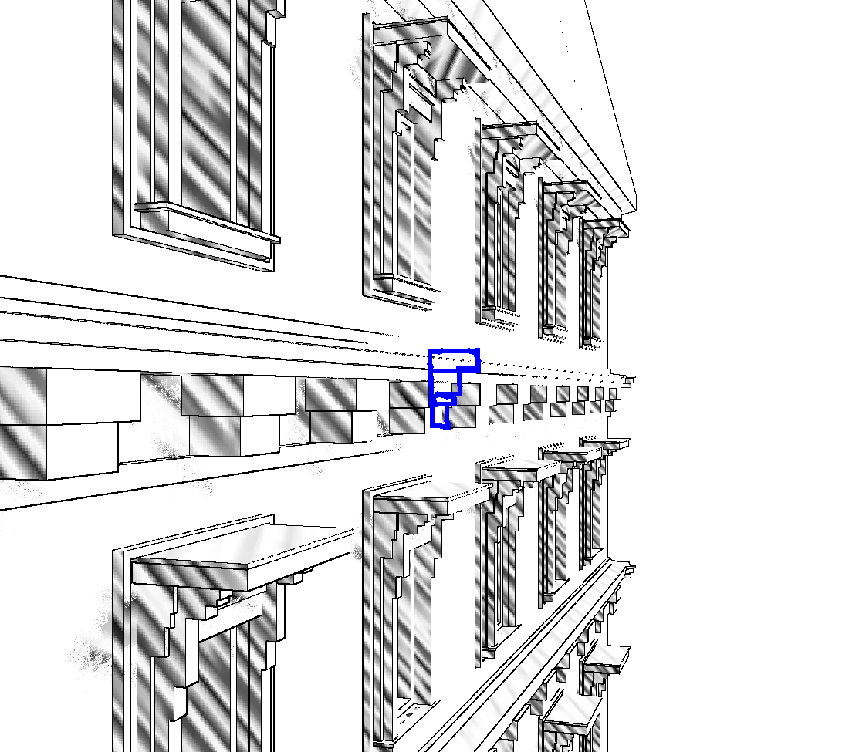
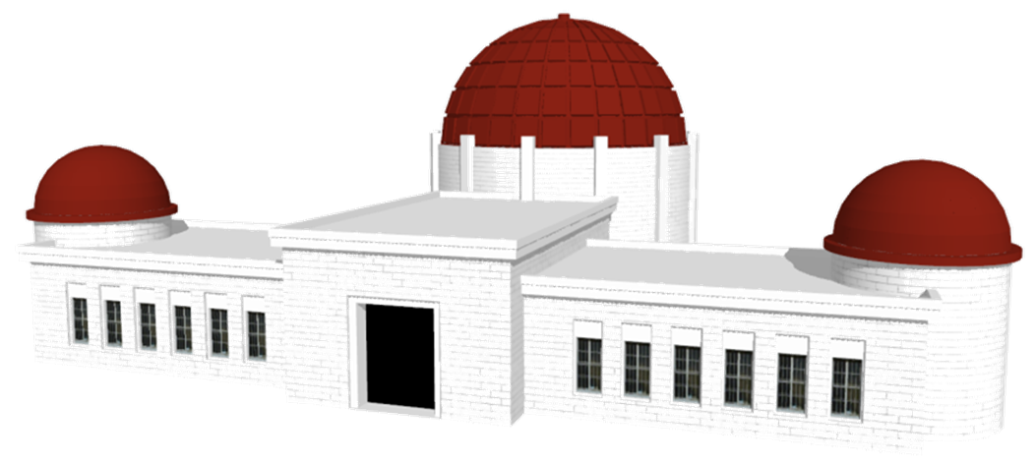
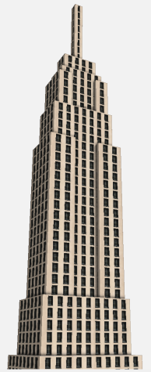
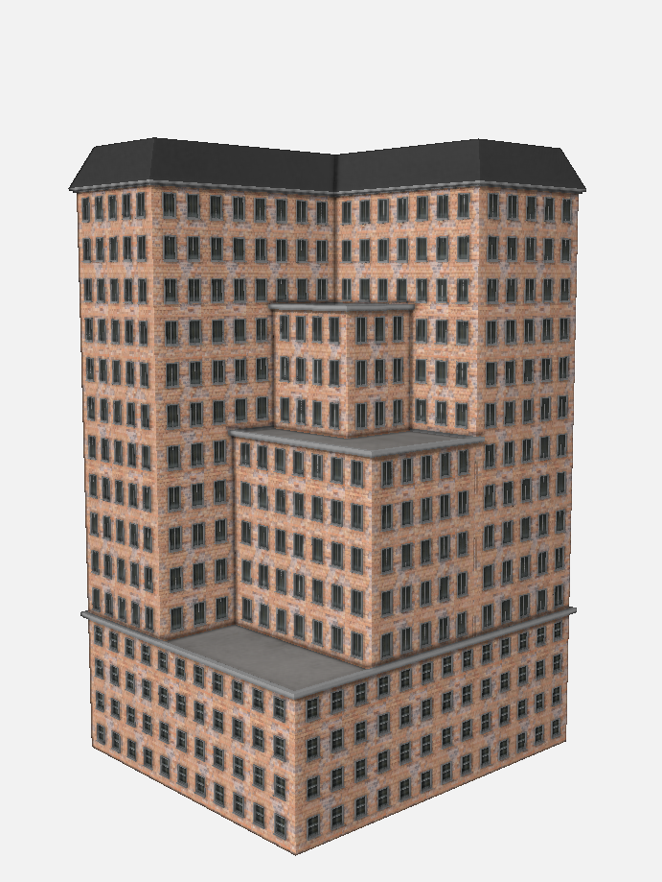
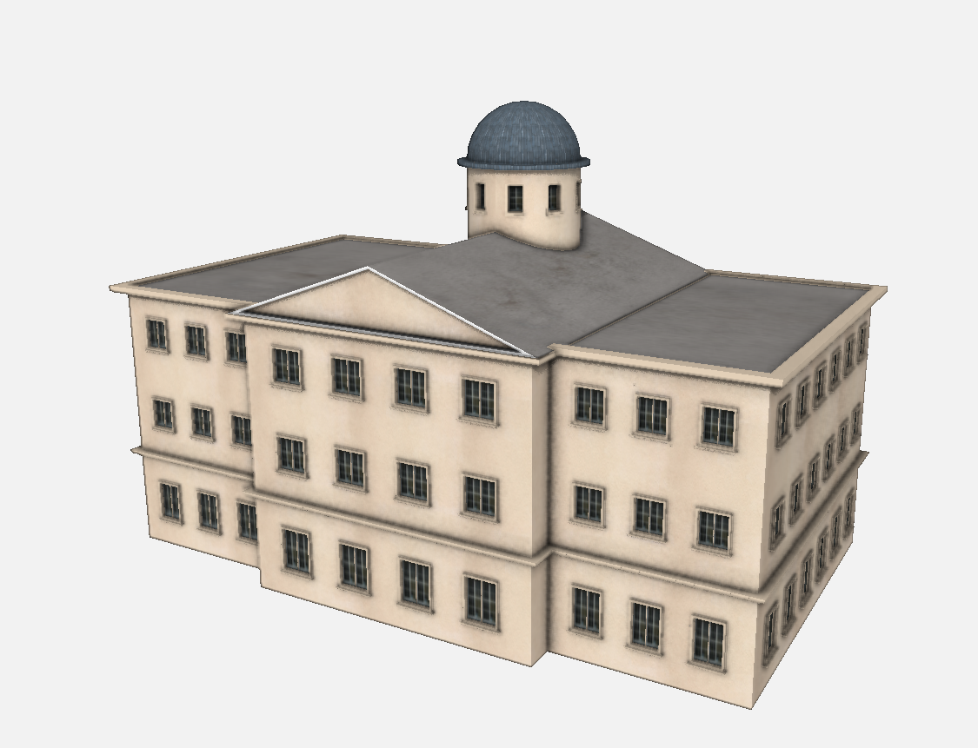
Interactive Sketching of Urban Procedural Models
Procedural Modeling
Nishida et al. Purdue
User sketch-> Best instances
Sample procedural snippets by rendering
Train recognition and parameter CNNs
Provide sketch-based procedural modeling
Notes:
I’ll start this section will with a brief introduction of urban modeling pipelines, forward and inverse. Then I will organize inverse procedural modeling approaches into three categories based on the input: image based, mesh based, and point based. Then some representative papers per category will be discussed.

Slide 6
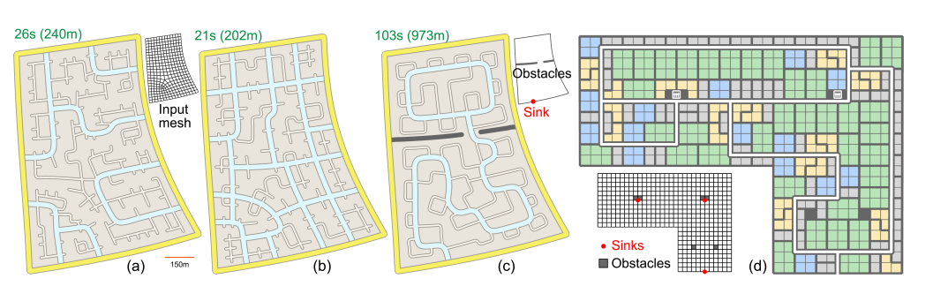
Computational Network Design From Functional Specifications
Procedural Modeling
Peng et al., KAUST+ASU
High level specification + input mesh -> network layout
Solve the conflicting requirements using integer programming
Manage traffic, add/remove sinks, no dead-ends, no t-junctions, etc.
Notes:
I’ll start this section will with a brief introduction of urban modeling pipelines, forward and inverse. Then I will organize inverse procedural modeling approaches into three categories based on the input: image based, mesh based, and point based. Then some representative papers per category will be discussed.

Slide 7
Crowd-Driven Mid-Scale Layout Design
Procedural Modeling
Feng et al., Singapore
Layout domain -> Crowd-aware layout
Optimize the layout using crowd dynamics: mobility, accessibility, coziness.
Train non-linear regressors to capture f([mob,acc,coz],[geo,top])
Personal opinion: Neither enough motivation, nor evaluation
Notes:
I’ll start this section will with a brief introduction of urban modeling pipelines, forward and inverse. Then I will organize inverse procedural modeling approaches into three categories based on the input: image based, mesh based, and point based. Then some representative papers per category will be discussed.

Slide 8
A Probabilistic Model for Exteriors of Residential Buildings
Procedural Modeling
Fan et al., KAUST+ASU
User sketch-> Best instances
Sample procedural snippets by rendering
Train recognition and parameter CNNs
Provide sketch-based procedural modeling
Notes:
I’ll start this section will with a brief introduction of urban modeling pipelines, forward and inverse. Then I will organize inverse procedural modeling approaches into three categories based on the input: image based, mesh based, and point based. Then some representative papers per category will be discussed.

Slide 9
Sessions
Procedural modeling
Meshes
Meshes & fields
Shape signature
Fabricating structure & appearance
Computational design of structures, shapes, and sound
Correspondence & mapping
Deformable surface design

Slide 10
HexEx: Robust Hexahedral Mesh Extraction
Meshes
Lyon et al., Rheinisch-Westfälische
Mesh extraction from imperfect parameterization
Sanitization: Clean up numerical inconsistencies,
Extraction: Find vertices and darts from integer grid+parametric image
Post-processing: Let darts cancel to get rid of flipping
Notes:
I’ll start this section will with a brief introduction of urban modeling pipelines, forward and inverse. Then I will organize inverse procedural modeling approaches into three categories based on the input: image based, mesh based, and point based. Then some representative papers per category will be discussed.

Slide 11
All-Hex Meshing Using Closed Form-Induced Polycubes
Meshes
Fang et al., Zhejiang
A frame field without internal singularities to guide the polycube construction
Extends the vector fields associated with the polycube from exact forms to closed forms
Curl free everywhere, but may be not globally integrable
Notes:
I’ll start this section will with a brief introduction of urban modeling pipelines, forward and inverse. Then I will organize inverse procedural modeling approaches into three categories based on the input: image based, mesh based, and point based. Then some representative papers per category will be discussed.

Slide 12
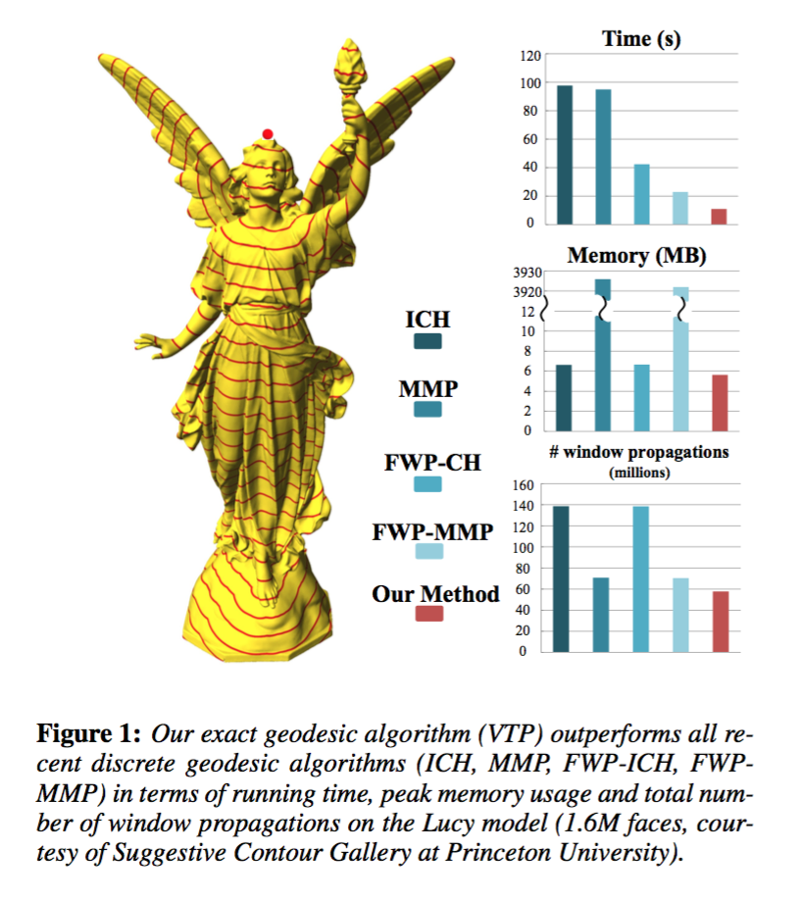
Fast and Exact Discrete Geodesic Computation Based on Triangle-Oriented Wavefront Propagation
Meshes
Qin et al., Hong Kong
A new geodesic computation algorithm based on a triangle-oriented region growing scheme
An exhaustive analysis of window propagation on geodesic
Notes:
I’ll start this section will with a brief introduction of urban modeling pipelines, forward and inverse. Then I will organize inverse procedural modeling approaches into three categories based on the input: image based, mesh based, and point based. Then some representative papers per category will be discussed.

Slide 13
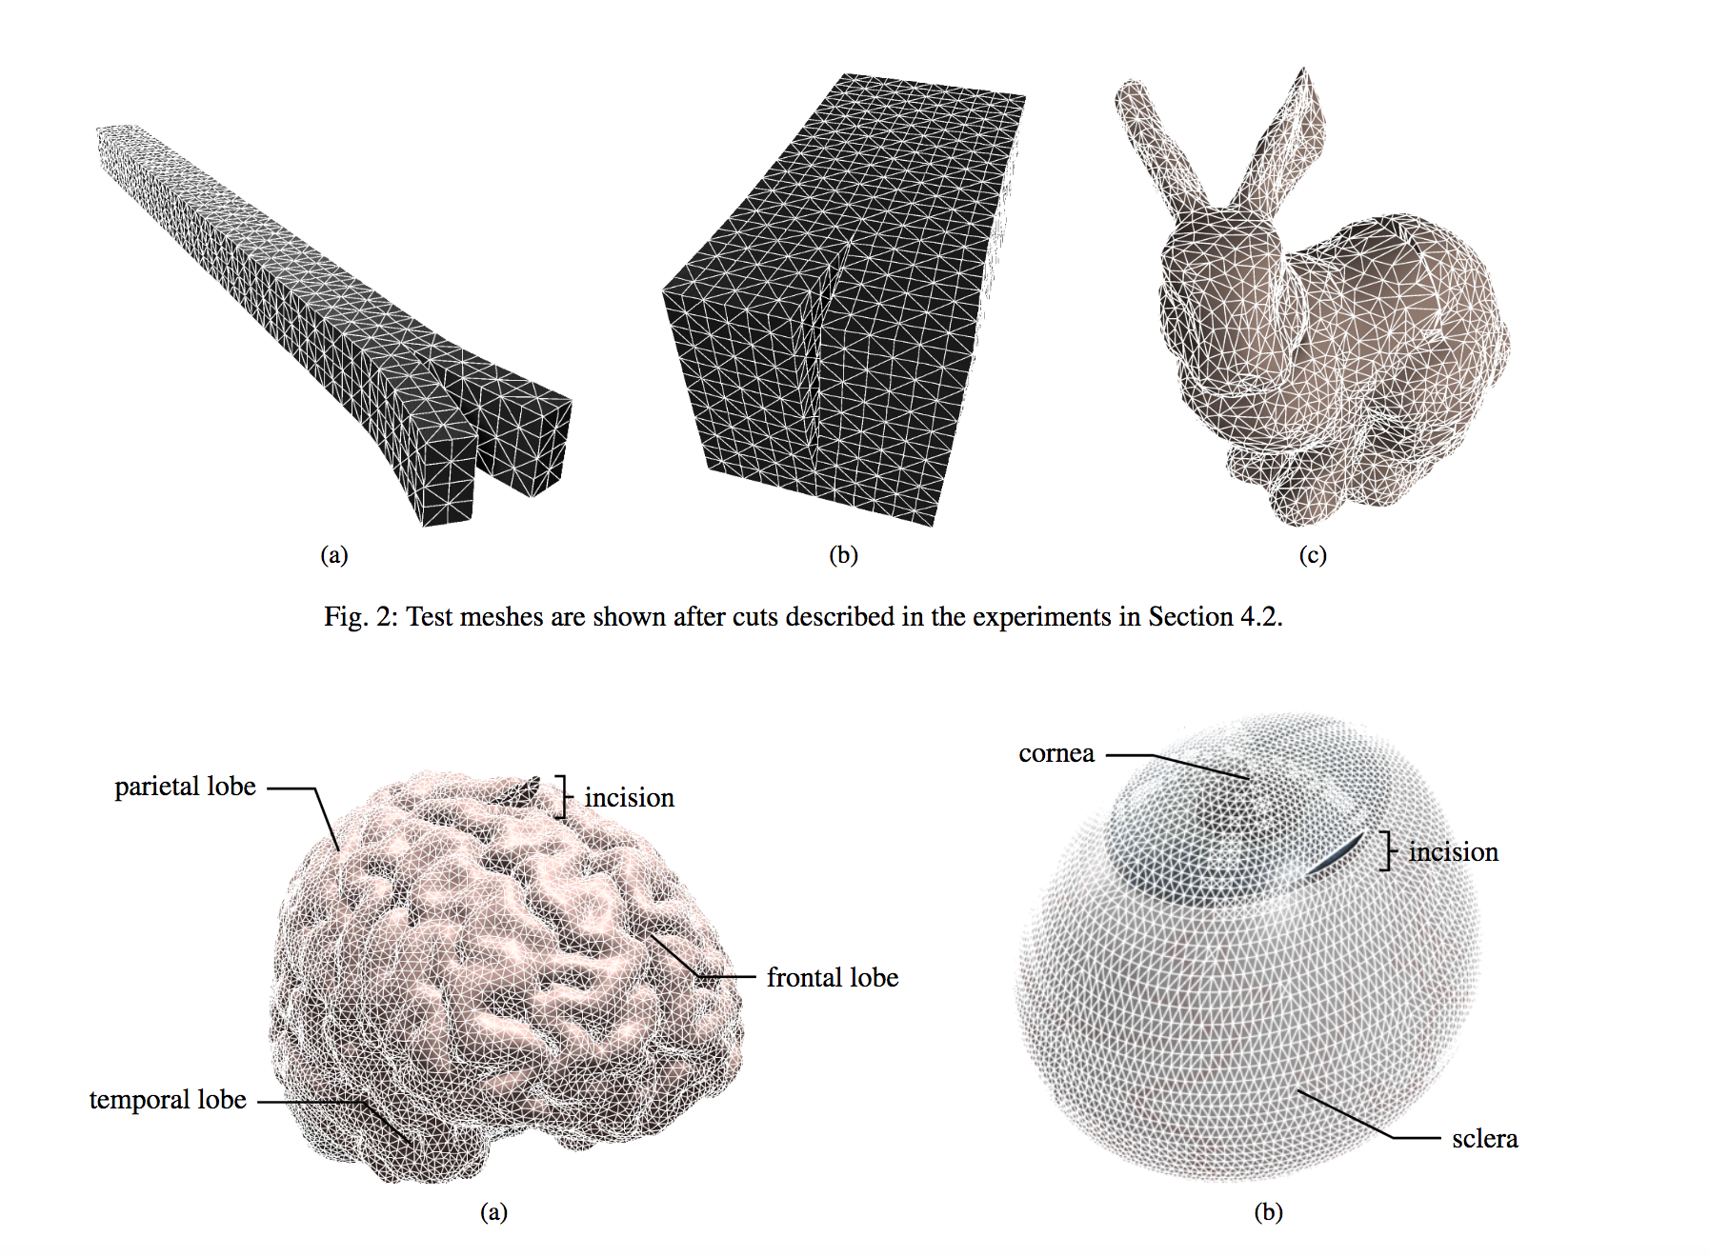
Interactively Cutting and Constraining Vertices in Meshes Using Augmented Matrices
Meshes
Yeung et al., Purdue
A finite element solution method that is well-suited for interactive simulations of cutting meshes in the regime of linear elastic models.
Fast updates to the solution of the stiffness system for real-time changes in mesh connectivity and boundary conditions.
Notes:
I’ll start this section will with a brief introduction of urban modeling pipelines, forward and inverse. Then I will organize inverse procedural modeling approaches into three categories based on the input: image based, mesh based, and point based. Then some representative papers per category will be discussed.

Slide 14
Sessions
Procedural modeling
Meshes
Meshes & fields
Shape signature
Fabricating structure & appearance
Computational design of structures, shapes, and sound
Correspondence & mapping
Deformable surface design

Slide 15
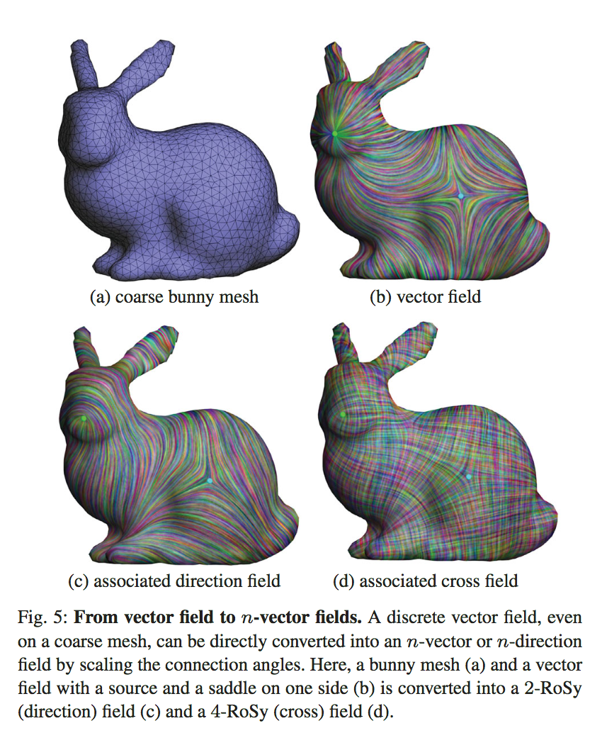
Discrete Connection and Covariant Derivative for Vector-Field Analysis and Design
Meshes & Fields
Liu et al., Pixar+CalTech
a discrete definition of connection on simplicial manifolds,
involving closed-form continuous expressions within simplices and
finite rotations across simplices.
The finite-dimensional parameters of this connection are optimally computed by minimizing a quadratic measure of the deviation to Levi-Civita connection induced by the embedding of the input triangle mesh.
A covariant derivative is constructed through exact differentiation, leading to explicit expressions for local integrals of first-order derivatives, and for L2-based energies.
With applications to the design and analysis of vector, n-vector, and n-direction fields.
Notes:
I’ll start this section will with a brief introduction of urban modeling pipelines, forward and inverse. Then I will organize inverse procedural modeling approaches into three categories based on the input: image based, mesh based, and point based. Then some representative papers per category will be discussed.

Slide 16
Subdivision Exterior Calculus for Geometry Processing
Meshes & Fields
De Goes et al., Pixar+CalTech
A new calculus for subdivision surfaces!
Conversion of DEC from polygonal domain to SEC to subdivision domain.
Notes:
I’ll start this section will with a brief introduction of urban modeling pipelines, forward and inverse. Then I will organize inverse procedural modeling approaches into three categories based on the input: image based, mesh based, and point based. Then some representative papers per category will be discussed.

Slide 17
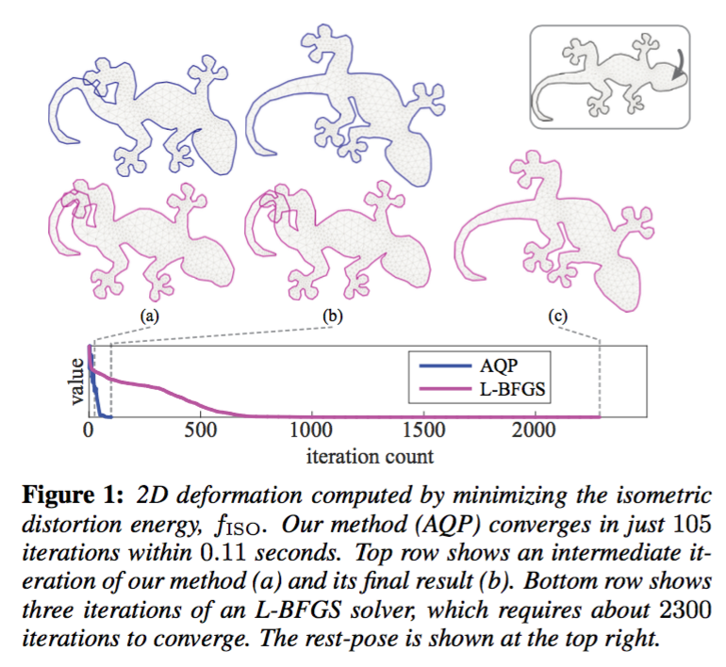
Accelerated Quadratic Proxy for Geometric Optimization
Meshes & Fields
Kovalsky et al., Weizmann
A simple first- order algorithm for the optimization of geometric energies over meshes
Replace Laplacian-like terms with Hessians using locally quadratic polynomial proxy
Notes:
I’ll start this section will with a brief introduction of urban modeling pipelines, forward and inverse. Then I will organize inverse procedural modeling approaches into three categories based on the input: image based, mesh based, and point based. Then some representative papers per category will be discussed.

Slide 18
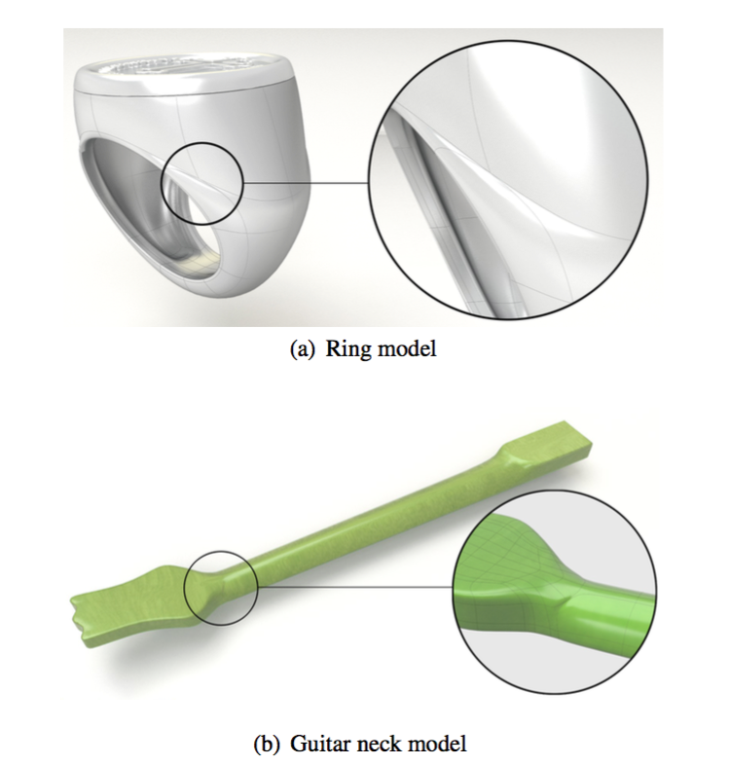
G1 Non-Uniform Catmull-Clark Surfaces
Meshes & Fields
Li et al.
New refinement rules for non-uniform Catmull- Clark surfaces
Design an “eigen polyhedron” in R2 for each extraordinary point, and
Formulate refinement rules for which refinement of the eigen polyhedron reduces to a scale and translation
In a nutshell, wrinkle-free blending functions for Catmull-Clark surfaces of any generator knot.
Notes:
I’ll start this section will with a brief introduction of urban modeling pipelines, forward and inverse. Then I will organize inverse procedural modeling approaches into three categories based on the input: image based, mesh based, and point based. Then some representative papers per category will be discussed.

Slide 19
Sessions
Procedural modeling
Meshes
Meshes & fields
Shape signature
Fabricating structure & appearance
Computational design of structures, shapes, and sound
Correspondence & mapping
Deformable surface design

Slide 20
Construction of Manifolds via Compatible Sparse Representations
Shape Signature
Wang et al., China
A novel approach for constructing manifolds from discrete meshes based on sparse optimization
Local geometry -> atom functions
Global optimization -> combine sparse locals
Notes:
I’ll start this section will with a brief introduction of urban modeling pipelines, forward and inverse. Then I will organize inverse procedural modeling approaches into three categories based on the input: image based, mesh based, and point based. Then some representative papers per category will be discussed.

Slide 21
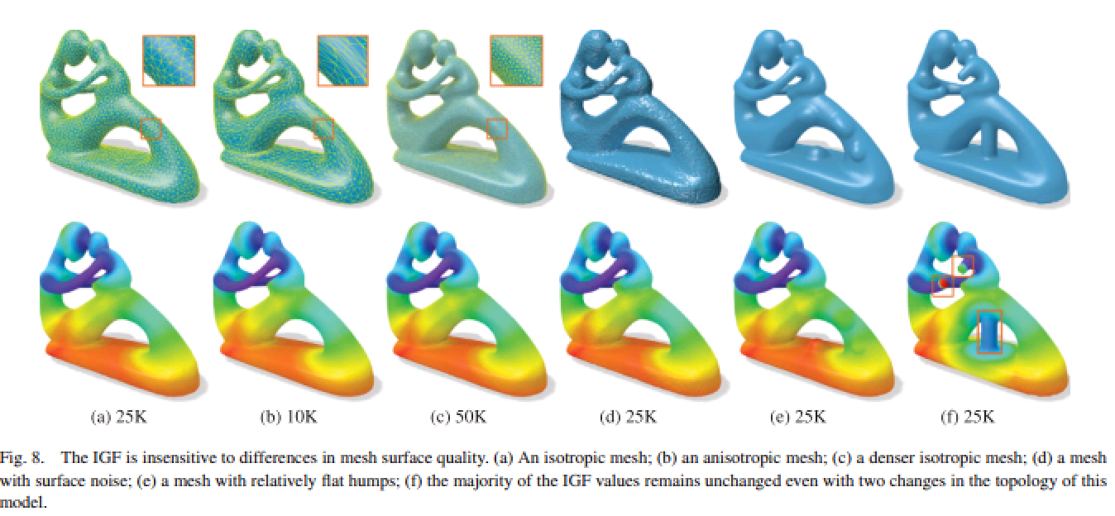
Intrinsic Girth Function for Shape Processing
Shape Signature
Xin et al., Ningbo
A new intrinsic function 3D shapes and use it for shape description and geometric feature detection.
For a point p on the surface, IGF(p) is the length of the shortest nonzero geodesic path starting and ending at p.
invariant under isometry,
insensitive to mesh tessellations,
robust to surface noise
Notes:
I’ll start this section will with a brief introduction of urban modeling pipelines, forward and inverse. Then I will organize inverse procedural modeling approaches into three categories based on the input: image based, mesh based, and point based. Then some representative papers per category will be discussed.

Slide 22
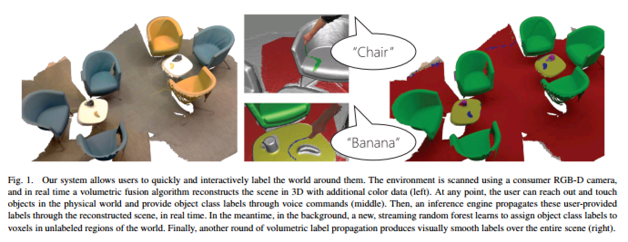
SemanticPaint: Interactive Segmentation and Learning of 3D Worlds
Shape Signature
Valentin et al., Microsoft
Scan, reconstruct, segment and label simultaneously
Volumetric data + mean-field inference on CRF + forests as labels
Notes:
I’ll start this section will with a brief introduction of urban modeling pipelines, forward and inverse. Then I will organize inverse procedural modeling approaches into three categories based on the input: image based, mesh based, and point based. Then some representative papers per category will be discussed.

Slide 23
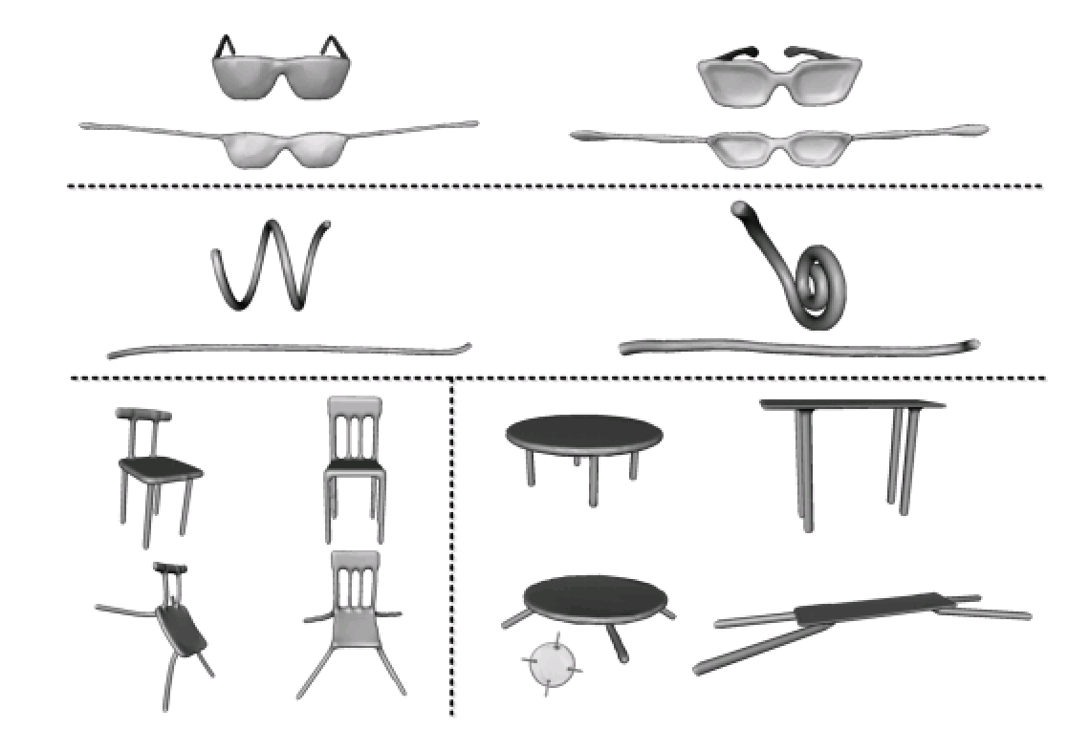
Detail-Preserving Mesh Unfolding for Non-Rigid Shape Retrieval
Shape Signature
Sahillioglu et al., METU
A shape deformation algorithm that unfolds any given 3D shape into a canonical pose that is invariant to nonrigid transformations.
preserve details for content-based nonrigid shape retrieval applications
A mesh in 3D -> move each vertex as far as possible subject to finite element regularization constraints
Notes:
I’ll start this section will with a brief introduction of urban modeling pipelines, forward and inverse. Then I will organize inverse procedural modeling approaches into three categories based on the input: image based, mesh based, and point based. Then some representative papers per category will be discussed.

Slide 24
Sessions
Procedural modeling
Meshes
Meshes & fields
Shape signature
Fabricating structure & appearance
Computational design of structures, shapes, and sound
Correspondence & mapping
Deformable surface design
Coming soon!

Slide 25
Sessions
Procedural modeling
Meshes
Meshes & fields
Shape signature
Fabricating structure & appearance
Computational design of structures, shapes, and sound
Correspondence & mapping
Deformable surface design

Slide 26
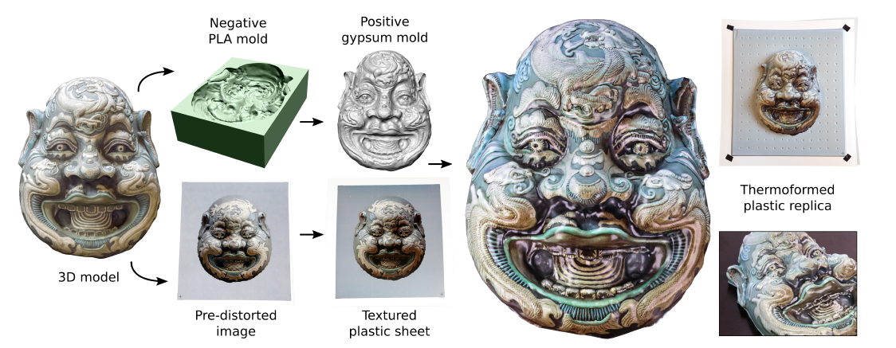
Computational Thermoforming
Fabricating structure & appearance
Schüller et al., Disney+ETH
Customize fabrication of 3D textured objects.
Create a pre-distorted image from the 3D textured model,
And wrap the sheet onto the 3D printed object.
Notes:
I’ll start this section will with a brief introduction of urban modeling pipelines, forward and inverse. Then I will organize inverse procedural modeling approaches into three categories based on the input: image based, mesh based, and point based. Then some representative papers per category will be discussed.

Slide 27
Procedural Voronoi Foams for Additive Manufacturing
Fabricating structure & appearance
Martínez et al., INRIA
Geometry from elasticity, using microstructures
Generate and print objects with spatially varying elasticity
Notes:
I’ll start this section will with a brief introduction of urban modeling pipelines, forward and inverse. Then I will organize inverse procedural modeling approaches into three categories based on the input: image based, mesh based, and point based. Then some representative papers per category will be discussed.

Slide 28
Printed Perforated Lampshades for Continuous Projective Images
Fabricating structure & appearance
Zhao et al., Shandong
A technique for designing 3D printed perforated lampshades that project grayscale images
Given the geometry of the lampshade and a target grayscale image,
compute a distribution of tiny holes over the shell,
the combined footprints of the light through the holes form the target image on a nearby diffuse surface.
The objective is to approximate the continuous tones and the spatial detail of the target image
Notes:
I’ll start this section will with a brief introduction of urban modeling pipelines, forward and inverse. Then I will organize inverse procedural modeling approaches into three categories based on the input: image based, mesh based, and point based. Then some representative papers per category will be discussed.

Slide 29
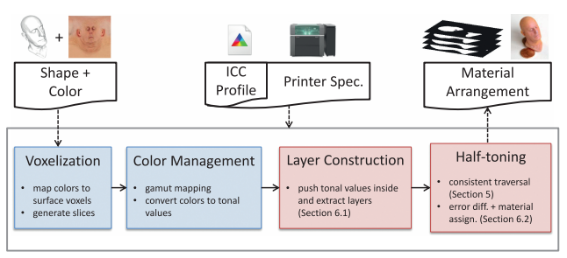
Pushing the Limits of 3D Color Printing: Error Diffusion With Translucent Materials
Fabricating structure & appearance
Brunton et al., Fraunhofer IGD
An error diffusion halftoning approach to achieve full color with multi-jet printers
Operates on multiple isosurfaces or layers within the object
A novel traversal algorithm for voxel surfaces, which allows the transfer of existing error diffusion algorithms from 2D printing
Notes:
I’ll start this section will with a brief introduction of urban modeling pipelines, forward and inverse. Then I will organize inverse procedural modeling approaches into three categories based on the input: image based, mesh based, and point based. Then some representative papers per category will be discussed.

Slide 30
CofiFab: Coarse-to-Fine Fabrication of Large 3D Objects
Fabricating structure & appearance
Song et al., China
3D printing (details on layers) + 2D laser cutting (base to connect)
An optimization model to compute fabricatable polyhedrons of max volume
An interlocking scheme to connect the laser-cut parts
An optimization for partitioning the external shell into 3D-printable parts
Notes:
I’ll start this section will with a brief introduction of urban modeling pipelines, forward and inverse. Then I will organize inverse procedural modeling approaches into three categories based on the input: image based, mesh based, and point based. Then some representative papers per category will be discussed.

Slide 31
Sessions
Procedural modeling
Meshes
Meshes & fields
Shape signature
Fabricating structure & appearance
Computational design of structures, shapes, and sound
Correspondence & mapping
Deformable surface design

Slide 32
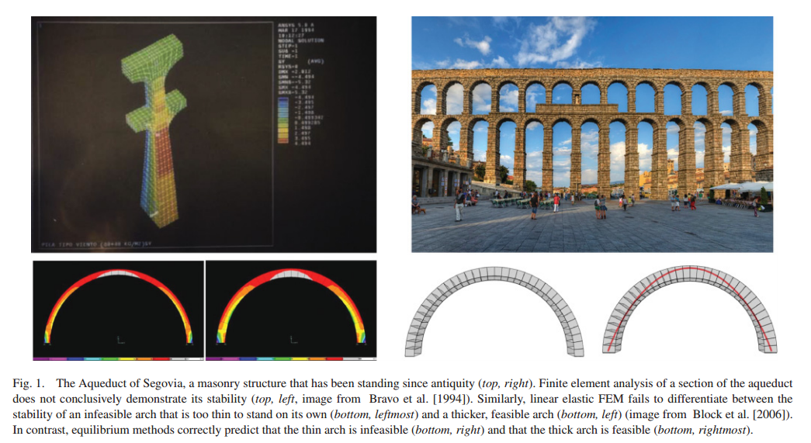
Reconciling Elastic and Equilibrium Methods for Static Analysis
Computational design of structures, shapes, and sound
Shin et al., MIT
Coupled analysis of FEM and equilibrium models for linear elasticity.
Present a unified formulation for the two approaches to stability analysis.
Notes:
I’ll start this section will with a brief introduction of urban modeling pipelines, forward and inverse. Then I will organize inverse procedural modeling approaches into three categories based on the input: image based, mesh based, and point based. Then some representative papers per category will be discussed.

Slide 33
Computational Design of Stable Planar-Rod Structures
Computational design of structures, shapes, and sound
Villalba et al., Austria
Planar input contours -> stable, self-supporting wire sculpture
Determine feasibility, ordering of wires
Optimize the shape to maximize stability under friction
Notes:
I’ll start this section will with a brief introduction of urban modeling pipelines, forward and inverse. Then I will organize inverse procedural modeling approaches into three categories based on the input: image based, mesh based, and point based. Then some representative papers per category will be discussed.

Slide 34
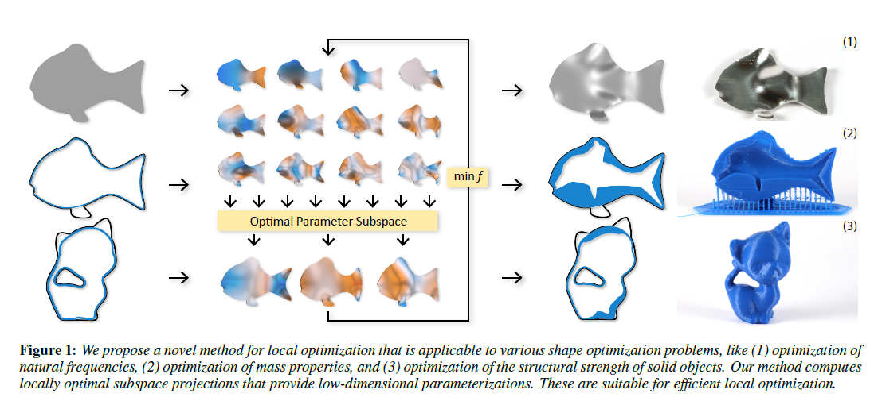
Non-Linear Shape Optimization Using Local Subspace Projections
Computational design of structures, shapes, and sound
Musialski et al., TUW
Surface representation + design goal -> projections to local subspaces -> optimal solutions based on the problem.
Notes:
I’ll start this section will with a brief introduction of urban modeling pipelines, forward and inverse. Then I will organize inverse procedural modeling approaches into three categories based on the input: image based, mesh based, and point based. Then some representative papers per category will be discussed.

Slide 35
Acoustic Voxels: Computational Optimization of Modular Acoustic Filters
Computational design of structures, shapes, and sound
Li et al., Columbia
Define a building block of sound, represented by its transmission matrix
Optimize the combination and parameters of the building blocks for the target acoustic filter within the target shape
Notes:
I’ll start this section will with a brief introduction of urban modeling pipelines, forward and inverse. Then I will organize inverse procedural modeling approaches into three categories based on the input: image based, mesh based, and point based. Then some representative papers per category will be discussed.

Slide 36
Sessions
Procedural modeling
Meshes
Meshes & fields
Shape signature
Fabricating structure & appearance
Computational design of structures, shapes, and sound
Correspondence & mapping
Deformable surface design

Slide 37
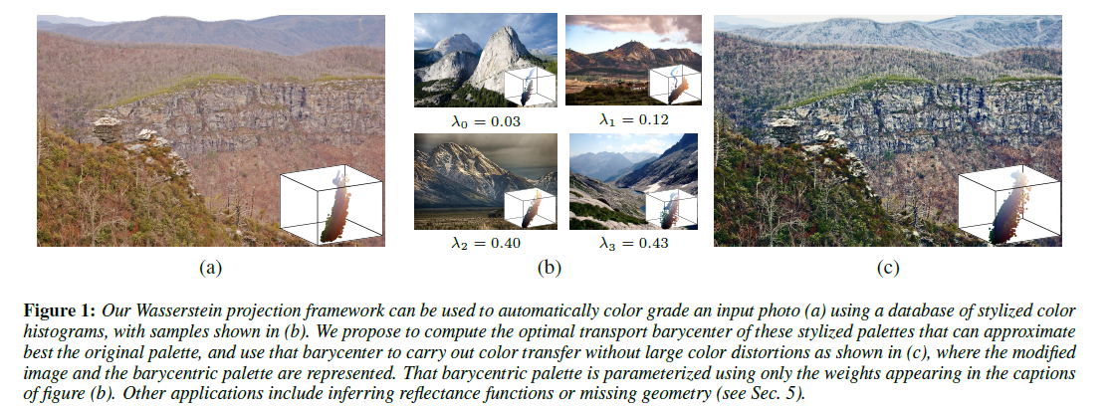
Wasserstein Barycentric Coordinates: Histogram Regression Using Optimal Transport
Correspondence & mapping
Bonneel et al.
Geometrically faithful regressions on histograms
Uses optimal transport and Wasserstein barycenters, for barycentric coordinates on histograms!
Notes:
I’ll start this section will with a brief introduction of urban modeling pipelines, forward and inverse. Then I will organize inverse procedural modeling approaches into three categories based on the input: image based, mesh based, and point based. Then some representative papers per category will be discussed.

Slide 38
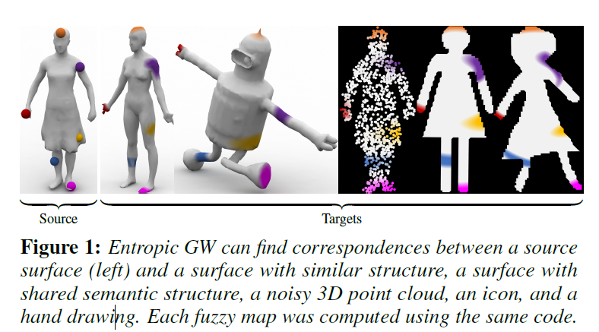
Entropic Metric Alignment for Correspondence Problems
Correspondence & mapping
Solomon et al. MIT
An algorithm for probabilistic correspondence that optimizes an entropy-regularized Gromov-Wasserstein (GW) objective.
Applicable to any geometric domain expressible as a metric measure matrix.
Can be used for incorporating partial distance matrices, user guidance, shape exploration, symmetry detection, and joint analysis of more than two domains.
Notes:
I’ll start this section will with a brief introduction of urban modeling pipelines, forward and inverse. Then I will organize inverse procedural modeling approaches into three categories based on the input: image based, mesh based, and point based. Then some representative papers per category will be discussed.

Slide 39
Point Registration via Efficient Convex Relaxation
Correspondence & mapping
Maron et al. Weizmann
An efficient convex semi-definite relaxation for procustes matching problem.
Imagine an ICP that returns a correct global solution.
Notes:
I’ll start this section will with a brief introduction of urban modeling pipelines, forward and inverse. Then I will organize inverse procedural modeling approaches into three categories based on the input: image based, mesh based, and point based. Then some representative papers per category will be discussed.

Slide 40
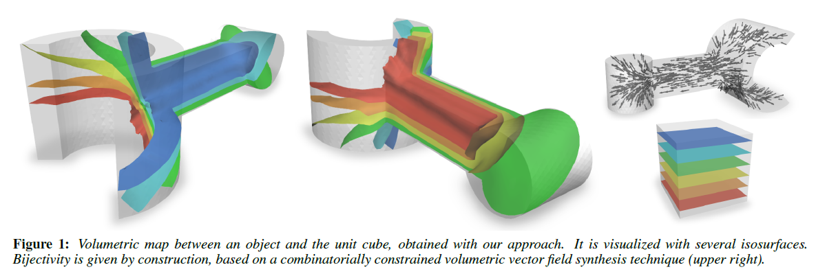
Bijective Maps From Simplicial Foliations
Correspondence & mapping
Campen et al. NYU
Bijective parameterization of 2D and 3D objects over canonical domains
Guaranteed bijectivity of mappings on shellable meshes.
Uses piecewise-linear foliation, decomposing the mesh into one-dimensional sub-manifolds
Notes:
I’ll start this section will with a brief introduction of urban modeling pipelines, forward and inverse. Then I will organize inverse procedural modeling approaches into three categories based on the input: image based, mesh based, and point based. Then some representative papers per category will be discussed.

Slide 41
Globally Optimal Toon Tracking
Correspondence & mapping
Zhu et al. Hong Kong
Use appearance + motion to track things in 2D hand drawn animation.
Correspondence likelihoods between temporal region pairs are formulated as a network flow graph problem.
Notes:
I’ll start this section will with a brief introduction of urban modeling pipelines, forward and inverse. Then I will organize inverse procedural modeling approaches into three categories based on the input: image based, mesh based, and point based. Then some representative papers per category will be discussed.

Slide 42
Sessions
Procedural modeling
Meshes
Meshes & fields
Shape signature
Fabricating structure & appearance
Computational design of structures, shapes, and sound
Correspondence & mapping
Deformable surface design

Slide 43
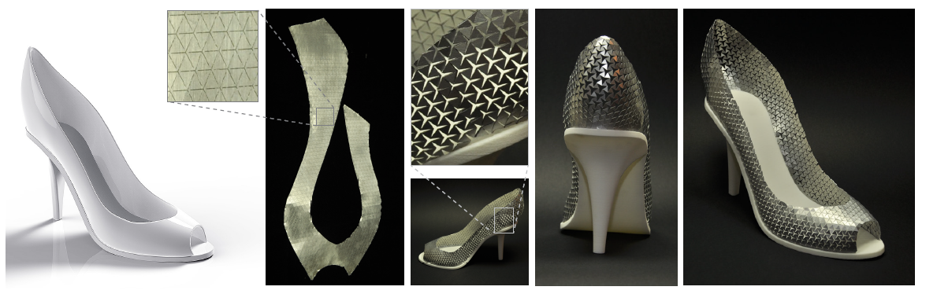
Beyond Developable: Computational Design and Fabrication With Auxetic Materials
Deformable surface design
Pauly et al., EPFL
Auxetic material = flat flexible material that can stretch uniformly
Enables approximation of doubly-curved surfaces using only flat pieces
Compute a global conformal map with bounded scale factor to initialize an otherwise intractable non-linear optimization.
Notes:
I’ll start this section will with a brief introduction of urban modeling pipelines, forward and inverse. Then I will organize inverse procedural modeling approaches into three categories based on the input: image based, mesh based, and point based. Then some representative papers per category will be discussed.

Slide 44
Interactive Design of Developable Surfaces
Deformable surface design
Tang et al.
Developables = splines, the nonlinear conditions relating to developability and curved folds = quadratic equations.
Combined into an energy-guided projection onto the constraint manifold, fast enough for interactive modeling.
Using a combined primal-dual surface representation, to robustly and quickly solve approximation problems
Notes:
I’ll start this section will with a brief introduction of urban modeling pipelines, forward and inverse. Then I will organize inverse procedural modeling approaches into three categories based on the input: image based, mesh based, and point based. Then some representative papers per category will be discussed.

Slide 45
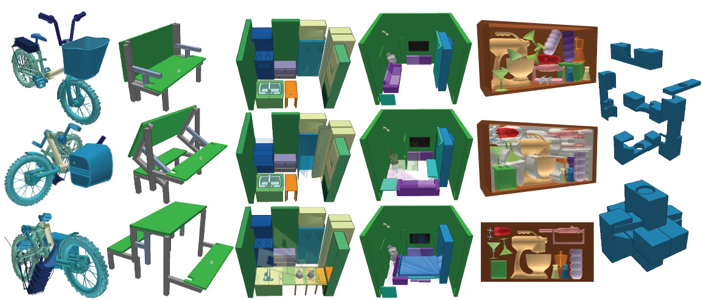
Computational Design of Reconfigurables
Deformable surface design
Garg et al., Columbia
A software environment intended to support fluid interactive design of reconfigurables, featuring tools that identify, visualize, monitor and resolve infeasible configurations.
Complex contacts are eliminated using constrained numerical optimization and swept-volume carving.
Notes:
I’ll start this section will with a brief introduction of urban modeling pipelines, forward and inverse. Then I will organize inverse procedural modeling approaches into three categories based on the input: image based, mesh based, and point based. Then some representative papers per category will be discussed.

Slide 46
Efficient and Flexible Deformation Representation for Data-Driven Surface Modeling
Deformable surface design
Gao et al.
A new rotation-invariant deformation representation and a novel reconstruction algorithm to accurately reconstruct the positions and local rotations simultaneously.
Meshes are reconstructed by matrix predecomposition, at the same time, hard or soft constraints can be flexibly specified with only positions of handles needed
Novel data-driven approaches to mesh deformation and non-rigid registration of deformable objects. Both problems are formulated consistently as finding an optimized model in the shape space that satisfies boundary constraints, either specified by the user, or according to the scan.
Notes:
I’ll start this section will with a brief introduction of urban modeling pipelines, forward and inverse. Then I will organize inverse procedural modeling approaches into three categories based on the input: image based, mesh based, and point based. Then some representative papers per category will be discussed.

