Slide 2
Covered Sessions by Gen Nishida
Rigging & skinning
Perception of shapes and people
Display software
Fluids simulation
Intrinsic images
Sketching & writing
Plants & humans
Expressive animation

Slide 3
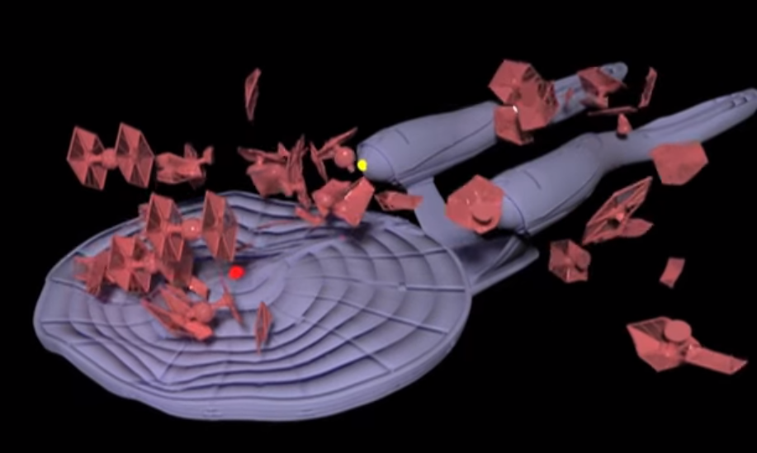
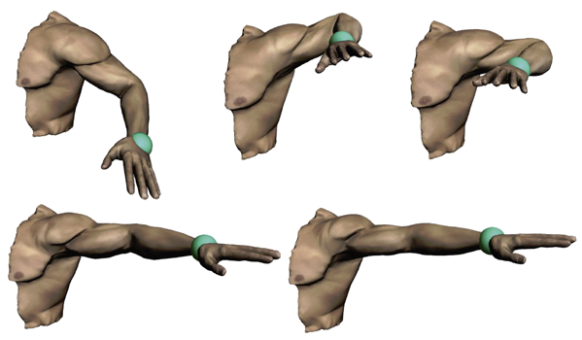
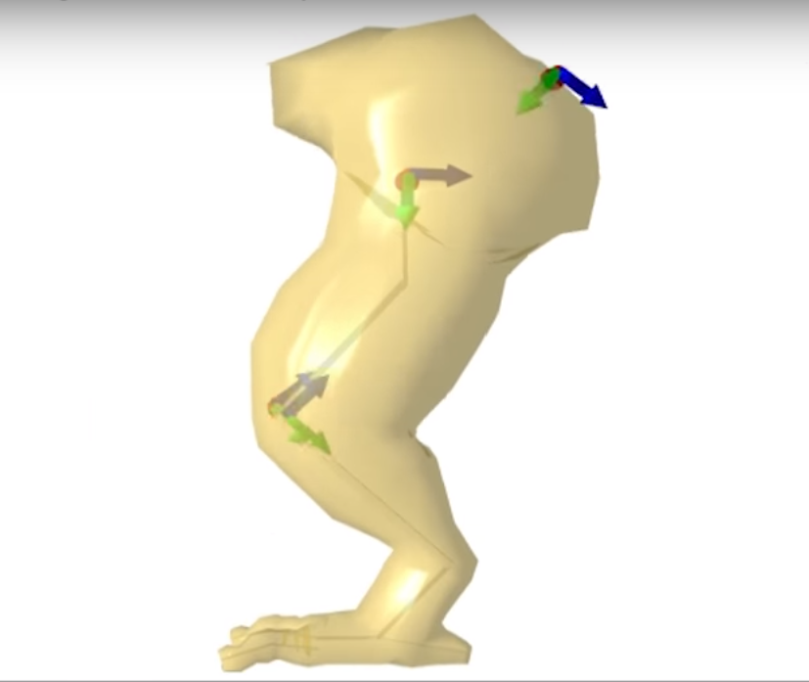
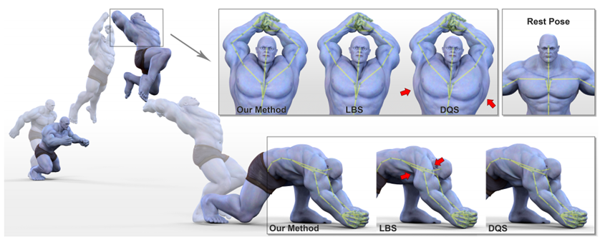
1. Rigging & skinning
Example-based plastic deformation of rigid bodies
Pose-space subspace dynamics
Efficient dynamic skinning with low-rank helper bone controllers
Real-time skeletal skinning with optimized centers of rotation

Slide 4
1.1. Example-based plastic deformation of rigid bodies
An artist provides example deformations
The simulation maps collision impulses to deformations and blends them

Slide 5
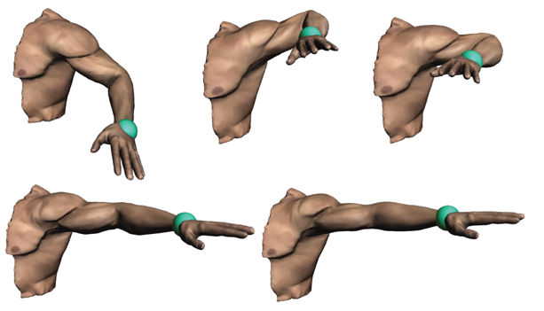
1-2. Pose-space subspace dynamics
Secondary soft-tissue FEM dyamics
Pose-dependent model reduction
Localized basis weights
1.2.mp4
(0:34 – 0:47)

Slide 6
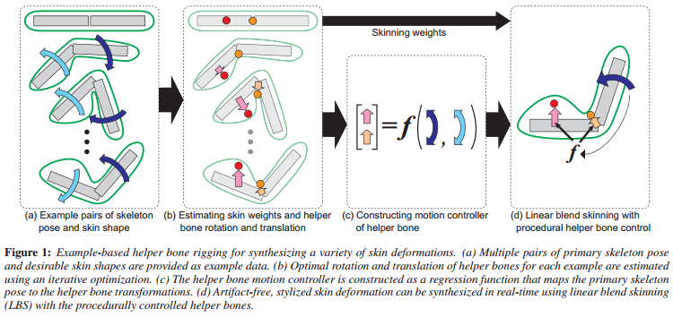
1.3. Efficient dynamic skinning with low-rank helper bone controllers
Helper bone system
Automatically build helper bone rigs from examples
https://youtu.be/LxI8tqdFSYo
(0:34 – 0:50)

Slide 7
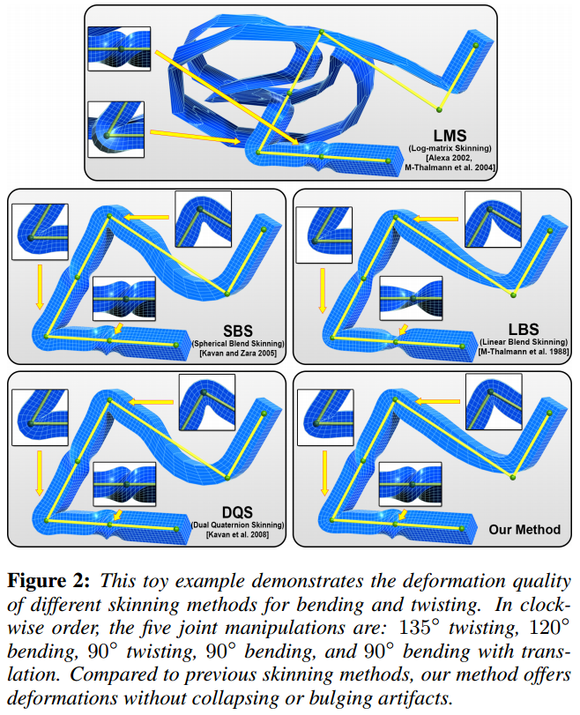
1.4. Real-time skeletal skinning with optimized centers of rotation
Linear blend skinning (LBS) and dual quaternion skinning (DQS) have many artifacts
E.g., elbow-collapsing, candy wrapper, and joint bulging
Precompute the optimized center of rotation and skinning weights
https://youtu.be/DfIfcQiC2oA
(0:13 – 1:08)

Slide 8
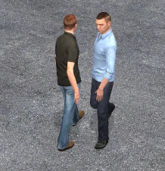
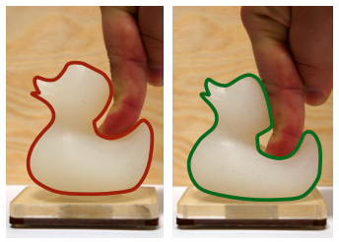
2. Perception of shapes and people
Tactile mesh saliency
Perceptual effect of shoulder motions on crowd animations
Body talk: crowd shaping realistic 3d avatars with words
An interaction-aware perceptual model for non-linear elastic objects

Slide 9
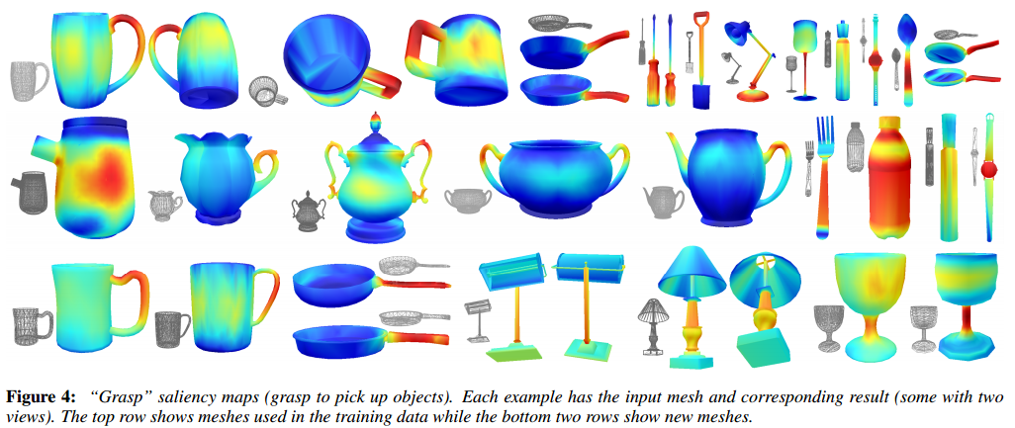
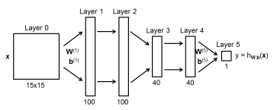
2.1. Tactile mesh saliency
The ground truth is collected by Amazon Mechanical Turk HITs
Multi-view based saliency value estimation using deep neural network input: depth image, output: saliency value

Slide 10
2.2. Perceptual effect of shoulder motions on crowd animations
3 shoulder motions
11 interposonal distances
Shoulder motions decrease the probability of perceiving collisions
https://people.rennes.inria.fr/Ludovic.Hoyet/Documents/Videos/2016_Siggraph.mp4
(4:20 – 4:30)

Slide 11
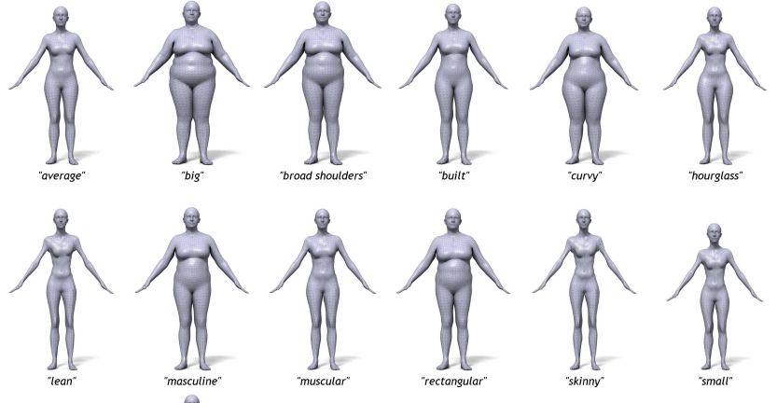
2.3. Body talk: crowd shaping realistic 3d avatars with words
8 principal shape components
30 body descriptor words e.g., curvy, fit, heavyset, round-apple
Use Mturk rators to collect the values for 30 descriptive words
Use linear regression to train
http://bodytalk.is.tue.mpg.de/

Slide 12
2.4. An interaction-aware perceptual model for non-linear elastic objects
12 stimuli with different internal structures were used to obtain force-displacement curves
Use non-metric MDS for a Euclidean embedding

Slide 13
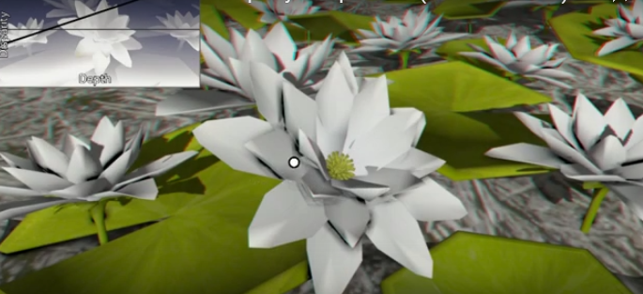
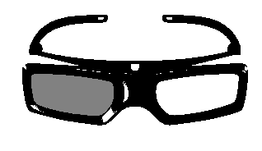
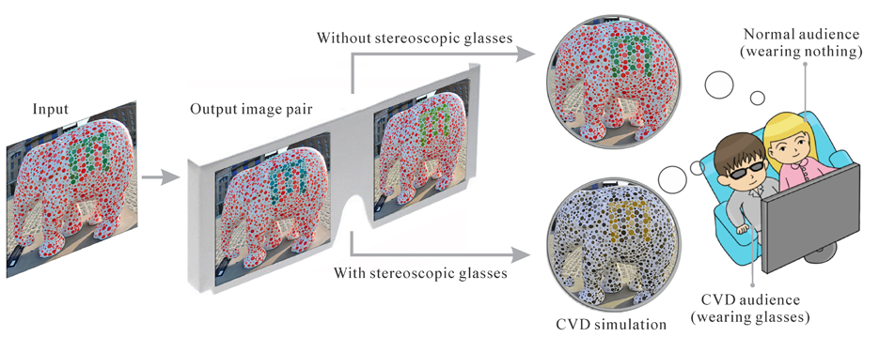
3. Display software
Emulating displays with continuously varying frame rates
GazeStereo3D: seamless disparity manipulations
Binary-continuous image decomposition for multi-view display
Seamless visual sharing with color-vision deficiencies

Slide 14
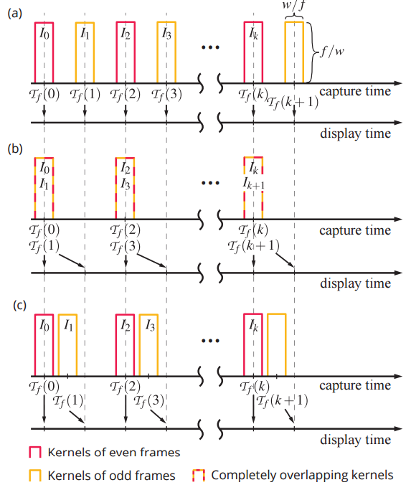
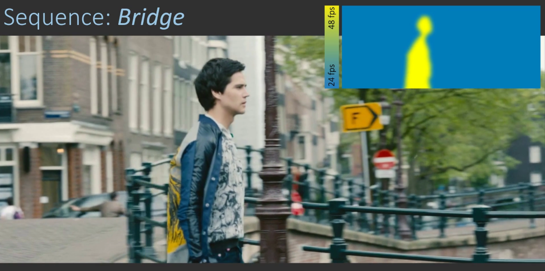
3.1. Emulating displays with continuously varying frame rates
Emulate varying frame rates on a single-frame-rate display
Displace kernels to achieve smooth interpolation

Slide 15
3.2. GazeStereo3D: seamless disparity manipulations
Utilize eye tracking or gaze prediction
Apply gradual stereoscopic depth adjustment

Slide 16
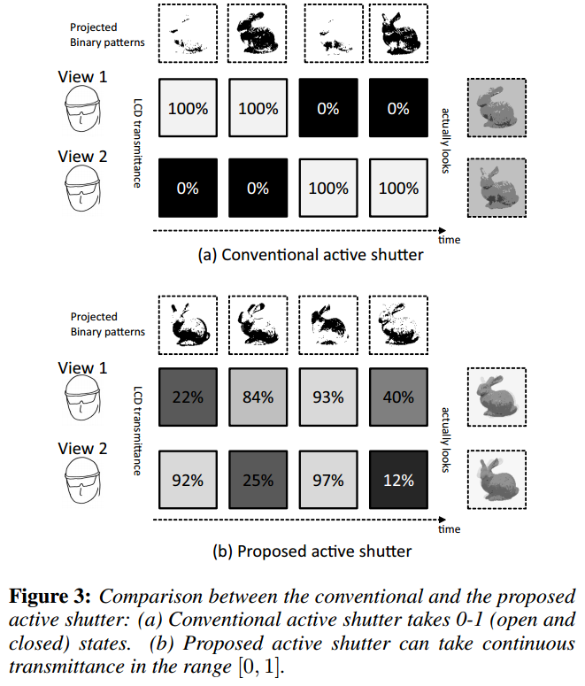
3.3. Binary-continuous image decomposition for multi-view display
Use the digital light processing (DLP) projection system
Extend the 0-1 state active shutter glasses to a continuous range [0, 1] to reduce “flicker” and quantization errors

Slide 17
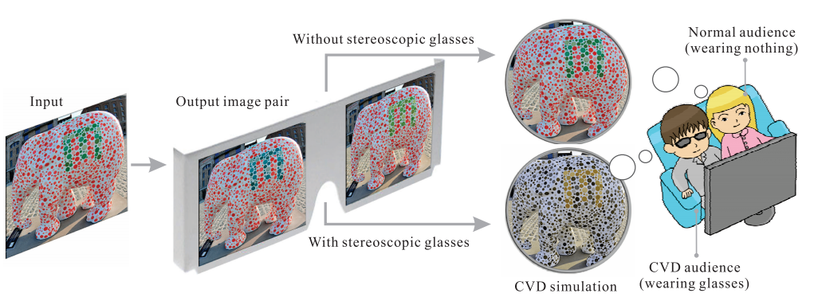
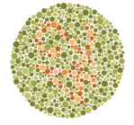
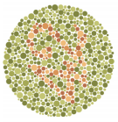
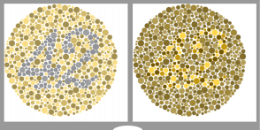
3.4. Seamless visual sharing with color-vision deficiencies
Color vision deficiency (CVD) and normal-vision audiences can share the same visual content
Linear blending for normal-vision audiences
Maximize the color distinguishability and binocular fusibility for CVD audiences

Slide 18
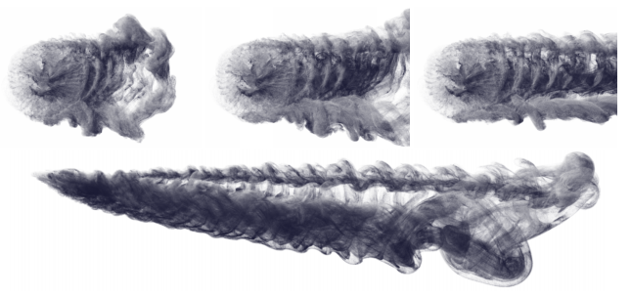
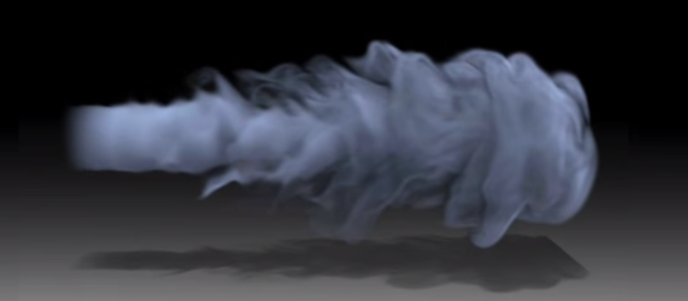
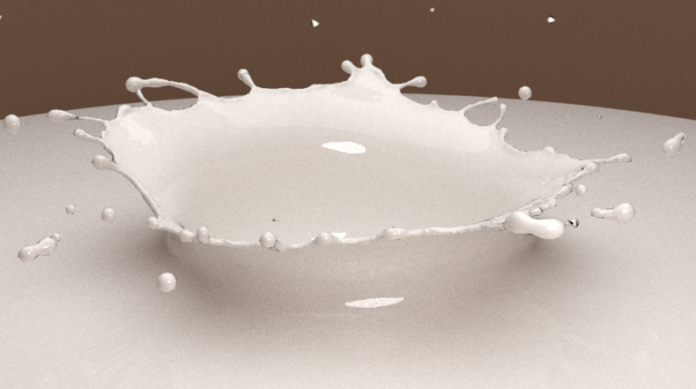
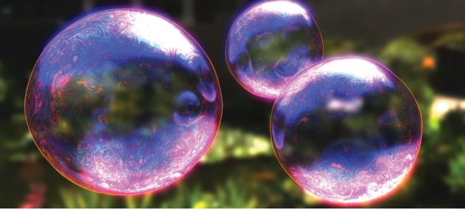
4. Fluids simulation
Resolving fluid boundary layers with particle-strength exchange and weak adaptivity
Schrödinger’s smoke
Surface-only liquids
Efficient fluid simulation on the surface of a sphere

Slide 19
4.1. Resolving fluid boundary layers with particle-strength exchange and weak adaptivity
Viscosity becomes crucial near solid boundaries
Add ghost particles near the boundary
Solve Navier-Stokes equation by a particle strength exchange (PSE) method
RK3 for particle advection
Use the Eulerian grid to make the field divergence free
4.1.mp4 (3:59 – 4:18)

Slide 20
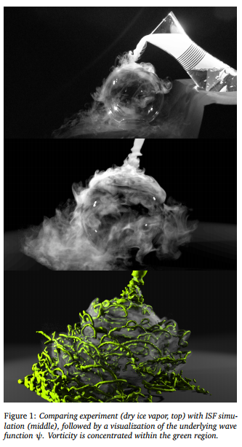
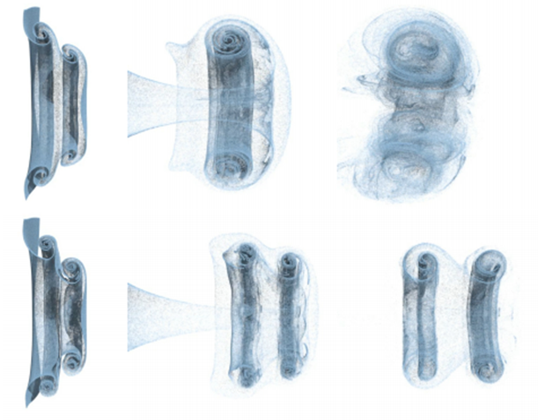
4.2. Schrödinger’s smoke
Pure Eulerian simulation under the Schrödinger equation subject to incompressibility constraints
No Lagrangian techniques is required for advection
MacCormack
ISF
https://youtu.be/5C9BLAXCe1I
(5:09 – 5:18)

Slide 21
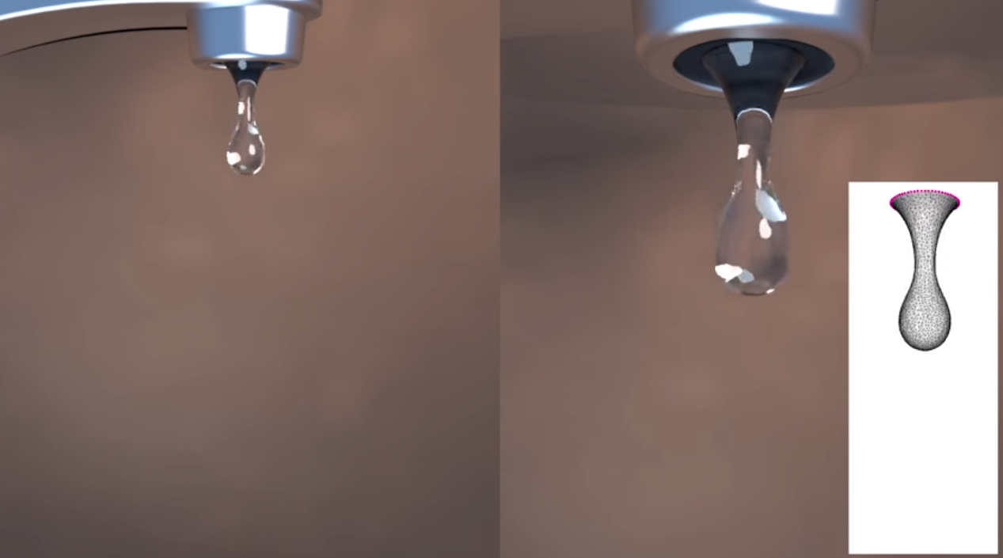
4.3. Surface-only liquids
Inviscid and uniform-density liquids with surface tension
Store a Lagrangian velocity field for the liquid surface
Use an orthogonal projection technique to remove the divergence
https://youtu.be/l43WusCMvZU
(0:05 – 0:25)

Slide 22
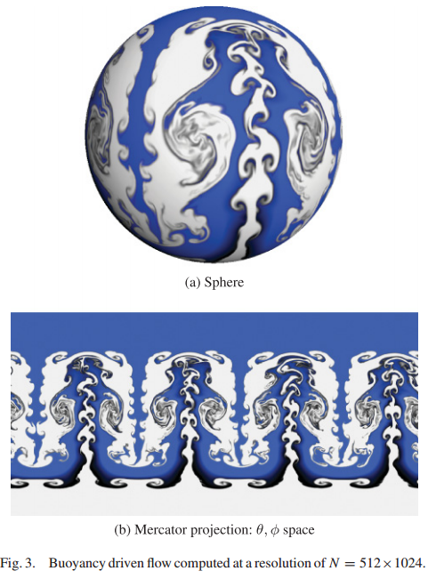
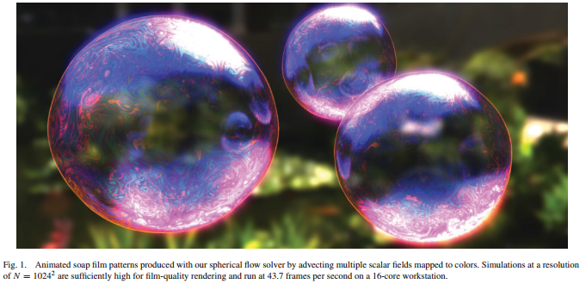
4.4. Efficient fluid simulation on the surface of a sphere
Use spherical polar coordinate system
Use Navier-Stokes equations on the surface
RK3 for advection or a modified MacCormack for higher-quality results

Slide 23
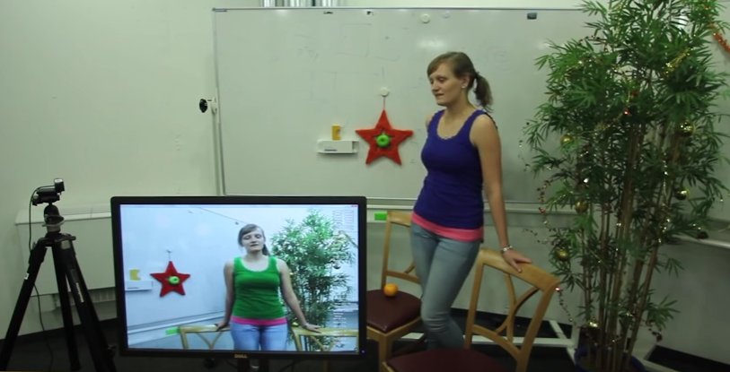
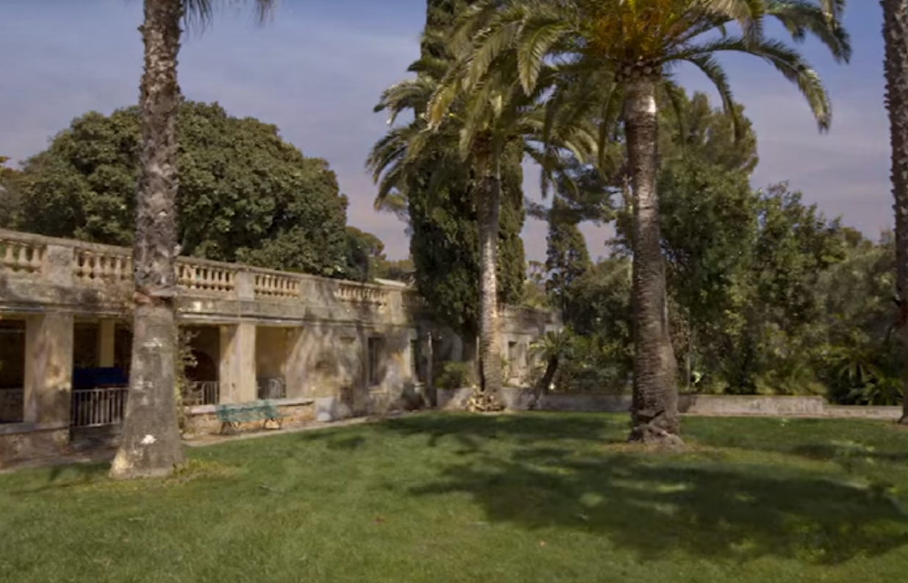
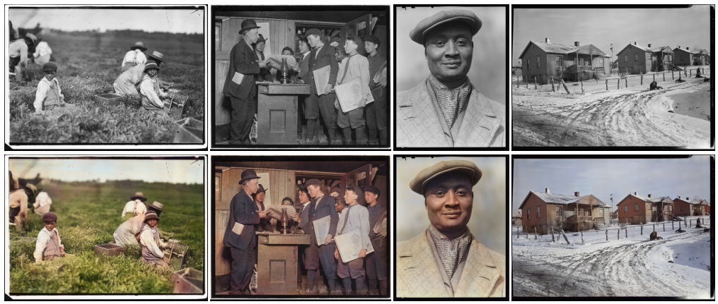
5. Intrinsic images
Live intrinsic video
Multi-view intrinsic images of outdoors scenes with an application to relighting
Let there be color!: joint end-to-end learning of global and local image priors for automatic image colorization with simultaneous classification
Approximate translational building blocks for image decomposition and synthesis

Slide 24
5.1. Live intrinsic video
Real-time intrinsic decomposition of live video footage
Temporally coherent decompositions using spatio-temporal priors
Coarse-to-fine optimization for real-time performance
No user input is required

Slide 25
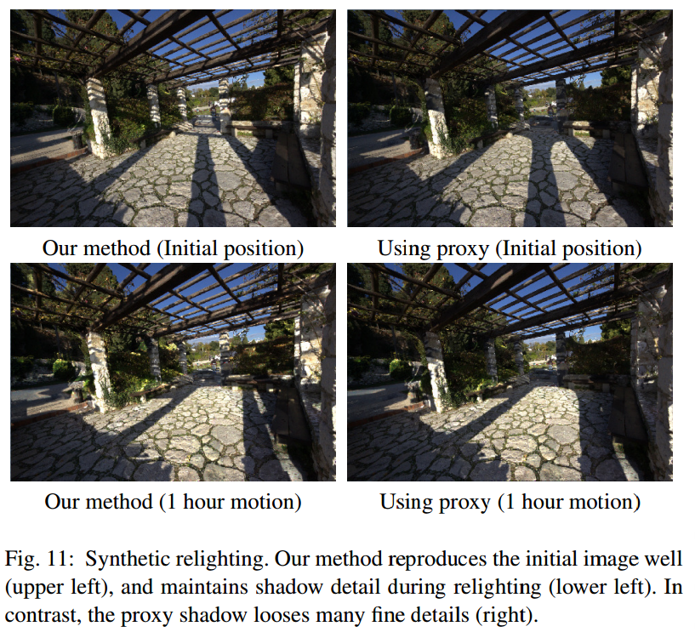
5.2. Multi-view intrinsic images of outdoors scenes with an application to relighting
Input: image, approximate 3D model constructed by the multi-view stereo 3D reconstruction, and the sun direction.
https://youtu.be/uRwfqNl0bpQ
(1:06 – 1:25)

Slide 26
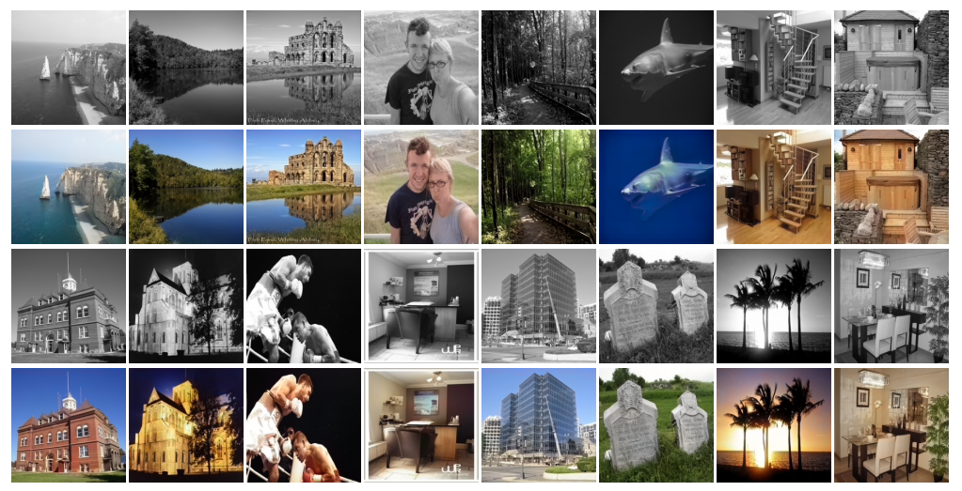
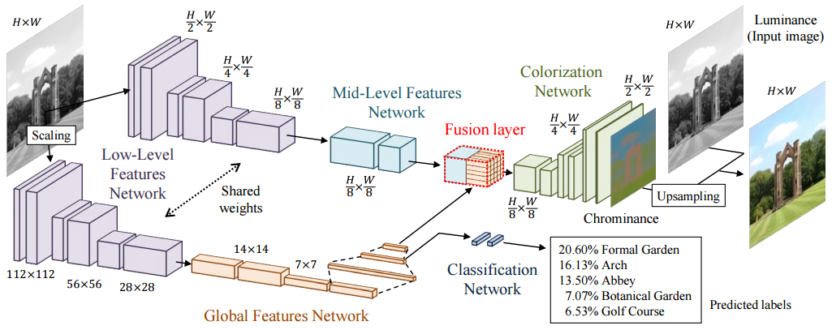
5.3. Let there be color!: joint end-to-end learning of global and local image priors for automatic image colorization with simultaneous classification
Combine global and mid-level features
Only global features are used for classification

Slide 27
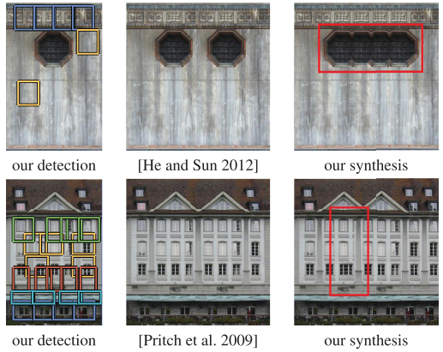
5.4. Approximate translational building blocks for image decomposition and synthesis

Slide 28
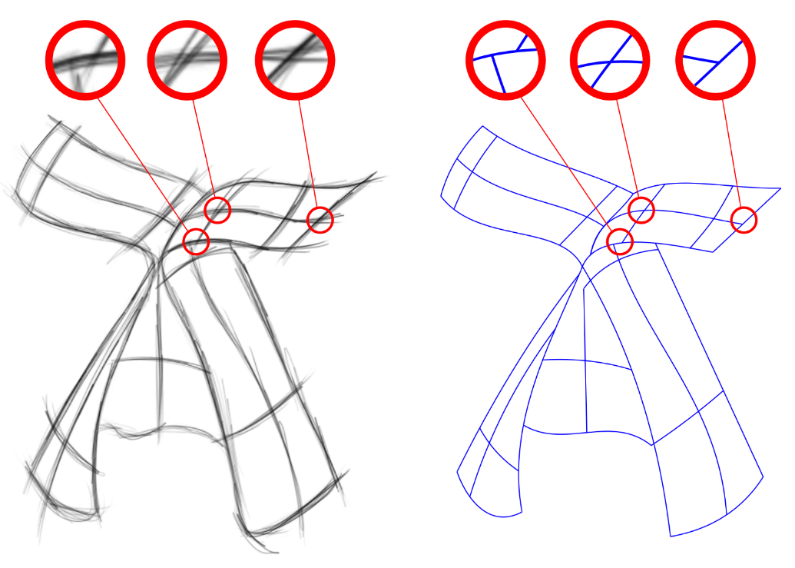
6. Sketching & writing
The sketchy database: learning to retrieve badly drawn bunnies
Fidelity vs. simplicity: a global approach to line-drawing vectorization
Learning to simplify: fully convolutional networks for rough sketch cleanup
Legible compact calligrams

Slide 29
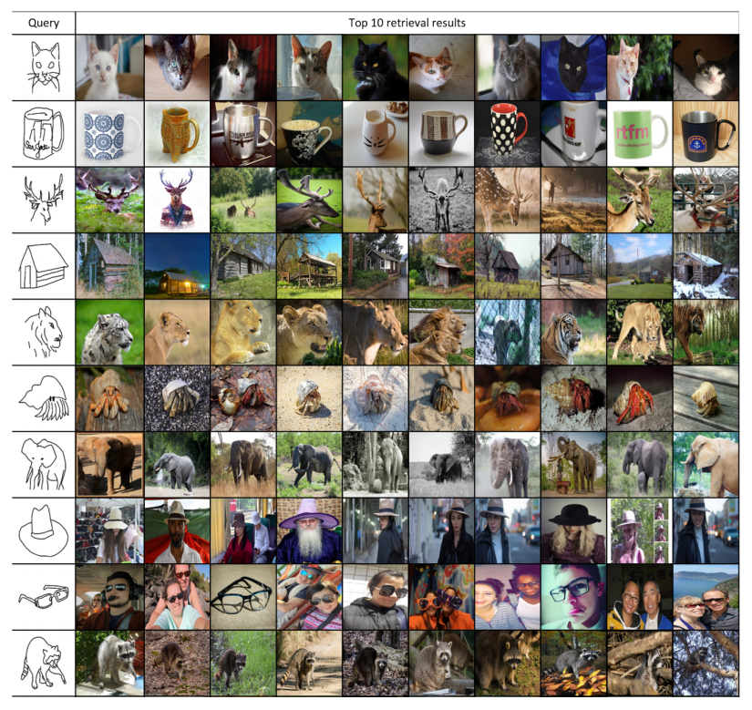
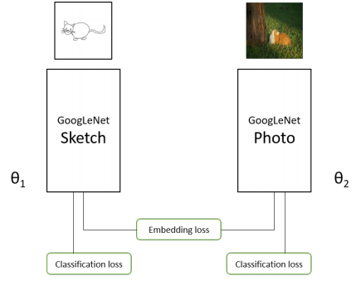
6.1. The sketchy database: learning to retrieve badly drawn bunnies
Learn cross-domain embedding by CNNs
Contrastive loss as used in a Siamese net

Slide 30
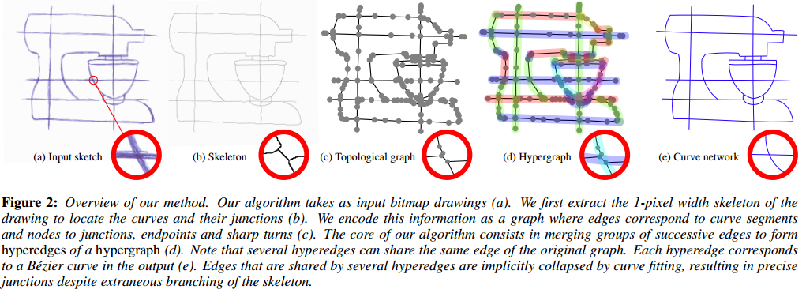
6.2. Fidelity vs. simplicity: a global approach to line-drawing vectorization
Use a concept of hypergraph to simplify the drawing
Perturb the hypergraph to optimize it balancing between the simplicity and fidelity

Slide 31
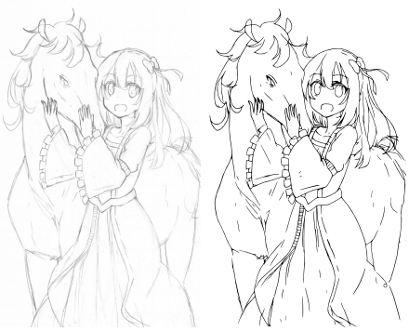
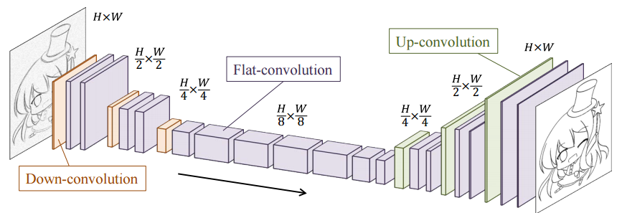
6.3. Learning to simplify: fully convolutional networks for rough sketch cleanup
Clean the user sketch by the deep CNN
Use Potrace to vectorize the output
Only 68 pairs of training images drawn by 5 artists

Slide 32
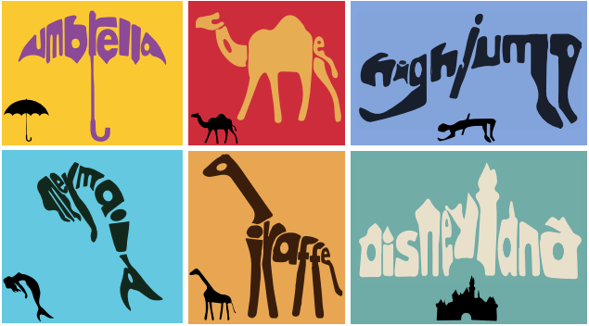
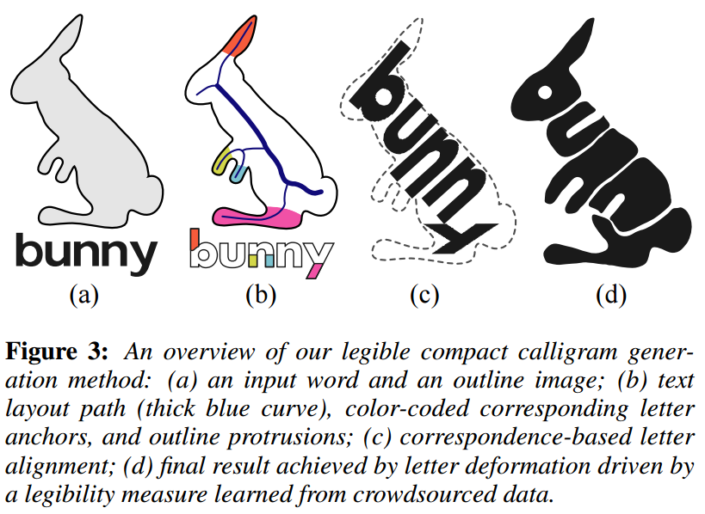
6.4. Legible compact calligrams
Fully automatic method
Use Mturk to measure the legibility of deformed letters

Slide 33
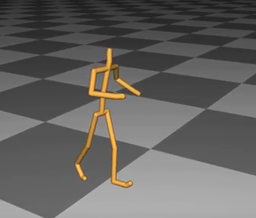
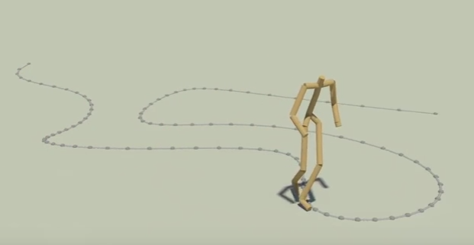
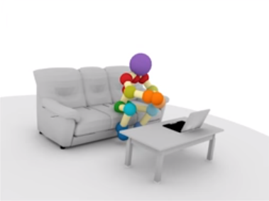
7. Plants & humans
Modeling dense inflorescences
Spectral style transfer for human motion between independent actions
A deep learning framework for character motion synthesis and editing
PiGraphs: learning interaction snapshots from observations

Slide 34
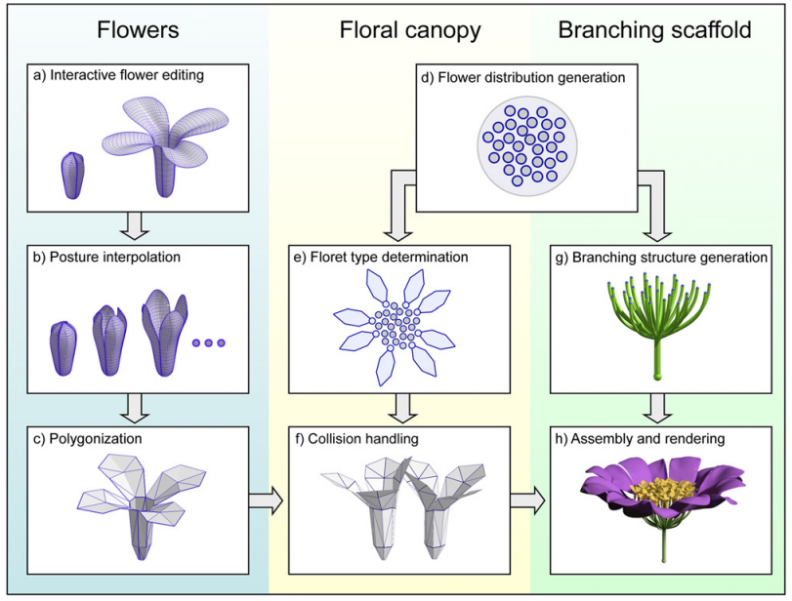
7.1. Modeling dense inflorescences
Semi-interactive method for polygonization
Resolve collisions by position based dynamics (PBD)
Generate branching by a extended Rodkaew algorithm
http://algorithmicbotany.org/papers/inflorescence.sig16.low.mp4
(1:10 – 1:20)

Slide 35
7.2. Spectral style transfer for human motion between independent actions
A spectral domain representation of the human motion A spatial correspondence free
Transfer the mood or identity of a motion to enhance the style database
https://youtu.be/NYDeH-knnAI
(0:16 – 0:27)

Slide 36
7.3. A deep learning framework for character motion synthesis and editing
Train a convolutional autoencoder to learn an embedding of motion data
No user intervention is required
Compute a Gram matrix from the hidden layer and for style transfer
https://youtu.be/urf-AAIwNYk
(1:35 – 1:55)

Slide 37
7.4. PiGraphs: learning interaction snapshots from observations
Use RGB-D sensors
Propose the PiGraph representation, which encodes a probability distribution over human pose and the surrounding environments
Given a sentence, generate a scene automatically
https://youtu.be/Ws9jPxCAFrg
(1:40 – 1:48)

Slide 38
8. Expressive animation
Artist-directed dynamics for 2d animation
Modeling character canvases from cartoon drawings
SketchiMo: sketch-based motion editing for articulated characters
Shadow theatre: discovering human motion from a sequence of silhouettes

Slide 39
8.1. Artist-directed dynamics for 2d animation
Characters are controlled by handles
Handle locations are defined by the artist
Both simulation parameters and example shapes can be used to guide the simulation
https://youtu.be/zICe4hYAJBE
(1:31 – 1:49)

Slide 40
8.2. Modeling character canvases from cartoon drawings
Generate a 3D character from a 2D drawing and a 3D skeleton
A 3D skeletons resolves much of the ambiguity

Slide 41
8.3. SketchiMo: sketch-based motion editing for articulated characters
A 3D articulated character and a motion data
Artists can intuitively edit the trajectories of the movement of the character by 2D strokes
Solve the sketch-based inverse kinematics to optimize the motion
https://youtu.be/hcOQ0H-ISRM
(0:05 – 0.40)

Slide 42
8.4. Shadow theatre: discovering human motion from a sequence of silhouettes
Use Covariance Matrix Adaptation Evolution Strategy (CMA-ES) algorithm to find a sub-optimal solutions.
If the result is unsatisfactory, add a new actor and start over the CMA-ES algorithm.
167 min
81 min
232 min
19 min

