Slide 1
VR Locomotion

Slide 2
VR Locomotion
We now have untethered VR systems, with wide-area, inside looking out tracking
Physical space is limited, and encumbered, and different from VE
Headset is heavy so wearing it extensively is tiring
Headset is heavy so abrupt motions are not possible

Slide 3
VR Locomotion
Locomotion other than walking requires additional tracking, haptics
VR swimming, flying

Slide 4
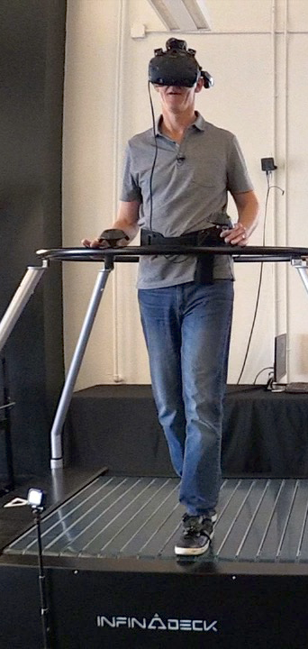
Physical device to keep user at center of physical space
VR treadmill
True walking
E.g., Infinadeck
Sliding
E.g., Virtualizer

Slide 5
Walking in place
User simulates walking, while standing in same location
Requires tracking more than head
Simulated walking is not real walking

Slide 6
Redirected walking
15 Years of Research on Redirected Walking in Immersive Virtual Environments, IEEE CG&A, Nilsson et al., 2018
An approach for making a large VE fit in a smaller physical space hosting the VR app
Manipulation of the user tracking data, such that real motion is not translated 1:1 to VE motion
Manipulation of VE geometry to fit in physical space available
Design criteria
Imperceptible
Safe (no collisions)
Generalizable, i.e. to any VE, any number of users
Comfortable (no side effects such as cybersickness)

Slide 7
Manipulation of user tracking data
Rotation gains
First ever redirected walking technique

Slide 8
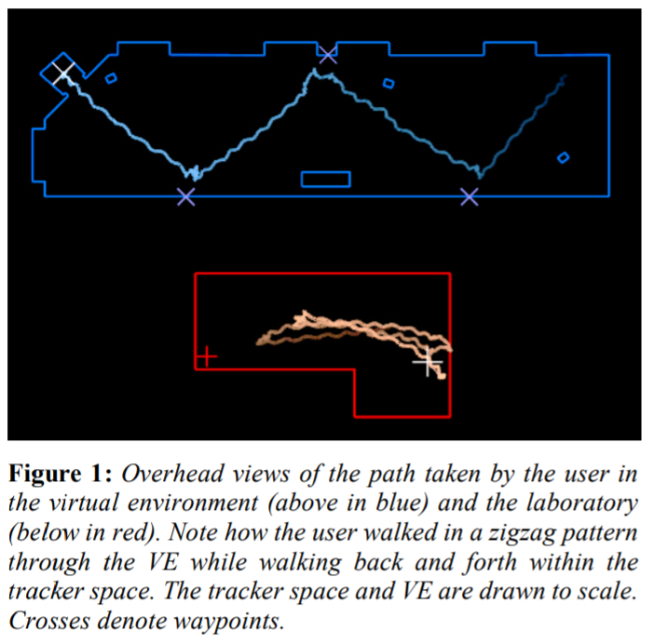
Redirected Walking, Razzaque et al., Eurographics 2001
Insight: “a person wearing a blindfold and instructed to walk in a straight line, unknowingly walks along an arc instead”

Slide 9
Redirected Walking, Razzaque et al., Eurographics 2001
Technique:
distort rotation to get the user to walk towards empty physical space
Distortion is a function of user position, orientation, and linear and angular velocities

Slide 10
Redirected Walking, Razzaque et al., Eurographics 2001
User study
VE: 4m x 10m
Task: fire drill, press four buttons located on walls of VE

Slide 11
Redirected Walking, Razzaque et al., Eurographics 2001
User study
VE: 4m x 10m
Task: fire drill, press four buttons located on walls of VE
“The subjects were unfamiliar with our building and did not see the lab before entering the virtual environment. All of them were surprised, upon removing the headset, when they saw the actual size of the lab. All subjects reported that the virtual environment was larger than the lab space. Subjects were also surprised to learn they had been walking back and forth between the ends of the lab, rather than zigzag through the lab.”

Slide 12
Manipulation of user tracking data
Rotation gains
First ever redirected walking technique
Translation gains
Scaling up forward steps
Curvature gains
Walk in circle

Slide 13
Unlimited Corridor: Redirected Walking Techniques using Visuo Haptic Interaction, Matsumoto et al., SIGGRAPH 2016 Emerging Technologies
https://youtu.be/uS9u2WMDAd4

Slide 14
Unlimited Corridor: Redirected Walking Techniques using Visuo Haptic Interaction, Matsumoto et al., SIGGRAPH 2016 Emerging Technologies
https://youtu.be/uS9u2WMDAd4

Slide 15
Manipulation of user tracking data
Rotation gains
First ever redirected walking technique
Translation gains
Scaling up forward steps
Curvature gains
Walk in circle
Control and benefit from user attention

Slide 16
Tuning Self-Motion Perception in Virtual Reality with Visual Illusions, Bruder et al., IEEE TVCG 2012
Illusions to modify the user’s perception of motion in VR, to hide translational gain
Layered motion: optical flow cues
Contour filtering: move edges
Change blindness: show grey screen, manipulate gain, show VE again, sync w/ saccades & blinks
Contrast inversion: show images with inverted contrast to hide gain

Slide 17
Tuning Self-Motion Perception in Virtual Reality with Visual Illusions, Bruder et al., IEEE TVCG 2012
Illusions to modify the user’s perception of motion in VR, to hide translational gain
Layered motion: optical flow cues
Contour filtering: move edges
Change blindness: show grey screen, manipulate gain, show VE again, sync w/ saccades & blinks
Contrast inversion: show images with inverted contrast to hide gain

Slide 18
Towards Virtual Reality Infinite Walking: Dynamic Saccadic Redirection, Qi Sun et al., SIGGRAPH 2018
Redirect user aggressively, yet imperceptibly, during saccades
Saccade = rapid eye movement
Viewers momentarily blind due to saccadic suppression
Method
Saccade detection using gaze tracking
Dynamic path planning Use
Subtle gaze direction by rendering temporally-modulated stimuli in a user’s visual periphery to induce visual saccades

Slide 19
Towards Virtual Reality Infinite Walking: Dynamic Saccadic Redirection, Qi Sun et al., SIGGRAPH 2018
VIDEO

Slide 20
Multi-User Redirected Walking
Two or more users exploring the same VE, without interaction between the users
Added challenge of avoiding other users, who are dynamic obstacles

Slide 21
Multi-User Redirected Walking
Approach: Artificial Potential Field
Multi-User Redirected Walking and Resetting Using Artificial Potential Fields, Eric R. Bachmann, Eric Hodgson, Cole Hoffbauer, and Justin Messinger , IEEE TVCG & IEEE VR 2019
Effects of Tracking Area Shape and Size on Artificial Potential Field Redirected Walking Justin Messinger, Eric Hodgson, and Eric R. Bachmann
Forces acting on blue user, including “repulsion” due to red user.

Slide 22
Overt Walking Redirection
Seven League Boots: A New Metaphor for Augmented Locomotion through Moderately Large Scale Immersive Virtual Environments, Interrante et al., 3DUI 2007
Determine user’s intended direction of travel
E.g. average recent direction, gaze direction
Augment just along intended direction
This preserves, for example, the side-to-side swaying of head of walking user
User turns augmentation on and off with handheld controller

Slide 23
Overt Walking Redirection
B. Williams et al., “Exploring large virtual environments with an HMD when physical space is limited,” Proceedings of the ACM Symposium on Applied Perception in Graphics and Visualization (APGV 07), 2007, pp. 41–48.
freeze–backup technique where the virtual experience is frozen, the experimenter guides the user to the center of the tracked space, and the virtual experience is resumed
freeze–turn technique where the display system is frozen, the user physically turns toward the center of the tracked space, and the virtual experience is resumed;
the 2:1 turn where the user is instructed to stop and physically turn while the VE rotates at twice her speed. The user physically turns 180° and is rotated 360° in the virtual world.

Slide 24
Not overt, not imperceptible
Distractors, for the user to focus on while rotation gain is applied
E.g. red ball, hummingbird
Distractors integrated in narrative
Agents walking in front of user to slow them down
Agents walking on collision path with user to force user direction change

Slide 25
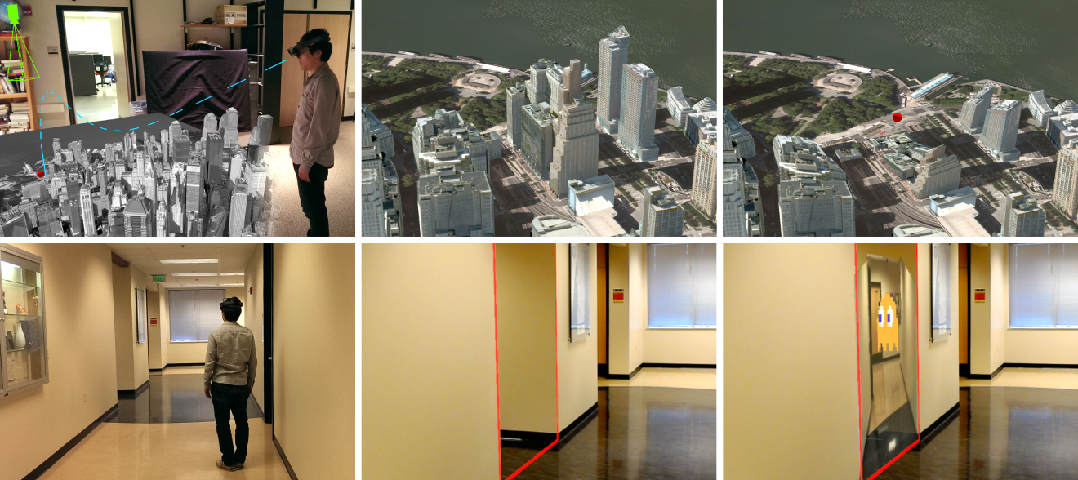
Making navigation more efficient by removing occlusions
Use additional viewpoints to route rays around occluders
Efficient VR and AR Navigation through Multiperspective Occlusion Management, Wu et al., IEEE TVCG & IEEE VR 2018

Slide 26
Manipulation of the VE geometry
Do not modify the tracking data, but rather the geometry of the VE, to make it fit in the available physical space
E.A. Suma et al., “Leveraging change blindness for redirection in virtual environments,” Proceedings of the 2011 IEEE Conference on Virtual Reality (VR 11), 2011, pp. 159–166.

Slide 27
Manipulation of the VE geometry
E.A. Suma et al., “Impossible spaces: Maximizing natural walking in virtual environments with self-overlapping architecture,” IEEE Transactions on Visualization and Computer Graphics, vol. 18, no. 4, 2012, pp. 555–564.

Slide 28
Manipulation of the VE geometry
Warp VE to fit in real world space
Compute off-line a globally surjective, locally injective map between virtual and real floor plan
Use map online, as you render each frame, to warp VE geometry
“Mapping virtual and physical reality.” Sun, Qi ; Wei, Li-Yi ; Kaufman, Arie. ACM Transactions on Graphics (TOG), 11 July 2016, Vol.35(4), pp.1-12

Slide 29
Manipulation of the VE geometry
Warp VE to fit in real world space
Compute off-line a globally surjective, locally injective map between virtual and real floor plan
Use map online, as you render each frame, to warp VE geometry
“Mapping virtual and physical reality.” Sun, Qi ; Wei, Li-Yi ; Kaufman, Arie. ACM Transactions on Graphics (TOG), 11 July 2016, Vol.35(4), pp.1-12

