Slide 1
Occlusion Management in VR: A Comparative Study
Lili Wang, Han Zhao , Zesheng Wang ,
Jian Wu , Bingqiang Li , and Zhiming He
Beihang University
Voicu Popescu
Purdue University
Notes:
Thank you for the introduction
I am FirstName and this work is together with Lili Wang, , Zesheng Wang, Jian Wu, Bingqiang Li, and Zhiming He from Beihang University, and Voicu Popescu from Purdue University.

Slide 2
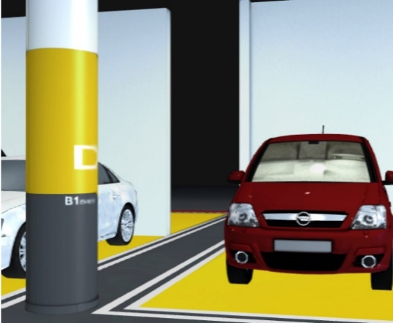
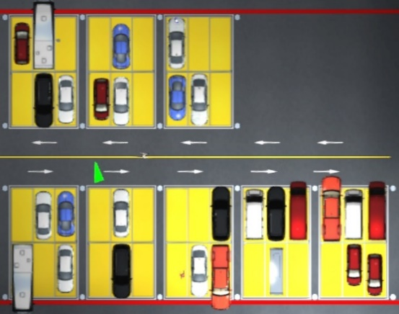
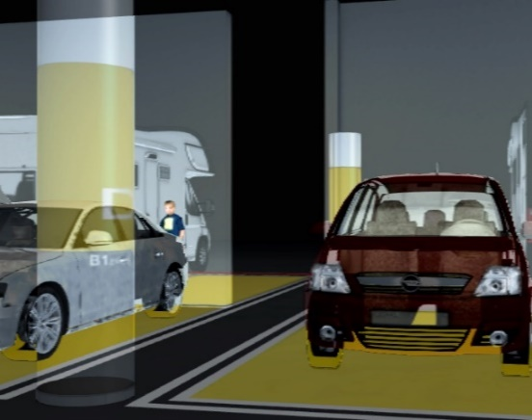
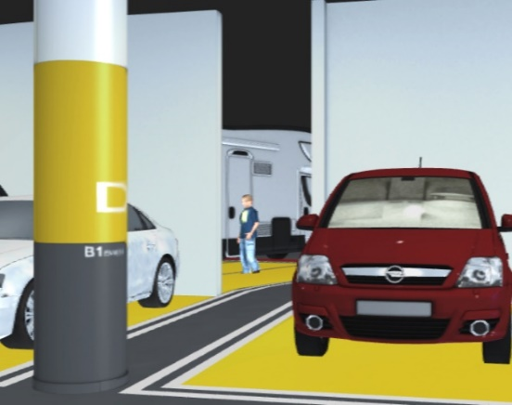
Motivation
VR scene exploration hindered by occlusions
occlusion
disocclusion
Notes:
VR applications rely on the user’s ability to explore the virtual scene efficiently.
In complex scenes, occlusions limit exploration efficiency as the user has to navigate the viewpoint around occluders to gain line of sight to hidden regions.
Furthermore, due to physical limitations, the user might not be able to assume a viewpoint that reveals an occluded region. (For example the viewpoint might be above the user’s head, or beyond the tracked area, and it cannot be reached by walking. )
This paper reports on a study that investigates three occlusion management methods (in the context of VR applications, comparing them to conventional navigation.

Slide 3
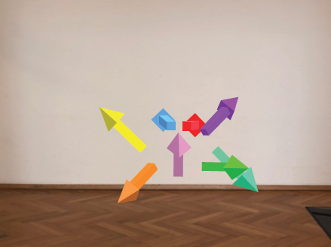
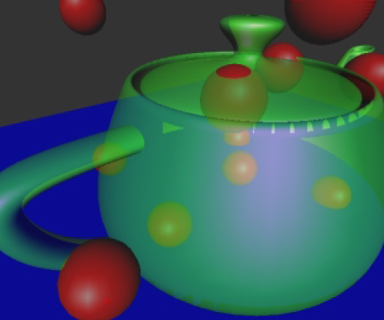
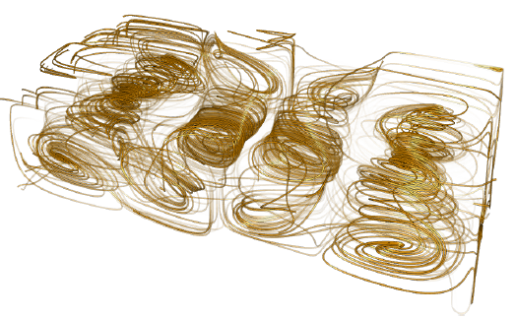
Occlusion Management Methods
Visual hints
Top-view
X-ray
[Bork et al. TVCG2018]
[Everitt et al. Nvdia2001]
[Gunther et al. TOG2013]
Notes:
One approach is to annotate the visualization to indicate to the user the path towards the regions of interest.
Another approach is to provide the user with a top-view of the scene that shows simultaneously the user position and the regions of interest.
A third option is to render the occluding layers transparently to reveal what they might hide.

Slide 4
Occlusion Management Methods
Multiperspective visualization
Conventional Multiperspective
[Wu&Popescu EuroVR2018]
Notes:
Another approach is to expand the visualization to integrate samples from multiple viewpoints.
For example here, a secondary viewpoint captures samples down the side corridor, which are integrated into the main view.

Slide 5
Occlusion Management Approaches Used in Study
Top view
X-ray
Multiperspective
Notes:
The three occlusion management methods used in our user study are top view, X-ray, and multiperspective visualization.
We have chosen these three methods for good coverage of the space of all possible occlusion management methods, while keeping the complexity of the user study manageable.

Slide 6
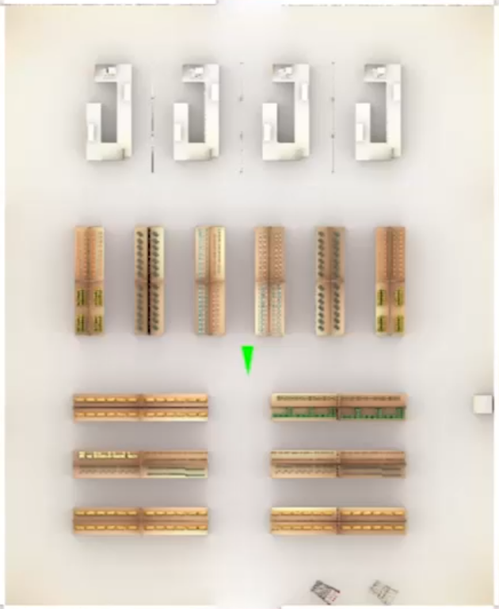
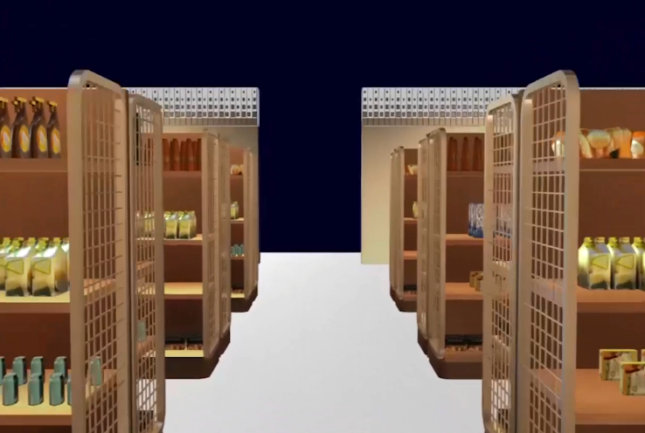
Top view visualization
First-person view
Top view
Notes:
We render the top view with an orthographic projection along the vertical direction. The user position and orientation is indicated with a green triangle.
The top view provides a comprehensive visualization of the scene.
When the regions of interest are easily identifiable from above, the user can build a mental model of their location, relative to the user’s current location.

Slide 7
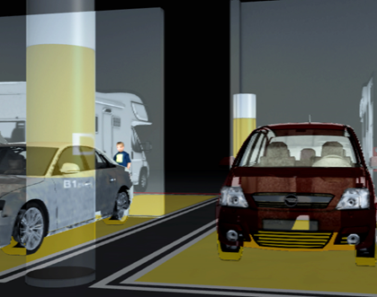
X-ray visualization
Conventional
X-ray
Notes:
X-ray visualization renders occluders semi-transparently, with the goal of exposing occluded regions of interest.
In the right picture, we can see the occluded little boy.
We implement X-ray visualization with a depth peeling approach that blends the closest occluding layers.

Slide 8
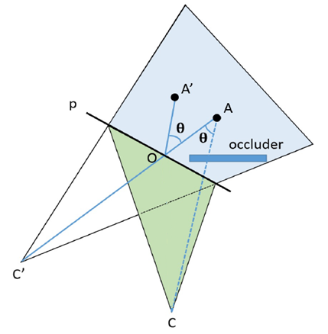
Multiperspective visualization
O($x_{0}, y_{0}$)
A($x_{1}, y_{1}$)
A’($x_{2}, y_{2}$)
$$x_{2}=\left(x_{1}−x_{0}\right)cosθ−\left(y_{1}−y_{0}\right)sinθ+x_{0}$$
$$y_{2}=\left(x_{1}−x_{0}\right)sinθ+\left(y_{1}−y_{0}\right)cosθ+y_{0}$$
Multiperspective projection
Notes:
Our multiperspective visualization is based on the graph camera.
Given a pinhole camera that models the primary user view with viewpoint C, a secondary viewpoint C’(apostrophe).
The camera allows the user located at C to see the target A to which there is no line of sight. We render the scene with the graph camera by rotating geometry vertices in the second blue sub-frustum around the center O of the part of p inside the frustum.
Furthermore, the geometry located inside the green primary frustum is rendered from the user perspective.

Slide 9
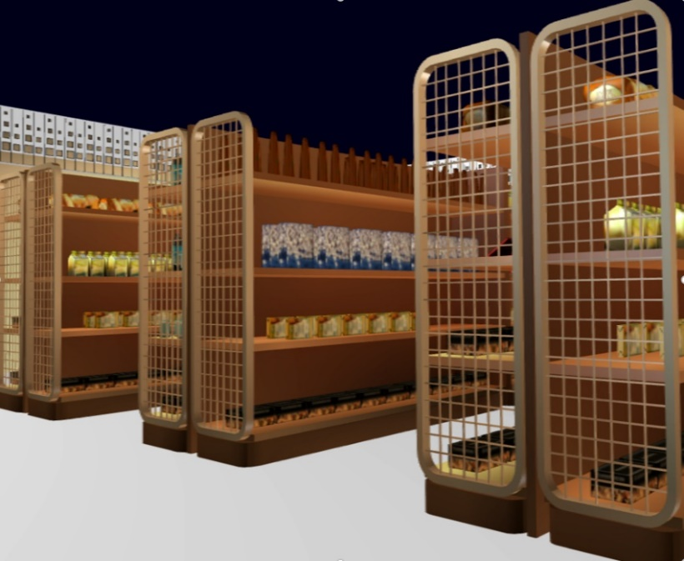
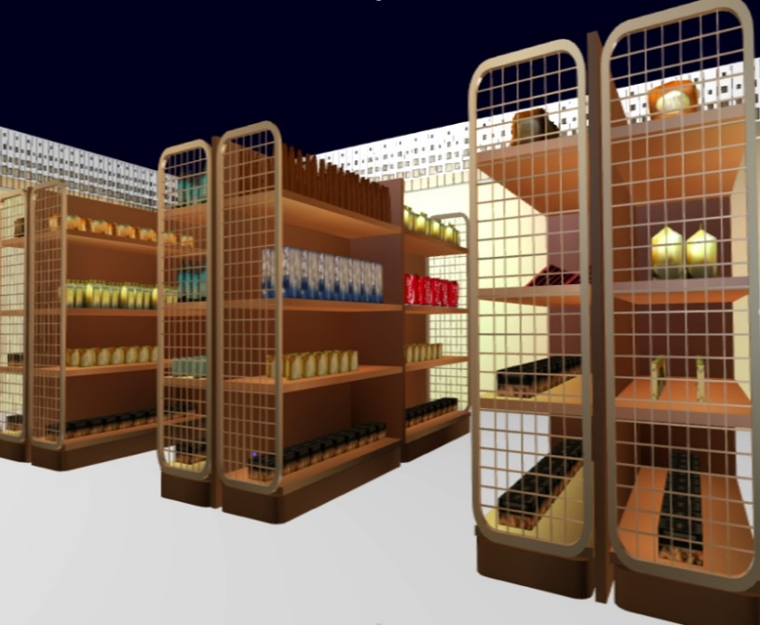
Multiperspective visualization
Conventional
Multiperspective
Notes:
Here a conventional visualization does not reveal the far part of the shelf.
The multiperspective visualization lets the user inspect the entire shelf from the current position, without walking forward to gain a direct line of sight to the far end.

Slide 10
User Study Overview
Task | Metric |  |  | Method
VR1: purchase items in a supermarket | completion time | viewpoint translation | view direction rotation | one of four occlusion management methods
 | spatial awareness
VR2: find persons in a garage | completion time | viewpoint translation | view direction rotation
 | depth perception
Notes:
In our study each participant performed two tasks, purchasing five items in a virtual supermarket, and to find three people in a virtual parking garage. The comparison metrics are task completion time, total viewpoint translation, total view direction rotation. We also tested participants’ spatial awareness in the supermarket scene and depth perception in the parking garage scene. We used a between subjects design, so each participant was assigned to one of the four conditions.

Slide 11
Participants
Totally 32 participants, 6 women, 10 with experience in VR
They were between the ages of 22 and 26
Randomly assigned 8 participants to each of the four conditions
Notes:
We recruited 32 participants from our university’s graduate student population. They were between the ages of 22 and 26, 6 participants were women, and 10 participants had prior experience with VR applications. We randomly assigned 8 participants to each of the four conditions: top view, X-ray, multiperspective, and conventional visualization.

Slide 12
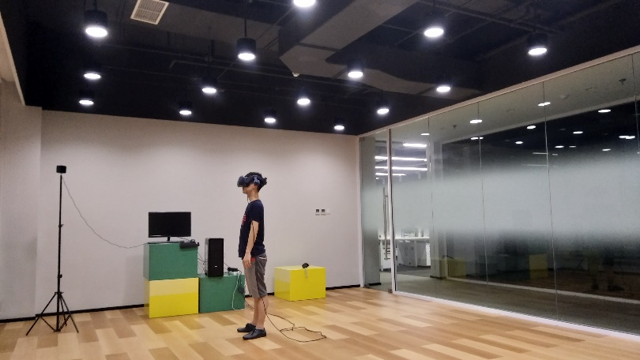
Experimental Procedure
step1 Pre-experiment SSQ
step2 Overview of experimental procedures and VR devices
step3 VR1 interaction practice, including disocclusion effect (5min)
step4 VR1 task
Notes:
We used the following experimental procedure.
First, the participant completes the pre-experiment simulation sickness questionnaire.
Then the experimenter verbally describes the tasks, helps the user put on the VR headset, and explains the functionality of the controller buttons.
Then, in step three, the participant practices the interaction with the supermarket scene used in the shopping task. This session lasts 5 minutes.
Then the participant performs the shopping task.

Slide 13
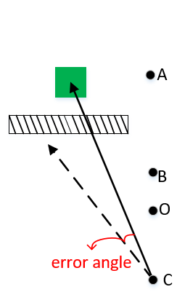
User Study Experimental Procedure
step5 After 2min of rest, spatial awareness test
step6 After 2min of rest, practice VR2 task interaction (5min)
step7 VR2 task
Notes:
After 2 minutes of rest, the participant participates in the spatial awareness test five.
We tested spatial awareness using a pointing test. Initially, the participant is at position O, and only the green target is present. For the conventional group, the participant is guided to position A, where they can see the target. For the occlusion management groups, the participant starts at O, they are guided to B, where they trigger their disocclusion effect, and then they are guided to position C, where they are asked to point to the location of the target. Since the target is occluded, the participant must rely on spatial awareness. The angle between the correct direction to the target and the pointing direction is a measure of spatial awareness error.
Like the first task, participant need practice the interaction of VR2 task in step six and then perform it in step seven.

Slide 14
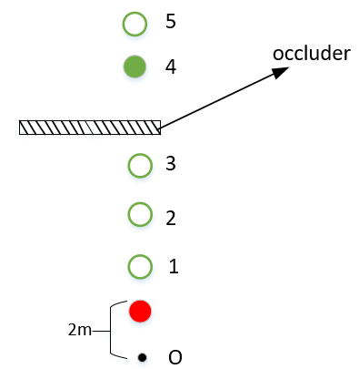
User Study Experimental Procedure
step8 After 2min of rest, depth perception test
step9 Post-experiment SSQ
Notes:
Then the participant performs the depth perception test in the garage scene.
The participant stands at position O. The red ball is always present, at the same position, 2m away from position O. The green ball appears at one of five positions randomly, and the participant is asked to estimate the distance between the red ball and the green ball, in multiples of 2m. For conventional visualization, the occluder is not present.
Finally, the participant completes the SSQ again.

Slide 15
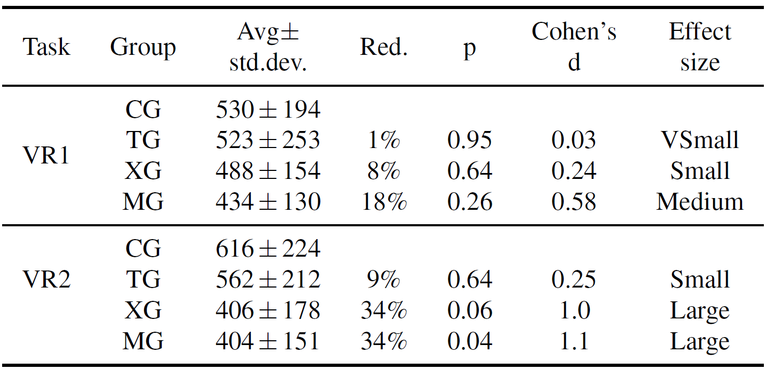
Task Completion Time [s]
Notes:
This table analyzes the differences in task completion times.
CG stands for conventional visualization group, TG for top-view group, XG for X-ray group, and MG for multiperspective visualization group.
Column 4 gives the relative reduction brought by the occlusion management technique over conventional visualization.
We analyzed the data using the t-test p value, and Cohen’s effect size d.
The multiperspective visualization brought the largest benefit, and it was significant for VR2.

Slide 16
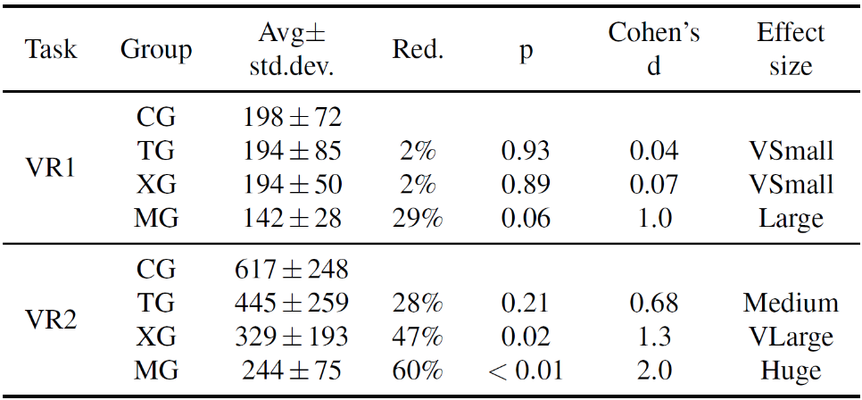
Viewpoint Translation [m]
Notes:
This table analyzes the differences in total viewpoint translation.
The multiperspective group translated the viewpoint the least, with significant differences, and the x-ray group was the runner up.

Slide 17
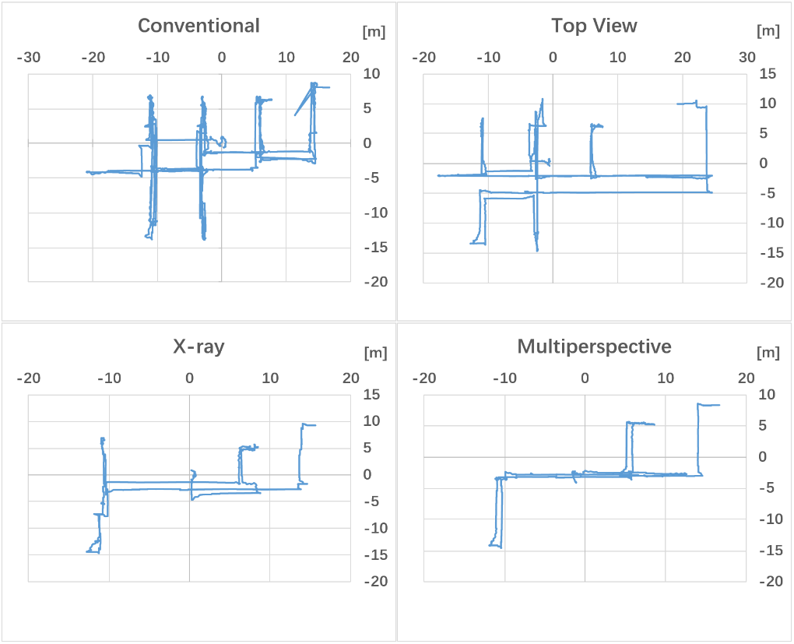
Typical VR2 Participant Trajectories
Notes:
Here is a look at typical participant trajectories, while performing the garage search task.
The CG trajectory shows confusion, as the same region of the scene is visited multiple times, whereas some regions remain unexplored.
The XG and MG trajectories focus on the main alley with occasional visits to the isles to collect the items seen from the main alley.

Slide 18
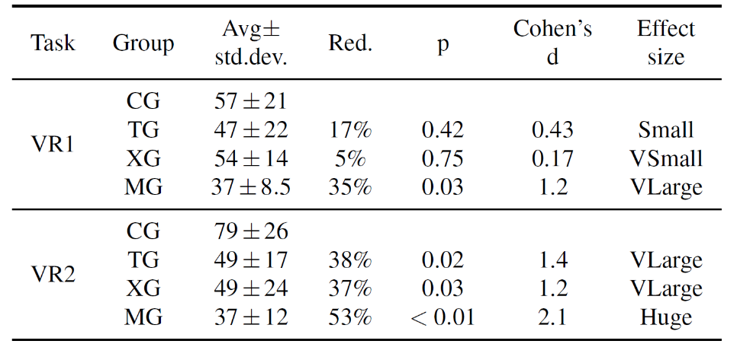
View Direction Rotation [x 360º]
Notes:
Here is a look at the view direction rotation metric.
Multiperspective visualization reduces view direction rotation significantly.
For VR2 all three occlusion management techniques bring significant advantages.
The top view does not help in the case of the supermarket scene, where it is hard to identify items on lower shelves due to occlusion, but it does help in the garage scene where the person searched for is easily seen.

Slide 19
Spatial awareness
Notes:
Here are the pointing angle errors for the four groups.
No difference was significant, which indicates that none of the disocclusion methods induce a significant loss of spatial awareness over conventional visualization.
X-ray actually improved over conventional visualization, but the improvement is small.

Slide 20
Depth Perception
Notes:
In terms of depth perception, again, the differences between occlusion management and conventional are not significant.
Top view improves over conventional, probably due to the orthographic sampling of the ground plane that eliminates perspective foreshortening which aids distance estimation.
Multiperspective visualization performed the worst as the hidden green ball is actually displaced for disocclusion.
In terms of simulator sickness, values of four groups are well below the threshold of 70, above which simulator sickness is considered to be present.

Slide 21
Conclusions
Top view visualization helped participants learn the scene layout and their position within the scene.
X-ray visualization worked better in the garage scene, with a low occlusion depth complexity.
Multiperspective visualization was effective, but it hindered depth estimation.
Notes:
In our work, we have presented a user study that compares three occlusion management to conventional visualization in the context of VR.
The results indicate that users benefit from top view visualization which helps them learn the scene layout and their position, but the top view does not let the user find targets easily due to occlusions in the vertical direction and the small image footprint of the targets.
The X-ray visualization method worked better in the garage scene, a scene with a few big occluders and a low occlusion depth complexity, and less well in the Supermarket scene, a scene with many small occluders that create high occlusion depth complexity.
The multiperspective visualization method achieves better performance than the top view method and the X-ray method, in both scenes. The samples captured from the additional viewpoint. However, multiperspective visualization introduces global scene distortions which can hinder depth perception.

Slide 22
Future Work
Expand the participant population and test occlusion management techniques in extensive exposures.
Explore algorithms for the automatic construction of the camera model underlying the disocclusion effect.
Notes:
In the future we will expand the participant population and test occlusion management techniques in extensive exposures to very dynamic VR environments when we conduct similar research.
In the current work, the disocclusion effects were designed manually. In the future, we want to explore algorithms for the automatic construction of the multiperspective camera model underlying the disocclusion effect.

Slide 23
Thank you
Lili Wang
e-mail: wanglily@buaa.edu.cn
Notes:
This video shows four methods in two scenarios.
That’s all. Thanks.

